Slide 1
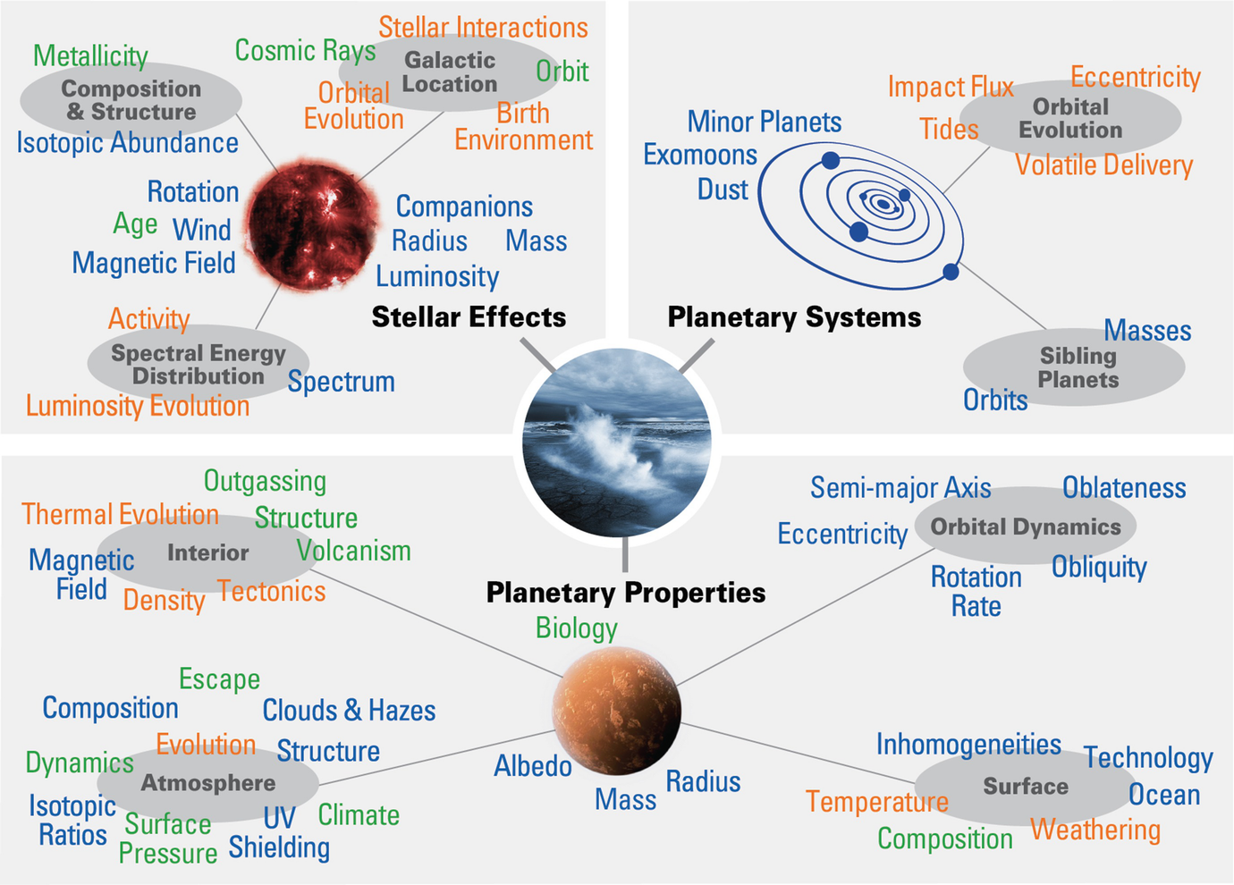
Helio2050 Workshop Takeaways
Interdisciplinary problem requires collaboration
Cross-divisional representation in review panels, conferences
Challenges in solar system vs. astronomical observations for model validation
Different timescales, instrument requirements, wavelengths
How applicable are solar system-based models to other exoplanet systems?

