Slide 1
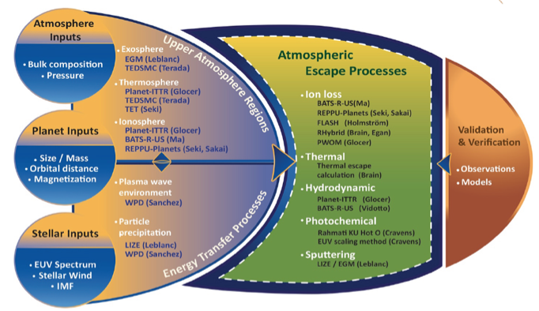
MACH
DRIVE Center to determine atmospheric escape rates from any star-planet combination
Team members (observers and modelers) from Helio, Planetary, and Astro
Multiple models/approaches for each upper atmospheric region and escape process – allowing estimate of uncertainty in model predictions
Partnered with CCMC to provide results to the community, including results from outside the team
Models run over 8-dimensional ‘input parameter space’ to compute escape rates
Web interface would allow users to request escape rates for any input parameters, and would interpolate using the pre-run models. Users could then access plots of model results or download the model output files directly.
Community members could provide results from their own models, which would be incorporated into the web interface.
MACH was not selected for Phase II, but we are exploring ways to continue this effort

Slide 2
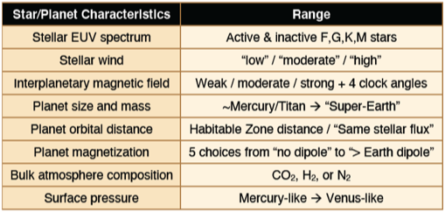
Dave Brain
Model validation (How confident are we that we are getting the right answer?)
Many models in heliophysics have been validated against observations
Applying a model using input parameters beyond the ‘validated range’ makes the model, by definition, unvalidated. This problem is particularly acute for exoplanets.
How can we have confidence in model results in these new situations?
One recommendation: Use ‘competing’ models and/or ensembles to test robustness
Identification of model parameters (Can we enable all of the science for all of the people?)
Every user has a different question or situation – some require specific input parameters and some require a large range
The parameter space to be covered is essentially infinite (as is the dimensionality)
It is not possible for the CCMC to ‘cover all the bases’
One recommendation: Cover the parameter space coarsely and provide tools to interpolate within the results. Continue to allow Runs-on-Request

