Slide 1
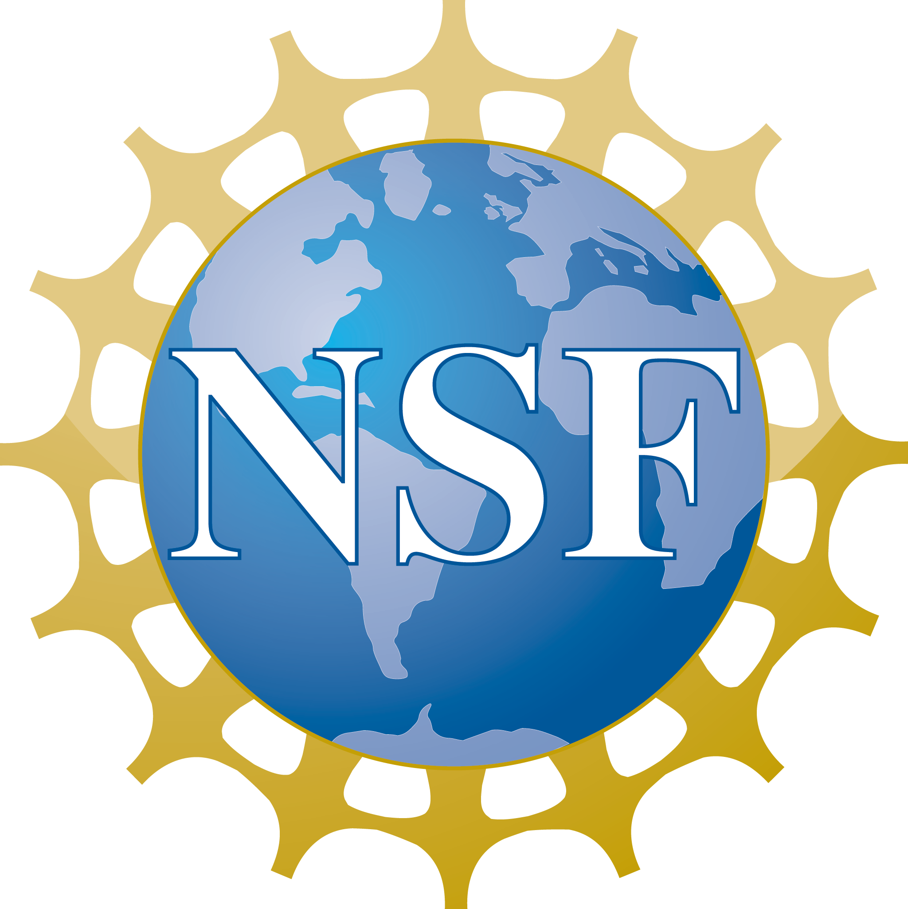
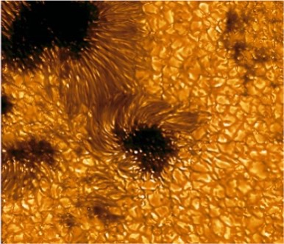
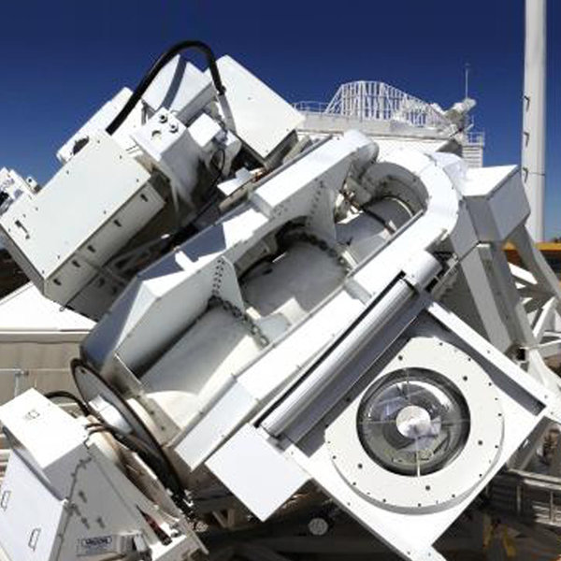
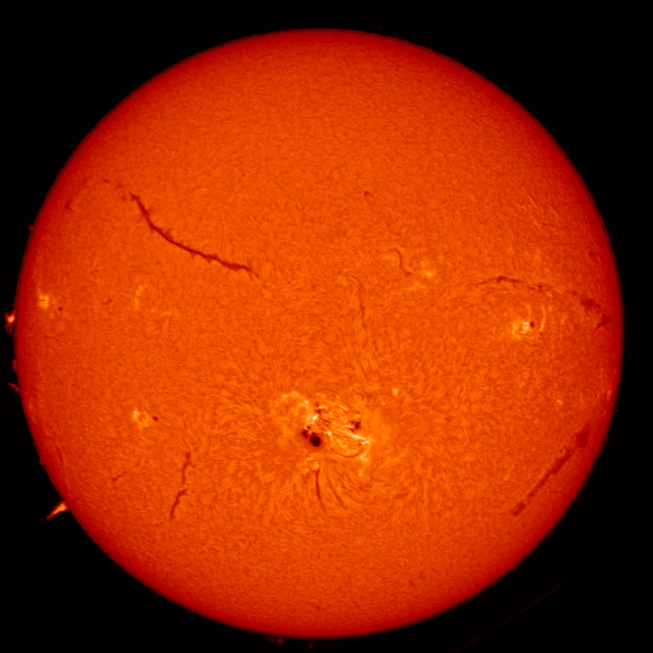
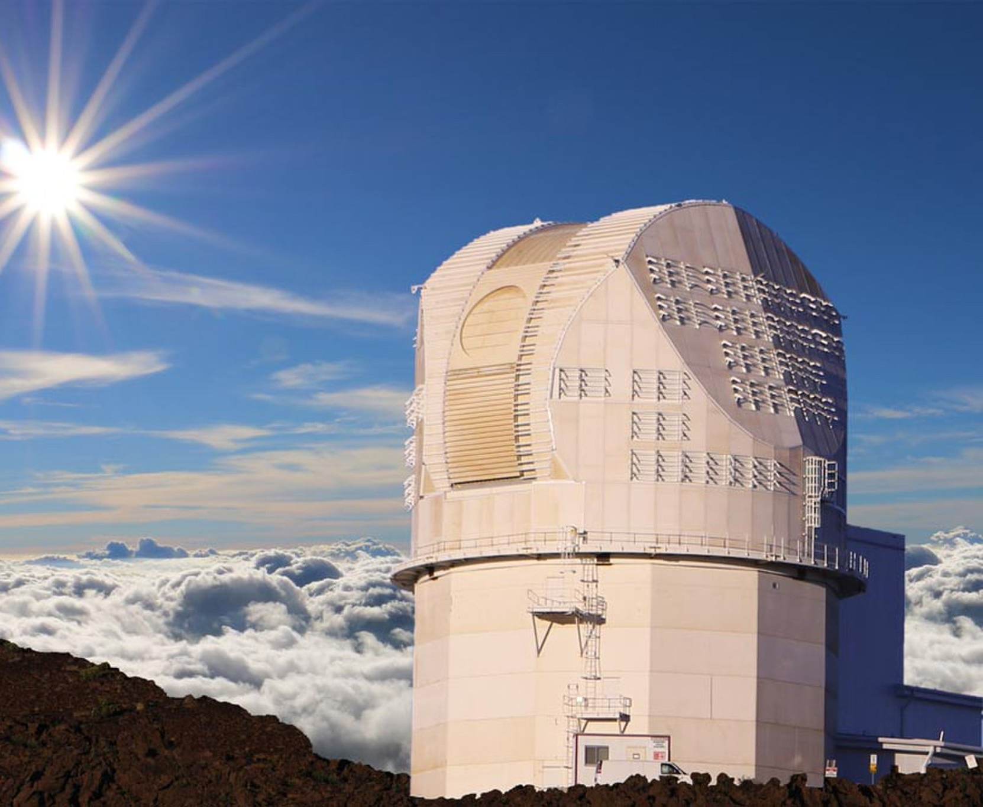
NSF and Sun as a star
Sun as a star is primary focus for AST
NSO is supported to investigate the Sun as an astronomical laboratory
DKIST, GONG, and SOLIS can all be used in the context
SOLIS has ISS, which was designed for Sun As a Star observations
Astronomy and Astrophysics Grants Program (Deadline: November 15)
Space Weather in other solar systems
The sun as lab for stellar influences on exoplanet habitability
Space Weather influences on Milky Way planets

