Slide 1
Heliophysics models applied to planets beyond earth and systems beyond the solar system
How can CCMC support these applications?

Slide 2
What are the highest priority planetary/exoplanetary-related needs for modeling services?

Slide 3
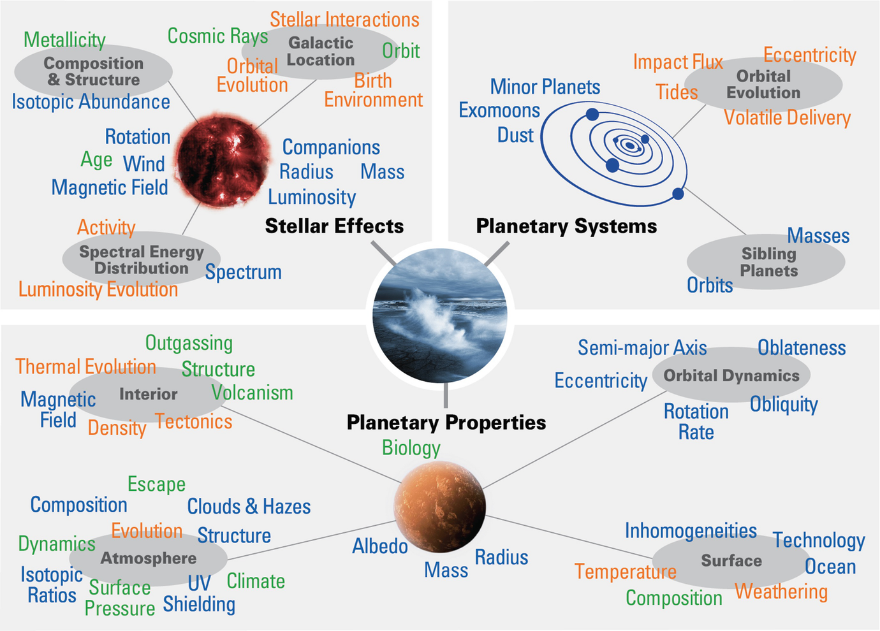
Helio2050 Workshop Takeaways
Interdisciplinary problem requires collaboration
Cross-divisional representation in review panels, conferences
Challenges in solar system vs. astronomical observations for model validation
Different timescales, instrument requirements, wavelengths
How applicable are solar system-based models to other exoplanet systems?

Slide 6
What are the highest priority planetary/exoplanetary-related needs for modeling services?

Slide 7
How does modeling beyond Earth and the solar system compare to “core” heliophysics modeling?

Slide 8
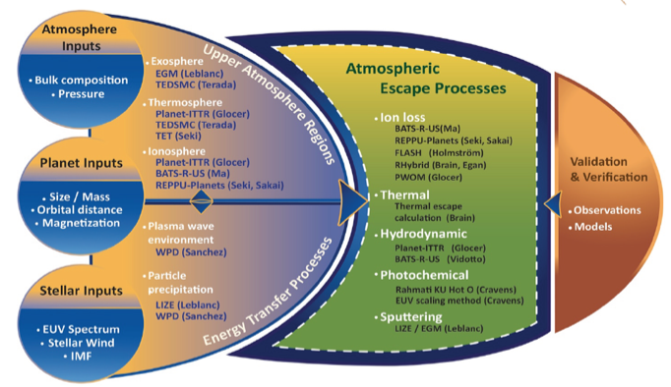
MACH
DRIVE Center to determine atmospheric escape rates from any star-planet combination
Team members (observers and modelers) from Helio, Planetary, and Astro
Multiple models/approaches for each upper atmospheric region and escape process – allowing estimate of uncertainty in model predictions
Partnered with CCMC to provide results to the community, including results from outside the team
Models run over 8-dimensional ‘input parameter space’ to compute escape rates
Web interface would allow users to request escape rates for any input parameters, and would interpolate using the pre-run models. Users could then access plots of model results or download the model output files directly.
Community members could provide results from their own models, which would be incorporated into the web interface.
MACH was not selected for Phase II, but we are exploring ways to continue this effort

Slide 9
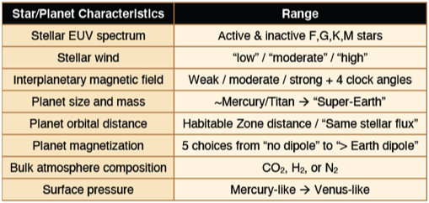
Dave Brain
Model validation (How confident are we that we are getting the right answer?)
Many models in heliophysics have been validated against observations
Applying a model using input parameters beyond the ‘validated range’ makes the model, by definition, unvalidated. This problem is particularly acute for exoplanets.
How can we have confidence in model results in these new situations?
One recommendation: Use ‘competing’ models to test robustness
Identification of model parameters (Can we enable all of the science for all of the people?)
Every user has a different question or situation – some require specific input parameters and some require a large range
The parameter space to be covered is essentially infinite (as is the dimensionality)
It is not possible for the CCMC to ‘cover all the bases’
One recommendation: Cover the parameter space coarsely and provide tools to interpolate within the results. Continue to allow user requests

Slide 10
Understanding Consequences of Star-Planet Interactions
Assessing Short-term vs Long-term Consequences
Short-term seeks to understand the impact of an individual event or recent statistics
How did a particular event affect the planet’s environment?
Long-term searches to understand how the star-planet interaction affects the planet’s evolution
How is the star-planet relationship responsible for changes over time?
Short vs Long term requires different approaches to solve the questions at hand
Consequences, goals, and required modeling capabilities vary with each planet
Mercury – space weathering of the surface
Mars – atmospheric evolution; future of human exploration
Application to Exoplanets
With the new MAVEN/M2M/CCMC collaboration, how can CCMC enable model development and validation at Mars?
Gina DiBraccio (gina.a.dibraccio@nasa.gov)

Slide 11
How does modeling beyond Earth and the solar system compare to “core” heliophysics modeling?

Slide 12
What links can be built to show the value of heliophysics to other science communities?

Slide 13
What links can be built to show the value of heliophysics to other science communities?
Chuanfei Dong
Princeton University

Slide 14
Heliophysics and its connection to other science communities
Heliophysics is the science of understanding the Sun and its interactions with Earth and the solar system, including space weather.
Link to Planetary Science: To study the Sun’s interactions with planets in the solar system, including space weather.
Link to Astrophysics: To understand stars and their interactions with exoplanets orbiting these stars, including space weather.
Link to Earth Science: To study Sun-climate connection and the coupling processes between the lower, middle, and upper atmospheres.
Chuanfei Dong, dcfy@Princeton.edu

Slide 15
The Value of Heliophysics to other science communities
The value to Planetary Science: The Earth’s magnetosphere, ionosphere, thermosphere (MIT) models have been adapted to study Sun’s interactions with planets/moons in the solar system.
The value to Astrophysics: The solar model and Earth’s MIT models have been adapted to study other stars and their interactions with exoplanets.
The value to Earth Science: The Earth’s MIT models provide upper boundary conditions for the middle and lower atmosphere models to include the Sun’s influences.
Suggestions:
To include stellar and (exo-)planetary models to CCMC and collaborate with, e.g., Exoplanet Modeling and Analysis Center @NASA-GSFC, Mars Climate Modeling Center @NASA-Ames, and NASA Center for Climate Simulation.
To organize and participate in interdisciplinary workshops (e.g., Comparative Climatology of Terrestrial Planets, Habitable Worlds, and Exoplanets in our Backyard) and increase cross-NASA Divisional collaboration to mutually enhance the scientific return and impact of the heliophysics and other divisions.
Chuanfei Dong, dcfy@Princeton.edu

Slide 16
What links can be built to show the value of heliophysics to other science communities?

