Slide 1
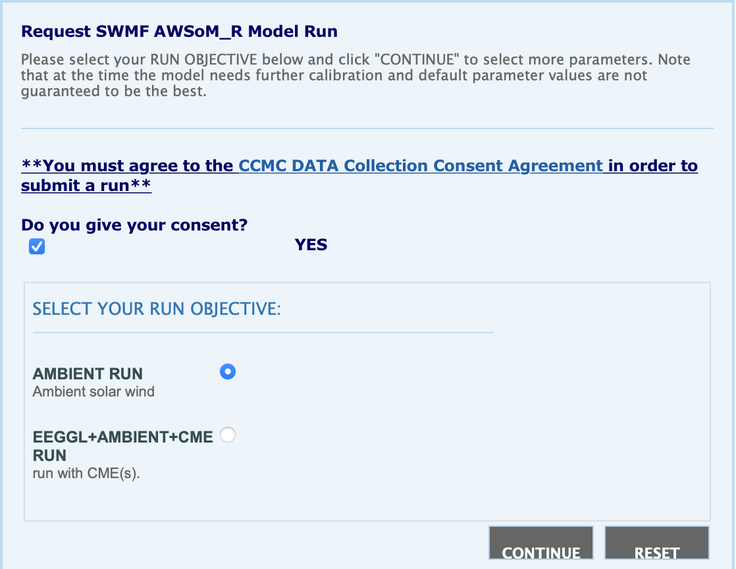
Onboarding processes of AWSoMR and MFLAMPA to CCMC
AWSoMR: Alfven Wave Solar Atmosphere Model
MFLAMPA: Multiple-Field-Line-Advection Model for Particle Acceleration
Two environment
NASA Pleiades
AWSoMR run-on-request (available online)
M-FLAMPA run-on-request (on-going)
AWS
AWSoMR real time (on-going)
MFLAMPA real time (on-going)
Get model developers familiar with environment
Environment documentation
NASA Pleiades: https://www.nas.nasa.gov/hecc/support/kb/
Notes:
1
The difference between these two categories are getting blurry.

Slide 2
Onboarding processes of AWSoMR and MFLAMPA to CCMC
How to write documentation to help users understand the input parameters and output data
How to balance between choosing the default parameters by developers v.s. giving user freedom to choose their own parameters
Flesibile v.s. Stable
Onboarding different versions
e.g. regular MHD and stream-aligned MHD
Easy to use, easy to understand, reliable
Notes:
2
The difference between these two categories are getting blurry.

