Slide 1
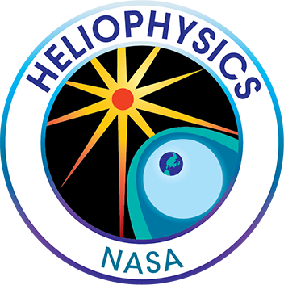
CCMC and the Heliophysics Digital Resource Library (HDRL)
CCMC Workshop, 6 June 2022
D Aaron Roberts
Code 672, NASA Goddard Space Flight Center
GSFC Project Scientists: SDAC – Jack Ireland
SPDF – Robert Candey, Lan Jian
HDRL – Aaron Roberts, Brian Thomas
Project Manager: HDRL – Tressa Helvey

Slide 2
HDRL ORGANIZATIONAL CHART
HP Data and Model Consortium/HDMC
D. Aaron Roberts (PS), Brian Thomas (DPS),
Tressa Helvey-Kasulke (PM)
Overall management of the HDRL.
Registries and DOIs for all digital resources; SPASE Data Model.
Heliophysics Data Portal (HDP; including solar)
Python and other software integration (PyHC).
Analysis and visualization services ((Py)SPEDAS, Autoplot).
Data upgrades and services.
HelioCloud initiative with data and software from all groups.
All activities within the various HDRL components are interrelated.
Space Physics Data Facility
Solar Data Analysis Center
Robert Candey (PS), Lan Jian (DPS)
Non-solar Data Final Active Archive for NASA (and other) missions.
CDAWeb data browsing and access; Web Service access.
OMNIWeb data production and serving.
SSCWeb and 4-D spacecraft orbit facility. Common Data Format.
Jack Ireland (PS)
Solar Data Final Active Archive for Solar Dynamics Observatory
and other NASA missions.
Virtual Solar Observatory data access.
Helioviewer. SolarSoft. SunPy.
High Performance Computing for NASA HP.
Collaborators
Community Coordinated Modeling Center
Data-model comparisons; Registry of models and output (SPASE); “Kamodo” enabled visualization.
Center for HelioAnalytics …
Notes:
If the information is needed, in FY22 SDAC is supporting 24 people (warm bodies), split as 1 CS FTE and 11.1 WYE across all funding vehicles.

Slide 3
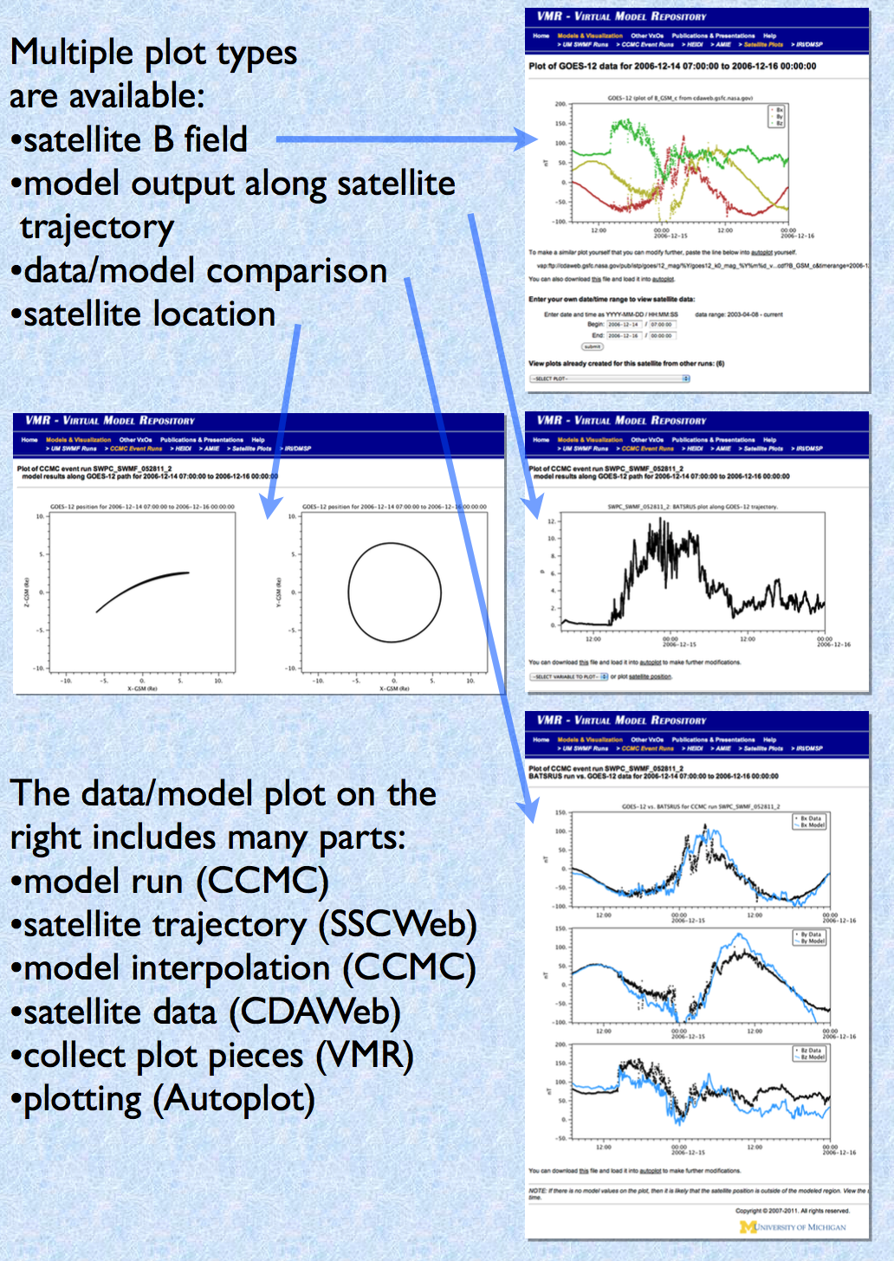
Data-Model Comparisons
http://vmr.engin.umich.edu
Now also at CCMC
Original HDMC effort: “Virtual Model Repository”
Uses Internet connectivity to load spacecraft data and simulations into the same visualization.
Moved (with author) to CCMC
Will be implemented using Kamodo and related tools

Slide 4
Vision
Where the System Observatory Comes Together
The HDRL enables the scientific analysis goals of the Heliophysics System Observatory:
provisioning and curation of scientific small-to-big data from many sources, PB volumes; (the Foundation: data, metadata, standards)
support for data analysis and modeling in multiple computational environments;
the design and implementation of a collaborative open science infrastructure.
Individual missions and simulations can do great science
The CCMC and HDRL will enable groundbreaking systems science

Slide 5
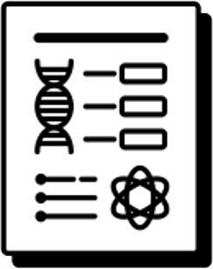
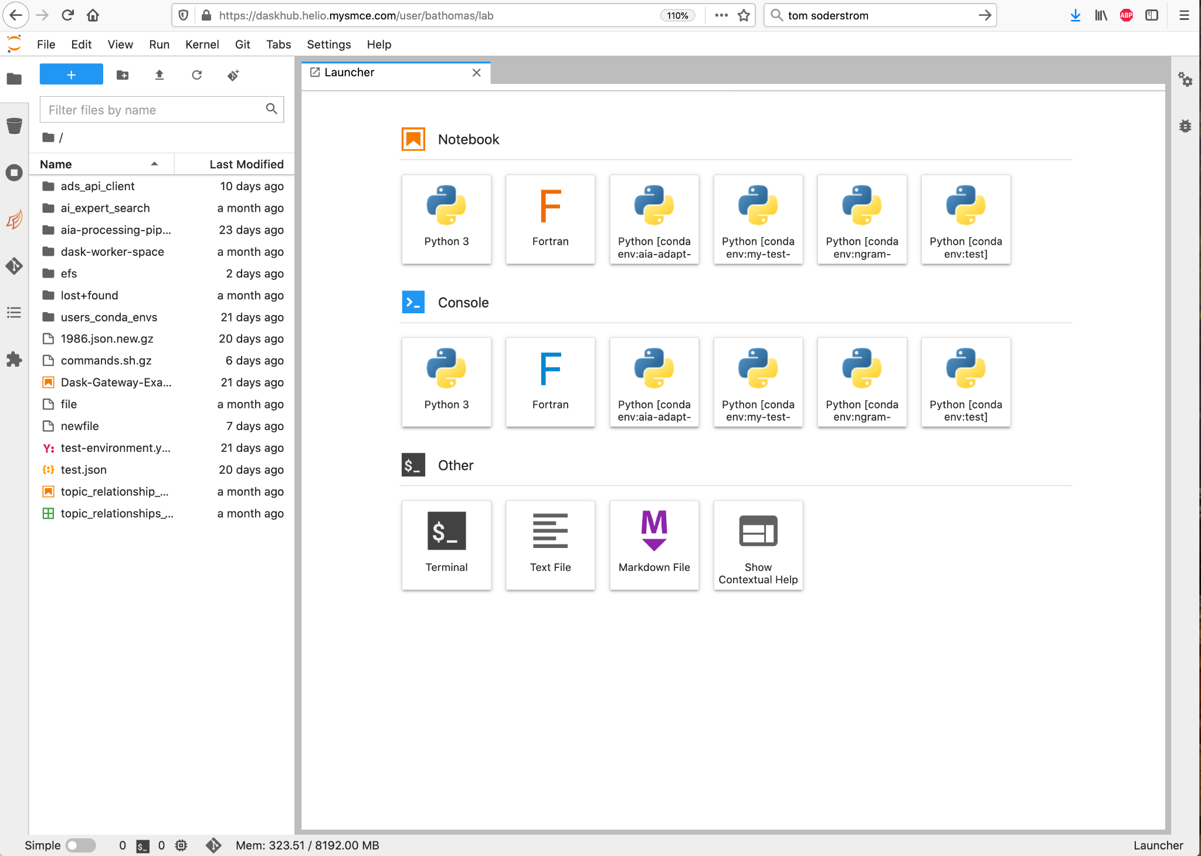
User-Driven Acceleration of Heliophysics Research:
How we get there
“Preserve”
“Discover”
“Explore Further”
“Share & Publish”
Goal
Provide Foundational Services
Enhance Discoverability
Unlock Big Data Research
Enable Team Open Science
Maintain and upgrade existing archives and services in light of increasing demands driven by Big Data
(variety & volume)
Increased interlinking of research artifacts, ADS integration, DOIs, improved standards, etc
High End Compute close to large (up to ~100 Tb) and Big Data (~Pb) with software support (AI/ML, PyHC, etc). Leverage earth science platform and expertise.
Collaborative Online Research, Compute, and Publishing Platform,
Open Science, Citizen Science
Strategy
Notes:
High-level strategy ONLY; many details missing!

Slide 7
