Slide 1
CCMC Support of NASA Space Weather Program and National Space Weather Activities
James Spann
Heliophysics Space Weather Lead
6 June 2022
Notes:
STILL

Slide 2
NASA Space Weather
Space Weather Vision: Advance the science of space weather to empower a technological society safely thriving on Earth and expanding into space.
NASA plays a vital role in space weather research by providing unique, significant, and exploratory observations and data streams for theory, modeling, and data analysis research, and for operations. SMD/HPD is uniquely poised to support needs of the National and International space weather enterprise and the Agency’s Artemis mission.
Various executive (NSW SAP) and legislative (PROSWIFT Act) mandates direct NASA to address research and application aspects of space weather. Operational agencies have a mandate to fulfill their mission, but NASA has the flexibility to “push the envelope”
NASA Heliophysics works as the research arm of the nation's space weather effort, coordinating with the U.S. National Oceanic and Atmospheric Administration, the National Science Foundation and the U.S. Geological Survey, and the U.S. Air Force Research Laboratory on the National Space Weather Action Plan.
Notes:
NASA’s contributions to observing and understanding space weather are critical for the success of the National and International space weather enterprise.
NASA has a preeminent space weather capability through the pursuit of the following goals:
1. Observe
Advance observation techniques, technology, and capability
2. Analyze
Advance research, analysis and modeling capability
3. Predict
Improve space weather forecast and nowcast capabilities
4. Transition
Transition capabilities to operational environments
5. Support
Support Robotic and Human Exploration
6. Partner
Meet National, International, and societal needs consistent with Government directives

Slide 3
Goals
1. Observe
5. Support
6. Partner
2. Analyze
3. Predict
4. Transition
Advance observation techniques, technology, and capability
Advance research, analysis and modeling capability
Improve space weather forecast and nowcast capabilities
Transition capabilities to operational environments
Support Robotic and Human Exploration
Meet National, International, and societal needs consistent with Government directives
NASA plays a vital role in space weather research by providing unique, significant, and exploratory observations and data streams for theory, modeling, and data analysis research, and for operations.
NASA’s contributions to observing and understanding space weather are critical for the success of the National and International space weather enterprise.
NASA has a preeminent space weather capability through the pursuit of the following goals:
https://science.nasa.gov/heliophysics/space-weather

Slide 5
HPD PROSWIFT Actions
PROSWIFT allows NASA to focus on what NASA does best in space weather: Pushing the limits of our understanding the Sun-Earth system including space weather phenomena and leading the evolution of the space-based network of Heliophysics observatories – and the science behind them – through new missions, technology development, and cutting-edge research and modeling.
Steps underway at NASA that are in line with responsibilities delineated in the PROSWIFT act include:
Participation in the new Space Weather Interagency Working Group established under the National Science and Technology Council;
Collaborating with NOAA to establish the Space Weather Advisory Group for the Interagency Working Group and a Space Weather Roundtable at the National Academy of Science
Strengthening our partnership with ESA and other international and interagency partners to ensure maintained operations of the SOHO/LASCO satellite, and other space weather monitoring satellites still in operations, including the ACE, DSCOVR, GOES, SDO, STEREO, and Wind observatories to ensure operational contingency plans that provide continuous space weather forecasting in the event of an unexpected SOHO/LASCO failure;
Planning for space weather monitoring capability on future NASA missions including the Lunar Gateway (HERMES) and Geospace Dynamics Constellation;

Slide 6
HPD PROSWIFT Actions Cont.
Working with other federal agencies including NOAA and DOD to build new space-based monitoring missions, like the NOAA-NASA SWFO-L1 mission (currently in development), to ensure the government has backup capability among our observatories to sufficiently maintain space weather forecasts
Carrying out basic research in solar and space physics, and space weather, including joint interagency research and modeling solicitations with NSF and NOAA;
Developing a robust partnership with NOAA, NSF, and DOD with the completion of an interagency Framework document that describes the process to transition federally funded space weather research to benefit operational and applied usage, and to ensure that the insights garnered from operations and applications can inform the future direction of NASA-sponsored research
Supporting competitively awarded grants for multidisciplinary Space Weather Centers of Excellence, for the purpose of advancing solar and space physics and space weather research-to-operations, and which could eventually develop products to be transitioned through the Framework process
Collaborating with international partners to improve our understanding and advance forecasting for space weather both in the near-earth regions and deep space beyond the protective cocoon of Earth’s magnetosphere – (e.g. Artemis/Gateway, Lagrange). Partners include, ESA, Canada, Japan, Korea, India, and Brazil.

Slide 7
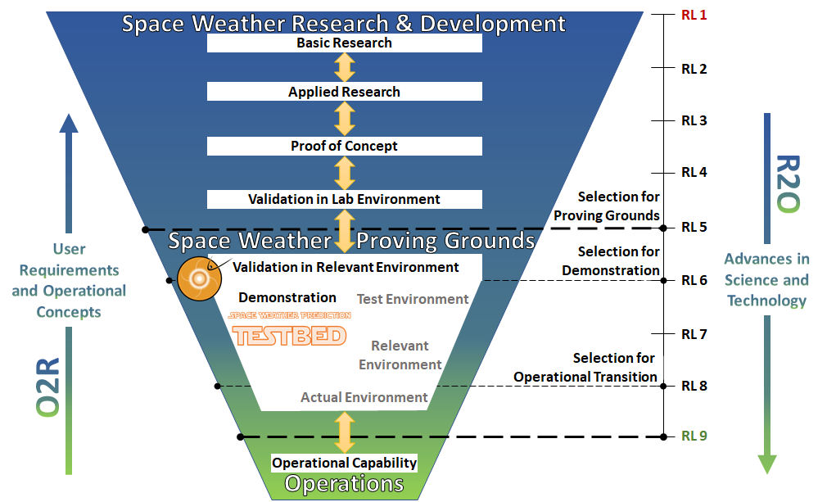
The R2O/O2R Process
ARC
R2O2R
COE
T-Step
7

Slide 8
NOAA Testbeds and Proving Grounds (TB/PG)
NOAA's Testbeds and Proving Grounds facilitate the orderly transition of research capabilities to operational implementation through development testing in testbeds, and pre-deployment testing and operational readiness/suitability evaluation in operational proving grounds
Projects within a TB/PG are guided through NOAA’s R2O process with progress monitored via the NOAA’s Readiness Levels (similar to NASA”s Technical Readiness Levels, see image at right)
More information on the 12 current TB/PG’s can be found here.

Slide 9
Space Weather Research to Operations / Operations to Research (R2O2R)
A yearly element conducted on behalf of NASA, NOAA, and NSF under a tri-agency agreement.
ROSES-22
High-Latitude Radiation Exposure
Downstream Updating of Solar Wind & CME Forecasts
ROSES-21 (6 selections)
Solar Flare Forecasts
Cislunar Space Environment
ROSES-20 (9 selections)
Ionospheric Disturbances
Satellite Drag
ROSES-19: (13 selections)
Open call
New: R2O2R “Transition Step”
An optional third year to support activities that facilitate transition to operations.
ROSES-18 (8 selections)
Energetic particles and plasmas in the magnetosphere
ROSES-17 (8 selections)
Solar wind forecasting

Slide 10
Space Weather Centers of Excellence (COE’s)
This is a new element in ROSES-22. There will structural similarities to DRIVE Science Centers, but this is not "DRIVE for space weather".
The purpose of these Centers will be to provide significant long-term investment in research and infrastructure development to address major challenges in space weather in an integrated multidisciplinary fashion, explicitly and fundamentally incorporating R20 and O2R.
Proposed Center efforts will need to be highly ambitious and should address critical challenges in space weather.
The ROSES B.22 COE solicitation is released
Step 1 proposals due 6/21/2022
Step 2 proposals due 8/25/2022

Slide 11
Small Business Innovation Research (SBIR)
NASA’s SBIR program seeks to transform scientific discovery into products and services through innovations that have the potential for infusion into NASA programs and missions, the potential for commercialization into NASA relevant commercial markets, and that have a societal benefit.
2022 Phase I proposals were due March 9
Successful awardees can receive $150,000 during the six-month Phase I
After Phase I, Phase II awards of $1,000,000 are possible for prototype development over two years; other funding opportunities follow.
Of specific interest to this group is the Space Weather Research to Operations (R2O/O2R) Technology Development subtopic, prioritizing:
Space-weather-forecast-enabling technologies
Commercial and decision-making applications for space-weather technologies
Space weather advanced data-driven discovery techniques
Space-weather instrumentation.

Slide 12
CCMC & the NASA Space Weather Strategy
CCMC has and will continue to provide unapparelled expertise for the NASA space weather community in several distinct ways including:
CCMC is a critical capability for NASA space weather efforts as an initial step for development/validation of community models for potential applications
CCMC is a key component to transition potential capabilities from research to testing or proving grounds for operational usage
CCMC is vital to enabling a cohesive space weather operator tool/visualization development.

