Slide 1
ISEP: The CCMC-SRAG-M2M partnership to address needs for human exploration
Kerry lee – Space Radiation Analysis Group Operations Lead
CCMC Space Weather Workshop 2022
june 6, 2022

Slide 2
SRAG: What We Do
Have supported human spaceflight since 1962
Guidance provided by NASA-STD-3001
Maintain crew radiation exposure As Low As Reasonably Achievable (ALARA)
Defines career and short-term exposure limits
Career limit keeps astronaut space radiation exposures below 600mSv NASA effective dose
Currently support International Space Station (ISS)…
…but always improving our capabilities as we look ahead to Artemis

Slide 3
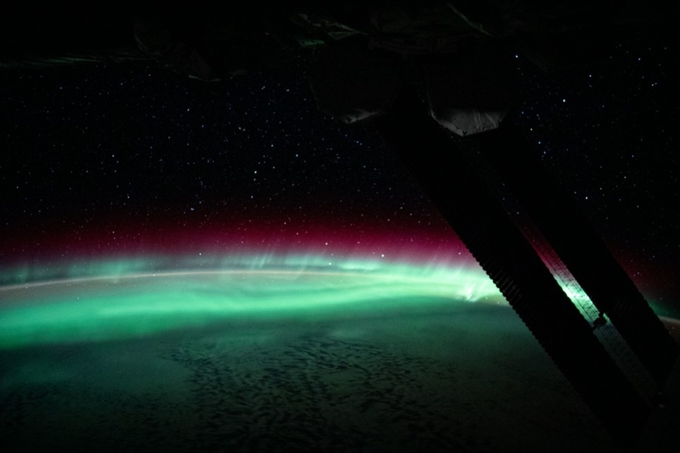
What Exactly is the Concern?
Trapped Radiation (Van Allen Belts)
Galactic Cosmic Radiation (GCR)
Solar Particle Events (SPEs)
Protons/electrons
High dose rate
Short term concern
Risk is understood and accepted
Many particle types (hydrogen through iron)
Low dose rate, high energy
Difficult to shield
Monitor for long-term health effects
Mostly protons
Potential for higher dose rate
Easier to shield
Acute health risks
Risk of acute effects and exceeding career limits
Aurora from CME that was geoeffective on 02 Aug 2021. Credit: ISS Exp 65 crew.

Slide 4
How Do ISS and Artemis Differ?
Geomagnetic cutoff along ISS orbit
The geomagnetic cutoff protects the ISS for most of the orbit
At high latitudes, energetic particles can reach the vehicle
Large geomagnetic storm can reduce the time in orbit vehicle experiences this protection
But…most of the trajectory of the Artemis missions will be in the free space radiation environment
As we transition to beyond-LEO missions, collaborations focusing on improvements to space weather prediction capability are crucial
Time profile of the January 2005 storms

Slide 5
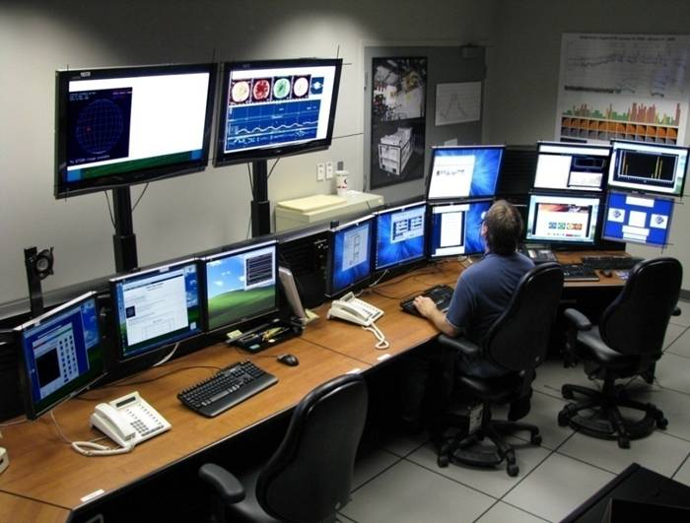
Multi-Pronged Approach for Exposure Mitigation
Mission Control support
In-situ radiation monitoring
Space weather modeling
Vehicle design
Crew / team training
SRAG maintains 24/7 console presence
Nominal ops: Maintain situational awareness
Contingency ops: Monitor environment and provide crew recommendations (e.g., shelter)
Communication with groups internal and external to NASA to understand environment
Artemis will necessitate move from on-call to full in-person support (3 shifts/day)
Successful mission support requires advancements in modeling
Event probability / warning time
Event duration
Event Intensity
SRAG Multi-Purpose Support Room (MPSR) in Mission Control

Slide 6
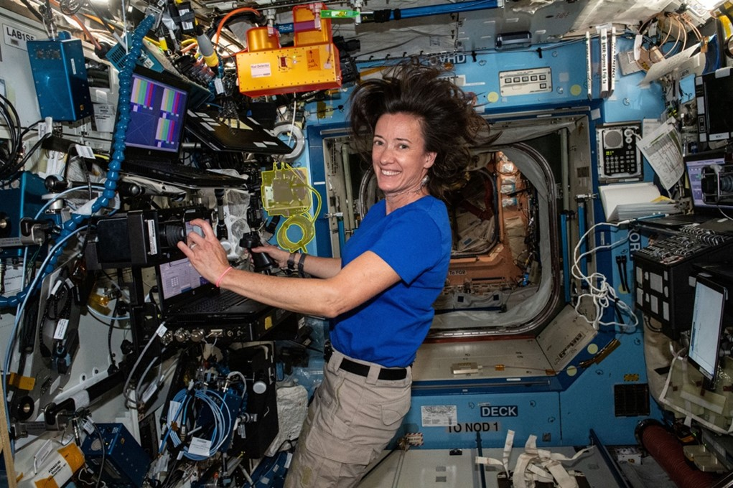
Multi-Pronged Approach for Exposure Mitigation
Mission Control support
In-situ radiation monitoring
Space weather modeling
Vehicle design
Crew / team training
Current (ISS)
Radiation Assessment Detector (RAD)
Radiation Environment Monitor 2 (REM2) - 7 Detectors on ISS
Crew Active Dosimeter (CAD)
Future (Artemis)
ISS used as testbed for technologies including Artemis HERA on Space Station (AHOSS)
Ar-I will be an opportunity to further test new HERA hardware
Additional internal/external area and crew dosimeters under development(ARES, EVA suit monitor, etc.)
Astronaut Megan McArthur in US LAB. The RAD (red), HERA (yellow) and REM2 (green) are visible in the module.

Slide 7
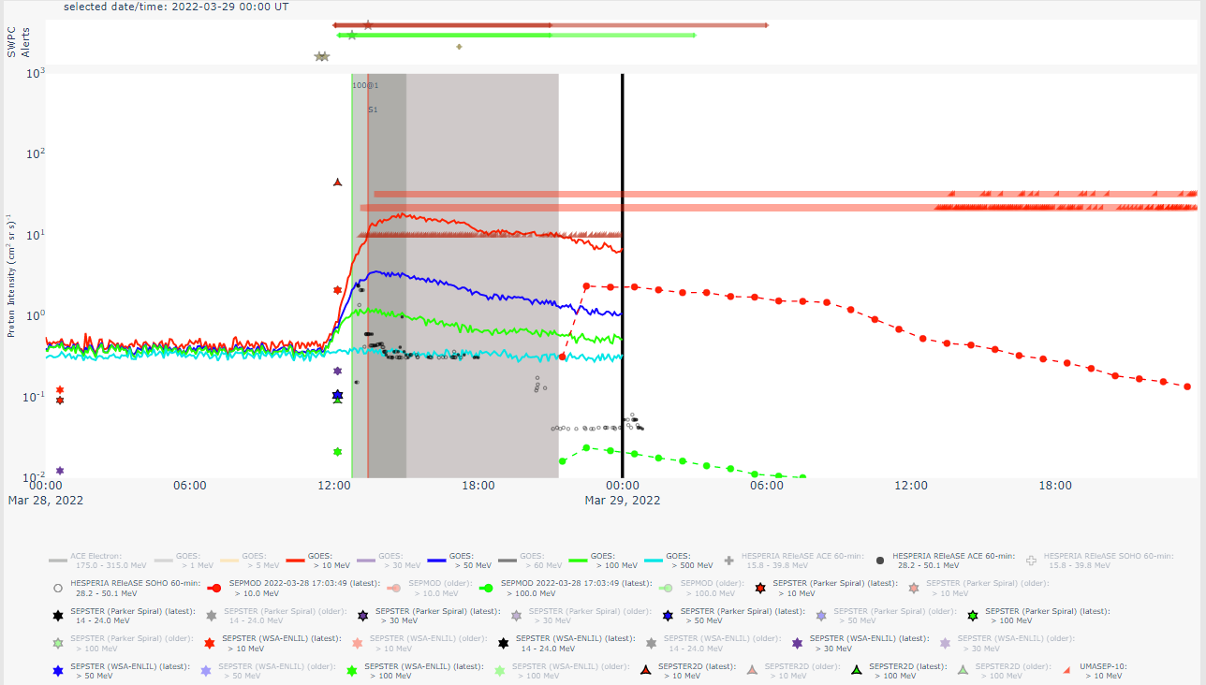
Multi-Pronged Approach for Exposure Mitigation
Mission Control support
In-situ radiation monitoring
Space weather modeling
Vehicle design
Individual astronaut cancer risk assessment
Crew / team training
Current capability geared to ‘nowcasting,’ relies on regular communication with SWPC
With free space missions, improvements to current forecasting capabilities become vital. New M2M office serves as testbed and proving ground for new models.
ISEP Scoreboards developed through CCMC/SRAG Collaboration
Artemis will also serve as a testbed for new console tools, including
ISEP Scoreboards
Acute Radiation Risk Tool (ARRT)
Intensity Scoreboard showing model outputs for 28 Mar 2022 ESPE. Scoreboards represent joint SRAG/CCMC/M2M effort.

Slide 8
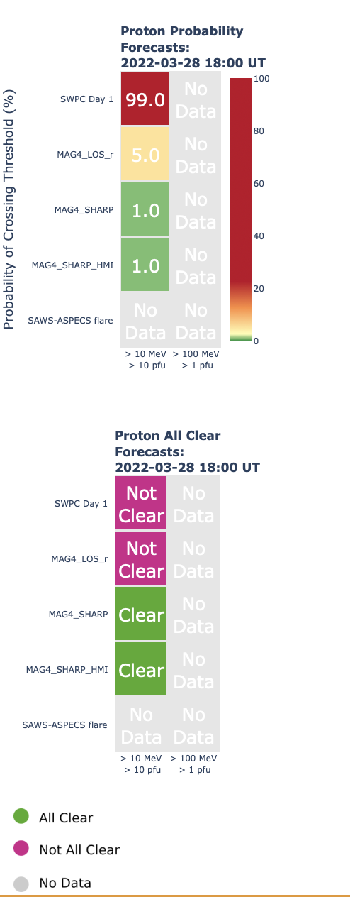
Probability Scoreboard (3/28/2022)
Notes:
UMASEP-100 gave us some advanced warning

Slide 9
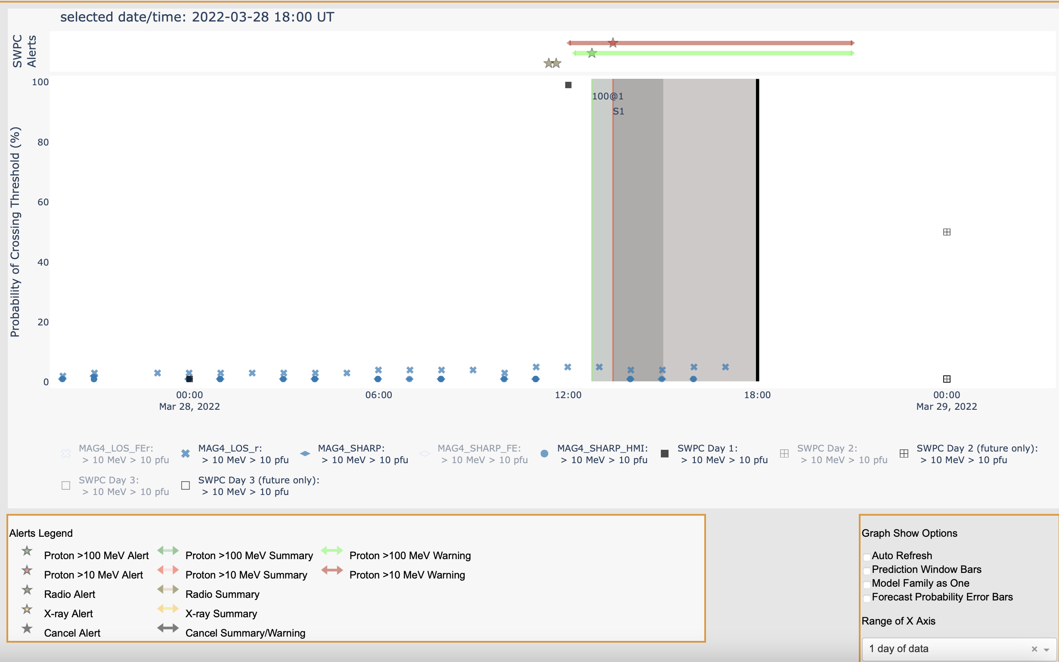
Probability Scoreboard (3/28/2022)
Notes:
UMASEP-100 gave us some advanced warning

Slide 10
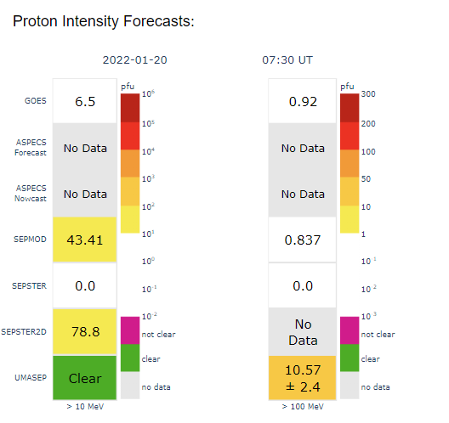
Intensity Scoreboard (1/20/2022)
Notes:
UMASEP-100 gave us some advanced warning

Slide 11
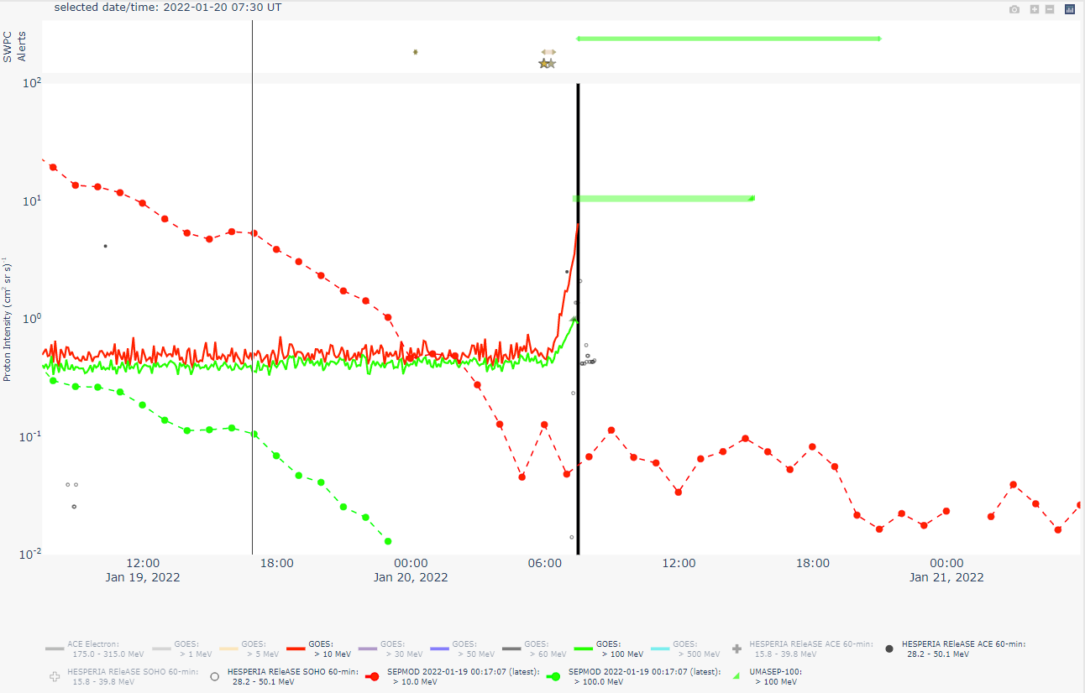
Intensity Scoreboard (1/20/2022)
Notes:
UMASEP-100 gave us some advanced warning

Slide 12
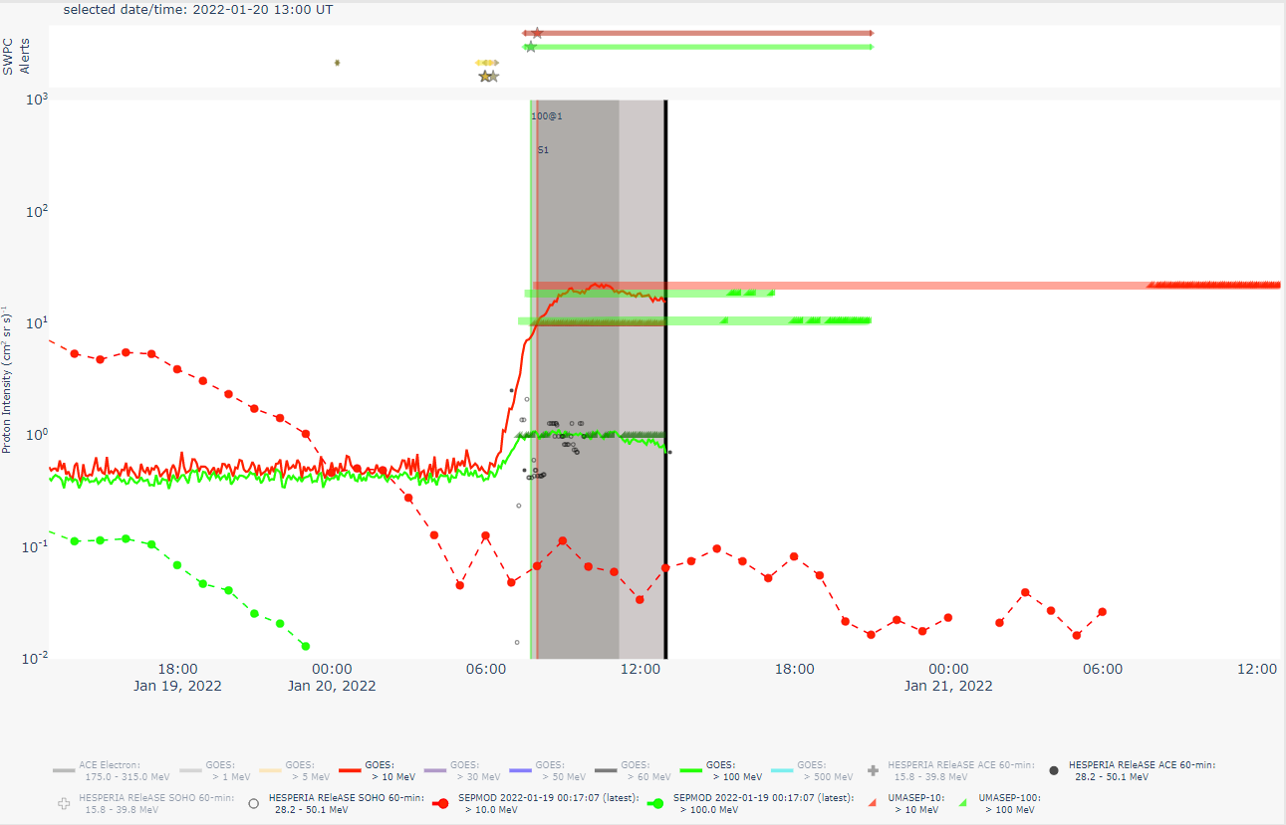
Intensity Scoreboard (1/20/2022)

Slide 13
Intensity Scoreboard (3/28/2022)

Slide 14
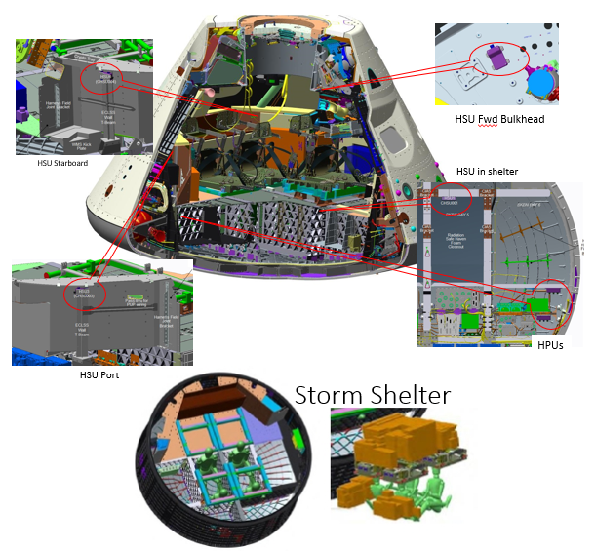
Multi-Pronged Approach for Exposure Mitigation
Mission Control support
In-situ radiation monitoring
Space weather modeling
Vehicle design
Crew / team training
MPCV represents the first time that crew radiation exposure considerations have been part of the iterative vehicle design process
Iteration of shielding analyses performed to optimize redistribution of vehicle mass for storm shelter

Slide 15
Multi-Pronged Approach for Exposure Mitigation
Mission Control support
In-situ radiation monitoring
Space weather modeling
Vehicle design
Crew / team training
Pre-mission
Space weather
Monitoring hardware
Mission projections
Pre-mission brief
Post-mission
Post-mission brief
Assessment of mission dose
Compare data to pre-mission projections to improve model predictions

Slide 16
Looking to the Future: Artemis
SRAG is tasked with mitigating the effects of radiation exposure due to enhanced space environment
ISS trajectory is mostly within the protection of the Earth’s geomagnetic field
Majority of Artemis mission time spent in free space
SWPC will provide operational forecasts for all missions
CCMC/SRAG collaboration resulted in the scoreboards which is critical to compare new models to data
New technologies tested at M2M are critical to enhance current capability, which will transition mature models to SWPC mission operations
Ar-I will act as a testbed for improved technologies in preparation for first crewed mission (Ar-II)
https://srag.jsc.nasa.gov/

