Slide 1
2012 March – Overview of Computations
Simulated Period: 2012-03-05T00 – 2012-03-20T00 (15 days)
Master scripts:
– wsadt-cdat – CME parameters in a single file
– wsadt-cdir – CME parameters in individual files in yyyy/mm directory
CME parameters – scientific fitting (Hong Xie, 5 CMEs):
– cmes-hx3.2012-mar.dat – elliptical cone from GCS model: Lat, Lon, Rmaj, Rmin, Tilt, Vcme
– cmes-hx2.2012-mar.dat – circular cone from “hx3”: Lat, Lon, Rmaj, Vcme
– cmes-hx1.2012-mar.dat – circular cone from “hx3”: Lat, Lon, Rmin, Vcme
CME parameters – operational fitting (SWPC team, 12 CMEs):
– cmes-swpc2.2012-mar.dat – (original swpc data as revised by Doug Biesecker)
CME parameters – operational fitting (SWRC team, 29 CMEs):
– $datadir/CMEs/DONKEY/yyyy/mm/yyyy-mm-ddThh:mm:ss-CME-xxx.dat
– $datadir/CMEs/SWRC/yyyy/mm/yyyymmdd_hhmmss_Dusans_file

Slide 2
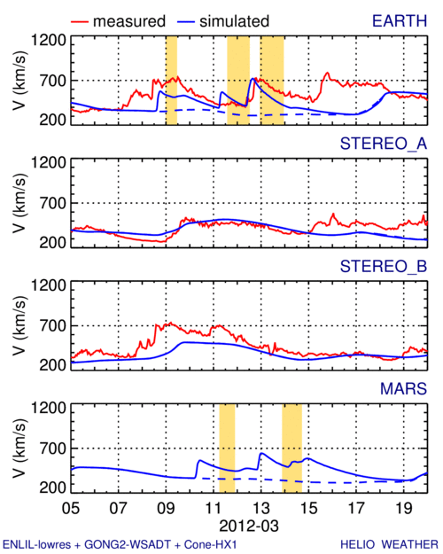
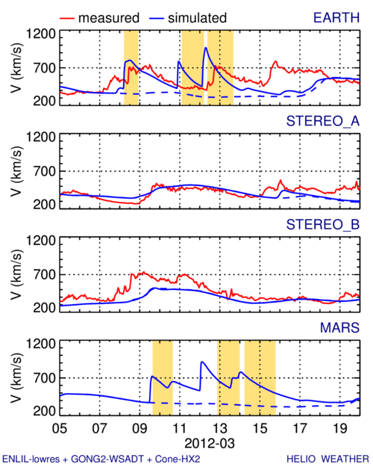
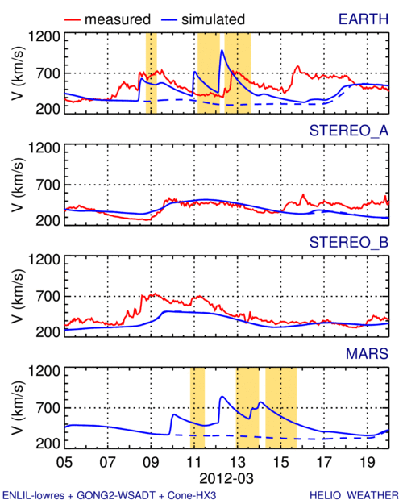
2012 March – In-Situ Comparison
hx1
hx2
hx3

Slide 3
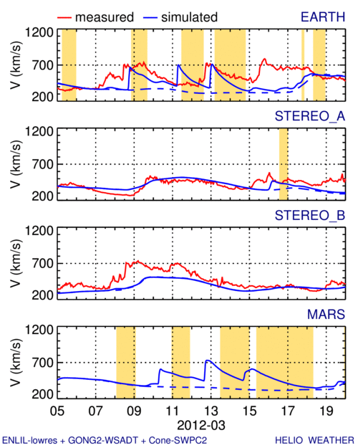
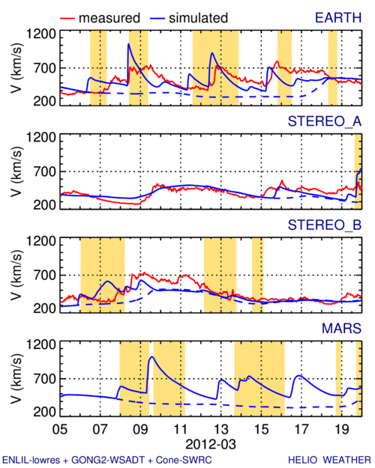
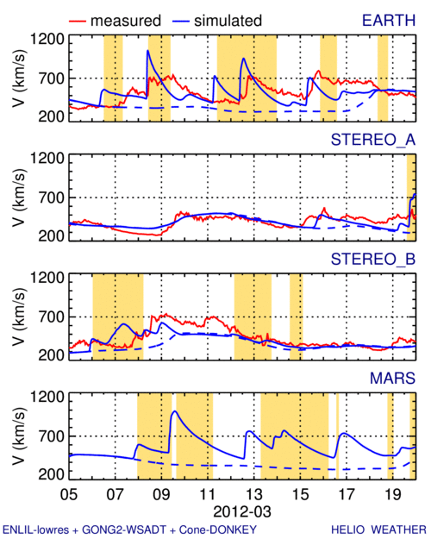
2012 March – In-Situ Comparison
swpc2
swrc
donkey

Slide 4
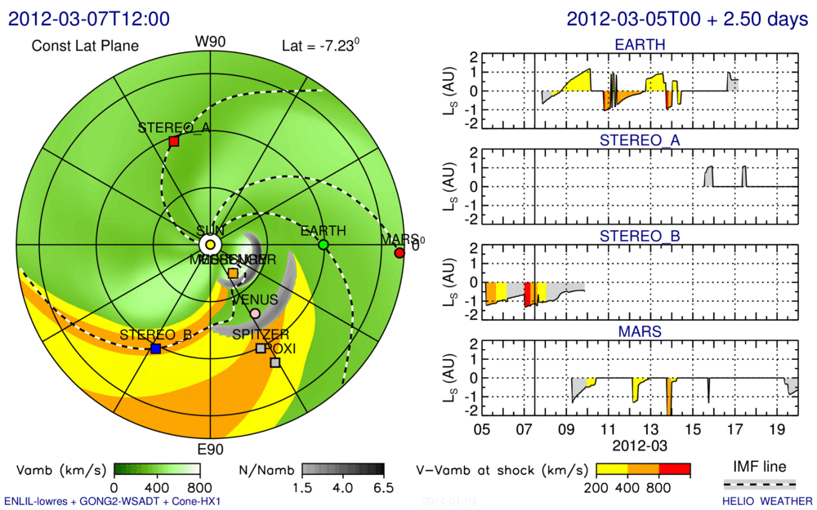
2012 March – Possible SEP Effect – hx1

Slide 5
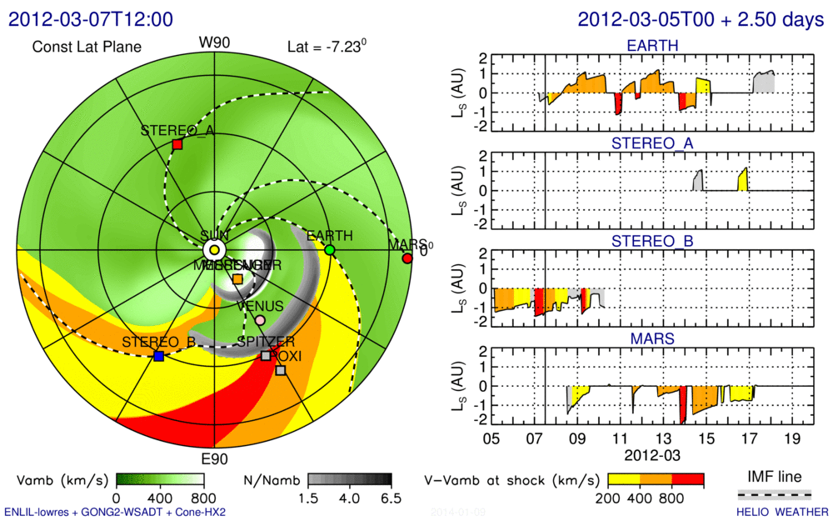
2012 March – Possible SEP Effect – hx2

Slide 6
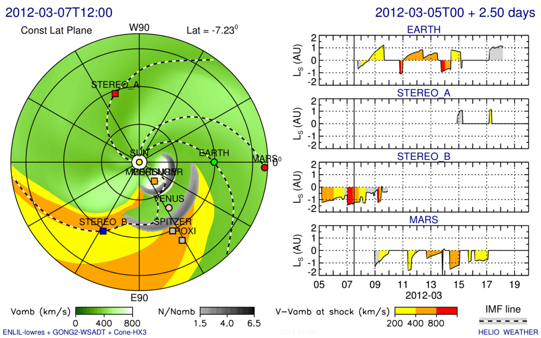
2012 March – Possible SEP Effect – hx3

Slide 7
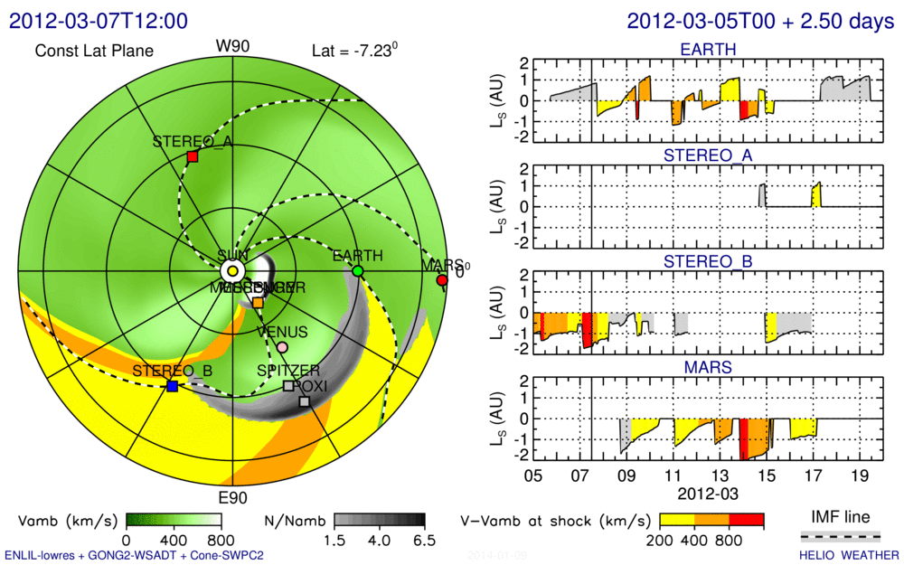
2012 March – Possible SEP Effect – swpc2

Slide 8
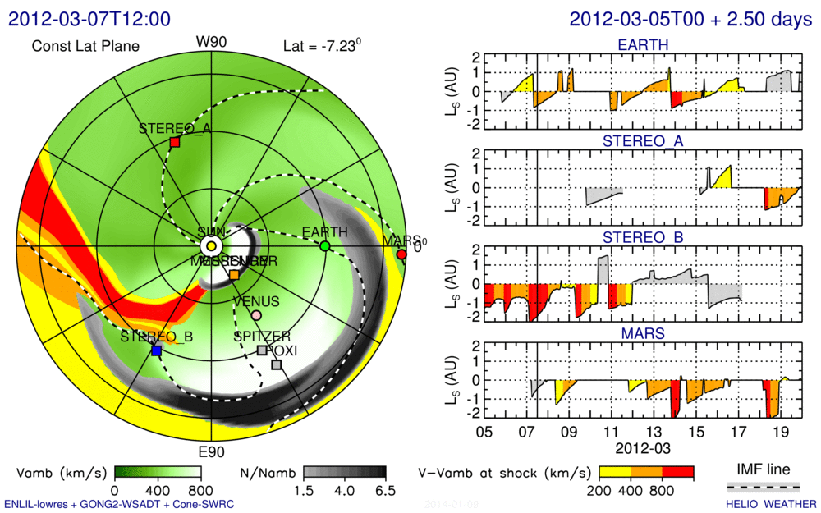
2012 March – Possible SEP Effect – swrc

Slide 9
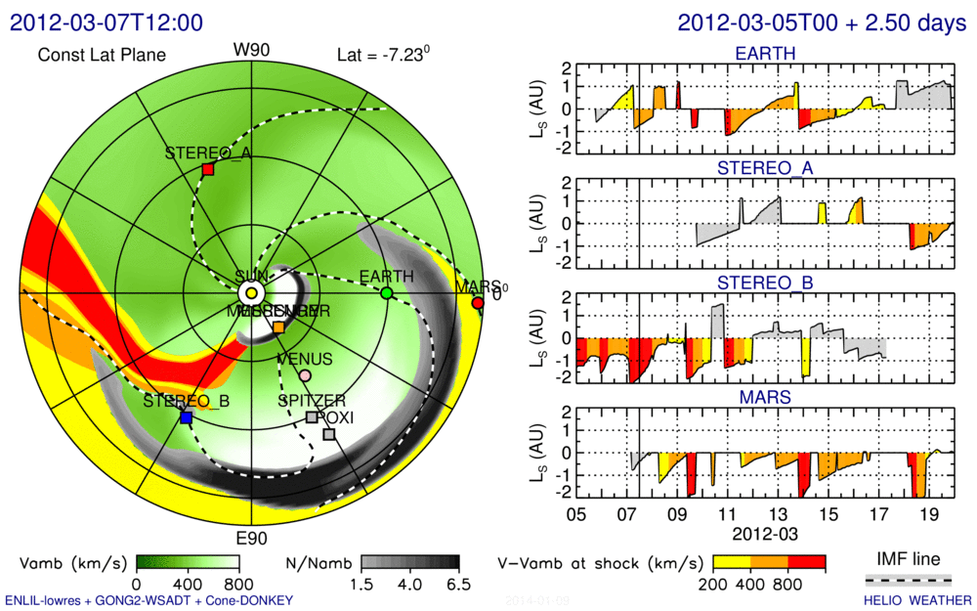
2012 March – Possible SEP Effect – donkey

Slide 10
2012 March – Next Runs
Presented results were computed by running the “wsadt-cdat” and “wsadt-cdir” scripts:
wsadt-cdat –cld hx3 –tfile cmes-hx3.2012-mar.dat
wsadt-cdat –cld hx2 –tfile cmes-hx2.2012-mar.dat
wsadt-cdat –cld hx1 –tfile cmes-hx1.2012-mar.dat
wsadatcdat –cld swpc2 -tfile cmes-swpc2.2012-mar.dat
wsadt-cdir –cld donkey –tdata CMEs/DONKEY
wsadr-cdir –cld swrc –tdada CMEs/SWRC
The following default values were used (in those two scripts):
reg=reg2 – computational domain up to 1.7 AU
res=low – numerical grid resolution of 4-degs angularly
tstop=360 – computations last 360 hours = 15 days
nblk=2 – computation is on two blocks (one for background, other for background+transients)
“Final” SEP application may require (some or all of) the following modifications:
<script> -reg reg5 –res med –tstop 480 –nblk <nblk>
I.e., computing up to 5.3 AU on 2-degs for 20 days on number of blocks that equals to
number of CMEs plus one (for computing just background).

Slide 11
Post-processing for SEPMOD
Post-processing is broken to six steps (in the given-below order), using IDL procedures, for easier development/experimentation:
sho1-params1 – Reads in evo.*.nc, fld.*.nc, and tim.*nc files, calculates the shock parameters
sho2-smooth1 – Smoothing of shock parameters
sho3-plt<x> -- Various plotting procedures
sho4-datsho – Interpolates from 1-hour-cadence results into 10-minute cadence and writes the text file with shock parameters
sho5-datbnd – writes the text file with IMF line end positions at the inner boundary
sho6-datfld – writes the text file with solar winds parameters along the IMF line

