Slide 1
2012 July – Overview of Computations
Simulated Period: 2012-07-12T00 – 2012-07-27T00 (15 days)
Master scripts:
– wsadt-cdat – CME parameters in a single file
– wsadt-cdir – CME parameters in individual files in yyyy/mm directory
CME parameters – operational fitting (SWRC team):
– swrc16<x>all.dat – all 16 CMEs, <x> =f (=s) for Vcme=3435 (2930) km/s on July 23
– swrc12<x>400.dat – as above but with Vcme’s > 400 km/s, 12 CMEs
– swrc07<x>800.dat – as above but with Vcme’s > 800 km/s, 7 CMEs
– swrc05<x>1000.dat – as above but with Vcme’s > 1000 km/s, 5 CMEs
– swrc01<x>2000.dat – as above but with Vcme’s > 2000 km/s, 1 CME
CME parameters – operational fitting (SWRC team):
– $datadir/CMEs/DONKEY/yyyy/mm/yyyy-mm-ddThh:mm:ss-CME-xxx.dat

Slide 2
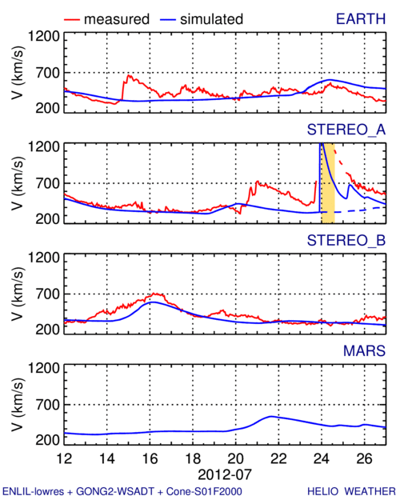
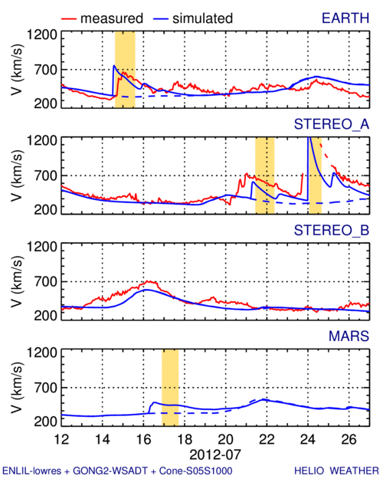
2012 July – In-Situ Comparison
swrc01f2000
swrc01s2000
swrc05s1000

Slide 3
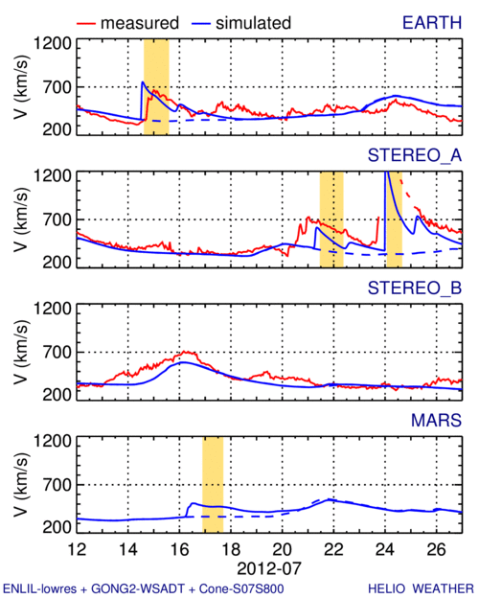
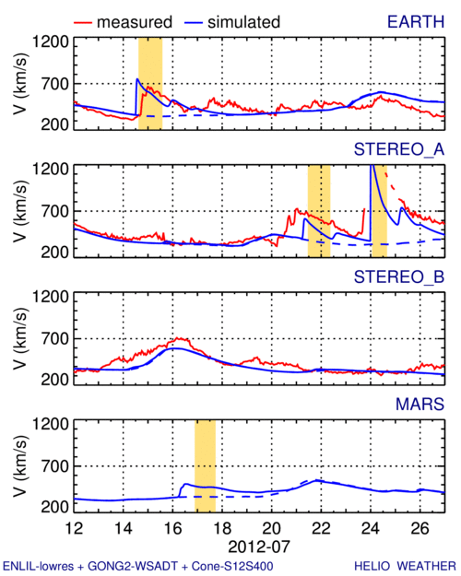
2012 July – In-Situ Comparison
swrc07s800
swrc12s400
swrc16sall

Slide 4
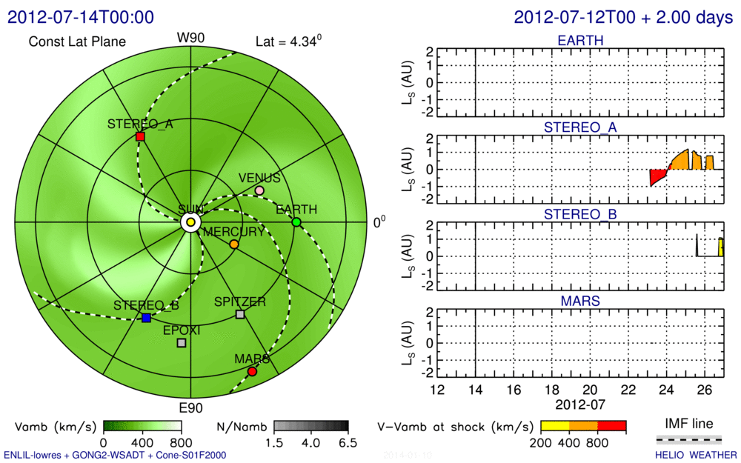
2012 July – Possible SEP Effect – swrc01f2000

Slide 5
2012 July – Possible SEP Effect – swrc01s2000

Slide 6
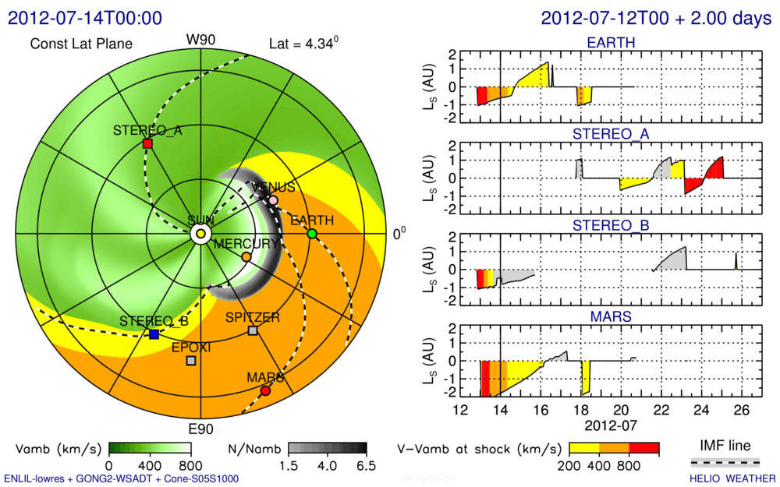
2012 July – Possible SEP Effect – swrc05s1000

Slide 7
2012 July – Possible SEP Effect – swrc07s800

Slide 8
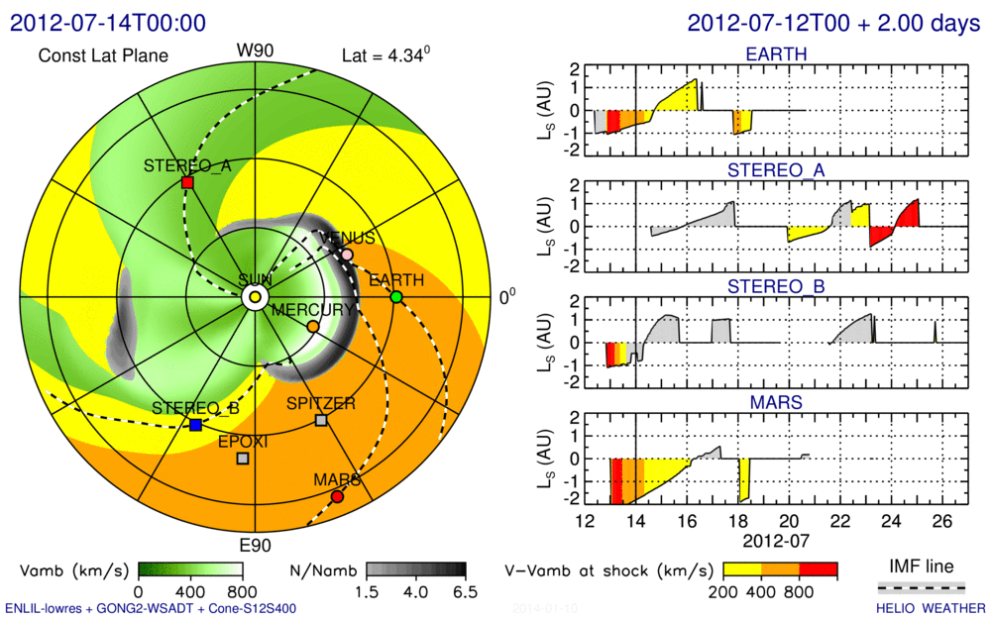
2012 July – Possible SEP Effect – swrc12s400

Slide 9
2012 July – Possible SEP Effect – swrc16sall

