Slide 1
2010 August – Overview of Computations
Simulated Period: 2010-08-01T00 – 2010-08-11T00 (10 days)
Master scripts:
– wsadt-cdat – CME parameters in a single file
CME parameters – operational fitting (6 CMEs):
– cmes-1.2010-aug.dat
CME parameters – operational +scientific fitting (11 CMEs):
– cmes-2.2010-aug.dat

Slide 2
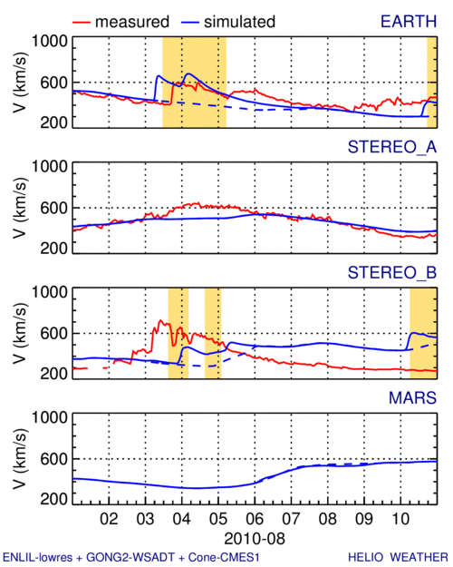
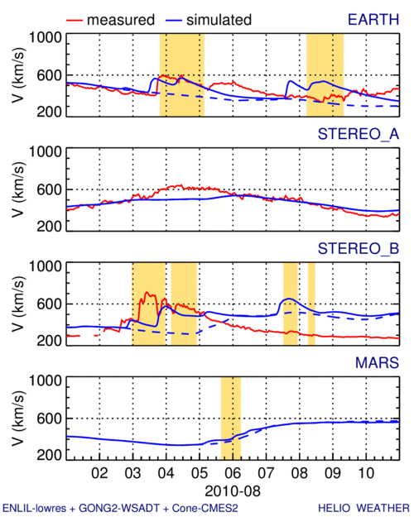
2010 August – In-Situ Comparison
cmes-1
cmes2

Slide 3
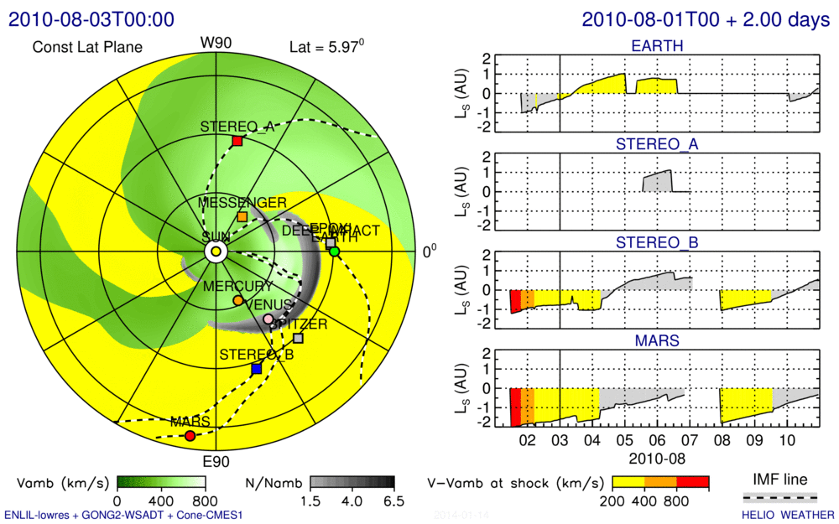
2010 August – Possible SEP Effect – cmes1

Slide 4
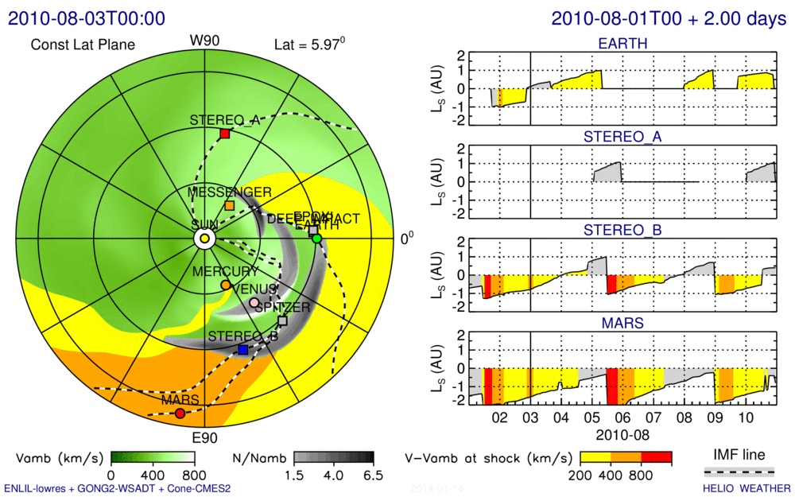
2010 August – Possible SEP Effect – cmes2

Slide 5
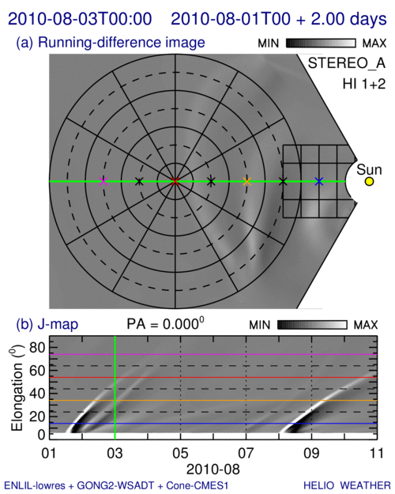
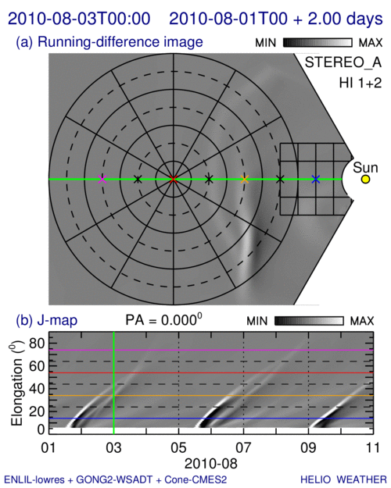
2010 August – Differences in J-maps
cmes-1
cmes-2

