Slide 1
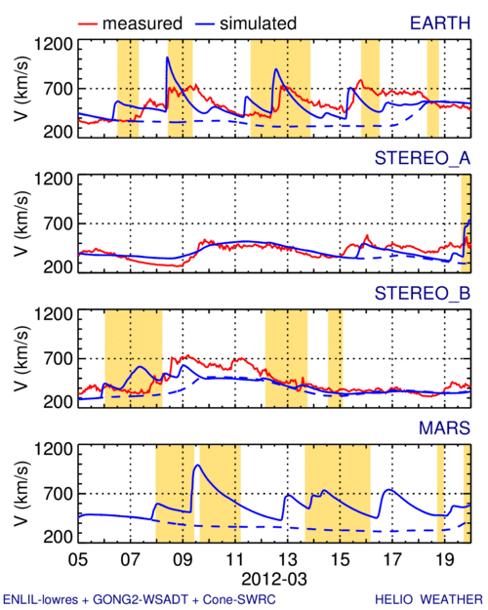
2012 March – In-Situ Comparison
swrc
Simulations from D. Odstrcil

Slide 2
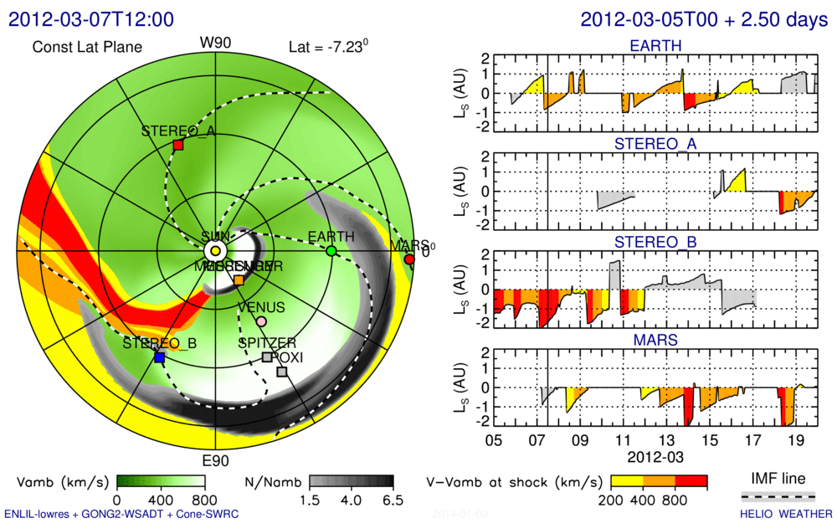
2012 March – Possible SEP Effect – swrc
Simulations from D. Odstrcil

