Slide 1
Space Weather products (models & observations)
Yihua Zheng
Space Weather Training on 2/15/2016

Slide 2
Storms and Effects
Radiation hazards to humans
SEEs on spacecraft components and electronics
PCA on radio waves
Event total dose
Radiation Storms
Geomagnetic Storms
Ionospheric Storms
Radio Blackouts due to flares
Energetic ions
Energetic electrons
Internal charging of electronics
Large/rapid variations/disturbances in space and time (in fields and plasma/neutral distribution)
Enhancement in currents
Affect
Communication
Navigation
Surface charging
Radio wave propagation
Radio emissions/noise associated with flares (direct impacts)
Radio wave blackouts
(dayside ionosphere)
X-ray/EUV emission altering ionospheric structure/composition (indirect)

Slide 3
Major SWx Concerns for Launch/spacecraft operations
Solar energetic particle event
On the ground: >100 MeV proton flux
Outside Earth’s protection: >30 MeV proton flux
Geomagnetic Storms
Kp >=7
Other mission specific concerns

Slide 4
SEP events
Suggested constraint
>100 MeV flux exceeds 1pfu

Slide 5
SWx products
Relevant to SEPs and geomagnetic storms
Layout
http://go.nasa.gov/1PUZOyK
http://bit.ly/products_launch_relevant

Slide 6
Other products
GOES > 0.8 MeV electrons and > 2 MeV electrons (internal charging)
Aurora products
Ovation prime

Slide 7
iSWA layouts -

Slide 8
layouts
Monitoring space weather activities
Events
Anomaly
Comparative study
Weekly summary and highlights of specifics

Slide 9
Layouts - examples
http://1.usa.gov/1rQXhWK - x1.4 flare on April 25, 2014
http://1.usa.gov/1kr0842 - summary 20140430
http://1.usa.gov/1i2Qemt scintillation with Kp
http://1.usa.gov/1gPzEKM scintillation
http://1.usa.gov/1deGdXC anomaly resolution
http://1.usa.gov/1fk5Fv6 coronal hole responsible for Saturn aurora

Slide 10
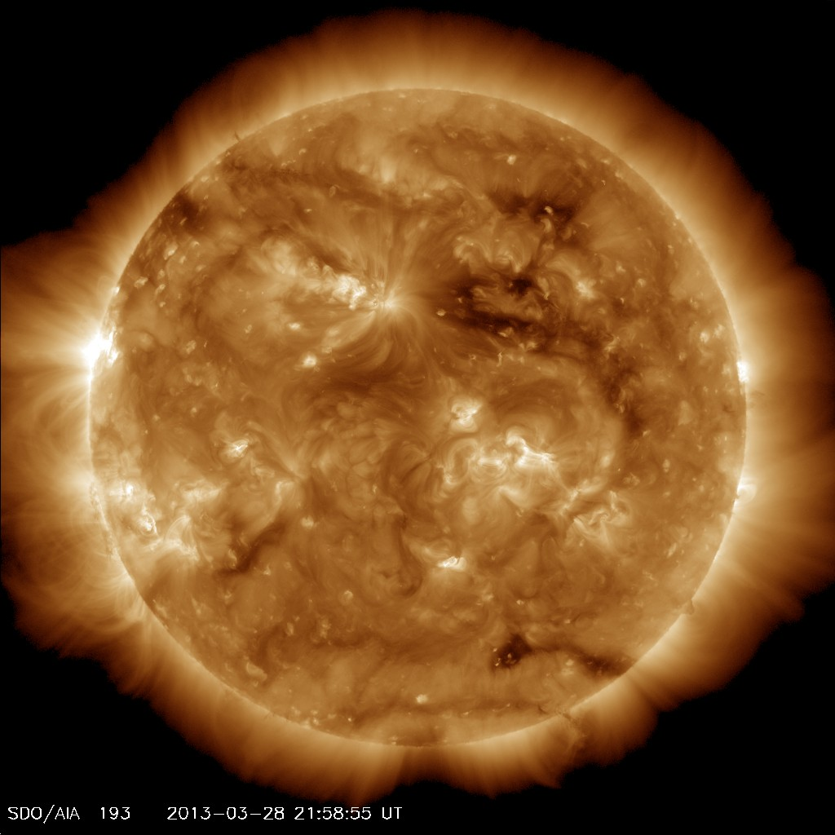
The Coronal Hole possibly responsible for the aurora at Saturn around May 20, 2013
Coronal Hole
Well, I tried ☺

Slide 11
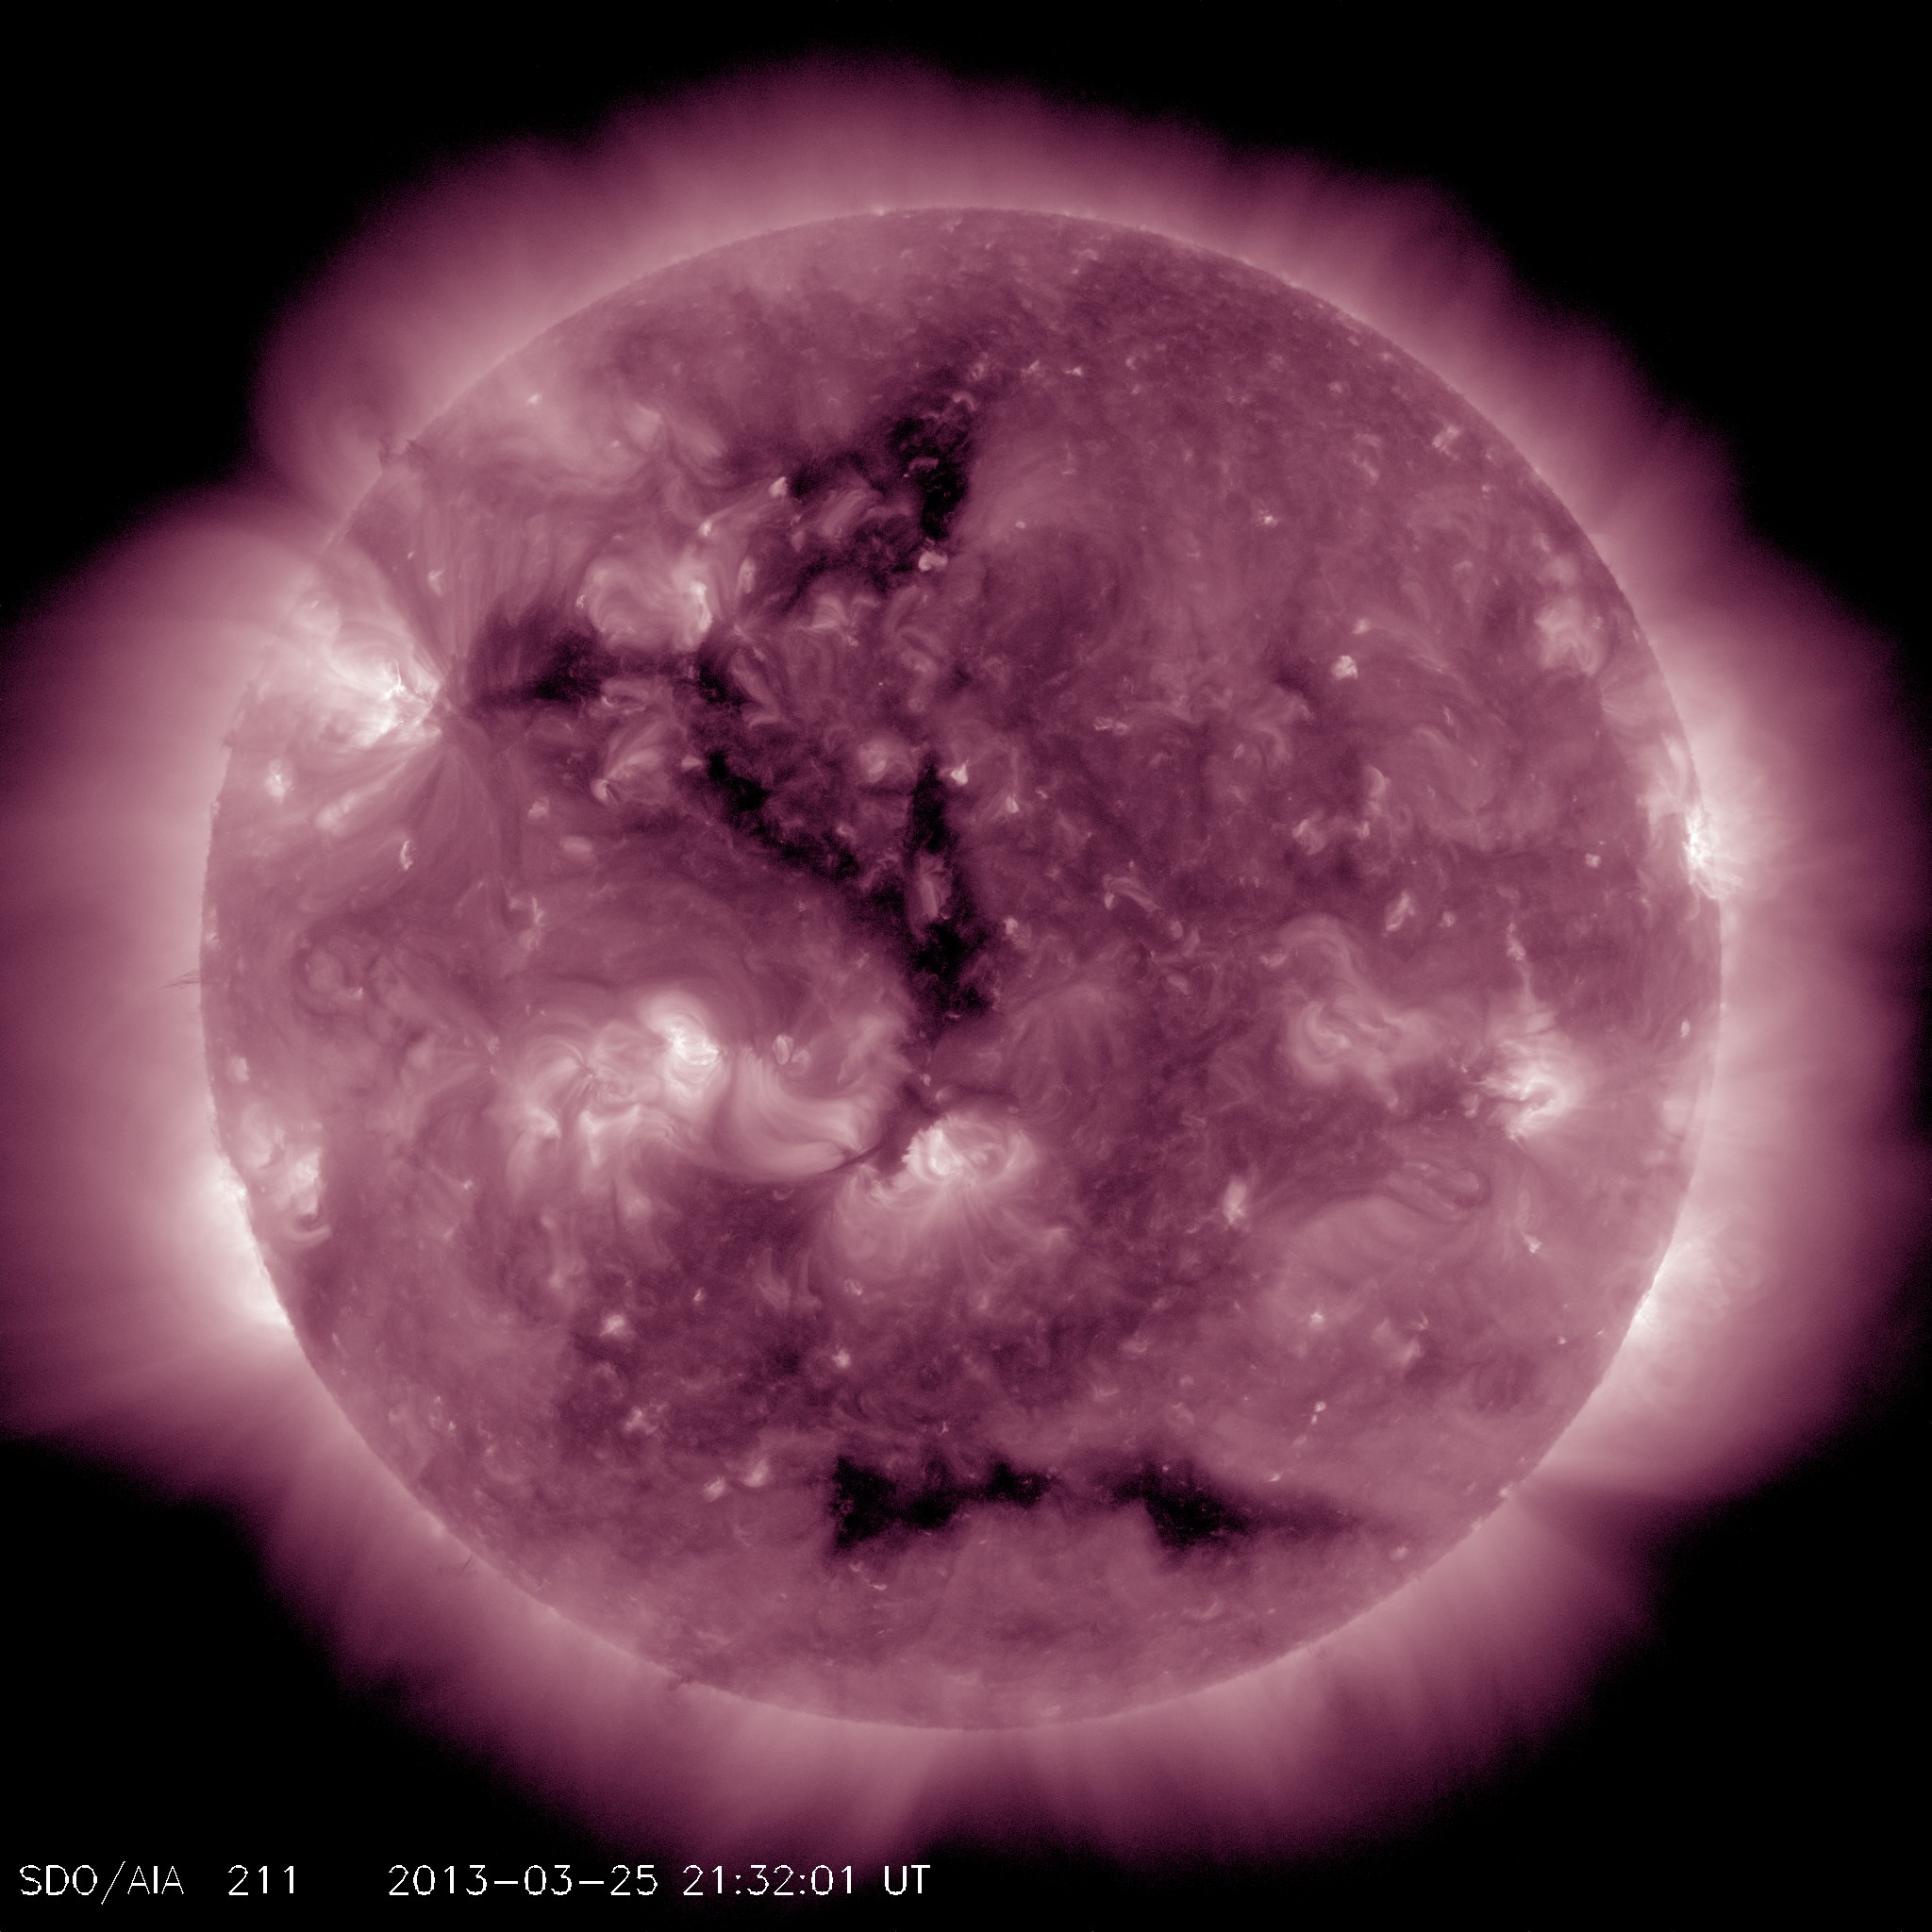
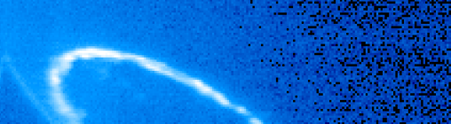
The Coronal Hole possibly responsible for the aurora at Saturn around May 20, 2013
Day 111 ~06:26 UT
Day 112~03:47 UT
Day 112~05:21 UT

Slide 12
Layouts - examples
http://1.usa.gov/1e5ZBDW - march 7, 2012 event
http://1.usa.gov/LSfnaC - evolution of March 2013 coronal hole in SDO, STA and STB
http://1.usa.gov/1lZjWeD - SDO view of the coronal hole when it arrived at ACE
http://1.usa.gov/1c51alC - layout of the 2013-09-29 CME and its impacts
http://1.usa.gov/HUue2U - summary_20131113
http://1.usa.gov/172TYTB - 20131107 CME highlight

Slide 13
Other layouts
http://swrc.gsfc.nasa.gov/main/demo

