Slide 1
FUV AuroraI Images/Products for Model Validation
Yongliang Zhang and Larry Paxton
JHU/APL
CEDAR Workshop, June 20, 2016

Slide 2
Outline
Why FUV?
  Strong O2 absorption without contamination from cloud/ground
FUV Aurora
  IMAGE, Polar, TIMED, DMSP
  Boundary, Polar cap/oval sizes
  Auroral structures
  Proton versus electron aurora
  Hemispheric Asymmetry
Auroral products
  E0,Q, NmE, HmE, boundary, HP, proton aurora
Application to model validation
Near real time Observations

Slide 3
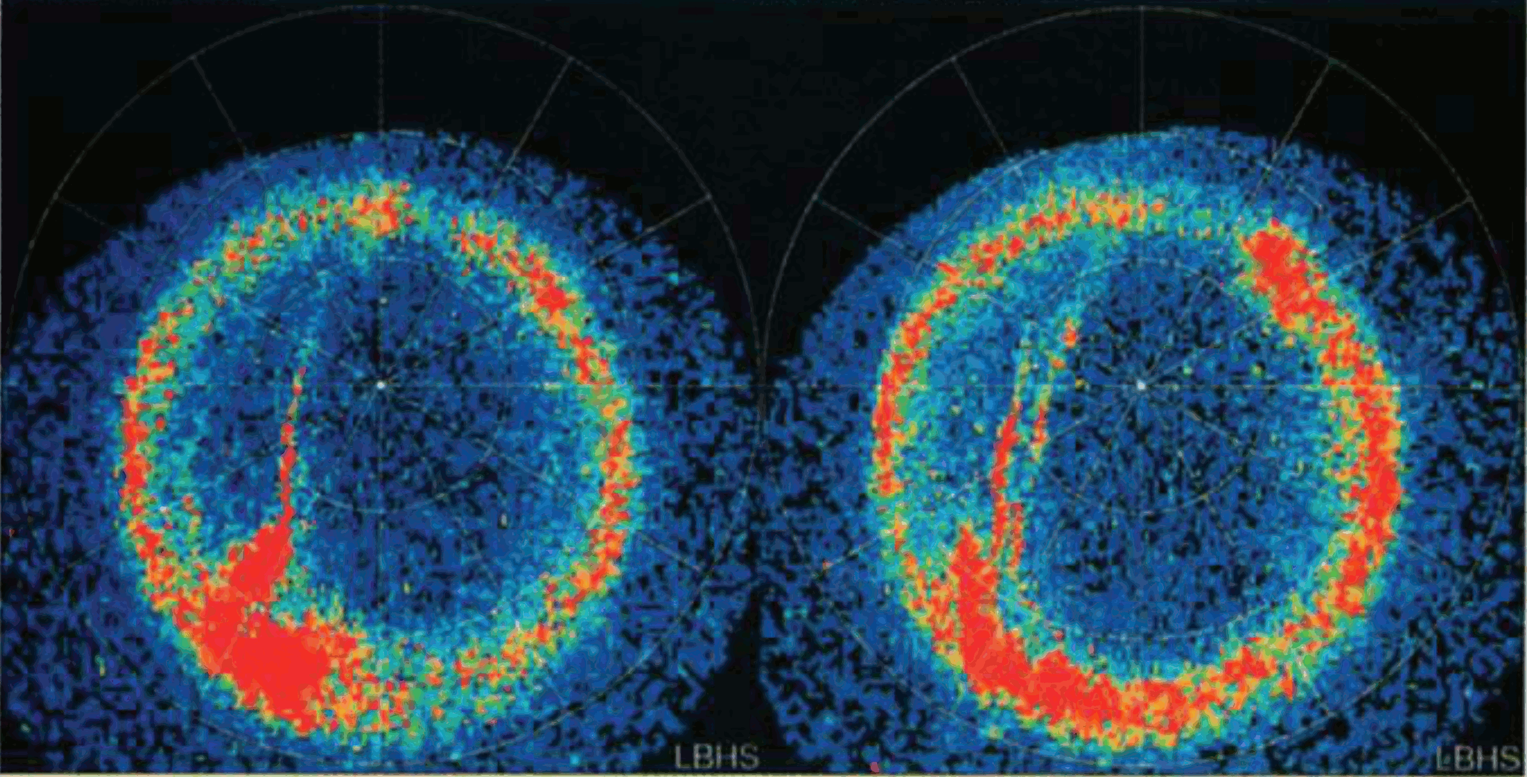
Polar UVI N2 LBH
Newell et al., 1999 JGR

Slide 4
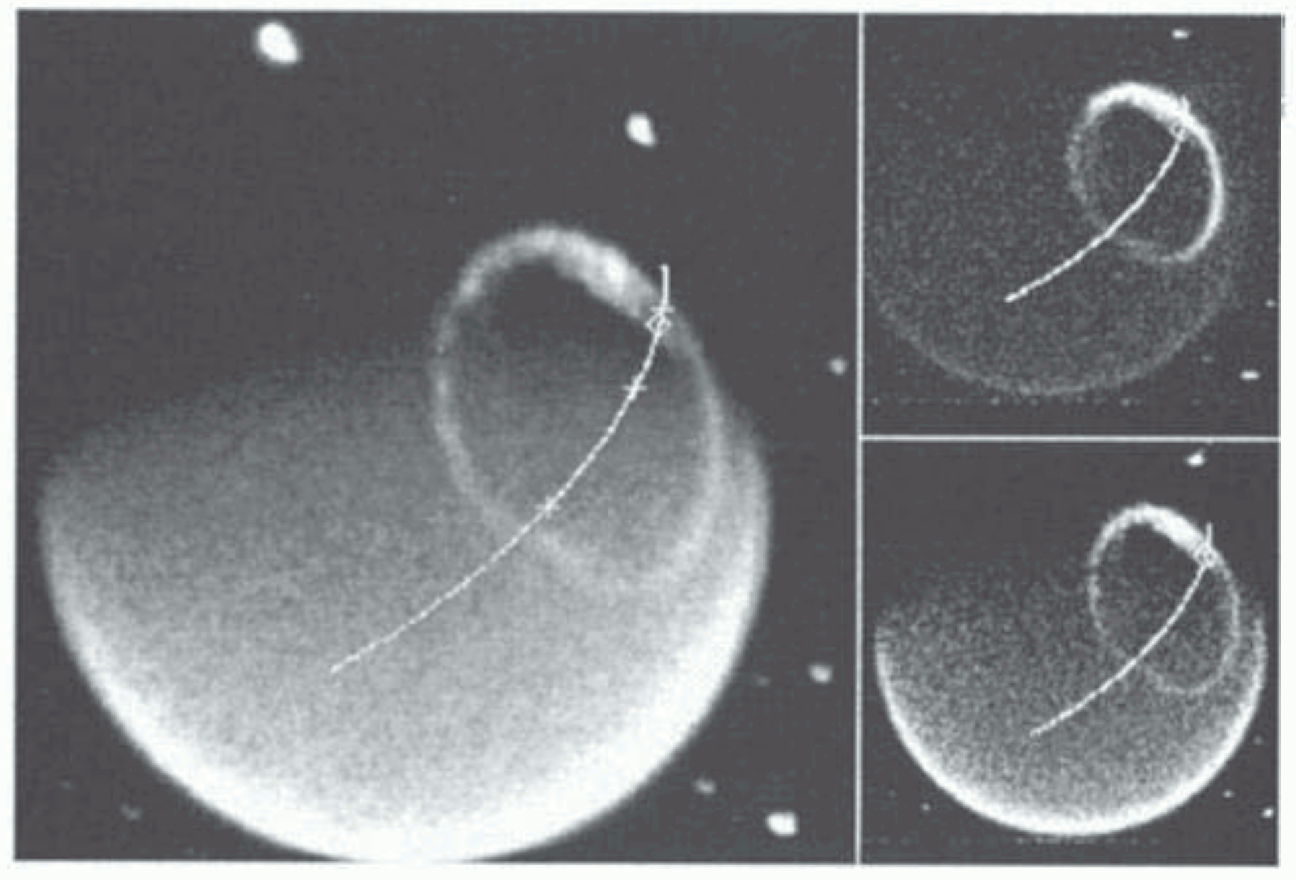
IMAGE FUV
Frey et al., 2001, JGR

Slide 5
IMAGE and Polar provide true global coverage of aurora oval. Unfortunately, their operation ended many years ago.
The current operation FUV auroral imagers are DMSP/SSUSI and TIMED/GUVI

Slide 6
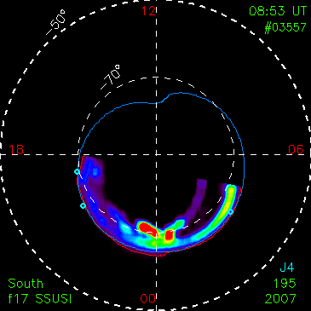
Equatorward auroral boundary
The TIMED/GUVI based
auroral model [Zhang and Paxton, 2008, JASTP] can be driven by Kp or boundary

Slide 7
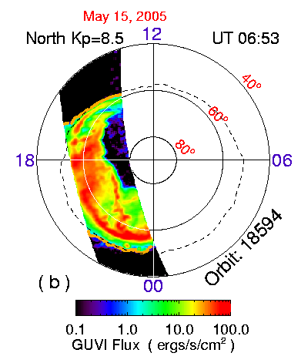
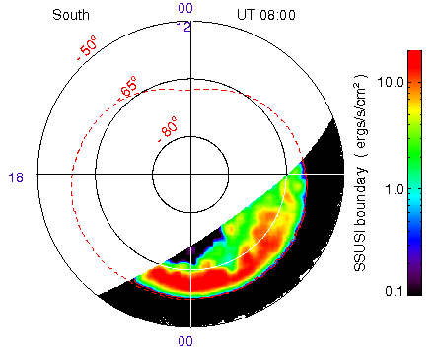

Slide 8
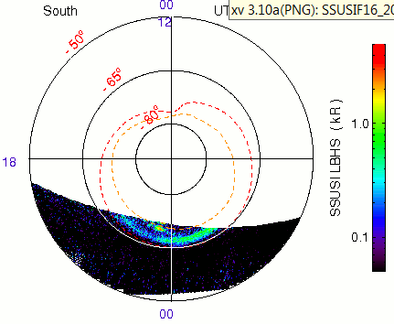
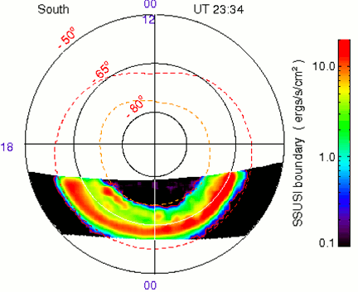
Poleward boundary: polar cap size and total open B flux
Equatorward boundary: magnetotail stretch
Both of the boundaries are useful for model validation

Slide 9
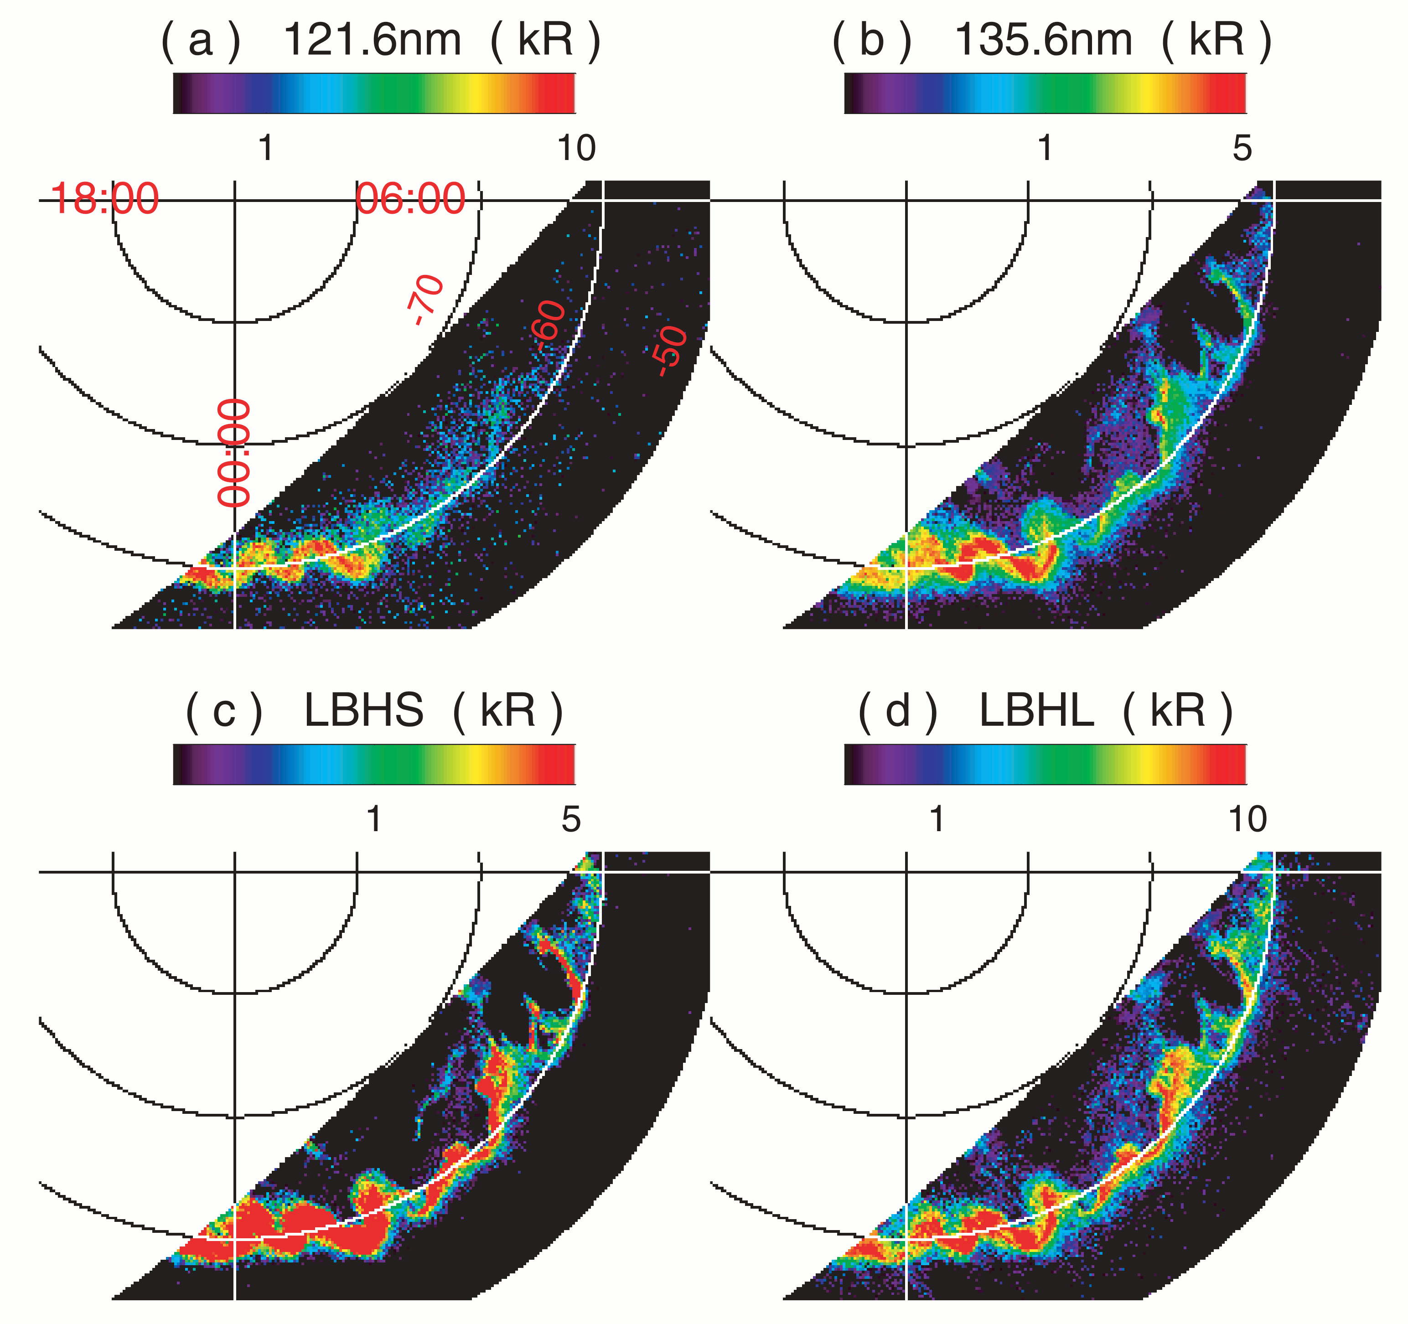
Auroral structures: future challenge
Zhang et al., 2005 JGR

Slide 10
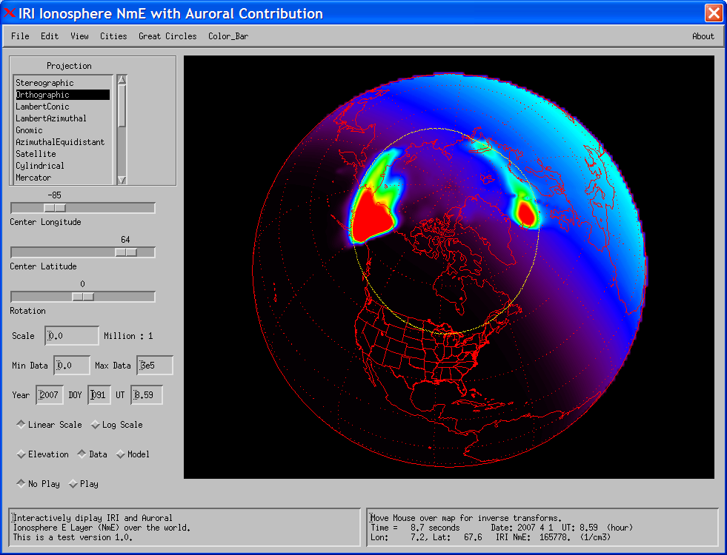
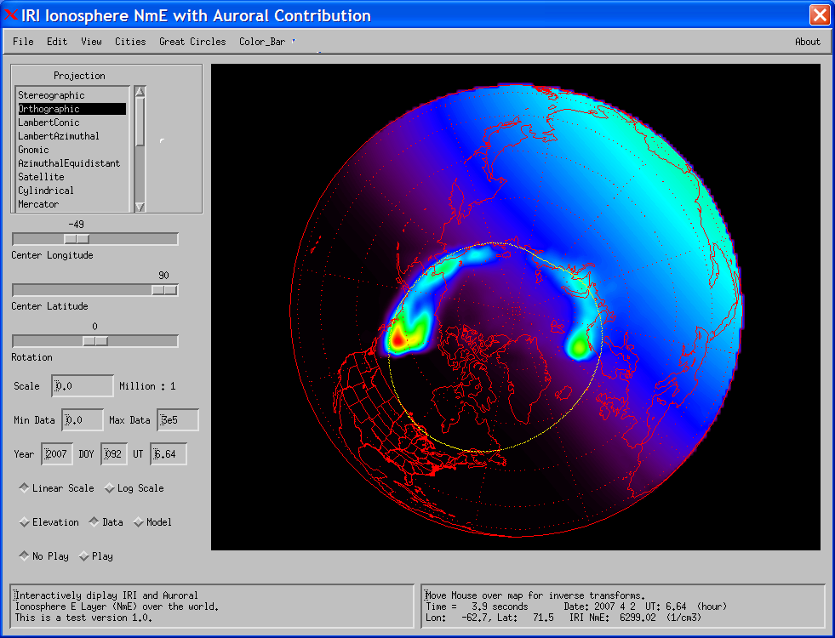
Assimilation of measured SSUSI NmE and boundary
in IRI (Kp =4.3, April 1, 2007, 8:59UT)

Slide 11
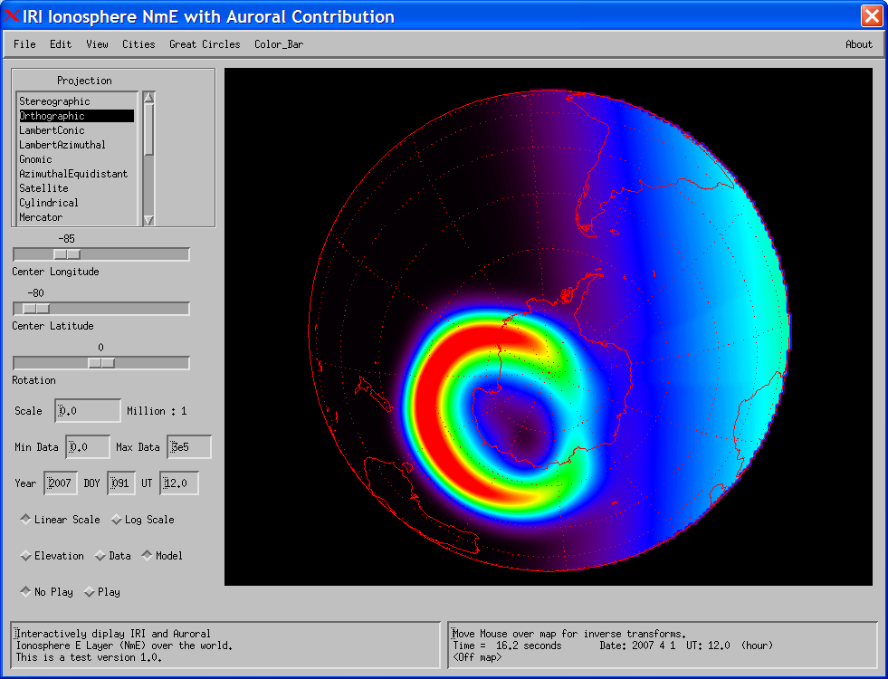
Assimilation of model NmE in IRI (Moderate Active time Kp =4.0)

Slide 12
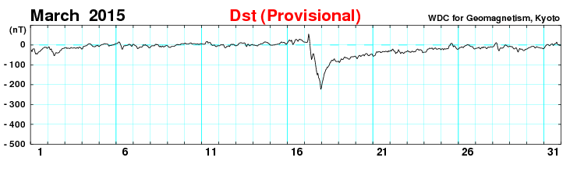
The March 17, 2015 St Patrick Storm

Slide 13
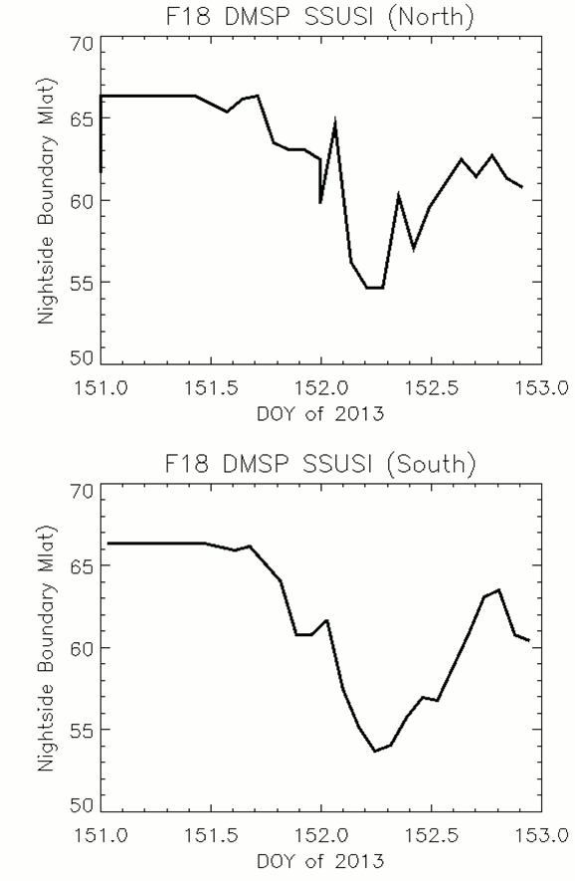
Nightside Boundary Variations

Slide 14
Summary
SSUSI Auroral data
  E0, Q, HmE, NmE, HP, equatorward/poleward boundaries, field line mapping, auroral arc identification, proton aurora
Near real-time (2-3 hour delay)
How to get the data?
  ssusi.jhuapl.edu (APL website)
  NASA SPDF
If Questions
  Larry.paxton@jhuapl.edu (PI of GUVI and SSUSI) yongliang.zhang@jhuapl.edu

Slide 15
Backup slides

Slide 16
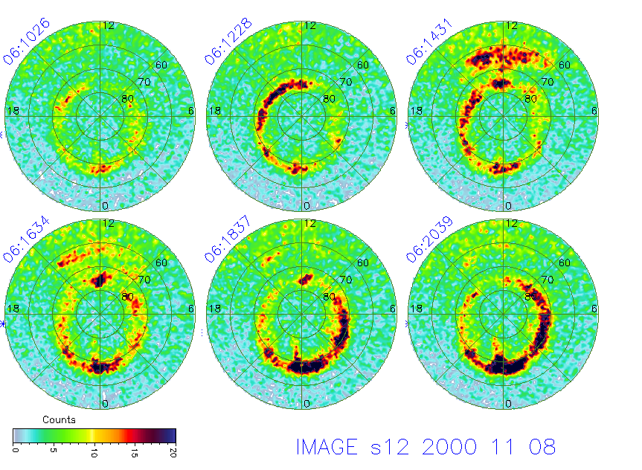

Slide 17
FUV Spectra and five “colors”
H 1216Å
O 1304Å
O 1356Å
N2 LBHL
N2 LBHS

Slide 18
FUV auroral images: TIMED/GUVI

