Slide 1
The Integrated Space Weather Analysis System
Yaireska (Yari) Collado-Vega
Aknowledgement: Marlo Maddox
Space Weather Training 2020
http://iswa.ccmc.gsfc.nasa.gov

Slide 2
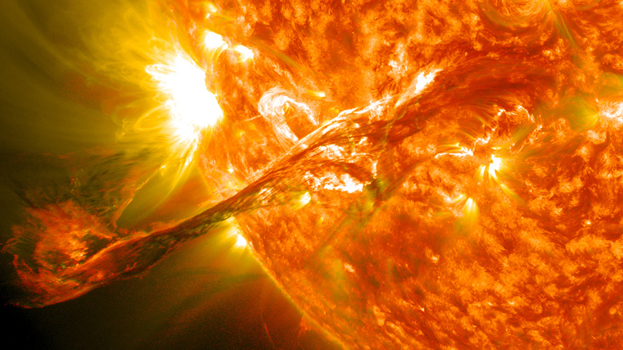
How Do You Quickly Determine Past, Present, & Expected Space Weather Impacts?

Slide 3
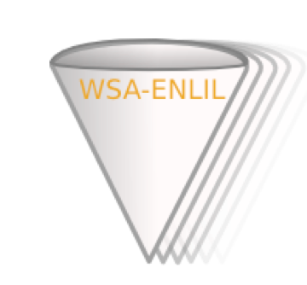
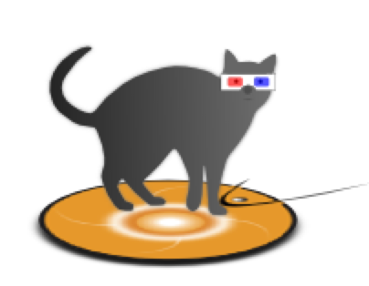
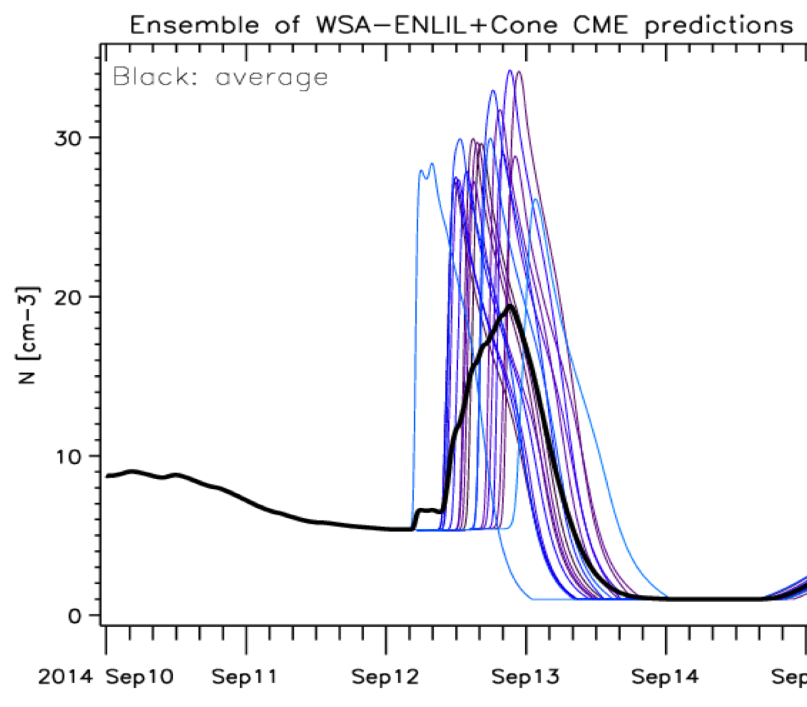
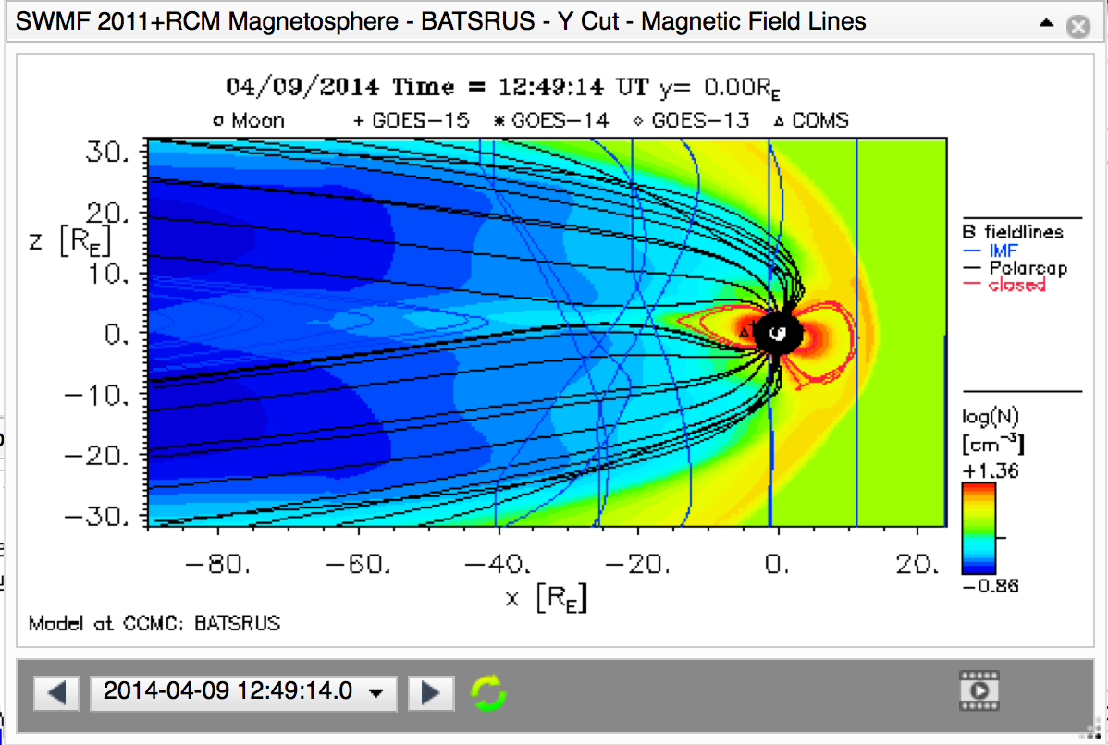
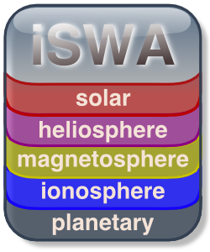
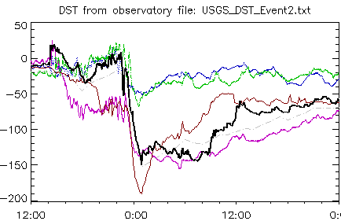
CCMC Tools, Systems, & Databases
for Research, Analysis, Metrics & Validation, Forecasting
Continuous
Real-time
Simulations
Event-Triggered
Real-time Simulations
Input
Parameters
Generation Tools
Ensemble
Simulations
1-Click
StereoCAT
iNtegrated Space
Weather Analysis
System
Databases:
Run Results,
Events, Impacts
interpretations
Forecasting Methods ScoreBoards
M&V Suite
to Trace Model
Improvements
DONKI
Notes:
Examples of Tools, Systems & Databases for Research Analysis, M&V, Forecasting
(AVAILABLE ONLINE, ACCESSIBLE WORLD-WIDE)
CONTINOUS REAL-TIME SIMULATIONS
Models continuously running in real-time (with real-time drivers).
Data flow monitoring and controlling systems
EVENT-TRIGGERED REAL-TIME SIMULATIONS
1-Click system to submit event-triggered forecasting simulations (e.g., Enlil Cone Model).
Enables any interested person to generate forecasts.
INPUT PARAMETERS GENERATION TOOLS
Stereo Coronal Mass Ejection Analysis Tool (StereoCAT) is a component of the CCMC’s on-line Input Parameters Generation Suite that enables RoR users and space weather forecasters to quickly calculate the kinematic properties of Coronal Mass Ejections (CMEs). With a few mouse clicks, StereoCAT uses triangulation of SOHO and STEREO coronagraph images to determine CME speed, direction, and opening angle. The derived CME parameters can be utilized as input for a broad range of CME propagation models (including real-time Enlil-Cone model of CME propagation).
ENSEMBLE SIMULATIONS
to address uncertainties in input parameters
M&V SUITE TO TRACE MODEL IMPROVMENETS
In support of community-wide Modeling Challenges and operational model selection by operational agencies the CCMC is developing on-line interactive model validation systems, maintaining databases, and organizing model validation sessions at community workshops.
FORECASTING METHODS SCOREBOARDS
A central location for the community to:
submit their forecast in real-time
quickly view all forecasts at once
compare forecasting methods when the event has arrived
generate experimental community-wide ensemble forecasts
DONKI:
Chronicles the daily interpretations of observations, simulation results, forecasting analysis and notifications.
Catalog of space weather phenomena.
Comprehensive search functionality for anomaly analysis.
Enables broader participation: world-wide partners, model and forecasting technique developers, students
iNTEGRATED SPACE WEATHER ANALYSIS SYSTEM (iSWA) is a state-of-the-art tool for real-time space environment monitoring, historical event analysis, informed decision making, system science, and education. iSWA collects data from a large and evolving list of diverse and distributed sources including CCMC real-time model simulations and the most recent observations. Real-time data streams are sorted, characterized, and processed into space weather analysis products (Cygnets) that have been tailored for specific missions/applications and are ready to be used by forecasters and decision makers. iSWA’s flexible dissemination system generates and provides a user-configurable display panel that can be accessed from a standard web browser. Users can configure custom display layouts by selecting products of interest from a pool of more than 400 unique space weather products. iSWA’s front-end features include historical date selection, dynamic movie modes, interactive numerical timelines, and save-and-share-layouts. iSWA data streams can also be accessed using a web service API that is opening opportunities for collaborative development.

Slide 4
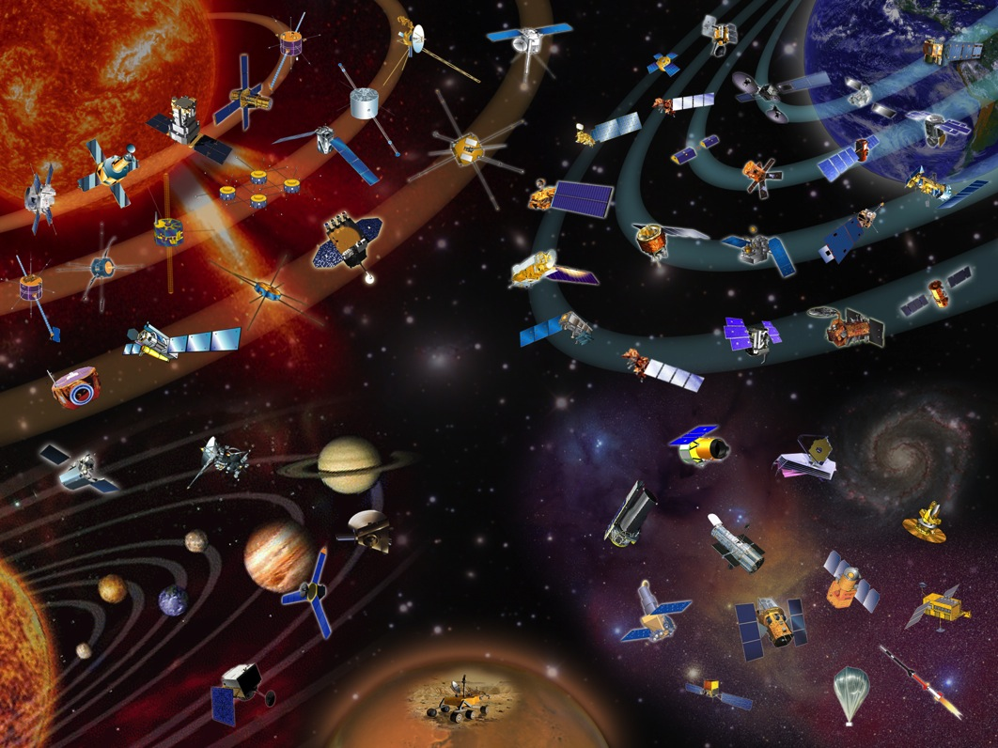
With so many NASA assets throughout the Heliosphere, the agency identified a critical need for the
Integrated Space Weather Analysis System
Objectives: provide the latest space weather information to NASA’s robotic mission operators, as well as DoD partners.

Slide 5
iSWA Solution & Deliverables
Acquire, ingest, and produce NASA relevant space weather information
Utilize both observational and simulation/model data
Produce and provide real-time data streams
Categorize and archive data for historical impact analysis
Provide customizable and highly configurable displays
Disseminate through the most widely deployed and accessible interface – the web
Notes:
Observational data tells you what is happening now.
Model & Simulation data provides forecasts of expected/predicted space weather activity.
Customization allows users to select regions and phenomenon of interest.

Slide 6
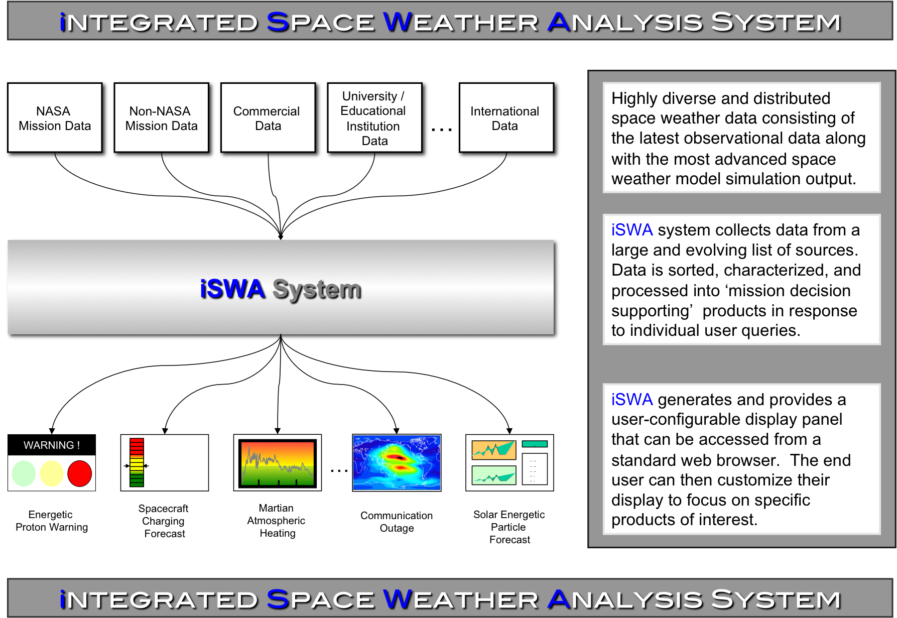

Slide 7
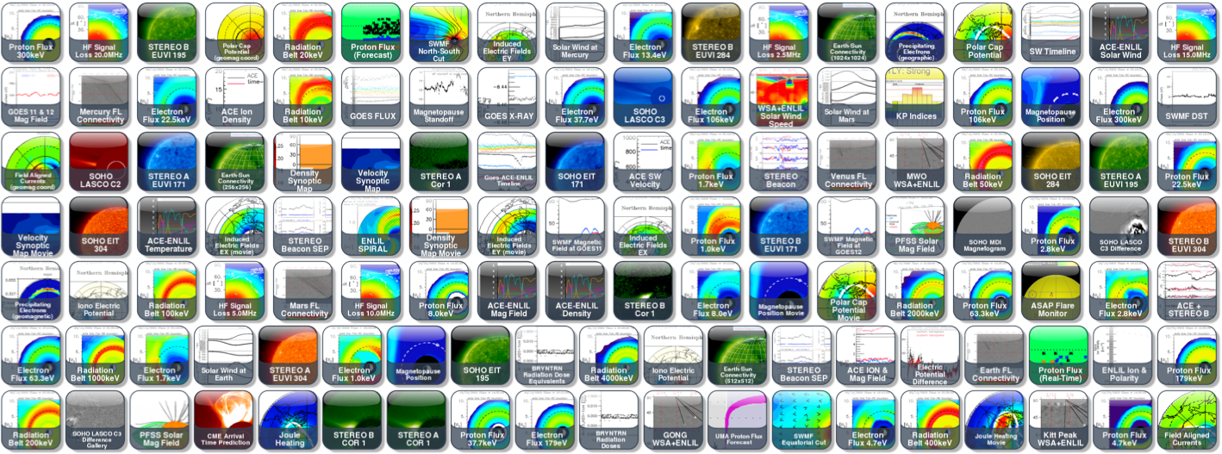
Innovative Dissemination
ISWA has ~300 products including modeling results and comprehensive sets of observational data.
Web-based. User configurable. Available world-wide.
One-stop shop for state-of-the-art information!
http://iswa.gsfc.nasa.gov

Slide 8
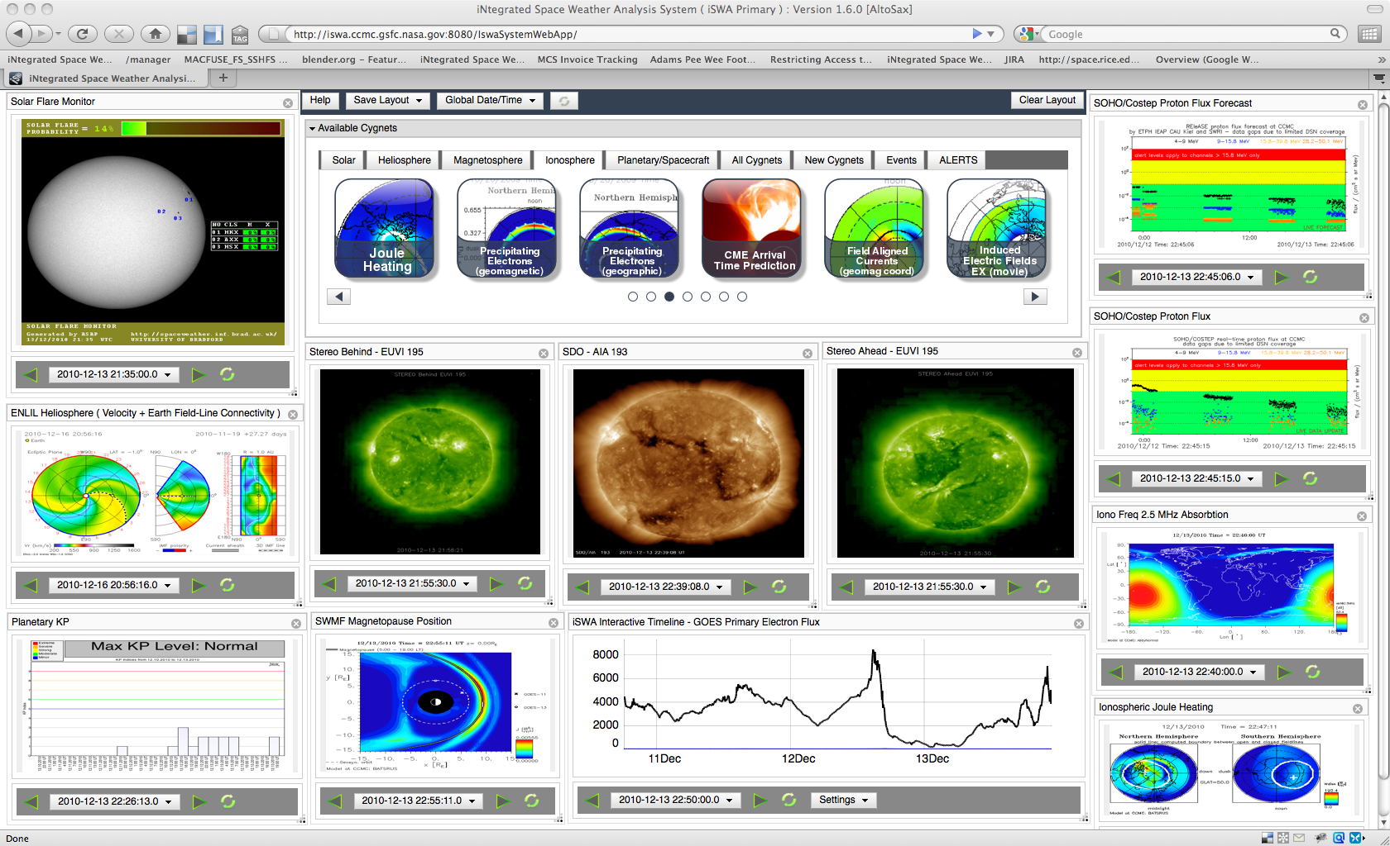
Unprecedented Access to Space Weather Information
http://iSWA.ccmc.gsfc.nasa.gov

Slide 9
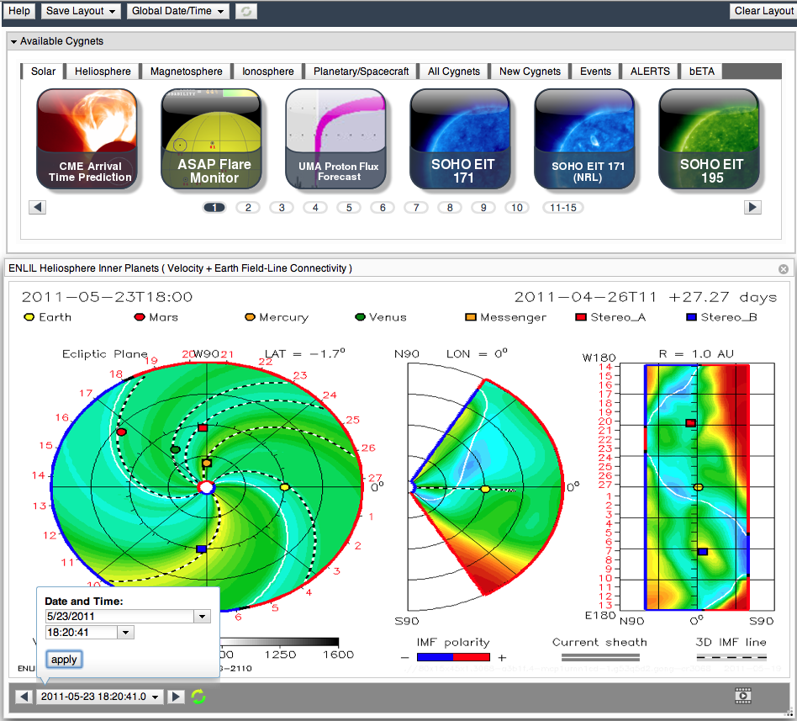
Layout & Global Controls
Cygnet
Control
Panel
Cygnet
Date
Controls
Options
Movie Mode Control

Slide 10
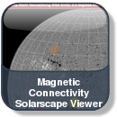
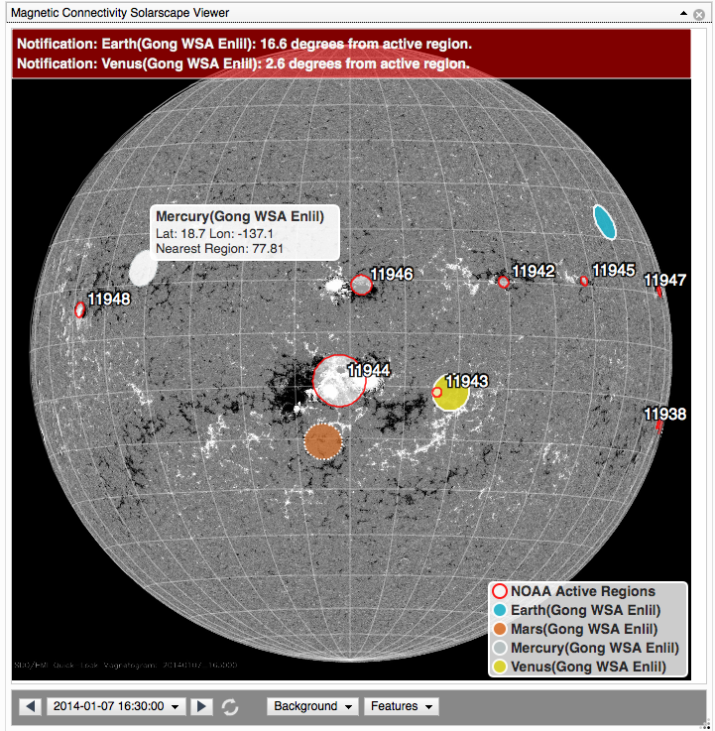
Dynamically Generated & Interactive Products: Solarscape
Alerts/Notifications
User Selectable Features
( MAG4, NOAA Active Regions, CCMC Magnetic Connectivity )
User Selectable Background
( SDO , Generic Grid )
Dynamic Product with User Selectable Features From Several Sources

Slide 11
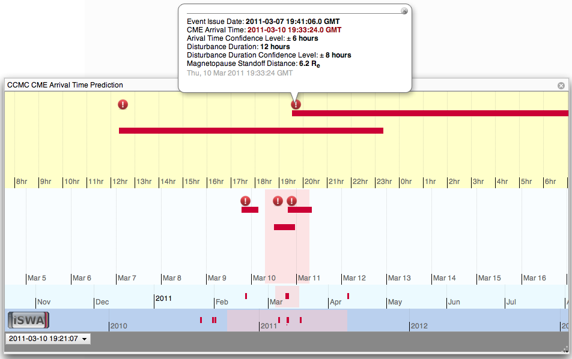
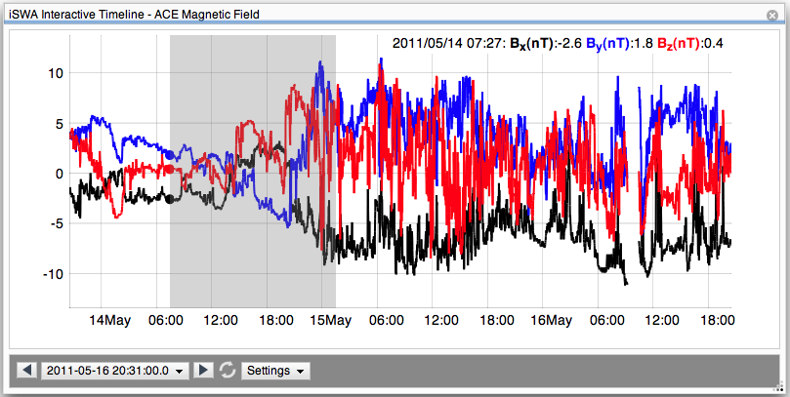
Interactive Timelines
Interactive CME alert tool with chronological record of SWx Center issued CME time of arrival predictions
Interactive timeline tool with pan, zoom, mouse-over, and quantity toggling functionality

Slide 12
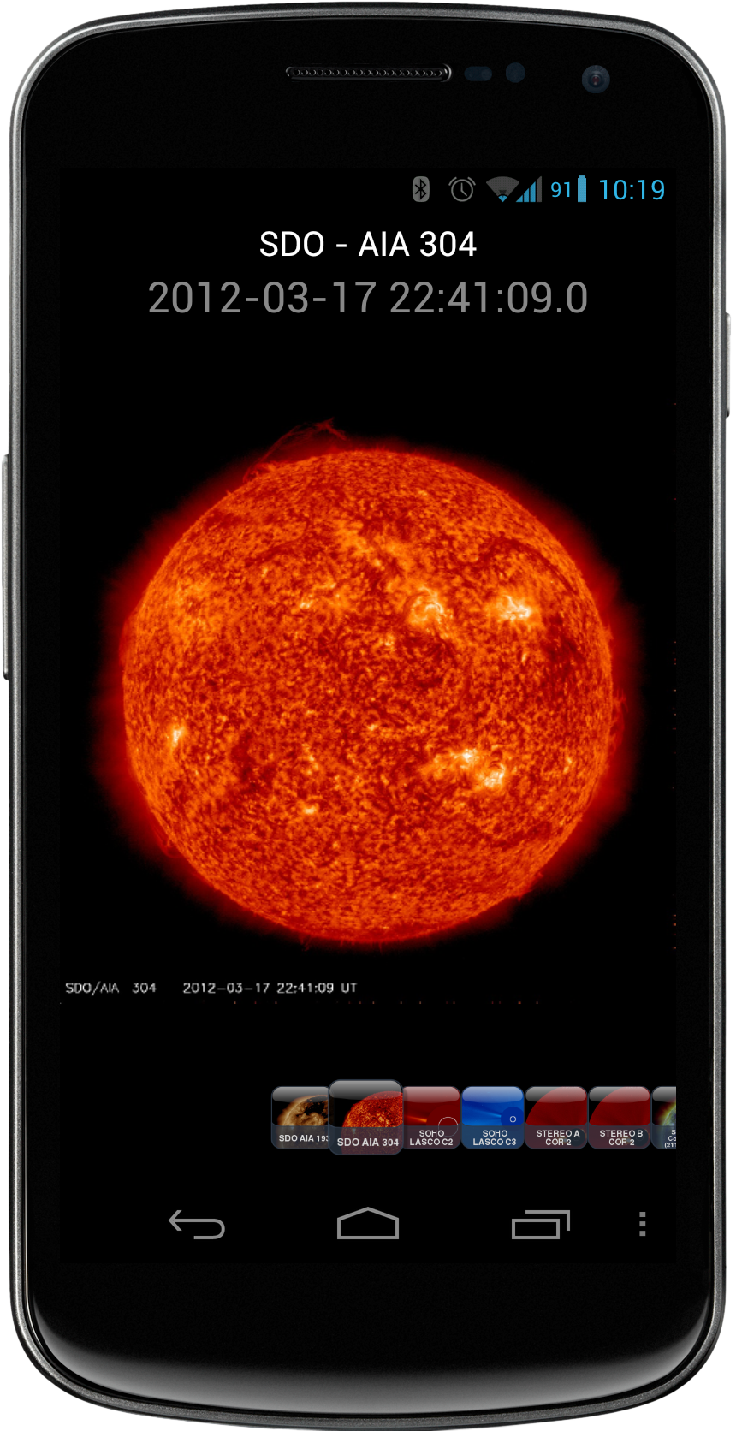
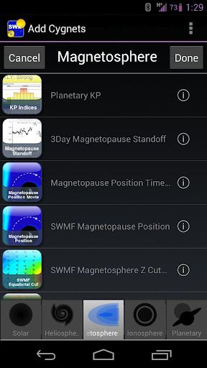
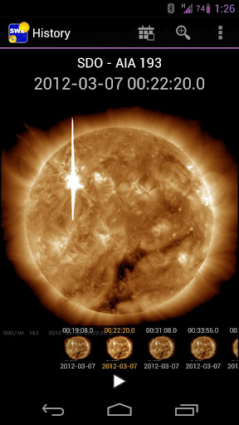
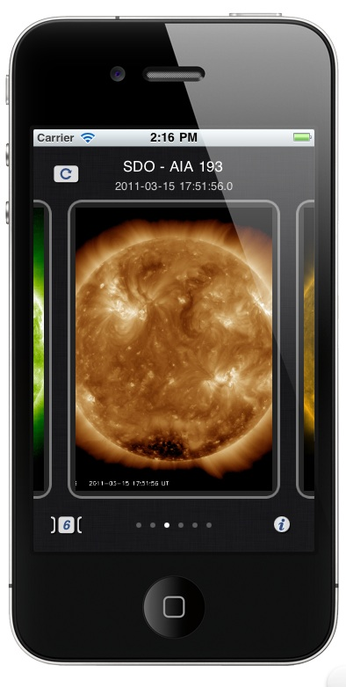
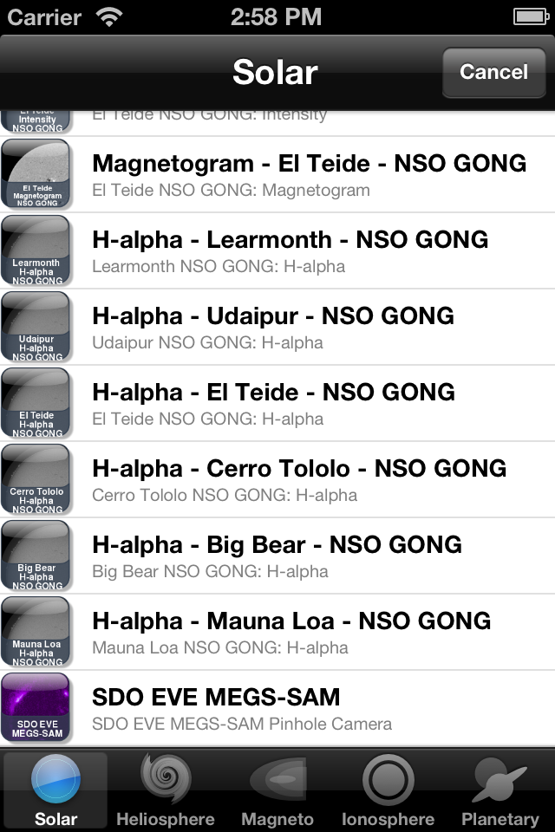
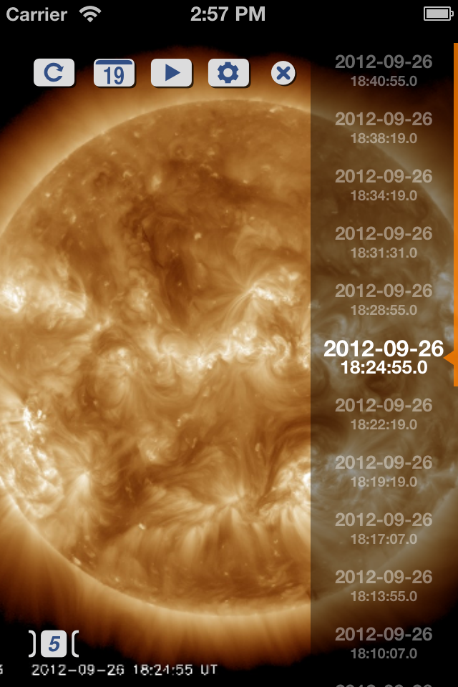
Mobile Access Powered by iSWA
Android Front-End to iSWA
History Mode
Movie Mode
>50k Downloads
Available in Google Play Store
IOS Front-End to iSWA
>100k Downloads
Available in App Store

Slide 13
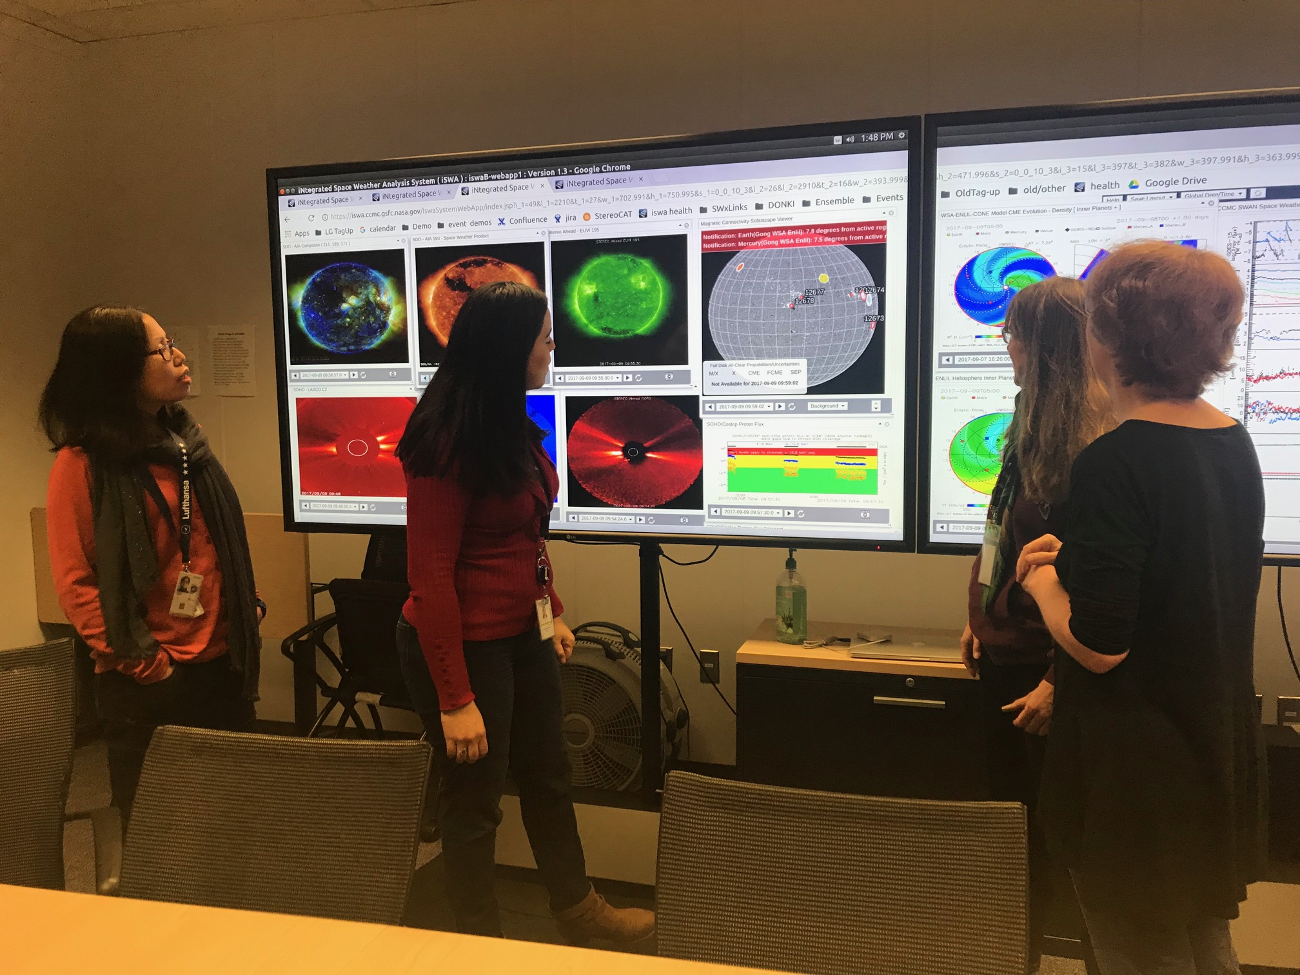
Services for NASA Robotic Missions
Powered by iSWA
1. Providing assistance in spacecraft anomaly resolution by assessing whether space weather has any role in causing the observed anomaly/anomalies.
2. Sending out weekly space weather reports/summaries to NASA mission operators, NASA officials and involved personnel.

Slide 14
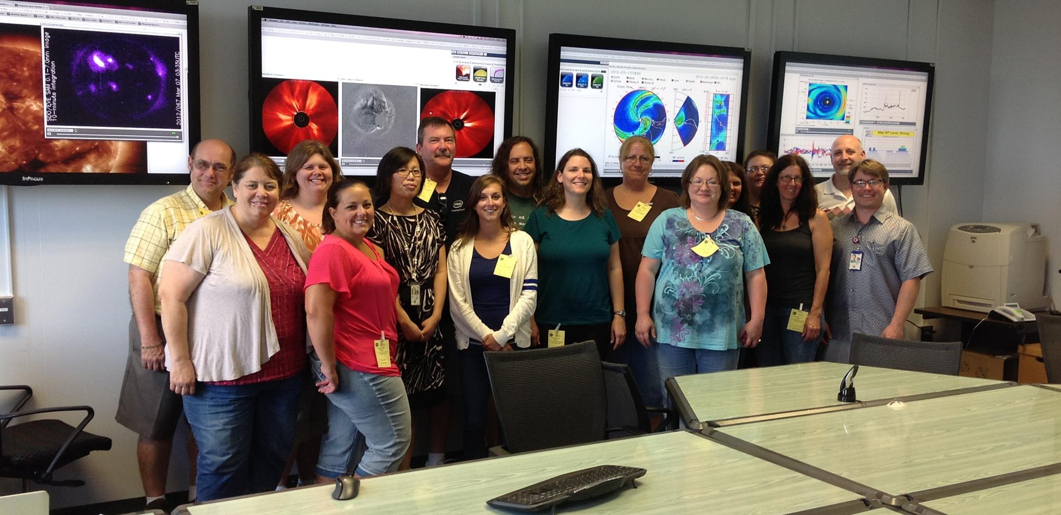
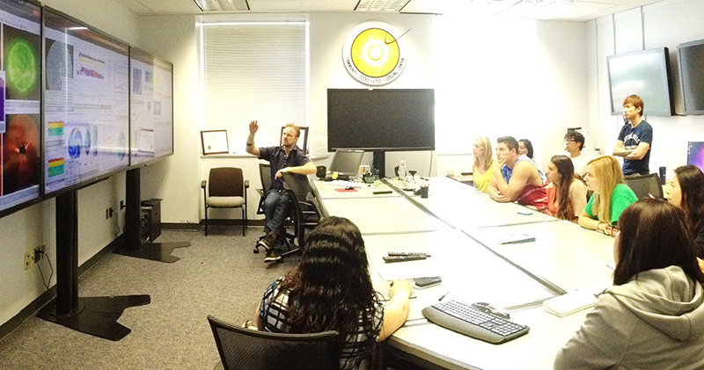
Education And Training
Powered by iSWA

Slide 15
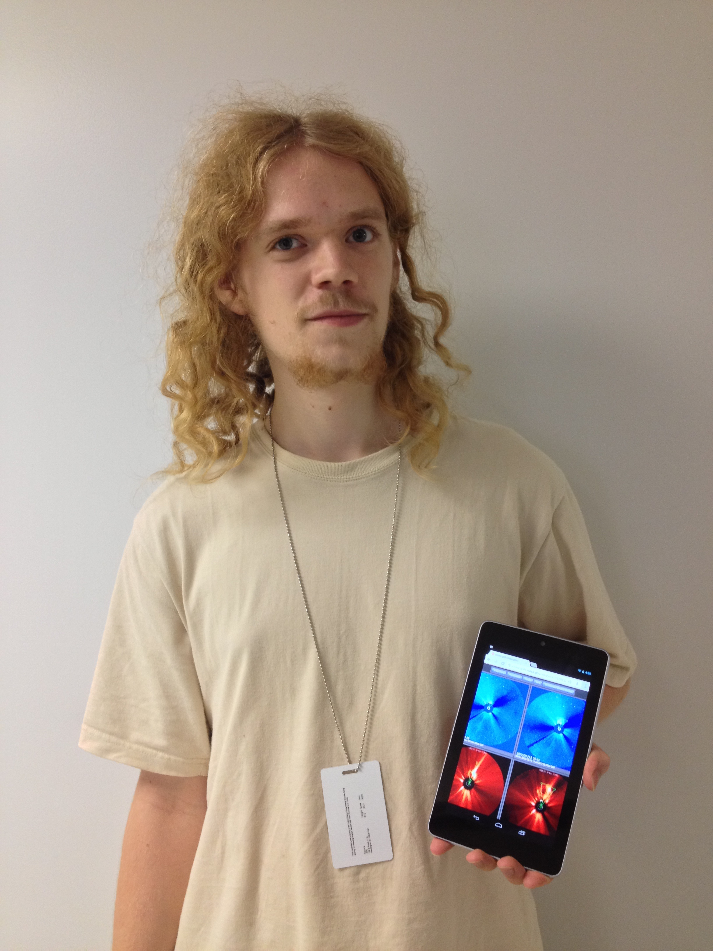
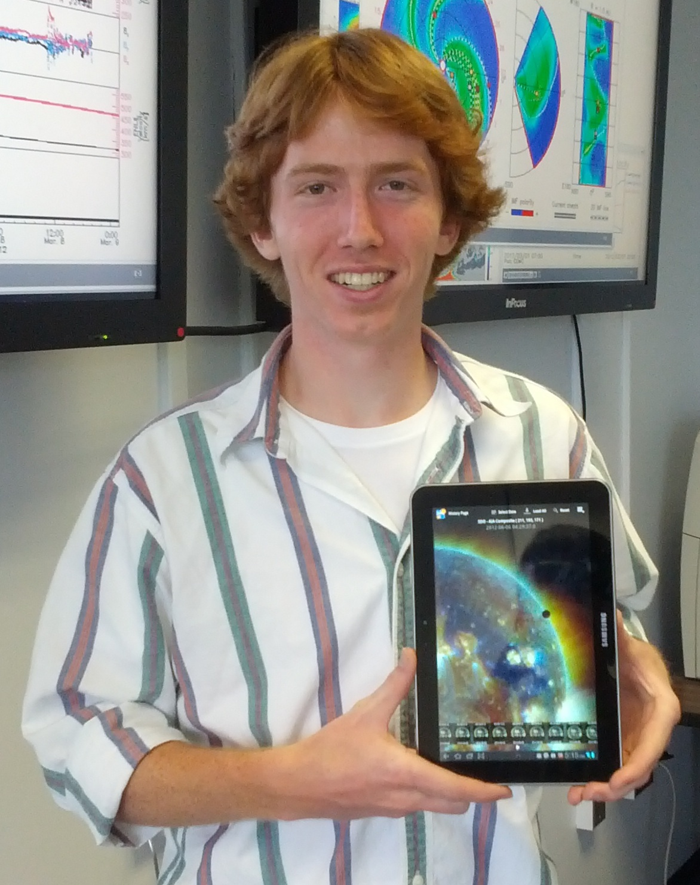
Undergraduate Computer Science Interns
SW Research Analysis Tool Development
Powered by iSWA
Jack LaSota
Web-based CME Analysis Tool
Justin Boblitt
Android iSWA App
CME Tool Link Sample Analysis Link

Slide 16
iSWA Impact
NASA
iSWA provides a new capability to quickly assess past, present, and expected space weather effects.
Mission operators have a resource to assist in both anomaly resolution as well as potential space weather impacts.
iSWA has helped enable the Space Weather Team service providing alerts, anomaly reports, and weekly space weather summaries based on iSWA tools and products.
External Agencies
Agencies can monitor the iSWA system 24x7 for CME eruptions and notify the CCMC as soon as an event is detected. Forecasters at the CCMC analyze the event and launch a simulation that estimates the CME arrival time, duration, and expected impact on earth.
iSWA has enabled numerous collaborations with data, model, and product developers/providers who want their tools to be available in iSWA.
Science, Education, and Public Outreach
Researchers, universities, and “citizen scientists” have access to a comprehensive suite of real-time and historical space environment data products.

Slide 17
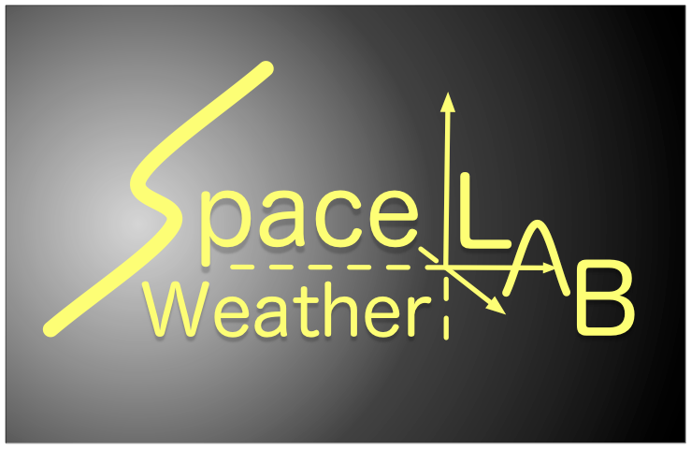
Who Uses iSWA?

Slide 18
Potential Users
Any agency, entity, or individual with space weather requirements and/or interests
Extended educational use ( training, K-12, higher education )
Extended research use ( case studies, correlation studies, historical events, general space weather research )
iSWA software can be applied to any agency, group, or project with general data ingestion, storage, management, display, & dissemination needs….
“instant ground system” for other NASA projects
turn-key software system for commercial and/or educational data management and dissemination
customizable interface for existing data archives and sets
Notes:
Potential use…

Slide 19
DEMO
http://iSWA.ccmc.gsfc.nasa.gov

