Slide 1
Space Weather Models running in real-time or forecasting mode
1
Yihua Zheng

Slide 2
About WSA+ENLIL

Slide 3
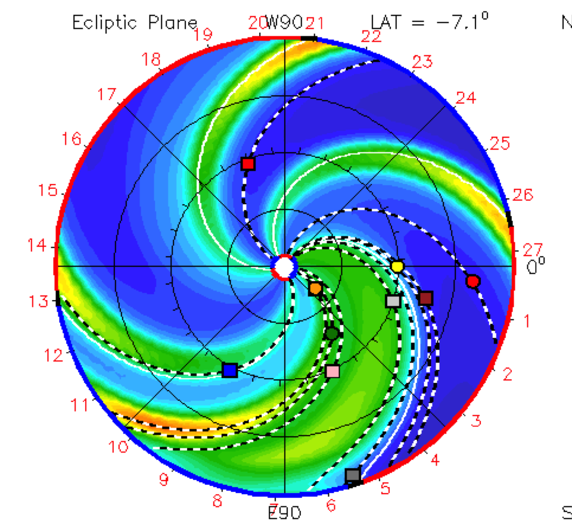
The WSA+ENLIL Model Suite
Wang-Sheeley-Arge (WSA Model)
1 Rs – 21.5Rs (0.0046 -0.1AU)
Photospheric magnetic field maps (can be from satellite observations such as SOHO/MDI or SDO/HMI or ground-based observations such as the GONG magnetogram) are used as input to the WSA model (model solar corona up to 21.5 Rs) to represent the ambient solar wind.
ENLIL: 0.1 AU – 2 AU (operations)
Model of the solar wind in the heliosphere
Notes:
Global Oscillation Network Group (GONG) magnetogramsa

Slide 4
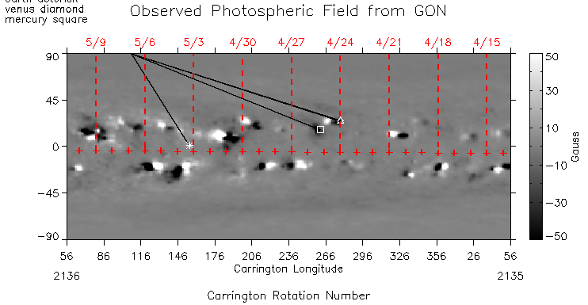
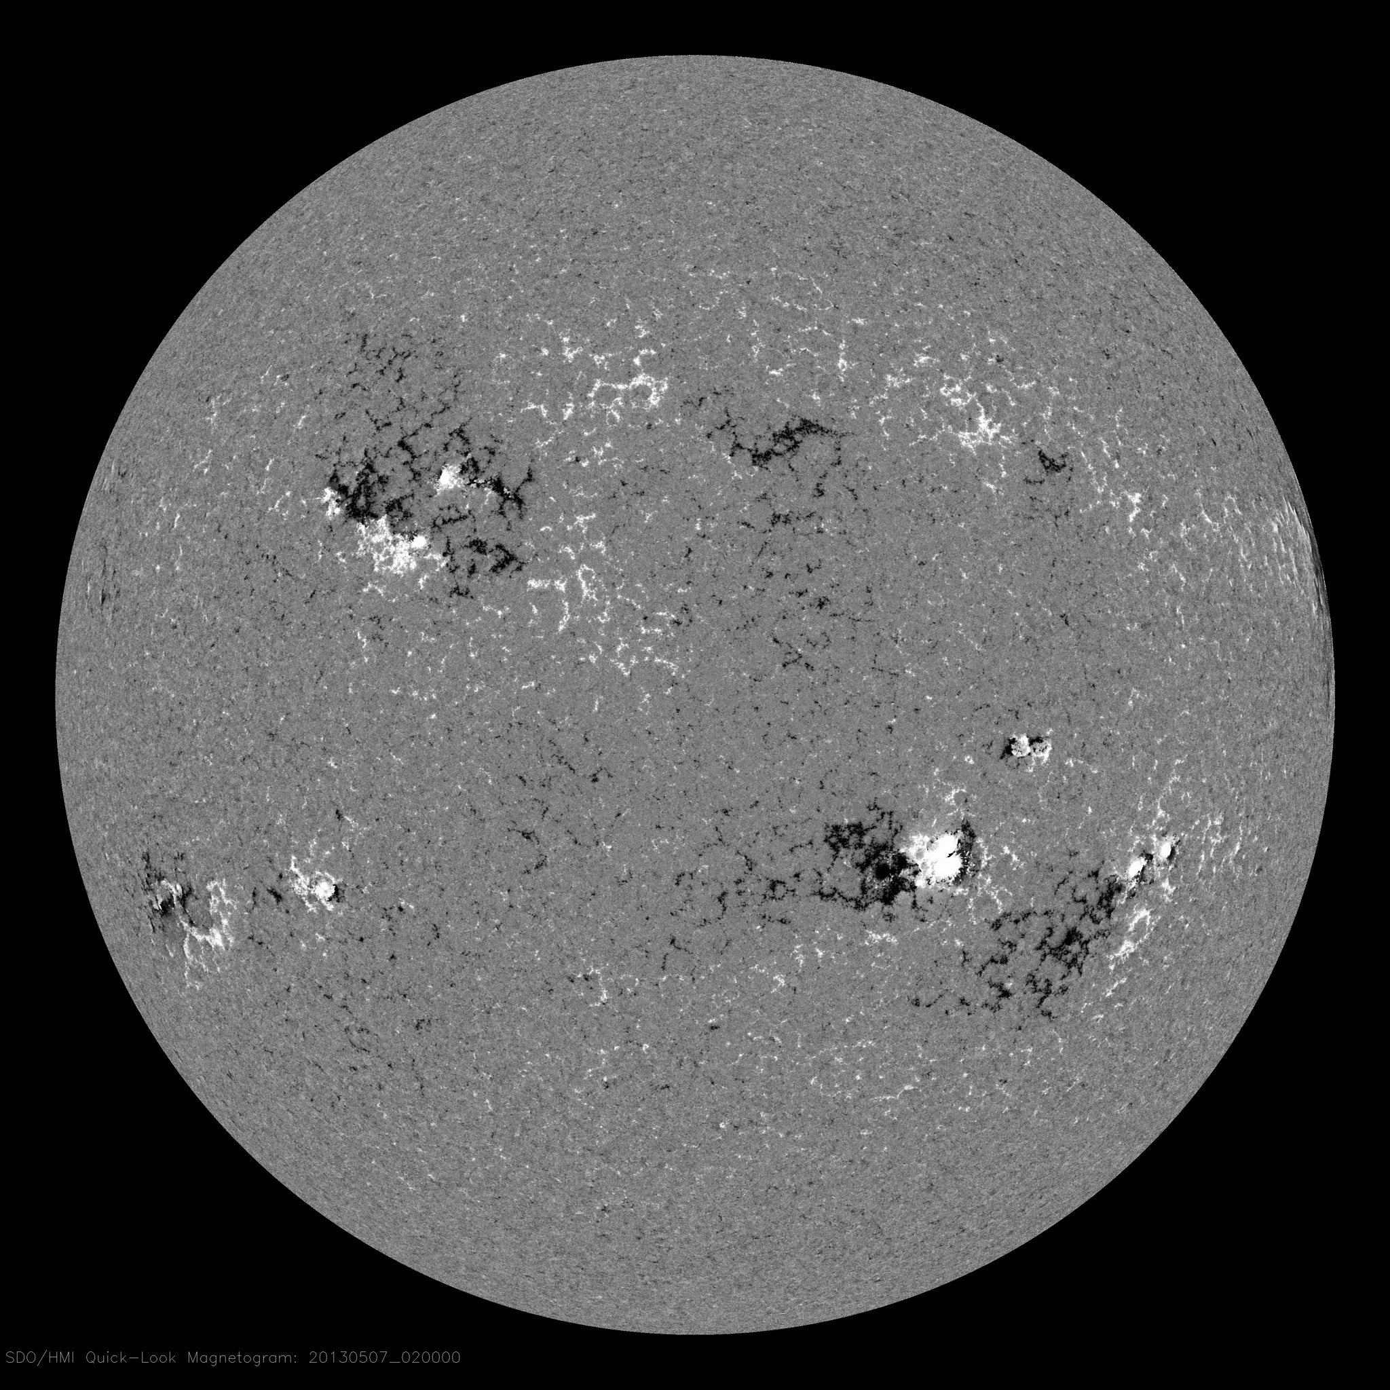
Inputs

Slide 5
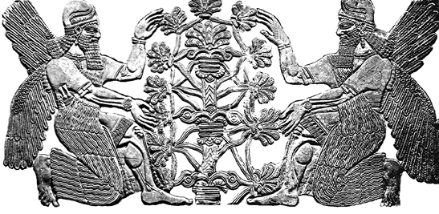
EN = Lord + LÍL = Storm, "Lord (of the) Storm"
Courtesy: Dusan Odstrcil

Slide 6
WSA+ENLIL: capable of modeling the solar wind for both ‘fair’ weather and ‘storm’ conditions

Slide 7
Fair weather: ambient solar wind

Slide 8
Stormy Weather: Eruptions (CME)
Notes:
20120307

Slide 9
Modeling of solar wind under stormy conditions

Slide 10
ENLIL Visualization
Courtesy of Stijn Calders @BIRA

Slide 11
Modeling of solar wind under stormy conditions
Earth-directed

Slide 12
Forecasting capability enabled by WSA+ENLIL
WSA+ENLIL+cone
WSA+ENLIL
Predicting impacts of CMEs
Modeling and predicting the ambient solar wind

Slide 13
SWMF

Slide 14
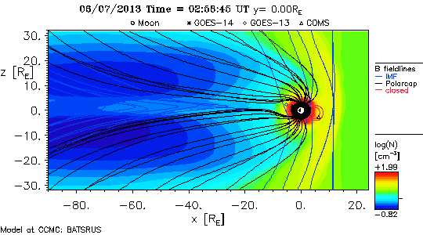
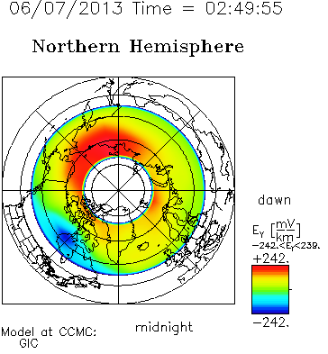
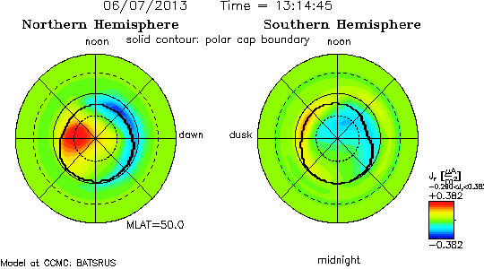
SWMF

Slide 15
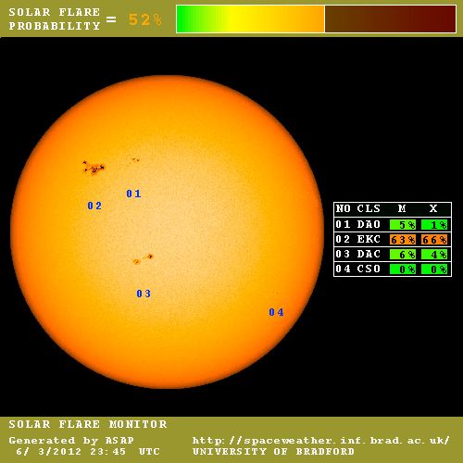
Flare Prediction Model
ASAP (Automatic Solar Activity Prediction)
http://spaceweather.inf.brad.ac.uk/asap/

Slide 16
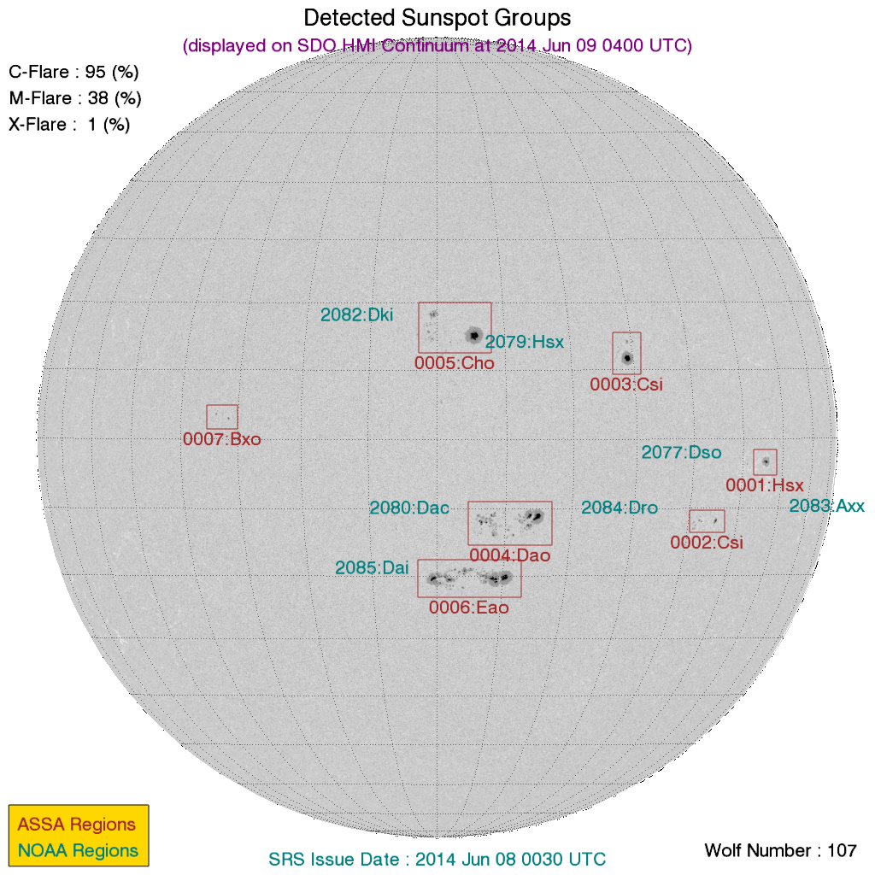
Flare Prediction Model
ASSA (Automatic Solar Synoptic Analyzer)
Provided by
Korean Space Weather Center

Slide 17
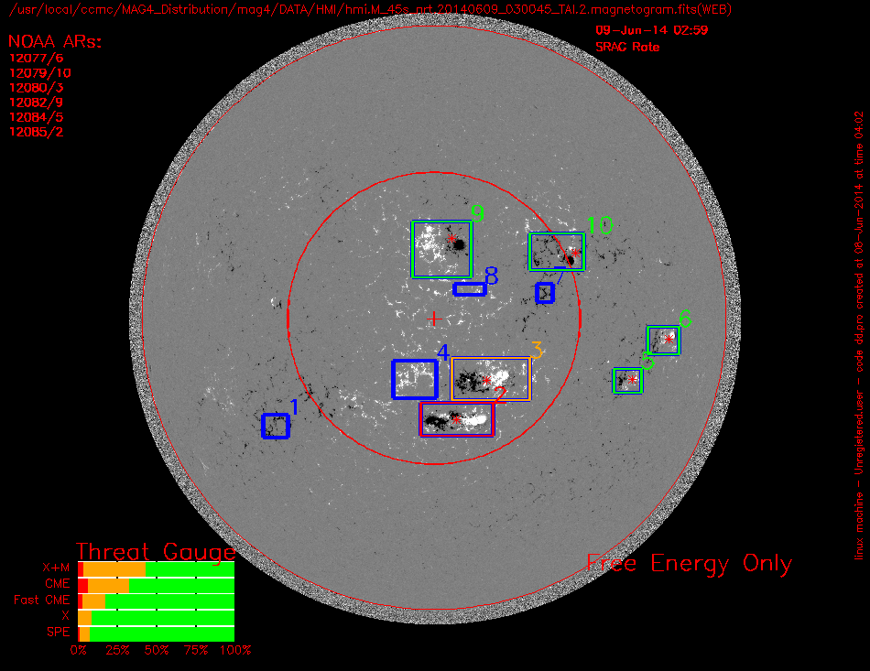
Flare Prediction Model
MAG4 (UAH/MSFC, Falconer et al.)
Notes:
Ref: Falconer, D. A., R. L. Moore, A. F. Barghouty, and I. Khazanov (2014), MAG4 versus alternative techniques for forecasting active region flare productivity, Space Weather, 12, doi:10.1002/2013SW001024.

Slide 18
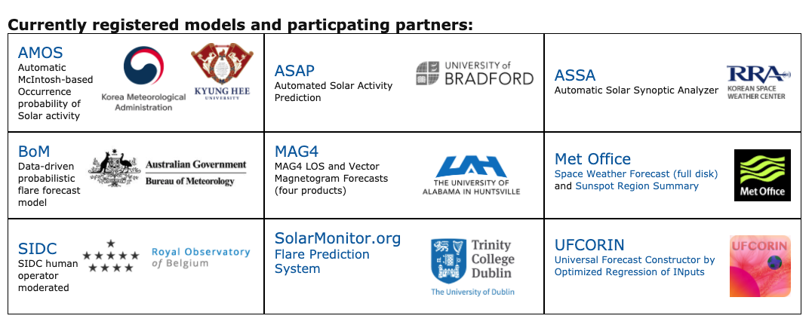
Flare Scoreboard https://ccmc.gsfc.nasa.gov/challenges/flare.php
Beta Flare Scoreboard Result
https://iswa.gsfc.nasa.gov/IswaSystemWebApp/index.jsp?i_1=606&l_1=7&t_1=33&w_1=1721&h_1=865&s_1=0
Notes:
https://ccmc.gsfc.nasa.gov/challenges/flare.php

Slide 19
SEP prediction
REleASE (Relativistic electron Alert System for Exploration)
Proton flux forecast model based on electron measurements by SOHO/COSTEP
developed by Arik Posner
Reference: Posner, A. (2007), Up to 1-hour forecasting of radiation hazards from solar energetic ion events with relativistic electrons, Space Weather, 5, S05001, doi:10.1029/2006SW000268.
HESPERIA_REleASE (v20190101)

Slide 20
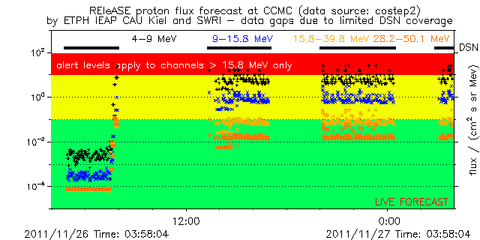
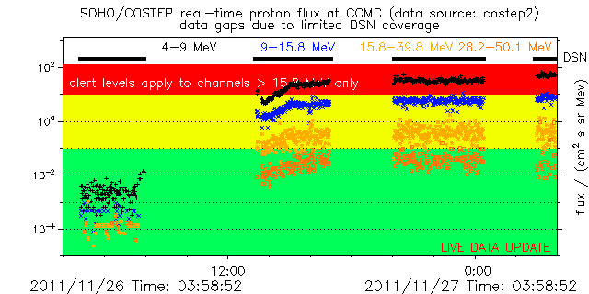
RELeASE: Example

Slide 21
SEP Prediction
UMA Proton Flux Forecast
Núñez, M. (2011), Predicting solar energetic proton events (E > 10 MeV), Space Weather, 9, S07003, doi 10.1029/2010SW000640.

Slide 22
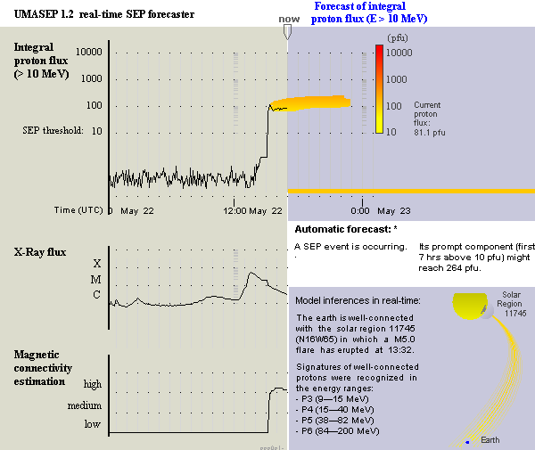
UMASEP Model

Slide 23
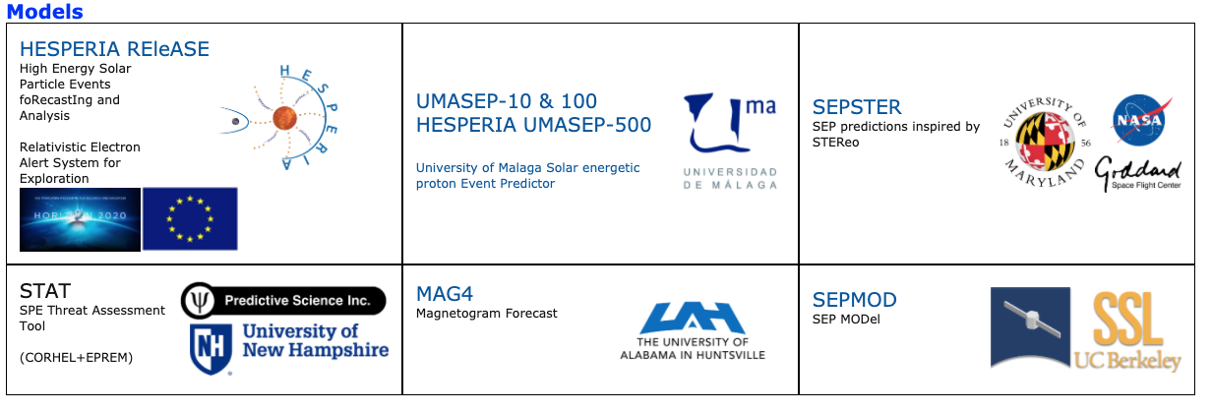
ISEP & SEP Scoreboard https://kahala2.ccmc.gsfc.nasa.gov/isep/
Notes:
https://kahala2.ccmc.gsfc.nasa.gov/challenges/sep.php

Slide 24
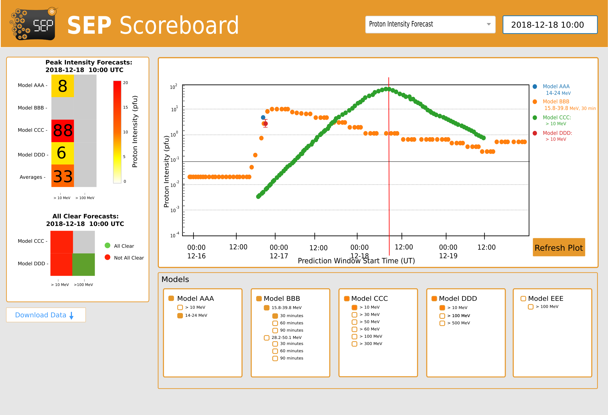
ISEP & SEP Scoreboard https://kahala2.ccmc.gsfc.nasa.gov/isep/
Notes:
https://kahala2.ccmc.gsfc.nasa.gov/challenges/sep.php

Slide 25
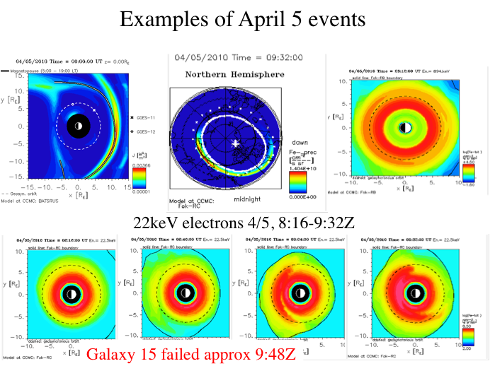
SWMF + Fok Ring Current Model

Slide 26
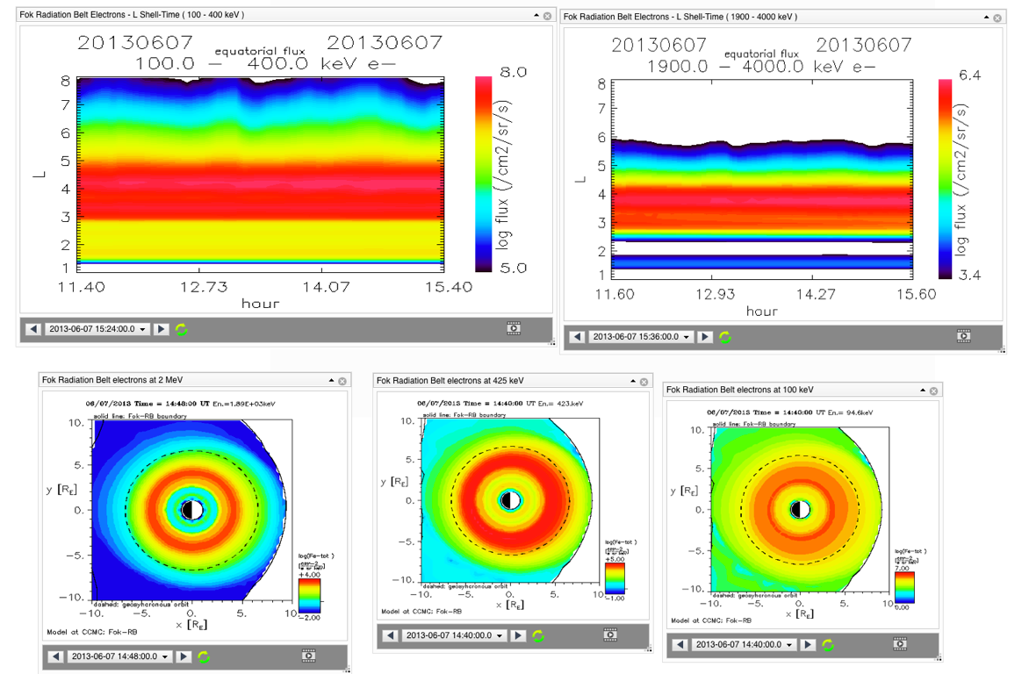
Fok Radiation Belt Model

Slide 27
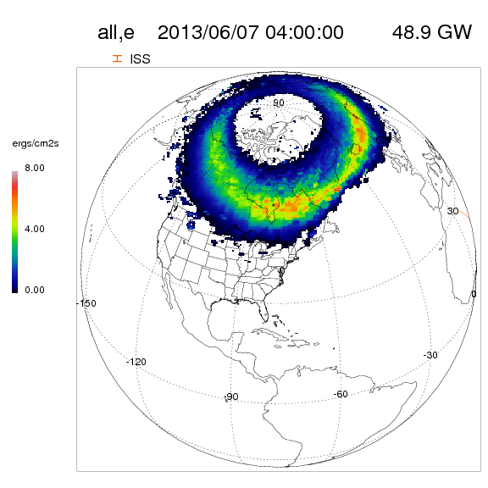
Auroral Model: Ovation Prime
Empirical model
based on ACE measurements at L1
Text
Newell et al., 2007, JGR
Notes:
Newell, P. T., T. Sotirelis, K. Liou, C.-I. Meng, and F. J. Rich (2007), A nearly universal solar wind-magnetosphere coupling function inferred from 10 magnetospheric state variables, J. Geophys. Res., 112, A01206, doi:10.1029/2006JA012015.

Slide 28
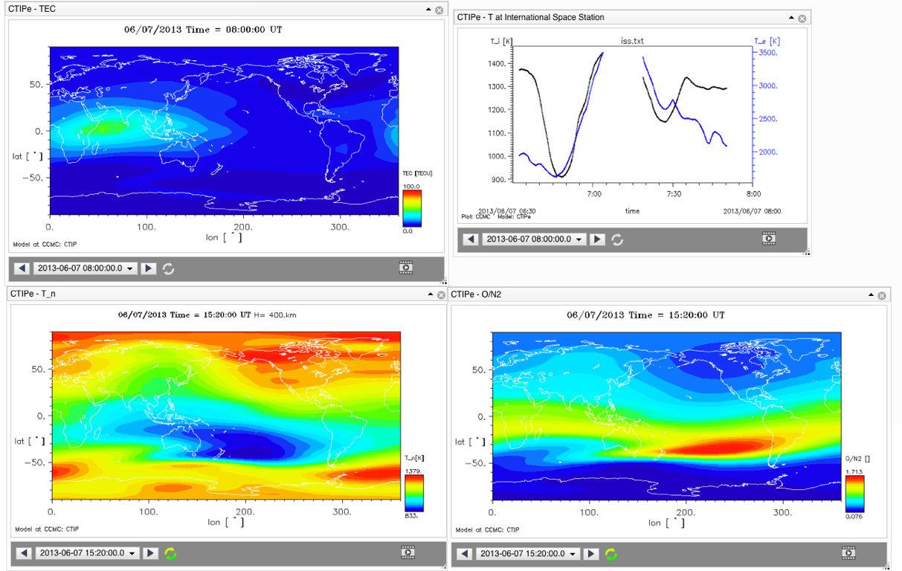
CTIPe
Coupled Thermosphere Ionosphere Plasmasphere Electrodynamics Model

Slide 29
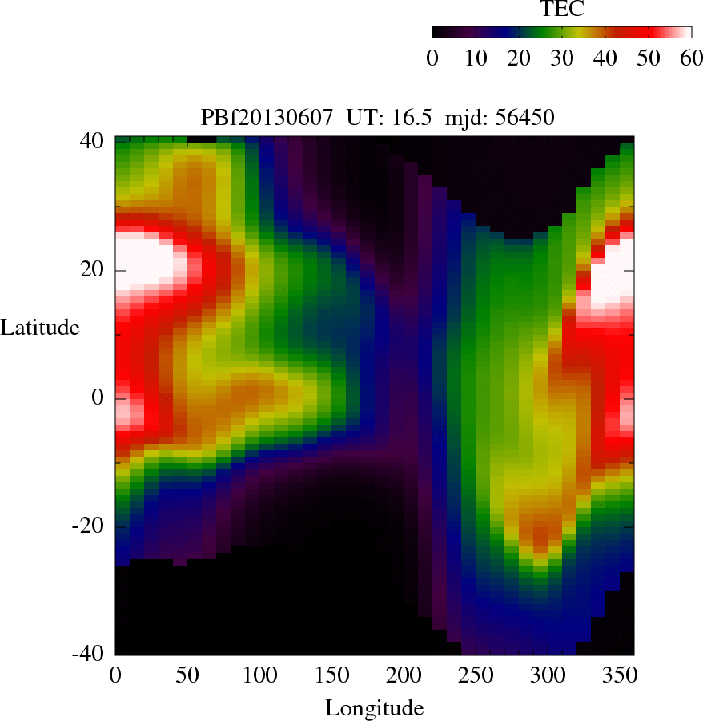
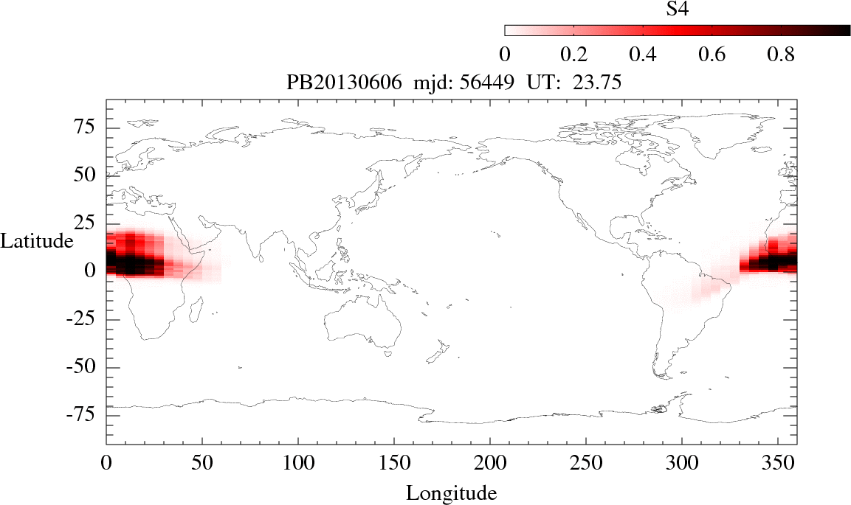
PBMOD
Scintillation Model
http://ccmc.gsfc.nasa.gov/RoR_WWW/pbmod-rt/PBMOD-Text.html
Physics Based MODels - Time-Dependent Model of The Global Low-Latitude Ionosphere, Plasma Irregularities, and Radio Scintillation

Slide 30
ABBYNormal
HF Signal Absorption due to Solar Flares
http://ccmc.gsfc.nasa.gov/models/modelinfo.php?model=ABBYNormal

Slide 31
Predicted Kp, Dst
Kp based on Newell et al. Formula
Dst from SWMF
Dst from WINDMI
http://ccmc.gsfc.nasa.gov/models/modelinfo.php?model=WINDMI

