Slide 1
Introduction to the Aurora and Auroral Dynamics
Bob Robinson
The Catholic University of America

Slide 2
Why the aurora is important to space weather?
The aurora is a source of energy input to the atmosphere.
The aurora changes the ionospheric electrical conductance, which modifies currents that couple the ionosphere to the magnetosphere.
The aurora produces disturbances to ionospheric electron density that disrupt communication, navigation, and surveillance (radar) systems.
The aurora contains information about the processes that take place as a result of solar wind forcing and magnetospheric processes.
The aurora is the ultimate check on our understanding of space weather effects on geospace.

Slide 3
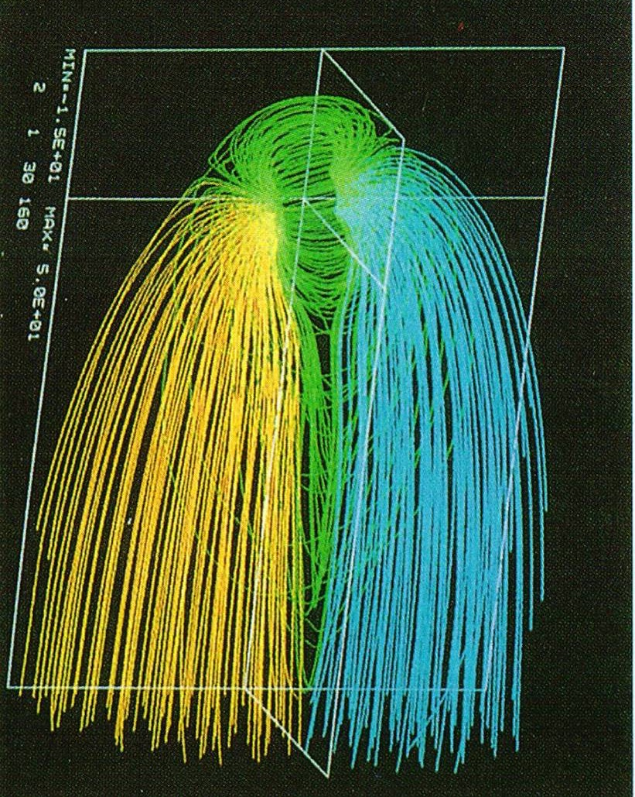
The aurora allows us to ‘see’ the magnetosphere and observe geospace processes
The magnetosphere is threaded by magnetic fields, which very quickly and efficiently transfer information along the length of the field lines

Slide 4
Decoding the Aurora What can the properties of the aurora tell us about the magnetosphere, the geospace system, and space weather?
Ionospheric effects
Light
Electron Density
Motion
Electrical Properties
Morphology

Slide 5
Magnetospheric Origin of Auroral Particles
Loss Cone
‘Isotropic Distribution’

Slide 6
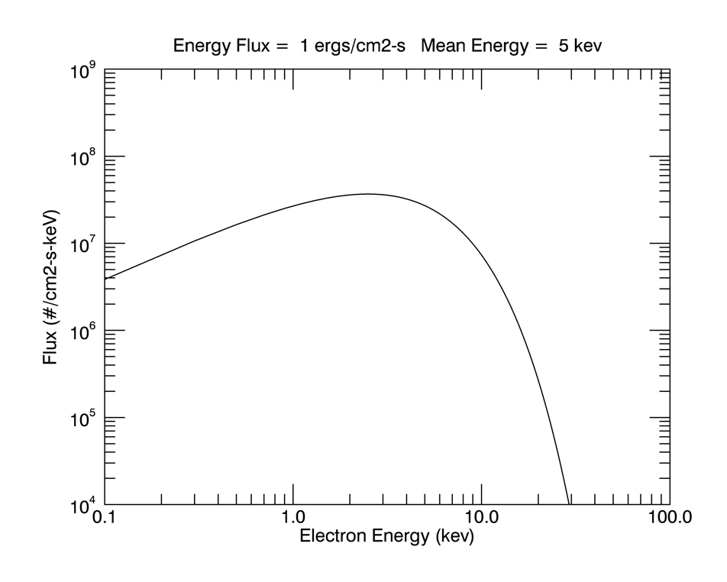
Auroral electrons (to first approximation) are characterized by a Maxwell-Boltzmann distribution
where Φ_{E} is the total energy flux and
kT is the temperature and
E is the mean energy (= 2*kT)

Slide 7
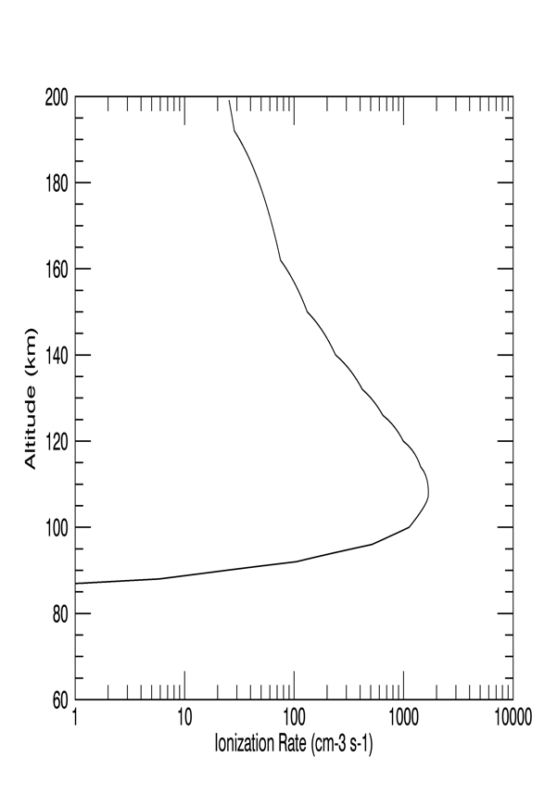
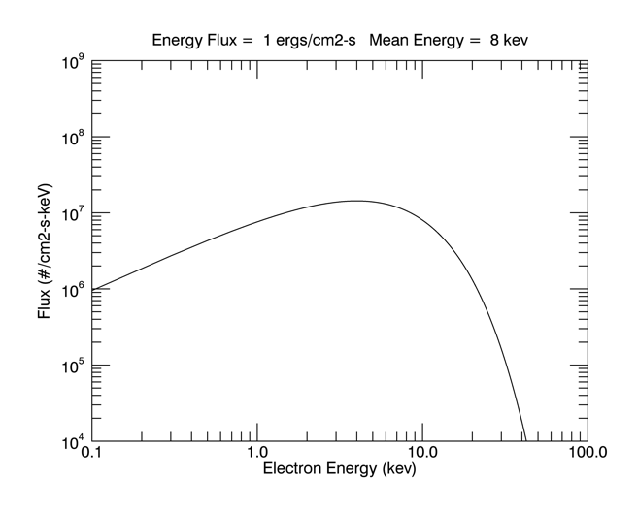
Auroral Energy Deposition
Electron Density
Luminosity
Auroral Electron Energy Distribution
Energy Deposition Profile

Slide 8
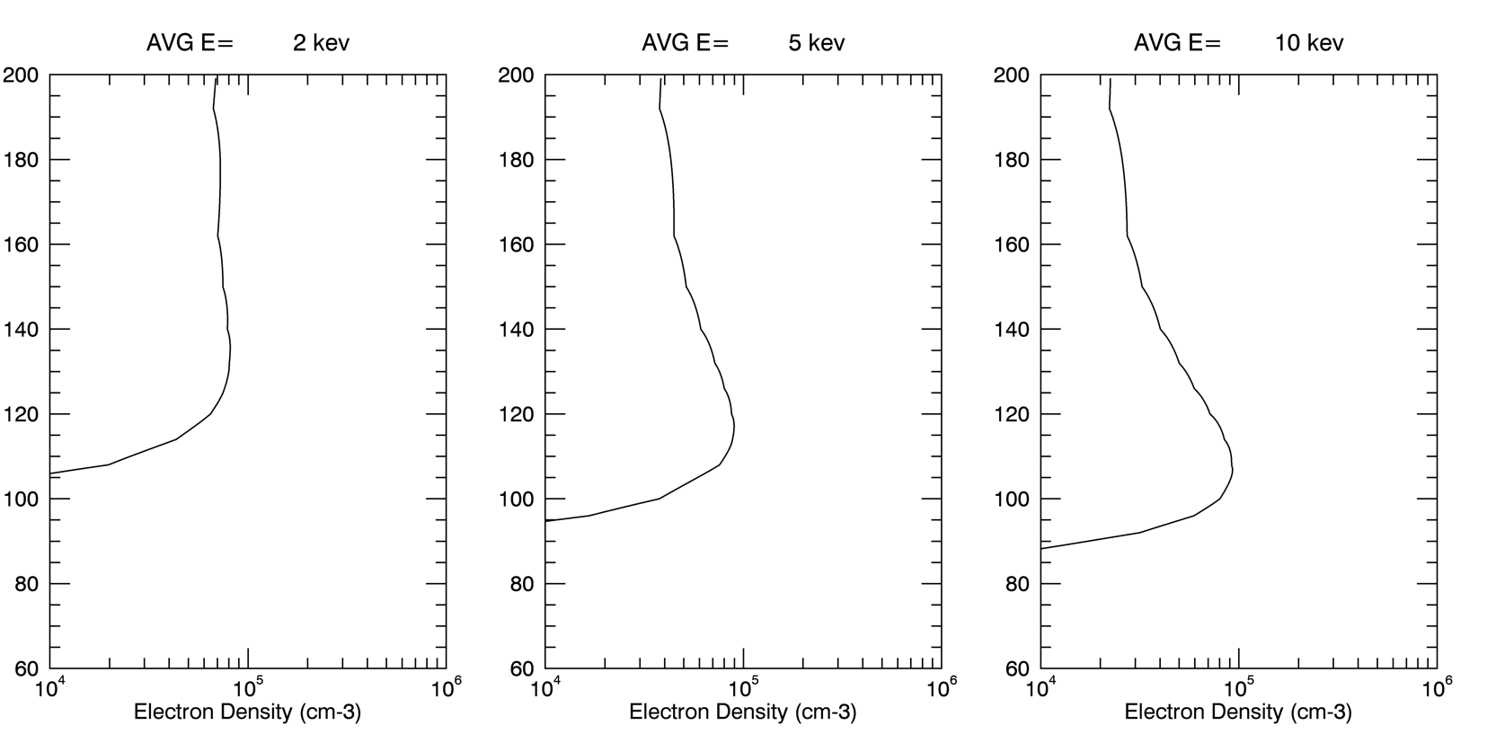
The energy flux and mean energy of the precipitation determine the peak electron density and the altitude of the peak

Slide 9
The color of the aurora tells us about the type and energy of the precipitating particles that cause it.

Slide 10
Auroral color tells us about the energy of the precipitating particles producing the light

Slide 11
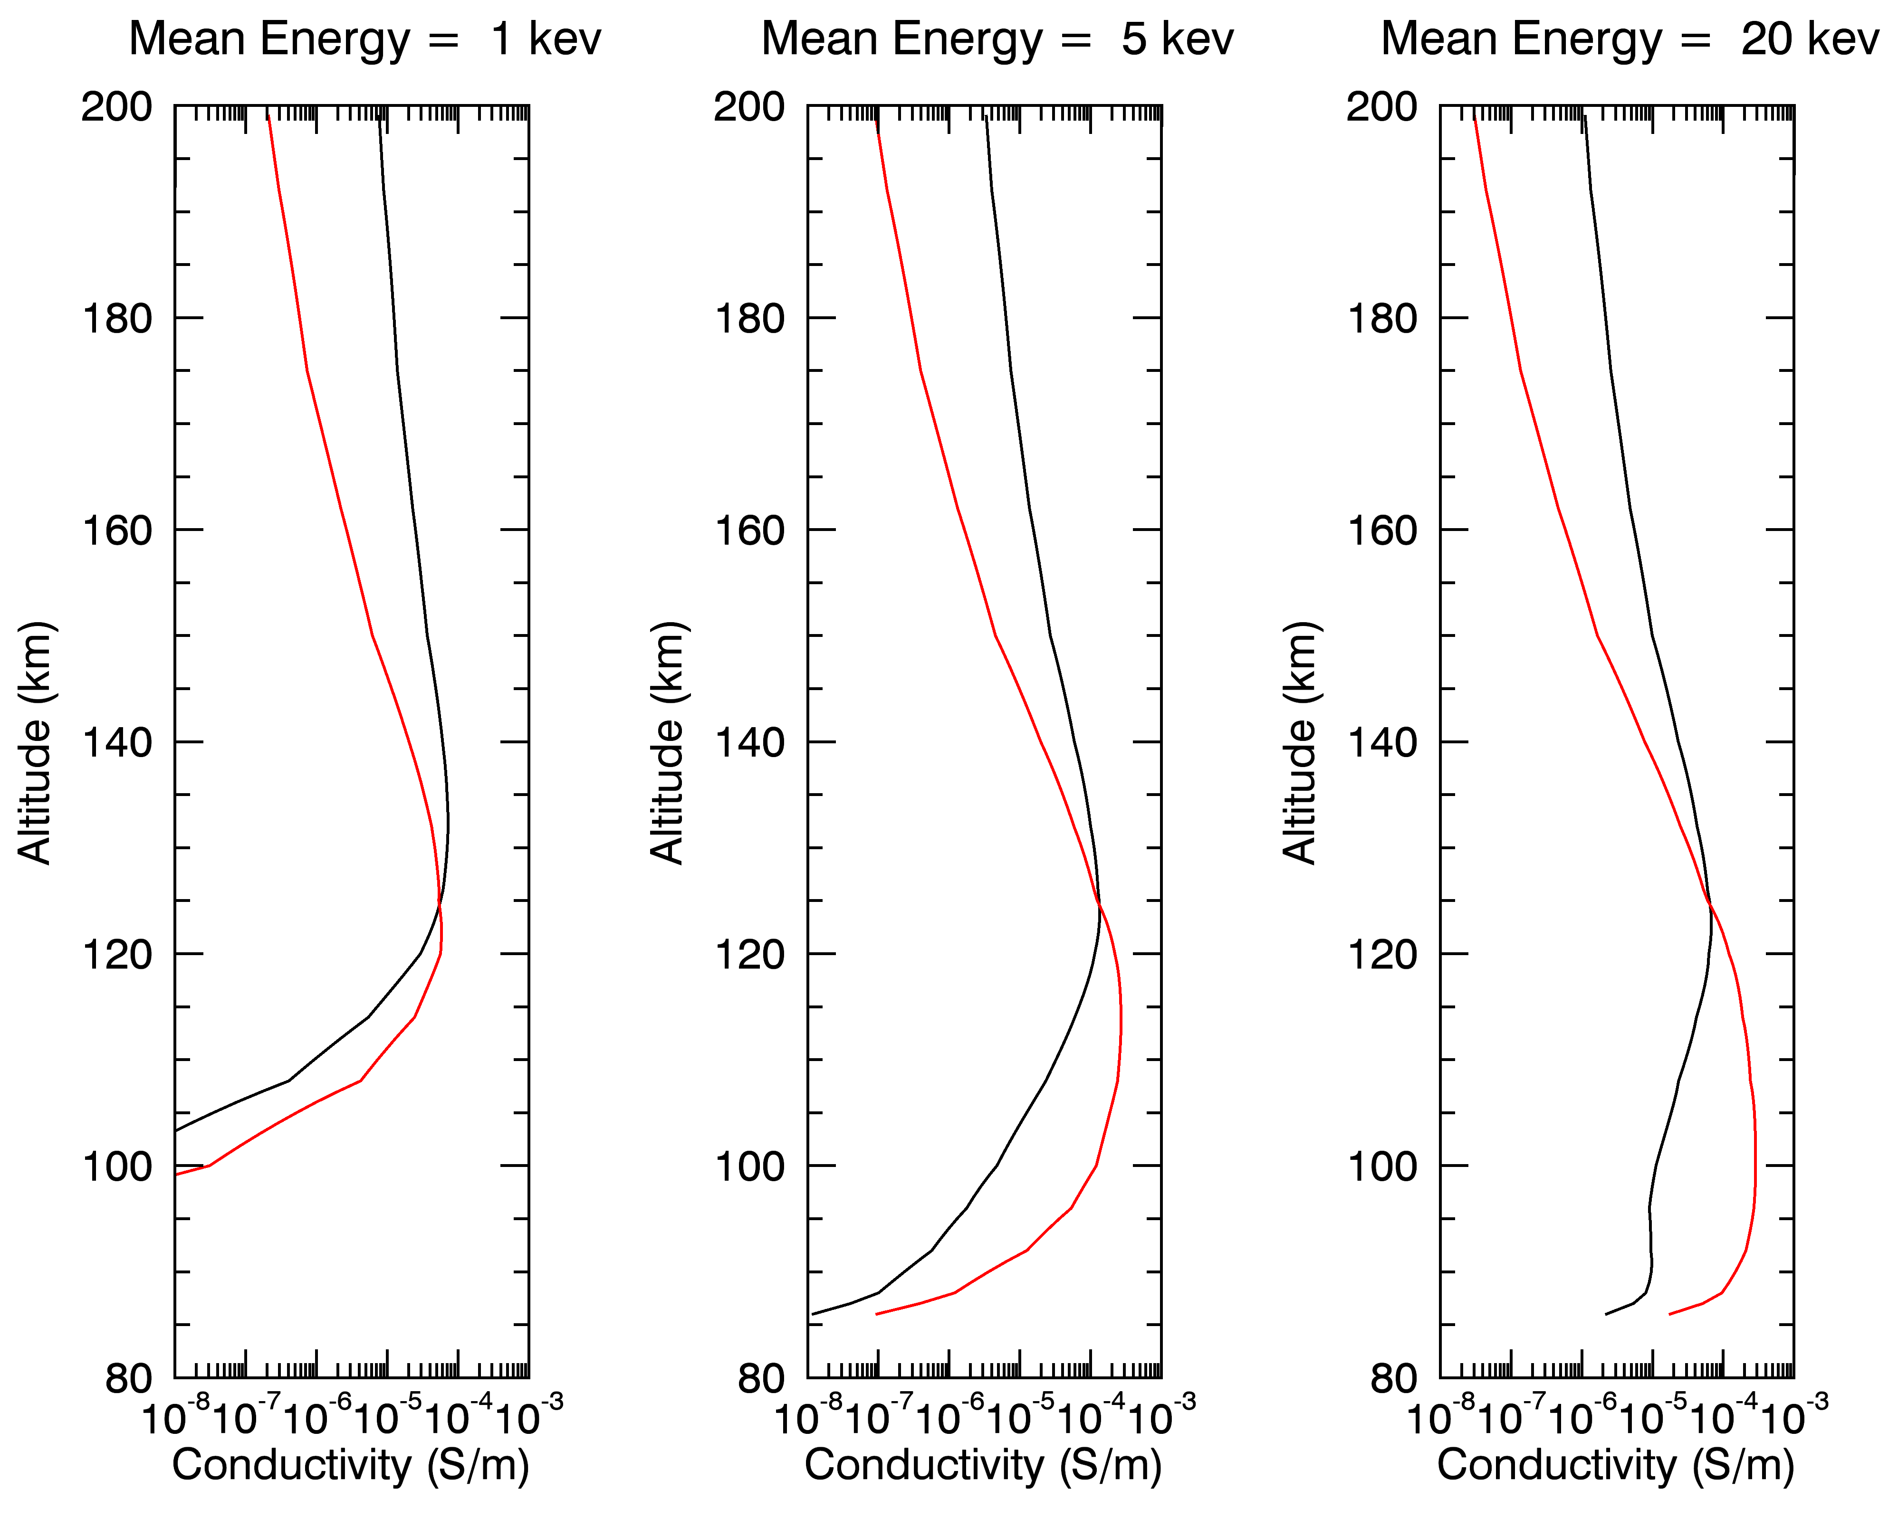
Ionospheric Conductivity Profiles

Slide 12
Two-Parameter Specification of Aurorally-Related Properties
Magnetospheric: electron number density and temperature
Auroral: Average energy and flux of electron precipitation
Ionospheric: total electron density and height of the E-region peak
Thermospheric: integrated light emission and ratio of two emissions with different altitude dependences
Electrodynamic: Hall and Pedersen conductance

Slide 13
Auroral Motions
Apparent motion due to Earth rotation
Apparent motion due to dynamics of the auroral acceleration region
Apparent motion due to changing magnetic fields

Slide 14
Motion due to Earth’s Rotation
Auroral Oval

Slide 15
Motion due to dynamics of auroral particles

Slide 16
Motion due to changing magnetic fields
3
3
2
1
1
2

Slide 17
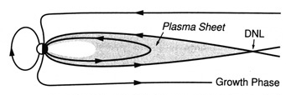

Slide 18
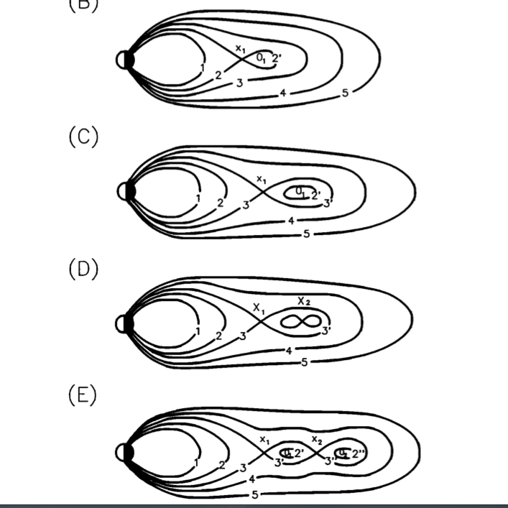
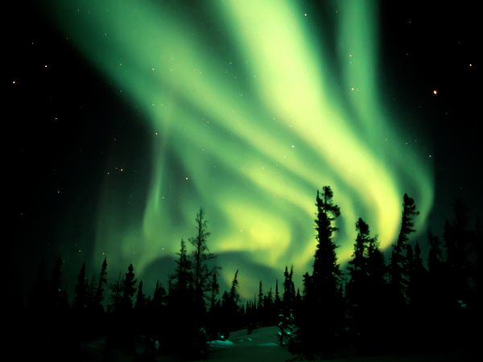
Observing the structure of the magnetotail from Earth

Slide 19
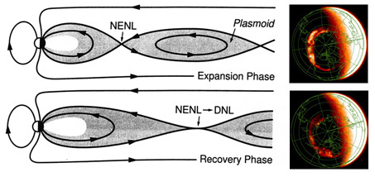
Auroral Breakup

Slide 20
Auroral Substorm Dynamics Seen from Space

Slide 21
Auroral morphology and how it relates to the magnetosphere
60
70
Polar Cusp
Sunward
Afternoon Arcs
80
Morning Sector Arcs
Sun-aligned Arcs (Theta Aurora)
Proton Aurora
Active Auroral Rays
Omega Bands
Detached Arcs (REP)
Westward Traveling Surge
Drizzle Zone
Discrete Auroral Arcs
Pulsating Aurora
Stable Auroral Red Arcs (Type A Red Aurora)
Diffuse Aurora

Slide 22
Auroral Electrical Properties
Electric fields, conductivities, and currents are needed
for a complete specification of auroral electrodynamics

Slide 23
Electric fields and convection

Slide 24
Birkeland (Field-Aligned) Currents

Slide 25
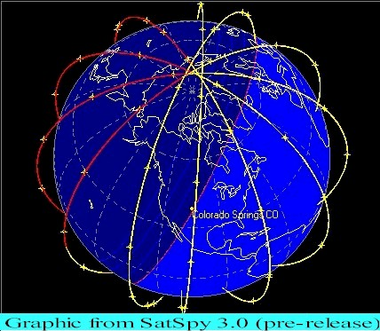
A solution based on field-aligned currents

Slide 26
Calculation of Auroral Electrodynamic Parameters
Tied to auroral luminosity
Field-Aligned Currents
Conductivities
Energy Flux
Horizontal Currents
Electric Field
Joule Heating

Slide 27
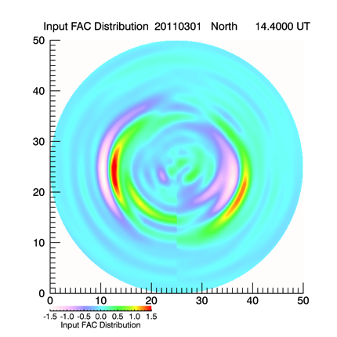
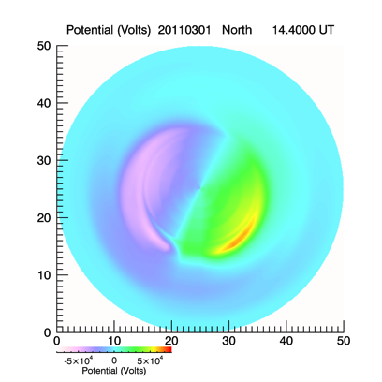
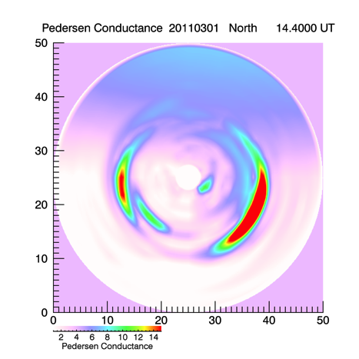
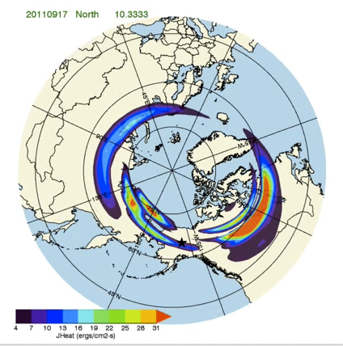
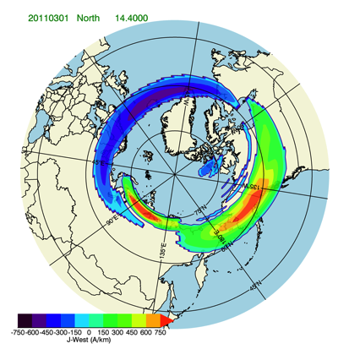
Calculation of Electric Fields, Horizontal Currents and Joule Heat from Field-Aligned Currents and Conductivities
Electrostatic Potential
Field-Aligned Currents
Conductances
Joule Heat
Horizontal Currents

Slide 28
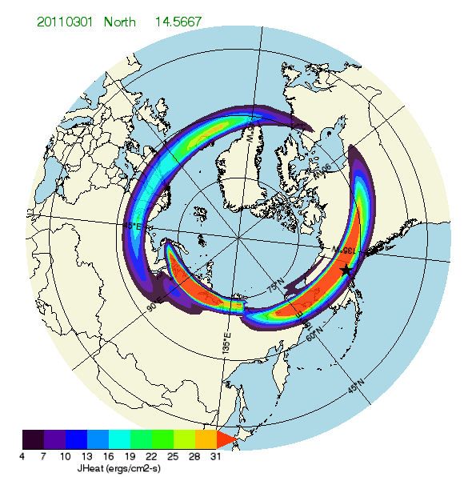
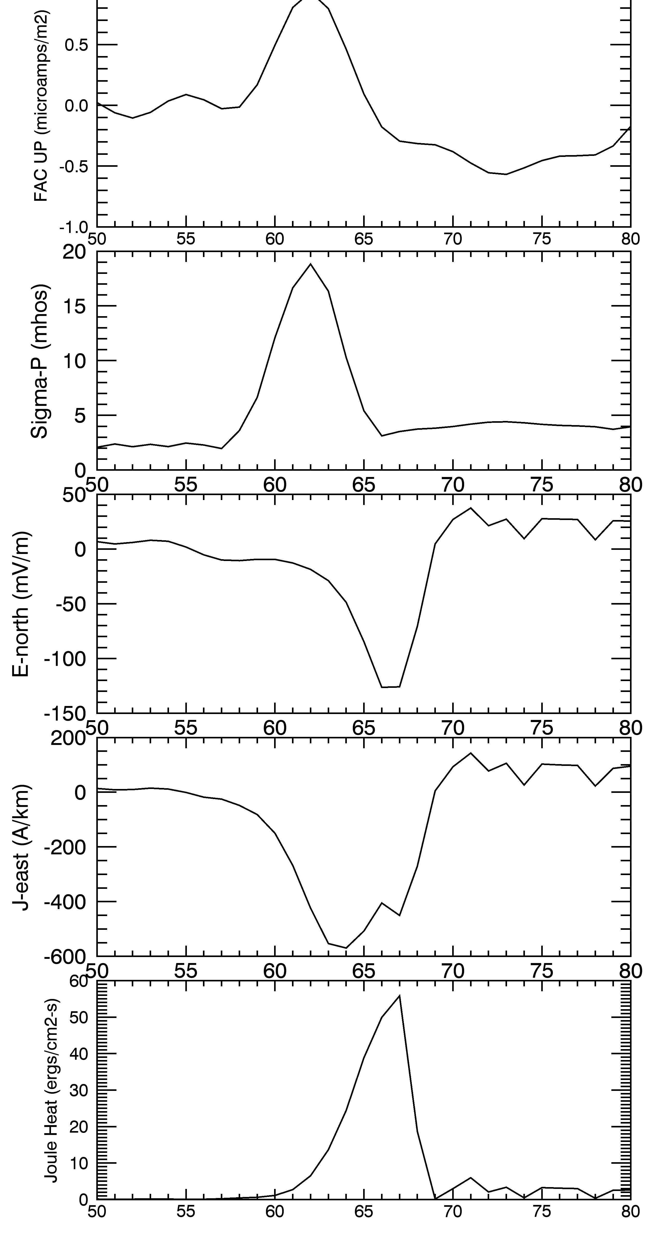
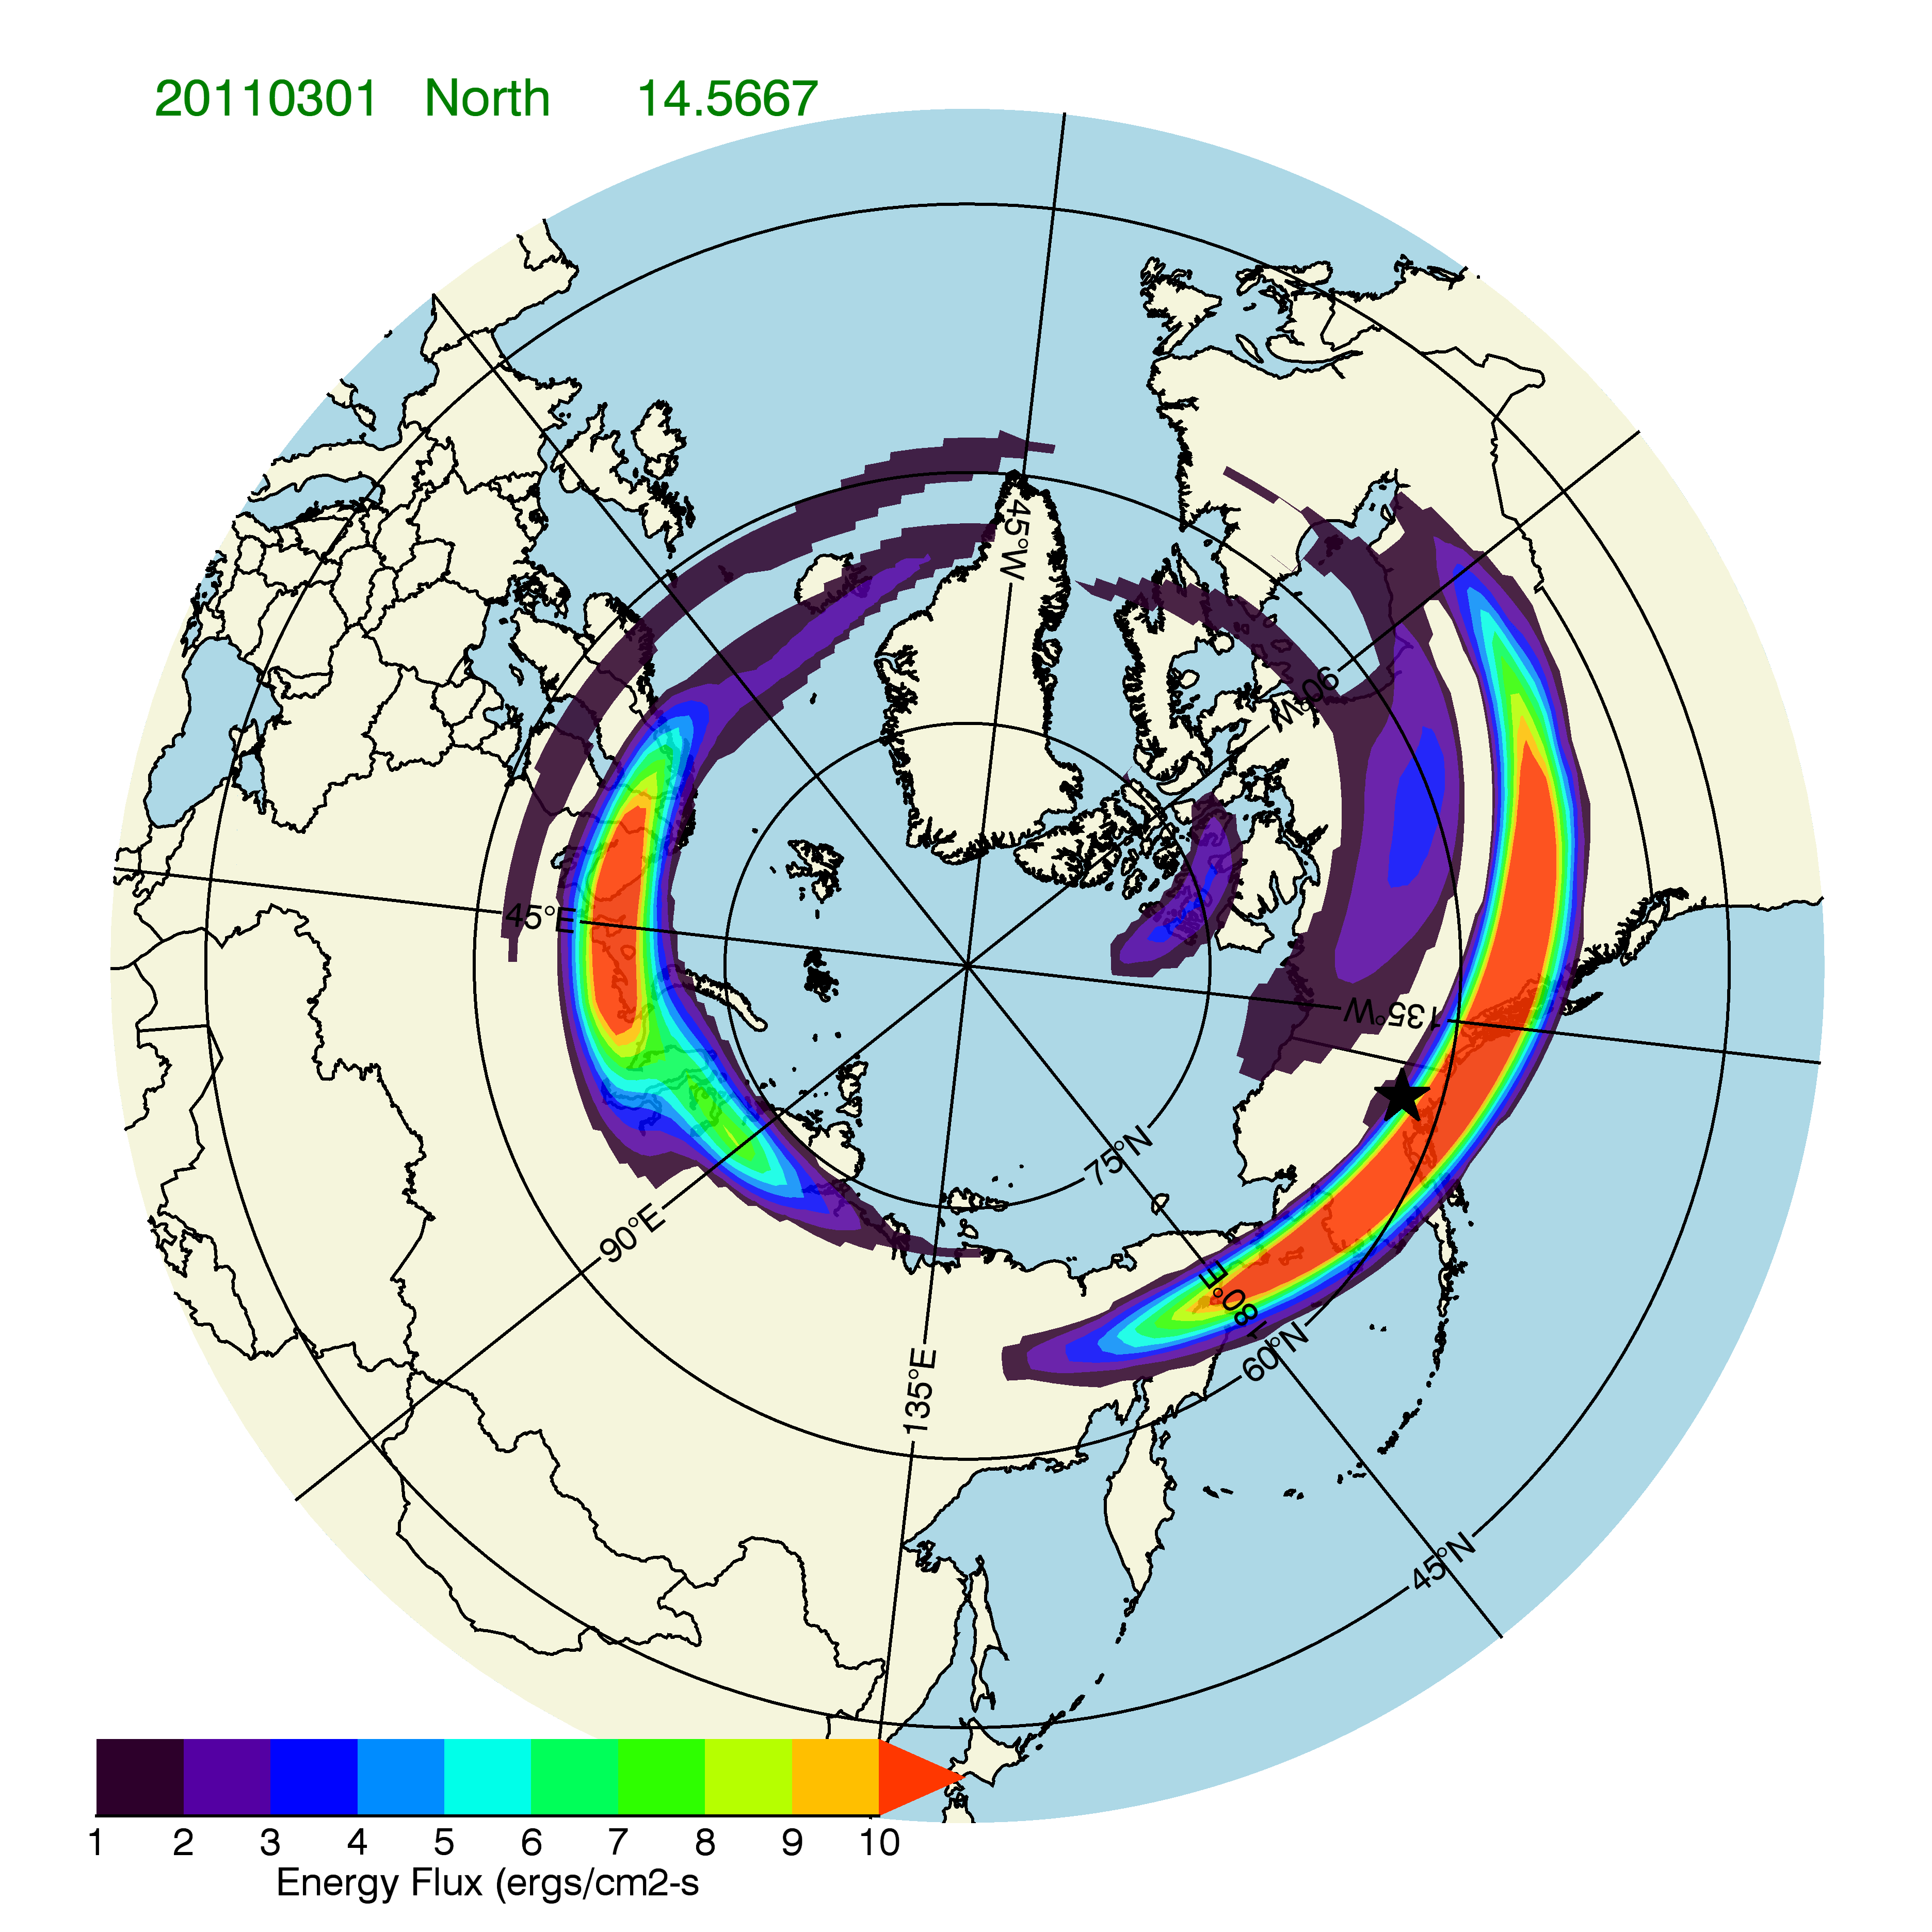
Greatest Auroral Power Dissipation Occurs Adjacent to the Aurora
Latitudinal Variations at 14:34 UT and 0300 MLT
Joule Heat
FAC
Σ_{P}
Energy Flux
E_{North}
J_{East}
Joule Heat
Magnetic Latitude

Slide 29
Power Dissipated in Electrical Circuits
Low Resistance
Low Resistance
High Resistance
High Resistance

Slide 30
The Importance of Auroral Conductances
Give information about the energy flux and average energy of precipitating electrons
Can be combined with field-aligned currents to determine electric fields and convection
Are used with electric fields to calculate currents and Joule heating

Slide 31
Summary
Studying the aurora provides quantitative information about:
The type and energy distribution of the precipitating particles
The density and temperature of the magnetospheric plasma associated with the auroral particle precipitation
The spatial and temporal properties of magnetospheric domains to which the aurora is magnetically connected
The changes in the magnetospheric magnetic fields resulting from magnetosphere-solar wind coupling
The convective motion of magnetospheric plasma
Resistive heating of the ionosphere and thermosphere

