Slide 1
Space Weather Impacts on Satellites/Space Assets
Yihua Zheng
Space Weather Laboratory (Code 674)
Acknowledgement:
Janet Barth
Mike Xapsos & Jonny Pellish
Joe Minow
previous bootcamp participants
June 7, 2018
Corrected: Feb 9, 2023
with right acknowledgement

Slide 2
Outline
Intro of man-made satellites
Intro of different orbits
Different types of space weather effects on satellites
Satellite anomalies from the Oct 2003 and the March 2012 space weather events

Slide 3
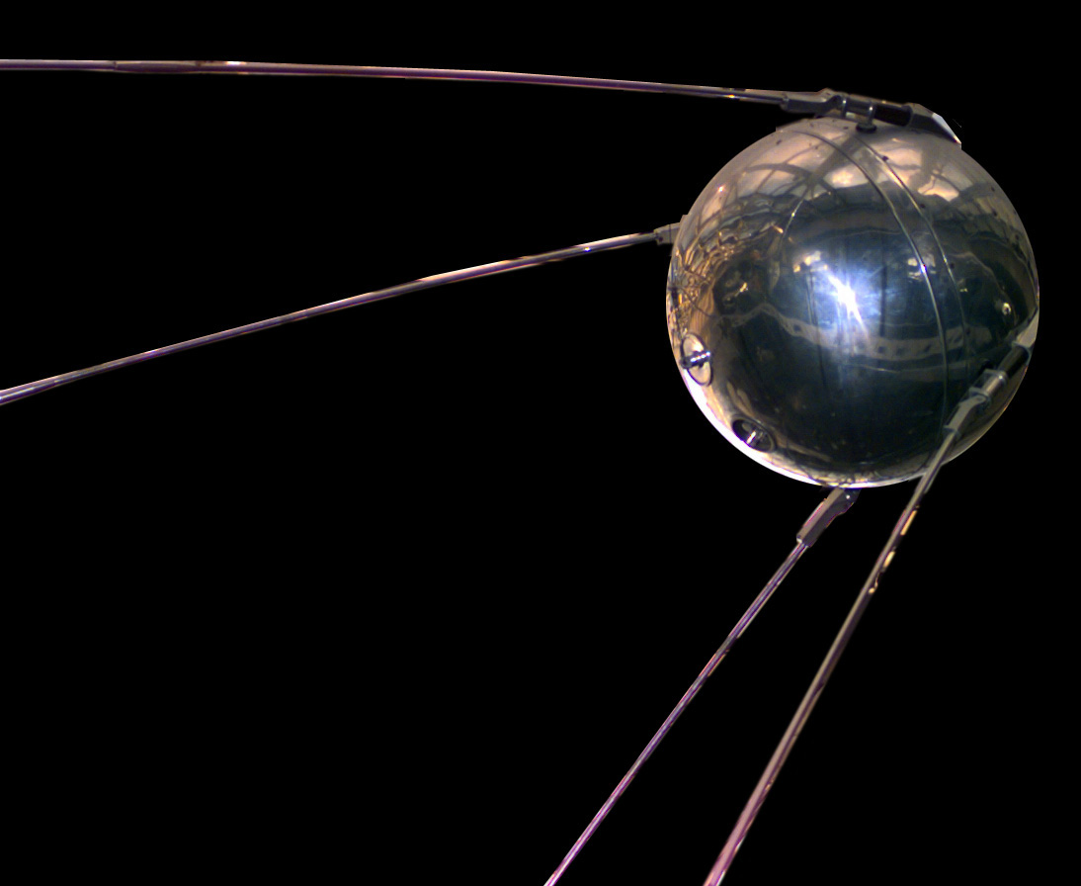
1st Satellite Launched Into Space
The world's first artificial satellite, the Sputnik 1, was launched by the Soviet Union in 1957.
Marking the start of the Space Age
4 October, 1957
International Geophysical Year: 1957

Slide 4
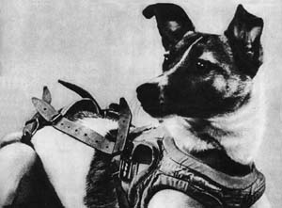
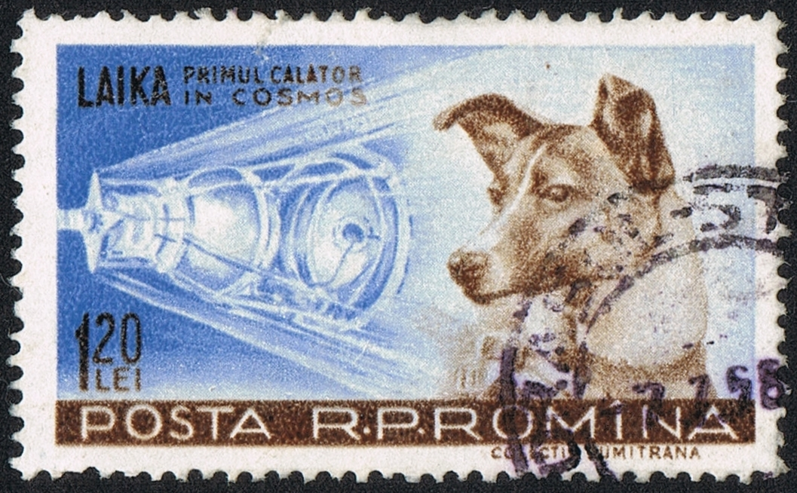
Space dog - Laika
The occupant of the Soviet spacecraft Sputnik 2 that was launched into outer space on November 3, 1957
Paving the way for human missions

Slide 5
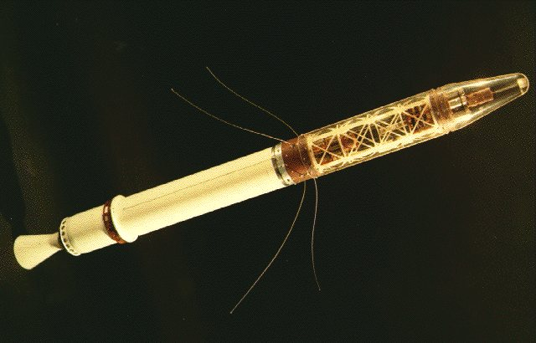
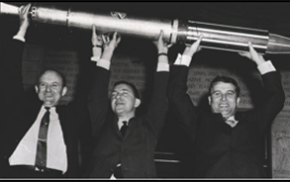
Explorer I – 1st U.S. Satellite
was launched into Earth's orbit on a Jupiter C missile from Cape Canaveral, Florida, on January 31, 1958 - Inner belt discovery
William Pickering (L), James Van Allen (center), Wernher von Braun (right)
Explorer 1 and 3: discovery of the inner radiation belt
Notes:
https://explorer1.jpl.nasa.gov/galleries/videos/svs/
https://www.nasa.gov/mission_pages/explorer/index.html

Slide 6
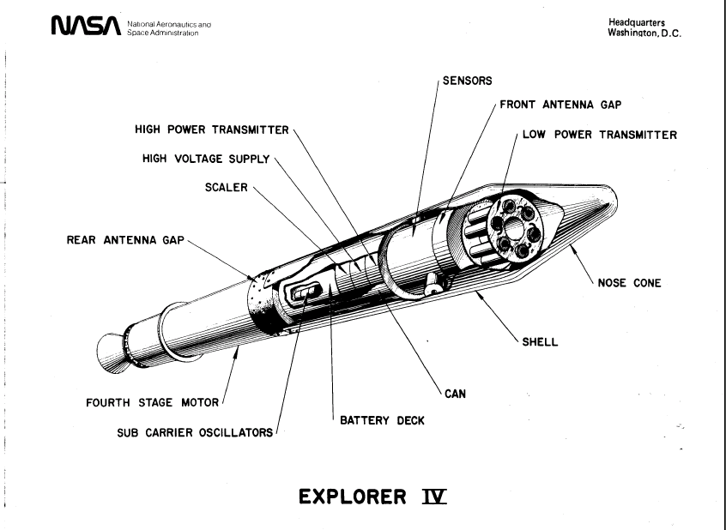
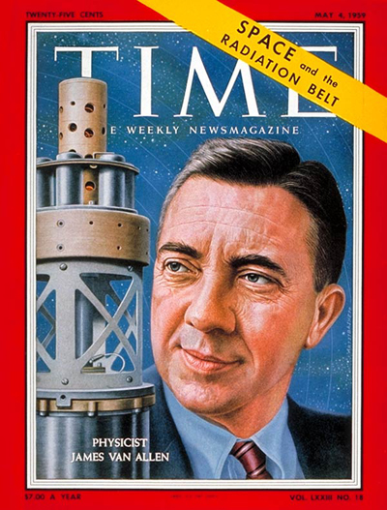
Discovery of the Outer Van Allen Radiation Belt
Pioneer 3 (launched 6 December 1958) and Explorer IV (launched July 26, 1958) both carried instruments designed and built by Dr. Van Allen. These spacecraft provided Van Allen additional data that led to discovery of a second radiation belt

Slide 7


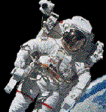

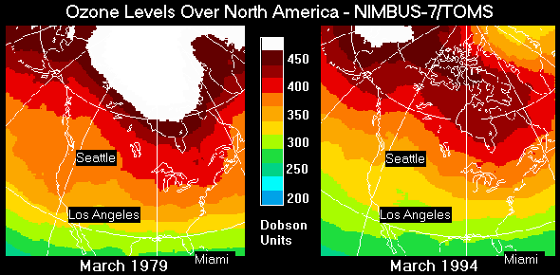
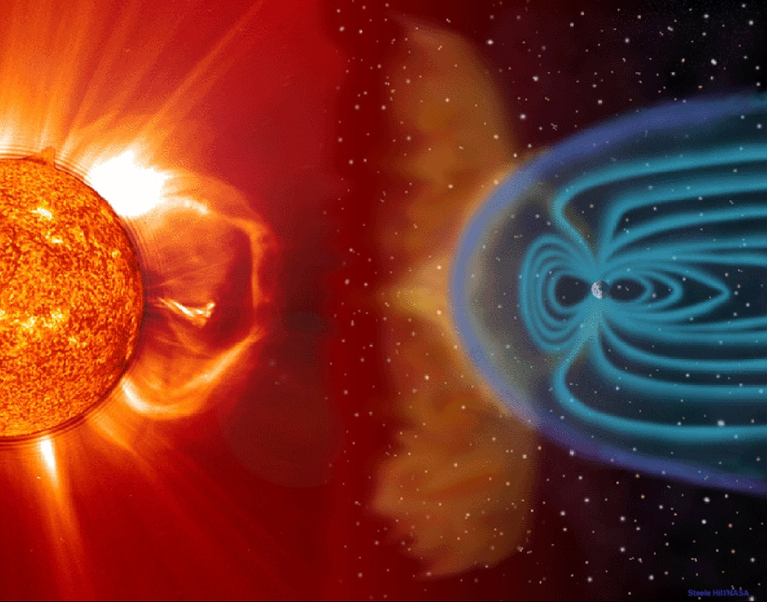
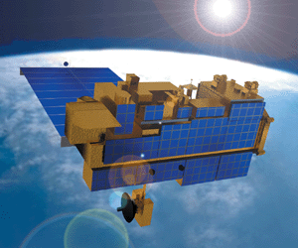
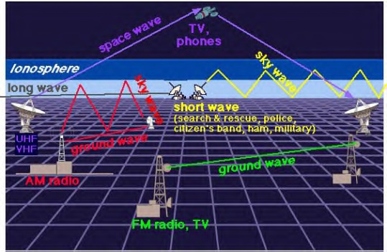
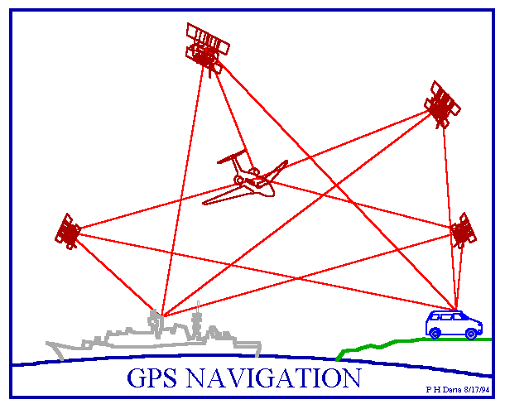
Importance & Our Increasing Reliance on Space Systems
Scientific Research
  Space Science
  Earth Science
  Human Exploration of Space
  Aeronautics and Space Transportation
Navigation
Telecommunications
Defense
Space environment monitoring
Terrestrial weather monitoring
Courtesy: J. Barth (NASA/GSFC, ret.)

Slide 8
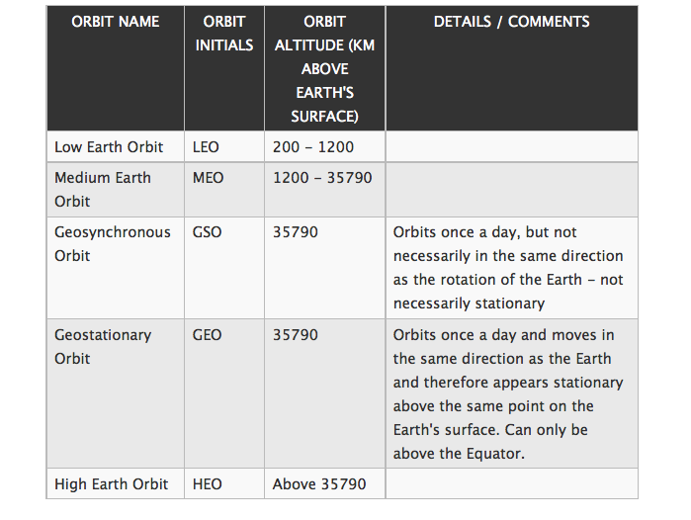
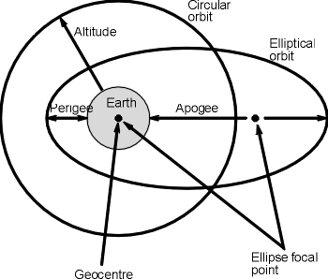
Orbits
Notes:
https://gisgeography.com/geosynchronous-geostationary-orbits/

Slide 9
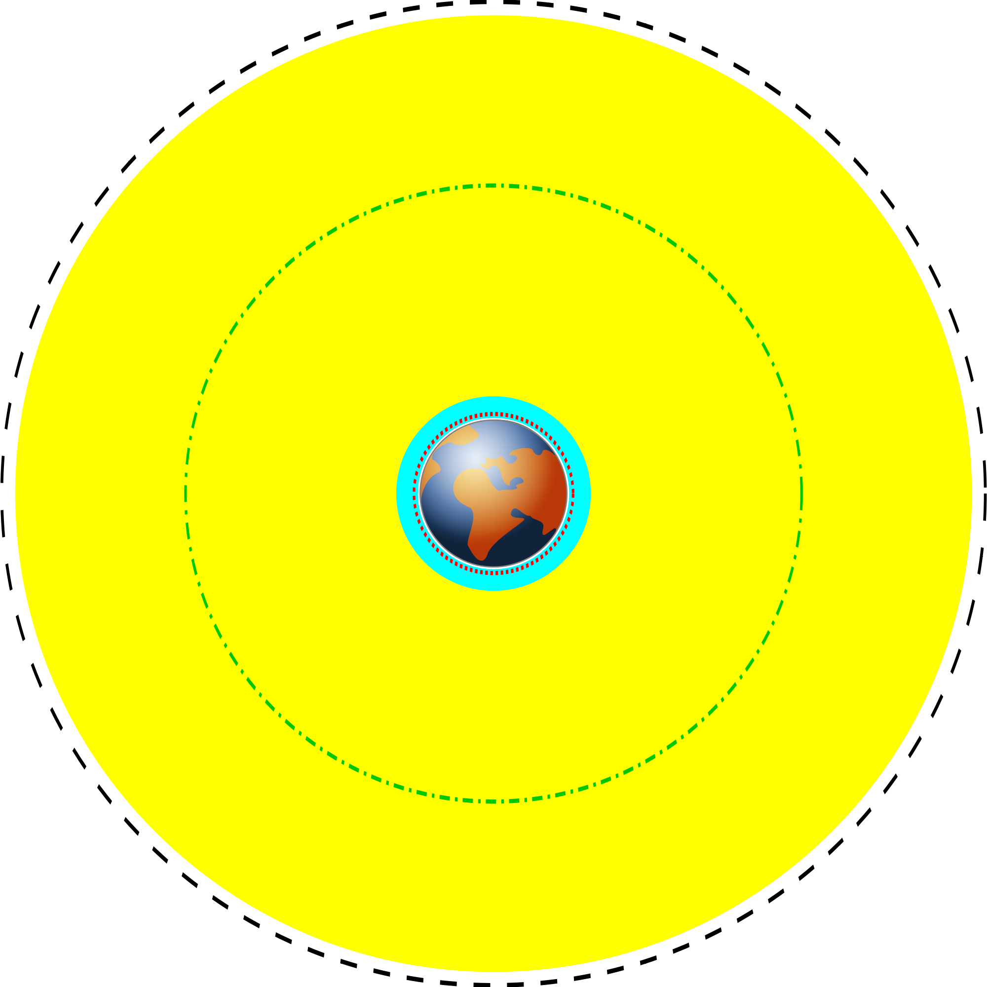
Orbits
GEO
Yellow: MEO
Green-dash-dotted line: GPS
Cyan: LEO
Red dotted line: ISS

Slide 10
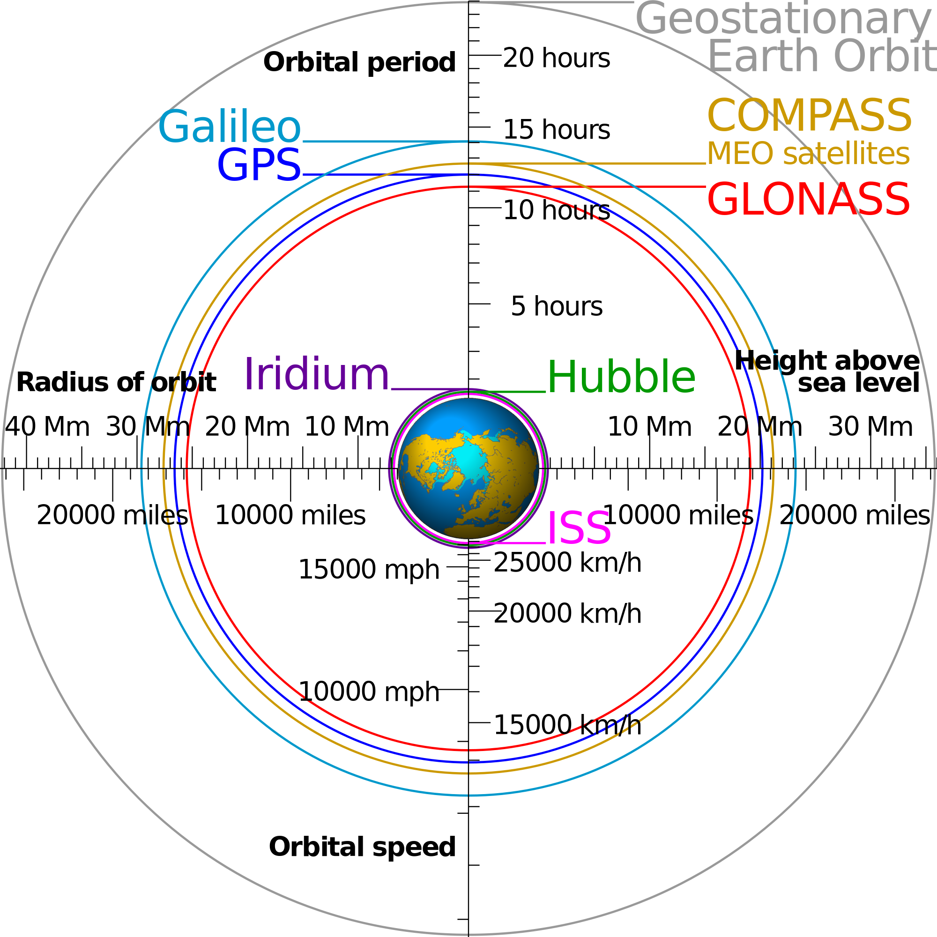
Orbits
Different observing assets in near-Earth environment

Slide 11
Orbit Classification Based on Inclination
Inclined orbit: An orbit whose inclination in reference to the equatorial plane is not zero degrees.
  Polar orbit: An orbit that passes above or nearly above both poles of the planet on each revolution. Therefore it has an inclination of (or very close to) 90 degrees.
  Polar sun synchronous orbit: A nearly polar orbit that passes the equator at the same local time on every pass. Useful for image taking satellites because shadows will be nearly the same on every pass.
    DMSP satellites

Slide 12
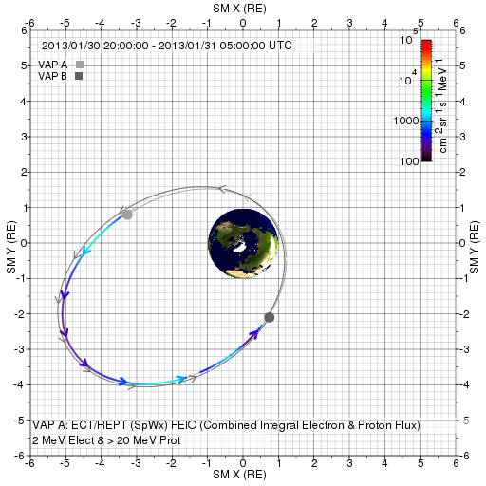
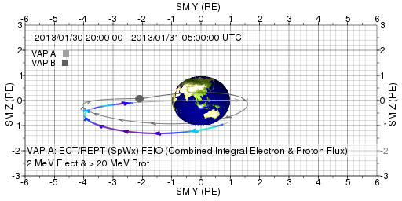
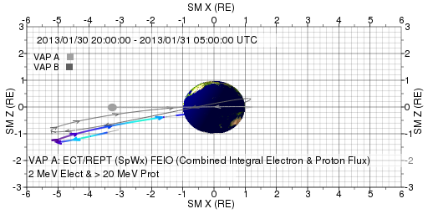
Van Allen Probes
Two Spacecraft In an Elliptical Orbit

Slide 13
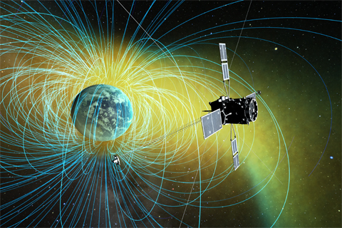
ERG/Arase
Energization and Radiation in Geospace (ERG)
Japanese satellite of exploring radiation belts
Launched on Dec 20, 2016
Orbit info
  Altitude
    Perigee about 440 km, Apogee: about 32,000 km
  Inclination
    32 degrees
  Elliptical orbit
  Period: 570 min
Notes:
ERG: exploration of Energization and Radiation in Geospace.

Slide 14
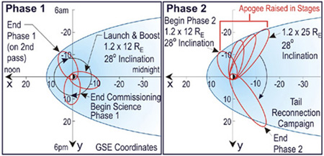
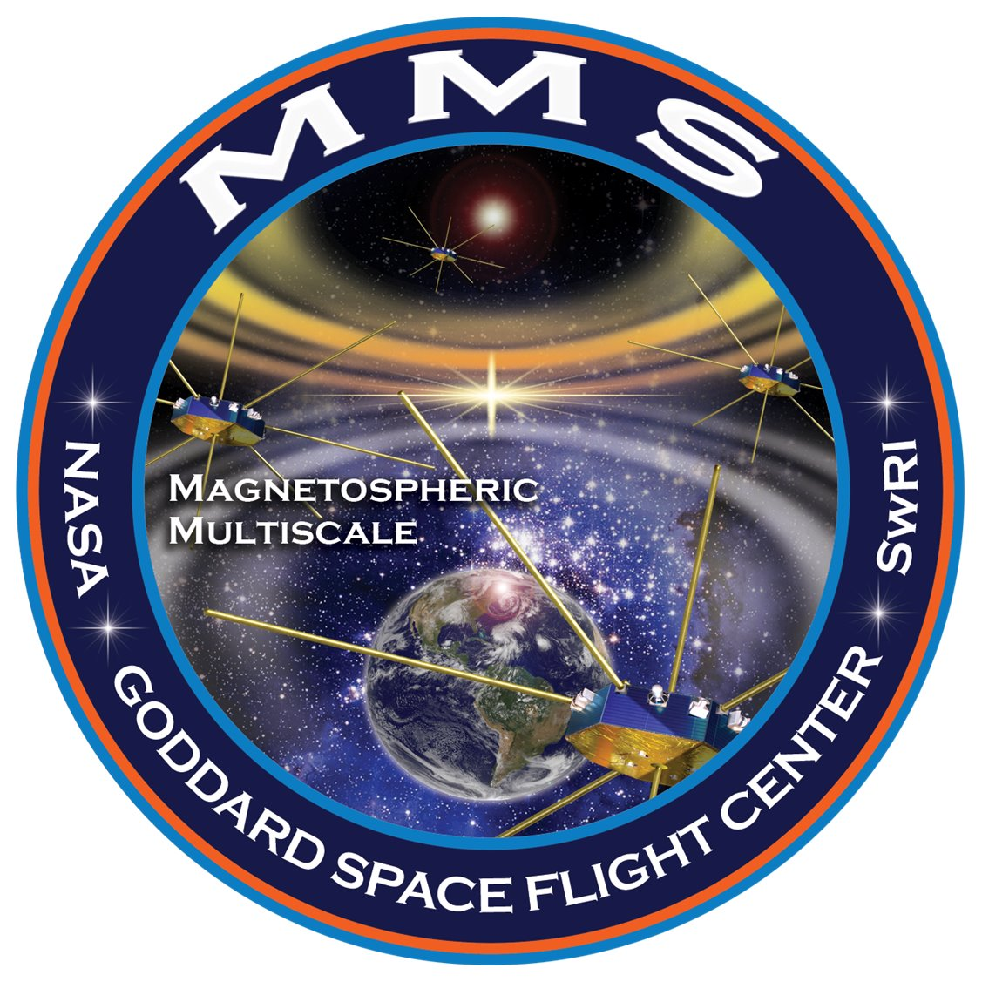
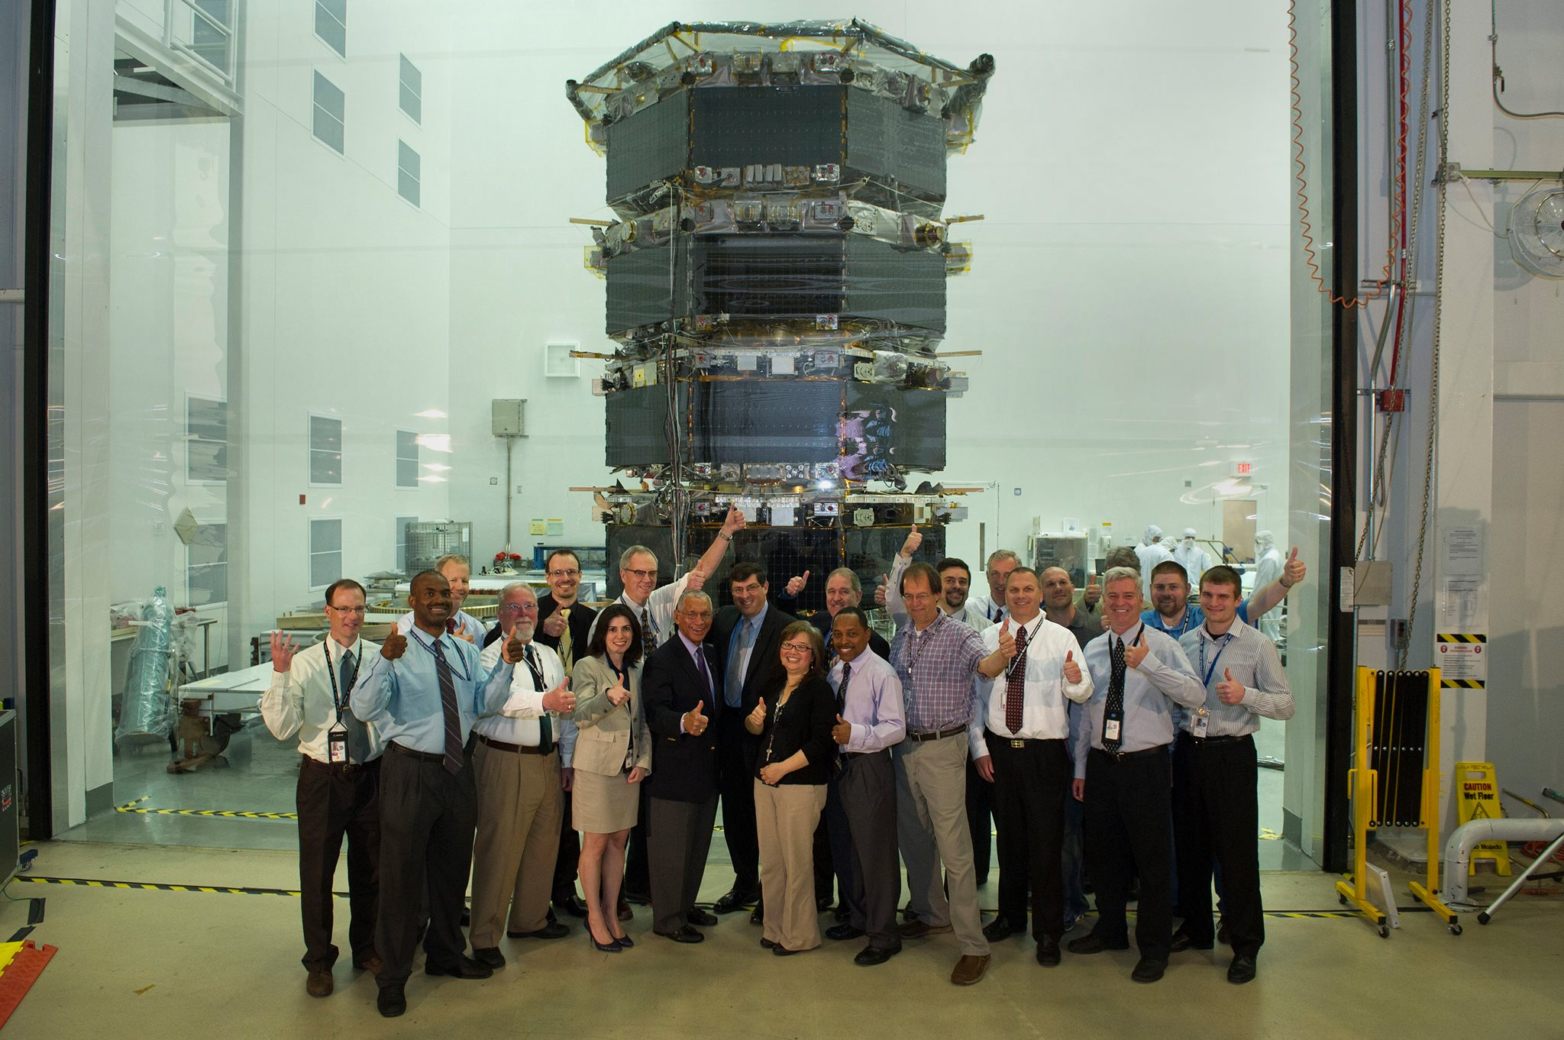
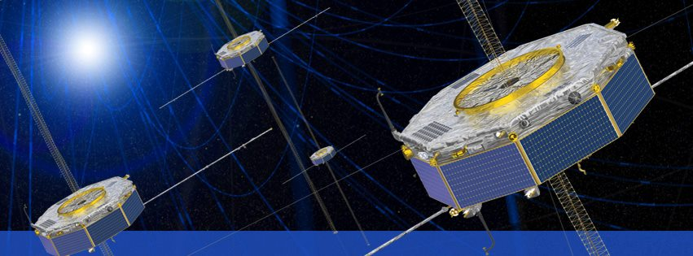
MMS (Magnetospheric Multiscale Mission)
Notes:
http://mms.space.swri.edu/mission-2.html

Slide 15
Other Types of Orbits
Heliocentric Orbit: An orbit around the Sun.
STEREO A and STEREO B
Interplanetary space
At different planets (in reference to a planet)
Unit in terms of Rs (solar radii) or AU (Astronomical Unit)

Slide 16
Orbit/Mission Design
New Horizon to Pluto
Closest approach to Pluto: 7:49:57 a.m. EDT (11:49:57 UTC) on July 14, 2015
http://www.jhu.edu/jhumag/1105web/pluto.html
Dr. Yanping Guo, a mission design specialist at APL
Reduced the journey by at least three years
For more information about New Horizon
http://www.nasa.gov/mission_pages/newhorizons/main/index.html

Slide 17
Space Weather and Spacecraft Operations
The primary approach for the spacecraft industry to mitigate the effects of space weather is to design satellites to operate under extreme environmental conditions to the maximum extent possible within cost and resource constraints
  “Severe Space Weather Events--Understanding Societal and Economic Impacts Workshop Report,”
  National Academies Press, Washington, DC, 2008 http://www.nap.edu/catalog/12507.html
This technique is rarely 100% successful and space weather will typically end up impacting some aspect of a space mission
  Some space weather issues are common to all spacecraft, e.g., space situational awareness is one example
  Specific details of space weather interactions with a spacecraft are often unique because spacecraft systems are unique, there is no “standard” space weather support to mission operations
  Miniaturization of space assets makes them more vulnerable

Slide 18
Space Weather impacts on spacecraft operation

Slide 19
Space Environment Model Use in Mission Life Cycle
Mission Concept
Mission Planning
Design
Launch
Operations
Anomaly Resolution
Space Climatology
Minimize Risk
NASA Space Weather services
Space Weather
Manage Residual Risk
Both
Models: big variety including assimilative ones
Effects of Space Weather on Technology Infrastructure, Proceedings of the NATO ARW on Effects of Space Weather on Technology Infrastructure, Rhodes, Greece, from 25 to 29 March 2003. Editors: Ioannis A. Daglis, Part of the book series: NATO Science Series II: Mathematics, Physics and Chemistry (NAII, volume 176), “Prevention of Spacecraft Anomalies — The Role of Space Climate and Space Weather Models,“ Janet L. Barth, Pages 123-145.
Courtesy: J. Barth (NASA/GSFC, ret.)

Slide 20
Space Climatology and Space Weather
Space Climatology:
  Variability over months to years
  Space environment effects on both satellites and launch vehicles are best mitigated by good design
Space Weather
  Variability over minutes to days
  Effects mitigated by design or operational controls
  Design satellites to withstand mean, extreme space weather events that may occur during time on orbit

Slide 21
Space Environment & Effects (1)
Mechanism | Effect | Source
Total Ionizing Dose (TID) | Degradation of microelectronics | Trapped protons Trapped electrons Solar protons
Displacement Damage Dose (DDD) | Degradation of optical components and some electronics Degradation of solar cells | Trapped protons Trapped electrons Solar protons Neutrons
Single-Event Effects (SEE) | Data corruption Noise on images System shutdowns Electronic component damage | GCR heavy ions Solar protons and heavy ions Trapped protons Neutrons
Surface Erosion | Degradation of thermal, electrical, optical properties Degradation of structural integrity | Particle radiation Ultraviolet Atomic oxygen Micrometeoroids Contamination
Adapted from a chart by J. Barth

Slide 22
Space Environment & Effects (2)
UNCLASSIFIED
Mechanism | Effect | Source
Surface Charging | Biasing of instrument readings Power drains Physical damage | Dense, cold plasma Hot plasma (ring current, aurora population) (few eV to 10s keV)
Deep Dielectric Charging | Biasing of instrument readings Electrical discharges causing physical damage | High-energy electrons (>300 keV)
Structure Impacts | Structural damage Decompression | Micrometeoroids Orbital debris
Satellite Drag | Torques Orbital decay | Neutral thermosphere
Adapted from a chart by J. Barth

Slide 23
Space Environment & Effects another way (a previous bootcamp participant)
Total Ionizing Dose (TID)
Degradation of microelectronics
Displacement Damage Dose (DDD)
Trapped protons, Trapped electrons, Solar protons, Neutrons
Degradation of optical components and some electronics
Single-Event Effects (SEE)
GCR heavy ions, Solar protons and heavy ions, Trapped protons, Neutrons
Data corruption
Surface Erosion
Degradation of thermal, electrical, optical properties
Degradation of solar cells
Trapped protons, Trapped electrons, Solar protons
Noise on images
System shutdowns
Electronic component damage
Particle radiation, Ultraviolet, Atomic oxygen, Micrometeoroids, Contamination
Degradation of structural integrity
Surface Charging
Dense, cold plasma, Hot plasma
Biasing of instrument readings
Power drains
Physical damage
Deep Dielectric Charging
High-energy electrons
Biasing of instrument readings
Electrical discharges causing
physical damage
Structure Impacts
Micrometeoroids, Orbital debris
Structural damage
Decompression
Satellite Drag
Neutral thermosphere
Torques
Orbital decay

Slide 24
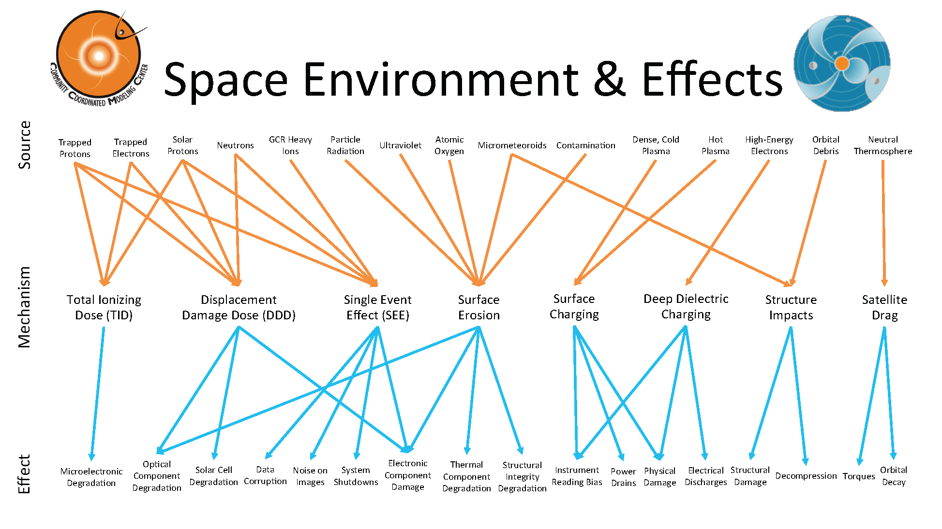
another way (Beryl Hovis-Afflerbach)

Slide 25
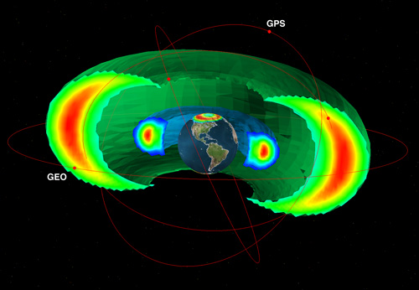
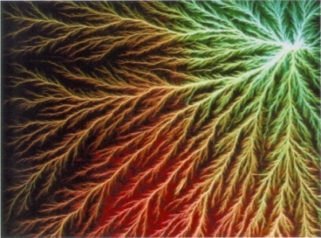
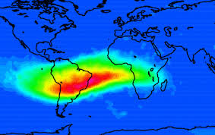
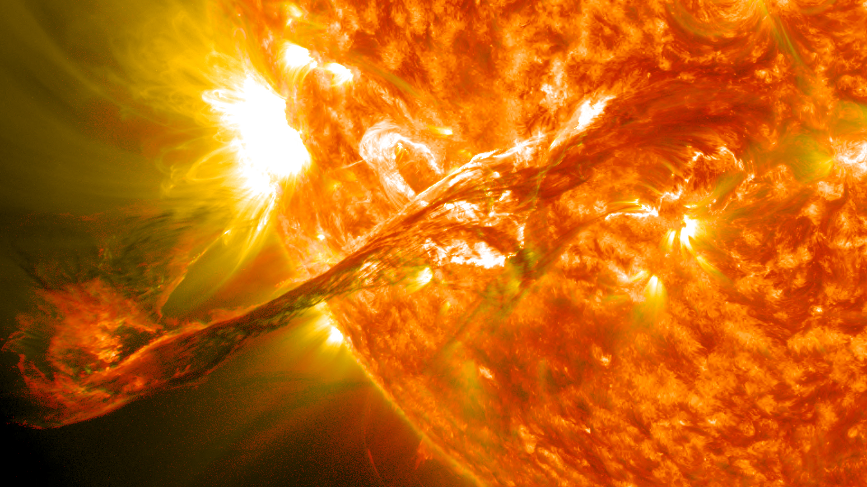

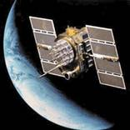
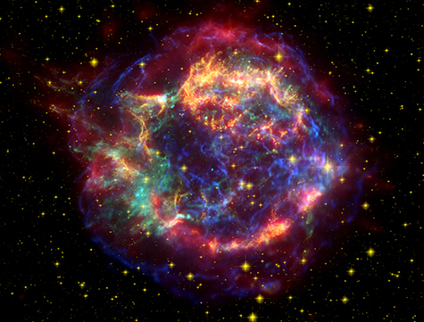
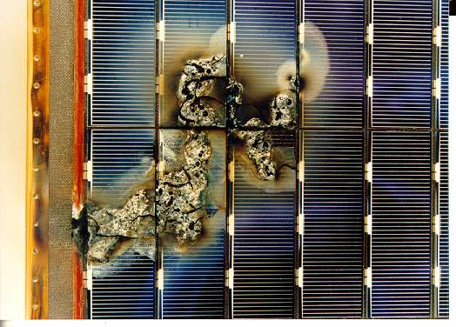
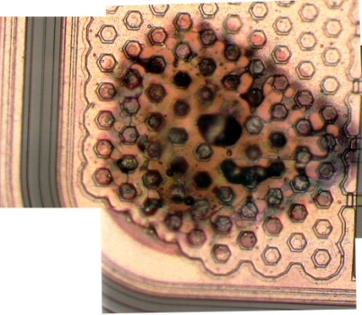
Electron radiation storms
Other Helpful Visuals/Slides
Radiation Belts
Ion radiation storms
Internal electrostatic discharge
Radiation Impacts on Aviation
Surface Charging
SAA
Single event effects
SEPs
Ring current, aurora, plasma sheet (<100 keV)
GCRs
Aviation Safety
Total Ionizing Dose (long term effect)
>100 keV electrons
>1 MeV protons
Mission Concept/Planning/Design
Mission Launch
Mission Operations
Anomaly Resolution

Slide 26
Visual Representation of Space Environment Hazards
Notes:
Additional reading material

Slide 27
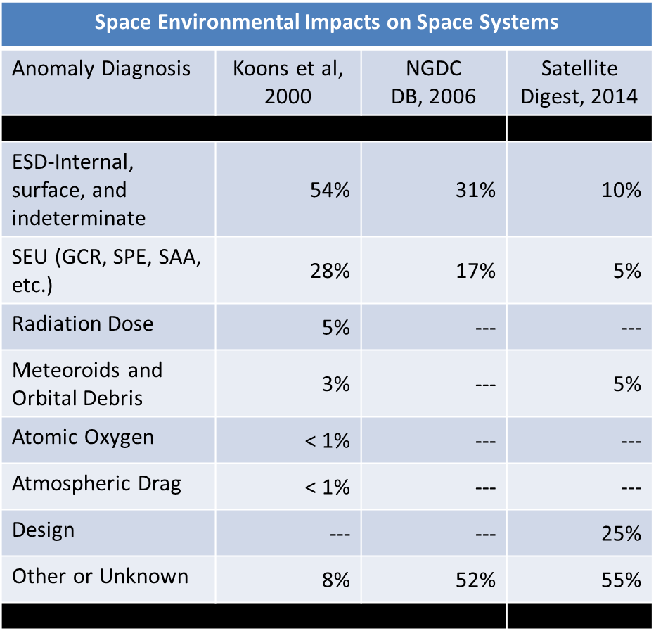
Space Environment Effects/Anomalies
McKnight 2015

Slide 28
Space Environment Impacts/Anomalies
According to a study by the Aerospace Corporation the 2 most common types of spacecraft anomalies by far are due to electrostatic discharge (ESD) and single event effects (SEE)
Reported results*:
Anomaly Type: | Number of Occurrences:
ESD | 162
SEE | 85
Total Dose and Damage | 16
Miscellaneous | 36
* H.C. Koons et al., 6th Spacecraft Technology Conference, AFRL-VS-TR-20001578, Sept. 2000

Slide 29
A few types of space weather impacts on spacecraft

Slide 30
Surface charging: which can lead to electrostatic discharges (ESD)
ESD: can lead to a variety of problems, including component failure and phantom commands in spacecraft electronics [Purvis et al., 1984].
Surface Charging (1)
Purvis, C. K., H. B. Garrett, A. C. Wittlesey, and N. J. Stevens (1984),
Design guidelines for assessing and controlling spacecraft charging
effects, NASA Tech. Pap. 2361
https://standards.nasa.gov/documents/detail/3314877

Slide 31
Surface Charging (2)
Substorm injections ( Aurora)
Commercial satellite anomaly
More often in the midnight to morning sector
<100 keV e- distribution: similar behavior as spacecraft anomalies
=> Surface charging might be the main cause of the anomalies.
Choi, H.‐S., J. Lee, K.‐S. Cho, Y.‐S. Kwak, I.‐H. Cho, Y.‐D. Park, Y.‐H. Kim, D. N. Baker, G. D. Reeves, and D.‐K. Lee (2011), Analysis of GEO spacecraft anomalies: Space weather relationships, Space Weather, 9, S06001,doi:10.1029/2010SW000597.

Slide 32
Surface Charging Hazards Distribution

Slide 33
NASA Document on Mitigating Charging Effects
Title: Mitigating In-Space Charging Effects-A Guideline
Document Date: 2011-03-03
Revalid and Reaffirmed Date: 2016-03-03
Revision: A
Organization: NASA

Slide 34
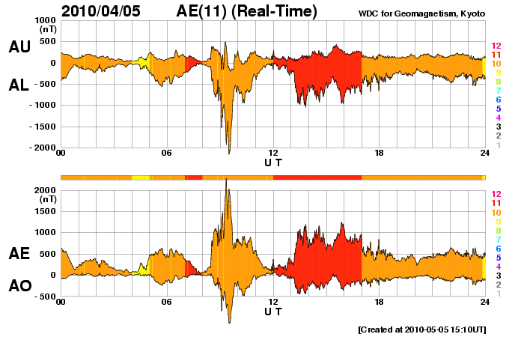
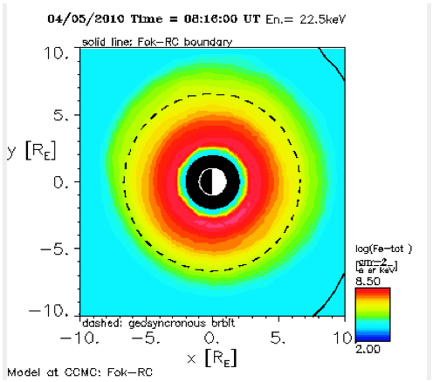
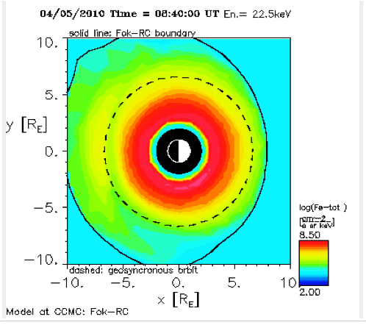
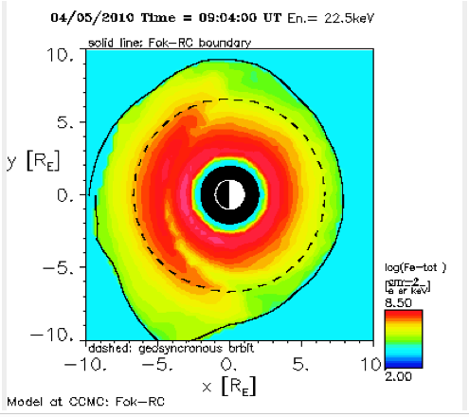
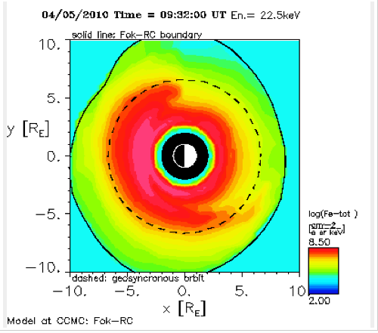
Surface Charging?!: Galaxy 15 failure on April 5, 2010
22keV electrons 4/5, 8:16-9:32Z
Galaxy 15 failed approx 9:48Z
Ring current model data show same

Slide 35
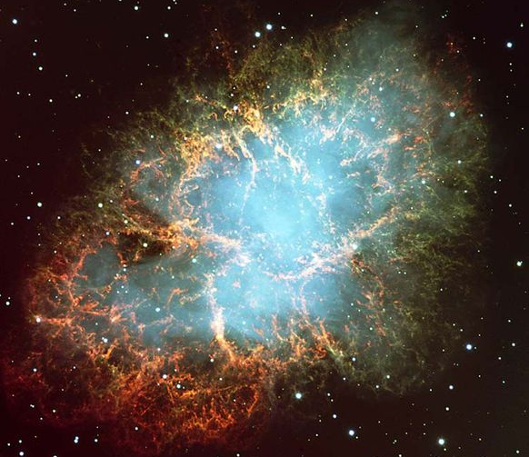
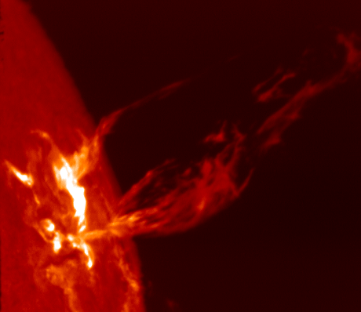
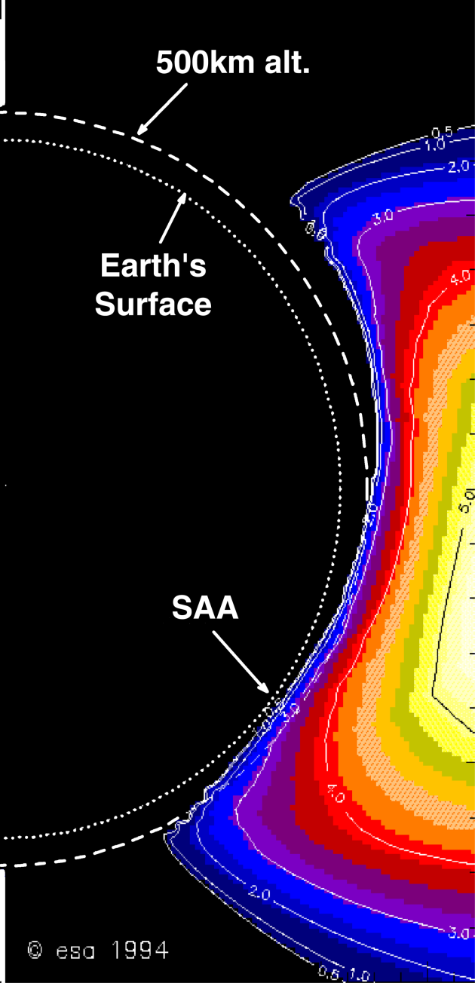
Single Event Effects: Source in Space
High Energy
Particle
Radiation
Galactic
Cosmic Rays
Solar Particle
Events (flare/CME)
Trapped
Particles (SAA)
High energy neutrons
Most unpredictable

Slide 36

Galactic Cosmic Rays
Galactic cosmic rays (GCR) are high-energy charged particles that originate outside our solar system.
Supernova explosions are a significant source
Anticorrelation with solar activity
More pronounced/intense during solar minimum

Slide 37
South Atlantic Anomaly
Dominates the radiation environment for altitudes less than about 1000 km.
Caused by tilt and shift of geomagnetic axis relative to rotational axis.
Inner edge of proton belt is at lower altitudes south and east of Brazil.
E.J. Daly et al., IEEE TNS, April 1996

Slide 38
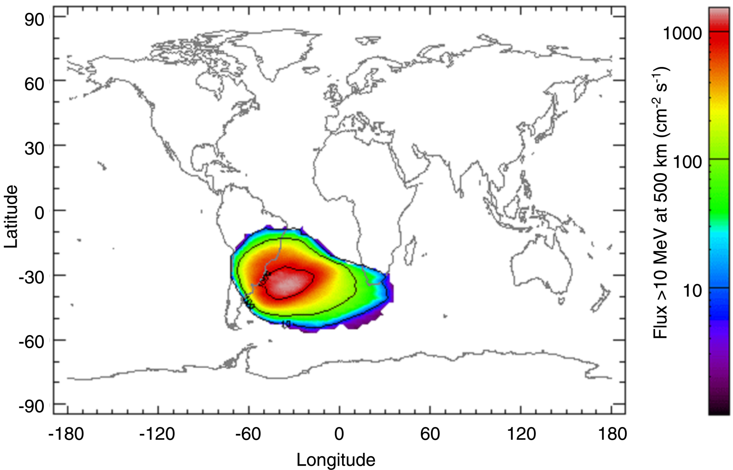
South Atlantic Anomaly
Solar Maximum
From SPENVIS, http://www.spenvis.oma.be/

Slide 39
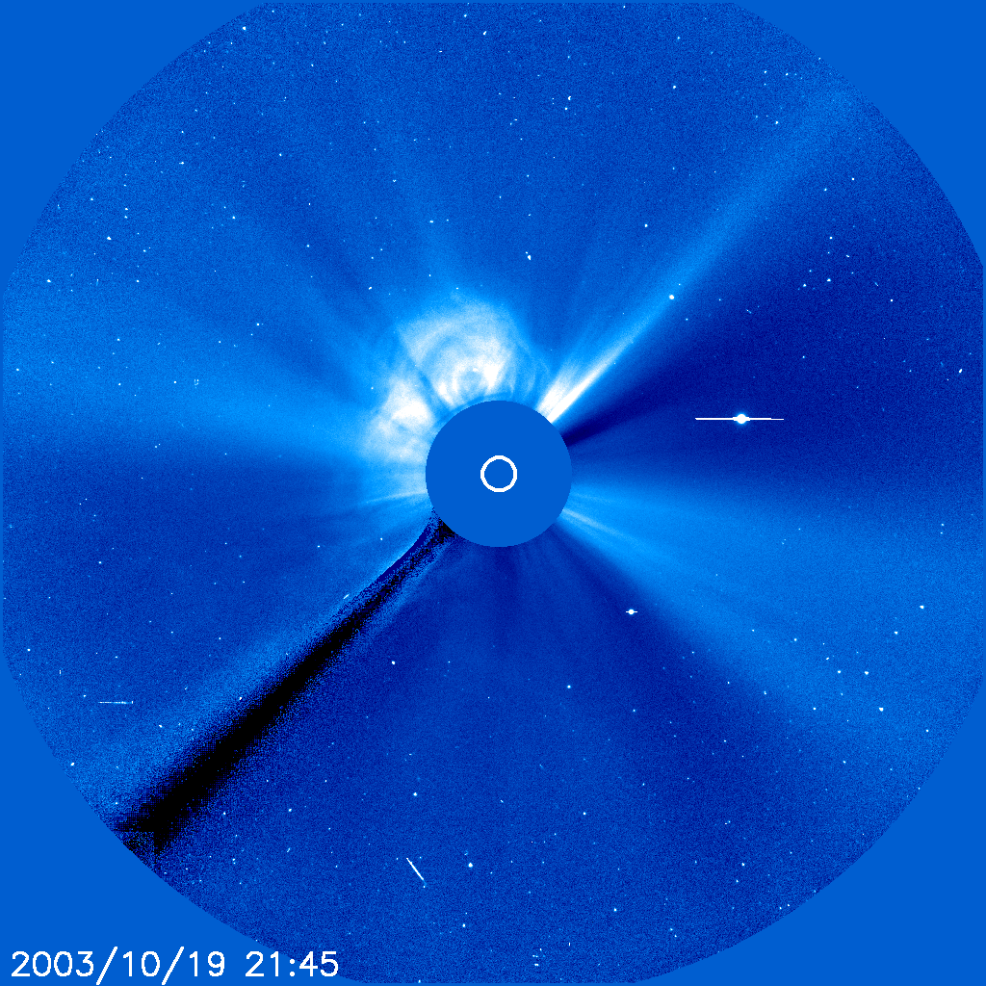
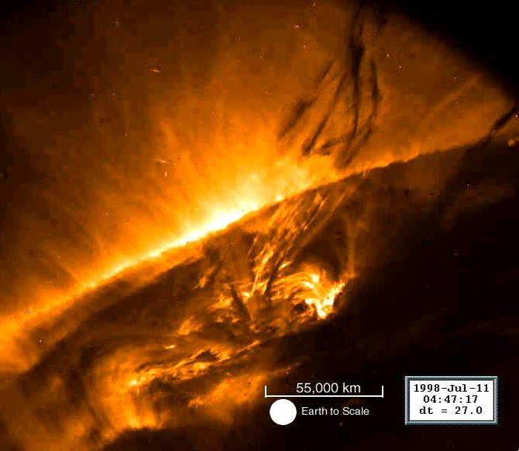
Characteristics of SEPs
Elemental composition* (may vary event by event)
  96.4% protons
  3.5% alpha particles
  0.1% heavier ions (not to be neglected!)
Energies: up to ~ GeV/nucleon
Event magnitudes:
  > 10 MeV/nucleon integral fluence: can exceed 10⁹ cm⁻²
  > 10 MeV/nucleon peak flux: can exceed 10⁵ cm⁻²s⁻¹

Slide 40
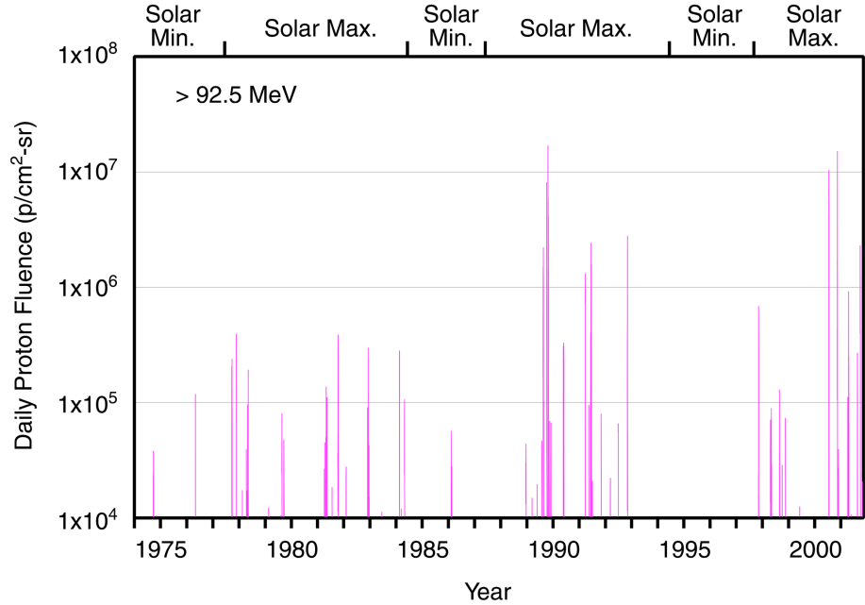
Solar Cycle Dependence
Most unpredictable

Slide 41
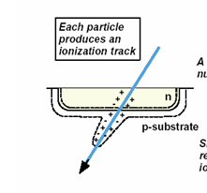
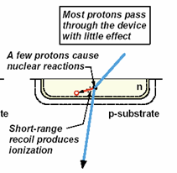
Single Event Effects (SEE)
Single event effect (SEE) : current generated by ion passing through the sensitive volume of a biased electronic device changes the device operating state
SEE Generated by Heavy Ions (Z=2-92)
High linear energy transfer (LET) rate of heavy ions produces ionization along track as ion slows down
Dense ionization track over a short range produces sufficient charge in sensitive volume to cause SEE
SEE is caused directly by ionization produced by incident heavy ion particles
SEE Generated by Protons (Z=1)
Proton LET is too low to generate SEE, but secondary heavy ions are produced in nuclear reactions with nuclei of atoms (usually silicon) inside electronics. Energy is transferred to a target atom fragment or recoil ion with high LET and charge deposited by recoil ion(s) is the direct cause of SEE.
Only a small fraction of protons are converted to such secondary particles (1 in 10^4 to 10^5).
Notes:
Z=92 Uranium

Slide 42

What is a Single Event Effect?
Single Event Effect (SEE) – any measureable effect in a circuit caused by single incident ion
  Non-destructive – SEU (Single Event Upset), SET (single event transients), MBU (Multiple Bit Upsets), SHE (single-event hard error)
  Destructive – SEL (single event latchup), SEGR (single event gate rupture), SEB (single event burnout)
Destructive event
in a COTS 120V
DC-DC Converter

Slide 43
Single Event Upsets
SEUs: are soft errors, and non-destructive. They normally appear as transient pulses in logic or support circuitry, or as bitflips in memory cells or registers.

Slide 44
Destructive SEEs
Several types of hard errors, potentially destructive, can appear:
Single Event Latchup (SEL) results in a high operating current, above device specifications, and must be cleared by a power reset.
Other hard errors include Burnout of power MOSFETS (Metal Oxide Semiconductor Field-Effect Transistor) , Gate Rupture, frozen bits, and noise in CCD (Charge-Coupled Device)s.
Note: anomalies during the March 2012 SWx events: SEEs dominate
Quite a few NASA spacecraft experienced anomalies, majority of which are SEEs. Some of them required reset/reboot.

Slide 45
Internal Charging
- energetic electrons in the outer radiation belt
CIR HSS geomagnetic storm
CME geomagnetic storms

Slide 46
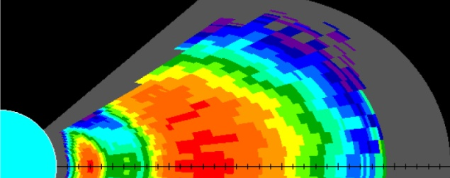
Space Environment Hazards (different types of charging) for Spacecraft in the near-Earth environment
Slot
(Dose behind 82.5 mils Al)
Inner
Belt
Plasma
Sheet
Single Event Effects tend to occur in the inner (proton) belt and at higher L shells when a solar particle event is in progress.
Internal electrostatic discharges (ESD) occur over a broad range of L values corresponding to the outer belt, where penetrating electron fluxes are high (300 keV – few MeV electrons)
Surface ESD tends to occur when the spacecraft or surface potential is elevated: at 2000-0800 local time in the plasma sheet and in regions of intense field-aligned currents (auroral zone) (few eV – 50 keV) - plasma sheet, ring current, aurora zone, magnetosheath
Event Total Dose occurs primarily in orbits that rarely see trapped protons in the 1-20 MeV range (e.g., GEO, GPS) because these are the orbits for which solar particle events and transient belts make up a majority of the proton dose (including displacement damage)
Outer Belt
Van Allen Probes
250
HEO
200
150
GPS
CRRES MEP-SEU Anomalies
100
SEUs
GEO
50
0
15
Internal
Charging
10
CRRES VTCW Anomalies
5
0
600
Surface
Charging
400
HEO-2 Charging Events
200
0
1
2
3
4
5
6
7
8
L ~ Equatorial Radial Distance (R_{E})
Courtesy: Paul O’Brien
Notes:
Not the main slide, for further reading and understanding

Slide 47

Total Dose Effects
128 Mb Samsung Flash Memory
Total Ionizing Dose (TID) – cumulative damage resulting from ionization (electron-hole pair formation) causing
  Threshold voltage shifts
  Timing skews
  Leakage currents
Displacement Damage Dose (DDD) – cumulative damage resulting from displacement of atoms in semiconductor lattice structure causing:
  Carrier lifetime shortening
  Mobility degradation
14
12
10
8
Voltage During Erase Function
6
Failed to erase
4
2
0
0
2
4
6
8
10
Total Dose [krad(Si)]
Solar Array Degradation
DDD can also be referred to in the context of
Non-Ionizing Energy Loss (NIEL)
CREDIT: NRL & JPL
Messenger, S. R., Summers, G. P., Burke, E. A., Walters, R. J. and Xapsos, M. A. (2001), Modeling solar cell degradation in space: A comparison of the NRL displacement damage dose and the JPL equivalent fluence approaches. Prog. Photovolt: Res. Appl., 9: 103–121. doi: 10.1002/pip.357
Notes:
Messenger, S. R., Summers, G. P., Burke, E. A., Walters, R. J. and Xapsos, M. A. (2001), Modeling solar cell degradation in space: A comparison of the NRL displacement damage dose and the JPL equivalent fluence approaches. Prog. Photovolt: Res. Appl., 9: 103–121. doi: 10.1002/pip.357

Slide 48
Human Safety in Space
GCR
SEP
Johnson Space Center/Space Radiation Analysis Group (SRAG)
Limit: the > 100 MeV flux exceeding 1pfu
(1 pfu = 1 particle flux unit= 1/cm^2/sec/sr)
All clear (EVA –extravehicular activity)

