Slide 1
Real-Time Modelling of CMEs Using the WSA-ENLIL+Cone Model
M. Leila Mays
Aleksandre Taktakishvili
CCMC at NASA GSFC

Slide 2
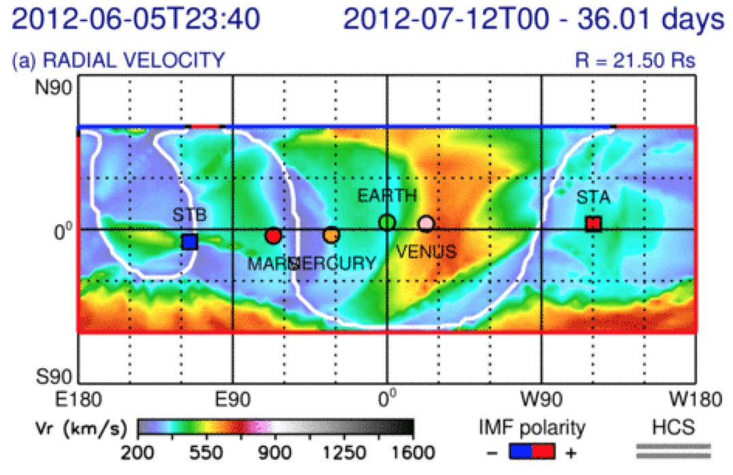
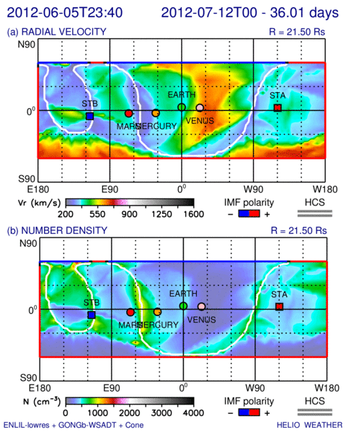
Modeling CMEs with WSA-ENLIL+Cone
Modeling CMEs with WSA-ENLIL+Cone

Slide 3
Modeling CMEs with WSA-ENLIL+Cone
Modeling CMEs with WSA-ENLIL+Cone

Slide 4
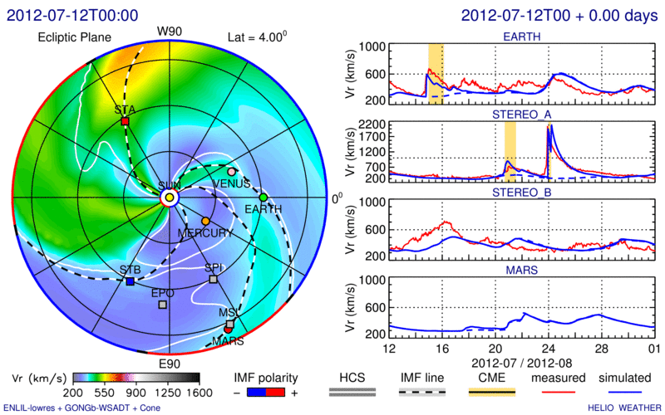

Slide 5
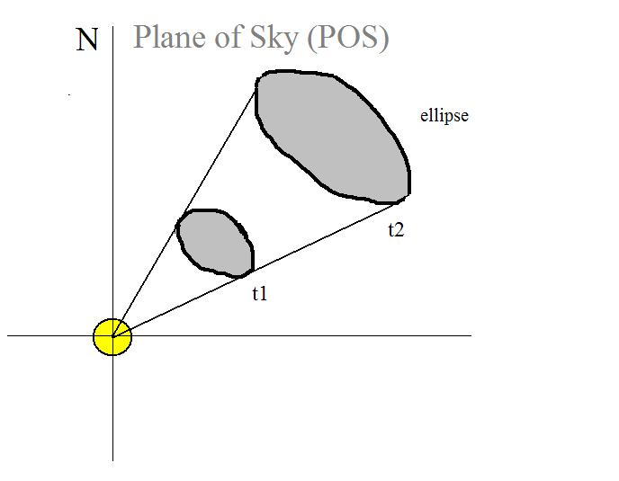
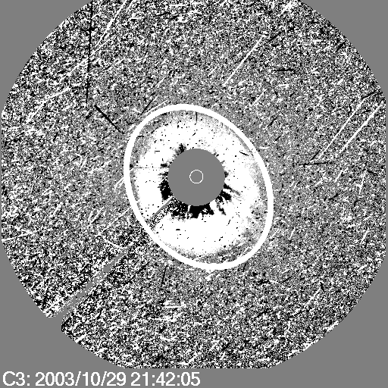
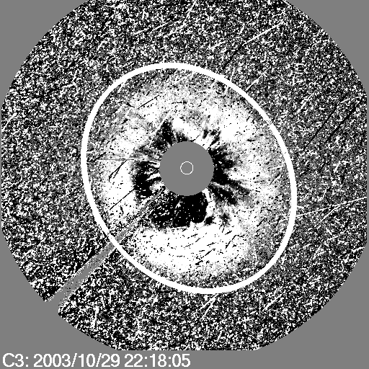
Cone Model for CMEs
CME measuring technique that assumes:
CME propagates with nearly constant angular width in a radial direction
CME bulk velocity is radial and the expansion is isotropic
Zhao et al, 2002, Cone Model:
The projection of the cone on
the coronagraph image is an ellipse
Notes:
Zhao was the first to come up with the Cone model of CME. The CME
cone model is based on observational evidence that CME has more
or less constant angular diameter in corona, being confined by the
external magnetic field, so that CME does not expand in latitude in the lower
corona, but expands in interplanetary space because of the weaker
external field. The assumptions are the following:
CME propagates with nearly constant angular width in a radial direction
CME bulk velocity is radial and the expansion is isotropic

Slide 6
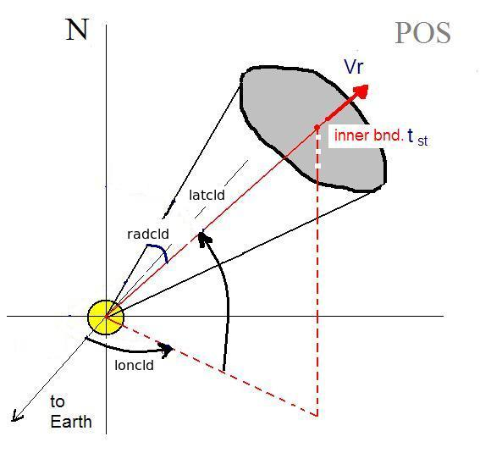
Cone model parameters
Input to ENLIL cone model run
time the CME reaches the inner boundary of 21.5 Solar Radii
Latitude (in HEEQ coordinates)
Longitude (in HEEQ coordinates)
Half-width‏ (deg)
Radial velocity (km/s)
Notes:
Parameters defined with CCMC CME Triangulation or other Tools yield CME
Parameters: Input To WSA-ENLIL Cone Model. These parameters are:
1- start time of CME at 21.5 Rs (inner boundary of the ENLIL model)
2- Cone axis latitude
3- Cone axis longitude
5- Cone Radius – half angle of the cone angular width
6- Radial Velocity

Slide 7
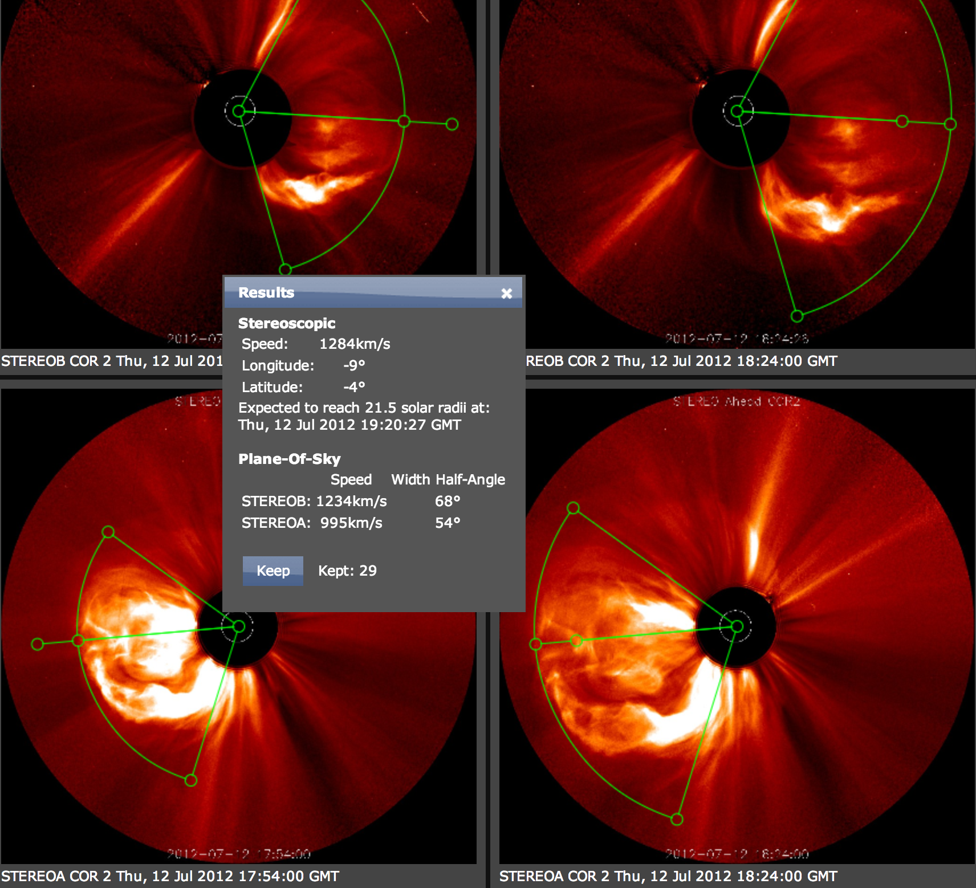
WSA-ENLIL Cone Model
Parameters Defined with CCMC CME Triangulation Tool: StereoCAT
CME Parameters: Input To WSA-ENLIL Cone Model
Notes:
Parameters defined with CCMC CME Triangulation Tool
(CAT) or other tools are used as input CMEpParameters
to WSA-ENLIL Cone Model.

Slide 8
SWPC CME Analysis Tool (SWPC_CAT)

Slide 9
Navigate to the quiz webpage:
http://www.quizzoodle.com/session/join/
Quiz admin session link.

Slide 10
What CME speed is used as input to the model?
a) The CME speed near the solar surface
b) The CME speed at the measured height
c) The CME speed extrapolated at 21.5 solar radii, the model inner boundary
d) The fastest CME speed measured at any height

Slide 11
Notes:
After we define the CME parameters we run the WSA-ENLIL cone model.

Slide 12
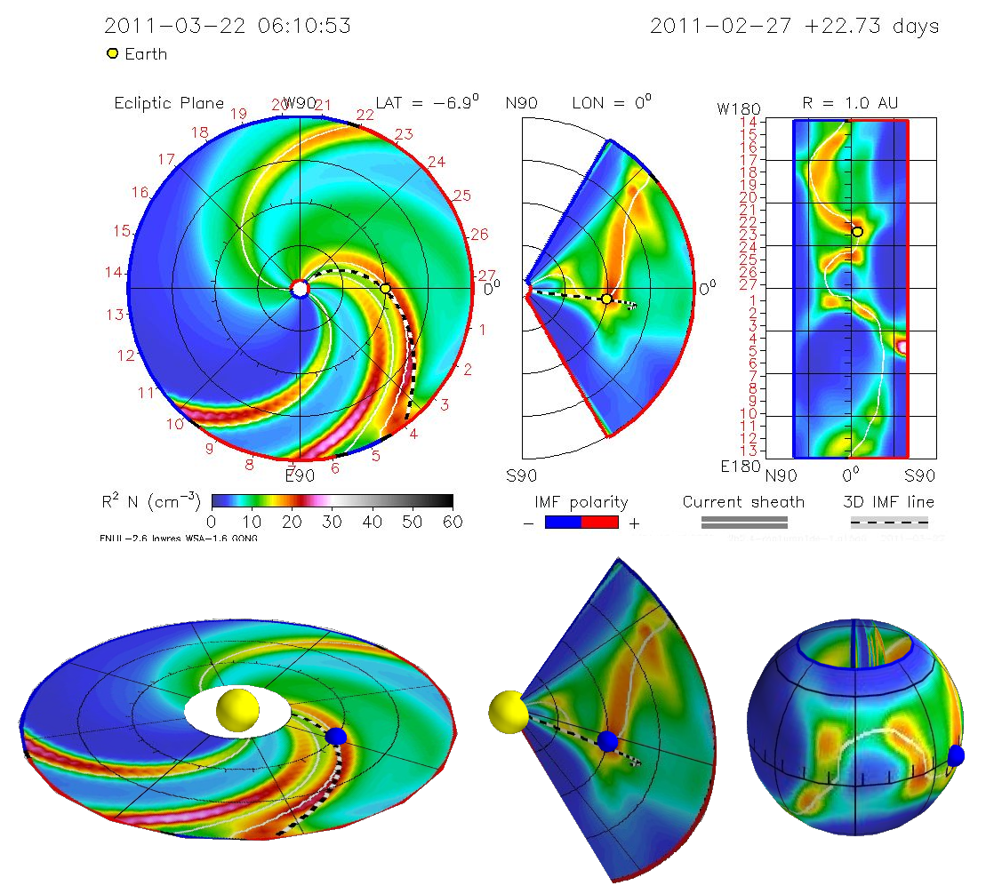

Slide 13
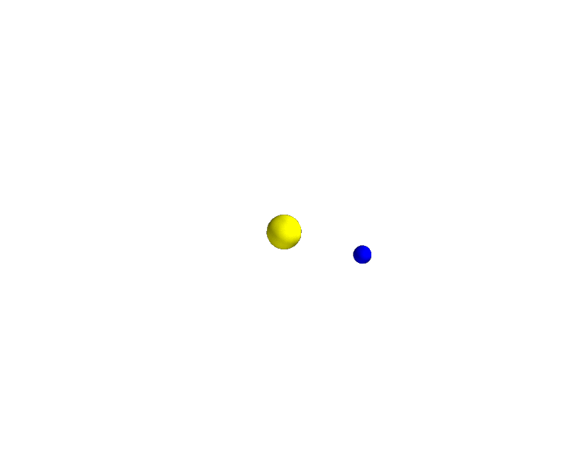

Slide 14
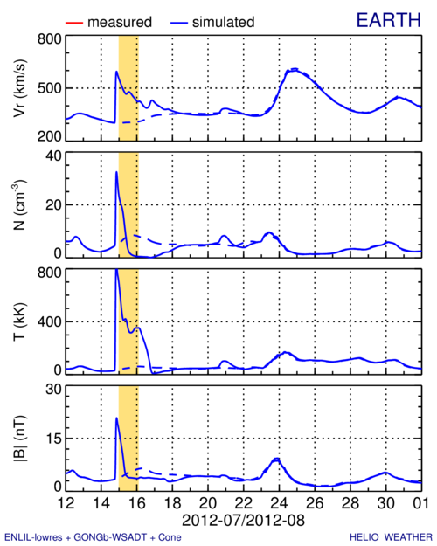

Slide 15
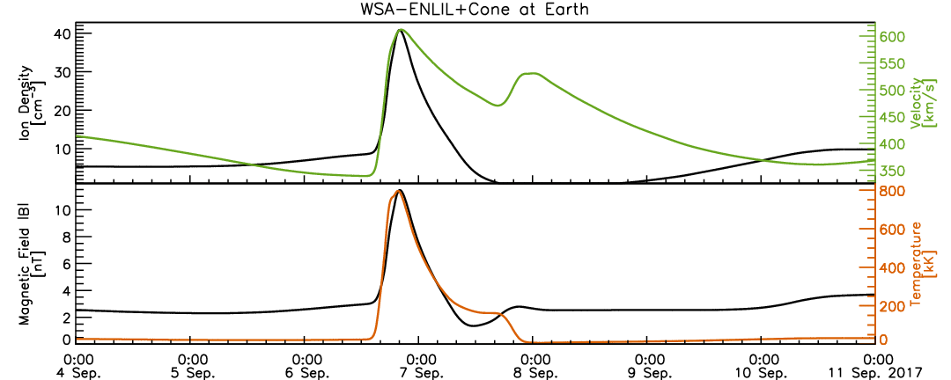
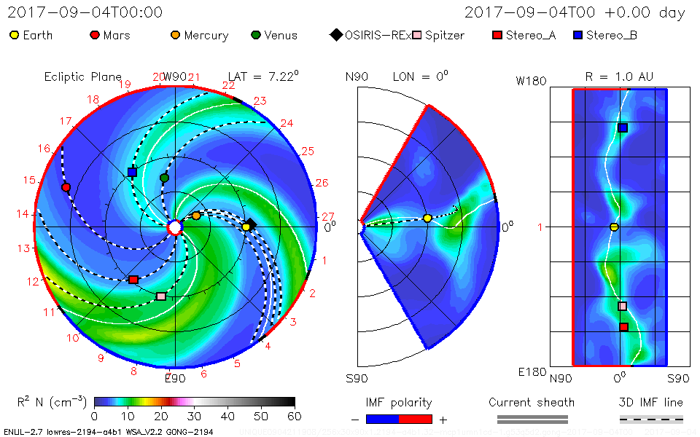
Determining CME Arrival Time
“direct” arrival

Slide 16
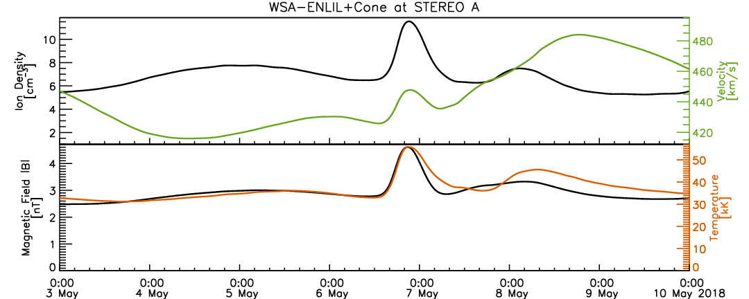
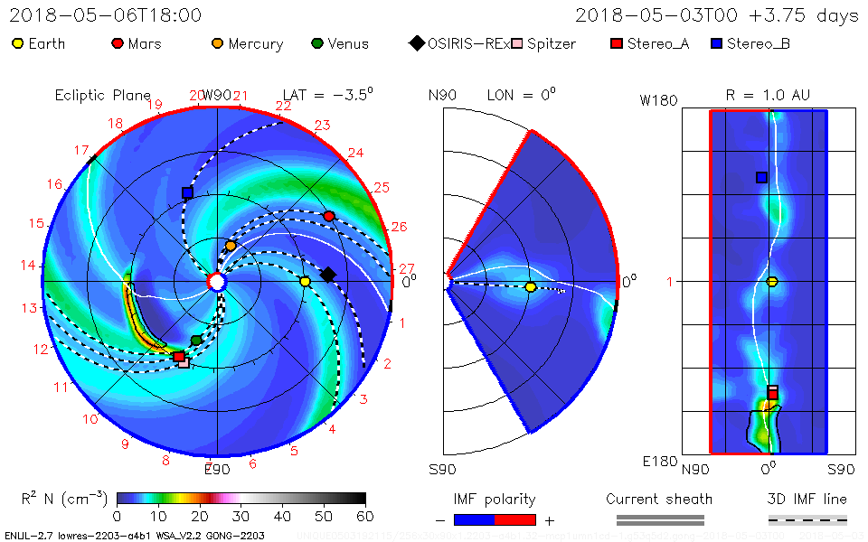
“flank” arrival

Slide 17
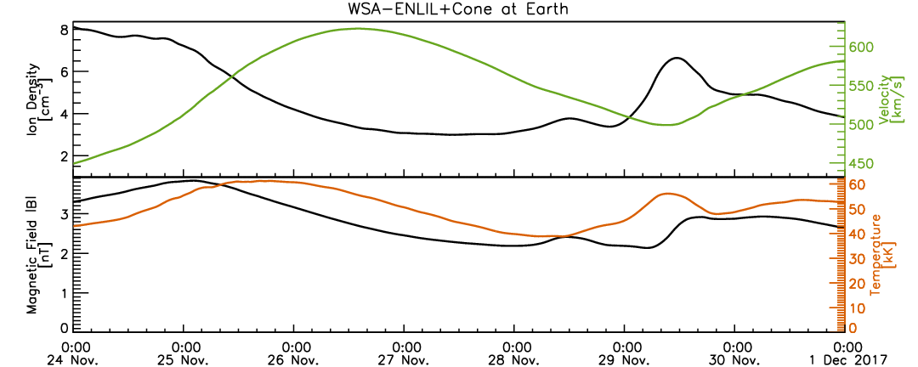
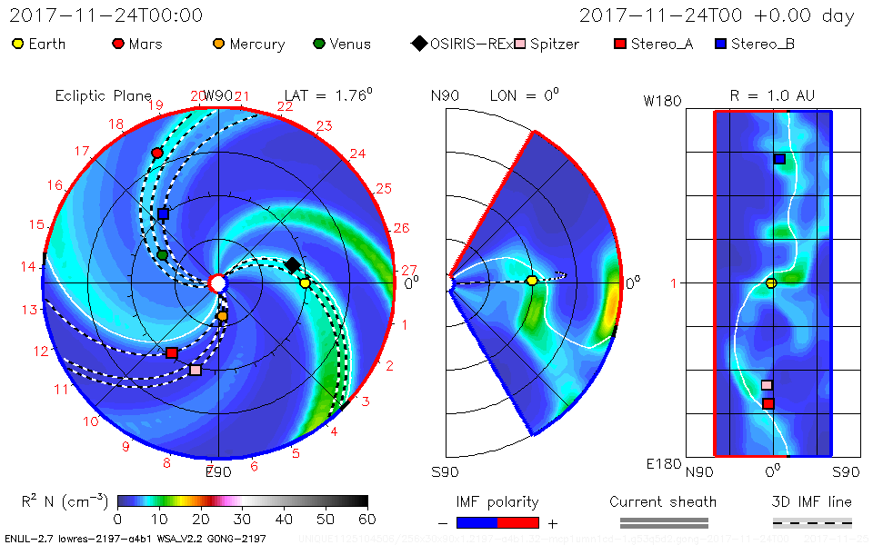
glancing

Slide 18
What are the main CME parameters that determine if it will have a direct impact, or a glancing blow?
a) speed, latitude, longitude
b) speed, longitude, half-width
c) latitude, longitude, half-width
d) half-width, speed, latitude

Slide 19
CME Impact: Arrival time, duration of passage, magnetopause standoff distance
CME shock arrival –
a sharp jump in the dynamic pressure
Duration of the disturbance – duration
of the dynamic
pressure hump
Magnetic field
required
to stop SW
Magnetopause standoff distance
Notes:
After the run is done, we estimate the CME impact on planets, satellites.
CME shock arrival – a sharp jump in the dynamic pressure.
2. Duration of the disturbance – duration of the dynamic pressure hump.
3. In case of the Earth we estimate also the degree of compressing of the
magnetosphere: when the CME mass reaches the magnetosphere it
pushes it inward and the magnetic field of the Earth is stressed like
a spring to stop the CME motion.

Slide 20
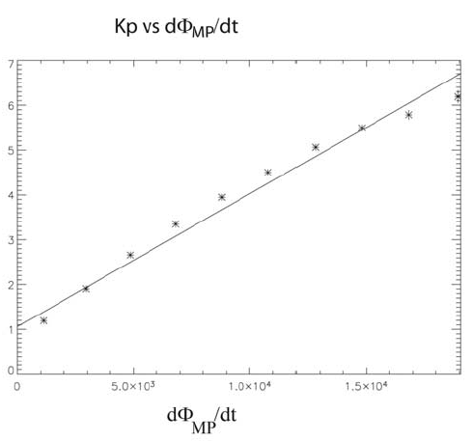
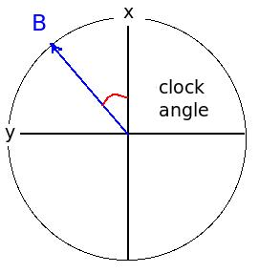
Kp Index Prediction– Newell Coupling Function
Kp is predicted using a relationship between the solar wind speed, magnetic field, and magnetic field clock angle.
(Θ_{C}=90°, 135°, and 180°)
Magnetic flux opening rate
at the magnetopause
Z
Notes:
In case of the Earth we estimate also the Kp index – a measure of the disturbance of the magnetosphere.
We use Pat Newel’s empirical formula for the Magnetic flux opening
rate at the magnetopause for that and an empirical relation between
Kp and d(Phi)/dt.

Slide 21
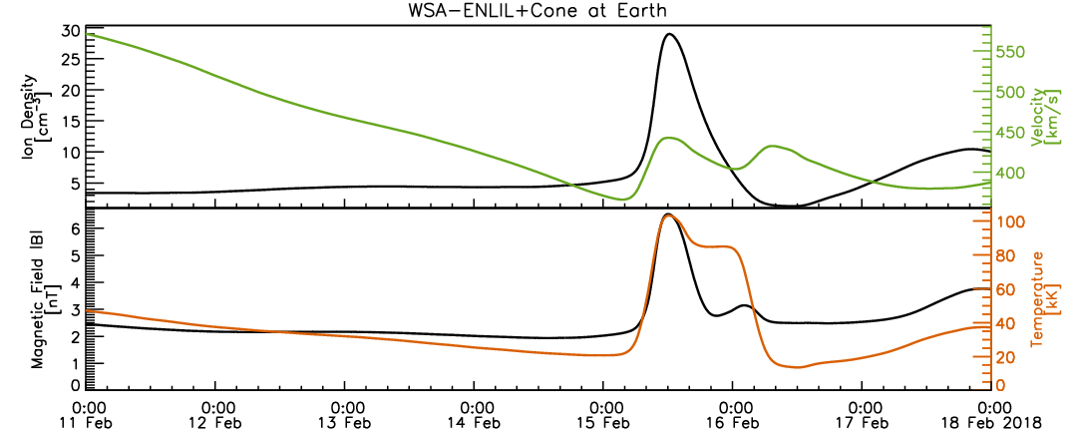
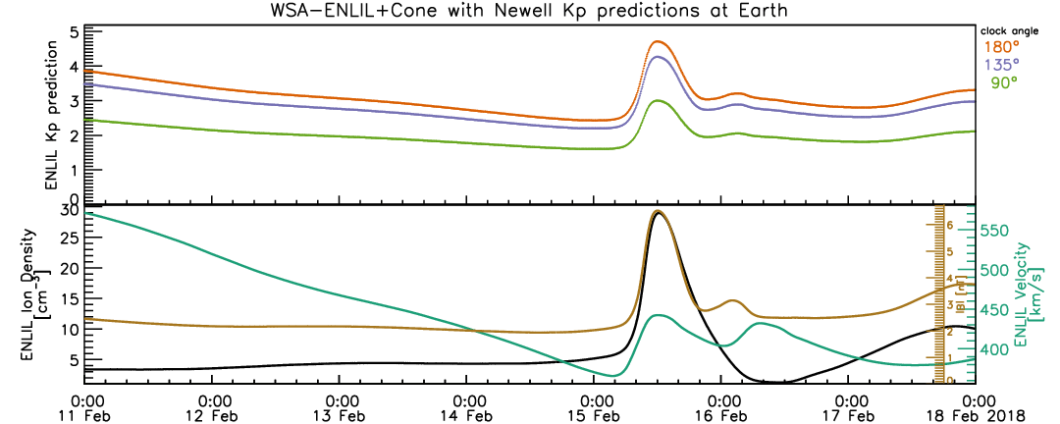
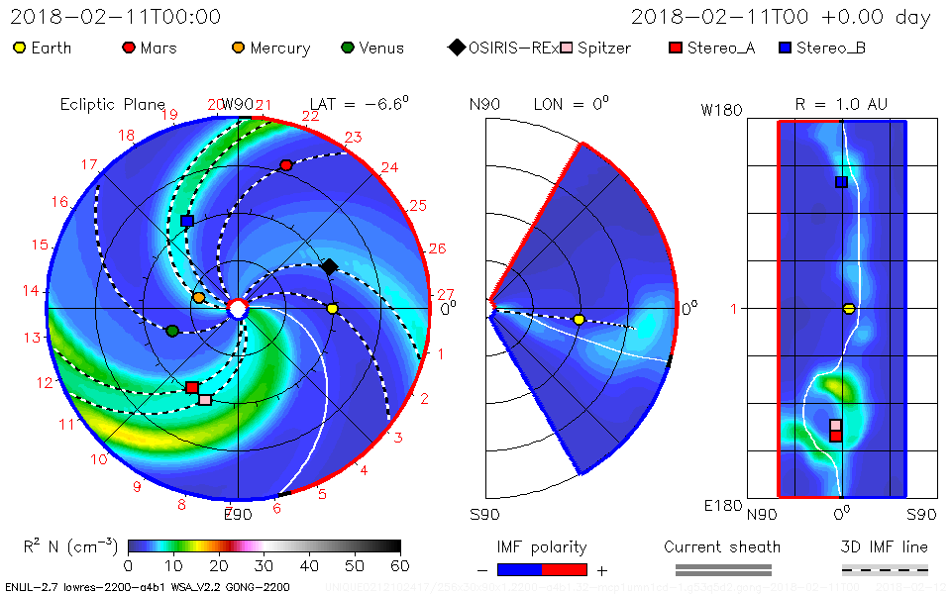

Slide 22
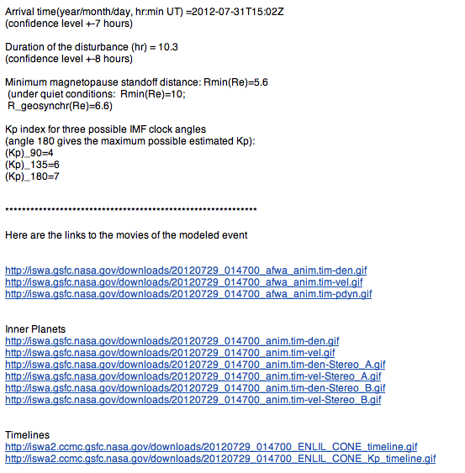
E-mail/text file with CME impact estimate at Earth
Notes:
And here is our response e-mail the them in details.
It contains the CME impact estimate for the Earth
(arrival time, magnetopause standoff distance,
Kp estimate for three possible clock angles of the IMF),
and links to the modeling animation and timelines.

Slide 23
Impact estimate at NASA mission locations
Notes:
But we are not monitoring only Earth impact. Being responsible for
providing space weather assessment to NASA robotic mission operators,
we are monitoring possible impact of the CME on NASA missions.
So we send out another e-mail, that shows this estimate.

