Slide 1
Geomagnetically Induced Currents
Antti Pulkkinen
NASA Goddard Space Flight Center,
Heliophysics Science Division

Slide 2
Contents
Why do we care?
Physics of geomagnetically induced currents (GIC).
GIC systems science.
Extreme GIC and E-field scenarios.
NASA GSFC work on the topic.
Conclusions.

Slide 3
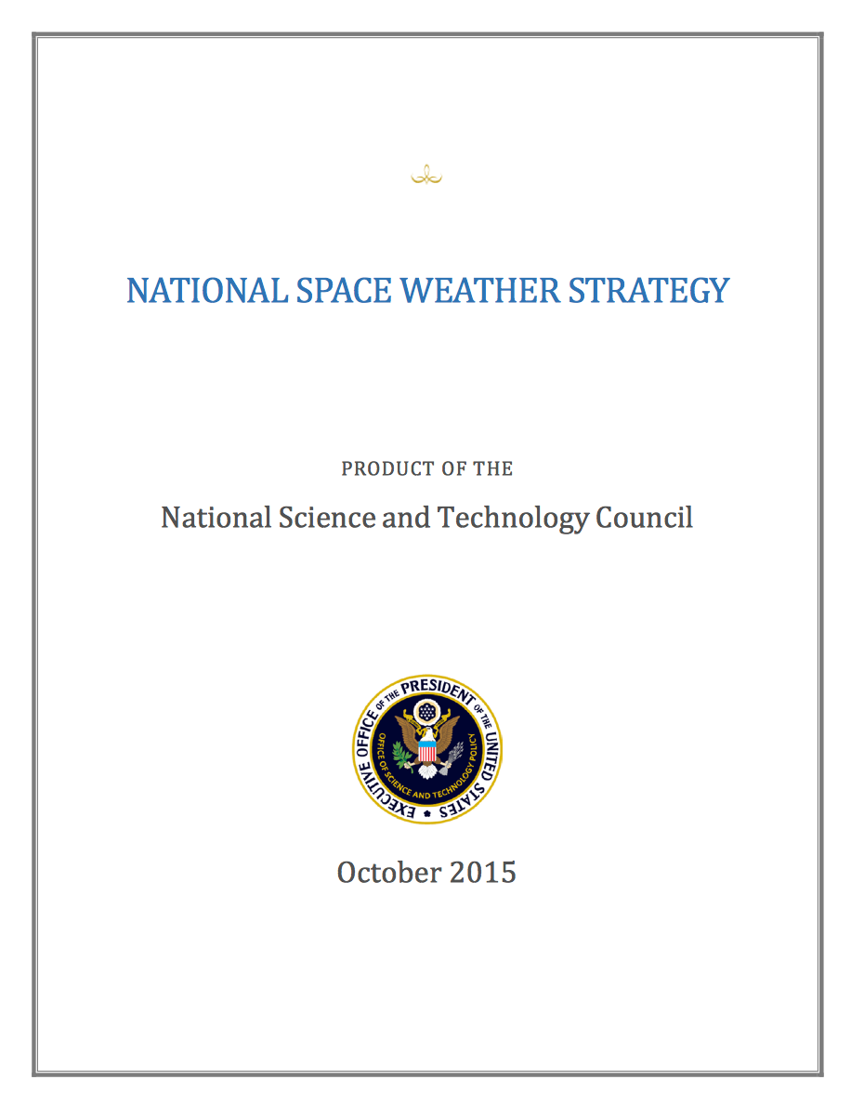
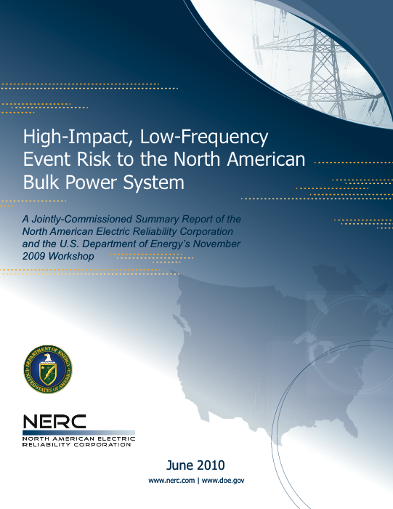
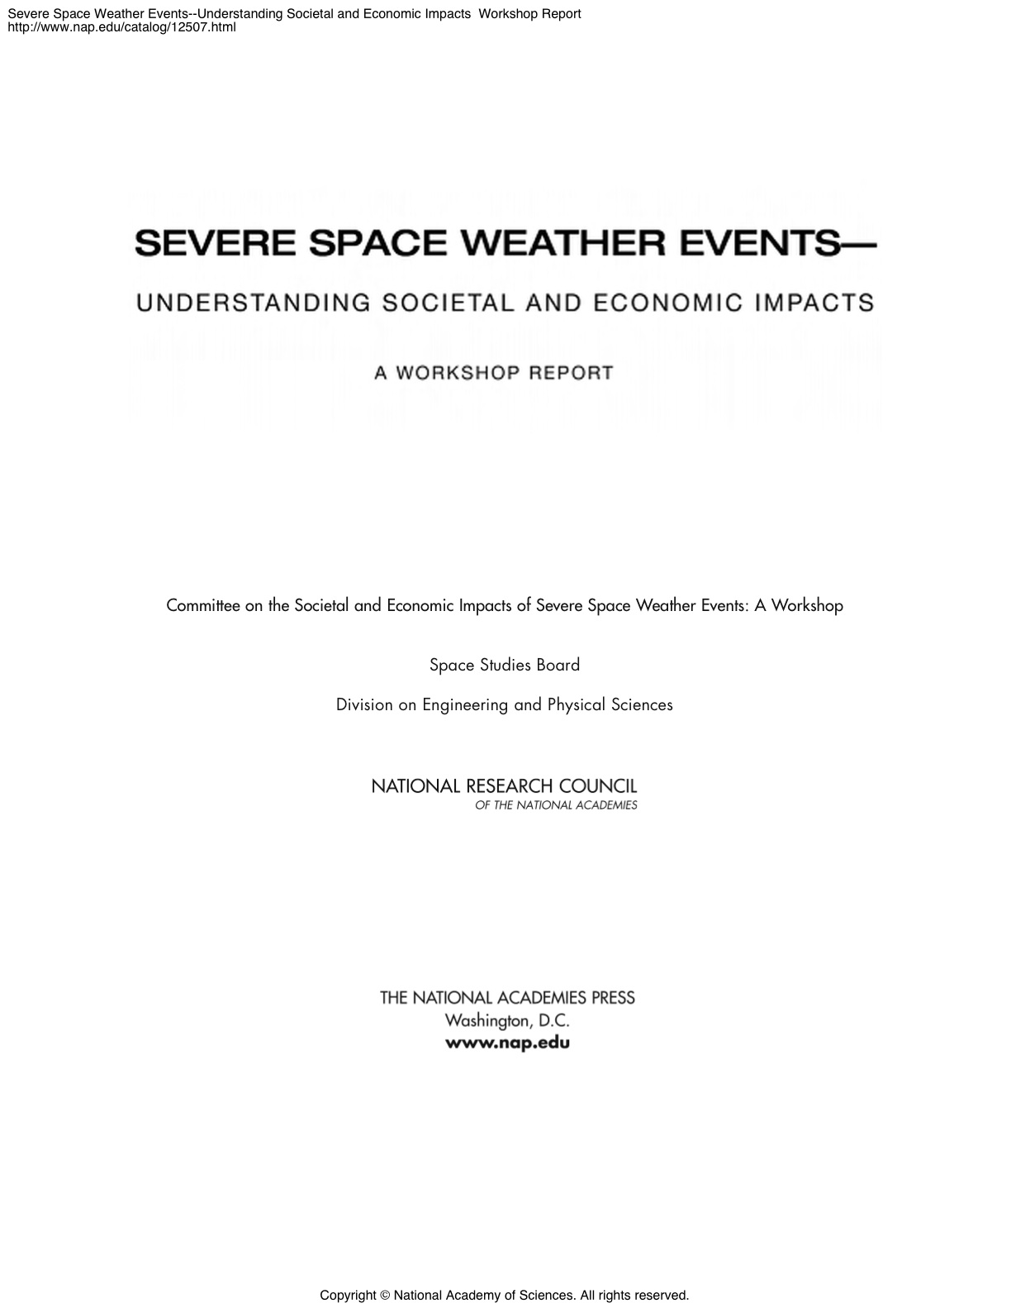
Brief history of the high-level US interest in the topic
Notes:
FERC order 779 May 2013.
National Space Weather Strategy released by National Science and Technology Council (branch of White House).

Slide 4
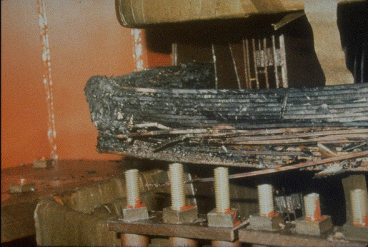
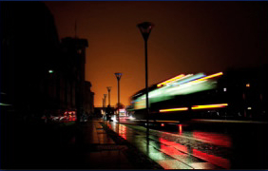
Why do we care?
GIC-driven half-cycle saturation of power transformers can cause:
  Leakage magnetic fields.
    →Transformer heating
  Harmonic currents.
  → Relay tripping
  Increased reactive power consumption.
  → Voltage instability
Hydro-Québec March 1989

Slide 5
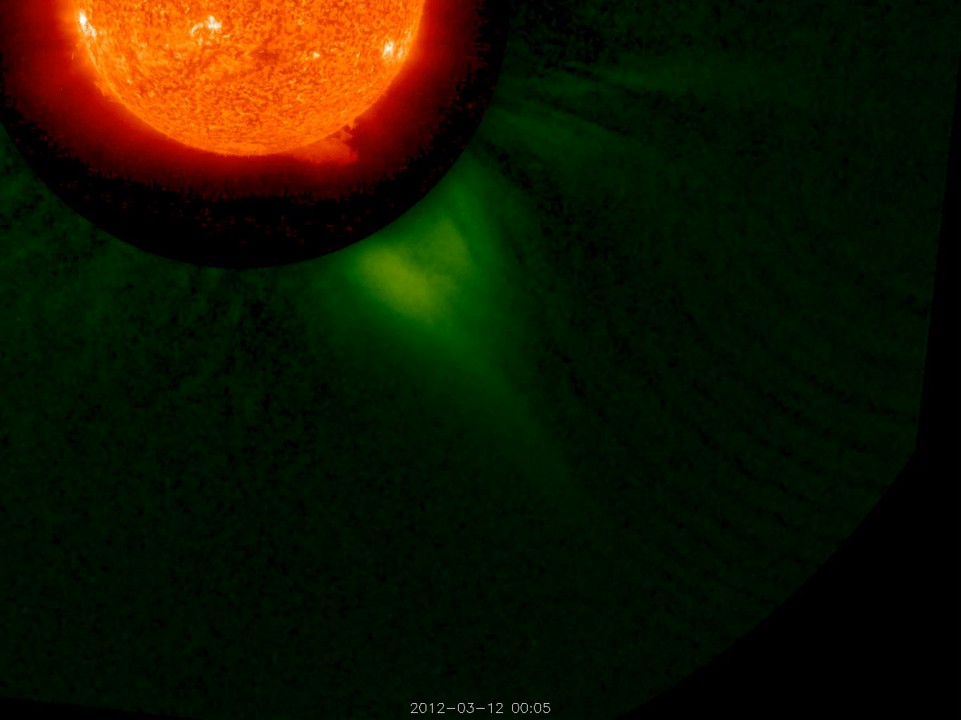
Physics of GIC
Many large solar eruptions are associated with coronal mass ejections (CMEs) releasing 10¹²-10¹³ kg of solar corona material at speeds of 200-3000 km/s. CMEs drive the most significant geomagnetic activity and GIC.
STEREO B 304 Angstrom EUV and white light coronagraph March 12, 2012

Slide 6
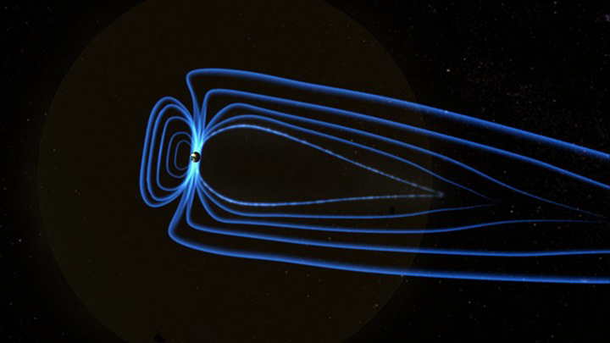
Physics of GIC

Slide 7
Physics of GIC
≈ 1 MA current into the ionosphere
Which powers electric currents in the system that generate the ground magnetic field variations
0.1-10 TW of power going in
Russell (IEEE Trans. on Plasma Science, 2000)

Slide 8
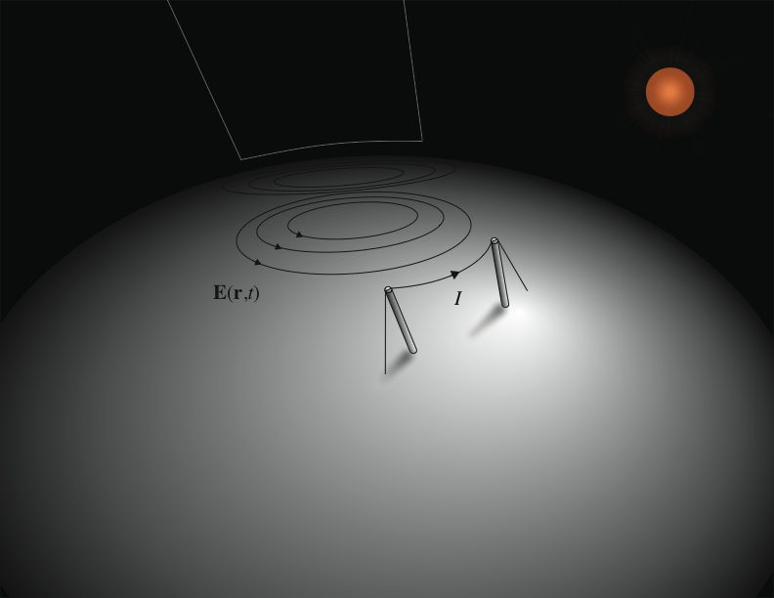
Physics of GIC
Geomagnetically induced current (GIC)

Slide 9
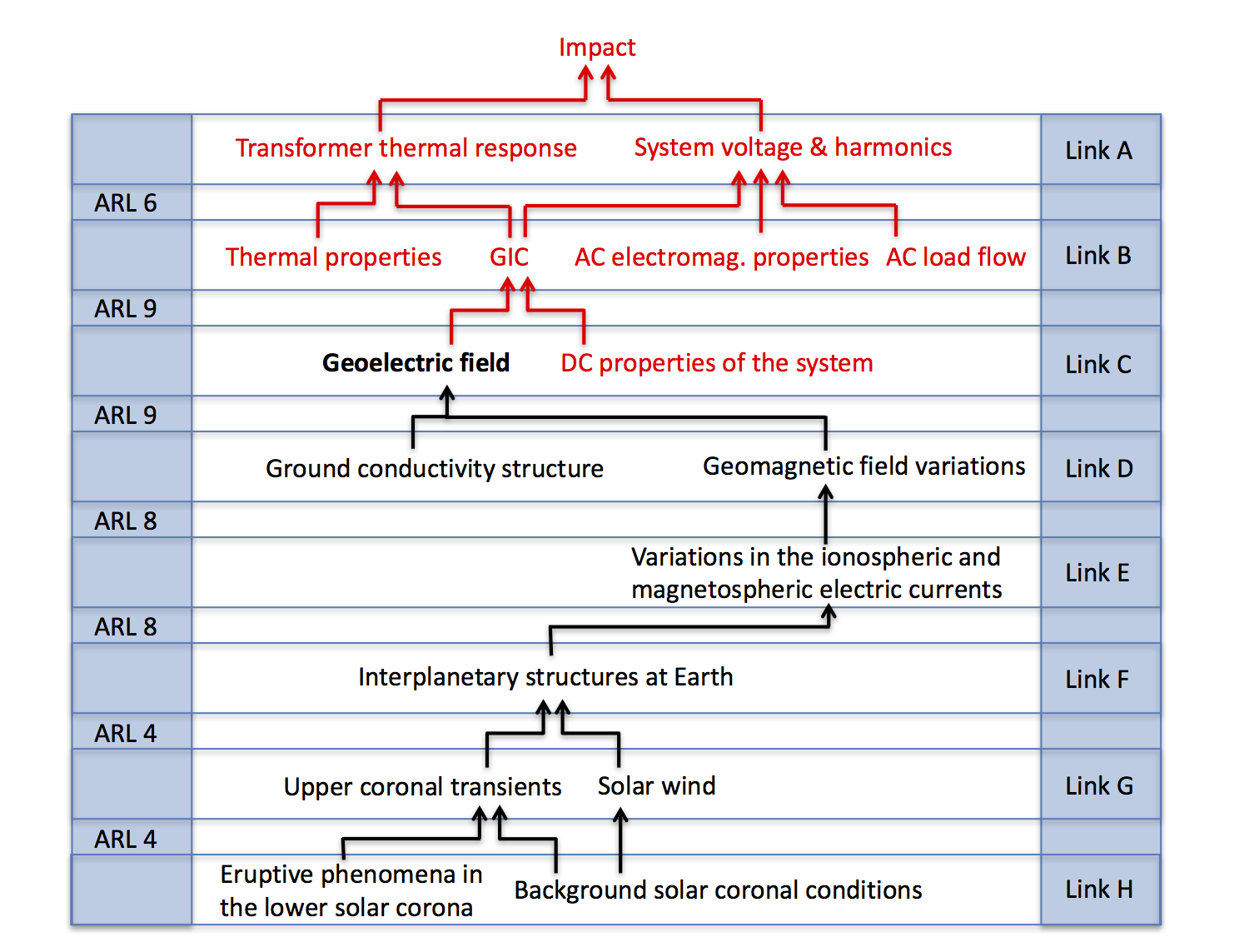
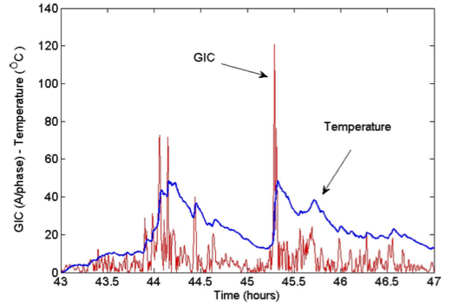
The GIC systems science
Marti et al. (2013)
Pulkkinen et al. (2017)

Slide 10
Extreme GIC
Current focus of the GIC work is to understand the Carrington storm-like extreme events.
Extreme events are driving the Federal Energy Regulatory Commission and National Space Weather Action Plan proceedings.

Slide 11
Extreme GIC
While the impact is highly system dependent, I use the following rule of thumb: “0.1 V/km - nobody cares, 1 V/km - hey pay attention, 10 V/km - lights out.”
IMAGE magnetometer chain
Pulkkinen et al. (2015)
“The magic” 8 V/km

Slide 12
Extreme GIC
What is this?
What is this?
October, 2003
INTERMAGNET network of geophysical observatories
March, 1989
Pulkkinen et al. (2012)

Slide 13
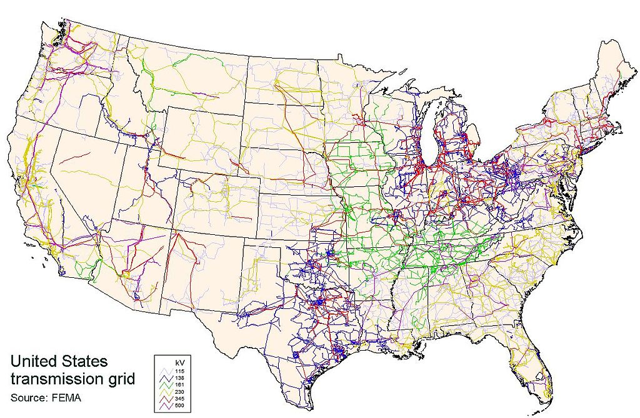
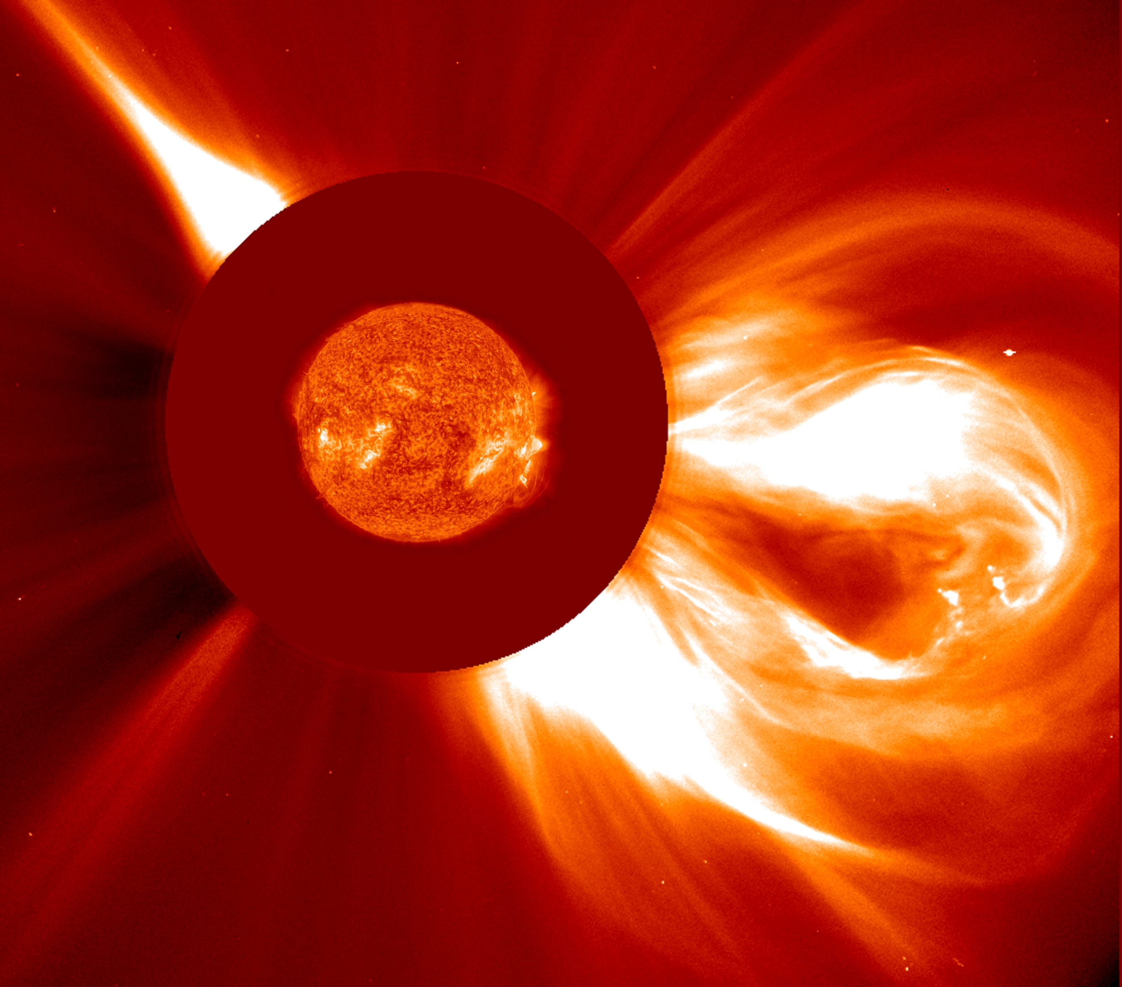
NASA GSFC Geomagnetically Induced Currents (GIC) Activities
GIC that affect high-voltage power transmission systems are being addressed on three primary levels at GSFC: observations, forecasting and extreme event analyses.
Extreme event analyses
Our extreme GIC event analyses have provided scientific guidance in the NERC/FERC geomagnetic disturbance standards development work.
Observations
We are in the process of establishing a network of GIC observation sites across the US. The work is carried out in close collaboration with the US power transmission industry.
Forecasting
We have developed state-of-the-art GIC forecasting system called “Solar Shield.” Solar Shield was developed further in collaboration with the Department of Homeland Security.

Slide 14
Conclusions
Pulkkinen et al. (Space Weather, 2017)

Slide 15
Conclusions
GIC offers many science, engineering and applications challenges.
Applied science challenges can boost basic research work.
There are many urgent open science questions pertaining to GIC → many interesting challenges for YOU!

