Slide 1
Coronal Holes and SWx
Michael S.F. Kirk
[NASA GSFC | CUA]
June 5, 2018

Slide 2
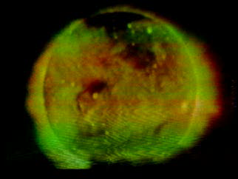
Hole-y Corona!
These are the first images that conclusively discovered low density, dark patches in the solar corona.
Waldmeier is the modern discoverer of coronal holes in 1957. However it wasn’t until photographs of the Sun from above the Earth’s atmosphere, they were identified as 3D structures in their own right.
Skylab’s Apollo Telescope Mount x-ray images from June 1973 revolutionized high temperature solar imagery.

Slide 3
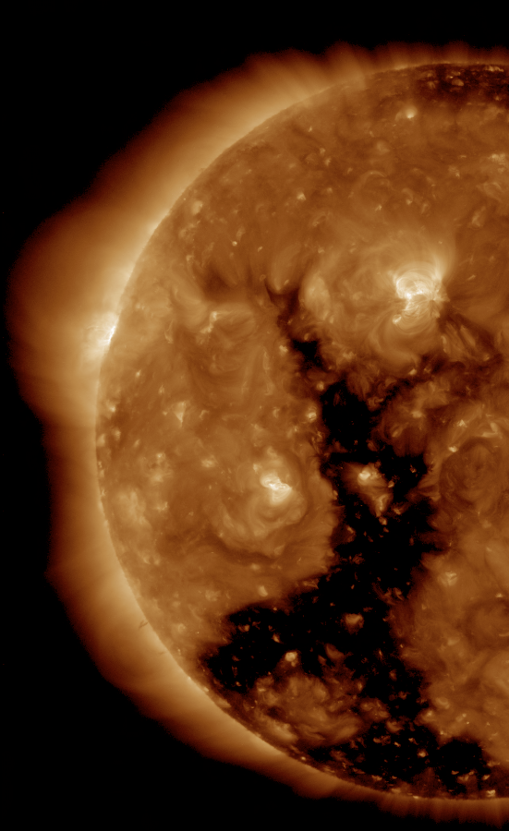
A Vacant Corona
“Coronal holes” simultaneously refer to three different phenomena:
Dark patches in x-ray or EUV images representing a lack of emitting coronal plasma.
“Open” magnetic field lines emanating from the solar surface.
Low emission off the limb of the sun.
1
2
SDO AIA 193
3

Slide 4
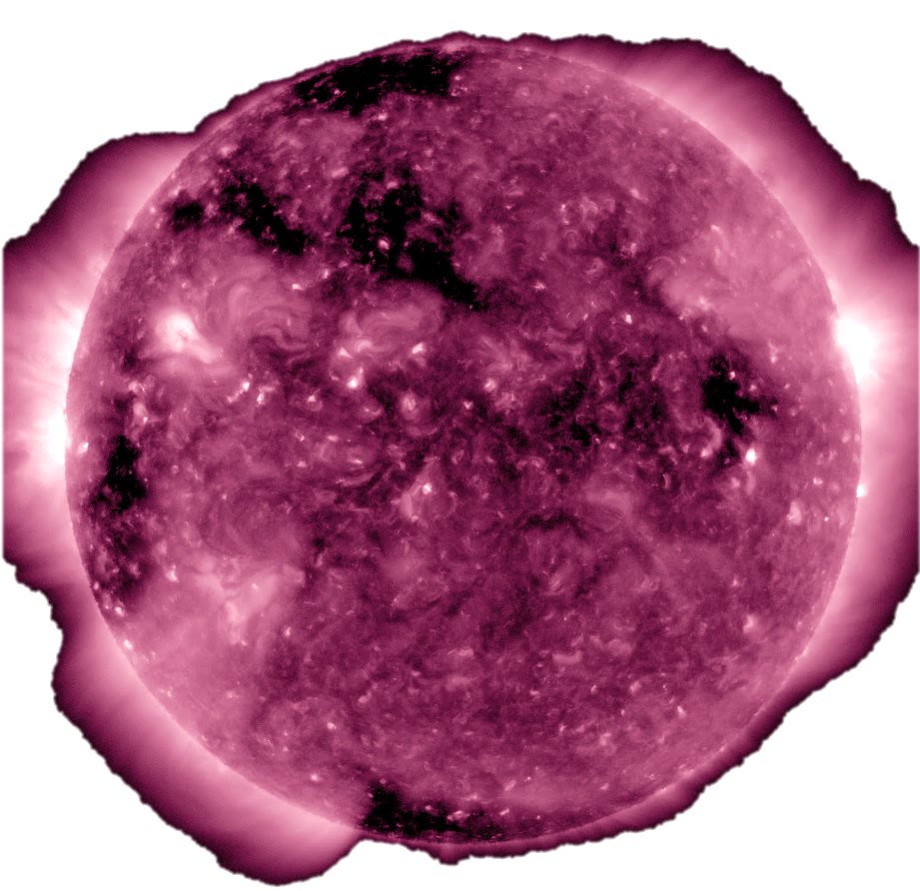
Dark Patches: Coronal Hole Zoology
Northern Polar Hole
.
Ephemeral Hole
55°
Equatorial Hole
.
.
55°
.
Southern Polar Hole
SDO AIA 211
Current observations are made in X-ray and EUV (and He I Triplet).

Slide 5
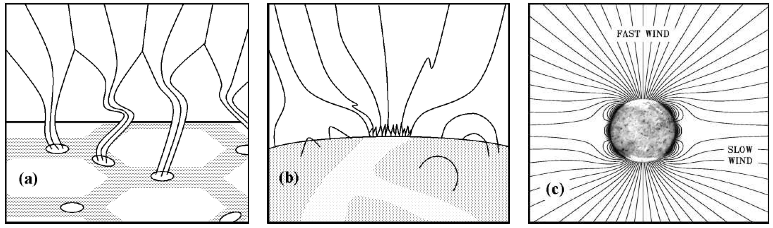
Open Field Lines: Coronal Hole Theory
Cranmer and van Ballegooijen (2005)
Magnetic field lines organize in the inter-granular lanes as flux tubes.
A fraction of these lines organize in the lanes of supergranules.
Large mono-polar regions extend into the corona and are ‘open.’
Megameter (Mm) = 1,000,000 m

Slide 6
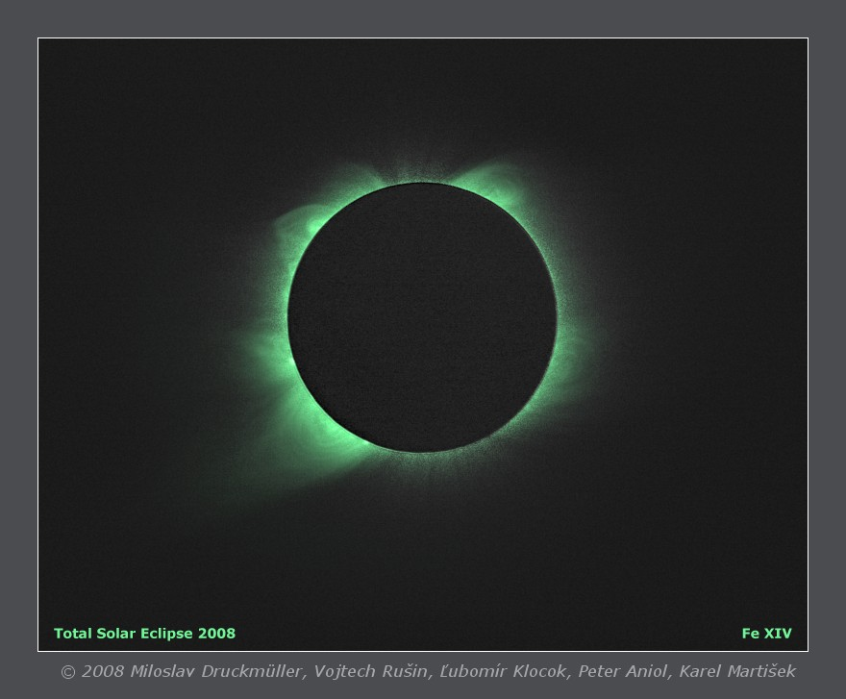
Low Emission: Ground-based Imaging
530.3 nm “Green line” images from natural or man-made eclipses were the only observations of coronal holes until the space age.
These images are rarely used in modern coronal hole studies, but are an essential link to historic datasets.

Slide 7
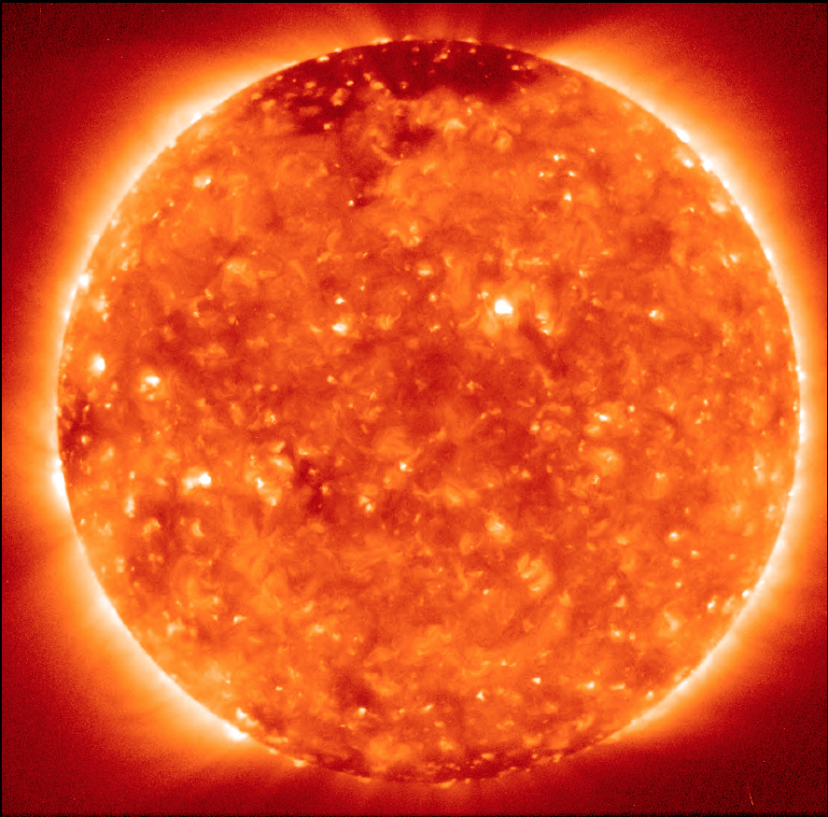
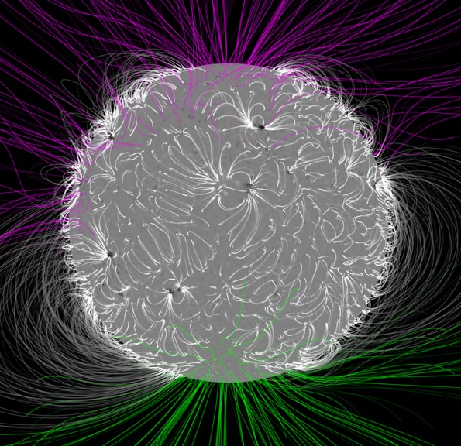
A less-than-solved problem…
EUV X-Ray Images
Ground-based Observations
Theory
Hinode XRT
Druckmüller, Fe XIV
PFSS Magnetic Field Model
All of these features are related, yet a one-to-one mapping between features has never been successful.

Slide 8
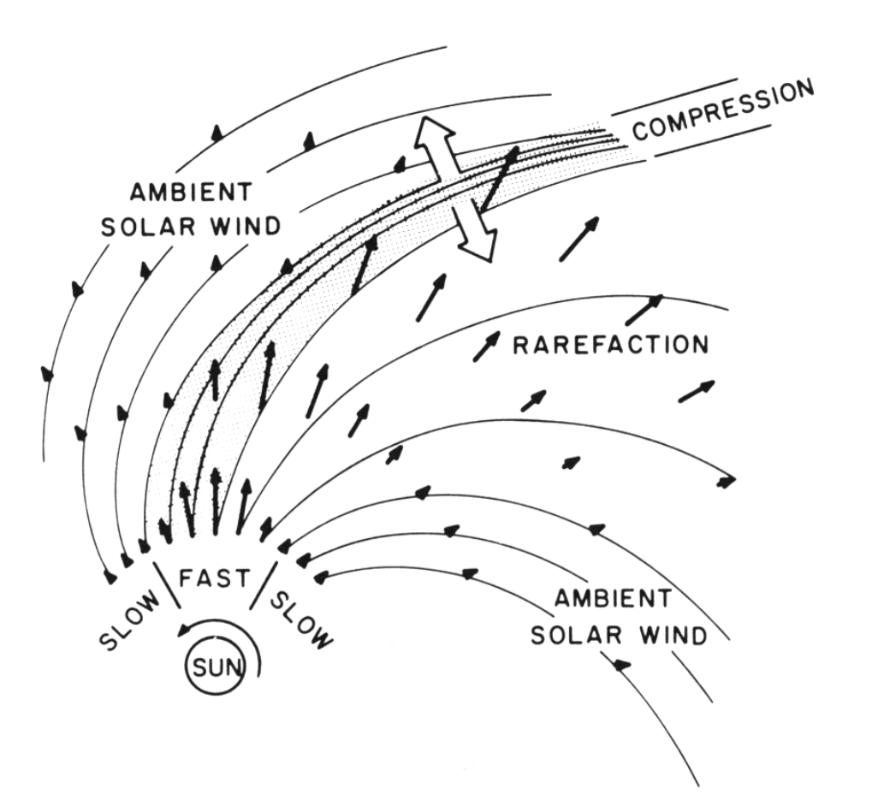
The Fast Solar Wind
Speed: 400 – 800 km s⁻¹
Density: n_{p} ~ 3 cm⁻³
Composition: ~ 95% H; 5% He;
some ions
Temperature: T_{p} ~ 2 × 10⁵ K
Magnetic Field: ~ 5 nT
Characteristics: Alfvénic (EM) fluctuations
Origin In Coronal Holes
Pizzo, 1985
(Bothmer and Zhukov, 2007)

Slide 9
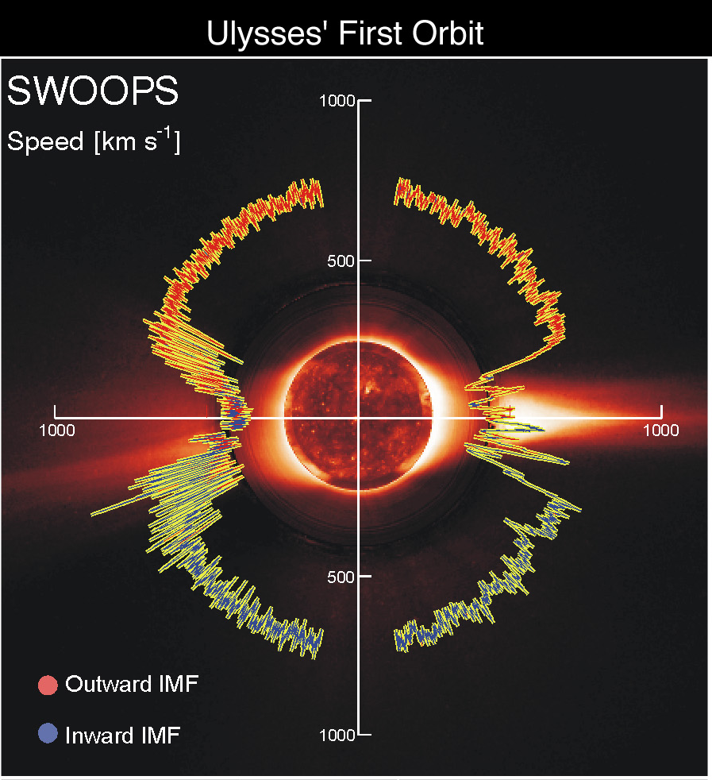

Coronal Holes and Space Weather
Fast solar wind comes from coronal holes.
Define the quiescent heliospheric environment.
Direct connection to transition region plasma.

Slide 10
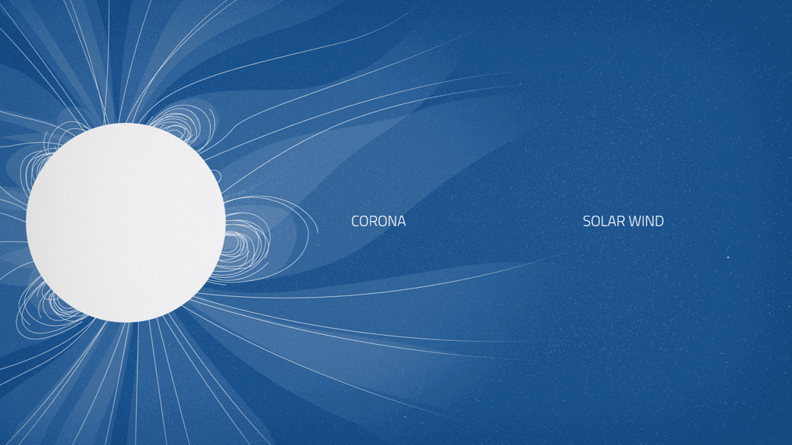
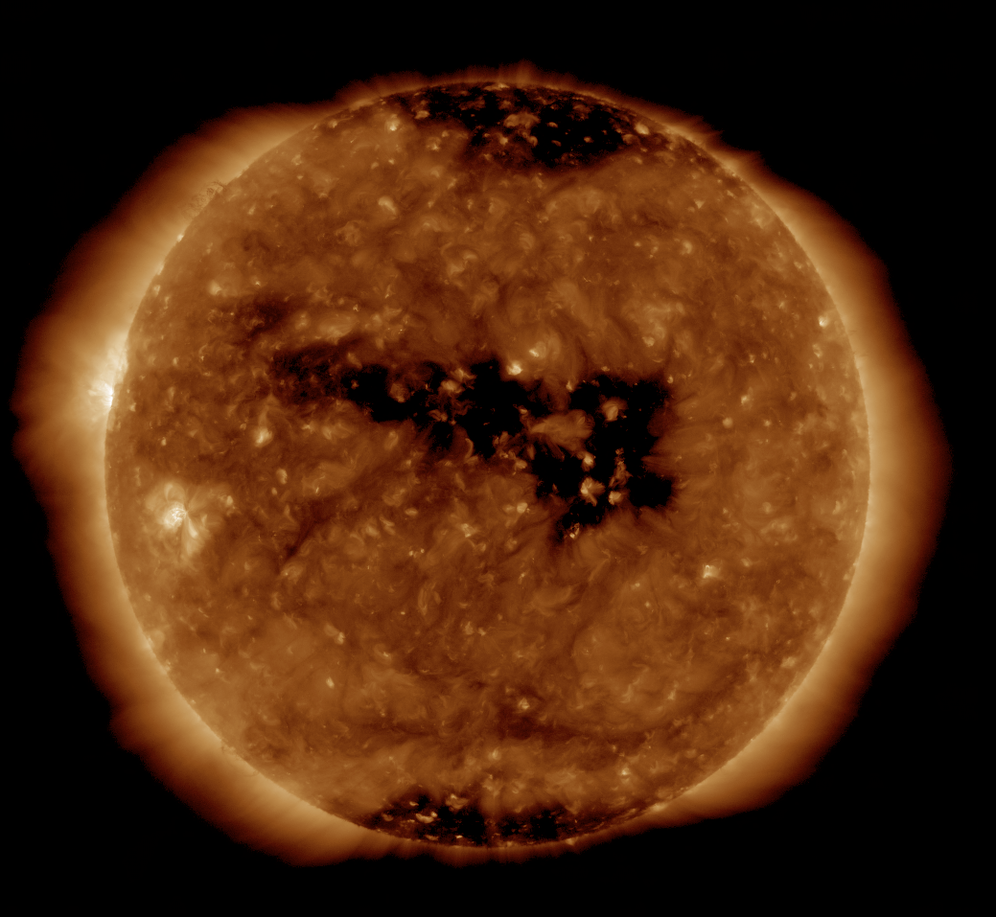
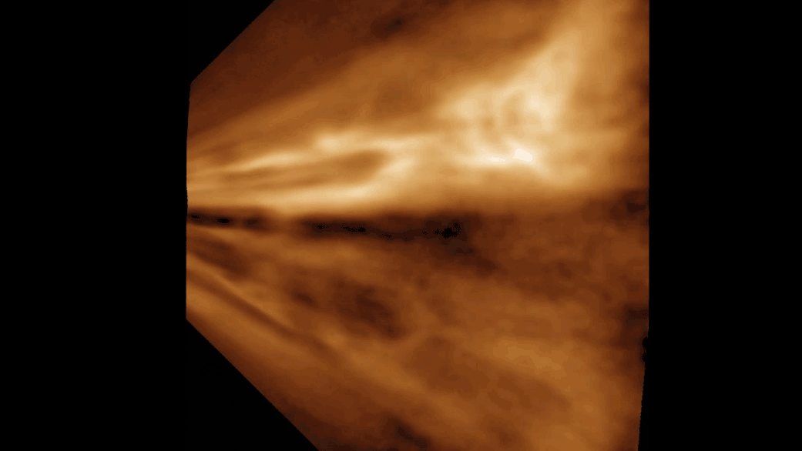
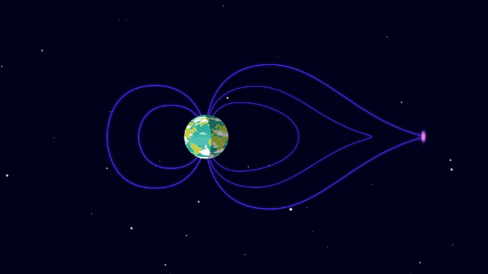
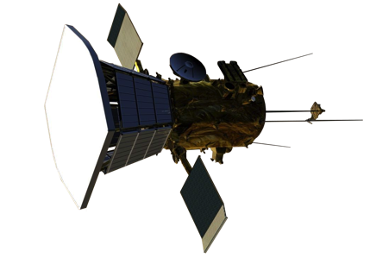
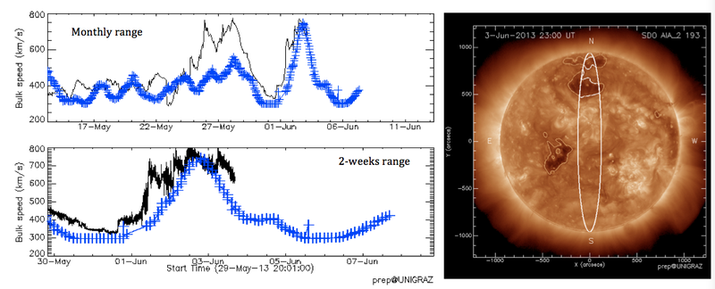
Coronal Holes and Space Weather

Slide 11
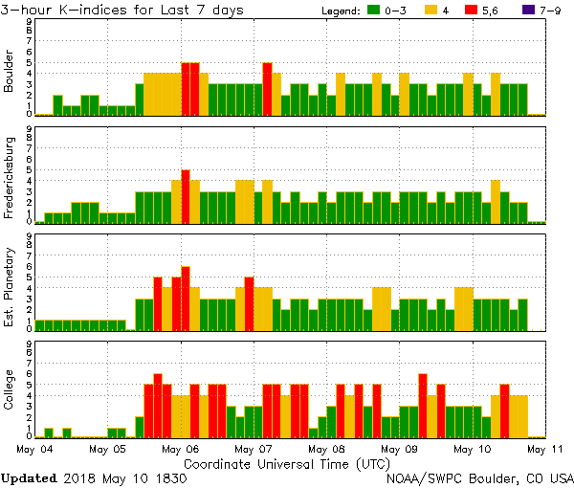
Coronal Holes to Earth
A high speed stream can cause an energetic electron flux enhancement and magnetic field disturbances on Earth.
K-index quantifies disturbances in the horizontal component of earth's magnetic field
AIA 193Å | May 4, 2018

Slide 12
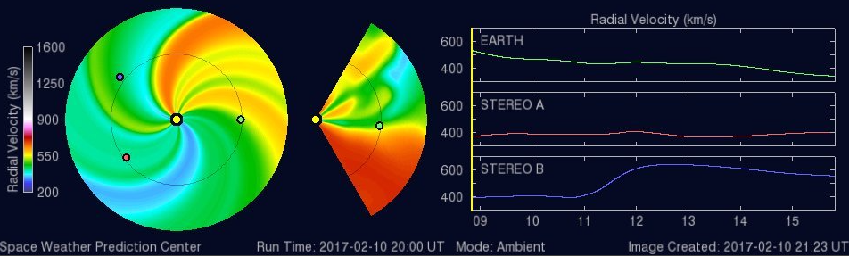
Hole Measurements, what are they good for?
Current forecasts are highly dependent on coronal hole size and location (ENLIL, ADAPT).
Geoeffective impacts of equatorial holes and CMEs are embedded in the quiescent solar wind
A solar cycle measurement that is not activity dependent.
Measurements of the global rearrangement of magnetic field at solar minimum.
WSA-ENLIL Solar Wind Prediction

Slide 13
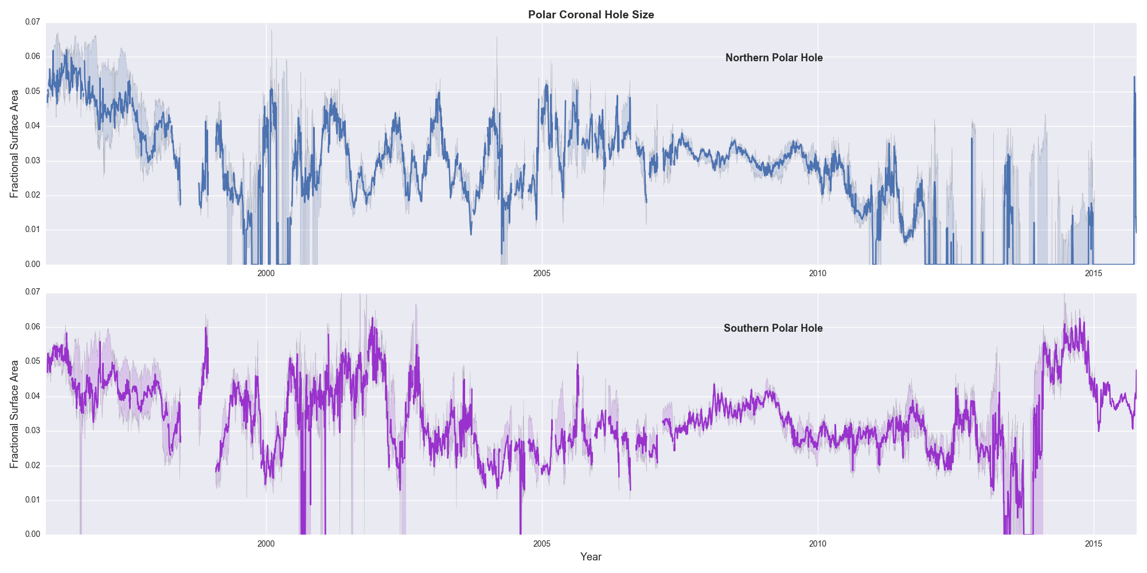
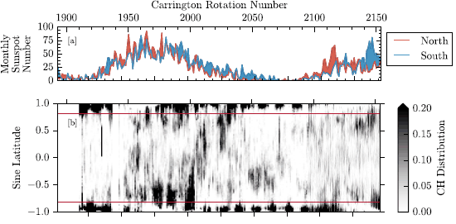
Evolution of the Holes
Polar Coronal Hole Size
0.07
Max
Min
Max
Coronal Hole Locations
Northern Hole
0.00
0.07
2000
2005
2010
2015
Southern Hole
1997
2005
2013
0.00
Lowder et al. 2016
2000
2005
2010
2015
Kirk et al. 2017

Slide 14
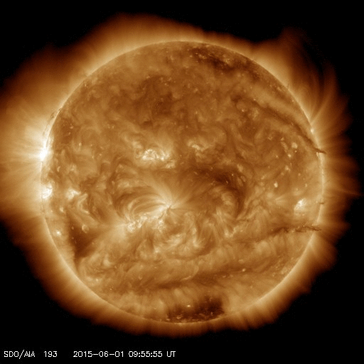
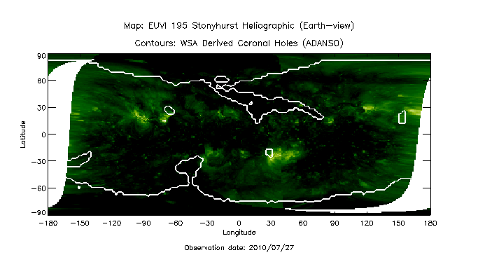
Current Measurement Techniques
Kirk et al. 2009
Arge et al. 2017
Examples of automated techniques for identifying coronal hole boundaries.

Slide 15
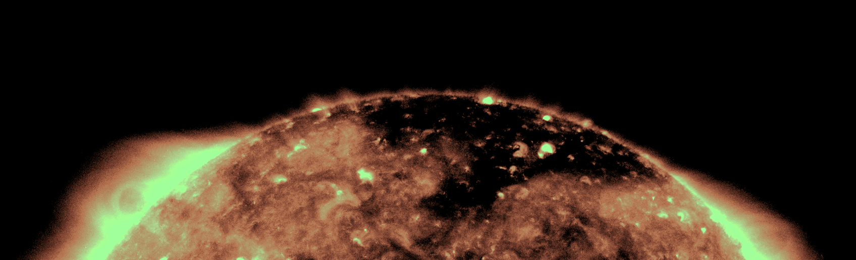
Coronal Holes: A Summary
Regions of low emission in x-ray and EUV images.
Characterized as regions of open magnetic field lines.
The primary source of the fast solar wind.

Slide 16

Want to know more?
Living Solar Review on Coronal Holes: https://link.springer.com/article/10.12942/lrsp-2009-3
…or come by and chat:
Room 041 (in the back cubical)
michael.s.kirk@nasa.gov
(and various other methods: slack, riot.im, twitter, skype, facebook, google hangouts, WhatsApp, dialing a phone, etc.…)

