Slide 1
CMEs and Space Weather
A. Taktakishvili
CCMC
NASA Goddard Space Flight Center
Notes:
In this presentation I will be talking about Coronal Mass Ejection and their relation to the space weather.

Slide 2
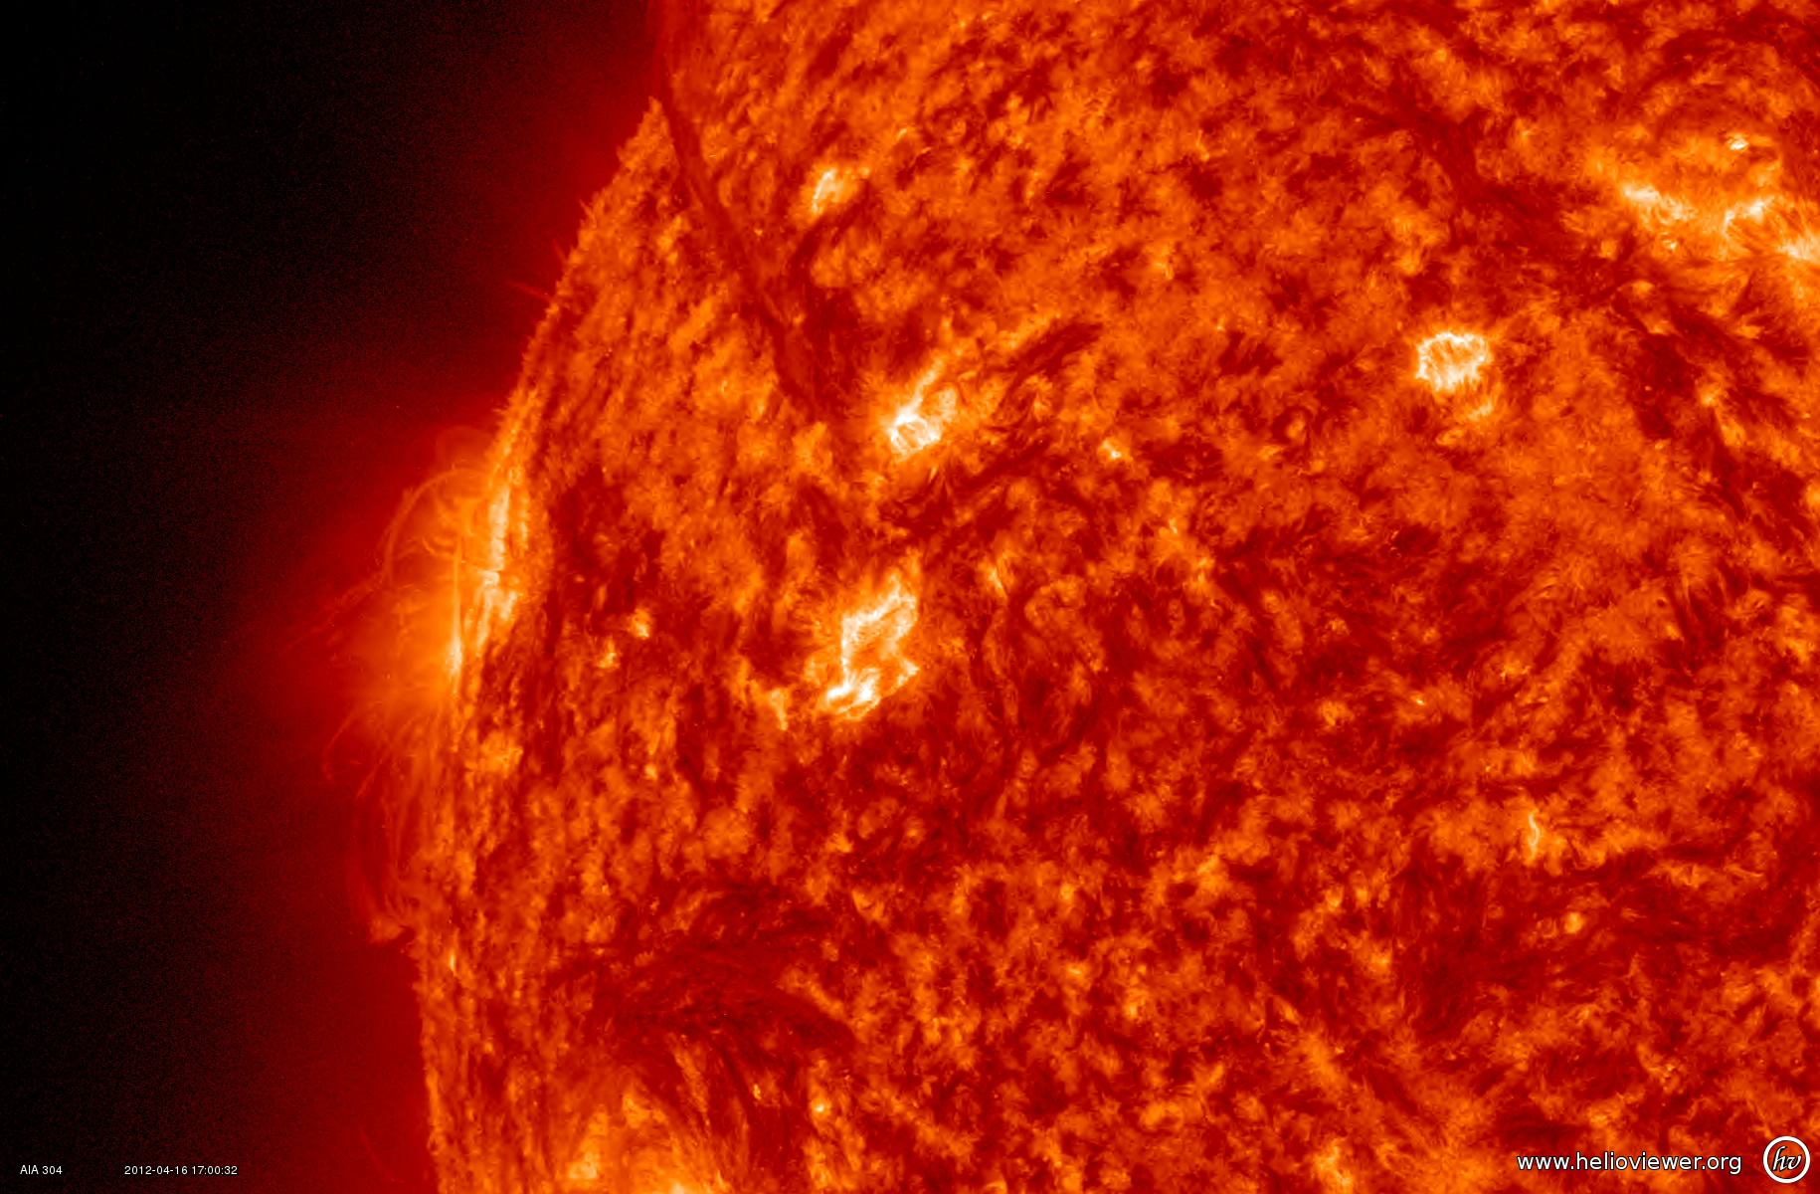
Flares and Coronal Mass Ejections
Powerful flares are often accompanied by CMEs in the active regions.
Notes:
Solar flares are often accompanied by so called Coronal Mass Ejection (CME) in the active regions. CME is when huge mass of solar plasma erupts from the solar atmosphere. http://iswa3.ccmc.gsfc.nasa.gov/wiki/index.php/Glossary ). If CME is directed towards Earth, it can reach the Earth in 1-3 days, , depending on it’s speed and size. CMEs are usually causing the strongest geomagnetic storms.

Slide 3
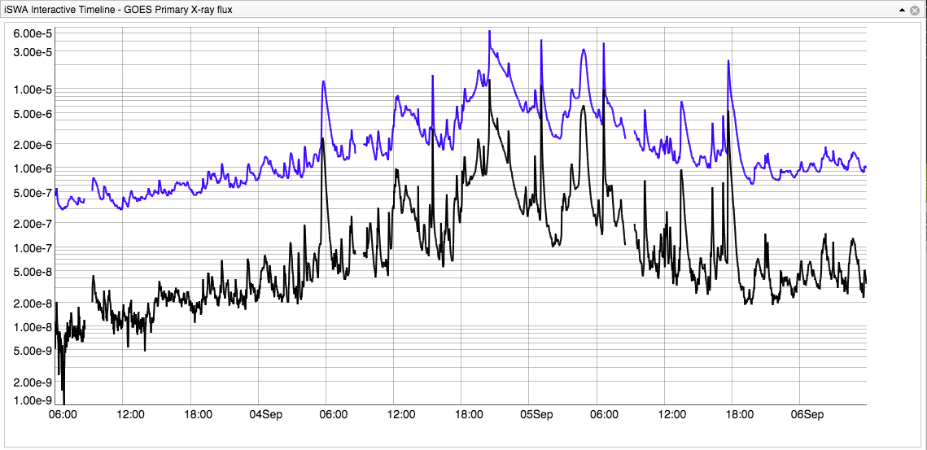
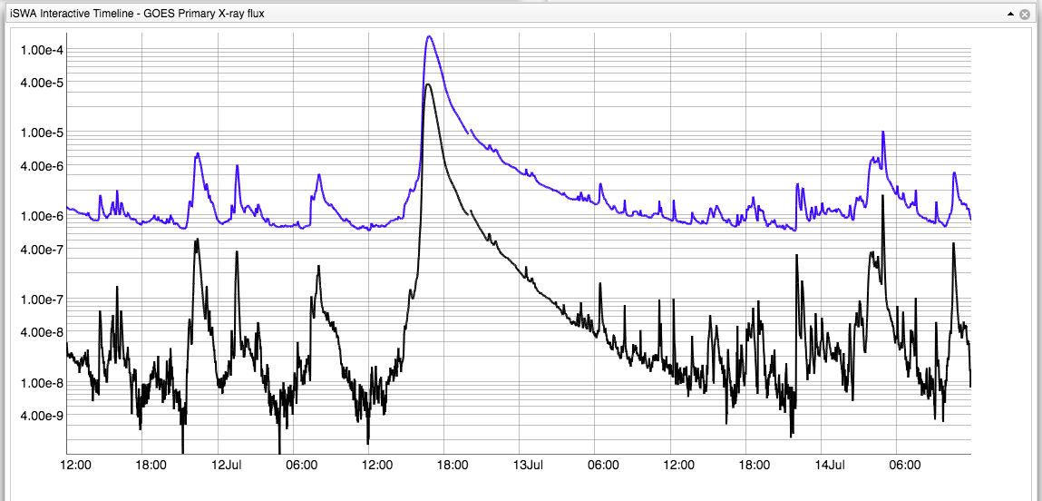
Flares and CMEs – cont.
Short duration flares –
no significant eruptions/CMEs
Long duration flare – usually followed by CMEs
Notes:
He have been observing flares and CME for years now on a daily bases. We made an observation: short duration flares are rarely followed by significant eruptions/CMEs. Long duration flares on the contrary – are usually followed by CMEs. This can be explained in terms of inertia: to accelerate huge masses of plasma, which CMEs are, you need some long duration, global process of magnetic field reconfiguration. Short duration, local process does not cut it.

Slide 4
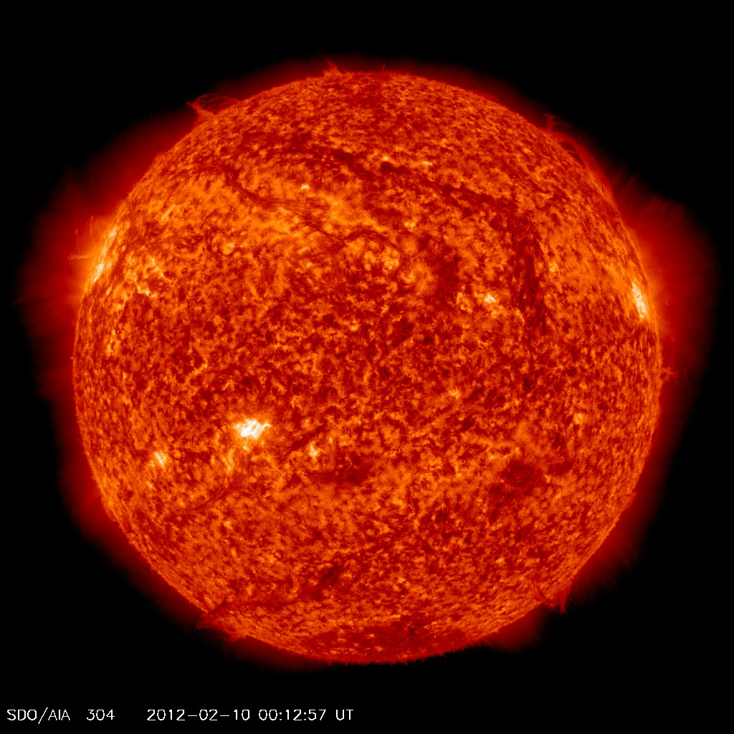
Coronal Mass Ejection from a Filament Eruptions
The most energetic CMEs occur in close association with powerful flares in the active regions.
Nevertheless large-scale CMEs do occur in the absence of major flares even though these tend to be slower and less energetic.
Notes:
Not all CMEs originate from the active regions. Here is shown an example of a CME caused by so called filament eruption. Filaments are formed in magnetic loops that hold relatively cool, dense gas suspended above the surface of the Sun. Most of the filaments are created by stretching of the active regions with two different polarities due to the differential motion of the solar photosphere material. Magnetic instabilities cause filaments to raise and parts of it disconnect from the solar surface resulting into CMEs.

Slide 5
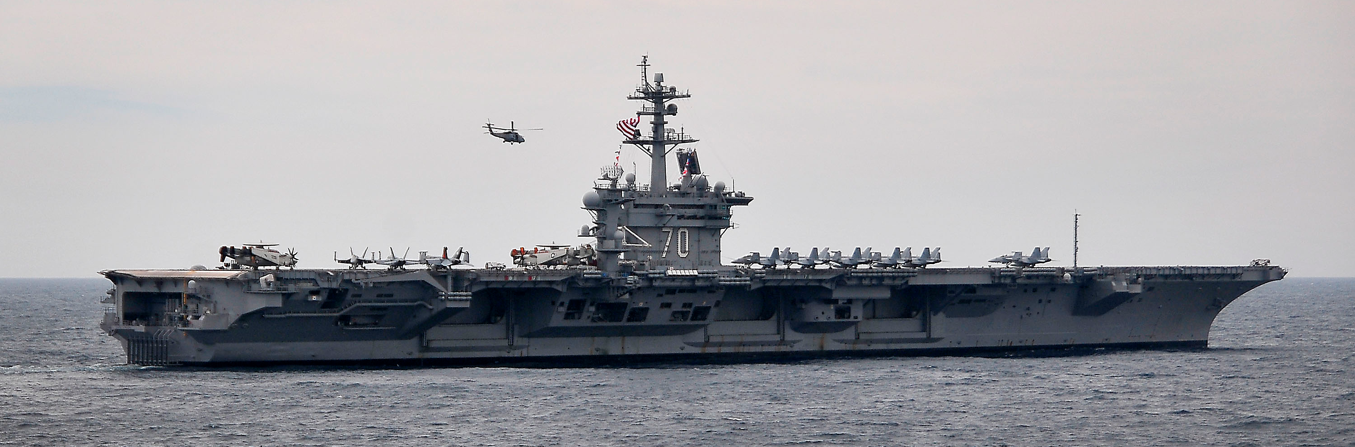
CME Properties
Mass: ~10¹⁵⁻¹⁶ g
Speed: few hundred - 3000km/s
..or
Mass: ~1 million Nimitz-class aircraft carriers
Speed: 1.5 -10 million km/hour
Earth?
Arrives to Earth in 1-2 days

Slide 6
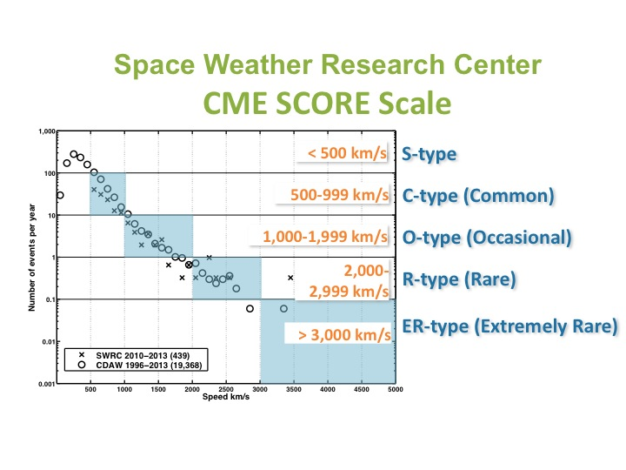
CME score
• A new category system for CMEs based on frequency of detection and speed
• Complements Flare Classes
• Applicable in space weather operations and research
Notes:
Nor so long time ago, we introduced, as we call it, CME SCORE scale, a simple new category system for CMEs based on frequency of detection and speed.
It complements flare classes and is applicable in space weather operations and research.
The graph here shows the frequency of the CME detection (number of events per year) as a function of the CME speed. Bin size is 100 km/s.
So we have S-type CMEs with the speed less then 500/km/s, C-type (common) for the range 500-999, O-type (occasional) for 1000-1999, R-type (rare) for 2000-2999 and ER-type (extremely rare) CMEs for CME s with the speed more then 3000 km/s.

Slide 7
Quick quiz
What do you think is causing CME?

Slide 8
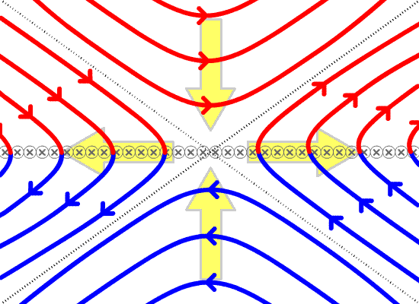
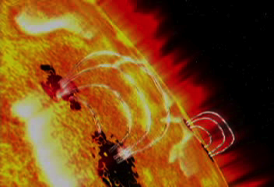
CME Mechanism
Magnetic Reconnection – the release of free magnetic energy, transformed to heat and particle acceleration
Magnetic field at the base of the convective zone is stressed and pushed to surface due to convection motion
Newly emerged magnetic field interacts with the existing field, reconnection/reconfiguration takes place, leading to heating, flares and eruptions/CMEs
Notes:
Magnetic Reconnection – the release of free magnetic energy, transformed to heat and particle acceleration
Magnetic field at the base of the convective zone is stressed and pushed to surface due to convection motion. Newly emerged magnetic field interacts with the existing field, reconnection/reconfiguration takes place, leading to heating, flares and eruptions/CMEs

Slide 9
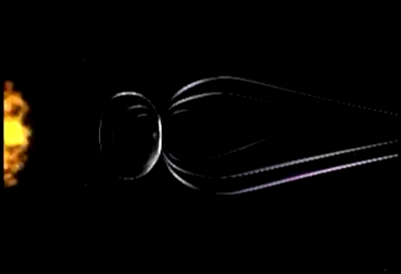
CME Interaction with the Earth’s Magnetic Field
Notes:
When CME arrives close to the Earth it interacts with the Earth magnetosphere – cavity created by the Earth’s magnetic field around it, which protects us from too much of the solar influence (solar wind, energetic particles, CMEs). CME shakes the magnetosphere, perturbing it’ magnetic field. It brings with it additional solar magnetic field flux, and if the this solar field has polarity opposing to the polarity of the Earth’s magnetic field at the dayside, reconnection occurs between two fields, which opens up magnetosphere for easier access of solar magnetic field flux and the CME impact is stronger.

Slide 10
CME Arrival at the Earth – Geomagnetic Storms
CME Arrival at
ACE/Discover
Notes:
When the CME arrived to the ACE satellite, close to the Earth, it caused a shock seen here in the magnetic field and the solar wind speed measurements by ACE. This impact caused a strong disturbance in the Earth’s magnetosphere or as they call it geomagnetic storm.

Slide 11
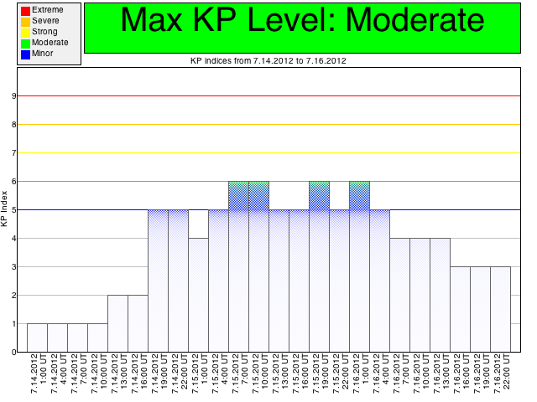
Geomagnetic Storm Kp Index
Kp – index (German “Kennziffer” – characteristic digit)
Notes:
The strength of the geomagnetic storm is measured by so called Kp index, which characterizes degree of the disturbance of the Earth’ magnetic field ground base measurements. Kp goes from 0 to 9. This storm with Kp=6 is considered to be a moderate one.

Slide 12
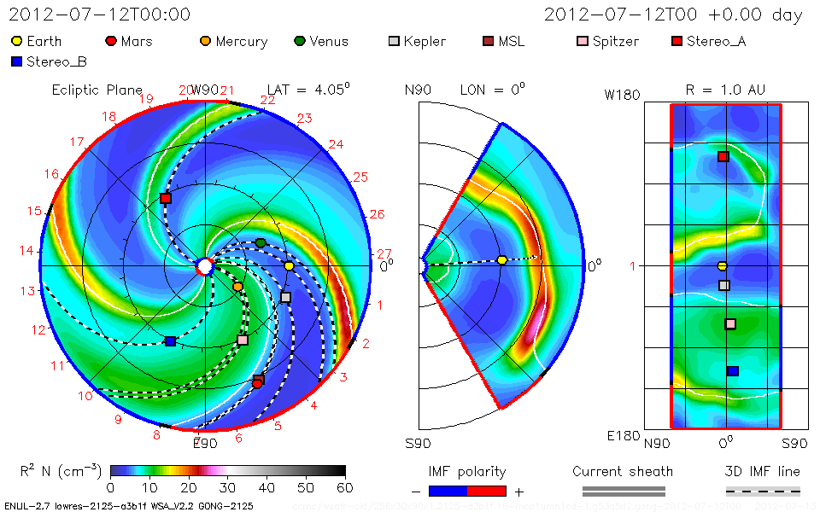

CME Modeling –
Space Weather Storms
Notes:
ENLIL modeling of 2012-07-12 CME. CME – space weather storm.

Slide 13
Quick Quiz
What physical parameters of CME do you think are important for the strength of the geomagnetic storm?

Slide 14
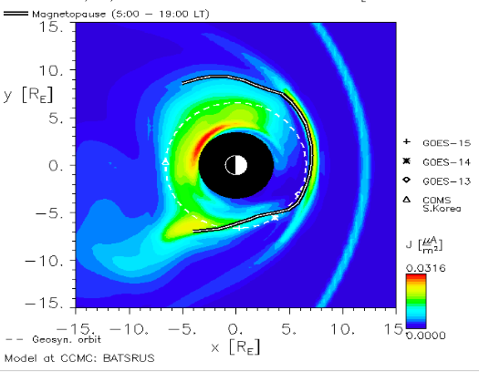
CME: Space Weather Impacts -Magnetopause Compression
Notes:
CME causes compression of the solar facing side of the magnetosphere, which can bring the magnetopause – the boundary of the between magnetosphere and solar wind – close, or even inside the geosynchronous orbit, where most of the communication satellites are located, this exposing satellites to the solar wind plasma, which can be hazardous for them.

Slide 15
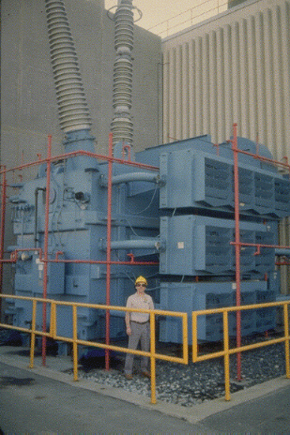
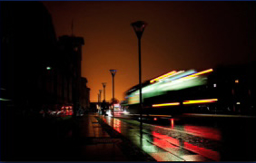
CME: Space Weather Impacts – Geomagnetic Storm, GIC
Lasts few hours to 1-2 d after CME arriving at Earth
Geomagnetically Induced currents
An average CME can dump about 1,500 gigawatts of electricity into Earth’s atmosphere—about twice the power-generating capacity of the entire United States!
Electric blackout
Transformer
damage
saturation
15
Notes:
Power transformer from Lethabo, South Africa. Severe winding damage due to GIC on October-November 2003.
Malmo blackout: October 30, 2003. 50000 customers without electricity for about an hour. Estimated losses 500.000 USD.
Quebec blackout: March 13, 1989. 6 million people without electricity for about a 9 hours. Estimated Quebec losses 13.000.000 USD.
NRC report from 2008 and NERC/DoE report from 2010.

Slide 16
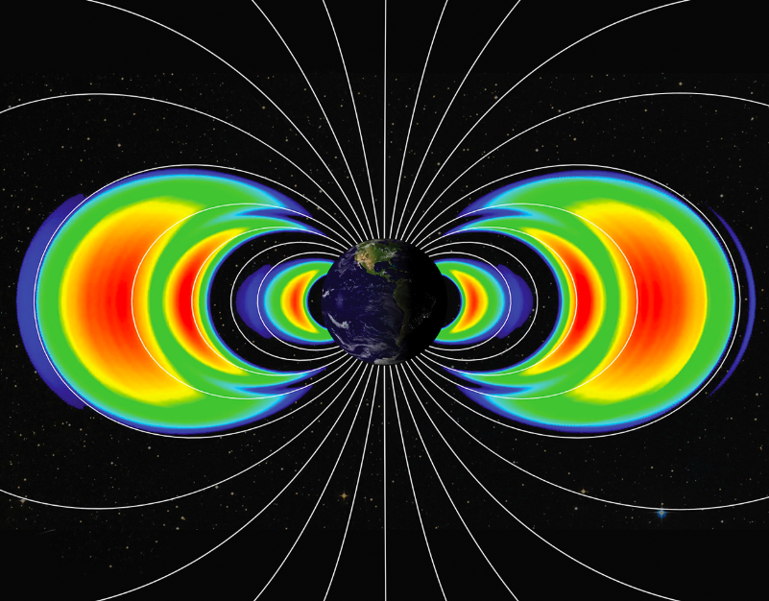
CME Space Weather Impacts –
Radiation Belts
Geomagnetic storms result in electron radiation enhancement in the near-Earth space: lasts 1-3 days
Affecting spacecraft electronics – surface charging/internal charging
Notes:
Geomagnetic storms result in electron radiation enhancement in the near-Earth space – in so called radiation belts, where charged particle are trapped in the dipole magnetic field of the Earth. Lasts 1-3 days. These affects spacecraft electronics – surface charging/internal charging.

Slide 17
CME Space Weather Impacts - SEP
Contributes to SEP (particle radiation): 20-30 minutes from the occurrence of the CME and after the CME arrival
Notes:
Energetic particle radiation can be hazardous for health.

Slide 18
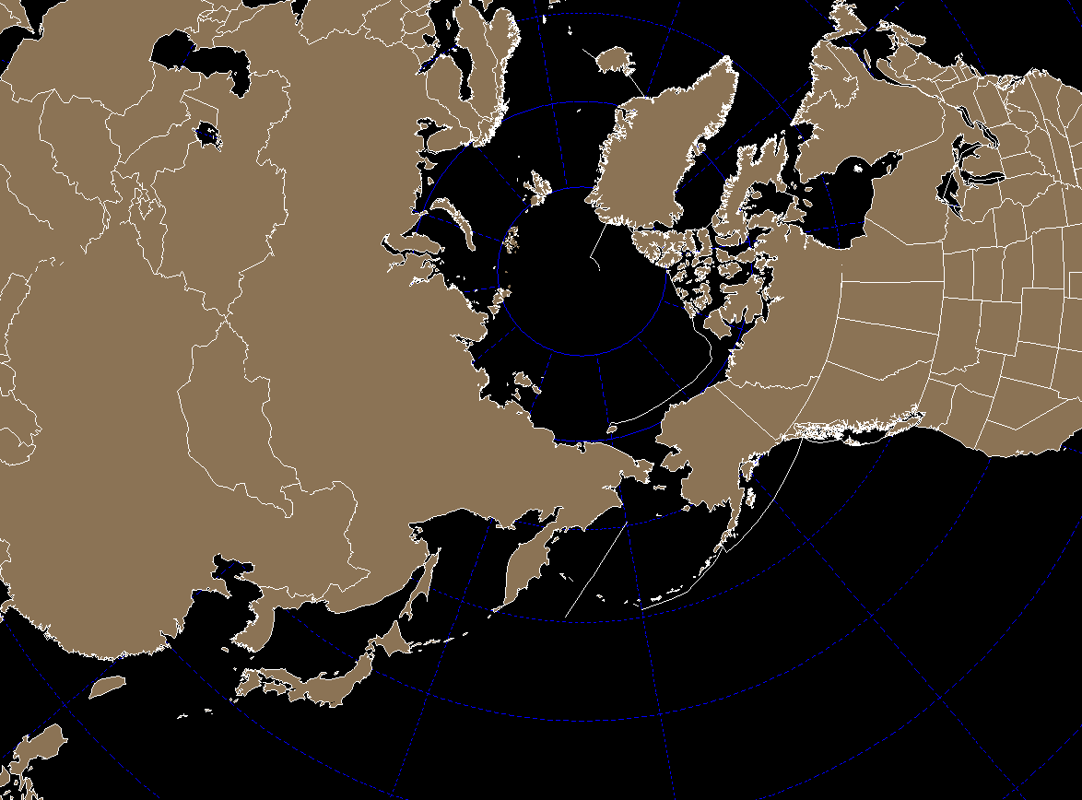
WASHINGTON
United Airlines polar routes
NEW YORK
82 N
CHICAGO
#1
#1A
#2
#3
#4
BEIJING
HONG KONG
SHANGHAI
OSAKA
TOKYO
Source: United Airlines
Notes:
This shows some of the United Airline polar roots. It is shorter to get to some destinations flying above the north pole. At the same time is is easier for energetic to penetrate to the regions close to the poles, This can disrupt the communications and also the crew, who fly frequently these roots can be exposed to the dose of additional radiation, that can be hazardous for health.

Slide 19
The END.
Notes:
SEPs can impact the Earth’s magnetosphere and present radiation hazards for spacecraft and astronauts.

