Slide 1
Forecast Space Weather Chains
Yihua Zheng

Slide 2
Linkage of space weather events (example 1, flare/CME)
Flare/CME
SEP (if any)
CME arrival (in-situ data)
Geomagnetic storm (indicated by Kp, or Dst)
Other impacts (ring current/radiation belt dynamics, aurora, enhanced total electron content,)

Slide 3
Flare/CME examples
March 7, 2012 event
http://bit.ly/March7_2012_event
https://goo.gl/MhUp5O (an alternative view)
The March 15, 2015 storm
http://bit.ly/20150317_geomagnetic_storm

Slide 4
Coronal Hole High Speed Streams (HSS)
Coronal hole HSS
Also leads to geomagnetic storms, but long duration and weaker (Kpmax 6 to 7, not exceeding 7)
Enhancement of the outer edge of the outer radiation belt (e.g., effective for pumping up the energetic electron flux at GEO orbit)
Examples:
2015-06-07
http://bit.ly/HSS_20150607_extended
https://goo.gl/CRqv3h
2016-05-07 (Kp=7)
https://goo.gl/XwppcY

Slide 5
Exception many x-class flares, no accompanying CMEs
AR2192 X class flares and the Oct 14 CME
http://bit.ly/AR2192_XclassFlares_oct14CME

Slide 6
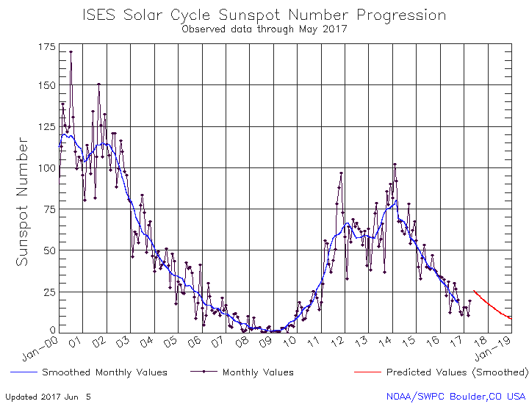

Slide 7
Other Examples
The Jan 23 – 27, 2012 SEP events
https://goo.gl/H1qWYb
AR 1429 timeline
https://goo.gl/GPLJkX
The Galaxy 15 Event
http://bit.ly/galaxy15_charging_event

Slide 8
More (Other layouts)
http://swrc.gsfc.nasa.gov/main/demo
Examine various layouts here

Slide 9
extras

Slide 10
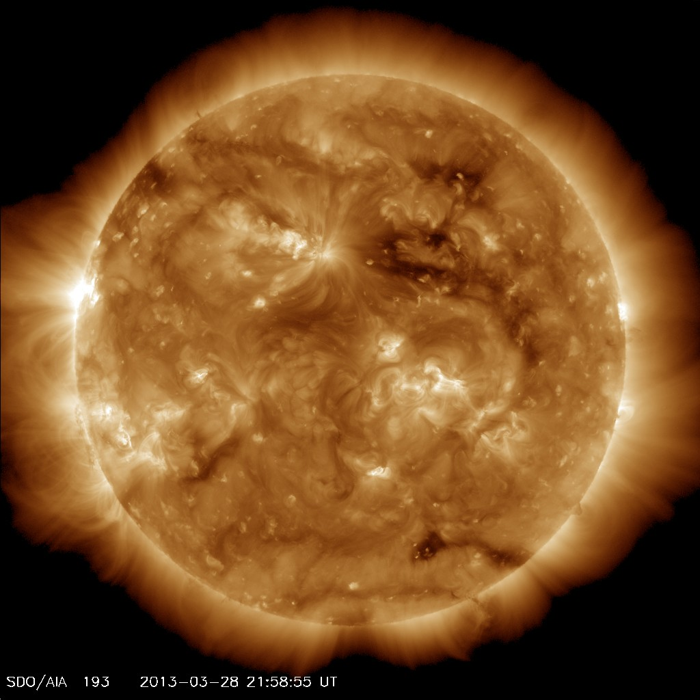
The Coronal Hole possibly responsible for the aurora at Saturn around May 20, 2013
Coronal Hole
Well, I tried ☺
Notes:
It took nearly two months for the solar wind to travel to Saturn

Slide 11
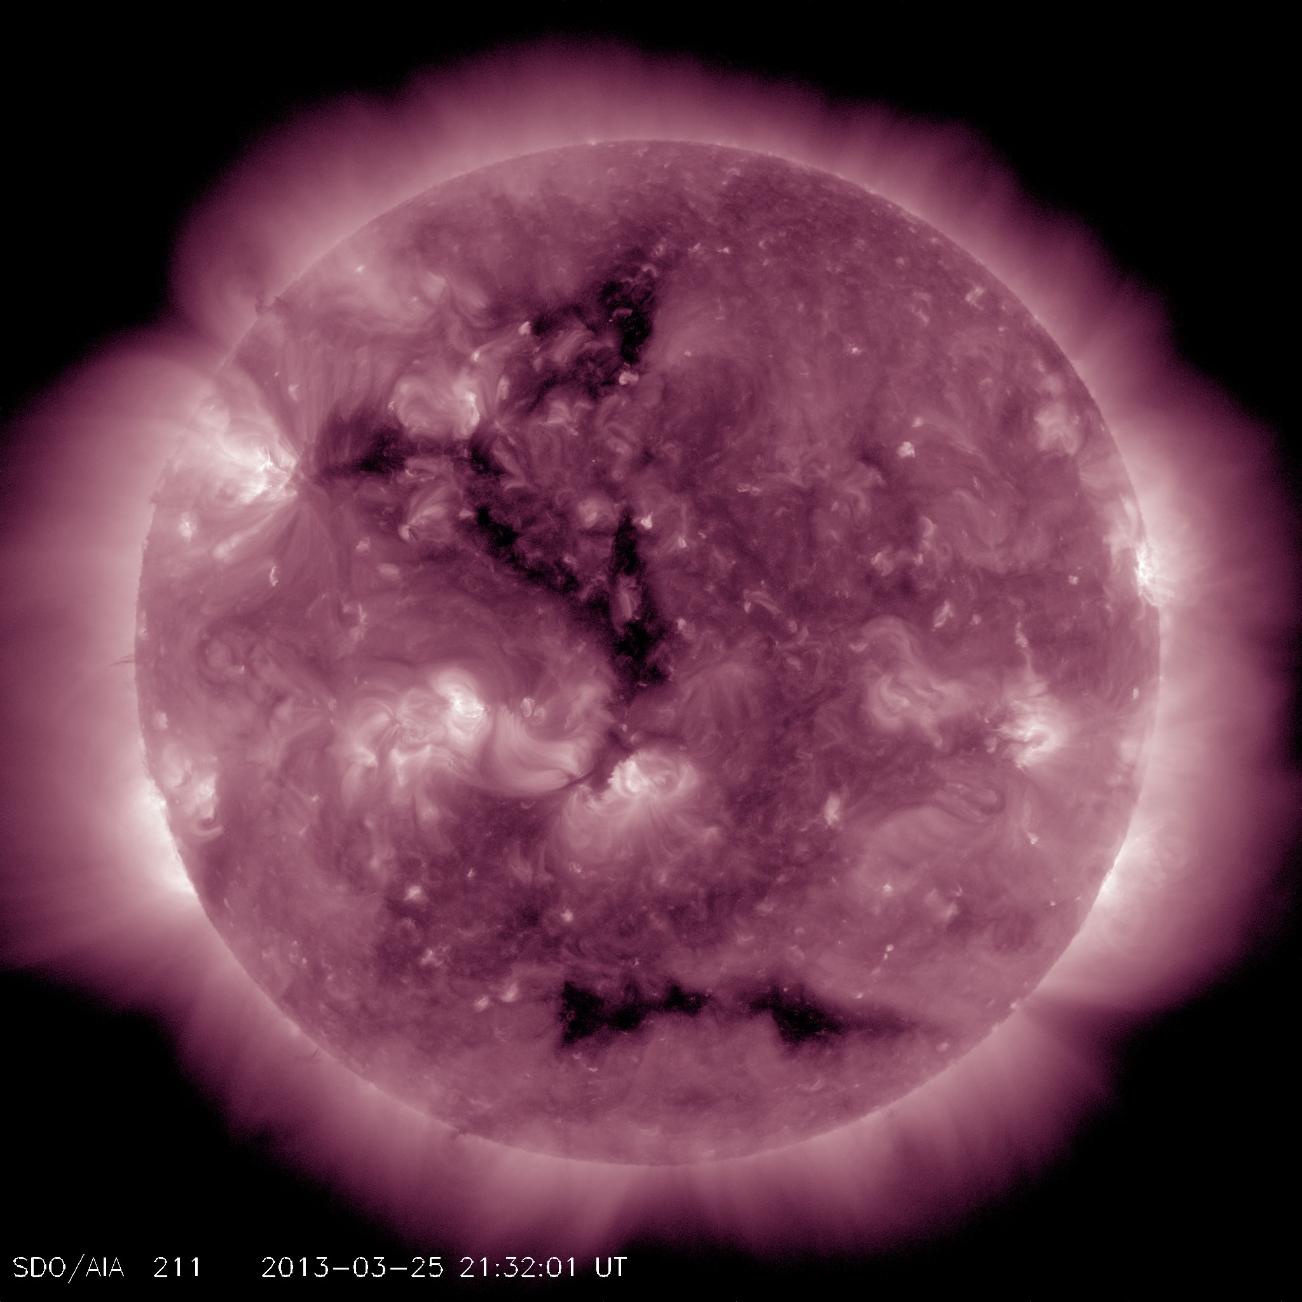
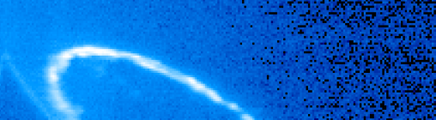
The Coronal Hole possibly responsible for the aurora at Saturn around May 20, 2013
Day 111 ~06:26 UT
Day 112~03:47 UT
Day 112~05:21 UT

