Slide 1
Real-Time Modelling of CMEs Using the WSA-ENLIL+Cone Model
M. Leila Mays
A. Taktakishvili
CCMC/SWRC
NASA Goddard Space Flight Center
Notes:
In this presentation we will make an introduction to the
WSA-ENLIL Cone model, used at SWRC to model propagation
of coronal mass ejections (CMEs) in the heliosphere.

Slide 2
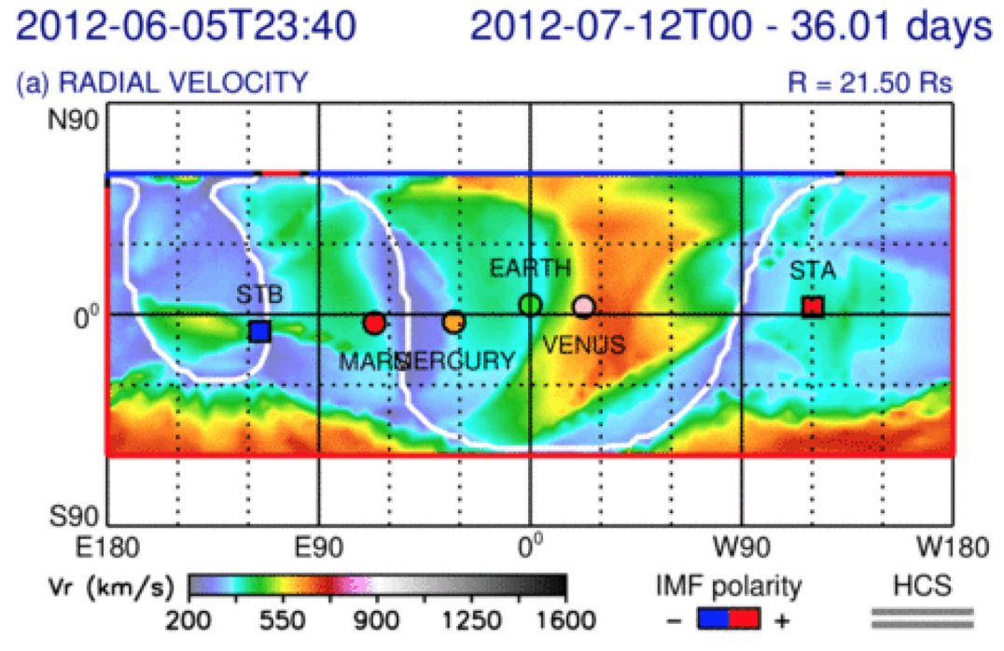
Modeling CMEs with WSA-ENLIL+Cone
WSA-ENLIL is a global 3D MHD model which provides a time-dependent description of the background solar wind plasma and magnetic field into which a spherical or ellipsoid shaped CME can be inserted.
A CME-like hydrodynamic structure is launched into the solar wind and magnetic field computed from the WSA coronal model at 21.5 R_{s}.
WSA coronal maps generated from synoptic magnetograms provide the magnetic field and solar wind speed at the boundary between coronal PFSS and heliospheric models
Other coronal models can also be coupled with ENLIL (e.g. MAS, heliospheric tomography).
Model References: Arge and Pizzo, 2000; Arge et al., 2004.
Odstrcil et al. 1996; Odstrcil and Pizzo, 1990a,b; Odstrcil, 2003.
Notes:
WSA-ENLIL is a global ideal 3D MHD model which provides a time-dependent description of the background solar wind plasma and magnetic field into which a spherical or ellipsoid shaped CME can be inserted.
A CME-like hydrodynamic structure is launched into the solar wind and magnetic field computed from the WSA coronal model at 21.5 Rs. Does not simulate CME initiation.
WSA coronal maps generated from synoptic magnetograms provide the magnetic field and solar wind speed at the boundary between coronal PFSS and heliospheric models using the Schatten current sheet model. The magnetic field is assumed to be radial at the outer surface. The solar wind speed is from an empirical relationship based on the divergence of the magnetic field and the proximity of the selected open field line to the nearest coronal hole boundary.
Other coronal models can also be coupled with ENLIL (e.g. MAS, heliospheric tomography).
Kinematic properties of CMEs (cloud velocity, location, and width) are inferred from coronagraphs. Any method may be used.
Cone model: method which assumes isotropic expansion, radial propagation, constant CME cone angular width.
CME disturbance is inserted as slices of a homogeneous spherical plasma cloud with uniform velocity, density, and temperature as a time-dependent inner boundary condition at 21.5Rs. The background magnetic field is unchanged.
The current version of real-time ensemble modeling at the CCMC/SWRC evaluates the sensitivity of CME arrival time predictions from the model to initial CME parameters.
Measure a set of n CME input parameters. Typically n=36 to 48 provides an adequate spread of input parameters, and this number can be increased as needed.
These are used as input to an ensemble of n WSA-ENLIL+Cone model runs.
This gives an ensemble of n profiles of MHD quantities and n CME arrival time predictions at locations of interest.

Slide 3
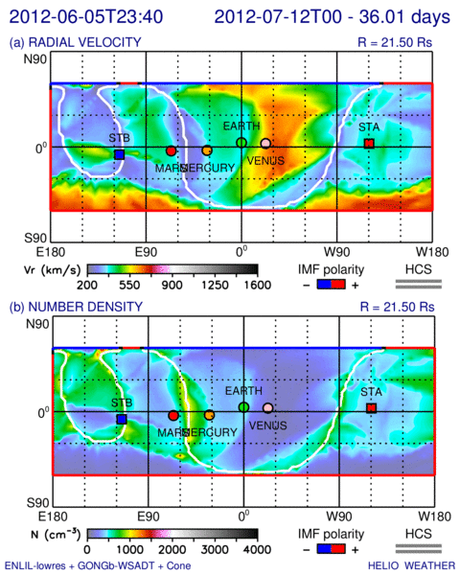
Modeling CMEs with WSA-ENLIL+Cone
WSA-ENLIL is a global 3D MHD model which provides a time-dependent description of the background solar wind plasma and magnetic field into which a spherical or ellipsoid shaped CME can be inserted.
A CME-like hydrodynamic structure is launched into the solar wind and magnetic field computed from the WSA coronal model at 21.5 R_{s}.
WSA coronal maps generated from synoptic magnetograms provide the magnetic field and solar wind speed at the boundary between coronal PFSS and heliospheric models
Other coronal models can also be coupled with ENLIL (e.g. MAS, heliospheric tomography).
Model References: Arge and Pizzo, 2000; Arge et al., 2004.
Odstrcil et al. 1996; Odstrcil and Pizzo, 1990a,b; Odstrcil, 2003.
Notes:
WSA-ENLIL is a global ideal 3D MHD model which provides a time-dependent description of the background solar wind plasma and magnetic field into which a spherical or ellipsoid shaped CME can be inserted.
A CME-like hydrodynamic structure is launched into the solar wind and magnetic field computed from the WSA coronal model at 21.5 Rs. Does not simulate CME initiation.
WSA coronal maps generated from synoptic magnetograms provide the magnetic field and solar wind speed at the boundary between coronal PFSS and heliospheric models using the Schatten current sheet model. The magnetic field is assumed to be radial at the outer surface. The solar wind speed is from an empirical relationship based on the divergence of the magnetic field and the proximity of the selected open field line to the nearest coronal hole boundary.
Other coronal models can also be coupled with ENLIL (e.g. MAS, heliospheric tomography).
Kinematic properties of CMEs (cloud velocity, location, and width) are inferred from coronagraphs. Any method may be used.
Cone model: method which assumes isotropic expansion, radial propagation, constant CME cone angular width.
CME disturbance is inserted as slices of a homogeneous spherical plasma cloud with uniform velocity, density, and temperature as a time-dependent inner boundary condition at 21.5Rs. The background magnetic field is unchanged.
The current version of real-time ensemble modeling at the CCMC/SWRC evaluates the sensitivity of CME arrival time predictions from the model to initial CME parameters.
Measure a set of n CME input parameters. Typically n=36 to 48 provides an adequate spread of input parameters, and this number can be increased as needed.
These are used as input to an ensemble of n WSA-ENLIL+Cone model runs.
This gives an ensemble of n profiles of MHD quantities and n CME arrival time predictions at locations of interest.

Slide 4
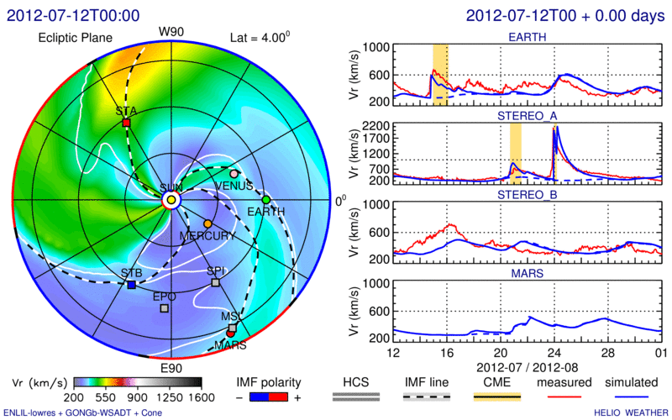
Modeling CMEs with WSA-ENLIL+Cone
WSA-ENLIL is a global 3D MHD model which provides a time-dependent description of the background solar wind plasma and magnetic field into which a spherical or ellipsoid shaped CME can be inserted.
A CME-like hydrodynamic structure is launched into the solar wind and magnetic field computed from the WSA coronal model at 21.5 R_{s}.
WSA coronal maps generated from synoptic magnetograms provide the magnetic field and solar wind speed at the boundary between coronal PFSS and heliospheric models
Other coronal models can also be coupled with ENLIL (e.g. MAS, heliospheric tomography).
Model References: Arge and Pizzo, 2000; Arge et al., 2004.
Odstrcil et al. 1996; Odstrcil and Pizzo, 1990a,b; Odstrcil, 2003.
Notes:
WSA-ENLIL is a global ideal 3D MHD model which provides a time-dependent description of the background solar wind plasma and magnetic field into which a spherical or ellipsoid shaped CME can be inserted.
A CME-like hydrodynamic structure is launched into the solar wind and magnetic field computed from the WSA coronal model at 21.5 Rs. Does not simulate CME initiation.
WSA coronal maps generated from synoptic magnetograms provide the magnetic field and solar wind speed at the boundary between coronal PFSS and heliospheric models using the Schatten current sheet model. The magnetic field is assumed to be radial at the outer surface. The solar wind speed is from an empirical relationship based on the divergence of the magnetic field and the proximity of the selected open field line to the nearest coronal hole boundary.
Other coronal models can also be coupled with ENLIL (e.g. MAS, heliospheric tomography).
Kinematic properties of CMEs (cloud velocity, location, and width) are inferred from coronagraphs. Any method may be used.
Cone model: method which assumes isotropic expansion, radial propagation, constant CME cone angular width.
CME disturbance is inserted as slices of a homogeneous spherical plasma cloud with uniform velocity, density, and temperature as a time-dependent inner boundary condition at 21.5Rs. The background magnetic field is unchanged.
The current version of real-time ensemble modeling at the CCMC/SWRC evaluates the sensitivity of CME arrival time predictions from the model to initial CME parameters.
Measure a set of n CME input parameters. Typically n=36 to 48 provides an adequate spread of input parameters, and this number can be increased as needed.
These are used as input to an ensemble of n WSA-ENLIL+Cone model runs.
This gives an ensemble of n profiles of MHD quantities and n CME arrival time predictions at locations of interest.

Slide 5
ENLIL - Schematic Description
ENLIL – Sumerian God of Winds and Storms
Dusan Odstrcil, GMU & GSFC
Input: WSA (coronal maps of Br and Vr updated 4 times a day). For toroidal
components at the inner boundary- Parker spiral.
ENLIL’s inner radial boundary is located beyond the sonic point: the solar wind flow is
supersonic in ENLIL.
Computes a time evolution of the global solar wind for the inner heliosphere, driven by
corotating background structure and transient disturbances (CMEs) at it’s inner radial
boundary at 21.5 Rs.
Solves ideal fully ionized plasma MHD equations in
3D with two additional continuity equations: for
density of transient and polarity of the radial
component of B.
Notes:
ENLIL – Sumerian God of Winds and Storms
Dusan Odstrcil, GMU & GSFC
Input: WSA (coronal maps of Br and Vr updated 4
times a day). For toroidal components at the inner
boundary- Parker spiral.
ENLIL’s inner radial boundary is located beyond
the sonic point: the solar wind flow is supersonic in
ENLIL.
Computes a time evolution of the global solar
wind for the inner heliosphere, driven by corotating
background structure and transient disturbances
(CMEs) at it’s inner radial boundary at 21.5 Ro.
Solves ideal fully ionized plasma MHD equations in
3D with two additional continuity equations: for
density of transient and polarity of the radial
component of B.

Slide 6
ENLIL Schematic Description
ENLIL model does not take into account the realistic
complex magnetic field structure of the CME magnetic
cloud and the CME as a plasma cloud has a uniform
velocity.
It is assumed that the CME density is 4 times larger than the
ambient fast solar wind density, the temperature is the same.
Thus, the CME has about four times larger pressure than the
ambient fast wind. Launching of an over pressured plasma
cloud at 21.5 Rs, roughly represents CME eruption scenario
Output:
3D distribution of the SW parameters at
spacecraft and planets and topology of IMF.
Notes:
Limitation of the ENLIL model:
It does not take into account the realistic complex magnetic field structure
of the CME magnetic cloud and the CME as a plasma cloud has a uniform velocity.
It is assumed that the CME density is 4 times larger than the ambient fast solar wind
density, the temperature is the same. Thus, the CME has about four times larger
pressure than the ambient fast wind. Launching of an over pressured plasma cloud
at 21.5 Rs, roughly represents CME eruption scenario
Output:
3D distribution of the SW parameters at
spacecrafts and planets and topology of IMF.

Slide 7
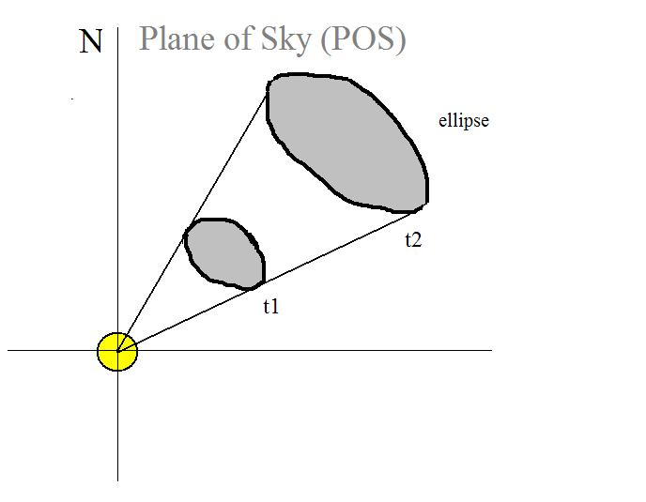
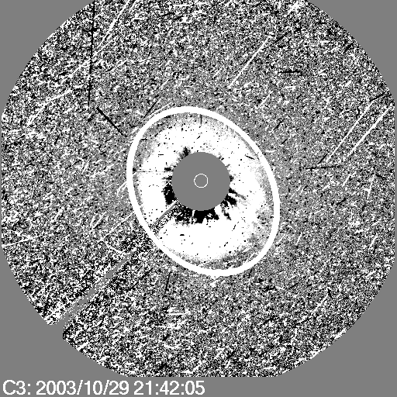
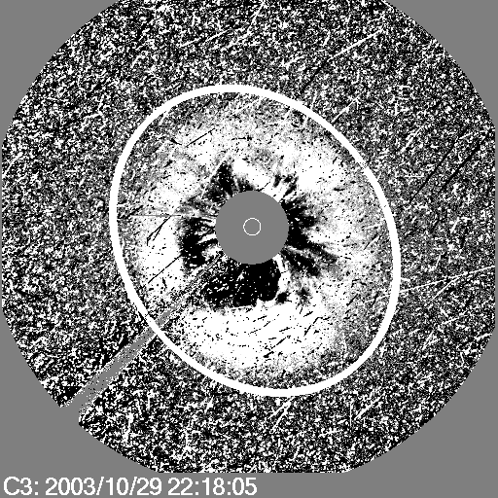
Cone Model for CMEs
Zhao et al, 2002, Cone Model:
The CME cone model is based on observational evidence that CME has more or less constant angular diameter in corona, being confined by the external magnetic field, so that CME does not expand in latitude in the lower corona, but expands in interplanetary space because of the weaker external field
CME propagates in a radial direction
CME bulk velocity is radial and the expansion is isotropic
The projection of the cone on
the POS is an ellipse
CME V and orientation
Input to WSA-ENLIL
Notes:
Zhao was the first to come up with the Cone model of CME. The CME
cone model is based on observational evidence that CME has more
or less constant angular diameter in corona, being confined by the
external magnetic field, so that CME does not expand in latitude in the lower
corona, but expands in interplanetary space because of the weaker
external field. The assumptions are the following:
CME propagates with nearly constant angular width in a radial direction
CME bulk velocity is radial and the expansion is isotropic

Slide 8
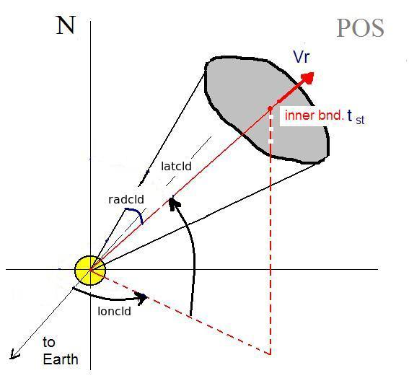
Cone model parameters
Input to ENLIL cone model run
time when cloud is at 21.5 Rs
Latitude
Longitude
half-width‏
Vr - radial velocity
Notes:
Parameters defined with CCMC CME Triangulation or other Tools yield CME
Parameters: Input To WSA-ENLIL Cone Model. These parameters are:
1- start time of CME at 21.5 Rs (inner boundary of the ENLIL model)
2- Cone axis latitude
3- Cone axis longitude
5- Cone Radius – half angle of the cone angular width
6- Radial Velocity

Slide 9
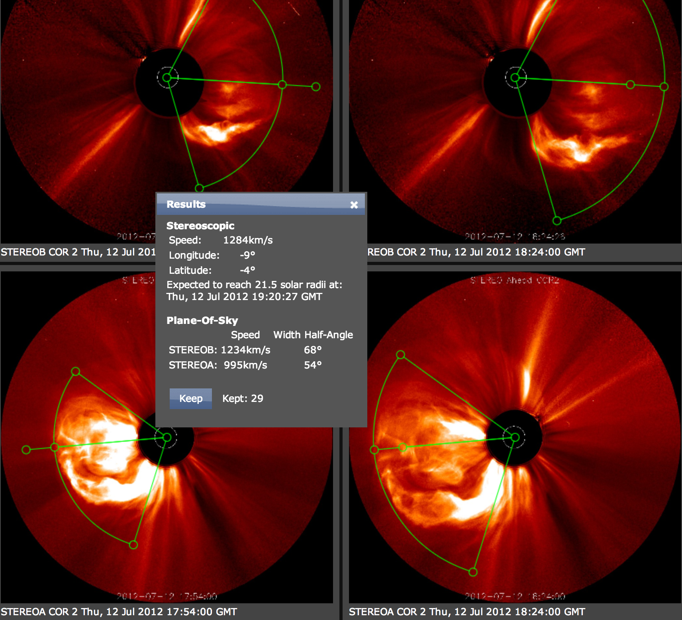
WSA-ENLIL Cone Model
Parameters Defined with CCMC CME Triangulation Tool
CME Parameters: Input To WSA-ENLIL Cone Model
Notes:
Parameters defined with CCMC CME Triangulation Tool
(CAT) or other tools are used as input CMEpParameters
to WSA-ENLIL Cone Model.

Slide 10
SWPC CME Analysis Tool

Slide 11
Notes:
After we define the CME parameters we run the WSA-ENLIL cone model.

Slide 12
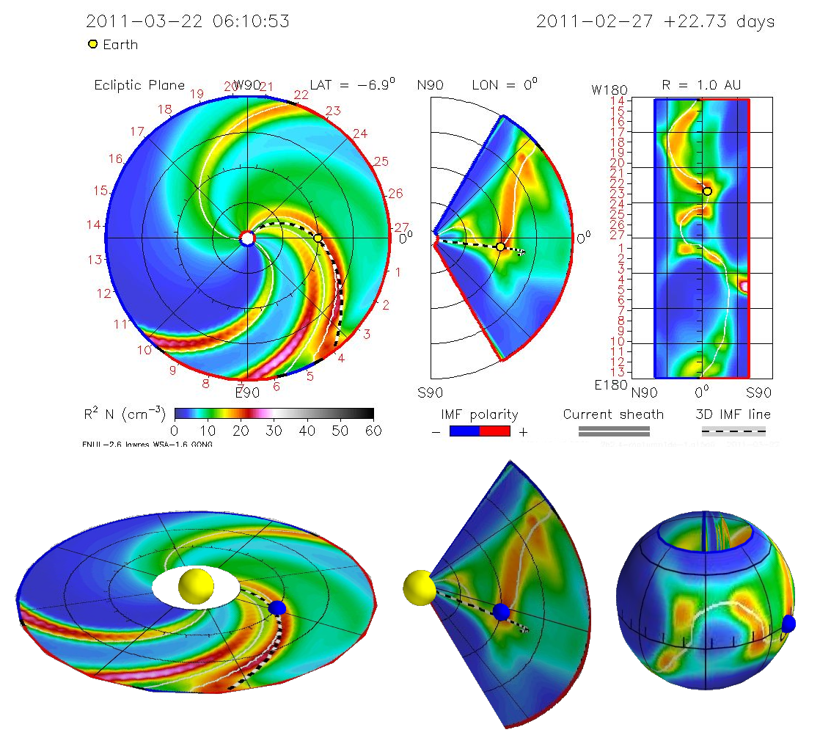

Slide 13
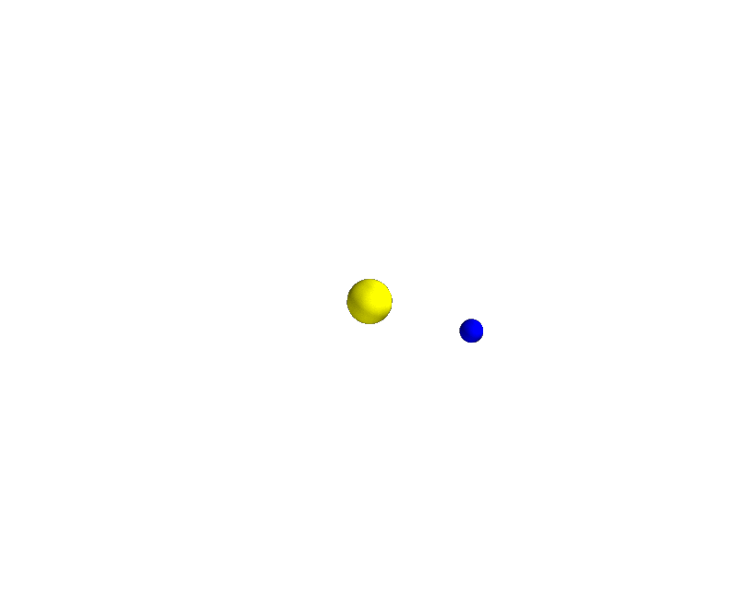

Slide 14
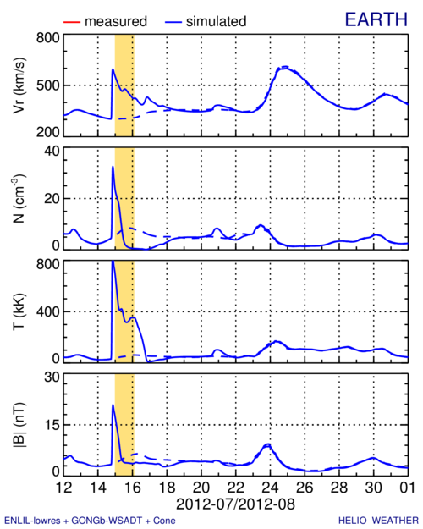

Slide 15
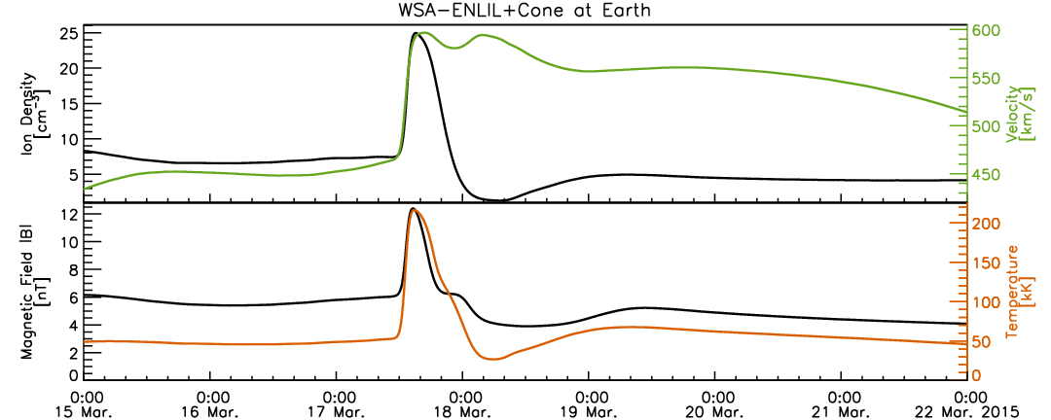

Slide 16
CME Impact – arrival, duration,
MP standoff distance
CME shock arrival –
a sharp jump in the dynamic pressure
Duration of the disturbance – duration
of the dynamic
pressure hump
Magnetic field
required
to stop SW
Magnetopause standoff distance
Notes:
After the run is done, we estimate the CME impact on planets, satellites.
CME shock arrival – a sharp jump in the dynamic pressure.
2. Duration of the disturbance – duration of the dynamic pressure hump.
3. In case of the Earth we estimate also the degree of compressing of the
magnetosphere: when the CME mass reaches the magnetosphere it
pushes it inward and the magnetic field of the Earth is stressed like
a spring to stop the CME motion.

Slide 17
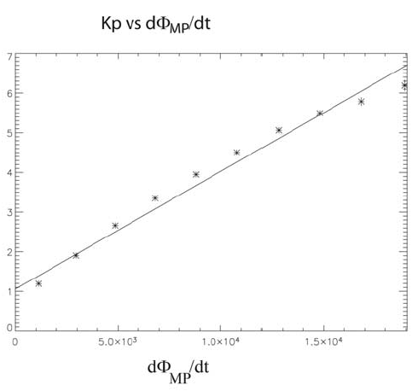
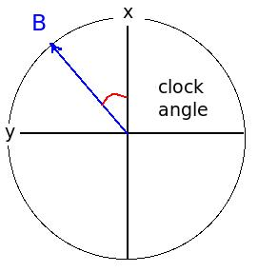
Kp Index Prediction– Newell Coupling Function
Magnetic flux opening rate
at the magnetopause
Z
Notes:
In case of the Earth we estimate also the Kp index – a measure of the disturbance of the magnetosphere.
We use Pat Newel’s empirical formula for the Magnetic flux opening
rate at the magnetopause for that and an empirical relation between
Kp and d(Phi)/dt.

Slide 18
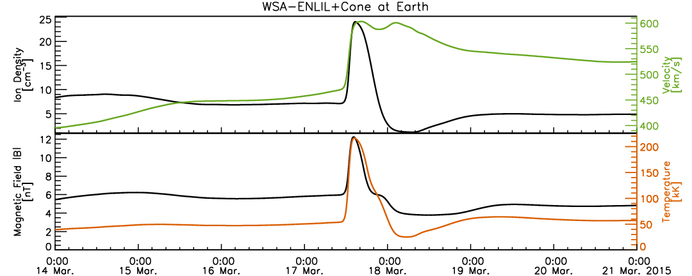
Determination of the
CME Arrival Time – clear arrival
Notes:
But we are not monitoring only Earth impact. Being responsible for
providing space weather assessment to NASA robotic mission operators,
we are monitoring possible impact of the CME on NASA missions.
So we send out another e-mail, that shows this estimate.

Slide 19
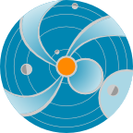
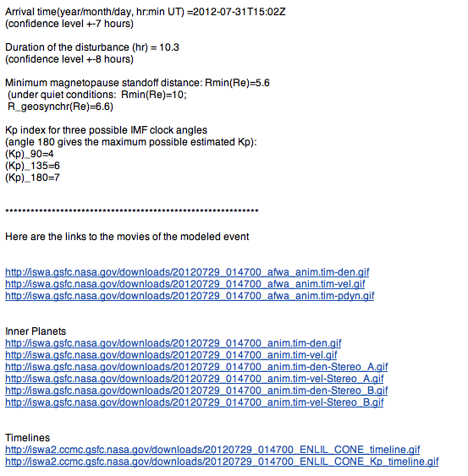
e-mail with CME impact
estimate at Earth
Notes:
And here is our response e-mail the them in details.
It contains the CME impact estimate for the Earth
(arrival time, magnetopause standoff distance,
Kp estimate for three possible clock angles of the IMF),
and links to the modeling animation and timelines.

Slide 20
e-mail for NASA missions
Notes:
But we are not monitoring only Earth impact. Being responsible for
providing space weather assessment to NASA robotic mission operators,
we are monitoring possible impact of the CME on NASA missions.
So we send out another e-mail, that shows this estimate.

