Slide 1
CMEs and SEPs
Nat Gopalswamy
Solar Physics Laboratory
NASA/GSFC
nat.gopalswamy@nasa.gov
2017 CCMC Bootcamp, Tuesday June 6

Slide 2
Overview
What are solar energetic particle events?
Coronal mass ejections (CMEs) and SEPs
Brief History
Radio bursts and shocks
Properties of SEP-producing CMEs

Slide 3
What are Energetic Particles?
Speed of 2 MK protons: 129 km/s = 4.3e-4c [√(kT/m)]; T = 2 MK; ε_{th}= 175eV
Speed of 2 MK electrons: 5547 km/s = 0.018c c = speed of light; m= mass
2 MK corresponds to an energy of 175 eV
Nonthermal particles are energetic: V >> V_{th} or ε >> ε_{th}
Electrons KeV to 100s of MeV, protons of keV to tens of GeV from the Sun (1 GeV protons have a speed of~0.875c = 260,000 km/s)
Electrons and ions are detected by particle detectors; electrons are also inferred from their nonthermal radio emission
Events involving emission of nonthermal particles are known as solar energetic particle (SEP) events
Space weather community also uses the term solar proton events (SPEs) to specifically refer to energetic protons

Slide 4
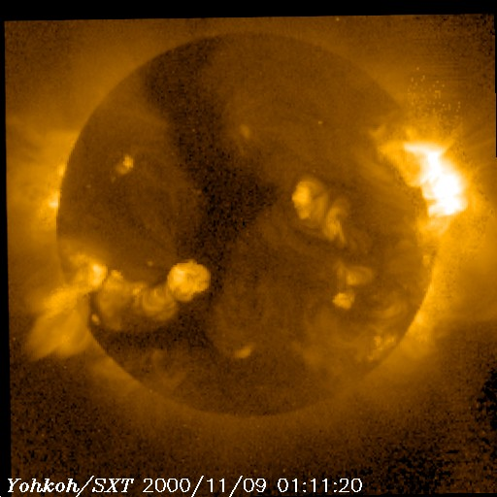
CMEs, Flares, SEPs
N10W77
Yohkoh/SXT
1-8 Å
0.5-4 Å
SOHO/LASCO and EIT
http://cdaw.gsfc.nasa.gov

Slide 5
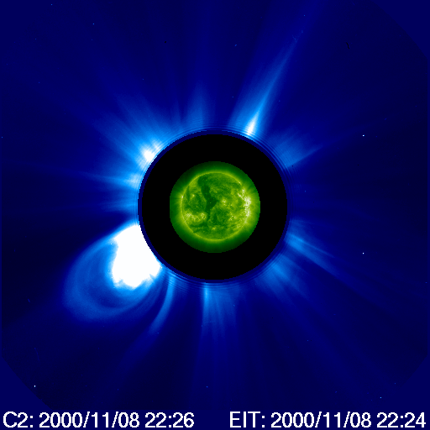
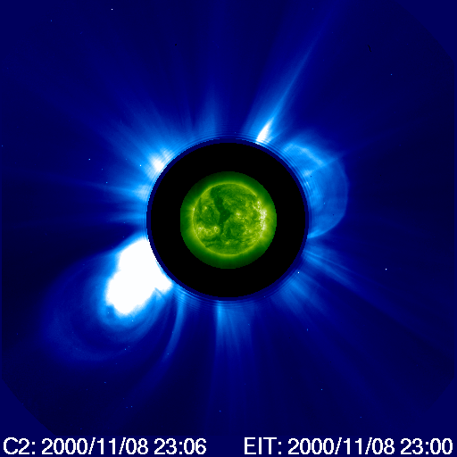
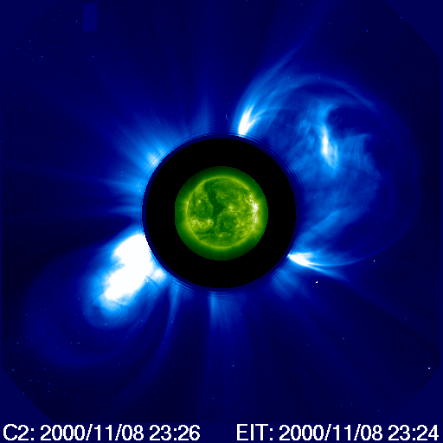
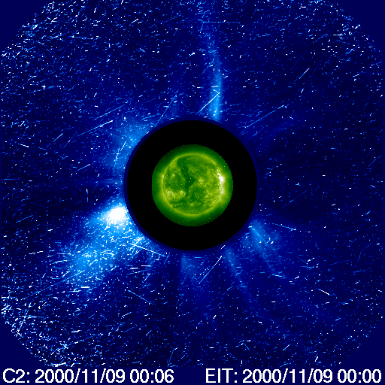
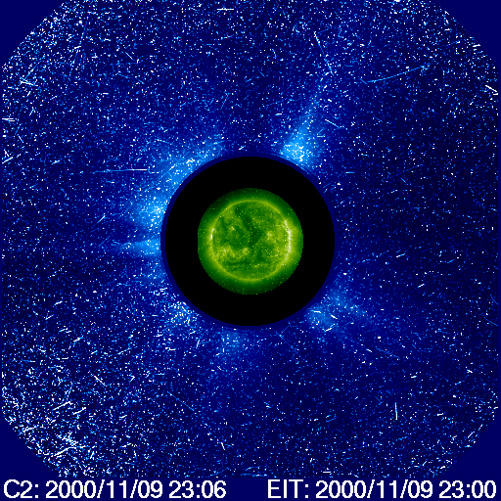
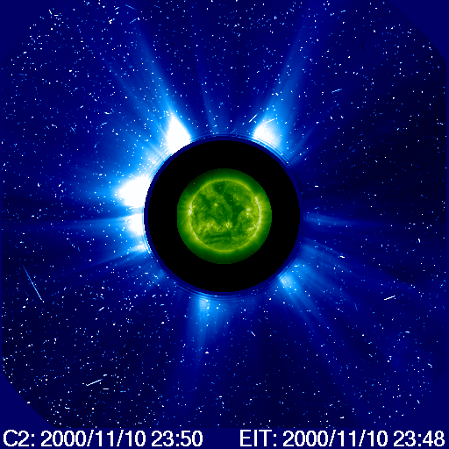
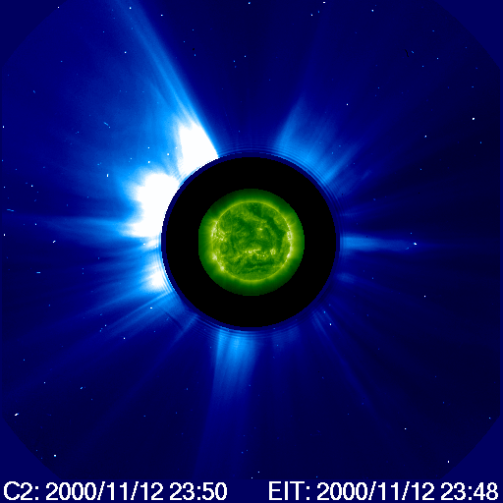
Image Degradation due to Particle Impact
3.85 Rs
5.04 Rs
6.08 Rs
44 min
1-AU shock
11/10 6 UT
4 Days later

Slide 6
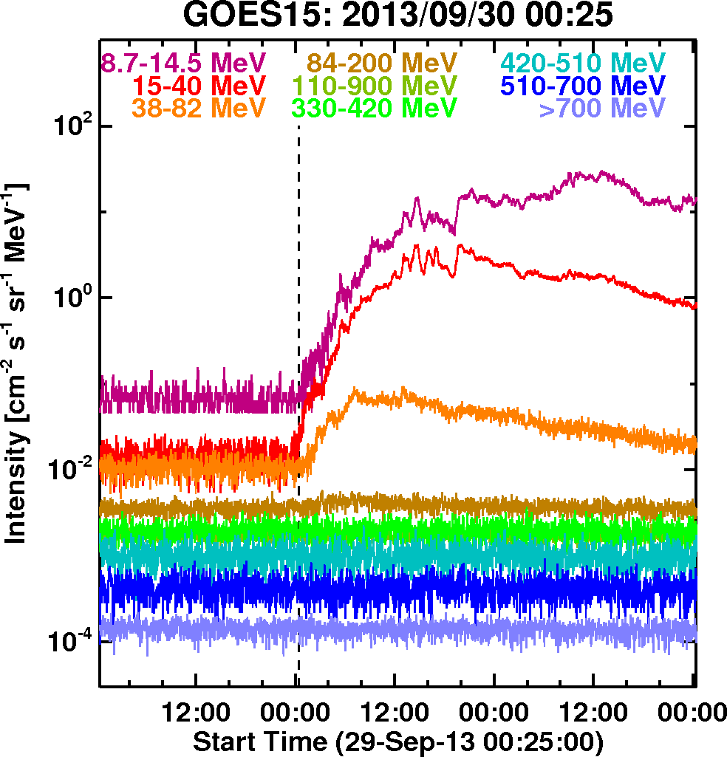
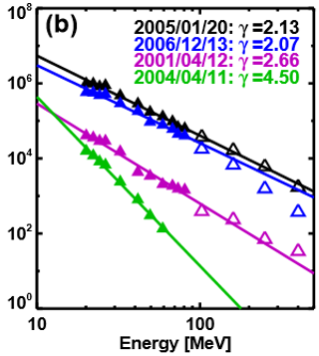
SEP Intensity, Energy Range, Spectrum
Fluence Spectrum
Intensity
Spectrum

Slide 7
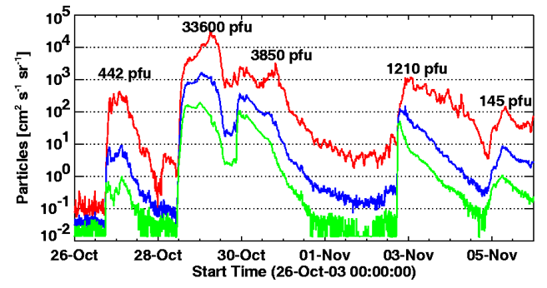
Double Whammy: Geomagnetic Storms & SEPs
Two halo CMEs: 10/28 and 10/29 2003
Some times eruptions
occur in quick succession
maintaining elevated level
of particle radiation
Gopalswamy et al. 2005
NORMAL
STORM
Transformer oil heated by 10º in Sweden; 50,000 people in Malmo had power blackout
SOHO/LASCO
Notes:
This connection between CMEs and the space weather consequences took a long time to achieve. I will attempt to highlight the key developments that led to the current understanding.

Slide 8
General Time Profiles of SEP Events
Onset plateau due to waves trapping particles
Peak when shock arrives at the detector
Reservoir behind the shock

Slide 9
About 14% of Earth is affected
during solar proton events.
Change in ionospheric conductivity
Ozone depletion
Radiation belt trapping and satellite anomalies
GOES
Protons mostly enter through the magnetotail and precipitate in the polar caps

Slide 10
GOES provides Proton flux
for >1 MeV to >100 MeV
100
1 MeV proton
60
Thermosphere
80
50
10 MeV proton
Mesosphere
40
60
Altitude (km)
Altitude (miles)
30
100 MeV proton
40
Stratosphere
20
20
1 GeV proton
Particles hit the airplane material and produce secondaries, which
affect crew and passengers in polar route
10
Troposphere
0
0
~2 GeV proton
11-14 km

Slide 11
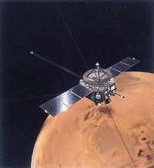
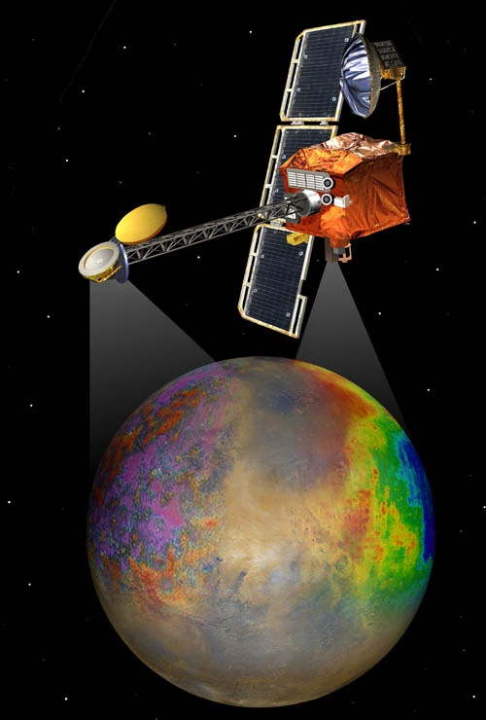
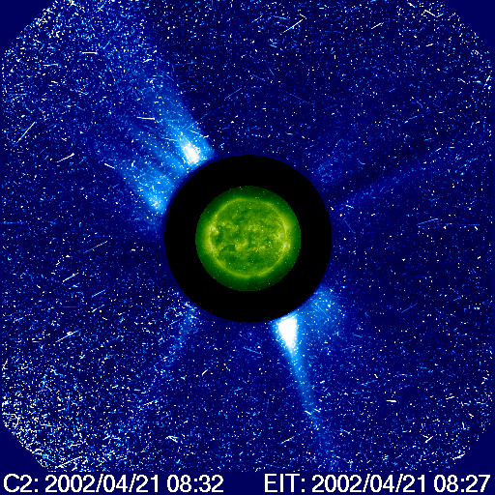
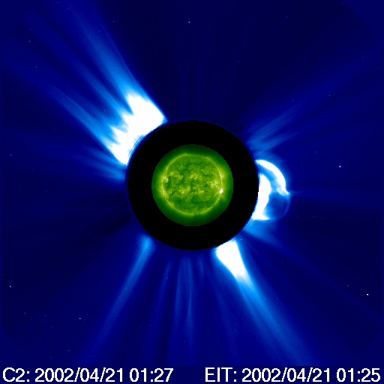
MARIE: The Martian Radiation Environment Experiment
Nozomi
The MARIE instrument on Mars Odyssey
observed the radiation levels on the way
to Mars and in orbit, so that future mission
designers could plan the trips of human
explorers to Mars.
One of the October 2003 SEP events
rendered MARIE inoperative. It is ironic,
as MARIE was designed to measure
the radiation environment at Mars.
Radiation Assessment Detector (RAD) on board
the Curiosity rover (Mars Science Laboratory)
that a 360-day round trip would add a dosage
of ~660 mSv. (Zeitlin et al. 2013)
This is ~66% of astronaut’s entire career
exposure limit (1000 mSv)
Mars Odyssey

Slide 12
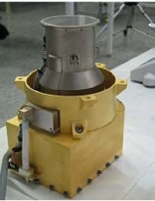
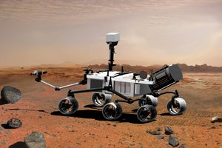
Curiosity provides Radiation info for a Mars Trip
Radiation Assessment Detector on Mars Science Laboratory (RAD/MSL)
RAD mounted on the top deck of Curiosity rover
Data collection:
6 December 2011 to 14 July 2012
1.84 mSv/day due to GCRs
Total: 660 mSv; 5.4% due to SEPs

Slide 13
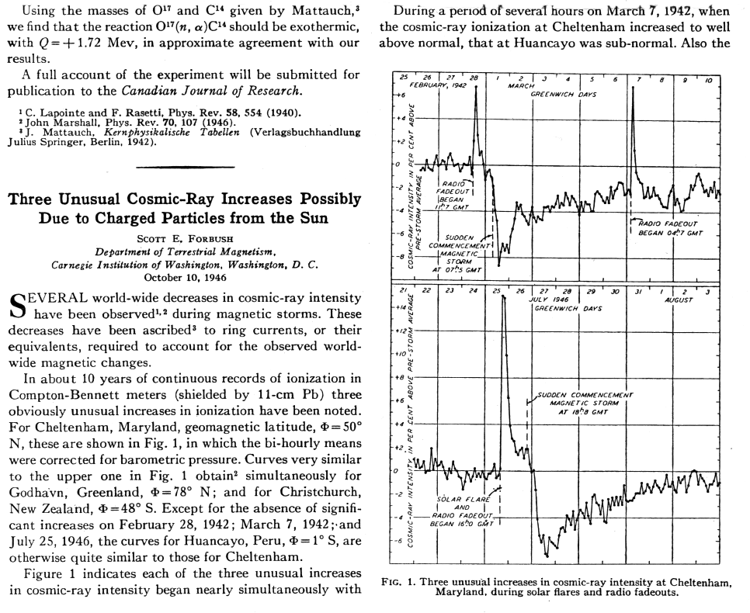
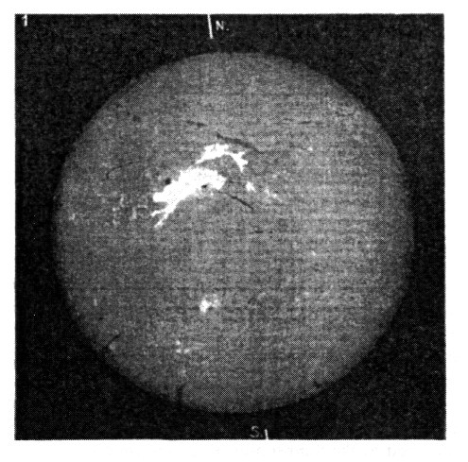
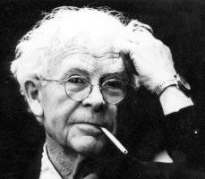
Forbush Decrease, SEPs
Forbush (1946) Phys. Rev. Lett.
N07E03
25 July 46 GLE Flare
Scott E. Forbush
(1904-1984)
a solar flare (bright chromospheric eruption)
Forbush decrease (1937)
Notes:
Cosmic rays were detected by Hess in 1912 using balloons (Theodor Wulf’s electrometer; Domenico Pacini’s simultaneous ionization variation over mountain, sea, lake, underwater – non-terrestrial source). Hess got Nobel Prize in 1936. Forbush reported global decrease in cosmic ray intensity, now known as Forbush decrease or Forbush effect. Ten years later, he reported on three cosmic ray increases at the time of solar flares. One of them is an extreme event, in that a geomagnetic storm occurred 19.5 h later

Slide 14
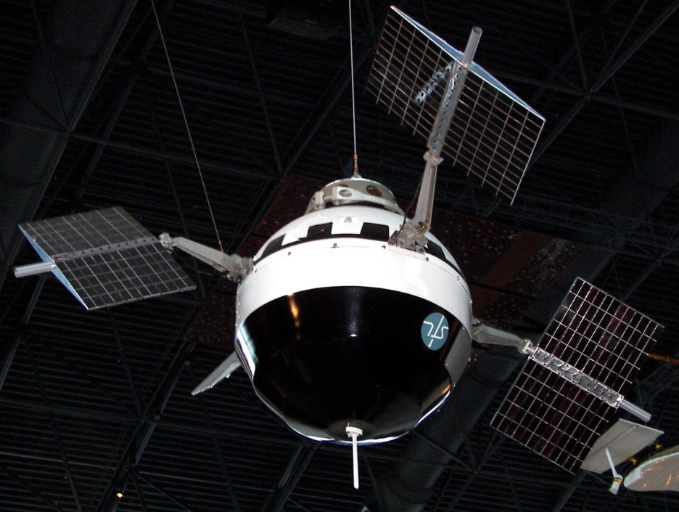
High Velocity Magnetized Plasma from the Sun
>75 MeV particles
Pioneer 5
launch: 3/11/1960
FD
“…we believe these Pioneer V results provide the most direct evidence to date for the existence of conducting gas ejected at high velocity from solar flares”
50 nT
Fan, Meyer, Simpson, 1960 Phys Rev Lett

Slide 15
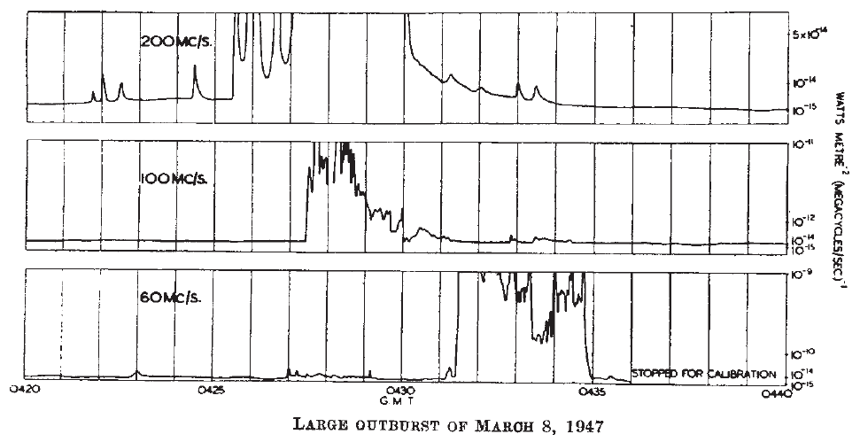
Radio Bursts Reveal Matter Leaving the Sun
The whole pattern drifts; 140 MHz in 6 min → df/dt = 0.4 MHz/s
“…the derived velocities are of the same order as that of prominence material…”
Plasma
density (cm⁻³)
Ruby Payne-Scott
1912 – 1981
5.0 x10⁸
750 km/s
-Classified as type II radio bursts (Wild & McCready 1950)
-Caused by ~10 keV electrons accelerated in MHD shocks (Uchida 1960)
-Plasma emission mechanism (Ginzburg & Zhelezniakov 1958)
Nelson & Melrose (1985)
1.2 x10⁸
WATTS METRE⁻²(MEGACYCLE/SEC)⁻¹
500 km/s
0.4 x10⁸
Payne-Scott, Yabsley & Bolton 1947, Nature 260, 256
Notes:
Hey 1946 explained 1942 Radar jamming during WWII as solar radio bursts

Slide 16
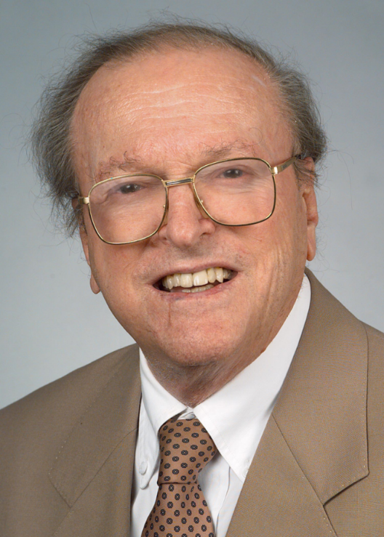
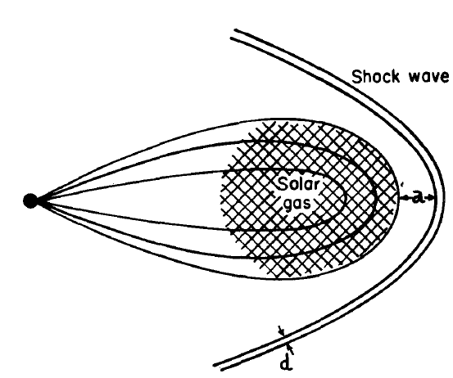
Shocks in the IP medium
1953: Gold proposed Interplanetary shock to explain the Sudden Commencement
T. Gold (1920 – 2004)
1962: “Idealized configuration in space,
showing solar plasma cloud,
the drawn-out field and the shock wave ahead”
Gold magnetic
bottle
MHD shock theory: de Hoffmann & Teller 1950
Parker applied it to interplanetary shocks in 1963
Notes:
Gold also inferred from the rapid rise time of the impulses that there must be an ambient medium with magnetic field in it.

Slide 17
Radio Bursts: Nonthermal Electrons from the Sun
Type III (electron beams) v ~ 0.3 c
Type II (shocks) v >/~ 600 km/s
df/dt = df/dr.dr/dt =(V/2) f n⁻¹(dn/dr)
V = 2L(dlnf/dt)
f ~n^{1/2} (plasma frequency)
Harmonic
f
df/dt ~0.1 MHz/s
Fundamental
t
min
Dynamic Spectrum

Slide 18
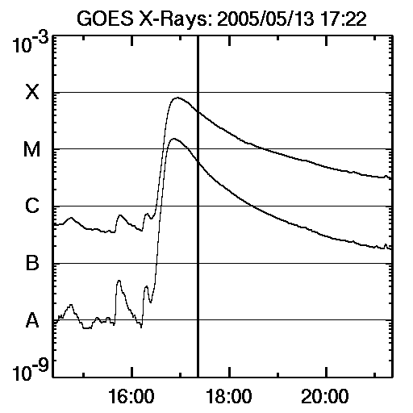
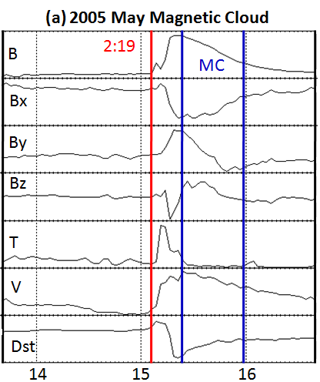
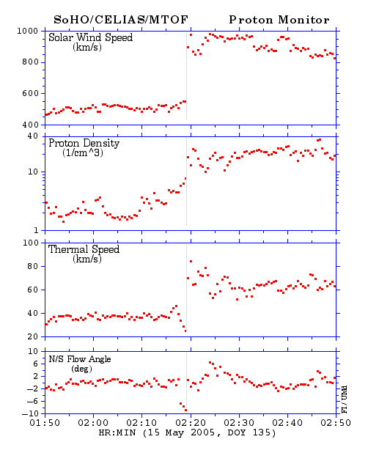
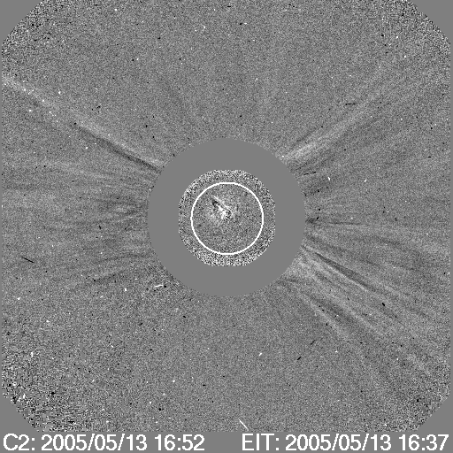
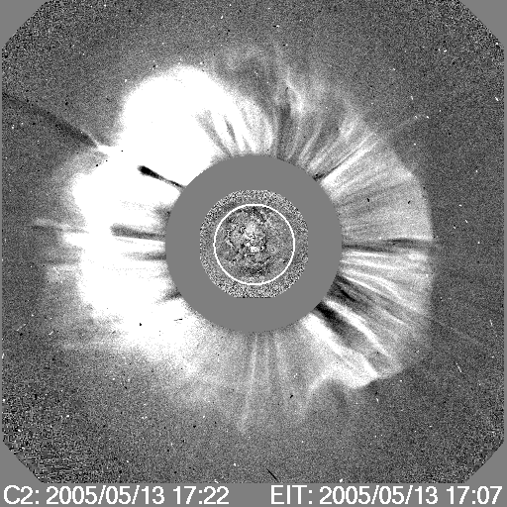
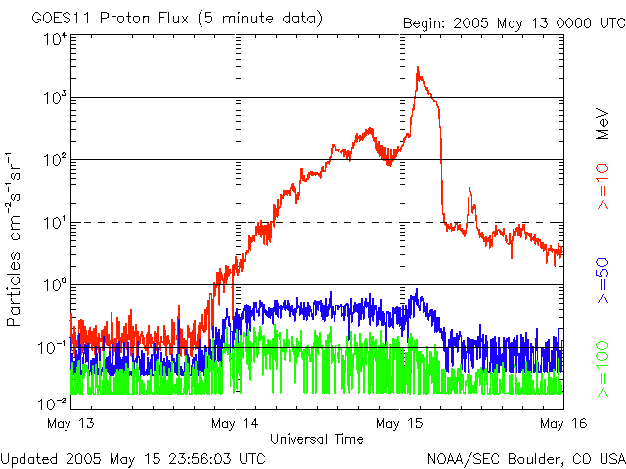
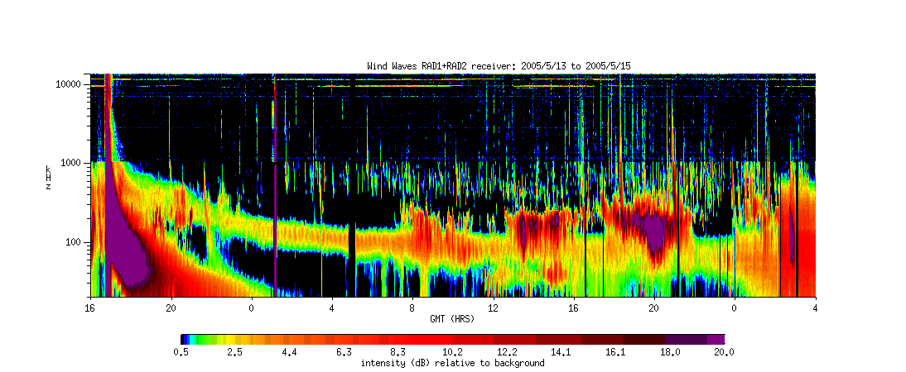
Range of Phenomena: 2005 May 13 CME
SW Shock
ESP 100 →3000 pfu
1689 km/s
Source Location
N11E12
SEP
Halo CME
Sun
33 h
Earth
shock
in-situ “view”
of the CME
Type II Burst
SSC

Slide 19
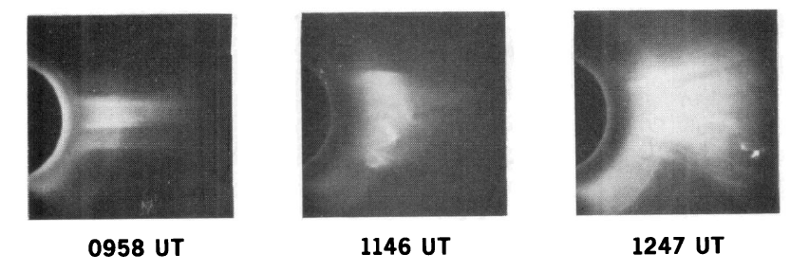
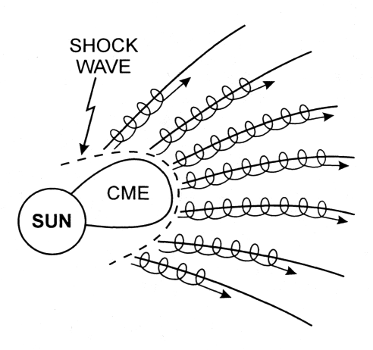
S. W. Kahler
Skylab CME on January 15, 1974
Studied 16 Skylab CMEs; 14 had SEP events
Found correlation between CME speed and SEP intensity
“We suggest that energetic protons are accelerated in the shock front just ahead of the expanding loop structures observed as mass ejections”
Kahler, Hildner, & Van Hollebeke (1978)
Cliver et al. 1982 for GLEs; Cane et al. 1988; Reames 1990

Slide 20
Interplanetary Shock and Radio Burst
Cane et al. 1987; Reiner et al. 1997; Bougeret et al. 1998; Gopalswamy et al. 2001; 2004; 2005, 2011
Notes:
IP type II bursts at 2 MHz have been known to be associated with IP shock and CMEs. The simultaneous observations in white light and radio of the same region of the corona has helped enormously in the physical connection among SEPs, type II bursts, CMEs, and shocks

Slide 21
Properties of CMEs Producing SEPs
Need to be fast enough to drive a shock
The shock should be magnetically connected to the observer

Slide 22
SEP Intensity vs. CME Speed
SEP Intensity correlated with CME speed
Large Scatter
Source and Environmental factors
connectivity

Slide 23
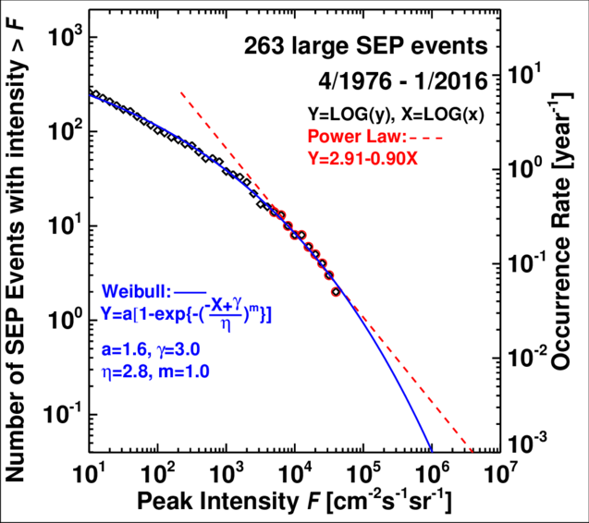
SEP Intensity and Fluence

Slide 24
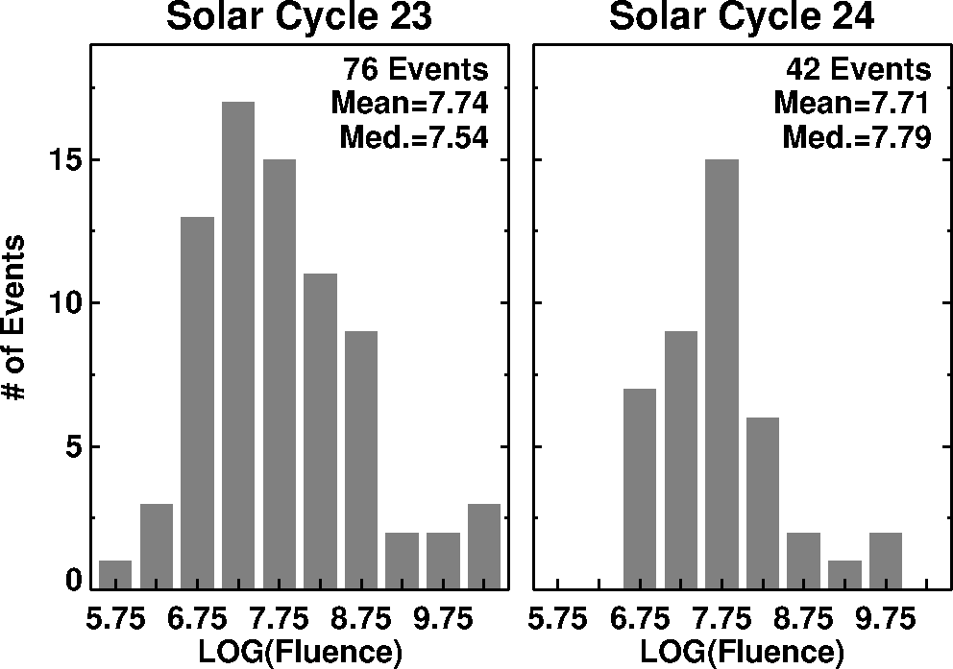
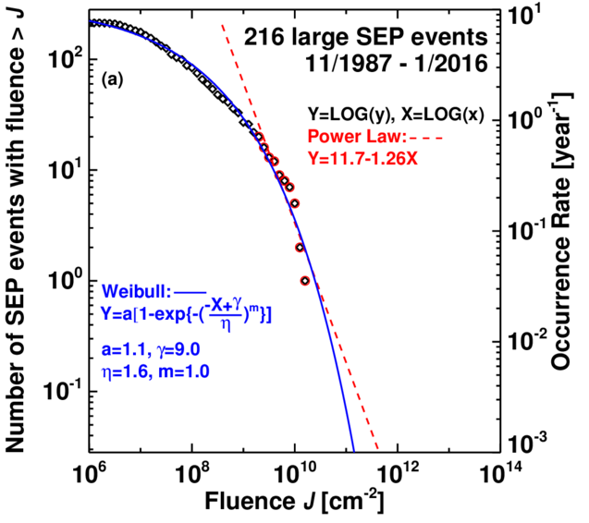
SEP Intensity and Fluence
>10 MeV

Slide 25
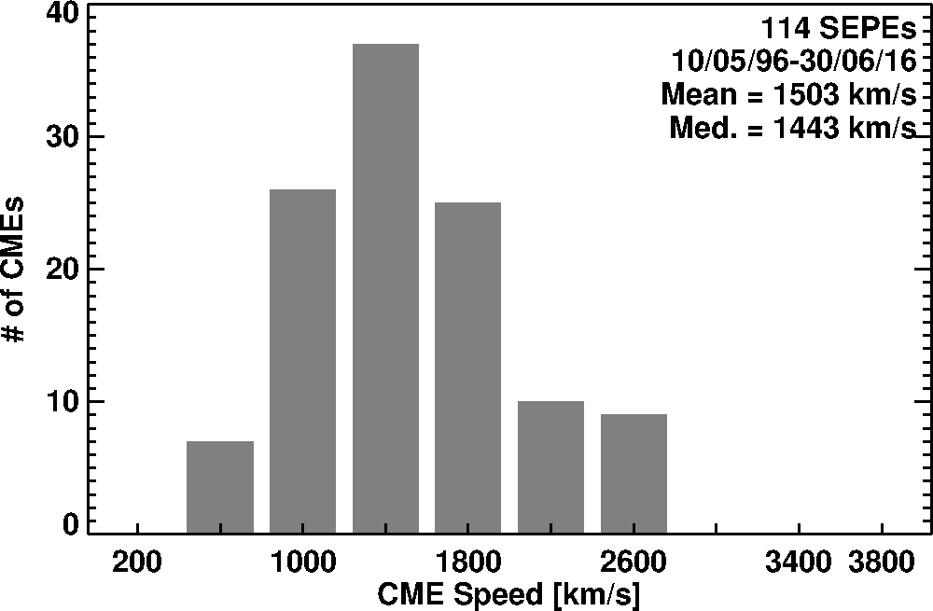
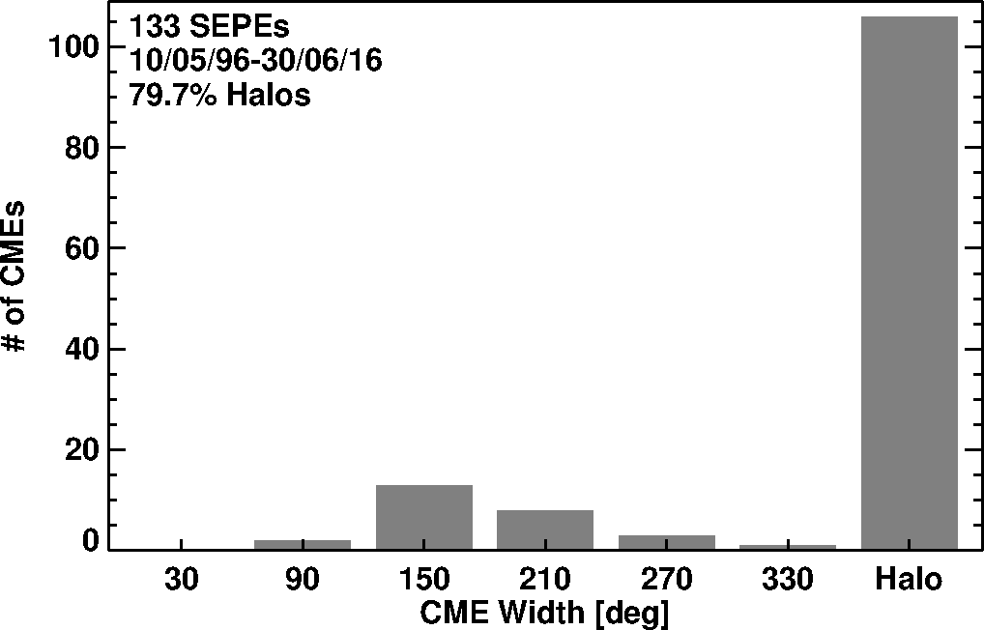
Properties of CMEs producing Large SEP Events
SEP Events are caused by fast and wide (energetic CMEs)
Typical energy of these CMEs ~10³² erg
Shock-driving capability of CMEs key for SEPs

Slide 26
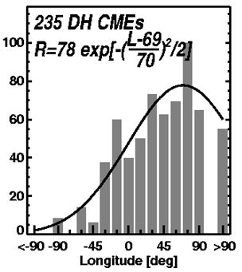
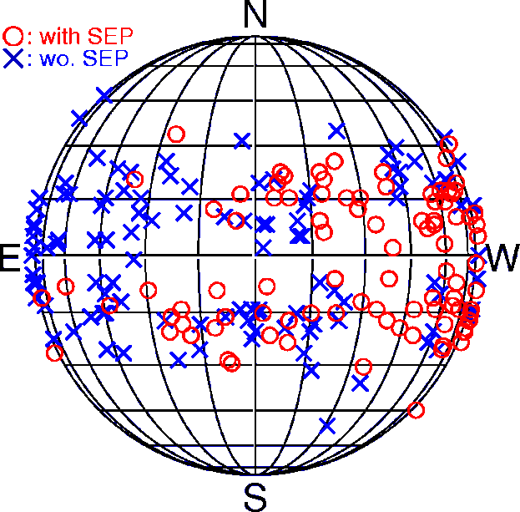
CMEs Associated with Type II Bursts and SEPs
Sources of CMEs associated with
type II bursts at f < 14 MHz
(Decameter-hectometer and
longer wavelengths)
Type II bursts from the western
hemisphere are likely to be
associated SEPs due to better
magnetic connectivity
Type II bursts from the eastern
hemisphere are associated with
SEPs that do not arrive at Earth
(e.g., STEREO B)
Gopalswamy et al. 2008 Ann Geo

Slide 27
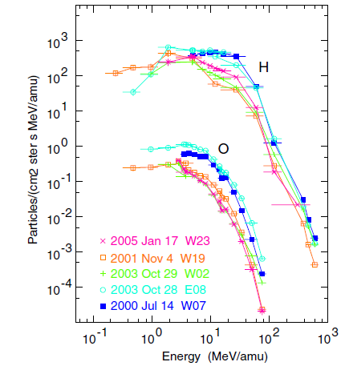
Steaming-limited Intensities of SEP Events
Reames & Ing 2010
Plateau in lower energies after initial rise
Tens of MeV protons cause Alfven waves, which throttle the lower energy particles (protons, He, Fe, O)
Max intensity ~400 H per (cm² s sr) in the energy range 5-20 MeV

Slide 28
It Matters Where the Shocks Form
Fluence Spectrum

Slide 29
Hard Spectrum Events are more hazardous
Reames 2013

Slide 30
Two mechanisms of particle acceleration
Confined flares: Particle acceleration in flares
CMEs associated with filament eruption outside Active regions: particle acceleration in shocks; ESP events

Slide 31
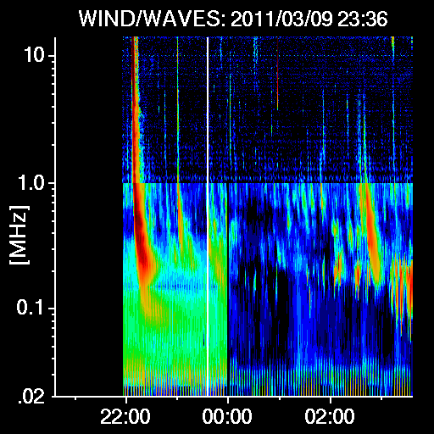
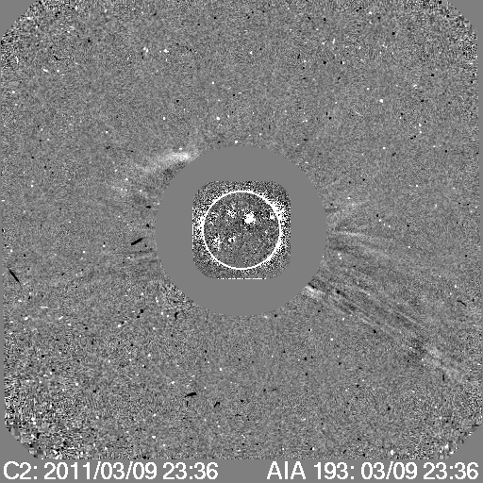
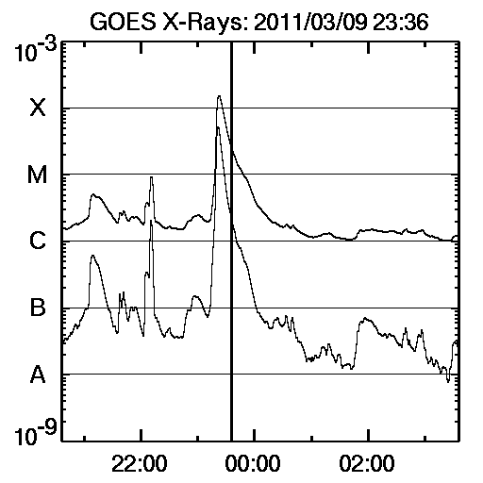
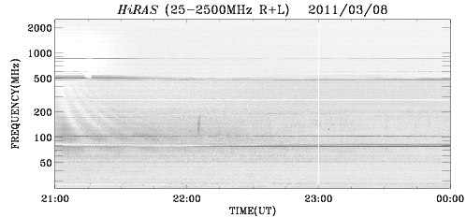
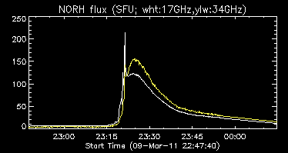
Confined Flare: No mass motion
No IP radio
emission
Flare
X1.5
Microwave burst, X-rays → nonthermal electrons propagating toward the Sun
No metric radio bursts → no
electrons away from the Sun
No Interplanetary radio emission
No SEP event
Universal Time
No metric radio bursts

Slide 32
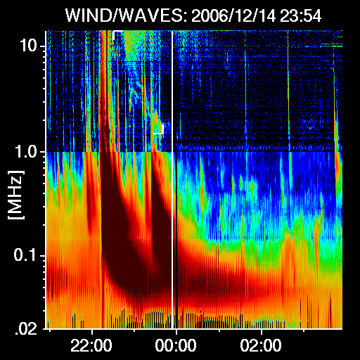
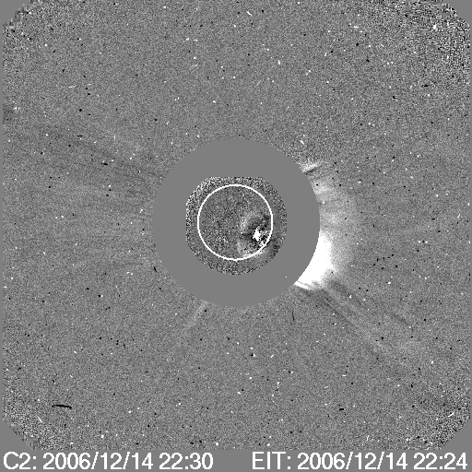
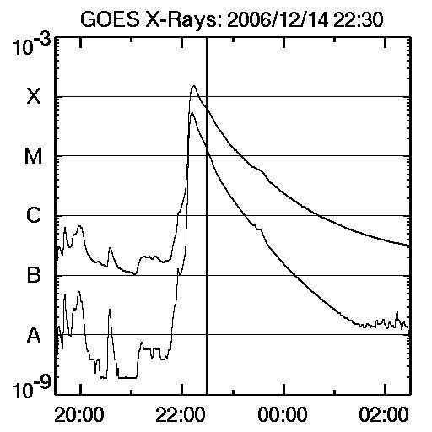
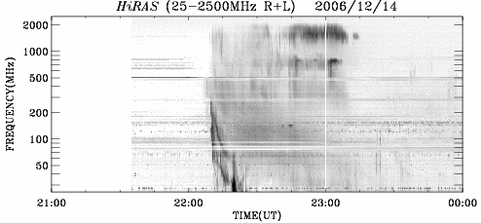
Eruptive Flare: CME involved
Flare
X1.5
Shock
EUV
WAVE
CME
Universal Time
Radio bursts → nonthermal electrons propagating away from the Sun
X-ray emission → electrons propagating toward the Sun
Interplanetary type II
Large SEP event
Type III
Type II
Type IV

Slide 33
A Generic CME
Solar wind
II
e
p,…
ep
flux rope
impulsive events associated with jets
Current
sheet
γ,X-rays,n
IV,µ
Post-Eruption Arcade
(Flare loops)
Gopalswamy 2006
adapted from Martens & Kuin 1989

Slide 34
Solar Cycle Variation

Slide 37
Why Low VBz? Anomalous Expansion of CMEs in Cycle 24
24
Cycle-24 CMEs are 50% wider for V=1000 km/s
Halos
P_{t24}
P_{t23}>P_{t24}
23
P_{t23}
Slope is significantly different
For a given speed, cycle 24 CMEs are wider

Slide 38
Solar Energetic Particles
>10 MeV SEP events
SEPs | Cycle 23* | Cycle24 | Ratio
>10 MeV | 81 (0.73/SSN) | 42 (0.67/SSN) | 0.52
>500 MeV | 27 (0.24/SSN) | 9 (0.14/SSN) | 0.33
>700 MeV (GLE) | 13 (0.12/SSN) | 2 (0.03/SSN) | 0.15
Low-energy SEP events drop (48%) ~ to SSN
>500 MeV SEP events dropped by 67%
>700 MeV SEPs dropped by 85%
These cannot be explained by the 34%
drop in FW CMEs

Slide 39
State of the Heliosphere
24%
Parameter | SC 23 | SC 24 | % Decline
Pt (pPa) | 43.1 | 32.6 | 24
B (nT) | 6.7 | 5.40 | 19
N (cm^-3) | 6.5 | 6.0 | 8
T (x10^5 K) | 1.1 | 0.8 | 28
Va (km/s) | 58.2 | 48.0 | 18
19%
8%
Reduced B
Reduced acceleration efficiency (Kirk, 1994)
dE/dt ∝ B (rate of energy gain)
28%
18%
Reduced Alfven speed near Sun
No major reduction in the # SEP Events
Gopalswamy et al. 2014 GRL (updated)

Slide 40
SWx Sources: Cycle 24 Compared to Previous Cycles
21
22
SWx in Cycle 24 is clearly very mild
CME and sunspot activity have discordant behavior
between the two sunspot number peaks
More fast CMEs during first peak, but a smaller SSN
X-class flares are more during the second peak
# of SEP events, magnetic storms similar to CMEs
23
24

Slide 41
Extreme SEP Events
>10 MeV
Miyake et al. 2012; Mekhaldi et al. 2015

Slide 42
Back up Slides

Slide 46
Extreme SEP Events

Slide 49
Notes
Atomic mass unit (amu) = 1/12 the mass of 12C
It is close enough to nucleon masses
MeV per nucleon in indistinguishable from MeV per amu for SEP studies
Total energy W = AM_{u}γ ; M_{u} = m_{u}c² = 931.494 MeV
γ = (1- β²)^{-1/2}; β = v/c
Kinetic energy Ɛ = AM_{u}(γ -1)

Slide 50
³He-Rich Events
Flare-accelerated particles at 1 AU
3He/4He > 0.1 (solar wind 5x10⁻⁴)
No CME association with ³He-rich events
³He-rich events associated with type III radio bursts produce by flare-accelerated electrons escaping into the IP space
Other heavy ions and the Fe/O-ratio enhanced
Enhancements of other heavy ions and Fe/O uncorrelated with ³He/⁴He
Mason et al. 1986
Mason et al. 1986

Slide 51
Shock Acceleration
Power-law energy spectrum in downstream region (Axford et al. 1977; Blandford & Ostriker 1978; Bell 1978; Lee 1983):
$${dJ}/{dE}∝E^{−γ}$$
Simple shock acceleration predicts independence of charge-to-mass ratio (Q/A)
Shock lifetime and size limit the maximum energy of particles
Diffusive shock acceleration (DSA):
Quasi-parallel shock (θ_{BN}≤45°)
particles scattering between up- and downstream magnetic fluctuations (1st order Fermi acceleration)
Slower acceleration rate
Efficient scattering requires enhanced level of turbulence/waves
Shock drift acceleration (SDA):
Quasi-perpendicular shock (θ_{BN}≥45°)
Induced electric field E=V×B at shock front
Fast acceleration rate
Higher maximum energy
θ_{BN} is the angle between the shock normal and the direction of the upstream magnetic field
Decker 1988

