Slide 1
Space Weather Bootcamp (week 1)
Thurs 8th June 2017
Introduction to the neutral atmosphere
Erin Dawkins
Space Weather Lab (Code: 674) erin.dawkins@nasa.gov

Slide 2
Image credit: John Emmert/NRL
Notes:
Image credit: John Emmert/NRL.

Slide 3
Image credit: John Emmert/NRL
Notes:
Image credit: John Emmert/NRL.

Slide 4
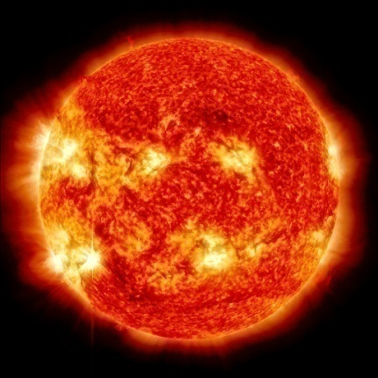
Absorption of solar radiation
Wikpedia.com

Slide 5
Greenhouse effect
Image: www.earthobservatory.nasa.gov
Wikpedia.com
Image: www.ux1.eiu.edu
Notes:
https://earthobservatory.nasa.gov/Features/RemoteSensing/Images/atmos_win.gif
https://earthobservatory.nasa.gov/Features/EnergyBalance/page4.php

Slide 6
Image credit: John Emmert/NRL
Notes:
Image credit: John Emmert/NRL.

Slide 7
Air composition
Gas name | Chemical formula | Percent volume (%)
Nitrogen | N₂ | 78.08
Oxygen | O₂ | 20.95
Water | H₂O | 0-4
Argon | Ar | 0.93
Carbon dioxide | CO₂ | 0.04
Neon | Ne | <0.01
Helium | He | <0.001
Methane | CH₄ | <0.001
Hydrogen | H₂ | <0.001
Nitrous Oxide | N₂O | <0.001
Ozone | O₃ | <0.001
mesosphere
stratosphere
troposphere
Misra et al. (2014)

Slide 8
Air composition
O₂ + hv → 2O
O + O₂ ←→ O₃
Gas name | Chemical formula | Percent volume (%)
Nitrogen | N₂ | 78.08
Oxygen | O₂ | 20.95
Water | H₂O | 0-4
Argon | Ar | 0.93
Carbon dioxide | CO₂ | 0.04
Neon | Ne | <0.01
Helium | He | <0.001
Methane | CH₄ | <0.001
Hydrogen | H₂ | <0.001
Nitrous Oxide | N₂O | <0.001
Ozone | O₃ | <0.001
mesosphere
stratosphere
troposphere
Misra et al. (2014)
www.theozonehole.com

Slide 9
Image credit: John Emmert/NRL
Notes:
Image credit: John Emmert/NRL.

Slide 10
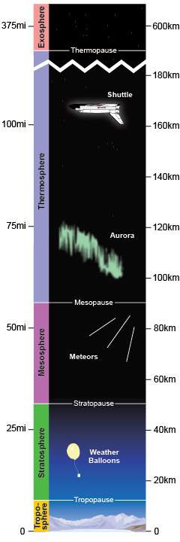
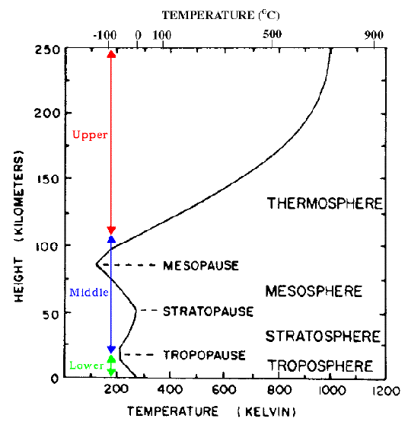
Troposphere (0-15 km)
‘Tropo-’ ∼ turbulent
~80% of atmospheric mass.
Most of our weather occurs within this region.
Well-mixed.
troposphere

Slide 11
Stratosphere (15-50 km)
‘Strato’ ∼ stable/stratified
Temperature increases with altitude.
Ozone layer peak at ~20-30 km, protecting Earth from harmful UV radiation.
~19.9% of atmospheric mass
stratosphere

Slide 12
Mesosphere (50-90 km)
‘Meso’ ∼ middle
Temperature decreases with altitude → limited local heating
Mesopause is the coldest part of the Earth’s atmosphere, with mean T of ~130 K/-143ºC/-225ºF!
Noctilucent clouds.
Meteoroids burn up here.
mesosphere

Slide 13
Thermosphere (90-500+ km)
thermosphere
‘thermo-’ ∼ heat
Temperature increases with altitude.
High T generated from absorption of intense solar radiation by predominantly, O₂ molecules.
Very low pressure, low density of molecules.
Gravitational settling of species by mass. Not well-mixed.

Slide 14
Vertical coupling exists between all
parts of the atmosphere.
Image credit: John Emmert/NRL
Notes:
Image credit: John Emmert/NRL.

Slide 15
Solar radiation
thermosphere
TRANSITION REGION
mesosphere
Dynamics
stratosphere
troposphere

Slide 16
Solar radiation
thermosphere
TRANSITION REGION
mesosphere
Dynamics
stratosphere
troposphere

Slide 17
Coupling between the lower and upper atmosphere
Polar stratospheric clouds
NASA/MODIS imagery
Polar mesospheric clouds (aka noctilucent clouds)
Sources: nasa.gov
arise-project.eu
Notes:
https://www.nasa.gov/sites/default/files/images/161102main_image_feature_680_ys_full.jpg
https://eoimages.gsfc.nasa.gov/images/imagerecords/8000/8967/ISS017-E-11632_lrg.jpg

Slide 18
Molecular diffusion
Solar radiation
Ionisation by
solar EUV
TRANSITION REGION
TRANSITION REGION
Turbulent
mixing
Neutral dynamics

Slide 19
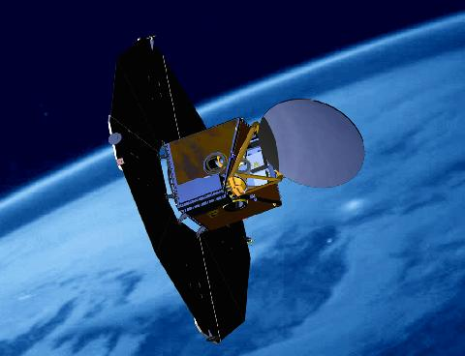
How can we observe the neutral atmosphere?
In situ observations
Remote sensing
ALOMAR lidar
Odin/OSIRIS
Brian Vasel, NOAA/ESRL
Origin.arstechnica.com
Nasa.gov

Slide 20
Molecular diffusion
Relatively poorly understood part of the atmosphere
Solar radiation
Ionisation by
solar EUV
TRANSITION REGION
TRANSITION REGION
Turbulent
mixing
Dynamics

Slide 21
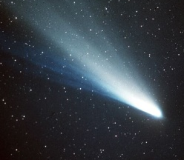
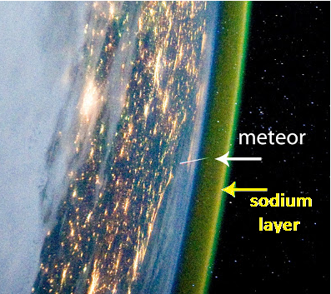
Observing the MLT
Mg+
Na+
Na
Fe+
Ca+
Na+
Fe
Fe+
Fe
K+
Mg
K
Na
Fe
Ca
Na
Na
Ca
Mg
Na
Fe
ALOMAR lidar
Odin/OSIRIS
http://www.albany.edu/faculty/rgk/atm101/s

Slide 22
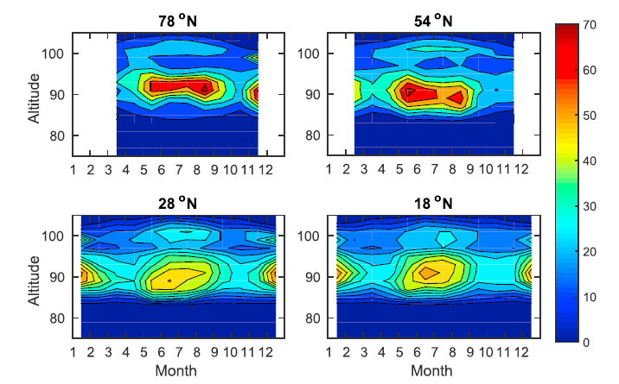
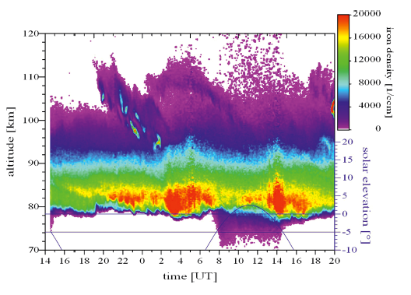
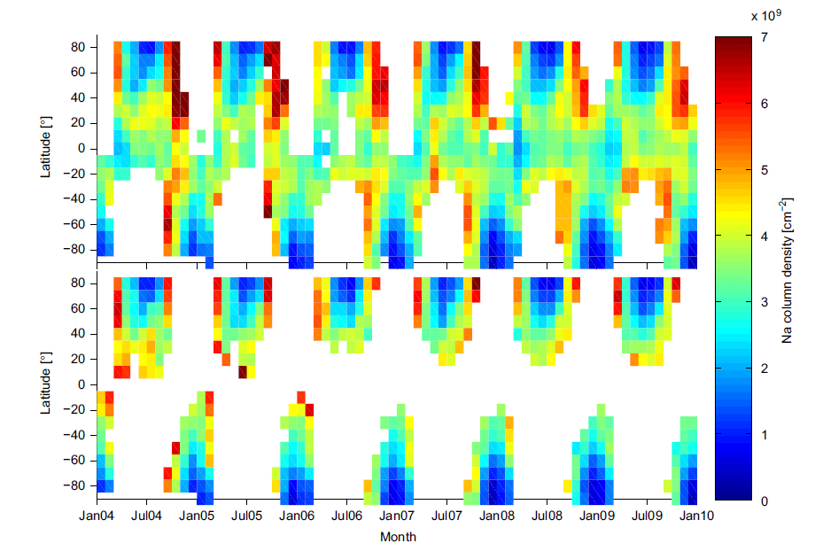
Observing the MLT: meteoroids and metals.
Pfrommer et al. (2009)
Typical mean mid-latitude Na metal layer profile
[removed due to file size issues]
Simulation of global meteoric sodium.
Dawkins et al. (2015)
Dawkins et al. (2015)
https://www.iap-kborn.de/
Courtesy of D. Janches/D. Marsh
Hedin and Gumbel (2011)

Slide 23
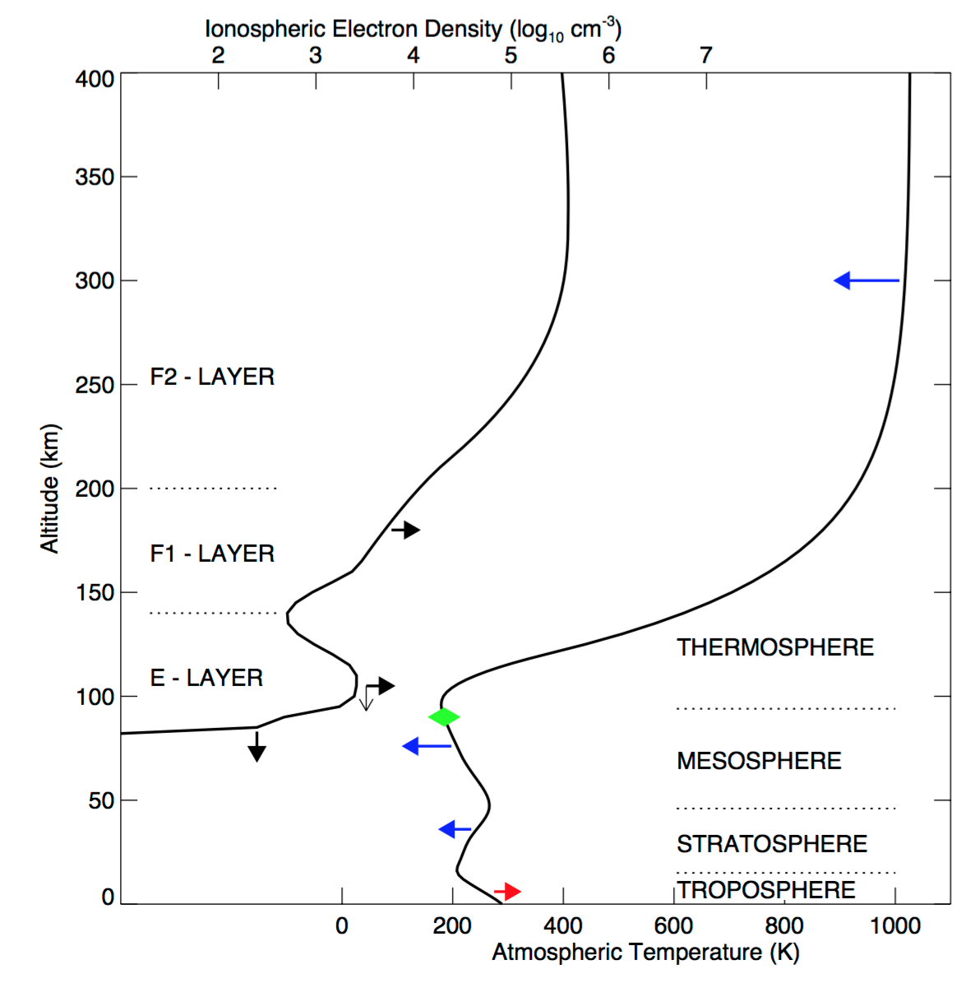
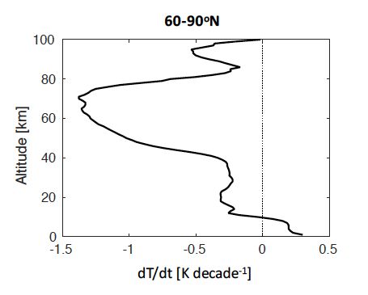
How is our atmosphere changing?
thermosphere
mesosphere
Cooling in upper atmosphere
Decadal temperature change
stratosphere
troposphere
Warming in lower atmosphere
Laštovička et al. 2008

Slide 24
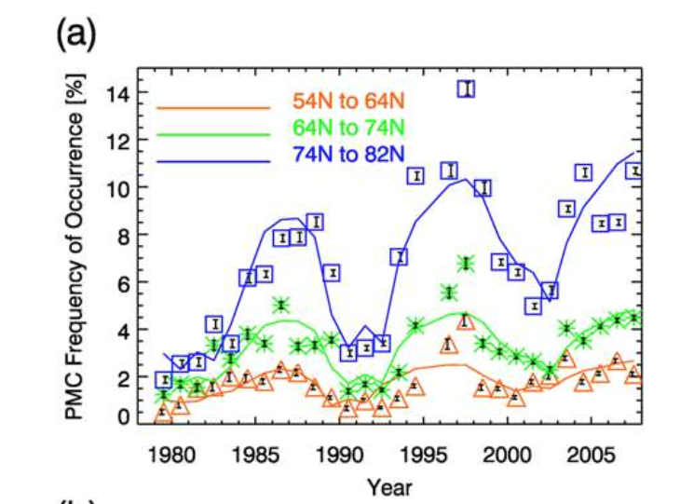
Credit: Mike Hollingshead
How is our atmosphere changing?
Image: NASA AIM/CIPS
esrl/noaa.gov
Emmert et al. (2007)
Analyses of satellite drag data indicate a long-term trend of decreasing thermosphere densities.
Shettle et al. (2009)

Slide 25
Space weather and our neutral atmosphere
Randall et al.

Slide 27
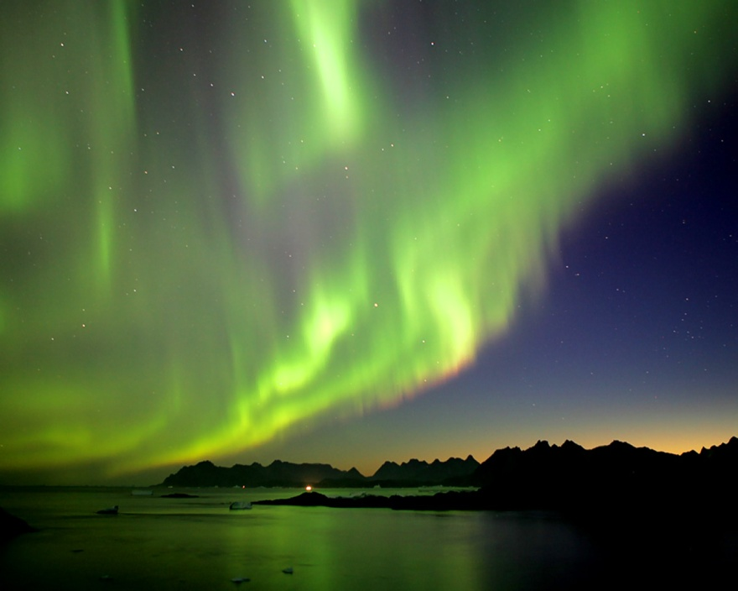
Summary
erin.dawkins@nasa.gov
Each layer of the atmosphere is well-defined.
Vertical coupling between all parts of the neutral atmosphere.
All parts of the Earth-Sun system interlinked.
Our neutral atmosphere is changing. Important to monitor and improve understanding of these.

Slide 28
Image: Forbes and Fritts

