Slide 1
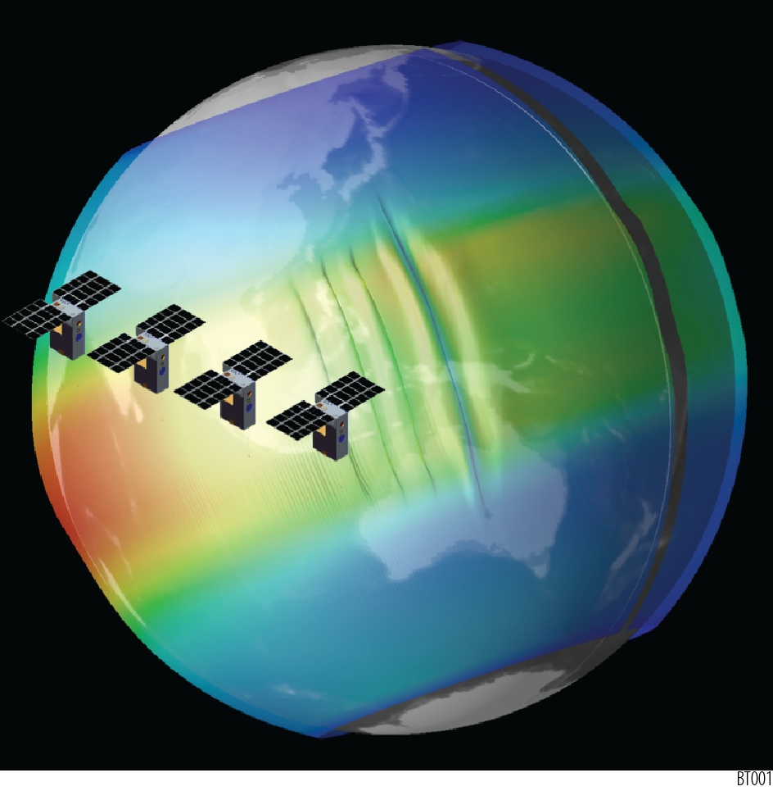
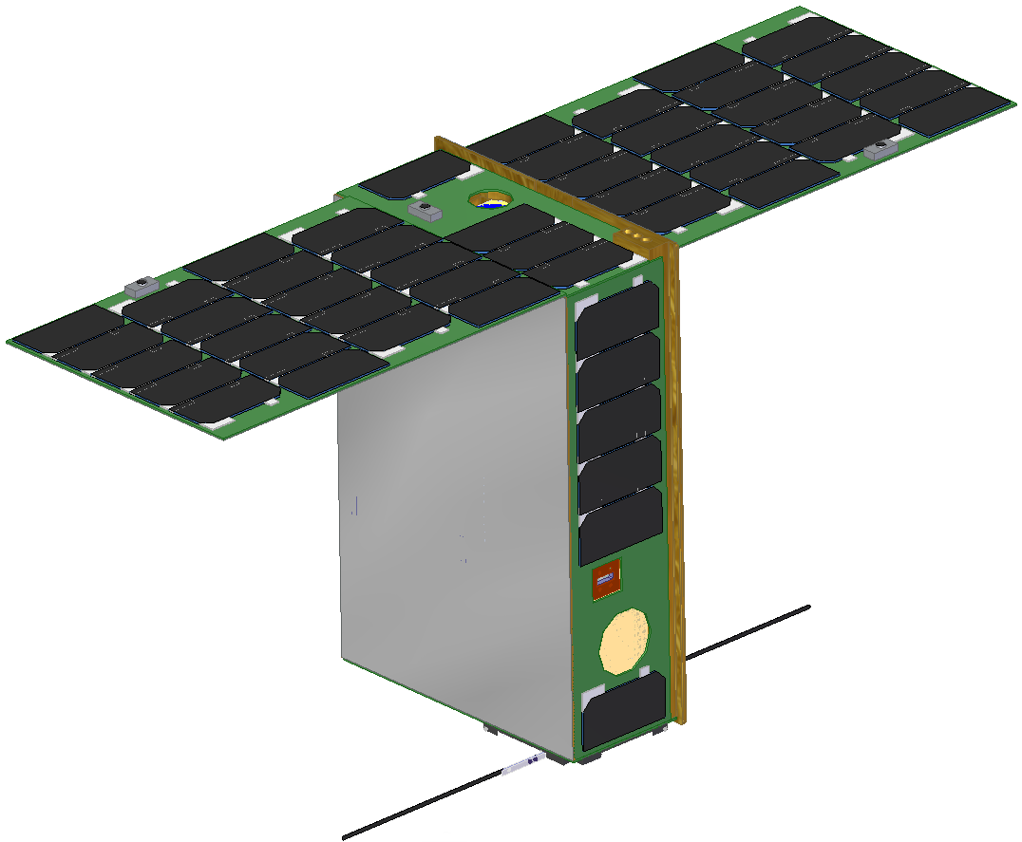
From Space Climate to Space Weather
Mission concepts to unravel the enigma of ionospheric plasma density structures
Jeff Klenzing (674)
and the petitSat and BOWTIE teams

Slide 2
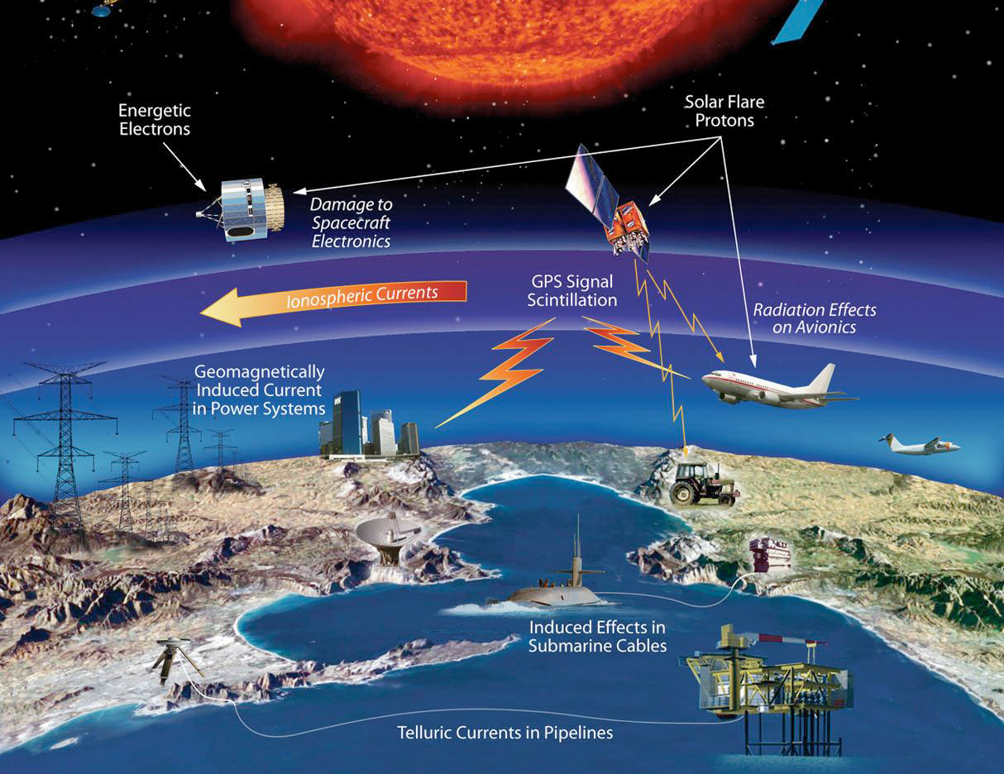
Roadmap
Plasma Bubbles and Communication Outages
How do these bubbles and other plasma structures form?
Mission Concepts
petitSat: Connecting plasma enhancements to neutral wave activity
BOWTIE: Identifying onset conditions of bubbles

Slide 3
Space Weather

Slide 4
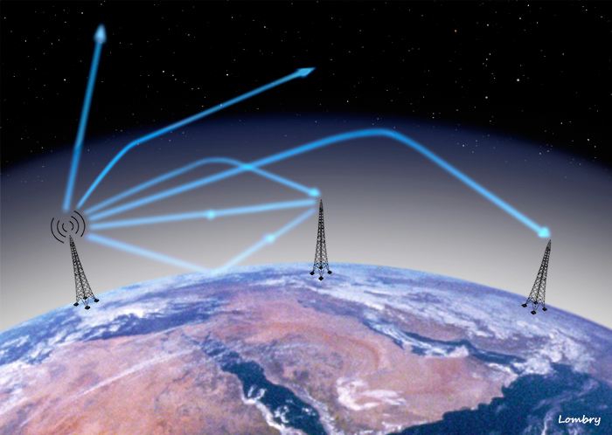
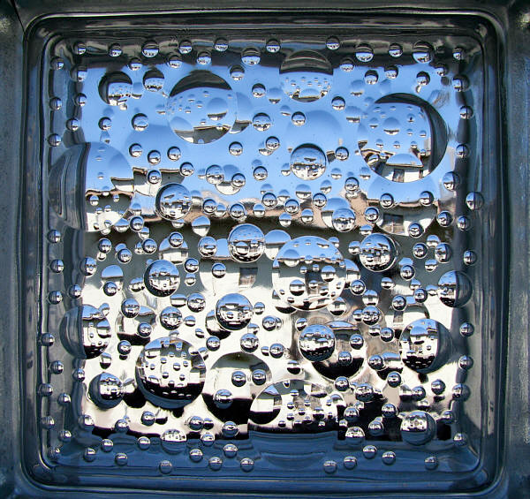
Radio waves in the Ionosphere
Transmission
Refraction
Reflection
Plasma bubbles disperse electromagnetic waves, affecting radar, GPS, and communications signals.
image from http://www.astrosurf.com/luxorion

Slide 5
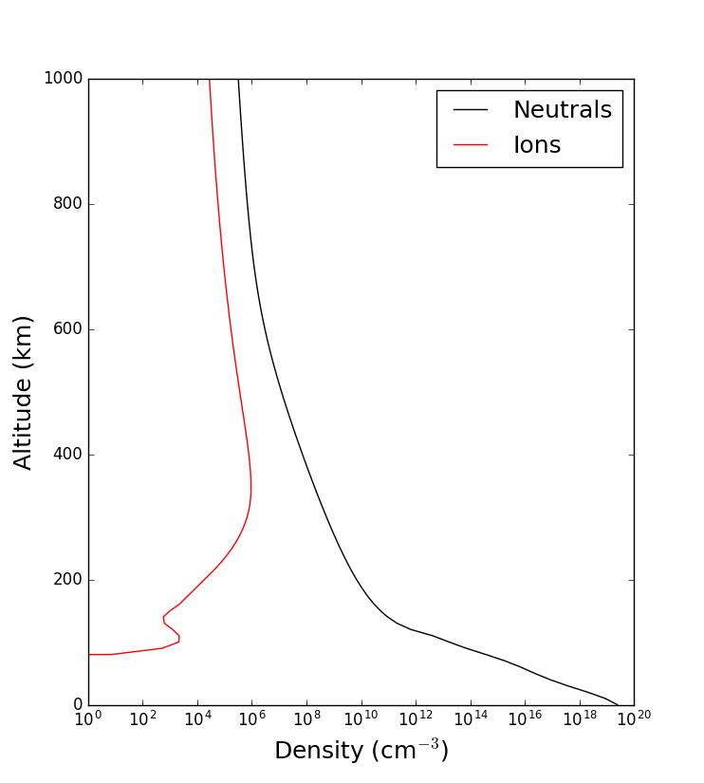
What drives the Ionosphere?
Electrodynamics
Solar EUV
Electrodynamics and Fluid Dynamics create and support a variety of plasma structures
Fluid Dynamics

Slide 6
Neutral Pressure Contours

Slide 7
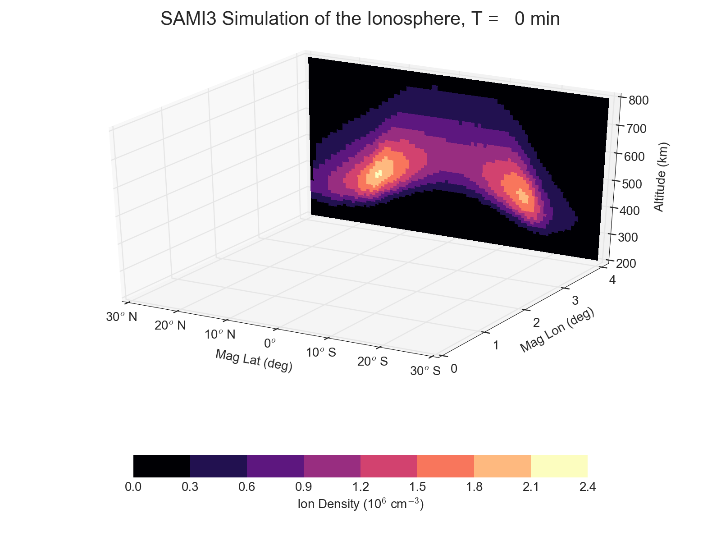
simulation courtesy Joe Huba, NRL

Slide 8
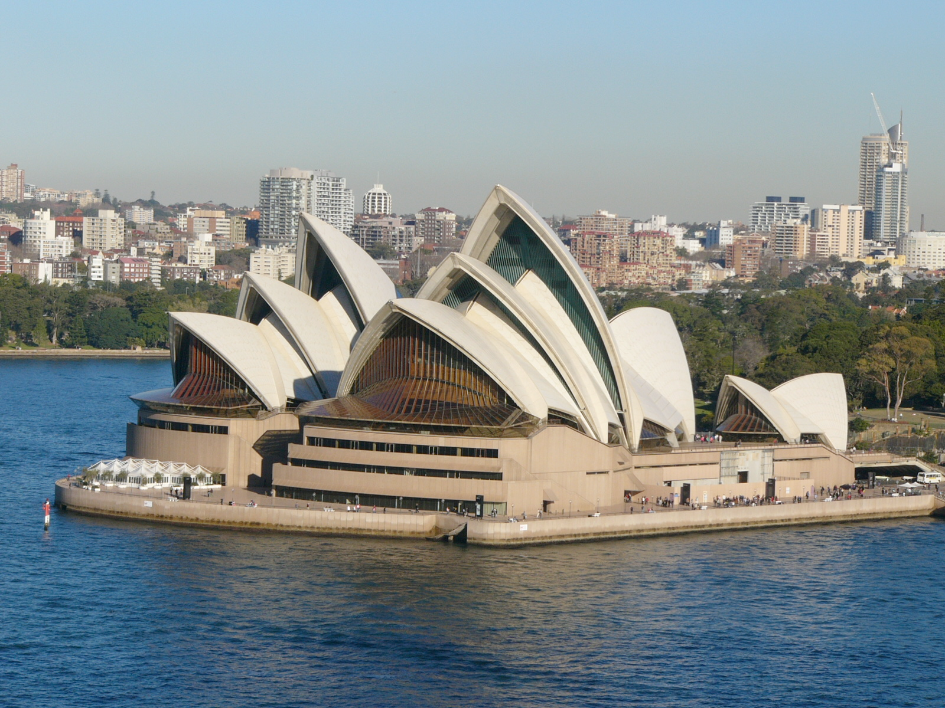
simulation courtesy Joe Huba, NRL

Slide 9
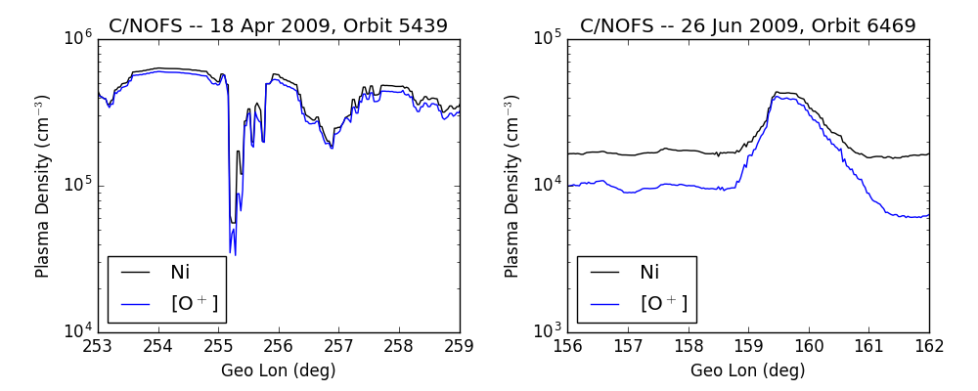
Plasma Structure as viewed by Satellite
Plasma Depletion
“Bubble”
Plasma Enhancement
“Blob”

Slide 10
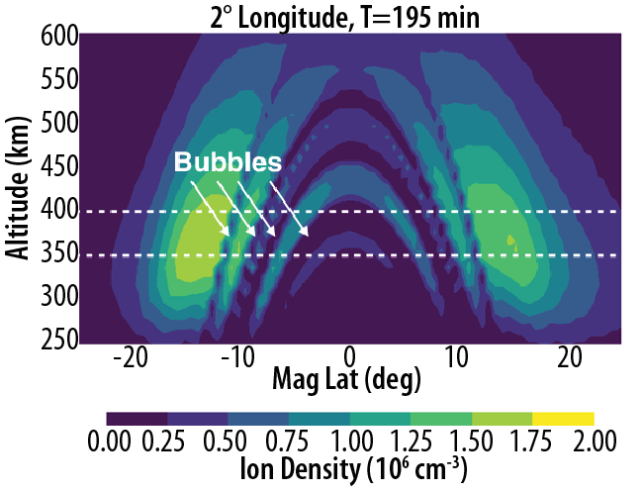
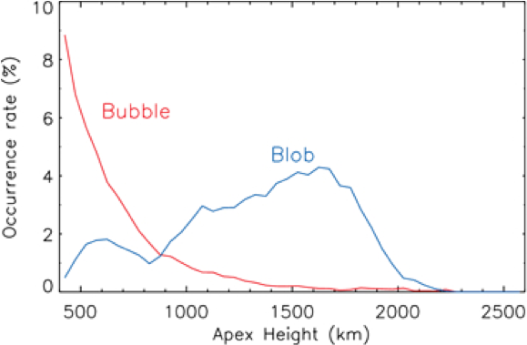
Are Plasma Enhancements related to Bubbles?
Previously, many statistical surveys combined all irregularities. Local enhancements in plasma can form on the edge of a bubble due to the electric fields generated by the bubble.
C/NOFS Results
[Choi et al, 2011]

Slide 11
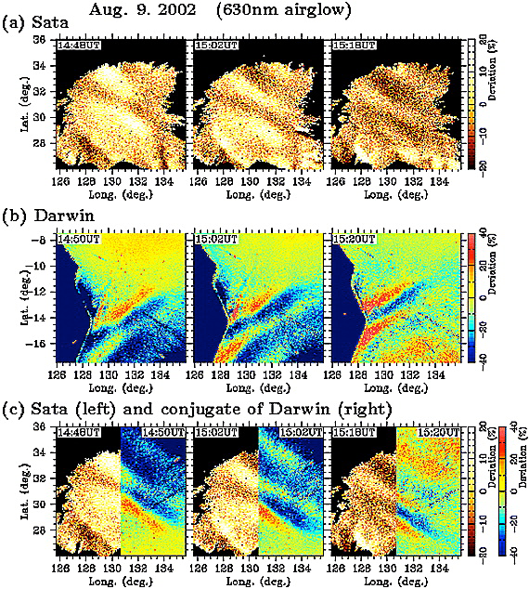
Are Plasma Enhancements formed by MSTIDs?
Medium-Scale Traveling Ionosphere Disturbances
Wave-like structures propagating westward and equatorward
Waves in one hemisphere can map to the other
[Otsuka et al, 2004]

Slide 13
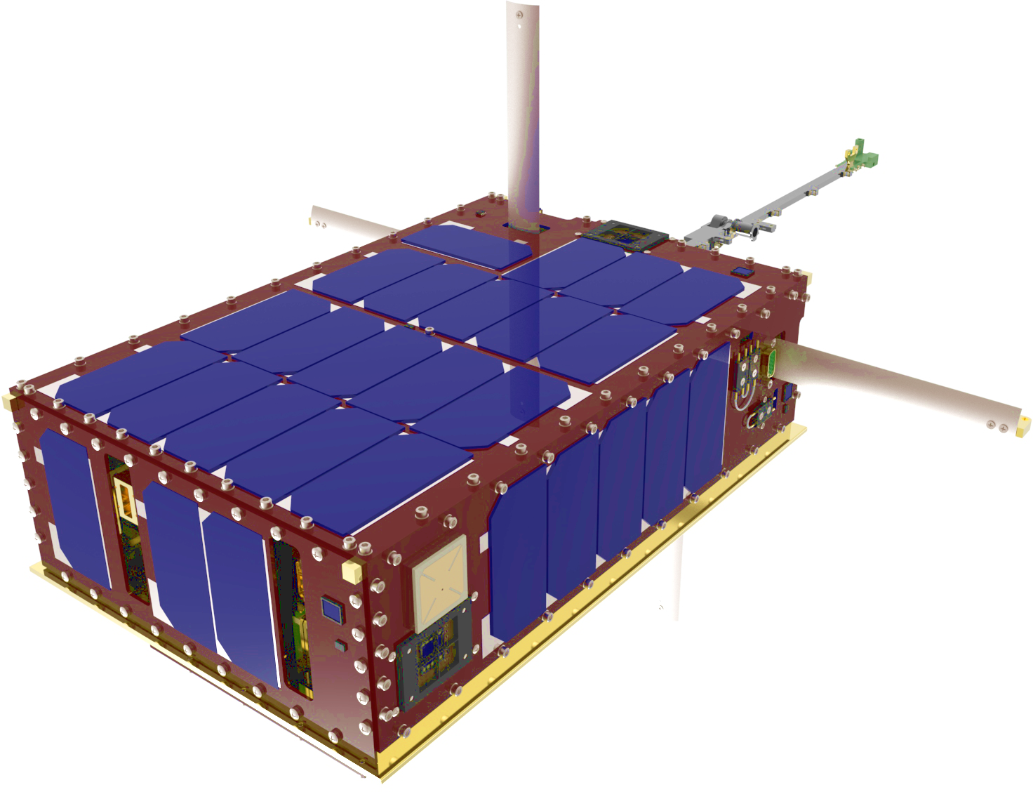
What do we need?
A satellite in a mid-inclination orbit low enough to observe the F-region ionosphere.
Ion densities and 3D drifts to identify plasma blobs and the flow structure within.
Neutral composition to identify local waves in the neutral atmosphere.
Ground-based imagers to confirm MSTID behavior.

Slide 14
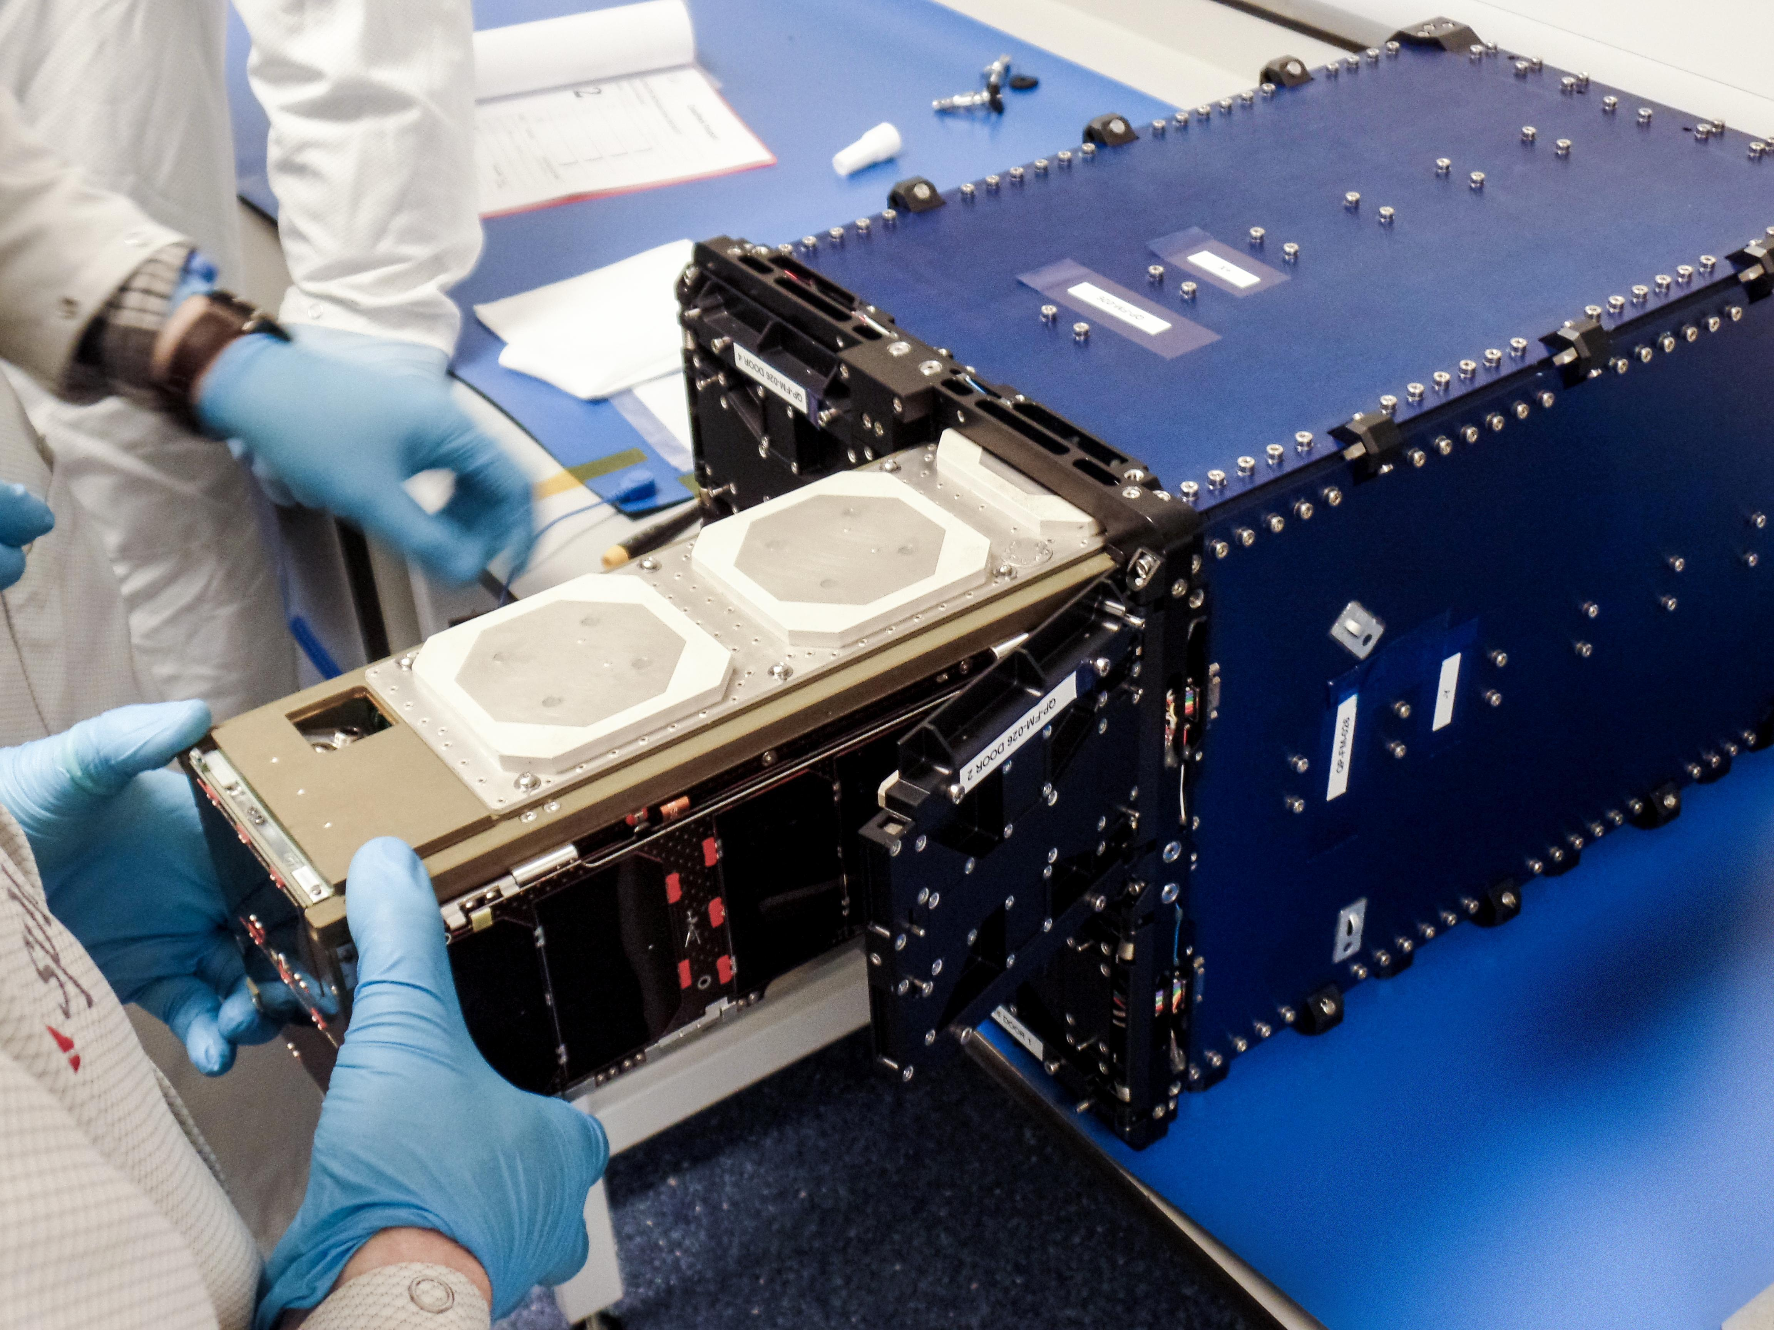
What is a CubeSat?
Small Spacecraft designed to be launched from a canisterized dispenser.
1U = 10 cm Cube
Launch as a secondary payload from International Space Station or commercial satellites.
30 cm
10 cm
20 cm

Slide 15
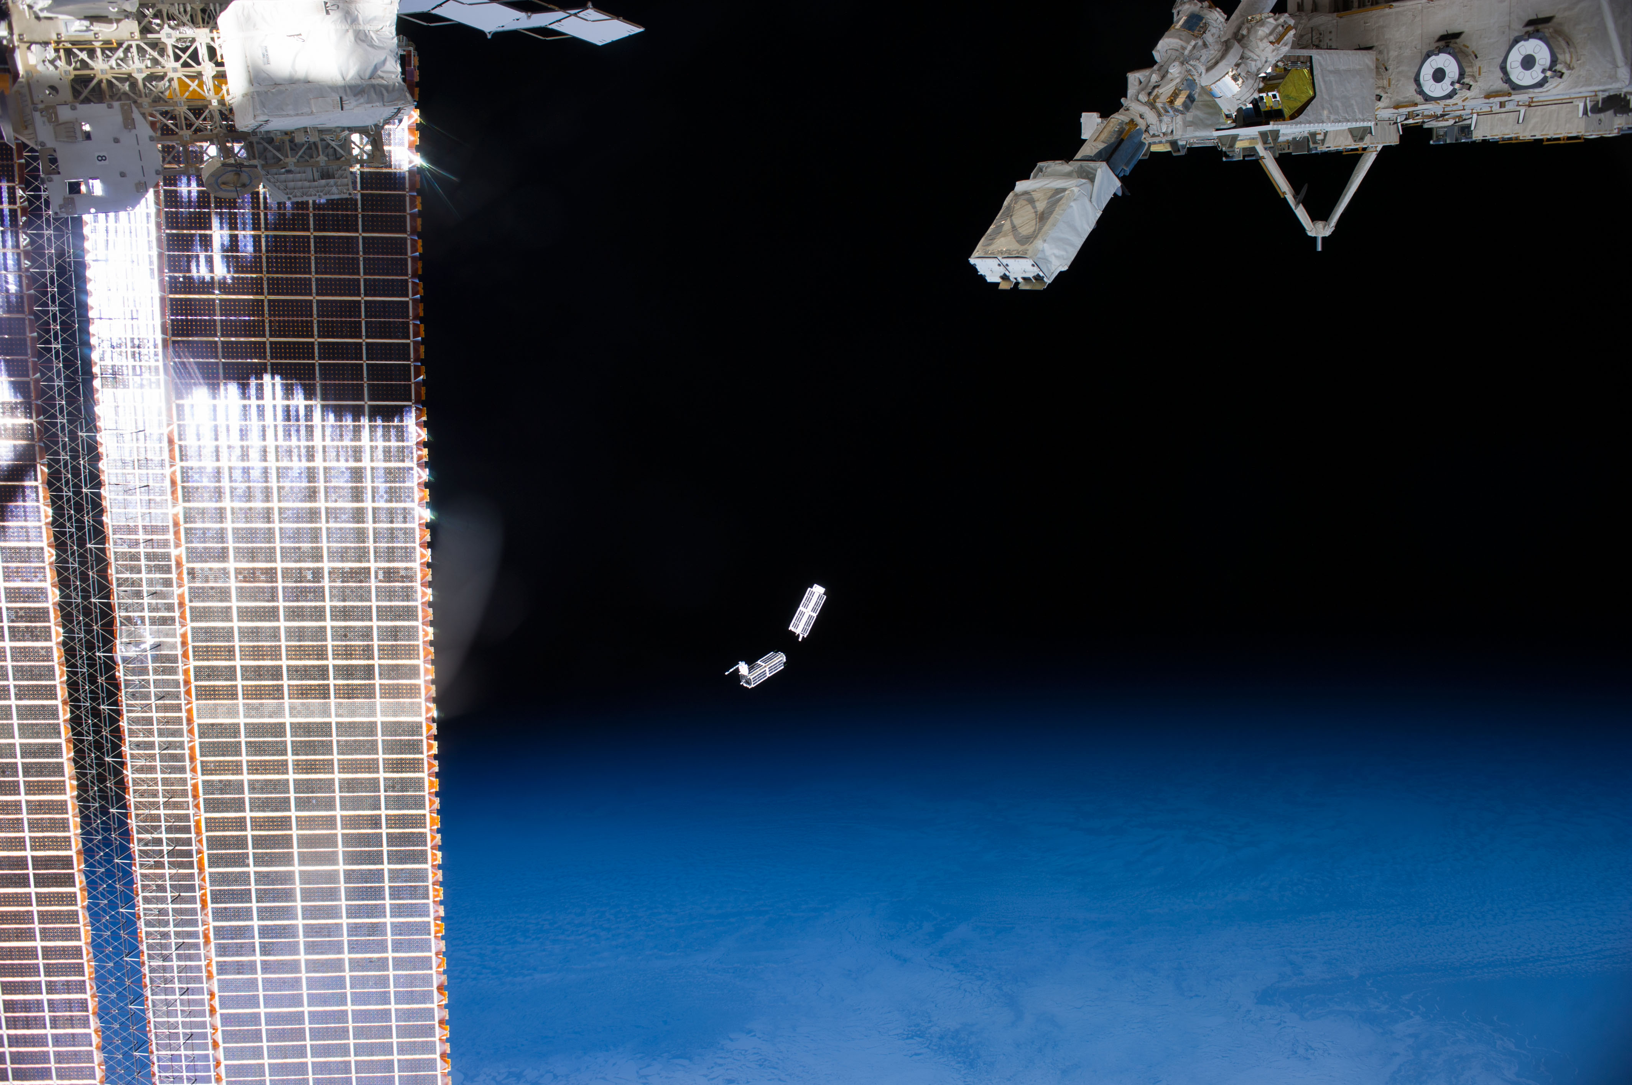

Slide 16
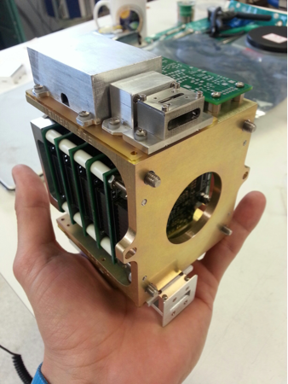
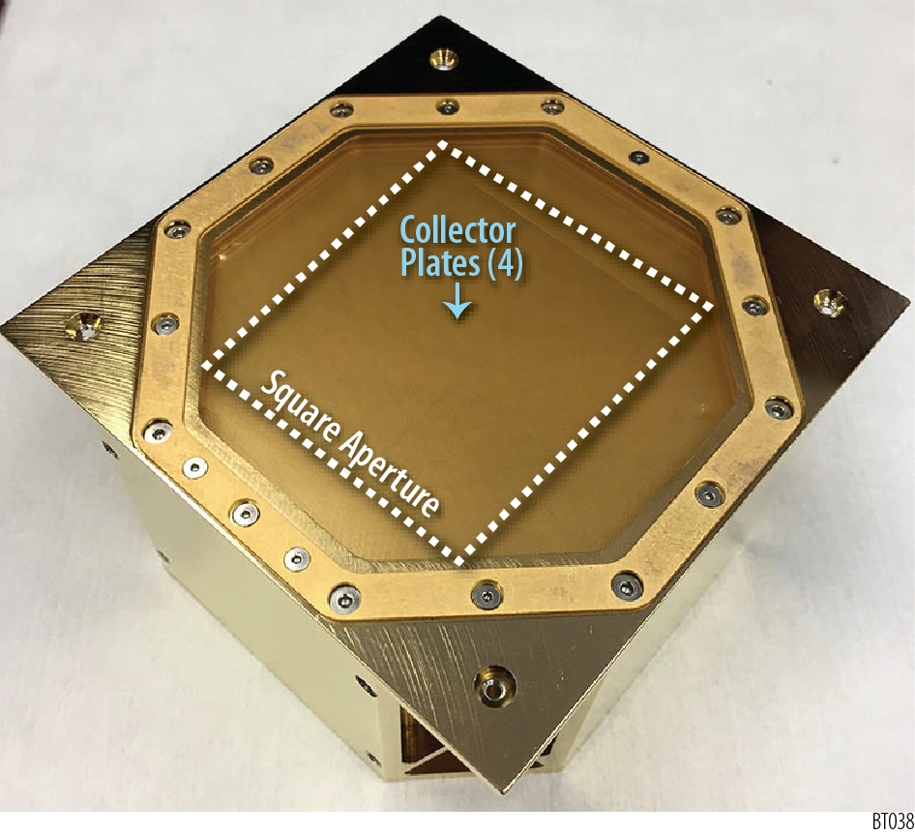
petitSat
NMS
Plasma Enhancements in The Ionosphere-Thermosphere
6U H-TIDeS CubeSat based on Dellingr
Scheduled for a 2020 launch from the ISS
Neutral Mass Spectrometer (NMS, GSFC) - identify local neutral waves
Gridded Retarding Ion Distribution Sensor (GRIDS, USU/VT) - identify plasma enhancements and drift structures
GRIDS

Slide 17
petitSat
NMS
Star Tracker
GRIDS
Deployable Solar Panels

Slide 18
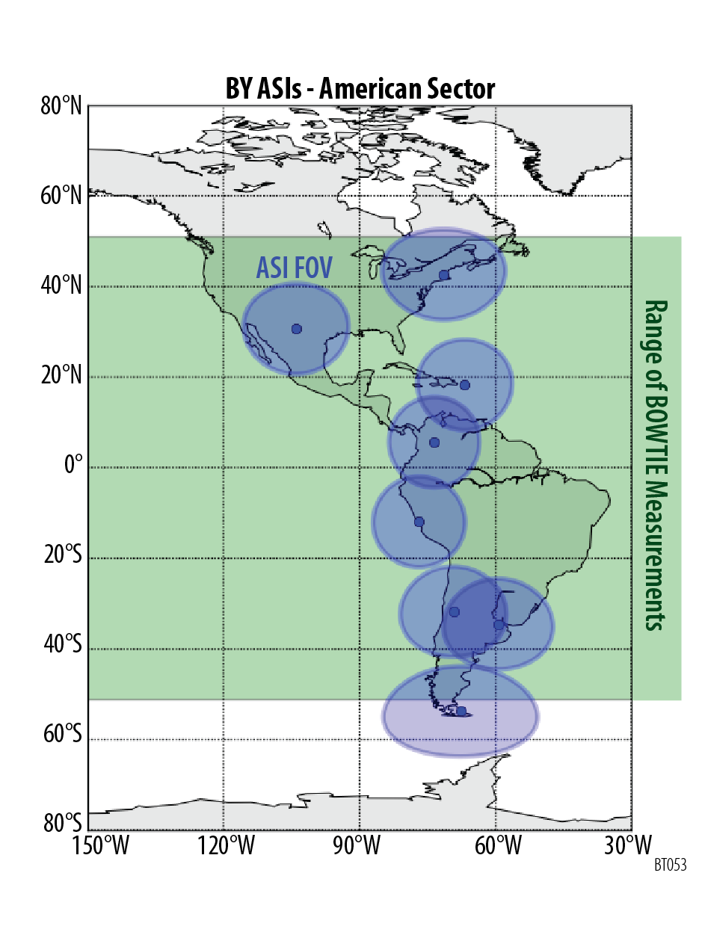
BU ASI Network - American Sector
petitSat will provide the first comprehensive study of plasma density enhancements and their causes
Instrument | Identifies
GRIDS | Plasma Enhancements
NMS | Local Neutral Waves
ASI | MSTIDs
Range of petitSat Measurements

Slide 19
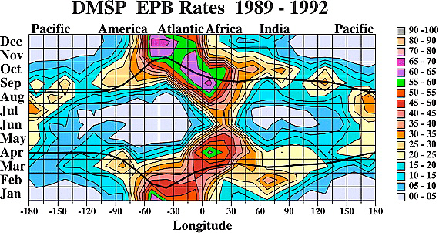
The next step: Forecasting
Probability of observing a bubble at 800km
[Gentile et al, 2004]
We can identify the probability of bubbles forming in a season, but not on a given day.

Slide 20
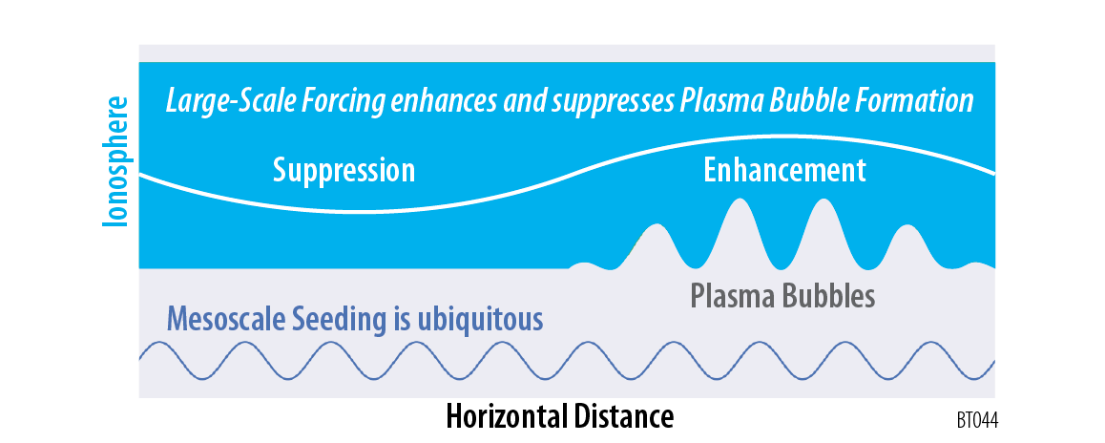
What is the effect of large-scale forcing on bubble formation?

Slide 21
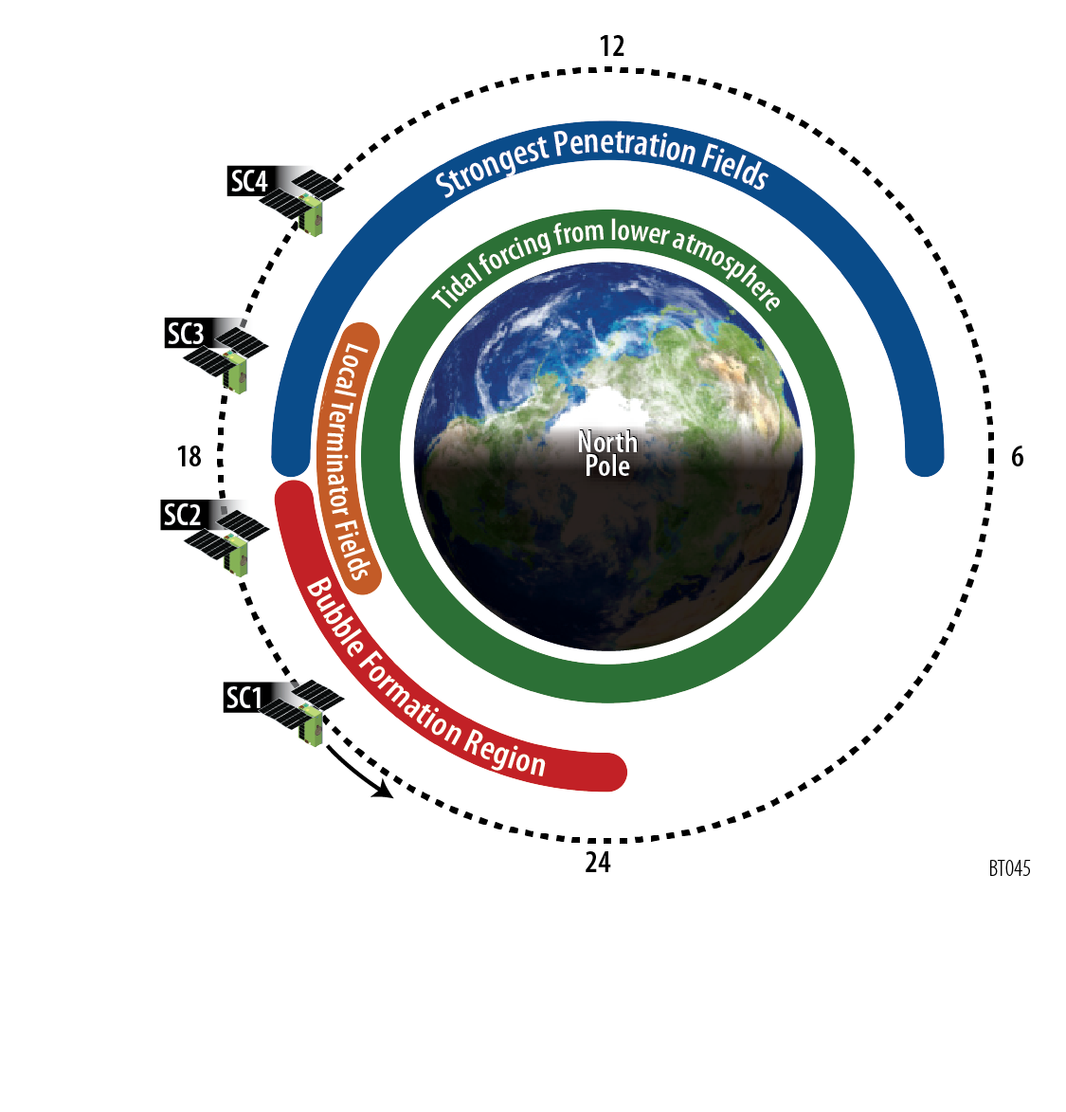
Use a CubeSat Constellation to Identify the sources of bubbles
Four spacecraft flown as “pearls on a string” untangle the spatial and temporal variations in the ionosphere.
Organized by | Caused by
Longitude | non-migrating Tides
Local Time | Local Terminator Fields
UT | High-lat forcing

Slide 22
Summary
Plasma bubbles in the ionosphere disrupt critical radio signals, including radar, GPS and communication signals.
To aid forecasting, CubeSats can aid by providing new research:
petitSat - bubbles need to be isolated from plasma irregularities from other sources.
CubeSat constellation - separate spatial and temporal variations to understand how external forcing can enhance and suppress bubble growth.

