Slide 1
iSWA layouts

Slide 2
Purpose of layouts
Monitoring space weather activities
Event monitoring/study
Anomaly
Comparative study
Weekly summary and highlights of specifics

Slide 3
Layouts - examples
Launch relevant iSWA cygnets
http://bit.ly/products_launch_relevant
http://aia.lmsal.com/public/instrument.htm
http://www.nasa.gov/mission_pages/sunearth/news/light-wavelengths.html#.V1cbSFf1aOp
The March 15, 2015 storm
http://bit.ly/20150317_geomagnetic_storm
Coronal holes
http://bit.ly/HSS_20150607_extended
AR2192 X class flares and the Oct 14 CME
http://bit.ly/AR2192_XclassFlares_oct14CME

Slide 4
Layouts - examples
The Jan 23 – 27, 2012 SEP events
http://bit.ly/Jan23_27_2012_layout
AR 1429 timeline
http://bit.ly/AR1429_timeline_all
The Galaxy 15 Event
http://bit.ly/galaxy15_charging_event

Slide 5
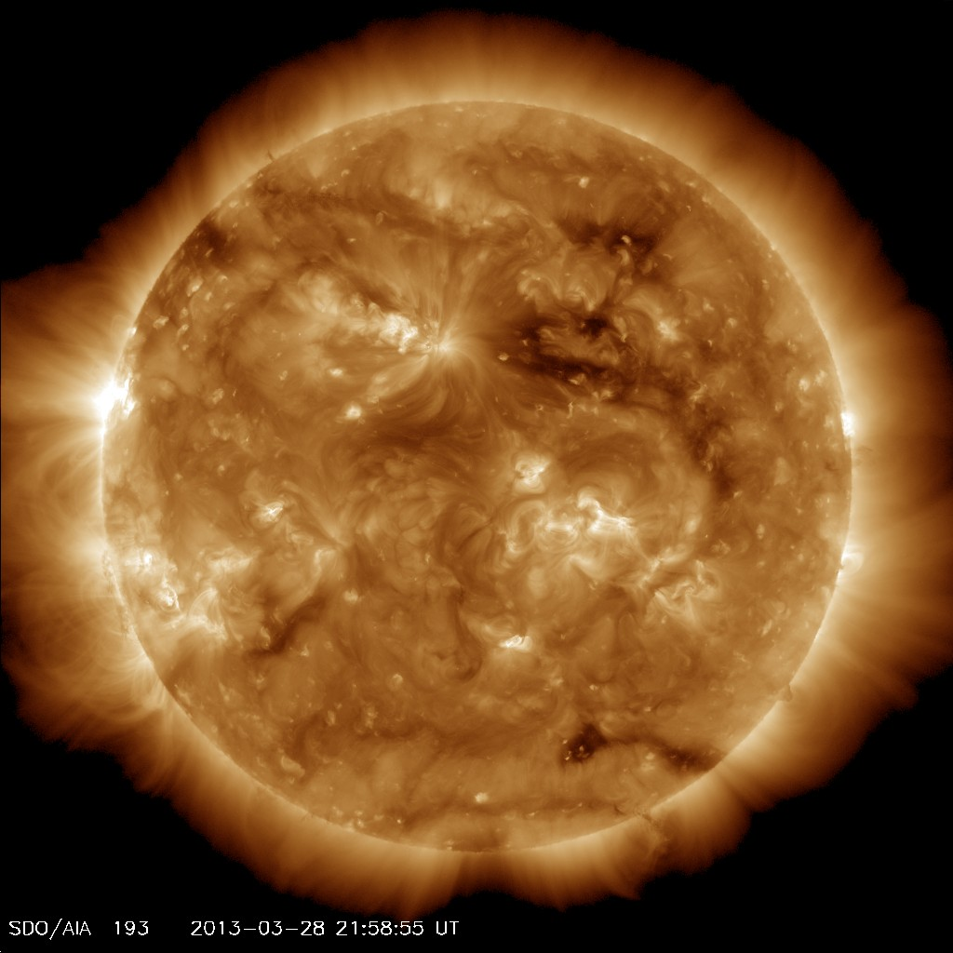
The Coronal Hole possibly responsible for the aurora at Saturn around May 20, 2013
Coronal Hole
Well, I tried ☺
Notes:
It took nearly two months for the solar wind to travel to Saturn

Slide 6
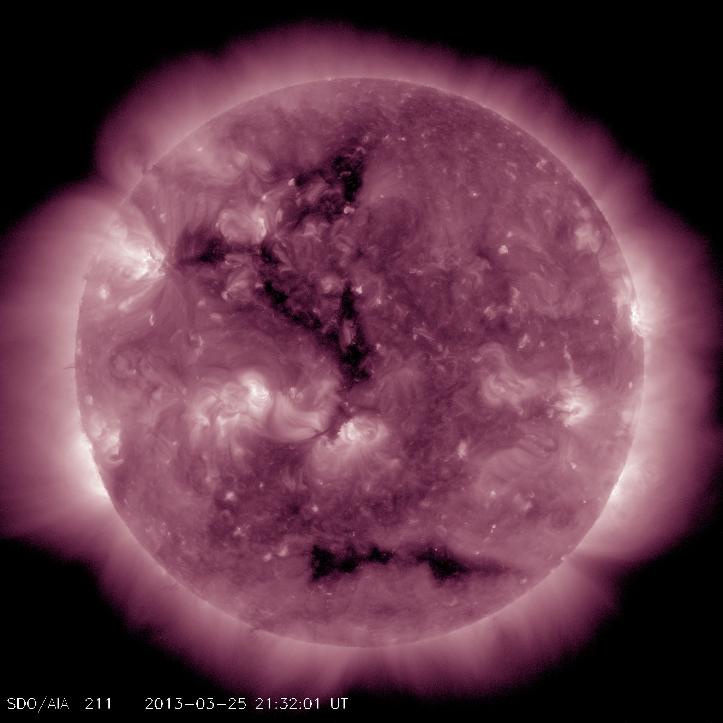
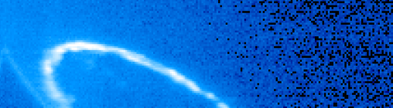
The Coronal Hole possibly responsible for the aurora at Saturn around May 20, 2013
Day 111 ~06:26 UT
Day 112~03:47 UT
Day 112~05:21 UT

Slide 7
Other layouts
http://swrc.gsfc.nasa.gov/main/demo
Examine various layouts here

