Slide 1
Community Coordinated Modeling Center (CCMC)
Tour of CCMC Models.
Runs-on-Request:
Global Magnetosphere Models
Masha Kuznetsova & CCMC Team
Notes:
Welcome to the “Introduction to Space Weather: Tools and Concepts” School. My name is Masha Kuznetsova. I am leading the Community Coordinated Modeling Center (CCMC). The CCMC (http://ccmc.gsfc.nasa.gov) is an asset of US multi-agency partnership including sponsoring agencies NASA and National Science Foundation. CCMC is also an asset of the entire space science and space weather community world-wide. Several members of the CCMC team came to this workshop to provide support for this school. You will learn more about CCMC, its tools and services during this school and workshop.
CCMC Staff: http://ccmc.gsfc.nasa.gov/staff/index.php
CCMC Staff attending the Workshop (at your service):
Masha Kuznetsova (magnetosphere scientist, CCMC director)
Marlo Maddox (lead developer of CCMC Integrated Space Weather Analysis System http://iswa.ccmc.gsfc.nasa.gov)
Yihua Zheng (magnetosphere and space weather scientist and analyst, lead of CCMC Space Weather Research, Education and Development Initiative (Space Weather REDI, http://ccmc.gsfc.nasa.gov/support/SWREDI/swredi.php)
Sandro Taktakishvili (solar and space weather scientist and analyst)
Ja Soon Shim (ionosphere scientist)
Satabjit Bakshi (CCMC IT Infrastucture engineer)
Alex Glocer (magnetosphere scientist, CCMC advisor)

Slide 2
Dissemination of Space Weather Resources:
CCMC Runs-on-Request (RoR) System
Knowledge/
Understanding
Observational Data
Models
Dissemination
Models are served to the international research community
MODELS
DATA
http://ccmc.gsfc.nasa.gov
Notes:
Dissemination of simulation results was an issue prior to CCMC (before 2000).
The CCMC brings you the power to access state of the art modeling capabilities through your laptop.
During one of the hands-on sessions you will learn how to use CCMC Runs-on-Request system.

Slide 3
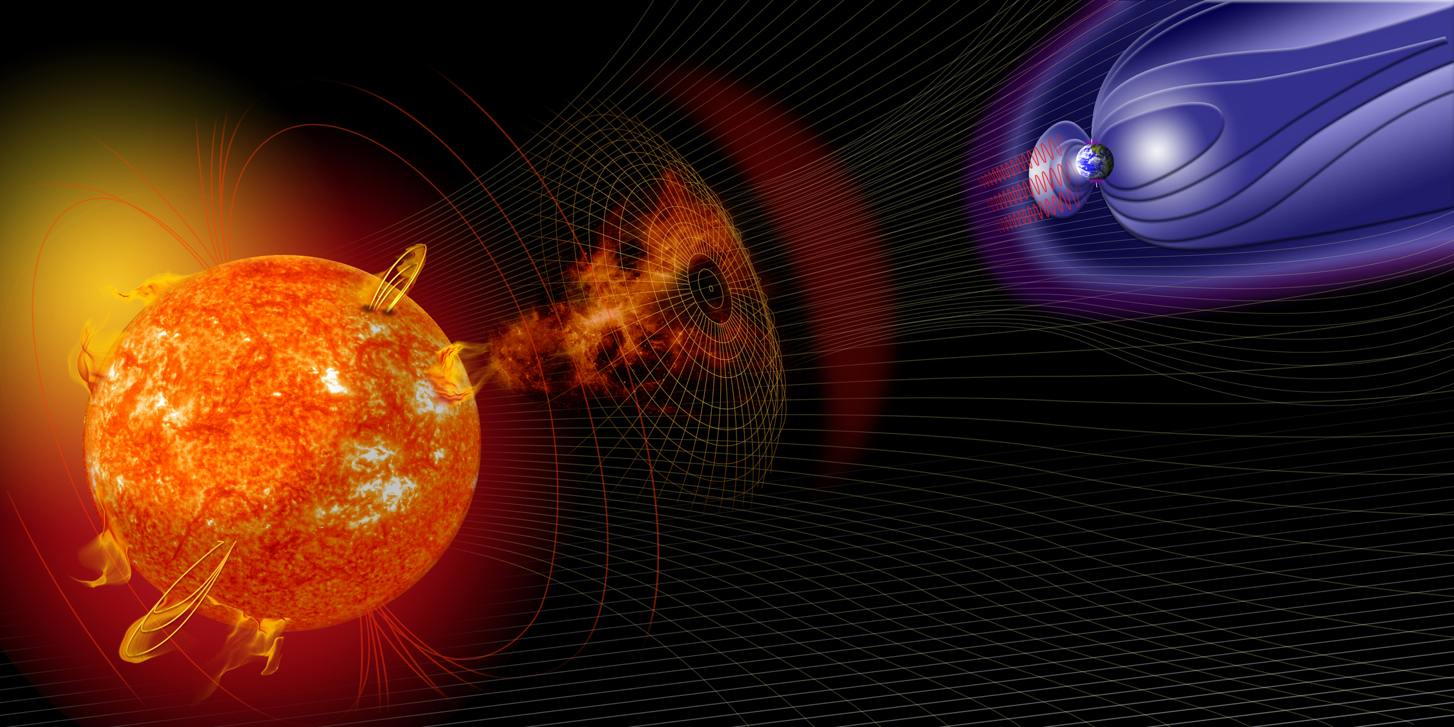
Expanding Collection of Models at CCMC: > 80
LFM-TING
GUMICS
SAMI-2
SAMI-3
SWMF.SC
LFM-MIX
TIE-GCM
PFSS.Petrie
GIC
ENLIL
CTIPe
IRI
PFSS.Macneice
OpenGGCM
Posner SEP
USU-GAIM
PFSS.Luhmann
SWMF+RCM+deltaB
RCM
ANMHD
PREDICCS
SWMF+RCM
Fok.CIMI
SWACI-TEC
MODEL ZOOM IN HERE
EXO Solar Wind
SWMF+RCM+RBE
Fok.RC
ABBYNormal
UMASEP
EMMREM
SWMF+RCM+CRCM
UPOS RB
MSIS
SRPM
LFM-MIX-TIEGCM
CORHEL
AE-8/AP-8
GITM
MAG4
WINDMI
LANLstar
Heltomo SMEI
AE-9/AP-9
PBMOD
ASAP
IGRF
Tsyganenko
ENLIL+Cone
VERB
TRIPL-DA
WSA
Fok RBE
Weigel-deltaB
Heltomo IPS
Weimer IE
MAGIC
PS VP
Apex
BRYNTRN
Weimer-deltaB
AACGM
Ovation Prime
ASSA
SNB3GEO
SWMF.SH
JB2008
NLFFF.Wiegelmann
COSGROVE-PF
Corona
Heliosphere
Magnetosphere
Inner
Magnetosphere
Ionosphere/Thermosphere
Notes:
Expanding collections of space environment models and model chains cover the entire domain from the solar corona to the Earth’s upper atmosphere.
In the next slide I will present a few examples illustrating different sub-domain using simulation results of different models.

Slide 4
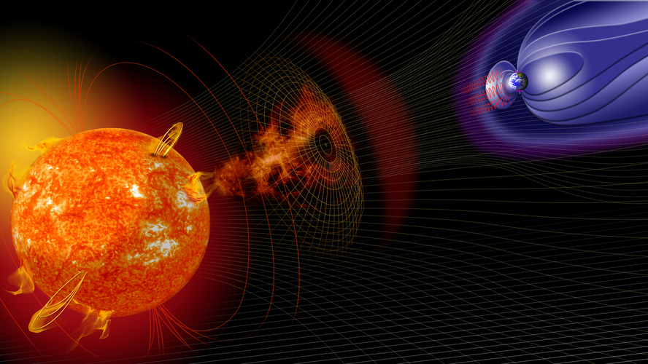
Space Environment Spatial Scales
Heliosphere: ~ 100 au ~ 100 au
From Sun to Saturn: ~ 10 au
From Sun to Earth: 1 au ~ 150,000,000 km
1 a.u ~ 200 Solar radii (Rs)
Earth
Ionosphere/
Thermosphere
Earth Magnetosphere
Sun
1 Solar radius ~ 110 Earth radii (Re)
1 Earth’s radius (Re) = 6370 km
Geosynchronous orbit 6.6 Re
Kinetic scales: ~100 m – 0.1 Re
Plasma structures
in ionosphere: ~ 1 m – 100 m
Diversity of spatial scales : > 10¹⁰
There is a strong coupling between the scales
Notes:
To summarize our ran through the space weather phenomena in heliopshere let’s review spatial scale of the space weather system.
Heliosphere: ~ 100 au
From Sun to Saturn: ~ 10 au
From Sun to Jupiter: ~ 5 au
From Sun to Earth: 1 au ~ 150,000,000 km
1 a.u ~ 200 Solar radii (Rs)
1 Solar radius ~ 110 Earth radii (Re)
1 Earth’s radius (Re) = 6370 km
Geosynchronous orbit 6.6 Re
Kinetic scales: ~100 m – 0.1 Re
(depending on particle mass, energy, local magnetic field strength)
Diversity of spatial scales (more that 10 orders of magnitude).
For comparison: terrestrial weather spatial domain is about 30 km thick (wrapped around the Earth).
Typical clouds extend no further than only 10 km, about the height of Mt. Everest.
No wonder that understanding and forecasting space weather is a serious challenge.

Slide 5
Type of Models
Empirical Models
Physics-based (first principle models with different approximations). Examples:
- Magnetohydrodynamics (MHD) – single species fluid
- Multi-fluid, Hall MHD
- Kinetic (particles)
Data assimilative

Slide 6
Modeling Sub-Domains
Solar Corona [ Rs ]: 1-2.5 Rs, 1-20 Rs
Heliosphere [au]: 1-2 au, 1-10 au +
Global Magnetosphere [Re]:
2 -3 Re – inner boundary
20 – 40 Re – inflow boundary
(- 1000) – (-300 Re) – tailward boundary
Ionosphere Electrodynamics: on the sphere (120 km)
Inner Magnetosphere [Re]: 1-8 Re
- ring current ( 1- 8 Re)
- radiation belts
Ionosphere [km]: 80 – 1000 km
Notes:
To address the issue of diversity of special scales the heliosphere is divided (for modeling purposes) into subdomains.
Different levels of approximations is required in different sub-domains depending on the underlying physical process.
There is a strong coupling between some subdomains
To trace CME propagation from the solar corona to the Earth’s upper atmosphere – coupling model chain are required.
Community is building “Space Weather Modeling Frameworks”.

Slide 7
Multi-scale models, coupled model chains and adaptive simulation grids are required to model impacts from the Sun
Example: Space Weather Modeling Framework (SWMF), Gombosi et al, U. Mich.

Slide 8
Runs-on-Request
Models are served to the international research community
through web-based interactive Runs-on-Request service
Super Computing Clusters
> 2400 CPU’s
Searchable Simulation Archive
(>14,000 runs)
Peta-Bytes of Data Storage
Online
Visualization & Downloads
ccmc.gsfc.nasa.gov
Requests
Results
(since 2001)
User-configurable input parameters and model settings.
Users advising and custom simulations.
Create synergy between analysis of observational data and scientific modeling.
Maximize return on investments into model development.

Slide 9
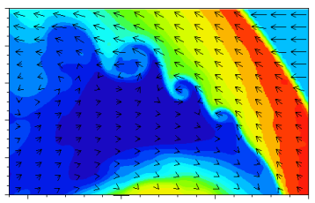
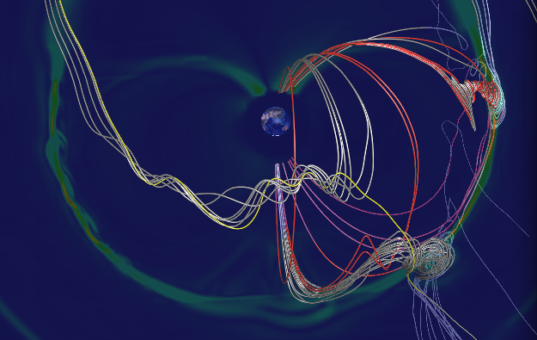
Interactive On-line Visualization & Analysis
Basic model output and derived quantities.
User-ordered custom variables (email the formula to Lutz and it will be tested & added).
Automated movie & time series generation.
Time series plotter & analyzer.
2D slices, Line plots, 3D flow lines, ASCII lists
Magnetic mapping.
Interfaces with Virtual Observatories.
Change-Log on CCMC web page.
Choose Quantities:
Lutz Rastaetter

Slide 10
Expanding Collection of Models at CCMC: > 80
LFM-TING
GUMICS
SAMI-2
SAMI-3
SWMF.SC
LFM-MIX
TIE-GCM
PFSS.Petrie
GIC
ENLIL
CTIPe
IRI
PFSS.Macneice
OpenGGCM
Posner SEP
USU-GAIM
PFSS.Luhmann
SWMF+RCM+deltaB
RCM
ANMHD
PREDICCS
SWMF+RCM
Fok.CIMI
SWACI-TEC
MODEL ZOOM IN HERE
EXO Solar Wind
SWMF+RCM+RBE
Fok.RC
ABBYNormal
UMASEP
EMMREM
SWMF+RCM+CRCM
UPOS RB
MSIS
SRPM
LFM-MIX-TIEGCM
CORHEL
AE-8/AP-8
GITM
MAG4
WINDMI
LANLstar
Heltomo SMEI
AE-9/AP-9
PBMOD
ASAP
IGRF
Tsyganenko
ENLIL+Cone
VERB
TRIPL-DA
WSA
Fok RBE
Weigel-deltaB
Heltomo IPS
Weimer IE
MAGIC
PS VP
Apex
BRYNTRN
Weimer-deltaB
AACGM
Ovation Prime
ASSA
SNB3GEO
SWMF.SH
JB2008
NLFFF.Wiegelmann
COSGROVE-PF
Notes:
Models sorted by domain at the CCMC website:
http://ccmc.gsfc.nasa.gov

Slide 11
Solar Magnetograms: Input for Models of Solar Corona
Notes:
Solar magnetograms are used as input for models of Solar Corona

Slide 12
Nonlinear Force-Free 3-D Coronal Magnetic Field Reconstruction
Solar Corona:
1-2.5 Rs, 1-20 Rs
NLFFF
Wiegelmann
Model
Notes:
Solar Corona models
Solar Corona [ Rs ]: 1-2.5 Rs, 1-20 Rs

Slide 13
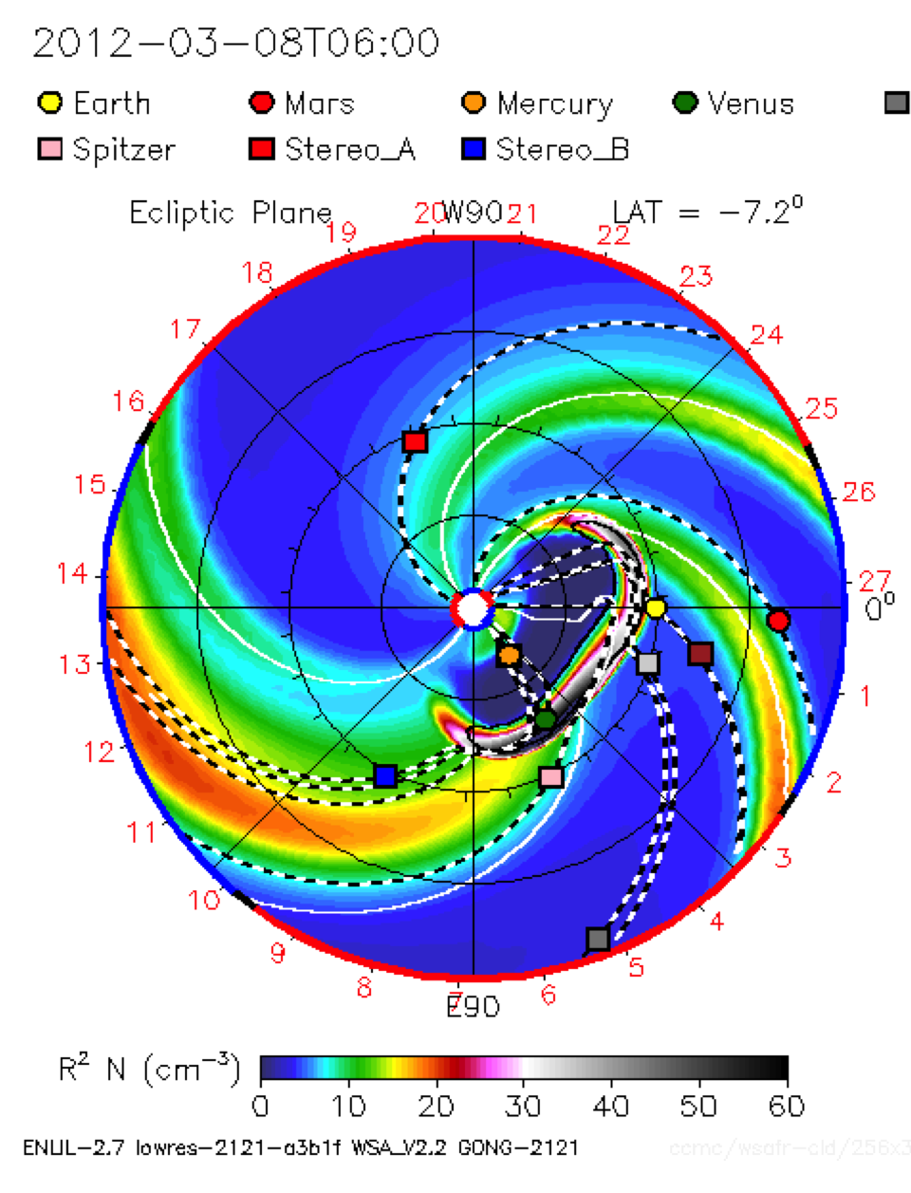
Heliospheric Model Enlil
Inner
Heliosphere:
21.5 Rs – 2 a.u.
Spiral (IMF field-line)
Sun
Earth
Solar Equator
Lat=0
CME
Enlil Cone Model,
D. Odstrcil
MHD
Notes:
Enlil = Sumerian god of wind

Slide 14
Magnetosphere Model SWMF/BATSRUS (MHD)
Magnetosphere:
2 Re – 1000 Re
Sun
Space Weather Modeling Framework (SWMF), Gombosi et al, U. Michigan
Red lines (closed): Magnetic field (MF) lines with both ends connected to the Earth
Black lines (open): MF lines with only one end a the Earth
Blue lines (interplanetary): MF lines with both ends in the interplanetary space

Slide 15
Ionosphere Electrodynamics
Closed MF lines
Closed MF lines
Open
MF lines
Open
MF lines
Polar Cap Boundary
Closed: Magnetic field (MF) lines with both ends connected to the ionosphere
Open: MF lines with one end connected to the ionosphere and another end to the interplanetary space

Slide 16
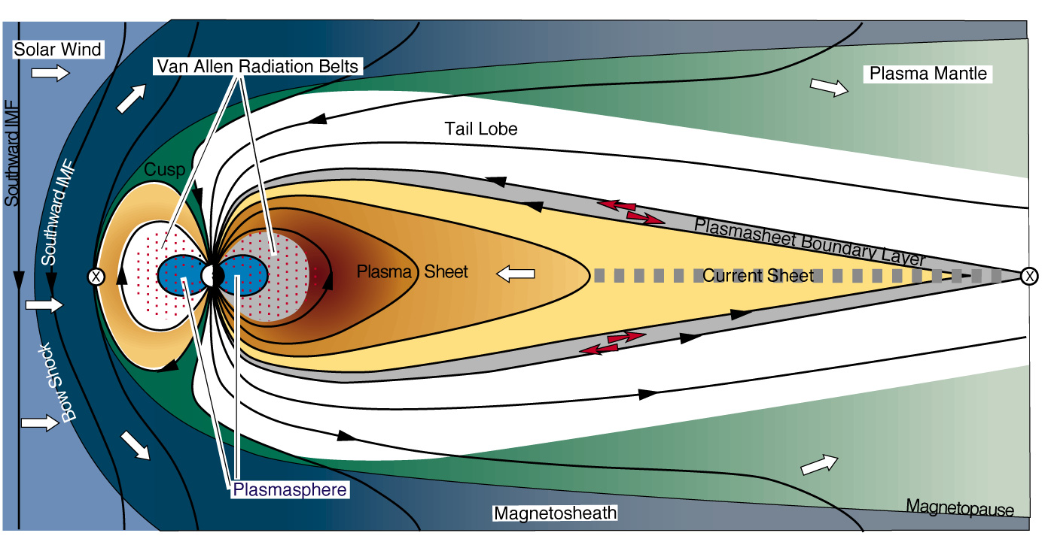
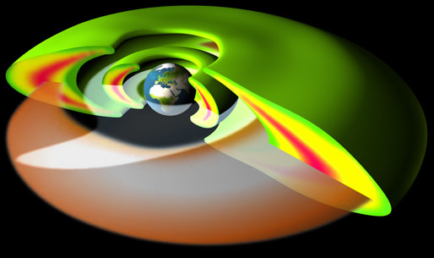
Inner Magnetosphere
(up to ~ 10 RE)
Van Allen Belts
400 keV – 6 MeV
Plasmasphere
1-10 eV
Ring Current
1-400 keV
APL

Slide 17
The charged particles that make up the inner magnetosphere current system are trapped in the Earth's magnetic field, bouncing back and forth along the magnetic field lines between "mirror points" in the northern and southern hemispheres.
MHD
Ring current circles the Earth in the equatorial plane and is generated by the longitudinal drift of energetic (10 to 200 keV) charged particles trapped on field lines.

Slide 18
Inner Magnetosphere Model
Fok Ring Current
Inner Magnetosphere:
1 Re – 10 Re
Electron Total Flux. Energy 22.45 keV.
Equatorial Plane
Magnetopause
Sun
Geosynch. Orbit
Electron Flux increase
at the geosynch. orbit
in response to
geomagnetic storm

Slide 19
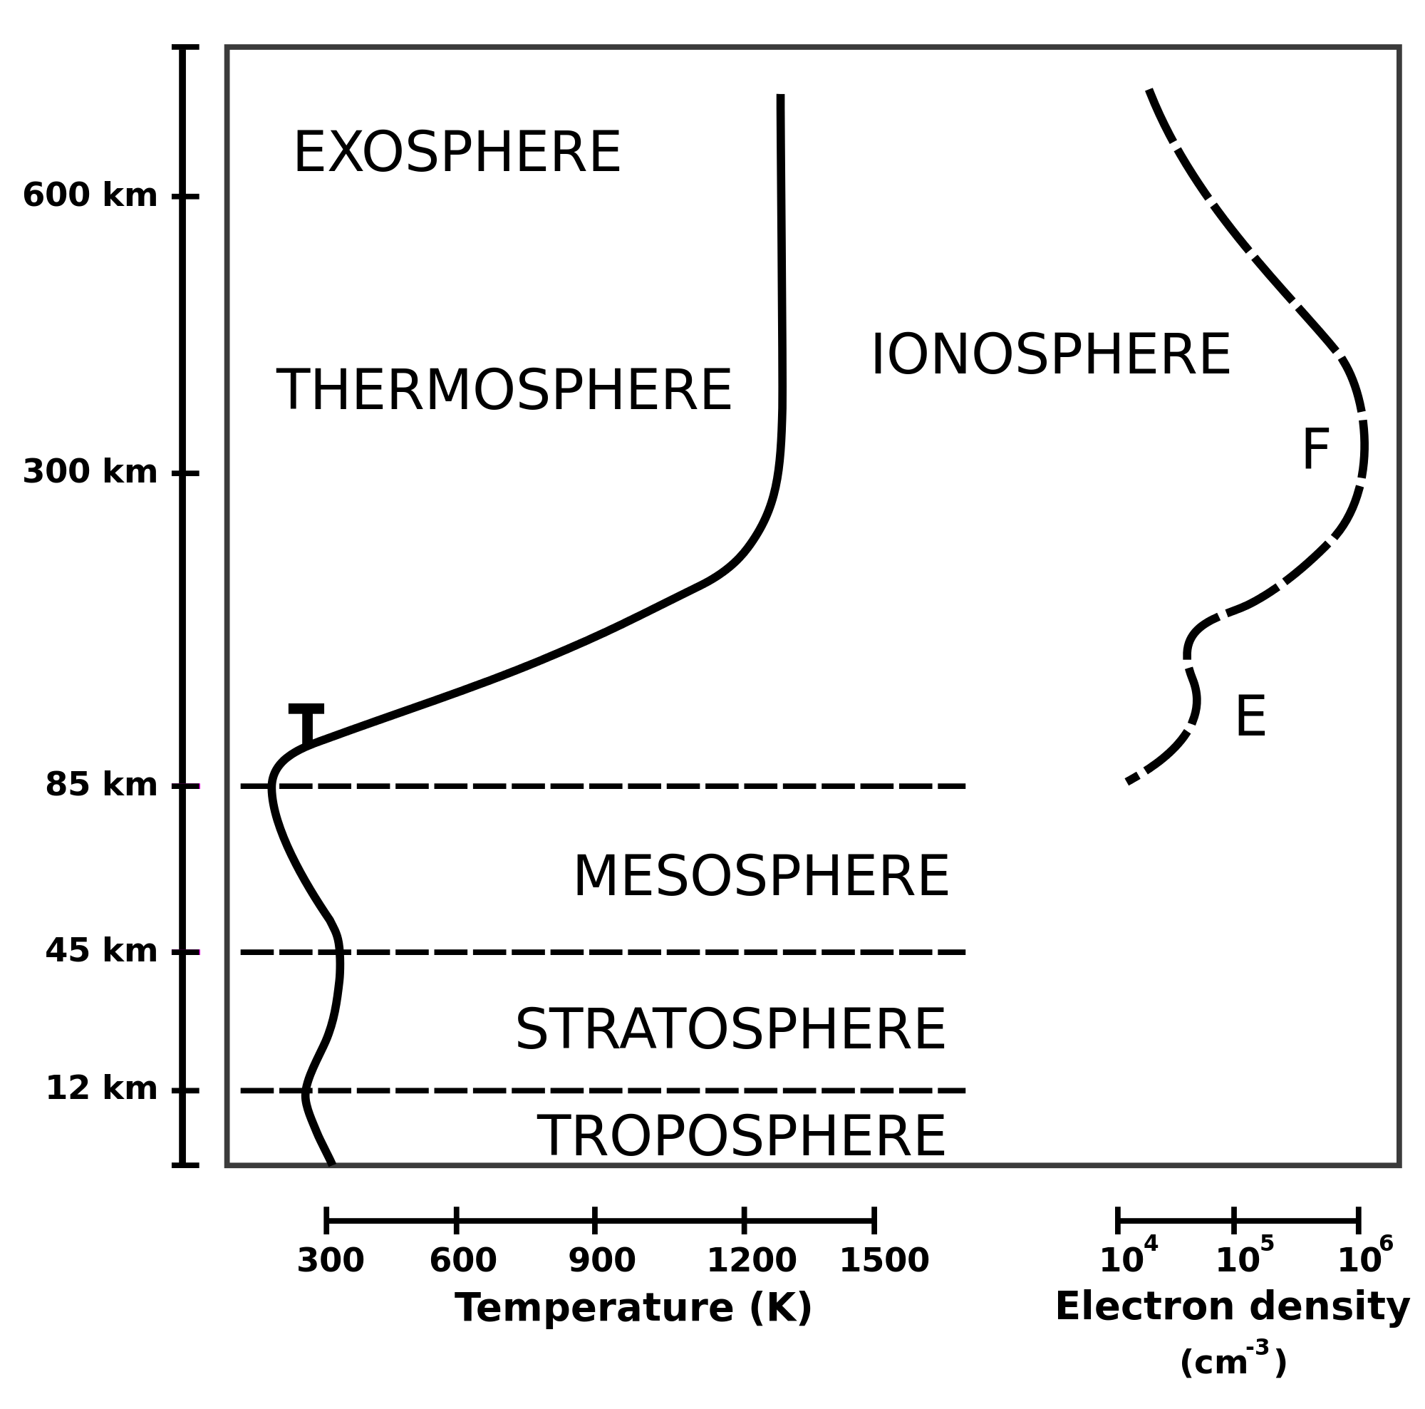
Global Ionosphere/Thermosphere Models

Slide 20
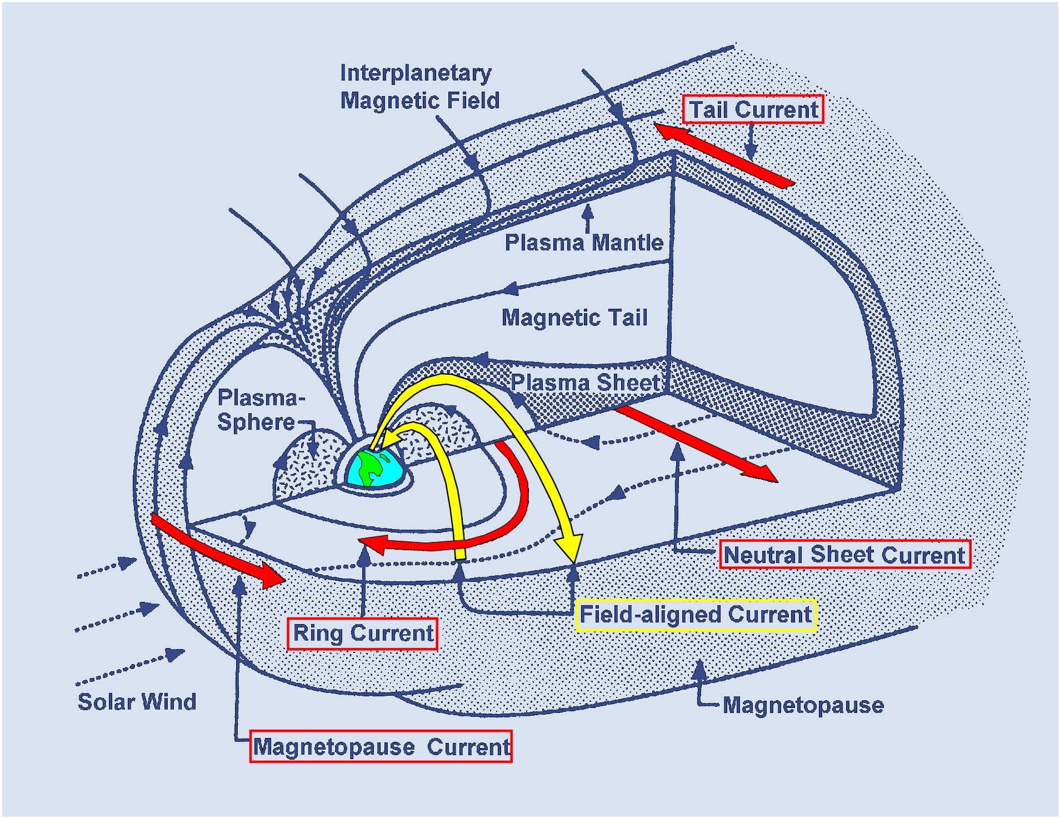
Anatomy of Magnetosphere

Slide 21
Runs with artificial Conditions
http://ccmc.gsfc.nasa.gov/
support/SWREDI/bootcamp/
results_mag_model.php

Slide 22
Runs with artificial Conditions
http://ccmc.gsfc.nasa.gov/
support/SWREDI/bootcamp/
results_mag_event.php

