Slide 1


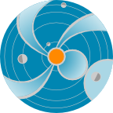
Sun-Earth Connection;
The Earth’s Magnetosphere and the Importance of Space Weather
Space
Weather
Research
Center
Presented by:
Dr. Yaireska (Yari) Collado-Vega
CCMC/SWRC
NASA Goddard Space Flight Center
Thanks to the CCMC/SWRC team
Notes:
In this presentation I will be talking about the Sun and its activity in relations to the space weather
(http://iswa3.ccmc.gsfc.nasa.gov/wiki/index.php/Glossary/_space_weather)

Slide 2

The Sun

Slide 3
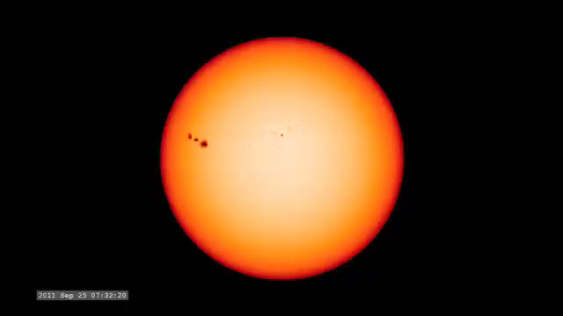
The Sun’s Rainbow

Slide 4


Slide 5
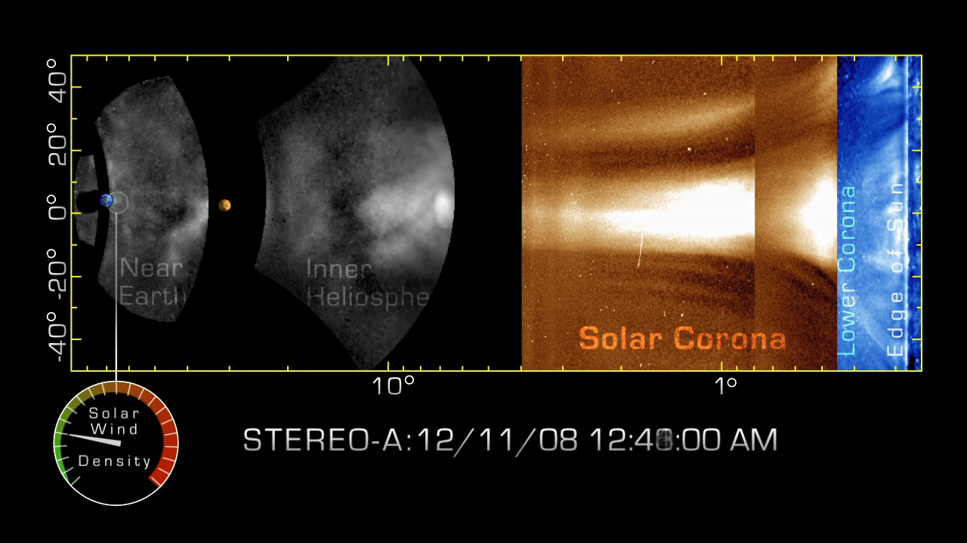
CME propagation
CME propagation to the Earth takes typically 1-3 days.

Slide 6
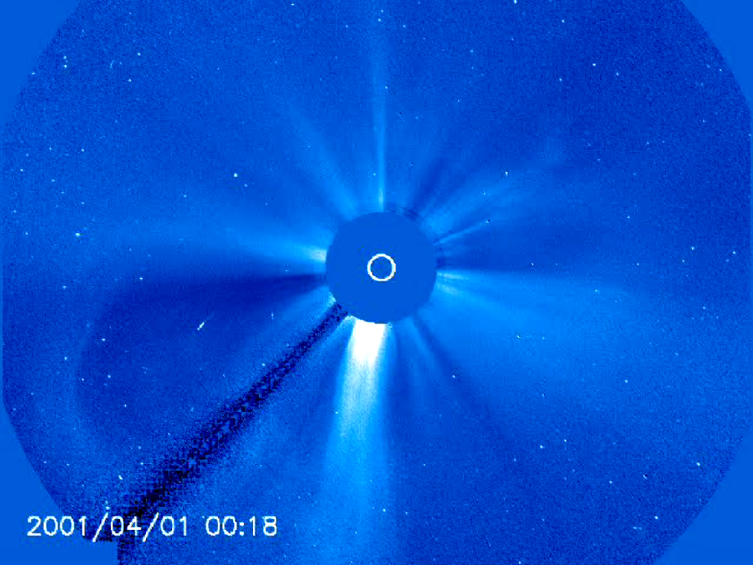

Slide 7
Magnetic Field of the Earth
The Earth's magnetic field is similar to that of a bar magnet.
The magnitude varies over the surface of the Earth in the range 0.3 to 0.6 Gauss.
Notes:
The Earth's magnetic field is similar to that of a bar magnet tilted 11 degrees from the spin axis of the Earth.
The magnitude of the magnetic field varies over the surface of the Earth in the range 0.3 to 0.6 Gauss.

Slide 8
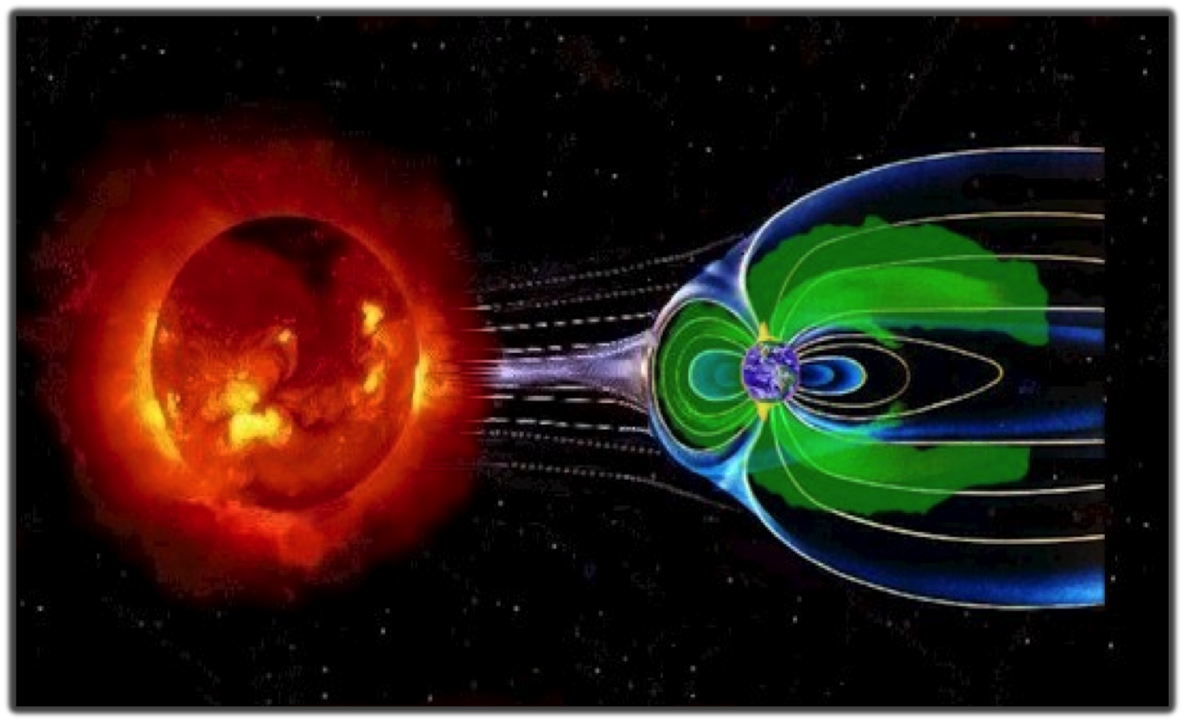
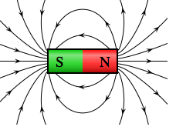
Earth’s Magnetic Field
(not to scale)
Magnetosphere
Magnetopause Sub-solar point
Earth
The solar wind pushes and stretches Earth’s magnetic field into comet-shaped region called the magnetosphere. The magnetosphere and Earth’s atmosphere protect us from the solar wind and other kinds of solar and cosmic radiation.
Notes:
The solar wind pushes and stretches Earth’s magnetic field into a vast, comet-shaped region called the magnetosphere. The magnetosphere and Earth’s atmosphere protect us from the solar wind and other kinds of solar and cosmic radiation.
Solar wind – Earth’s magnetic field field interaction flatten the nose (dayside – towards the sun) and drag field lines to the tail (night-side – away from the sun).
The magnetopause separates Earth's magnetic domain from the solar wind and its embedded interplanetary field (IMF).
The three-dimensional location of the magnetopause represents a balance of pressures: Pressures of solar-origin (predominantly solar wind flow ram pressure) balance pressures of Earth-origin (predominantly outward magnetic pressure) at the magnetopause.
The magnetic field is the shield that protects the Earth from the solar plasma particles because they have difficulty in moving across the magnetic field lines.
If the Earth did not have the magnetic field, continuously blowing solar wind and CMEs would most likely wipe out all the life forms on the Earth. Scientists speculate that something like this could have happened on Mars, who lost its magnetic field over the time.
The Sun-Earth line cross the magnetopause at the Sub-solar point. Magnetopause stand-off distance is the distance to the magnetopause sub-solar point.
Under quiet conditions the magnetopause sub-solar point is about 10 to 12 Earth’s radii away from Earth.
1 R_{E} (Earth’s radius) = 6370 km
In dense solar wind or in the presence of a strong and negative solar wind magnetic field component B_{z}, the magnetopause can move closer and even cross geosynchronous orbit (distance about 6.7 R_{E}).

Slide 9
Spatial Scales
Magnetosphere
Earth
1 R_{E} (Earth’s radius) = 6370 km
1 R_{S} (Solar radius) ~ 110 R_{E}
1 AU (Distance between the Sun and the Earth ) ~ 215 R_{S}
Notes:
Distances in Solar Corona are expressed in Solar radii: 1 – 20 R_{S}
Solar radius is approximately 100 times larger than the Earth’s radius.
Distances in magnetosphere are expressed in Earth radii.
During quit solar wind conditions the sub-solar point of the magnetosphere boundary is at about 10 R_{E} from the Earth.
The tail width is about 30-40 R_{E,.}The tail length is 1000s R_{E}
The distance to the moon is about 60 R_{E,}

Slide 10
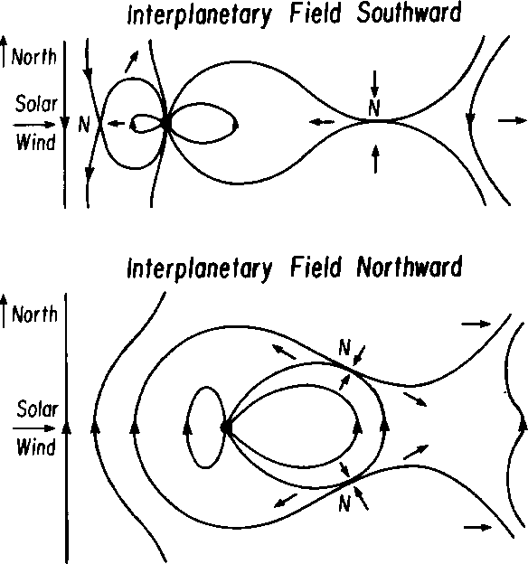
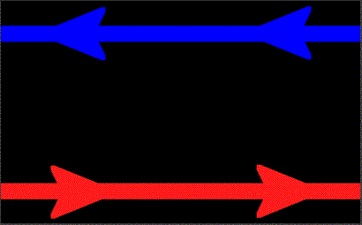
Magnetosphere for Southward and Northward IMF Orientation
Magnetic Reconnection

Slide 11
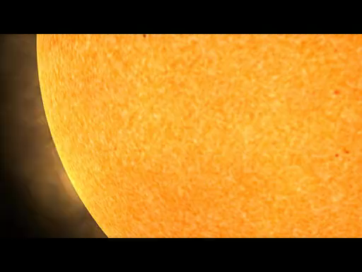

Slide 12
Magnetosphere:
Northward IMF
X: Earth to Sun
Z: South to North
Z
X
Sun
Red lines (closed): Magnetic field (MF) lines with both ends connected to the Earth
Black lines (open): MF lines with only one end a the Earth
Blue lines (interplanetary): MF lines with both ends in the interplanetary space

Slide 13
Magnetosphere:
Southward IMF
Red lines (closed): Magnetic field (MF) lines with both ends connected to the Earth
Black lines (open): MF lines with only one end a the Earth
Blue lines (interplanetary): MF lines with both ends in the interplanetary space

Slide 14
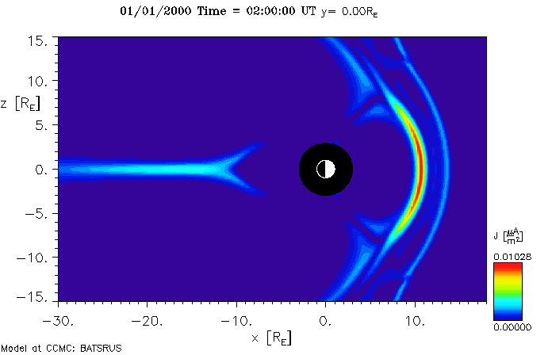
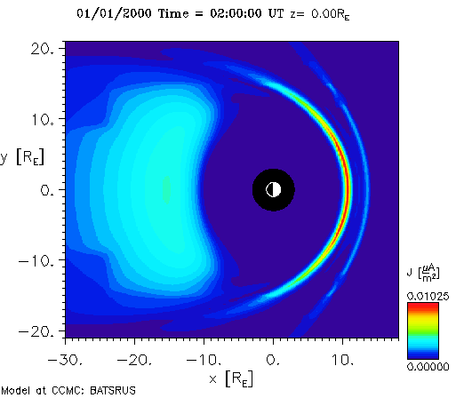
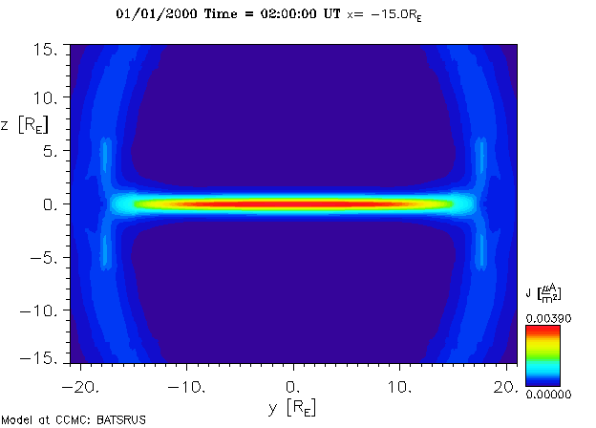
Magnetosphere
in Different Cut Planes
meridional cut Y=0
Bow shock
equatorial cut Z=0
Bow shock
Magnetotail
Magnetopause
Magnetotail current sheet
cross-tail cut X= -15 R_{E}

Slide 15
Magnetosphere:
Quiet vs. Compressed
Geosynch. orbit
Magnetopause

Slide 16
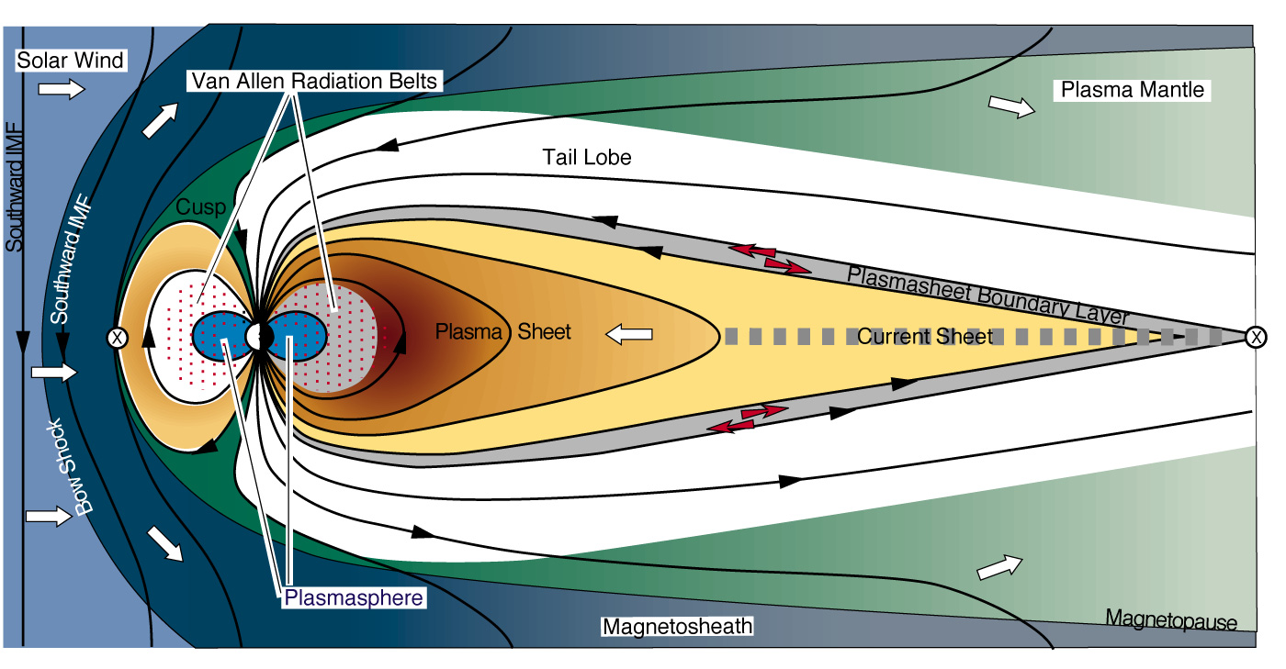
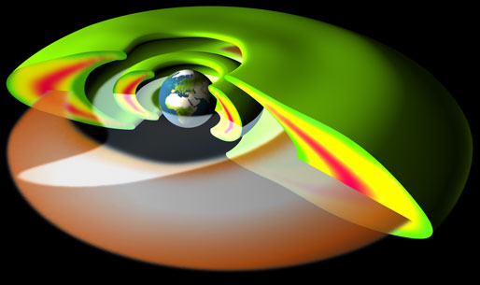
Inner Magnetosphere
(up to ~ 10 RE)
Van Allen Belts
400 keV – 6 MeV
Plasmasphere
1-10 eV
Ring Current
1-400 keV
APL
Notes:
1 nT = 10 ⁻⁵ Gauss

Slide 17
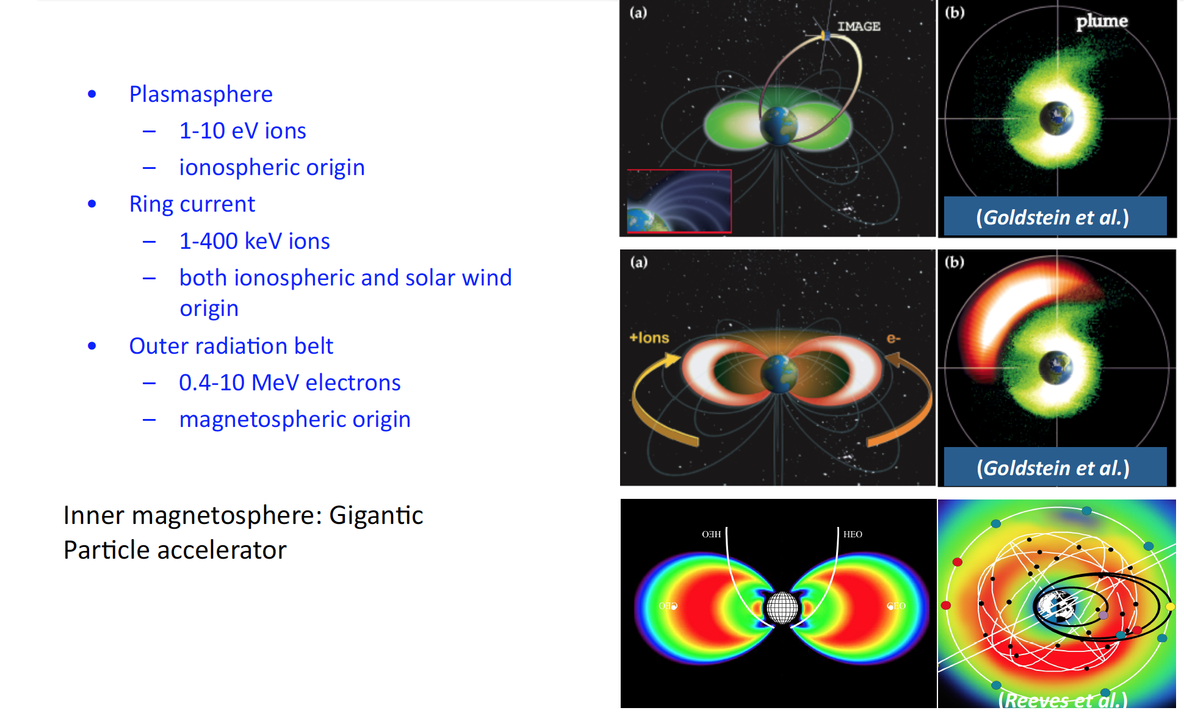
Inner Magnetosphere Plasmas

Slide 18
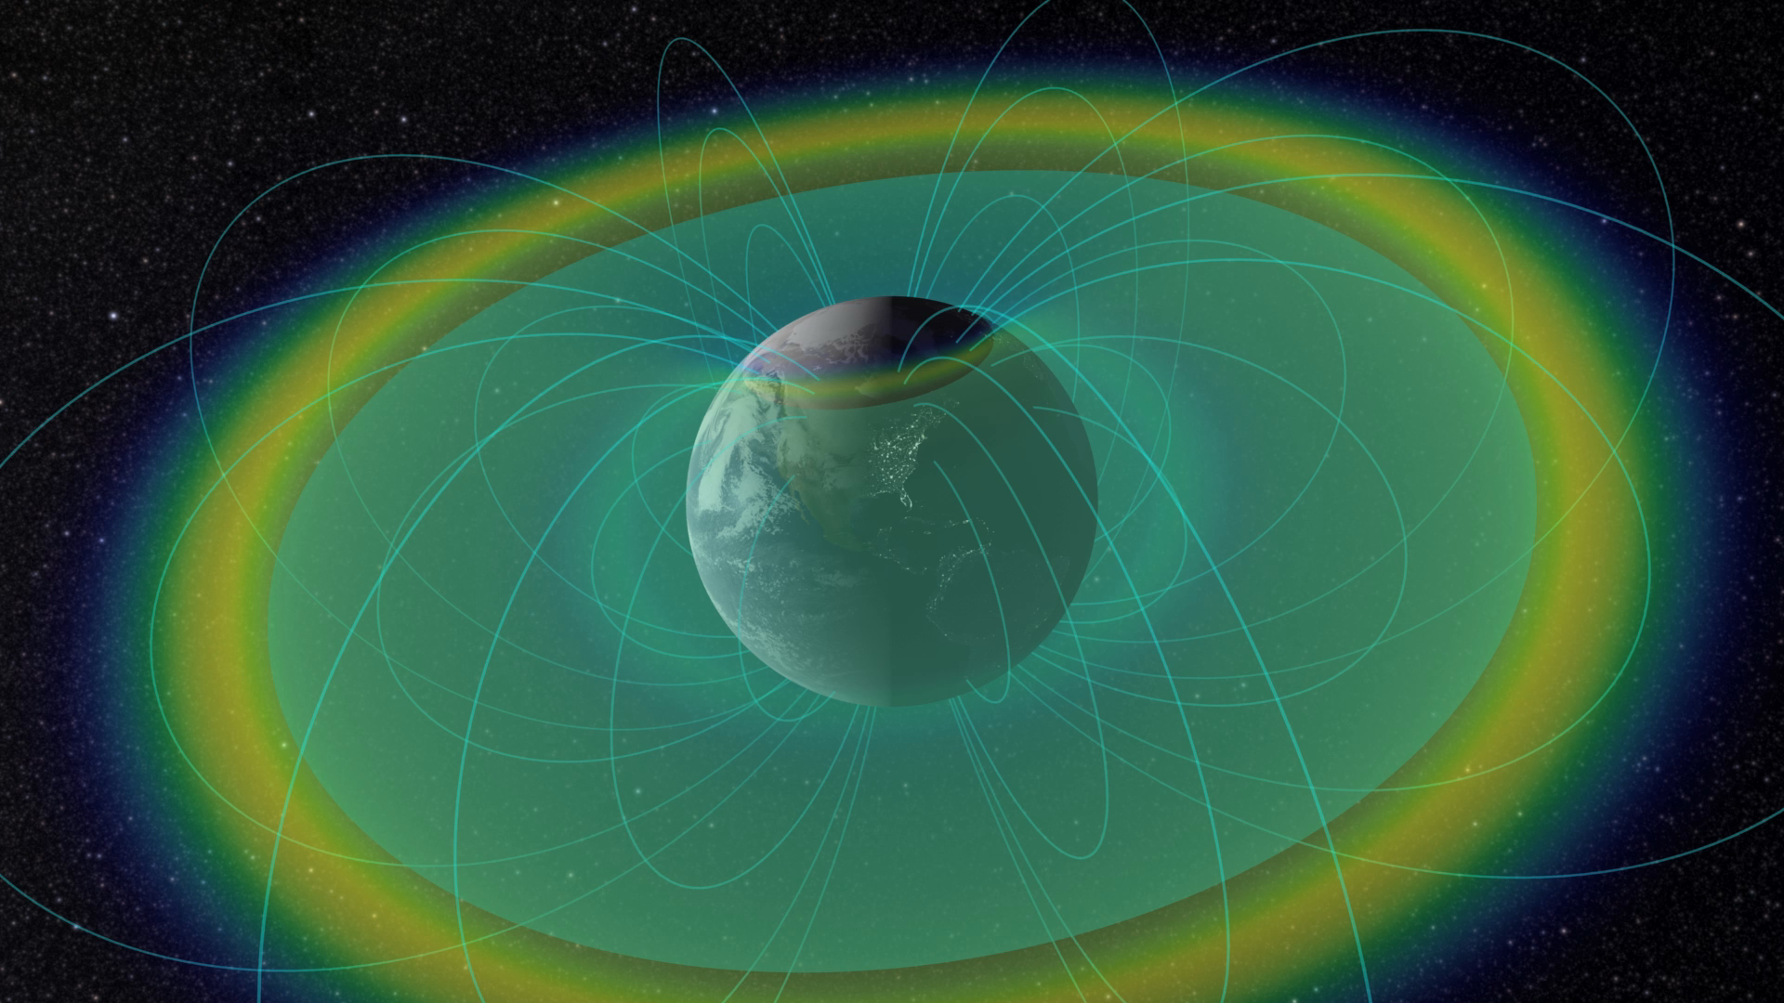

Slide 19
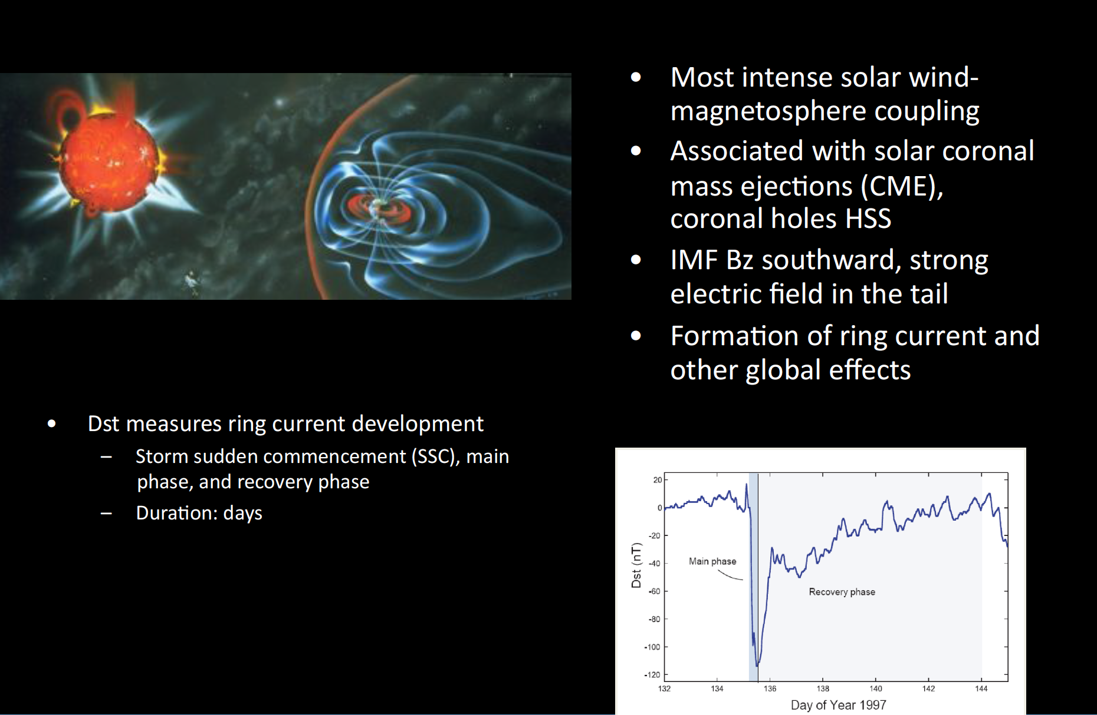
Magnetic Storms

Slide 20
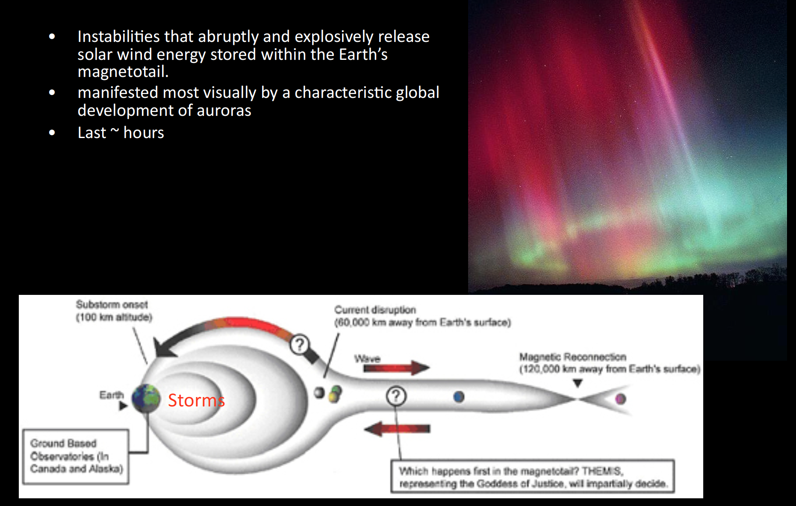
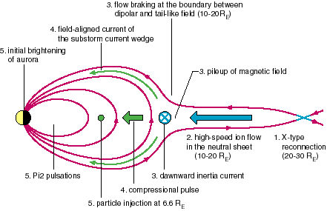
Substorms

Slide 21
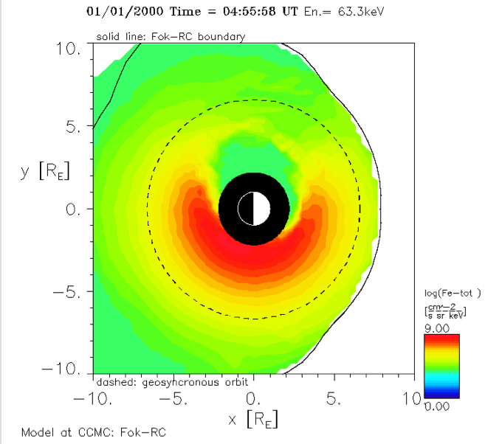
Electron Total Flux.
Energy 63.3 keV. Color Contour
Equatorial Plane
Magnetopause
Geosynch. Orbit
Sun
Earth radius

Slide 22
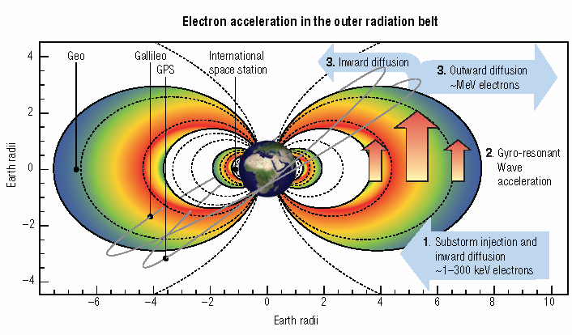
Horne et al., 2007, Nature Physics

Slide 23
Ring Current:
Quiet vs. Active

Slide 24
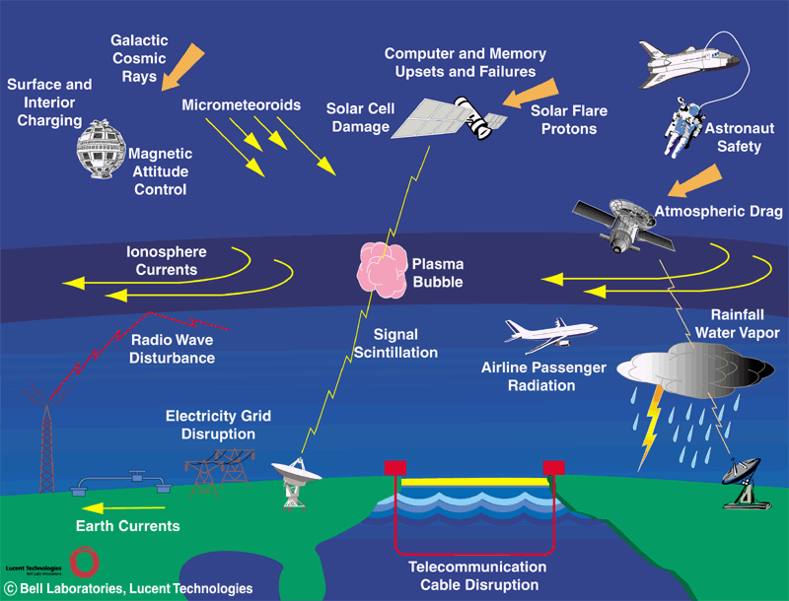
Space Weather Impacts
Space weather impacts (credit: L. Lanzerotti/Bell Labs)

Slide 25
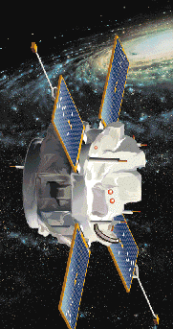
Lagrange Point – L1
Advanced
Composition
Explorer
L1 (Solar Wind Monitor ACE location): ~ 200 R_{E} sunward
You can fit 1 Sun between the Earth and L1.
2 R_{S} (Solar diameter) ~ 220 R_{E}
Notes:
The Lagrangian points (/L-points) are the five positions in an orbital configuration where a spacecraft affected only by gravity can
maintain its position relative to the two massive bodies (the Earth and the Sun).
You can almost fit 1 solar diameter (~ 200 R_{E} ) between the Earth and L1.
Solar wind monitor ACE is positioned at L1 point.
It takes about 30 – 60 min (depending on the speed of the solar wind) for the disturbance observed at L1 to reach the Earth.

Slide 26
Solar Wind Speed at ACE

Slide 27
Solar Wind Parameters at ACE
on 04/05/2010
Magnetic field
B_{x}, B_{y,} B_{z}
nT
X: Earth to Sun
Z: North to South
km/s
Velocity
Density
part/cm³
Notes:
1 nT = 10 ⁻⁵ Gauss

Slide 28
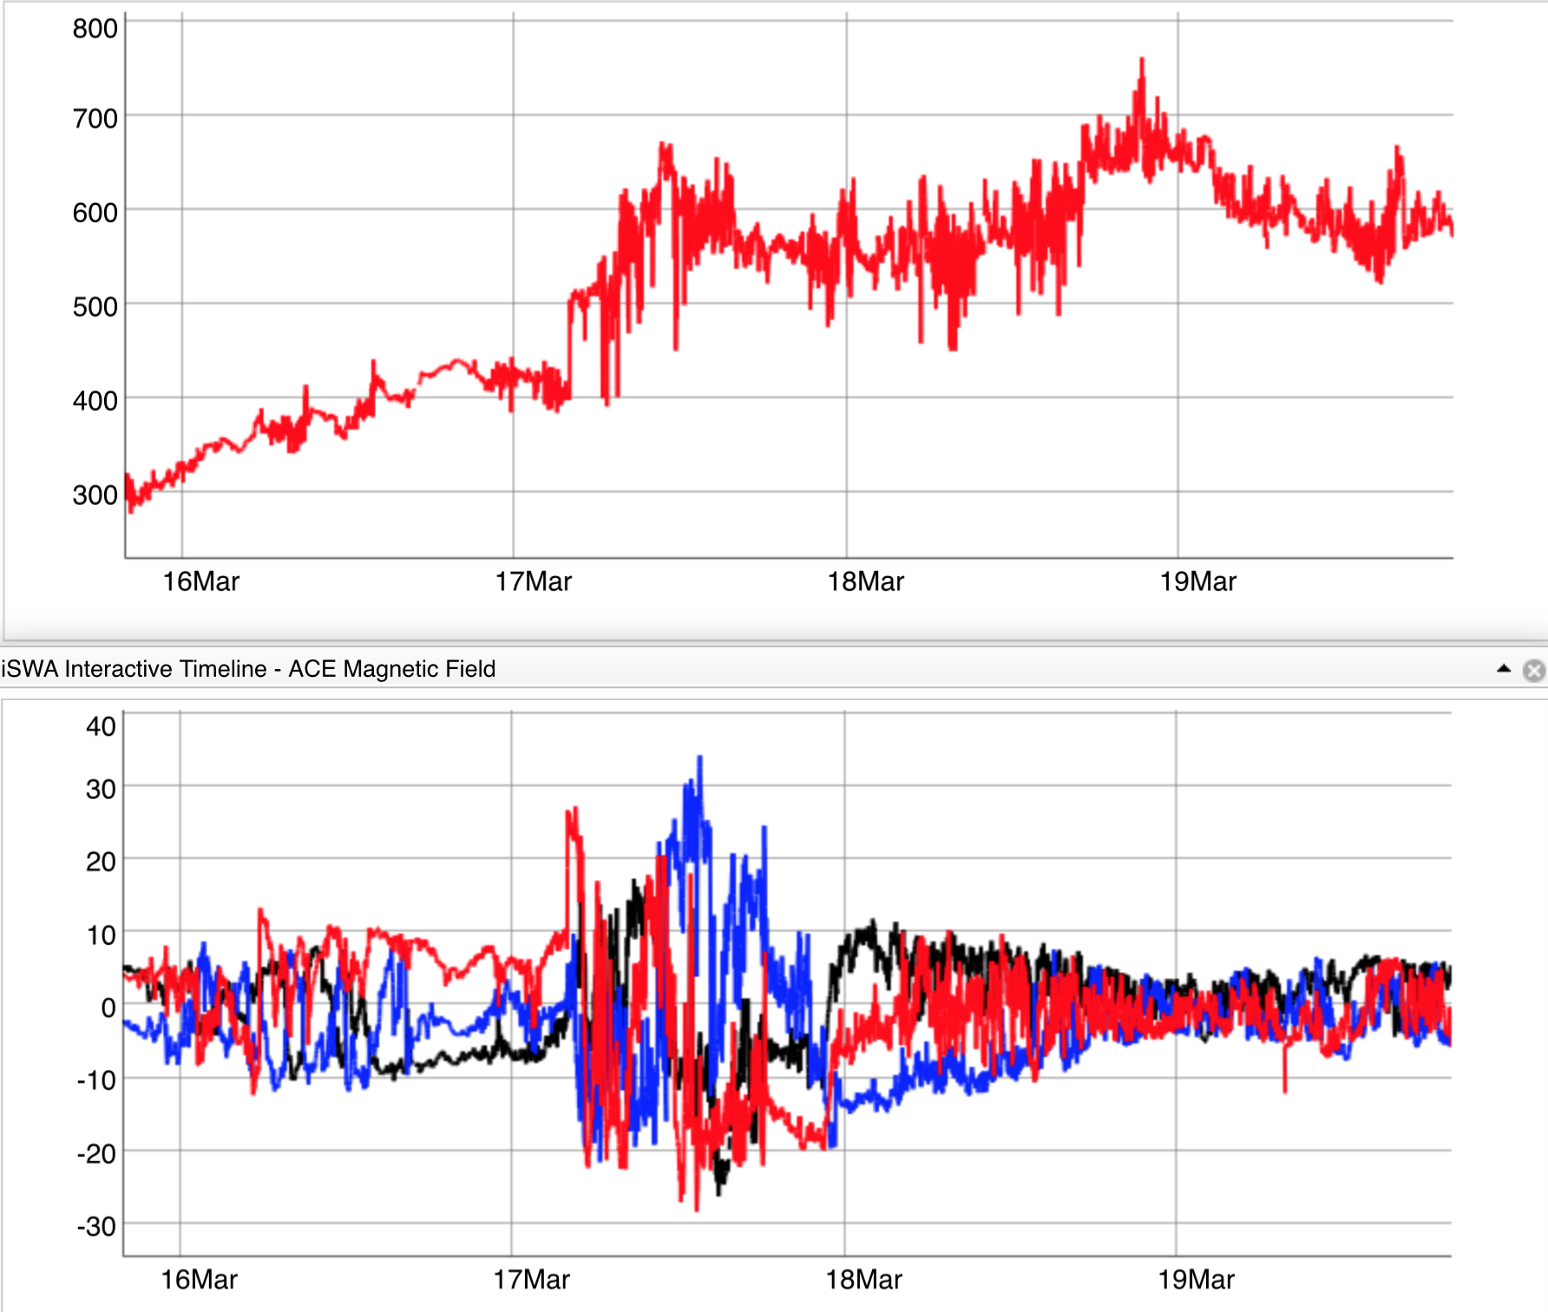
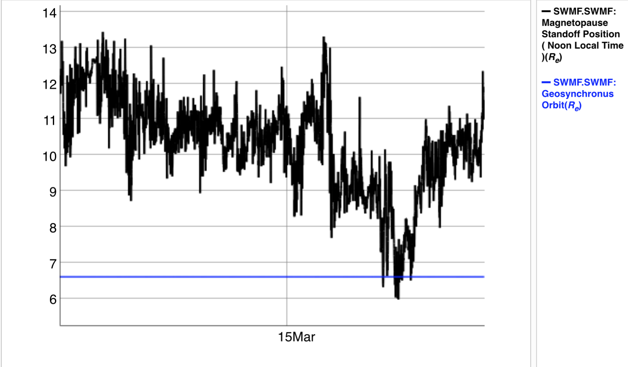
Magnetopause Stand-off Distance
Degree of compression of MP due to dynamic pressure of solar wind
March 17, 2015

Slide 29
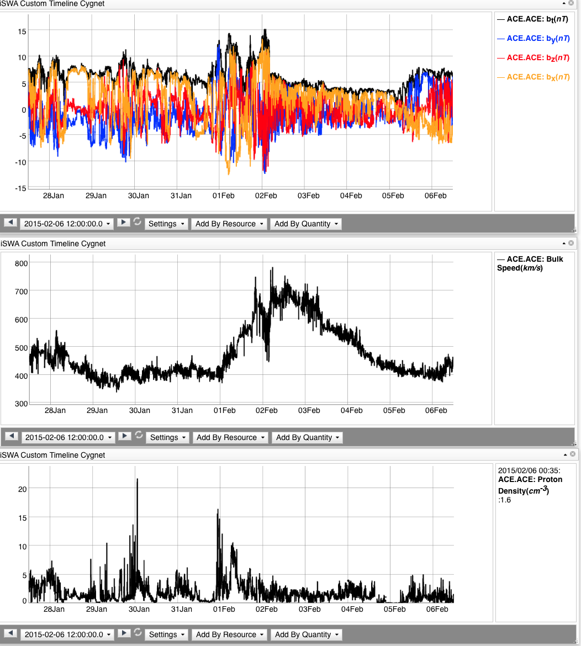
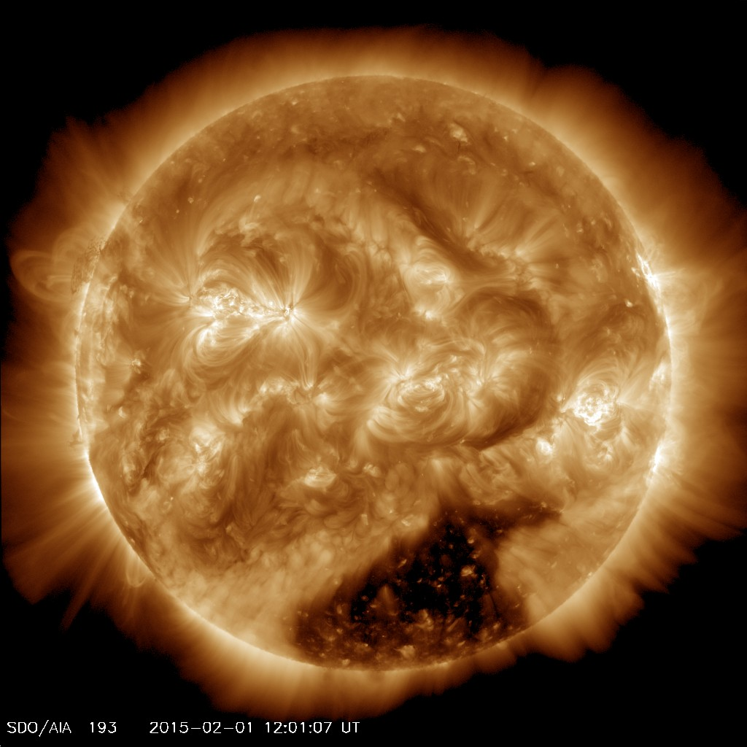
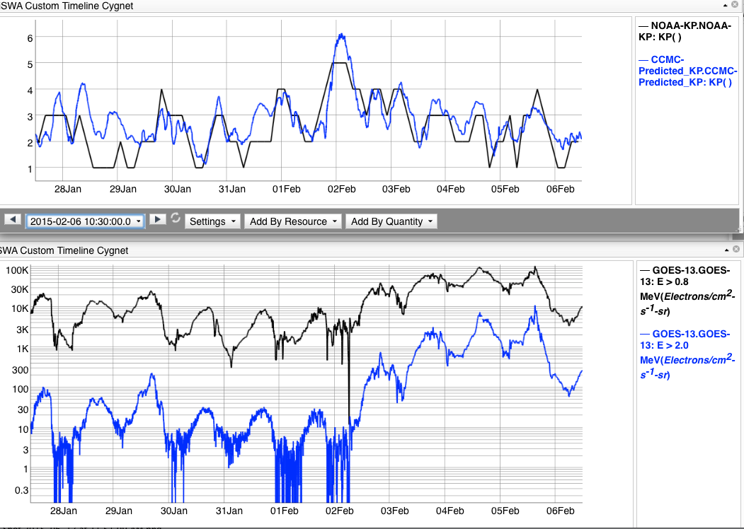
HSS and radiation belt electron flux enhancement

Slide 30
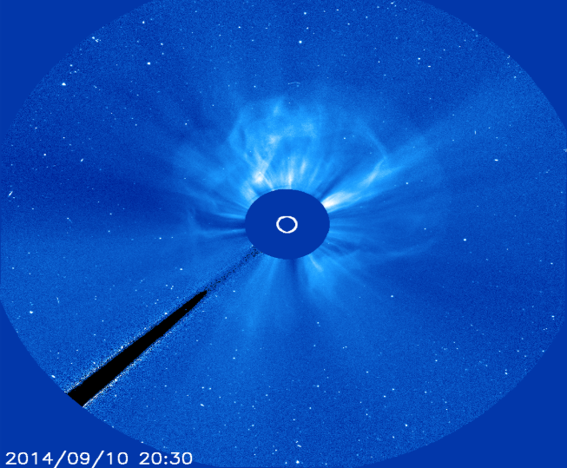
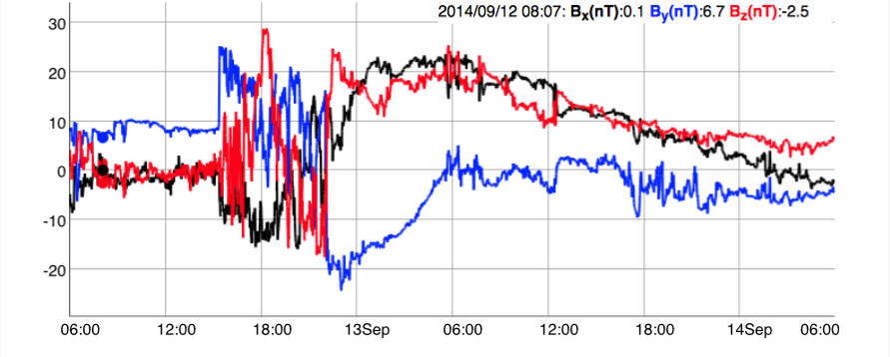

Slide 31
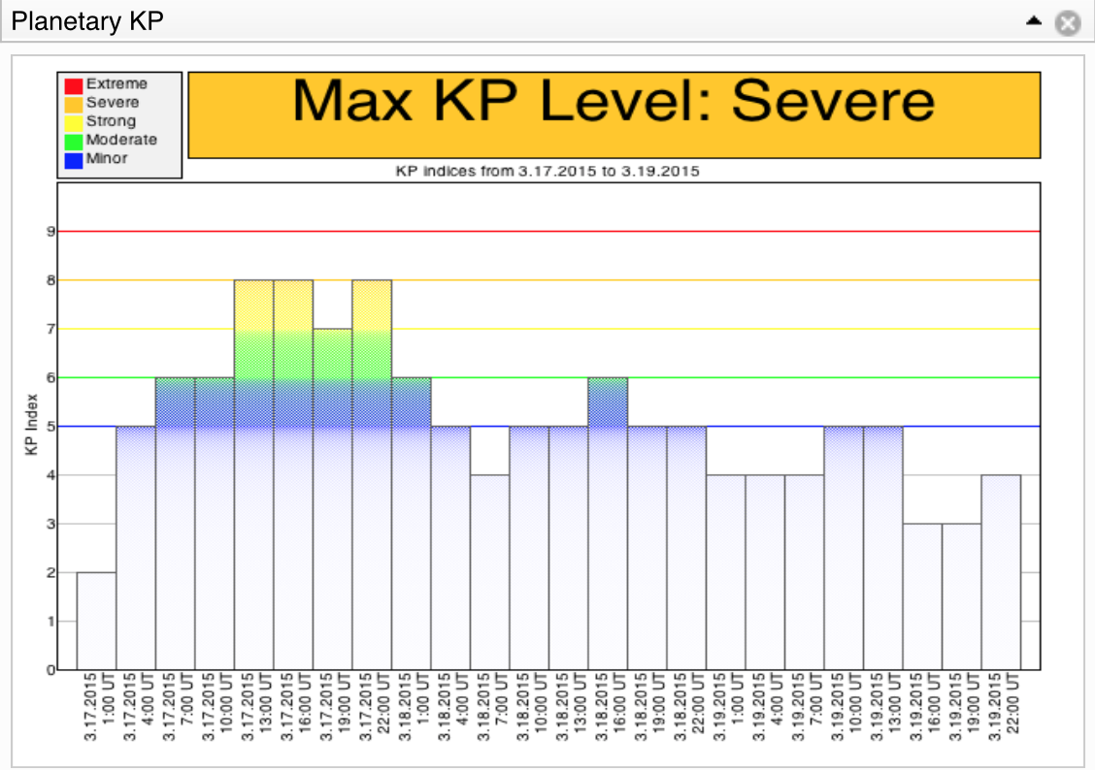
Kp index
"planetarische Kennziffer" ( = planetary index).
Geomagnetic activity index - range from 0-9 disturbance levels of magnetic field on the ground – currents
Threshold Kp>=6
Notes:
The Kp index indicates the magnitude of geomagnetic disturbance on a 0-9 scale, with zero being very quiet and 9 indicating a major geomagnetic storm. The index has a three-hour cadence. Higher values of Kp are associated with geomagnetic storming

Slide 32
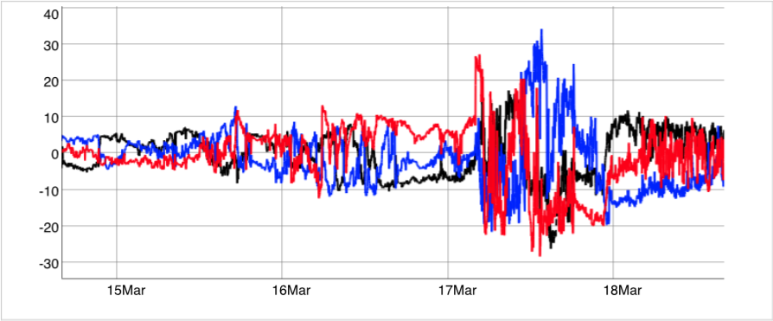
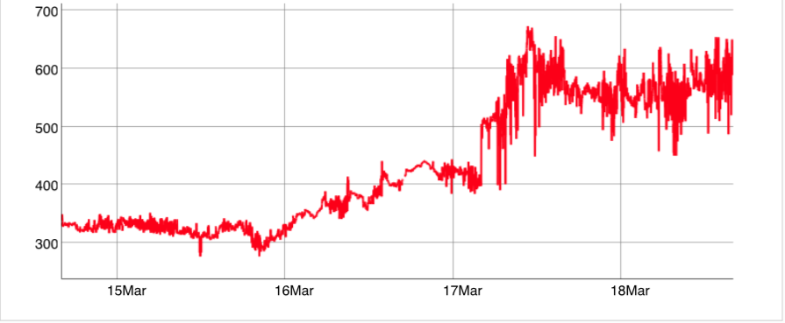
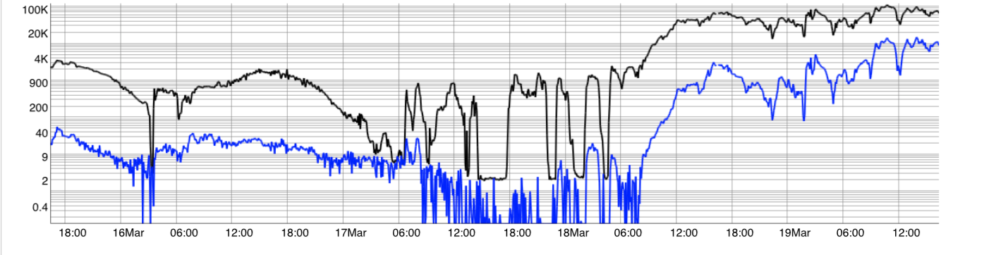
HSS and Radiation Belt
Electron Flux Enhancement

Slide 33
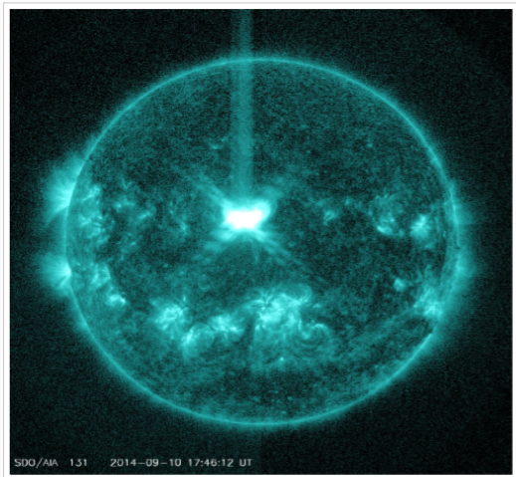
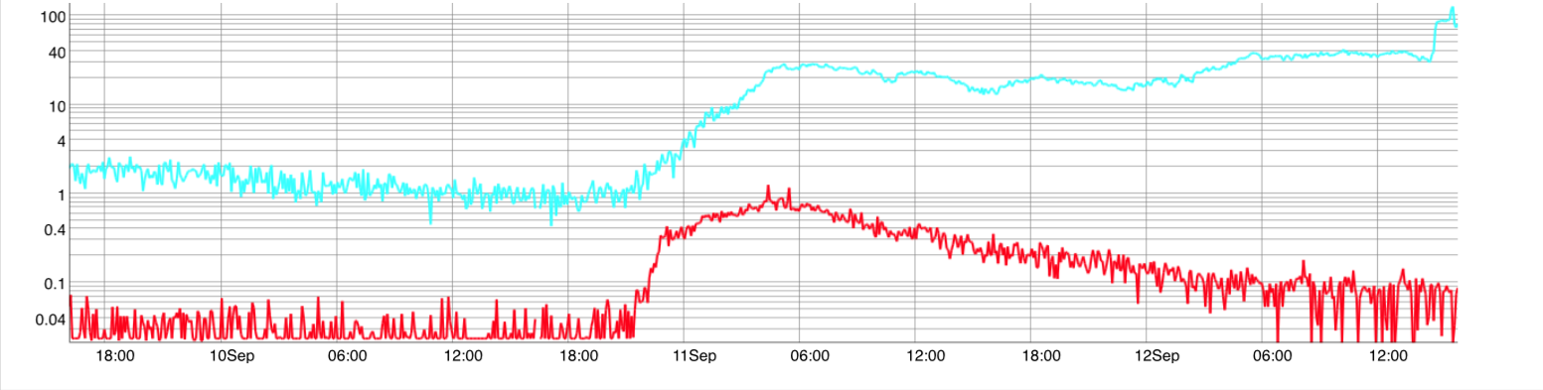
Energetic Proton Flux
>10 MeV flux by GOES spacecraft
Threshold: 10 pfu
>100 MeV flux by GOES spacecraft
Threshold: 1 pfu

Slide 34
Watch the video
http://missionscience.nasa.gov/sun/sunVideo_04magnetosphere.html
Notes:
The Earth's magnetic field is similar to that of a bar magnet tilted 11 degrees from the spin axis of the Earth.
The magnitude of the magnetic varies over the surface of the Earth in the range 0.3 to 0.6 Gauss.

Slide 35
iSWA Layout:
07/12/2012
http://goo.gl/V0JjxV

Slide 36
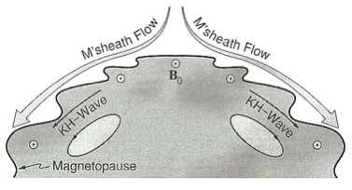
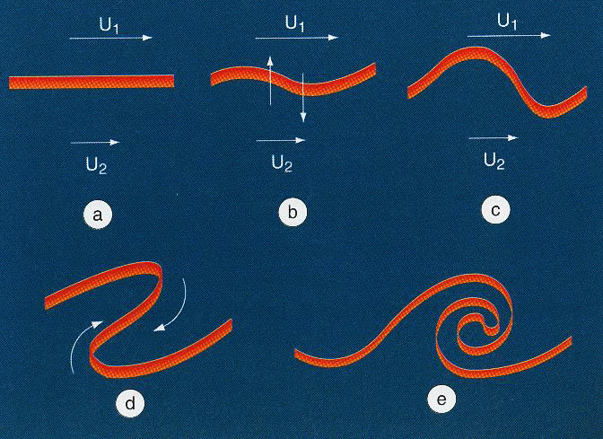
Kelvin-Helmholtz Instability
Magnetosphere Physics Research
Waves that occur between the velocity shear of two fluids.
It creates vortices on the magnetopause, specially on the flanks.
Predominantely at high solar wind velocities and northward IMF (positive Bz) component.
Many scientific models have been created to study these two parameters: the flow velocity and the magnetic field.
Notes:
The Kelvin-Helmholtz instability rises between two fluids between a boundary with a velocity shear. In the diagram above the velocity in 1 is higher than in 2 creating a very high velocity shear that creates an instability at the boundary. At the non-linear stage can create a vortex like the one formed in E. (CLICK)
At the magnetosphere this instability takes place specially on the flanks where the velocity shear is higher. Predominantly it occurs at high solar wind velocities and northward IMF component.
Many scientific models have been created to study this two important parameters for this instability: The fow velocity and the magnetic field.

Slide 37

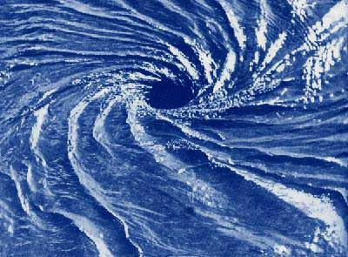

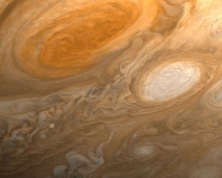
Examples of Kelvin-Helmholtz Instability

Slide 38
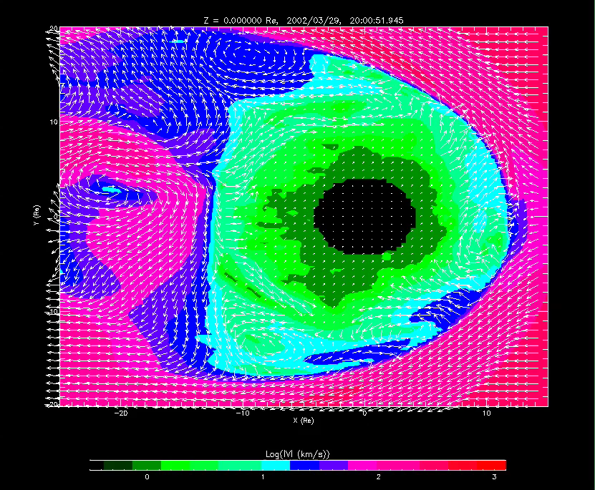
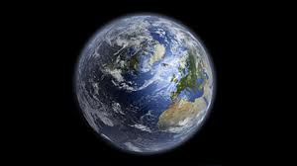
Magnetosphere Physics Research
Collado-Vega, Y. M., et al., JGR, 2007

Slide 39
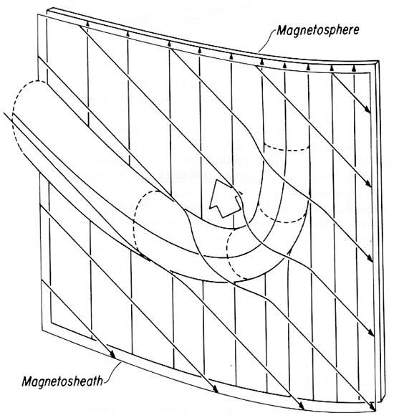
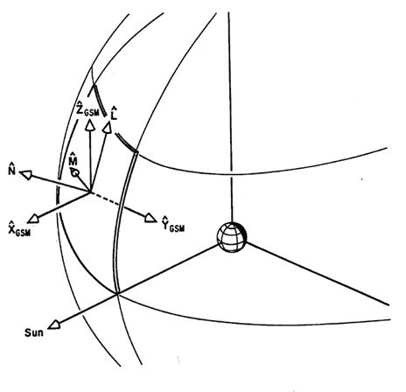
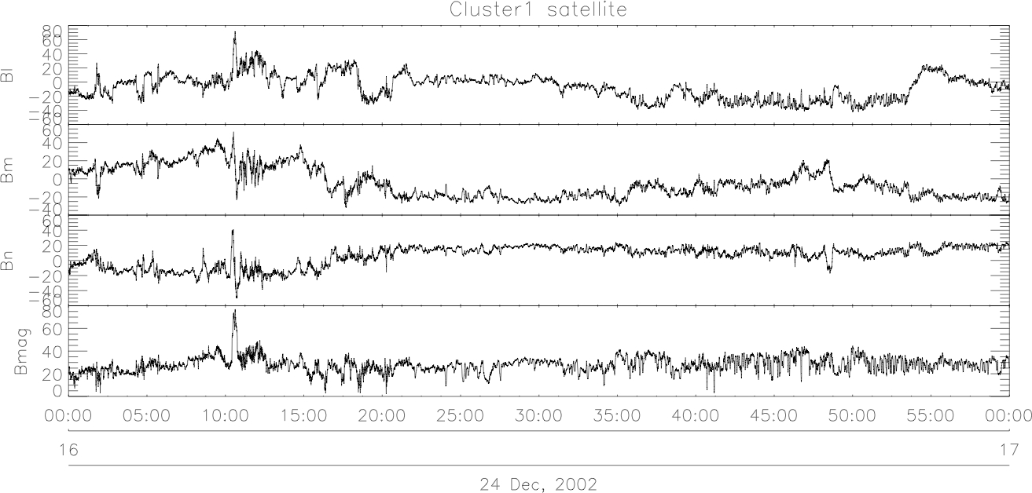
Flux Transfer Events (FTEs)
2nd Part
Flux Transfer Events (FTE’s) are magnetopause signatures that result from the passage of flux ropes produced by reconnection.
Russell and Elphic (1978)
Notes:
Flux Transfer Events (FTE’s) are magnetopause signatures that result from the passage of flux ropes produced by transient bursts of reconnection. They exhibit bipolar signatures in the component of the magnetic field normal to the magnetopause and transient increases or crater-like structures in the magnetic field strength.

Slide 40
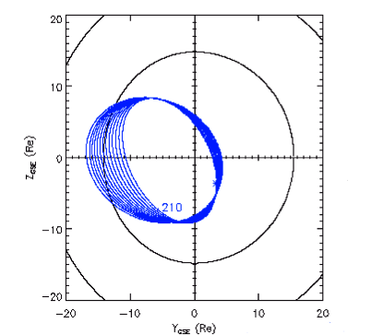
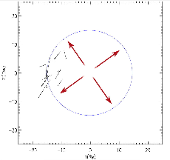
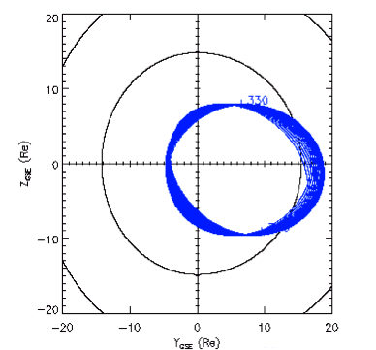
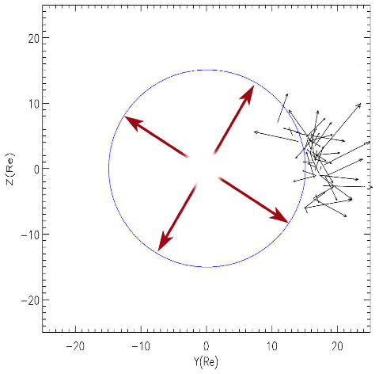
From Collado-Vega, Y. M., Ph.D. Thesis, 2013
2nd Part
November and December 2002
July 2002
Largest – 386 km/s
Largest – 412 km/s
Smallest – 90 km/s
Smallest – 92 km/s
16 events
48 events
V_{sheath}

Slide 41
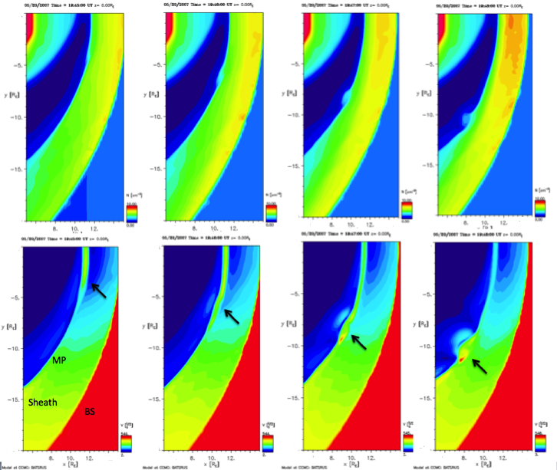
MHD Simulations (19:45-19:48 UT)
2nd Part
0
0
0
0
Y
X
Density
-20
-20
-20
14
-20
14
6
14
6
14
6
6
0
0
0
0
FTE
Velocity
-20
-20
-20
-20
6
6
14
6
14
6
14

Slide 42

Magnetopause Stand-off Position
From Collado-Vega, Y. M., et al., In progress

