Slide 1
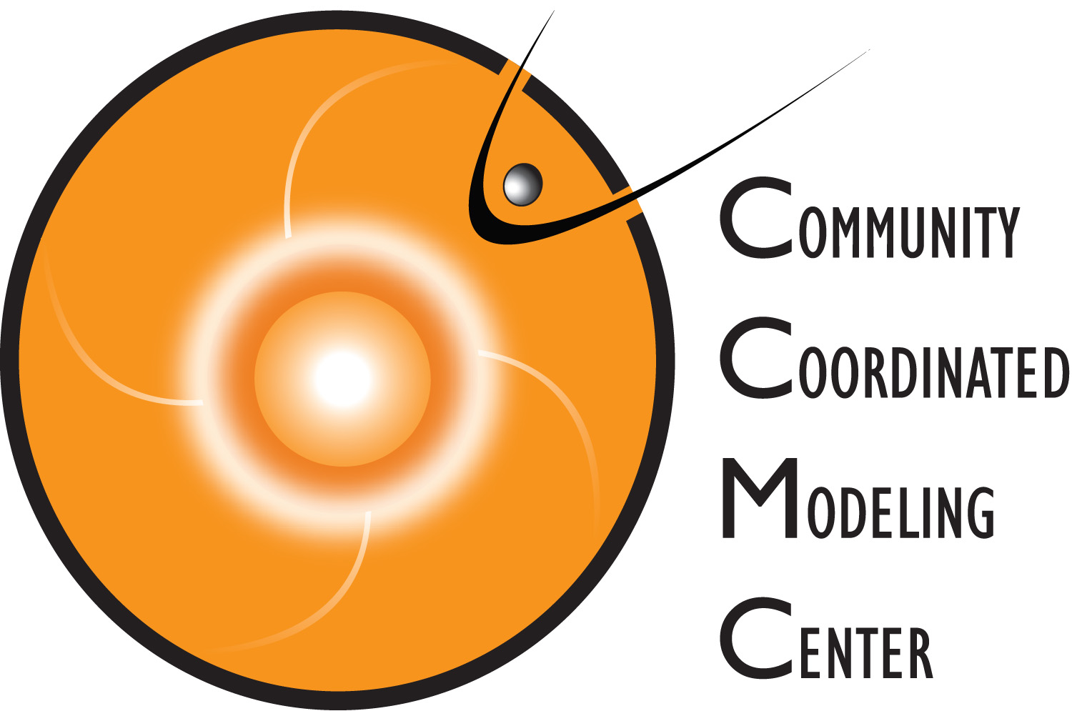
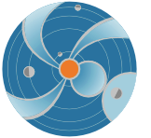
Part 2: CME Analysis with StereoCAT for Space Weather: Limitations
SOHO/LASCO C2
Barbara Thompson (NASA/GSFC) (presented by Leila Mays) barbara.j.thompson@nasa.gov
SW REDI 2014 June 3-13

Slide 2
CME Measuring geometries
CMEs are typically viewed using a coronagraph. CMEs are large and usually seen as a semi-transparent cloud, so what you see is the CME integrated along the path length of the viewer (like you'd see a cloud of smoke or fog).
It is a 2-D projection of a 3-D object, and the challenge is to take those 2-D observations and determine what the "real" 3-D structure is.
However, coronagraphs function in a way that is different from your eyes or a "typical" imager. Coronagraphs view photons scattered off of electrons in the corona, and the scattering efficiency of an electron depends on the location of the observer. This complicates things quite a bit!
Notes:
CMEs are typically viewed using a coronagraph. CMEs are large and usually seen as a semi-transparent cloud, so what you see is the CME integrated along the path length of the viewer (like you'd see a cloud of smoke or fog). It is a 2-D projection of a 3-D object, and the challenge is to take those 2-D observations and determine what the "real" 3-D structure is. However, coronagraphs function in a way that is different from your eyes or a "typical" imager. Coronagraphs view photons scattered off of electrons in the corona, and the scattering efficiency of an electron depends on the location of the observer. This complicates things quite a bit!

Slide 3
CME Measuring geometries
Factors involved:
1) Based on viewing angle, where is the apparent leading edge of the CME relative to the *real* leading edge?
2) How close is the apparent leading edge as seen from one spacecraft to the apparent leading edge as seen from another?
3) Based on Thomson scattering geometry, how bright will the leading edge of the CME be relative to the rest of the CME? (For angles > 60° out of the plane of the sky, the mass is basically invisible, and you will only see the part of the CME closer to the image plane.)
4) How can we determine which spacecraft pairs are most ideal and will produce the most accurate measurements for different viewing geometries?
Notes:
1) Firstly, you want to measure the speed of the "front" of the CME, but how can be sure you're seeing the front, or leading edge? If the CME is moving perpendicular to the observer (what we call "in the plane of the image" or "in the plane of the sky") then it's likely that the leading edge in the image is close to the "true" leading edge of the CME. (Hold up an object like a coffee mug and ask students to indicate what they think is the location farthest to the right. Now rotate the mug and ask them again. They will see that the "edge" depends on the viewpoint).
2) if you are performing "simple" triangulation (i.e. looking at the CME from two different angles) you may not be seeing the same "front." What appears to be the front from one viewpoint may be the side from another, and if you triangulate with the assumption that they are the same point, you can get a *very* different answer from the "real" answer.
3) When you take into account the varying scattering behavior of electrons in the corona, you see that a feature that is between the observer and the Sun has very low scattering amplitude. This means that something coming right at you(or going straight away from you) is effectively invisible! This must be considered when you try to determine the 3-D structure from multiple viewpoints.
4) Given the above constraints, how can we take them into account when performing our CME measurements? Fortunately, they all depend on viewing angle, so with a little consideration of your "viewing geometry" you can overcome the above constraints (or at least not be misled by them!)

Slide 4
Warning: StereoCAT should not be used for halo CMEs, and for wide CMEs (>50 degrees half width) measurements can be very inaccurate.
StereoCAT is a useful and versatile tool for measuring CMEs. However, StereoCAT will *always* give you an answer, even if it makes no sense! You can click anywhere and it will give you an answer. Therefore, StereoCAT is a powerful tool in the hands of a knowledgeable user, but you must always be mindful of the measurements and the results that you receive, and keep your eyes open for results that appear "suspicious.”
Let’s go through a few examples…
Notes:
StereoCAT is a useful and versatile tool for measuring CMEs. However, StereoCAT will *always* give you an answer, even if it makes no sense! You can click anywhere and it will give you an answer. Therefore, StereoCAT is a powerful tool in the hands of a knowledgeable user, but you must always be mindful of the measurements and the results that you receive, and keep your eyes open for results that appear "suspicious."

Slide 5
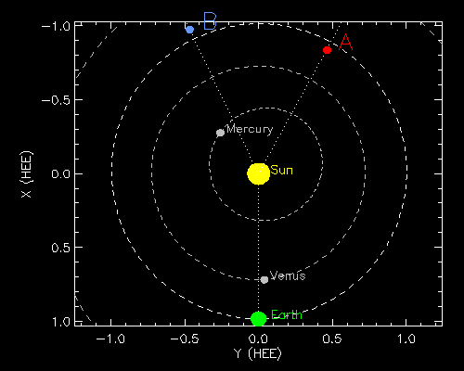
CME Measuring geometries
For STEREO locations on 2014-01-16
STEREO-A:
151° longitude
STEREO-B:
-154° longitude
Notes:
Let's use the example of earlier this year: STEREO-A and STEREO-B were separated by 55 degrees, and SOHO (near Earth) had a viewpoint right in between (though on the opposite side). These viewpoints were far enough apart that a CME could look somewhat different from each angle.
Remember: you may not always have the luxury of having all three viewpoints to choose from! Regardless, you should be aware of the limitations when performing your measurements.

Slide 6
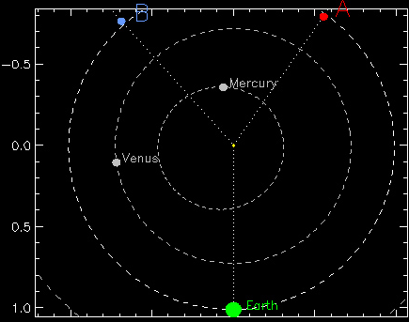
Diagram of a West limb (90°) CME at 14 R_{Sun} (Sun not to scale) The arrows indicate the "leading edge", or tangential line, from the viewpoint of each of the coronagraphs.
How close is the apparent leading edge as seen from one spacecraft to the apparent leading edge as seen from another?
Notes:
A hypothetical CME of a size equal to 14 times the radius of the Sun is shown. The arrows indicate the "leading edge", or tangential line, from the viewpoint of each of the coronagraphs.

Slide 7
Measuring angles (tangent points) for a West limb CME at 14 R_{Sun}
x
x
x
How close is the apparent leading edge as seen from one spacecraft to the apparent leading edge as seen from another?
Notes:
Shown here are just the leading edge, or tangential points. The next slide zooms in on this.

Slide 8
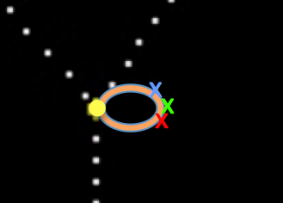
Diagram of a West limb (90°) CME at 14 R_{sun}
Zoom in
SOHO
STEREO-A
STEREO-B
Best* combination: STEREO-A and SOHO. Apparent leading edges are closest.
Second place: STEREO-B and SOHO. Next closest leading edges.
Worst: STEREO-A and STEREO-B. They each see very different leading edges, neither close to the true leading edge.
* Of course, you don't know what the CME longitude is when you start measuring, so how are you supposed to know which pair will produce the best results? Perhaps considering source longitude on the Sun can help.
Notes:
Zooming in, you can see that the leading edges from the 3 viewpoints are in different locations. SOHO's leading edge is closest to the "true" leading edge, and STEREO-A's leading edge is second-closest. Also, the SOHO and STEREO-A points are fairly close together. Therefore, triangulation of the two points will produce a result closest to the "true" leading edge.
The second best combination is STEREO-B and SOHO, because they are still relatively close, but not as close at STEREO-A.
The worst is STEREO-A and STEREO-B. They are farthest apart, and neither are near the "true" leading edge.
Unfortunately, this argument is a bit backwards. It assumes that you know the direction of the CME, and that it's in the SOHO plane of the sky! But the reason you do triangulation is to find the 3D trajectory of the CME and you don't know the longitude in advance. That is why it is good to examine the inner coronal images (SDO AIA, STEREO-A and STEREO-B EUVI) for clues as to what longitude the CME is. EVEN IF A CME DOESN'T LOOK LIKE A HALO it still might be way out of the plane of the sky!

Slide 9
Diagram of a 45° CME at 14 R_{Sun}
How close is the apparent leading edge as seen from one spacecraft to the apparent leading edge as seen from another?
Notes:
Let's consider another angle. Instead of perpendicular to SOHO, let's tilt it 45 degrees toward SOHO.
NOTE: See the blue path of the STEREO-B viewpoint. This CME is probably a halo (or partial halo) in STEREO-B imagery, so be careful.

Slide 10
Diagram of a 45° CME at 14 R_{Sun}
x
x
x
How close is the apparent leading edge as seen from one spacecraft to the apparent leading edge as seen from another?
Notes:
Here are the leading edge/tangent points.

Slide 11
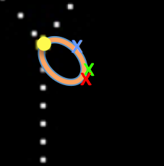
Diagram of a 45° CME at 14 R_{Sun}
Zoom in
SOHO
STEREO-A
STEREO-B
Best combination: STEREO-A and SOHO.
Second place: STEREO-B* and SOHO.
Worst: STEREO-A and STEREO-B.
* Note CME is far from image plane in STEREO-B. See discussion of scattering amplitudes below.
Notes:
Zooming in, you can see that the STEREO-B leading edge is far from the front. There is also a problem with the visibility of a CME far from the plane of the sky, which we will discuss more later.
In this case, the SOHO and STEREO-A points are close together, and they are also close to the leading edge. If you use SOHO and STEREO-A to triangulate your results, it should be really close to the "true" 3-D CME. However, if you use STEREO-B, you may be a very poor answer!

Slide 12
Diagram of a 120° CME at 14 R_{Sun}
How close is the apparent leading edge as seen from one spacecraft to the apparent leading edge as seen from another?
Notes:
One more example – let's tilt the CME away from SOHO. Note that in this case, the CME may appear to be a halo or partial halo in STEREO-A images.

Slide 13
Diagram of a 120° CME at 14 R_{Sun}
x
x
x
How close is the apparent leading edge as seen from one spacecraft to the apparent leading edge as seen from another?
Notes:
Here are the leading edge/tangent points

Slide 14
Diagram of a 120° CME at 14 R_{Sun}
SOHO
STEREO-A
STEREO-B
Best combination: STEREO-B and SOHO.
Second/third place: STEREO-B + STEREO-A if you want better estimate of leading edge speed, but STEREO-A + SOHO if you want to be triangulating the same point.*
* Again, see discussion of scattering amplitudes. Even the flank that STEREO-A is measuring is far out of the image plane, but your integration path is longer, so it will be much brighter than the true leading edge.
Notes:
Zooming in, what combination works best! You can see that STEREO-A is farthest from the leading edge. Although SOHO and STEREO-A are closer together, STEREO-B and SOHO make the best combination because they are nearer to the leading edge. However, it's difficult to determine what combination is second best. The STEREO-A + SOHO points are closer together, so you'll be triangulating similar features. However, STEREO-B is closest to the leading edge, so it will register a higher speed. The STEREO-B + STEREO-A combination might give you a better value for speed.
There is always difficulty in dealing with halo CMEs. A CME appears more faint if it is farther from the plane of the image. However, if you are looking straight down the "leg" of a CME, it may appear brighter because there is more CME along that viewpoint. Again, it is difficult to interpret this information when you do not know the "true" propagation angle of a CME – you must consider the possibilities when interpreting your results.

Slide 15
Note: For East limb CMEs, the STEREO A/B geometry is reversed.
SOHO
STEREO-A
STEREO-B
x
x
x
x
Notes:
We showed only west limb CMEs. Remember to consider your viewing angles relative to each spacecraft.

Slide 16
Example: 50° half-width Earth-directed halo CME (Sun not to scale)
Notes:
Now let's do an example where we know you'll get the wrong result! That way you can see how much a StereoCAT result can differ from the true leading edge. Here we have an Earth-directed CME, and we'd like to measure it. We have it directed just a little bit to the left (longitude = -1), so from the SOHO viewpoint it is going slightly faster to the left than to the right, so the user clicks on the left side.
The CME in this example is fairly wide, but fast CMEs tend to be wider so this is a good exercise. : )
Let's say that you don't know that StereoCAT should no be used for halo CMEs. You have three viewing angles, and you click on what you think is the leading edge from each viewpoint. Already you can see that we are heading for trouble – these points are far from eachother!

Slide 17
Example: 50° half-width CME, halo CME pointing at Earth
StereoCAT user clicks on apparent leading edge from the point of view of
SOHO, STEREO-A and STEREO-B.
Actual location of CME front: 45 R_{sun} -1° longitude (so CME is slightly faster to east from LASCO POV)
Red/Blue (A-B) triangulation point: 74 R_{sun} 4° longitude (most accurate longitude, but 65% off by height)
Red/Green (A-SOHO) triangulation: 117 R_{sun} -10° longitude (>150 % off in height!)
Green/Blue (SOHO-B) triangulation: 49 R_{sun} -46° longitude (best height, but only the CME flank has been triangulated).
276pixels total distance
37 pixels CME height
Triangle: Width 41 height 17
Green/blue: Width22 height 22
red/blue: W 4 H58
red/green: w16 h 90
Now let’s look at the effect of CME width:
Notes:
The user clicked on a variety of locations, and StereoCAT dutifully gives an answer. It tells the user where these lines intersect.
So where do these viewpoints intersect? It turns out that they intersect all over the place!!
The "true" leading edge of the CME is 45 solar radii, and the "true" longitude is -1.
If the user used STEREO-A and STEREO-B (red and blue arrows) for their image pairs, they will receive an answer of 74 solar radii for the height, which is 65% more than the true height of 45 solar radii! The red and blue arrows intersect at a longitude of +4, which isn't very far off from the true longitude of -1, but it's more of a coincidence because their poor viewing angles canceled out!
If the user used STEREO-A and SOHO (red and green arrows) they would receive an answer of 117 solar radii, which is more than twice the true height!
If the user used SOHO and STEREO-B (green and blue arrows) they would get an answer that is closest to the true height, but far off in longitude.
(next chart is exactly the same except the STEREO-B leading edge is switched. You may want to toggle between the two vugraphs to make it clear what changed. )

Slide 18
Same example: 50° half-width CME, halo CME pointing at Earth
User clicks on apparent leading edge from the point of view of SOHO, STEREO-A and STEREO-B.
But now let's say the user chooses the other side in STEREO-B as the leading edge (for some strange hypothetical reason).
Actual location of CME front: 45 R_{Sun} -1° longitude
Red/Blue (A-B) triangulation point: 40 R_{Sun} 50° longtiude
Red/Green (A-SOHO) triangulation: 117 R_{Sun} -10° longitude
(>150 % off in height!)
Green/blue (SOHO-B) triangulation: 55 R_{Sun} -143° longitude (!!)
Notes:
Let's try a hypothetical situation: The user, for some reason, identifies a different leading edge of the CME from the STEREO-B (blue) point of view. Although it may appear that this is a user mistake, there are some situations where the CME's structure is so homogeneous that one part of the CME may be visible while another isn't. Later on, we will discuss some artifacts in coronagraph data that might mislead a user.
So, if the user clicks on a different leading edge in STEREO-B, what happens? The answers are even more off! The STEREO-A and STEREO-B combination, which produced our most accurate longitude before, is now off by more than 50 degrees.
The STEREO-A + SOHO combination didn't change.
However, look at the longitude derived by the SOHO + STEREO-B combination. It gives a longitude pointing away from the Earth, which would be a big mistake since the CME is pointed almost directly towards Earth!
So what is the correct answer? No matter what image pairs you choose, you don't get a speed and direction estimate that is very close to the true values. What's the problem?
The problem is that the CME is not only a halo, but it is also quite wide. This introduces another complication, and sometimes you have to remember that you're seeing a 2-D projection of a 3-D structure, and sometimes that structure is very complicated!

Slide 19
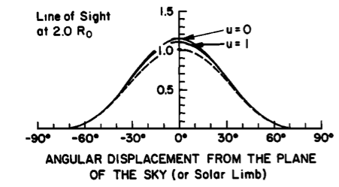
It is important to understand how coronagraphs work. Consider: What part of the CME can be seen? A feature 30° out of the plane of the sky has only half the overall scattering amplitude of a feature in the plane of the sky. For points >45° , scattering amplitude is very low. Features >60° away will not be seen in coronagraph images, and are effectively invisible.
Notes:
This brings us to another important point about coronagraphs. They do not directly view the mass of a CME, they view photons from the Sun that are scattered off electrons in the corona. If there is more mass (such as a CME) then there are more electrons, and therefore more scattering. However, the scattering efficiency is not constant. An electron in the plane of the image has 100% scattering effiency, while an electron along your line of sight (such as the front of a halo CME) has zero scattering efficiency.
The graph shows the scattering amplitude of a feature located at variious positions relative to you, the observer. If the feature is displaced zero degrees from the image plane (i.e., in the plane of the sky) then it has the highest scattering efficiency. If the feature is displaced 30 degrees from the image plane, its scattering effiency is only half. As you move to 45 degrees, the amplitude is very small, and beyond 60 the feature is effectively invisible!

Slide 20
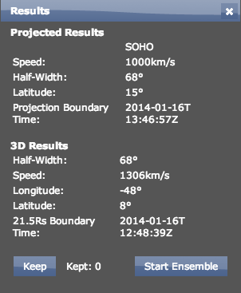
If the CME is out of the plane of the image more than 60 degrees, you definitely cannot see the leading edge. You are measuring far into the flank.
Any triangulation result giving a viewing angle >40° for either of the spacecraft should be viewed with great suspicion. The slope is high and features closer to the plane will still tend to dominate.
A 40° angle from the plane of the sky will give you ~25% increase in your calculated 3D speed. Therefore, anything >25% increase in one of the line-of-sight CME speeds should be examined closely.
Argh! What can we do about this?
Notes:
So, this poses a problem. A halo CME definitely has features far out of the plane of the sky, which are effectively invisible. You are probably seeing the side of the CME, or the flank, instead of the leading edge.
A good way to approach this is to examine the answers StereoCAT gives you. Does it give you a longitude that is more than 40 degrees away from the plane of the image? If so, you know that you probably weren't measuring the leading edge. Let's say you have a CME measurement that is determined to be 40 degrees from the plane of the sky. StereoCAT will divide by cosine theta, and the 3-D speed will be nearly 30% higher than the measured plane of the sky speed. This gives you a good rule of thumb – any increase greater than 25% is suspicious.

Slide 21
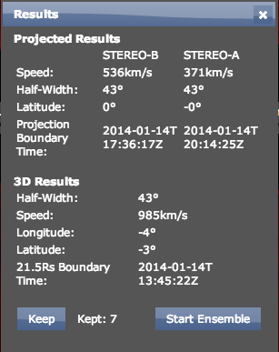
"Ice Cream Cone" Model
Speed is much faster than LOS speeds. Suspicious...
Lon = -4 means CME leading edge is 65° out of the POS for
STEREO-A and 60° for STEREO-B. Leading edge is invisible!
Ice cream cone reprojection: Lon = -15 v = 670 km/s
Notes:
One way to handle this is to take into account the 3-D structure of a CME and the relative viewing angles. This is called the "ice cream cone" model. Your CME is defined by the direction (angle from the plane of the sky), the width, and a hemispherical shell spanning the width. Believe it or not, the geometry isn't too bad! Using the ice cream cone model means you can click on different l points of a CME, and it will take into account the effect of viewing angle on the projection.
We will work through some ice cream cone reprojections in the homework exercises. In this example using a real CME, we have a StereoCAT measurement that gives us a STEREO-A speed of 371 km/sec and a STEREO-B speed of 536 km/sec. STEREO-A is located at 151 longitude, while STEREO-B is at -154.
The StereoCAT projected speed is nearly 1000 km/sec, which is much higher than 371! Examining the derived longitude, we see that a longitude of -4 corresponds to an angle of 65 degrees out of the plane of the sky for STEREO-A and 60 degrees for STEREO-B. If the longitude is truly -4, then the leading edge would not be visible from either viewpoint!
However, if we do the cone reprojection for the same measurements, we obtain a speed of 670 km/sec: 1/3 lower than the StereoCAT speed.

Slide 22
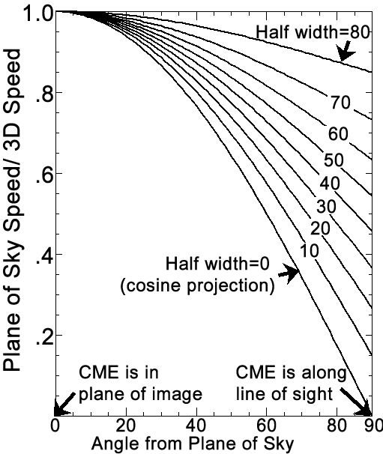
Handy conversion between the apparent speed of a spherical bright shell of varying angles and its observation angle.
Notes:
Rather than working through the geometry, we have this handy ice cream cone model CME reprojection graph that you can use. To use it, first determine your approximate longitude, and compute how far out of the plane of the sky that longitude is. Remember that STEREO-A and STEREO-B are always moving, so you need to look their longitudes up!
Next you need to estimate the width of a CME. A CME will appear wider the more it is tilted towards you, so in general the best value is the lowest one you measured. Let's say STEREO-A is at longitude = 151, and the CME you measure is at longitude = 111. That means the CME is 40 degrees out of the plane of the sky. You also measure CME half-widths of 40 and 47. So, you move up from the x-axis where the angle equals 40, and keep going until you intersect half-width equals 40. The place where they meet corresponds to a y-axis location of .88.
Now you measured a plane-of-sky CME speed (say it's 500), so you have to convert that to a 3-D speed by dividing by .88: you get a value of 568 km/sec. If you were to simply divide by cosine of 40, you'd get 652 km/sec.
If the CME half-width was 80, and the angle from the plane of the sky was 60, the ratio would be .92. The ice cream cone reprojection would give you a speed of 543 km/sec, but dividing by cosine theta would give you 1000 km/sec – almost a 100% difference!

Slide 23
Other weird results – make sure you examine the answers!
3D speed is lower than
STEREO-A??
Notes:
There are other strange things you can encounter with StereoCAT. In this case (this is a real example!) the so-called 3-D speed is lower than the STEREO-A speed. This doesn't make much sense, so you should re-examine your images and try to determine why one "leg" is greater than the hypotenuse!

Slide 24
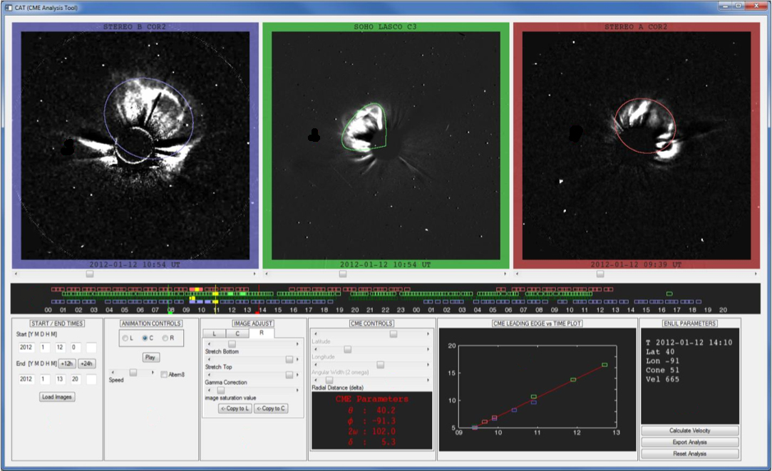
The best of both worlds: SWPC_CAT
Notes:
Of course, there are some CMEs that are just difficult to measure, and sometimes the angles just aren't advantageous. You will encounter some of these CMEs in the homework. Although we don't have time to cover more CME analysis software, you should be aware that there are more sophisticated tools available. One of these tools is SWPC_CAT, which fits a geometrical shape to CME images.

Slide 25
The best of both worlds: SWPC_CAT
SWPC_CAT performs the triangulation measurements like StereoCAT does, but it uses a 3D projection geometry similar to the cone projection model. Additionally:
- it be used to can fit halo CMEs (but be careful!)
- you can use 1, 2 or 3 viewpoints
- the image times do not have to match, after initial fit
Just remember how a coronagraph works: features far out of the plane of the sky are invisible, so you'll only see the edges of a halo CME and not the leading edge.
Notes:
There are several advantages to SWPC_CAT. You can fit the shape to halo CMEs, but you should be aware that SWPC_CAT doesn't take into account the fact that any feature more than 60 degrees out of the plane of the sky is invisible. You can also fit a varying number of viewpoints, and the image times do not have to match.
Question for the class: What's missing? It sounds like SWPC_CAT solves most of our problems. But there are other considerations in addition to the coronagraph scattering functions. For one, the shape that SWPC_CAT uses to fit CMEs may not fit the CME well. Some fit better than others. Another problem is that the shape is symmetric and its width in latitude is equal to its width in longitude. However, we know that CMEs are not always symmetrical! In particular, fast CMEs can show a great deal of distortion over a short distance. This is why CME measuring is still a "thriving industry" instead of a solved problem.

Slide 26
Misc. information
We have a little more information about analysis that may help guide you in the future. : )
Notes:
There are a few more bits of advice, as well as pitfalls that you should be aware of when viewing images in iSWA.

Slide 27
Deceleration to t@21.5
Remember that many CMEs (particularly fast ones) decelerate. Speeds entered into DONKI should be as close to the t@21.5 speeds as possible. If you cannot determine a speed close to 21.5 RSun, you may want to determine deceleration through the measurement field and correct for that.
Notes:
Remember that the CME speeds in DONKI are supposed to be the speeds at 21.5 solar radii, and not just the "best" speeds you can measure. The fields of view of the different coronagraphs extend to different distances. Often, you won't get good overlapping measurements near 21.5 solar radii.
Fast CMEs, in particular, can decelerate quite a bit by the time they get to 21.5 solar radii. Therefore, you'll want to measure the CME as far out as you can from at least one of the viewpoints (SOHO LASCO C3 extends to 30 solar radii). If you see a lot of deceleration over a particular time period, you may want to decelerate your 3-D answer as well.
Example: You obtain a triangulated speed of 700 km/sec at about 10 solar radii. The plane-of-sky speed you measured in SOHO LASCO images was 600 km/sec.
You then measure the trajectory out to 21.5 solar radii in the SOHO LASCO field of view, and find that it has decelerated from 600 to 400 km/sec. This is a decrease of 33%. Instead of a 3-D speed of 700 km/sec at 21.5 solar radii, you assume it fell by about 33%, so you estimate the 3-D speed to be closer to 470 km/sec at 21.5 solar radii.

Slide 28
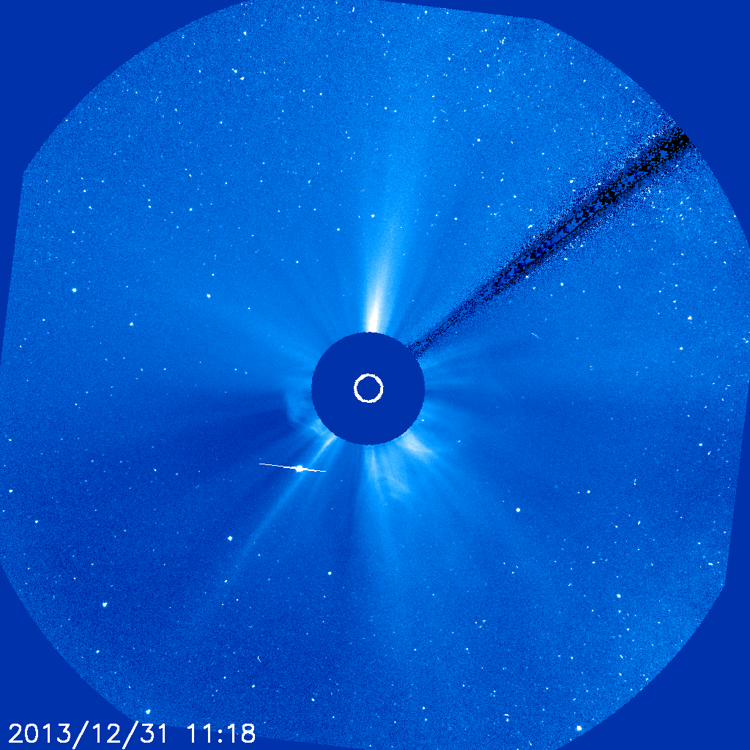
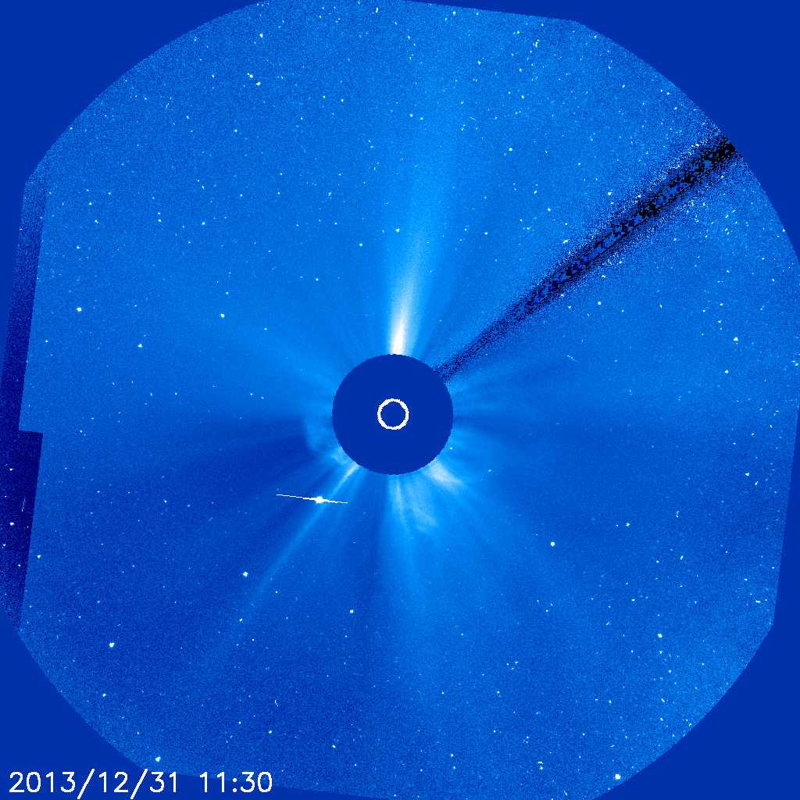
LASCO pitfalls:
Missing data are filled in with previous images. If triangulation doesn't make sense, it might be because they fill in missing data with the previous image(s)!
Example: These images are nearly identical. The red arrow shows where the "real" 11:30 UT image ends.
Beware of filled-in images! You'll be shown the location of where a CME "was" instead of where it "is." Check the difference pane for missing data, or check to make sure image advances with each frame.
Filled-in LASCO image
from 11:30 UT
Real LASCO image
from 11:30 UT
Notes:
A big pitfall in the SOHO data is that they often have missing data that they fill in with recent images! Sometimes you'll see an edge in an image that doesn't look like it could be a solar feature (see red arrow in the middle pane). That is often the boundary between the "real" image and the "filled in" image. If you use the iSWA SOHO Difference Image Gallery it becomes very clear when an image has been filled in, because it's just a big blank gray area.
If you were measuring this CME and you didn't realize that the image had been filled in, you would have clicked on the leading edge of the 11:18 CME, but you'd think it was an image time of 11:30!

Slide 29
LASCO pitfalls:
Features behind the pylon will be hard to see. Pylon will either be in upper right or lower left (depending on spacecraft orientation).
LASCO C2 and the STEREO coronagraphs also have pylons – the effect isn't as pronounced, but it is still something you should keep in mind.
Filled-in LASCO image
from 11:30 UT
Pylon location
Notes:
Another pitfall! All of the coronagraphs have occulters that block out the Sun. They can't just hover in space, so they need a support, or "pylon" to hold them there. These are effectively blind spots in coronagraph images. Some are more severe than others – it's very clear where the pylon is in SOHO LASCO C3 images, less clear in others. Be mindful that a CME may not be as clear behind a pylon, and you may measure a width that is small than the true width because part of the CME is obstructed by the pylon.

Slide 30
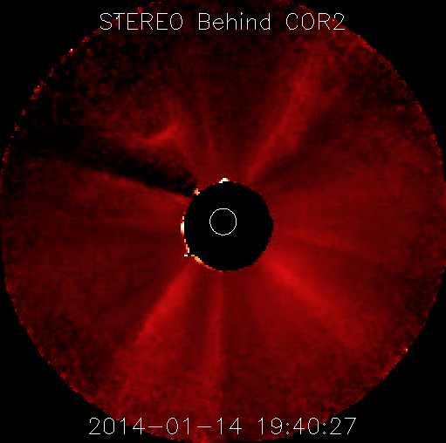
STEREO pitfalls:
STEREO doesn't fill in missing data, but the graininess of the beacon images means that some features can mimic CME shapes. There is a rapid falloff in brightness near the edge of the image, at certain angles - these can look like a leading edge. The "real" leading edge may be beyond the FOV – what you think is a front may be the dropoff in brightness convolved the remaining part of the CME.
This is not a CME. It's a fan of streamer features, and the brightness depressions at the top and the right side make it look more like a large CME.
Filled-in LASCO image
from 11:30 UT
Notes:
A big challenge of looking at the STEREO data is that you are seeing a highly compressed version of the images – lower resolution, higher compression, and this can introduce artifacts. Sometimes some of these features can look like a CME even when there isn't one! Remember to always view movies of the CMEs to be sure that something is moving. If it's not moving, it's not a CME!

Slide 31
Conclusions
- Choosing viewing angle pairs can greatly influence the resulting CME speed triangulation.
- Even if you are able to measure the same point on a CME, projection angle can have a huge impact on the measured speed relative to the true speed of the leading edge. In general, the wider the CME, the less accurate the measured speed (for a spherically expanding CME approximation).
- However, for a wide CME it is more likely that much of it will be invisible because of Thomson scattering limitations. A leading edge 30° out of the plane of the sky will have half the scattering efficiency relative to features in the plane of the sky. Features >60° out of the image plane are invisible.
- When you only have images from one viewpoint you can use the source signature location as an approximation of the CME lat/lon.
Notes:
In conclusion, there are several challenges when measuring CMEs. A savvy observer will consider which sets of images to use, and will be very aware of halo viewing geometries.
Even if you think you have a good set of images, there are still effects that can complicate things. A wide CME means that the leading edge will be more spread out in different viewing directions, and you'll get even more ambiguous results. Because faster CMEs tend to be wider, this problem is worse for the more energetic events.
There are also geometric considerations inherent to a coronagraph. The scattering efficiency, or "Thomson scattering," is effectively zero for features far out of the image plane (i.e. > 60 degrees). This means that if a CME is coming straight for you, you won't be able to see the leading edge at all!
You can never be certain that you have determined the longitude if you have only used coronagraph images. Remember to examine the EUV images to see if the source latitude and longitude make sense! If not, you may want to re-examine your measurements.

