Slide 1
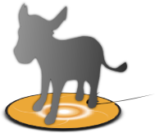
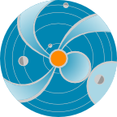
DONKI
Database of Notifications, Knowledge, and Information
M. Leila Mays
Software developers: Chiu Wiegand (lead), Rick Mullinix
June 2014
http://kauai.ccmc.gsfc.nasa.gov/DONKI
and the CCMC/SWRC team
SPACE
WEATHER
RESEARCH
CENTER
Feedback and suggestions are welcome!
Email: chiu.wiegand@nasa.gov, m.leila.mays@nasa.gov
Notes:
This presentation about DONKI: it is a space weather database of notifications, knowledge and information developed by the CCMC/SWRC.

Slide 2
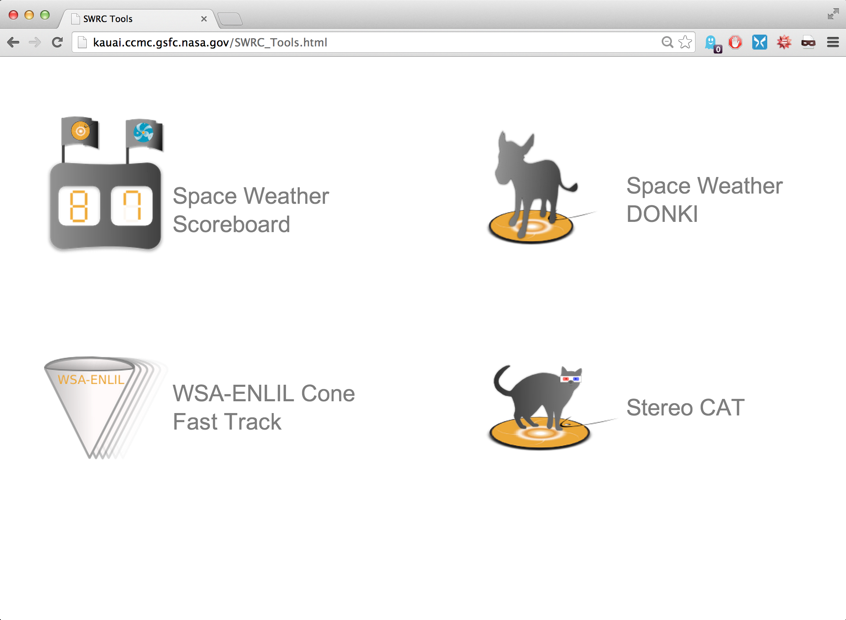
Space Weather Web Tools from CCMC/SWRC:
http://kauai.ccmc.gsfc.nasa.gov/
Notes:
This is a screenshot of the kauai CCMC webpage, which shows some of the space weather web tools available from the CCMC/SWRC.

Slide 3
Space Weather Web Tools from CCMC/SWRC:
http://kauai.ccmc.gsfc.nasa.gov/
Notes:
Today we are going to look at the Space Weather DONKI.

Slide 4
Before DONKI
Blogs for Daily space weather activity
Difficult to Search
Difficult to describe a chain of events
Difficult to disseminate
What we want to get away from: http://screencast.com/t/750Ci2aKM
Static email lists for notifications
Manually generated following templates
Tedious and Error-prone
Notes:
Before the DONKI system the SWRC was using blog software to keep daily logs of space weather activity. It was difficult to search, difficult to describe space weather event chains. There was also static templates which were manually edited and mailing lists for notifications which could lead to errors.

Slide 5
DONKI Database of Notifications, Knowledge, and Information
Catalog of space weather phenomena.
Chronicles the daily interpretations of space weather observations, simulation results, forecasting analysis, and notifications.
Key component of the forecaster tool suite, developed to address space weather needs of NASA missions.
Online tool for dissemination of forecasts, notifications, and archiving event-focused information (automatic dissemination coming soon)
Intelligent linkages, relationships, cause-and-effects between space weather activities
Comprehensive search functionality to support anomaly resolution and space science research:
Space weather activity archive (flares, CME parameters and simulation results, SEPs, geomagnetic storms, radiation belt enhancements) with links between activities
GSFC space weather notification and weekly report archive
Enables remote participation by students, world-wide partners, model and forecasting technique developers
Demo: http://kauai.ccmc.gsfc.nasa.gov/DONKI
Notes:
At its foundation DONKI is basically catalog of space weather phenomena.
The system allows us to chronicles the daily interpretations of space weather observations, simulation results, forecasting analysis, and notifications, made by forecasters at the SWRC.
DONKI is a key component of the forecaster tool suite, developed to address space weather needs of NASA missions.
It is an online tool for dissemination of forecasts, notifications for NASA missions (automatic dissemination, with different thresholds is coming soon).
It also serves to archive event-focused information along with intelligent linkages, relationships, cause-and-effects between space weather activities, for example SEPs associated with CMEs and flares.
DONKI is a comprehensive search functionality to support anomaly resolution and space science research:
It serves as a apace weather activity archive (flares, CME parameters and simulation results, SEPs, geomagnetic storms, radiation belt enhancements) with links between activities
Also as a GSFC space weather alert and weekly report archive
DONKI also enables remote participation by students, world-wide partners, model and forecasting technique developers

Slide 6
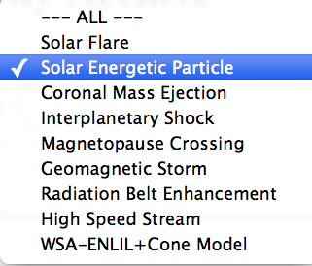
Click here to get started searching the database
by space weather activity type and date
Choose event type
Select start and end date for search
For example, Solar Energetic Particle (SEP), to see all SEP events above threshold values
DONKI
Notes:
Here is a screenshot of DONKI to show what you would see if you clicked “search space weather activity” in the sidebar.
This gives you a search form that allows you to search by event type and date. If you leave the end date blank, the current date is assumed. Leaving both the start and end date blank will search all events in the database (2010-present).
Solar flares are listed for M5 and above using GOES X-ray data.
Solar energetic particle events are listed for GOES: when the > 10 MeV proton flux exceeds 10 pfu, or >100 MeV proton flux exceeds 1pfu; SOHO COSTEP: when the one or more of the > 15.8 MeV protons channels exceeds 10^(-1) pfu/MeV; or STEREO 13-100 MeV protons exceeds 10^(-1) pfu/MeV .
CMEs are generally above 500 km/s and the parameters shown are determined using real-time beacon data and the StereoCAT tool.
Magnetopause crossings are determined from the magnetopause location from the SWMF model using ACE input data.
Geomagnetic storms are listed for Kp 6 and above storms, using the NOAA real time Kp index.
Radiation belt enhancements listed for when the GOES > 0.8 MeV integral electron flux is above 10^5 pfu, typically during high speed streams
High speed streams are listed generally for changes in solar wind velocity of > 100 km/s which show stream interaction region signatures in-situ.
WSA-ENLIL+Cone model results(and input parameters) are shown for all CMEs modeled by the SWRC.

Slide 7
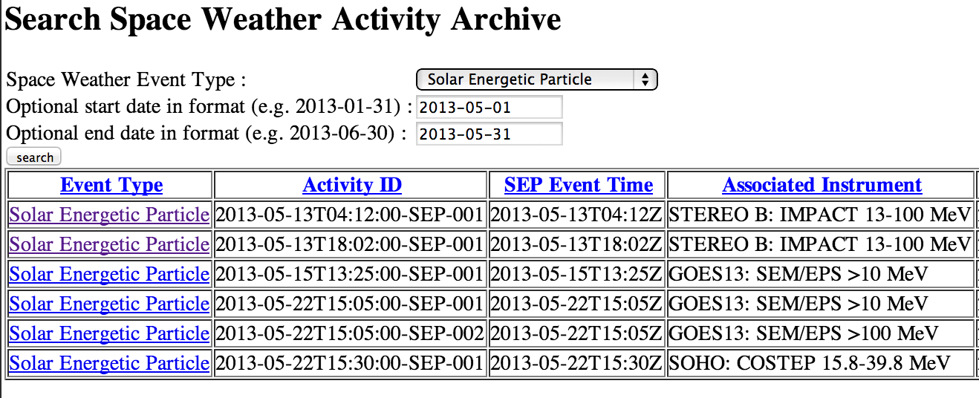
For example, Solar Energetic Particle (SEP), lists all SEP events above threshold values at various locations.
All columns are sortable!
(click column headings)
DONKI
Notes:
Here is a screenshot of some search results when looking for SEP events during the month of May in 2013. The left column, event type, can be clicked for more information about each SEP event. The activity ID and SEP Event Time in UT (columns 2 and 3) corresponds to the time the threshold was crossed for each instrument, show in the last column.
All columns are sortable by clicking column headings.

Slide 8
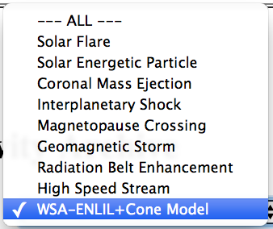
For another example, select “WSA-ENLIL+Cone Model” to see all CME simulations in a certain date range.
DONKI
Notes:
Here is another screenshot of the search page, this time let’s search for WSA-ENLIL+Cone simulation results.

Slide 9
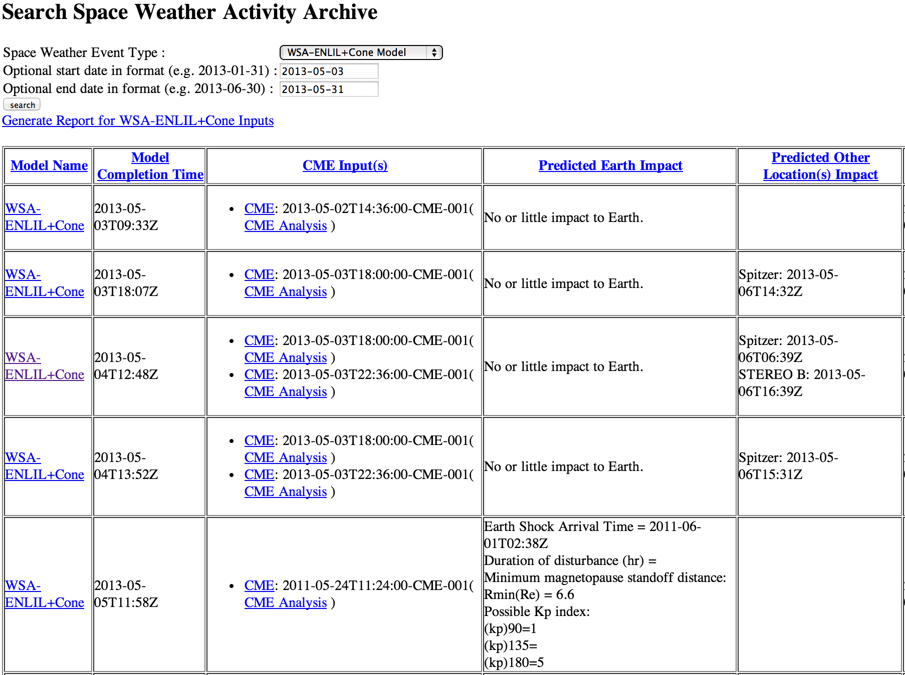
Selecting “WSA-ENLIL+Cone Model” lists all CME simulations in a certain date range.
All columns are sortable!
(click column headings)
Notes:
Here is a screenshot of some search results when looking for WSA-ENLIL+Cone model results during the month of May in 2013. More details about each simulation (including input parameters, impact times, simulation animations, and timelines) can be found by clicking the model name column link. The second column shows the time the simulation completed (UT). The third column lists the CMEs in the simulation. You can click the CME for information about it. The last two columns show the predicted Earth impact, other locations impact times, if any.
All columns are sortable by clicking column headings.

Slide 10
Shows impact prediction summary for each simulation
DONKI
Notes:
The third column lists the CMEs in the simulation. You can click the CME for information about it. The last two columns show the predicted Earth impact, other locations impact times, if any.

Slide 11
Click here to get full simulation results and graphics for a given run.
DONKI
Notes:
More details about each simulation (including input parameters, impact times, simulation animations, and timelines) can be found by clicking the model name column link.

Slide 12
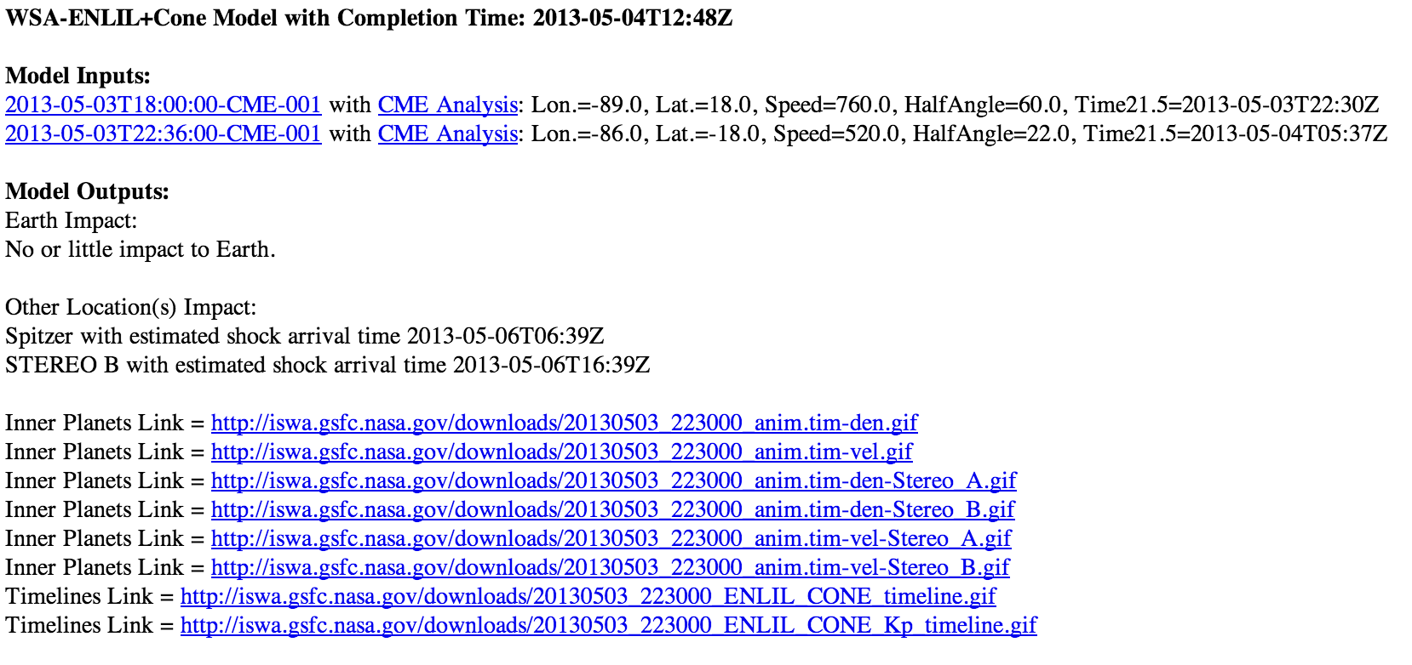
CME input parameters are listed for each activity ID (click ID for more CME information)
Full simulation results for the selected run:
Impact prediction times
Links to simulation movies and plots
DONKI
Notes:
Here is an example of what you would see after clicking the model name column link. At the top you see the CMEs, and their input parameters for each CME in the simulation. You can click on the CME activity ID (the CME start time) to see more information about the CME (for example other measurements, comments). At the model you see the model outputs. The impact times are shown if there was a detected impact at Earth or other locations. The simulation animations are linked at the bottom along with timeline plots.

Slide 13
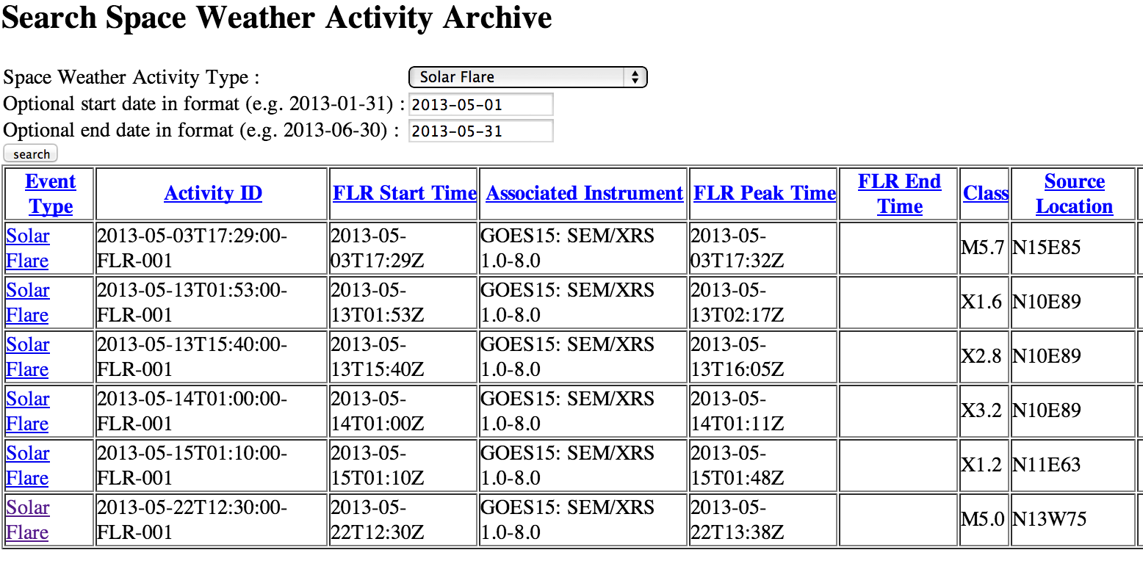
DONKI also shows intelligent linkages, relationships, cause-and-effects between space weather activities
For example, search for solar flares during May 2013, and click here for more information on the M5.0 flare
DONKI
Notes:
Here is a screenshot of search results for flares detected by GOES which are M5 and above during the month of May 2013. If you are interested in the M5.0 flare, you can click on the “solar flare” link in the first column.

Slide 14
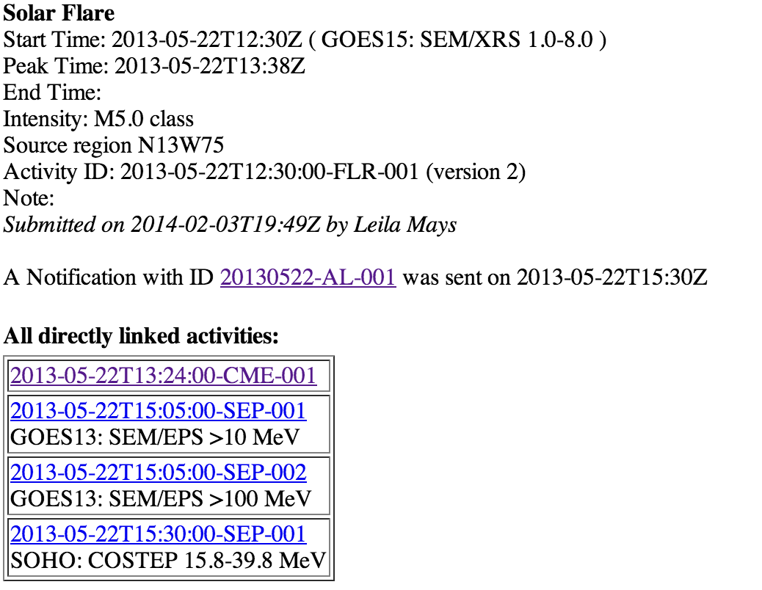
More details and relationships for the M5.0 flare:
Click the notification ID to see a copy of the flare notification.
Related events are listed at the bottom. This flare was associated with a CME and also an SEP event near Earth
Click on the activity IDs for information on the CME or SEPs.
DONKI
Notes:
This will lead you to more information about the flare, including the start, peak, and end time, source location and associated active region if any. If a notification was sent for this flare, you can click on the message ID to get to the full text of the flare notification.
At the bottom you will see “all directly linked events,” if the forecaster has determined that this flare was related to any other space weather activities, it will appear here. You can click on any of the activity IDs to get more information on any of the directly linked events.

Slide 15
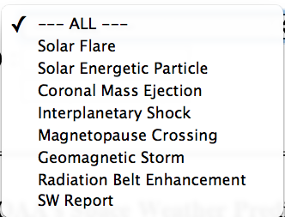
Alternatively, search the notification database
by space weather activity type and date
Choose event type,
or weekly report
Select start and end date for search
For example, select ALL to list all notification types and weekly reports.
DONKI
Notes:
Alternatively, search the notification database by space weather activity type and date. Select start and end date for search
For example, select ALL to list all notification types and weekly reports.

Slide 16
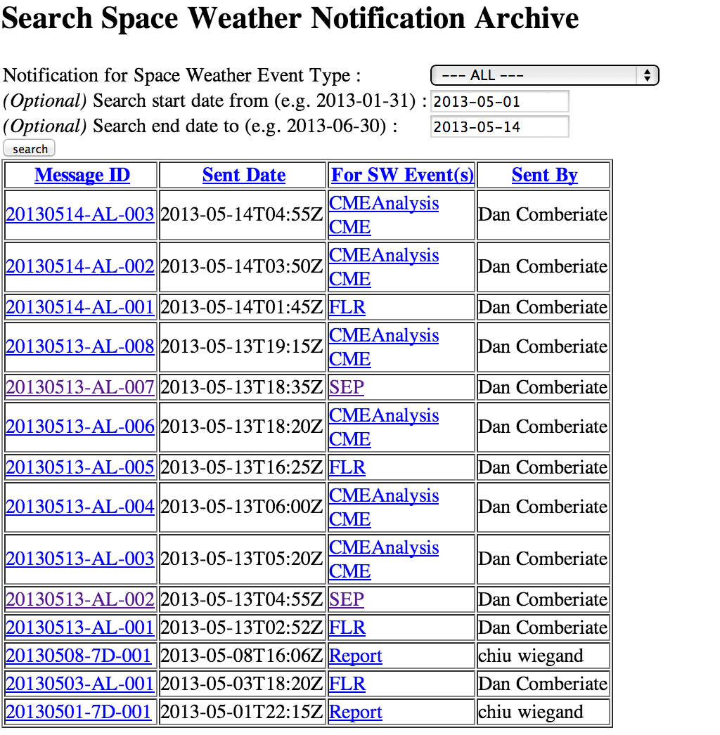
Selecting ALL lists all notification types and weekly reports in a certain date range.
Click on the message ID to see a copy the notification.
All columns are sortable!
(click column headings)
DONKI
Notes:
Here is a screenshot of an example of search results of all notification types for the first two weeks of May 2013. You can click on the message ID to see a full text copy of the notification. You can also click on the event type in the third column to go directly to the page for that space weather activity.

Slide 17
Demo:
DONKI
Database of Notifications, Knowledge, and Information
http://kauai.ccmc.gsfc.nasa.gov/DONKI/
Example: 2013-05-22 M7.3 flare and related activity,
2012-03-07 X5.4 flare.

Slide 18
DONKI - Caveats
Data entry for past events (using logs and alert archives) was performed by students:
Could be errors, mostly due to typos, or duplicate entries
We are adding data quality flags to indicate whether entries have been “checked”
Entries from Aug 2013 onwards is mostly verified.
Older ENLIL simulations from 2010- May 2011 have not yet been entered (different format), coming soon.
Search filters combinations will be added in the near future
More data export options coming (suggestions?)
CME measurements are made in real-time, with limited data.
Notes:
There are some caveats to consider when using DONKI
Data entry for past events (using logs and alert archives) was performed by students:
Could be errors, mostly due to typos, or duplicate entries
We are adding data quality flags to indicate whether entries have been “checked”
Entries from Aug 2013 onwards is mostly verified.
Older ENLIL simulations from 2010- May 2011 have not yet been entered (different format), coming soon.
Search filters combinations will be added in the near future
More data export options coming (suggestions?)
CME measurements are made in real-time, with limited data.

Slide 19
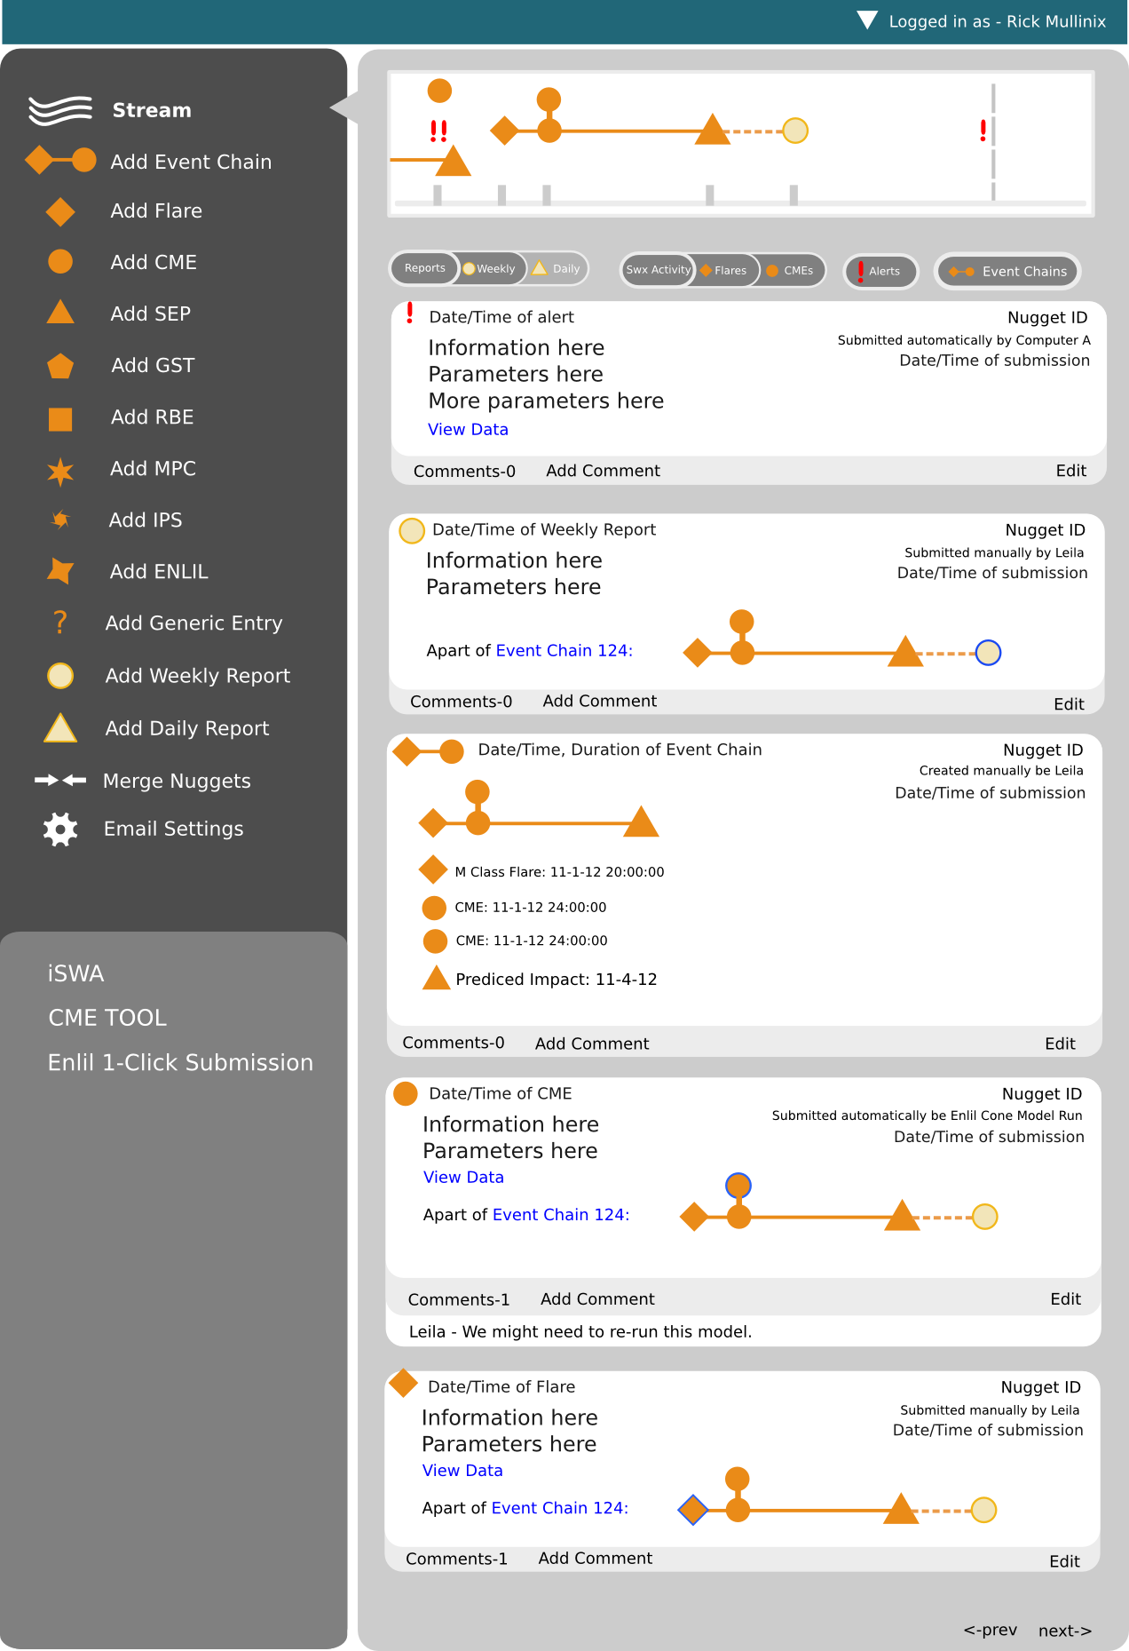
DONKI
Future Directions
Search with filters will be added in the near future
More data export options
Clear flags indicating data quality
Notes:
DONKI Future Directions. We are currently considering implementing the following:
Search with filters will be added in the near future
More data export options
Clear flags indicating data quality
And a GUI to easily browse space weather chains of events.
Linking with the CCMC runs on request database for specific space weather events is also planned.

Slide 20
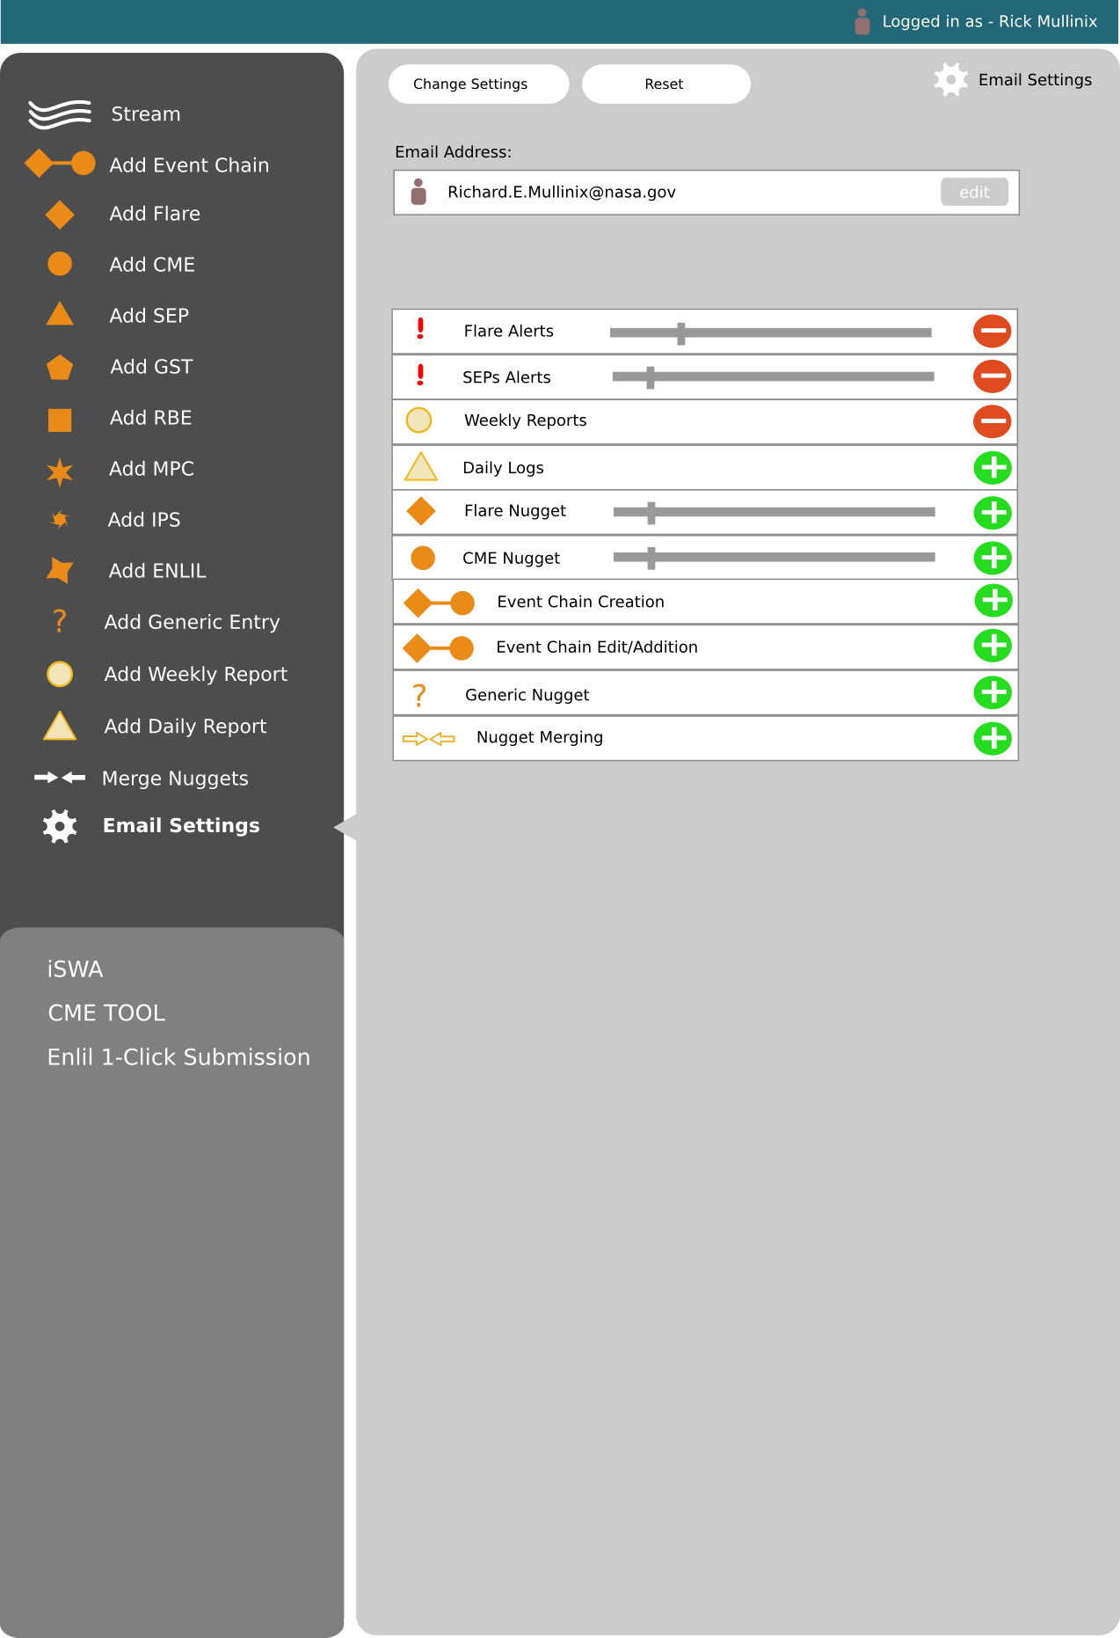
Notes:
In the future the system would allow personalized notifications and thresholds.

