Slide 1
CCMC/SWPC Validation Challenge
Geomagnetically Induced Currents (GICs) present a clear threat to critical infrastructure.
  Limited capability to forecast GIC impacts.
NOAA SWPC & NASA’s CCMC teamed up to evaluate GIC predictive capabilities.
  5 models evaluated for 6 storm events.
  Tested ability to predict ground |dB/dt| from
  upstream solar conditions.
  Simulations & analysis performed at CCMC.

Slide 2
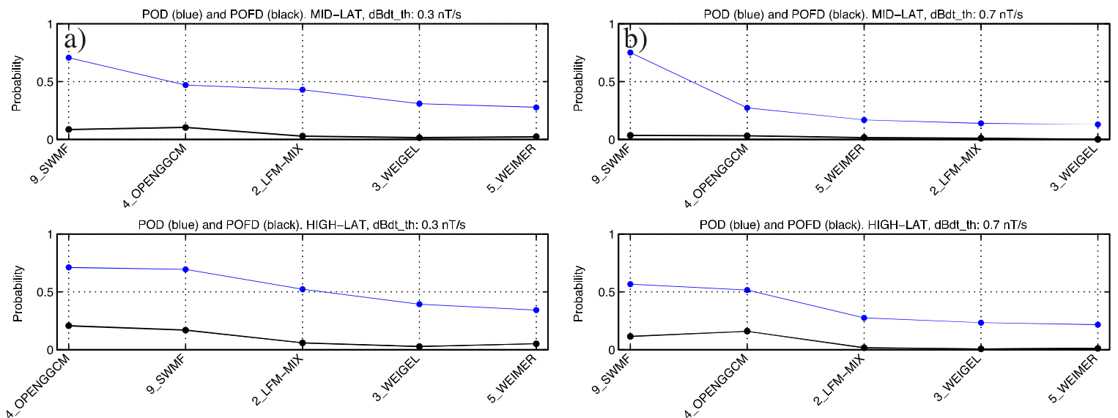
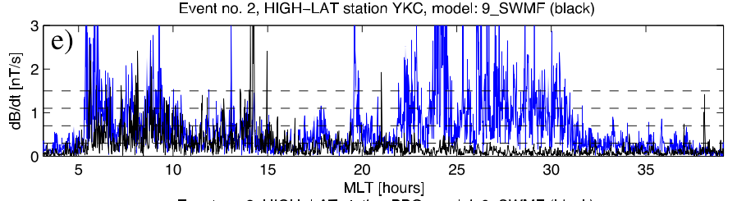
CCMC/SWPC Validation Results
See Pulkkinen et al., 2013
“Binary Event” analysis used to assess ability to predict when dB/dt crosses given thresholds.

Slide 3
Critical Questions
What is the range of validity for these models?
  Are the empirical relationships appropriate for intense storms?
How does performance depend on activity?
  Does the prediction error change with activity?
Can we explain the ranking of the models?
  Are there patterns that explain why some models performed better than others?

Slide 4
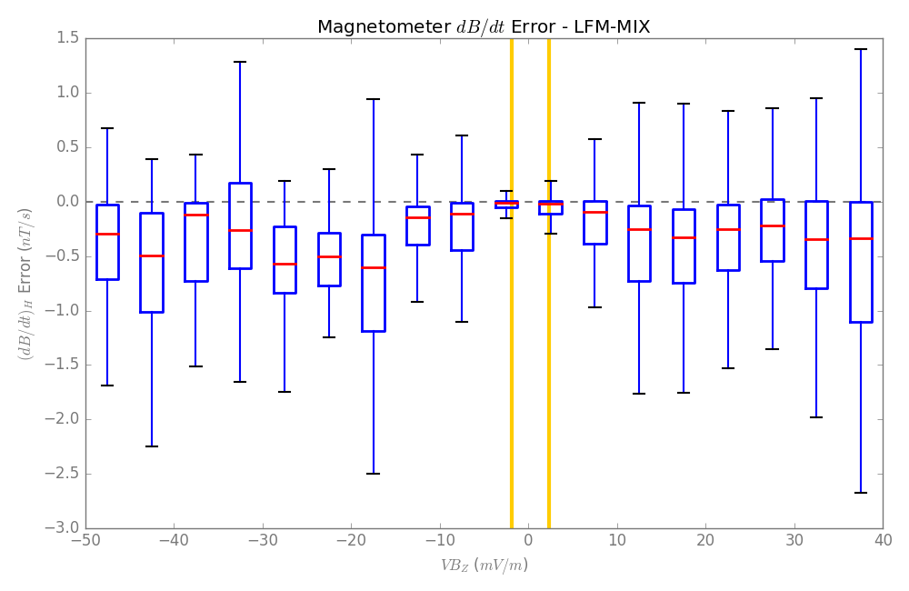
Error vs. Driving Example
Error > 0: OVER-PREDICTION
Error = 0
PERFECT
Error < 0: UNDER-PREDICTION
Northward IMF
Southward IMF

Slide 5
Error vs. Driving Example
Model shows bias
towards under prediction.

Slide 6
Median Relative Errors

Slide 7
Validation Challenge Details
Model | Approach | Empirical Relationships | Training Data
Weigel | Climatological + impulse response filter | Ground-based magnetometers | Jan. 2000 – Dec. 2006
Weimer | Spherical Cap Harmonic Analysis | Ground-based magnetometers | Feb. 1998 – Dec. 2005
LFM | MHD & ionospheric electrodynamics solver | Robinson et al., 1987 ➔Vickrey et al., 1981 ➔Chatanika radar data | 3 storm days 1976-1977
Open-GGCM
SWMF | MHD, ionospheric solver, kinetic ring current. | Empirical conductance from Ridley-AMIE. | Jan. 1997

Slide 8
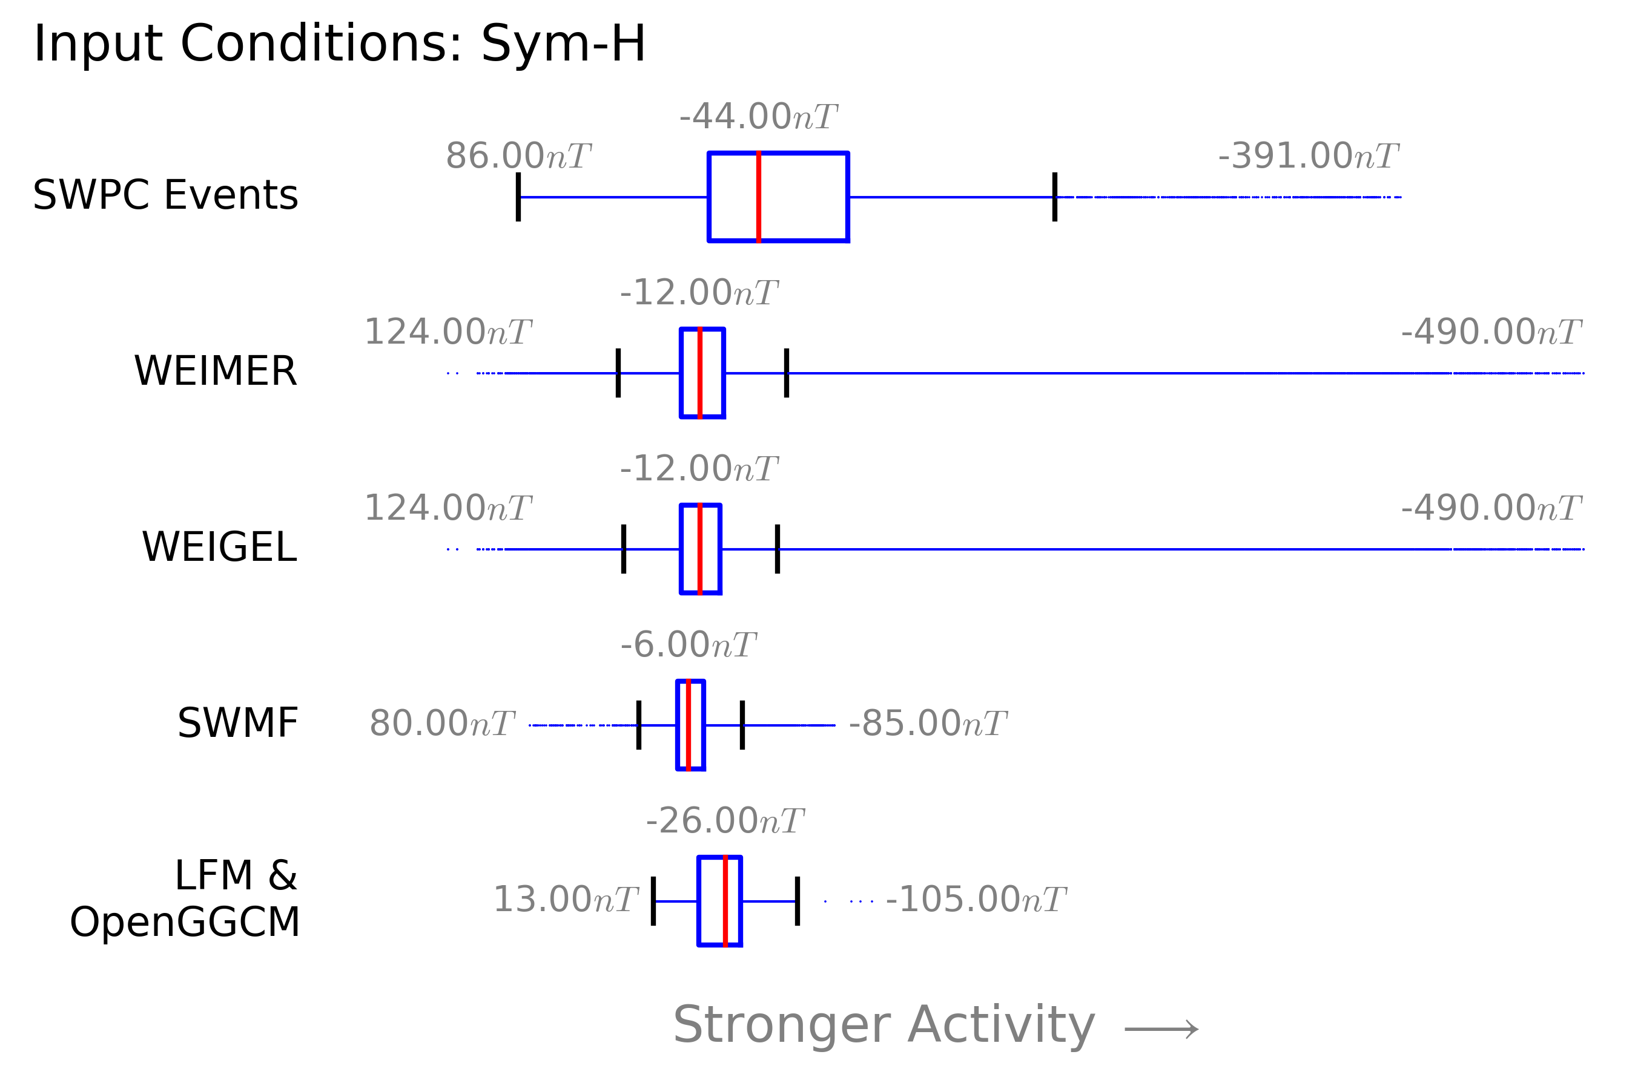
Range of Empirical Inputs
“Halloween Storm”
Oct. 29, 2003
WEAKER ACTIVITY
BIAS
Nov. 20, 2003
NO EXTREMES
Notes:
Let’s start by characterizing the six events during which we wish to predict dB/dt by looking at the distribution of all Sym-H values for these storms.
Now, let’s compare this distribution to the distribution of sym-h values from times that correspond to the input data was used to create the empirical models.

Slide 9
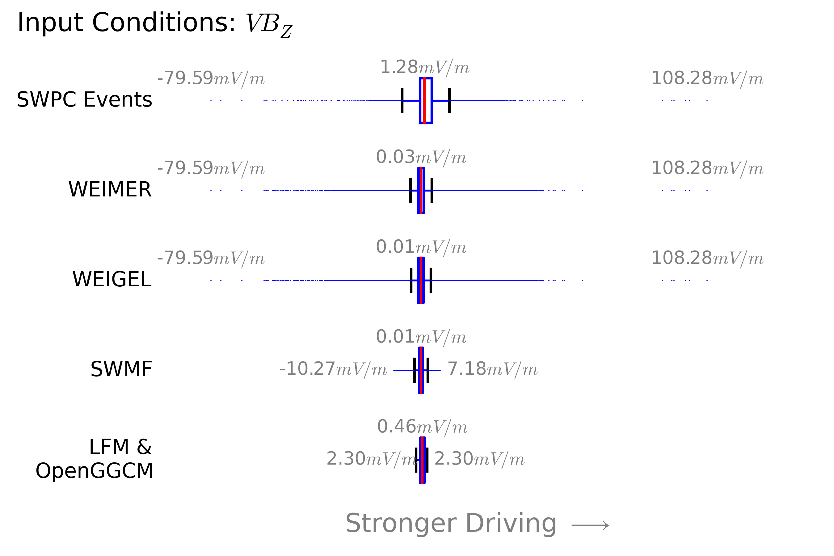
Range of Empirical Inputs
“Halloween Storm”
Oct. 29, 2003
“Halloween Storm”
Oct. 29, 2003
NO EXTREMES

Slide 10
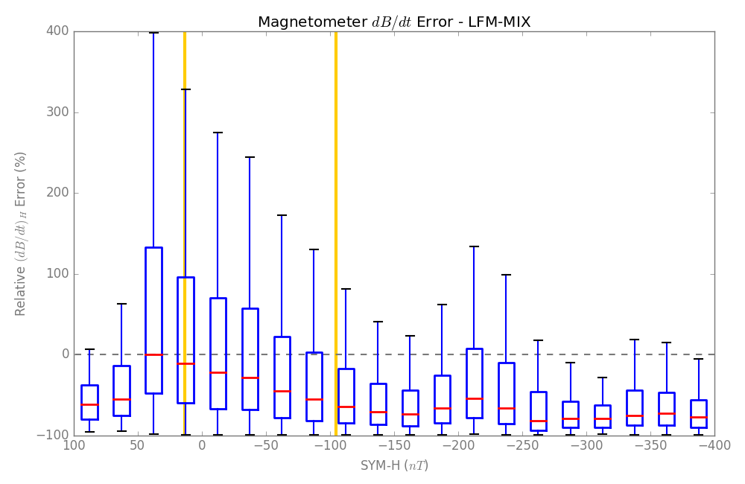
MHD Performance
Model performs best within limits of conductance model.

Slide 11
Some Thoughts
How much of MHD performance issues are due to shortcomings of conductance models?
  Lots of assumptions go into MHD models.
  Difficult to point to a single thing…
  BUT- empirical conductance models are very poorly refined!
  Testing and improving conductance models may be a low-hanging-fruit improvement for MHD.

