Slide 1

Comparison of Citizen Science Aurora Data and SSUSI
Observations for March 17-18, 2015 Geomagnetic Storm
fdaf
Burcu Kosar and Liz MacDonald
NASA Goddard Space Flight Center
Greenbelt, MD, USA
CEDAR-GEM Joint Workshop
June, 2016

Slide 2
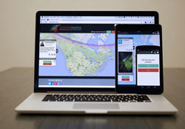

What is Aurorasaurus (aurorasaurus.org)?
- Citizen science project that engages the member of the public in science
- New global, real-time data sources from citizen scientists and tweets
- Alerts of auroral visibility for the public
Join Us!

Slide 3
FUV Observations from DMSP/SSUSI [JHU/APL]
Spectrograph based – measurements at different wavelengths
Reliable auroral products from FUV data (N and S)
  Electron energy flux
  Auroral boundaries [Zhang and Paxton, 2008, JASTP]
    Swath boundary from auroral image → GUVI based
    auroral model → global boundary
Good data source for comparison with Aurorasaurus data

Slide 4
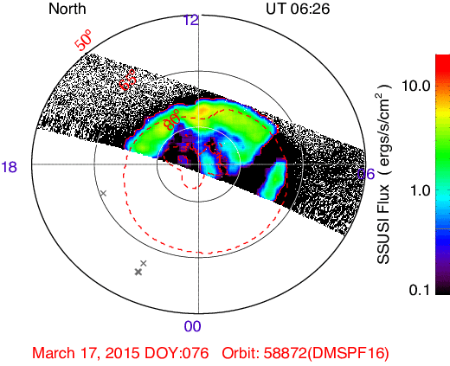
Citizen Science Data and DMSP/SSUSI Auroral Energy Flux
March 17-18, 2015 Geomagnetic Storm
±00:10 (for observations)
Grey points – observations
Red Dashed Line – model boundaries
30% success finding conjunctions with DMSP/SSUSI satellite passes.

Slide 5
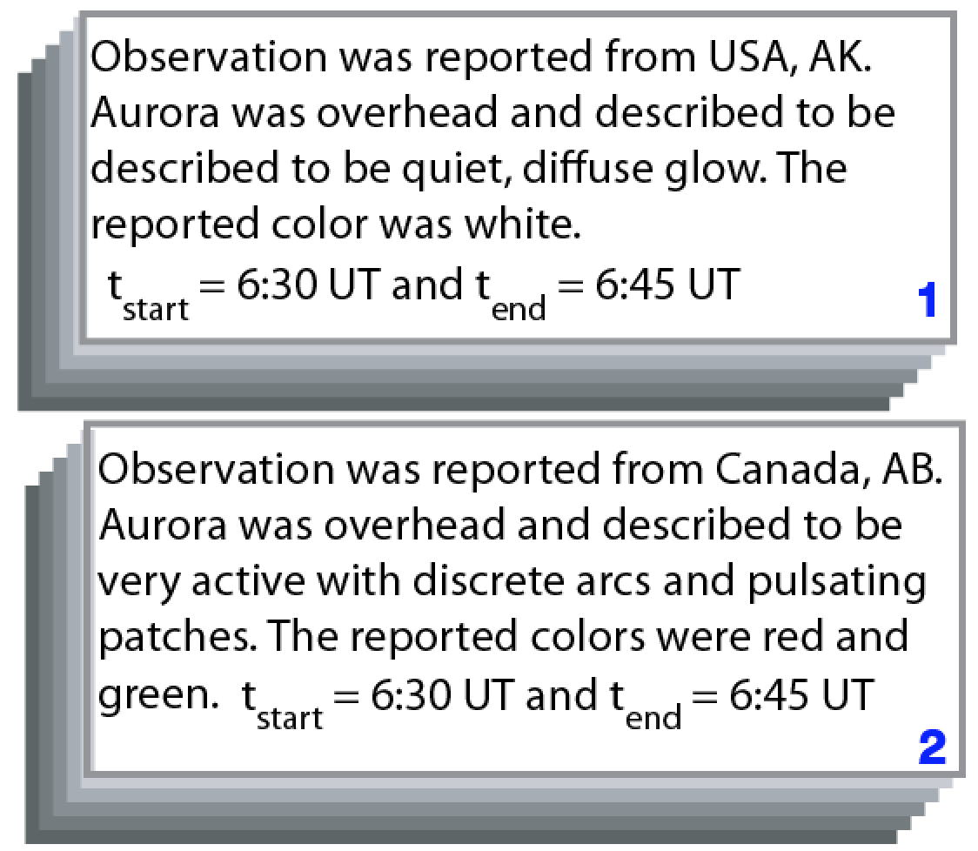
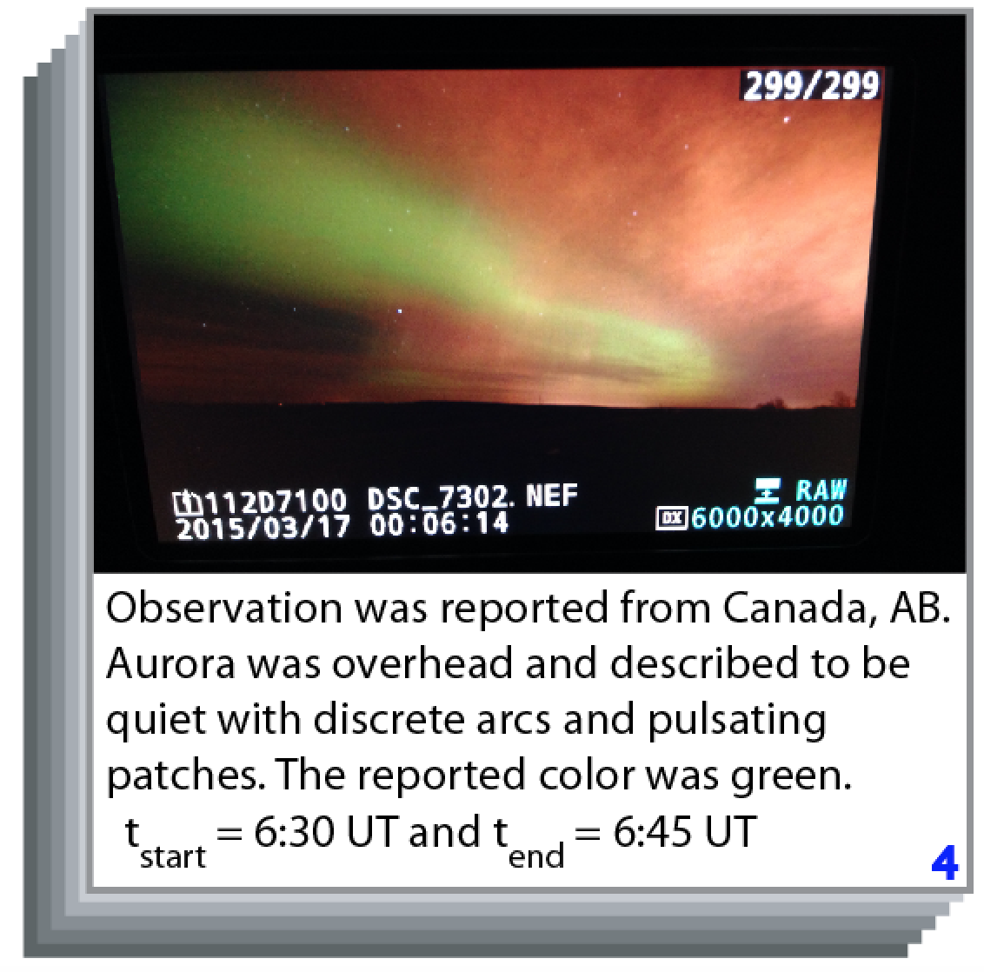
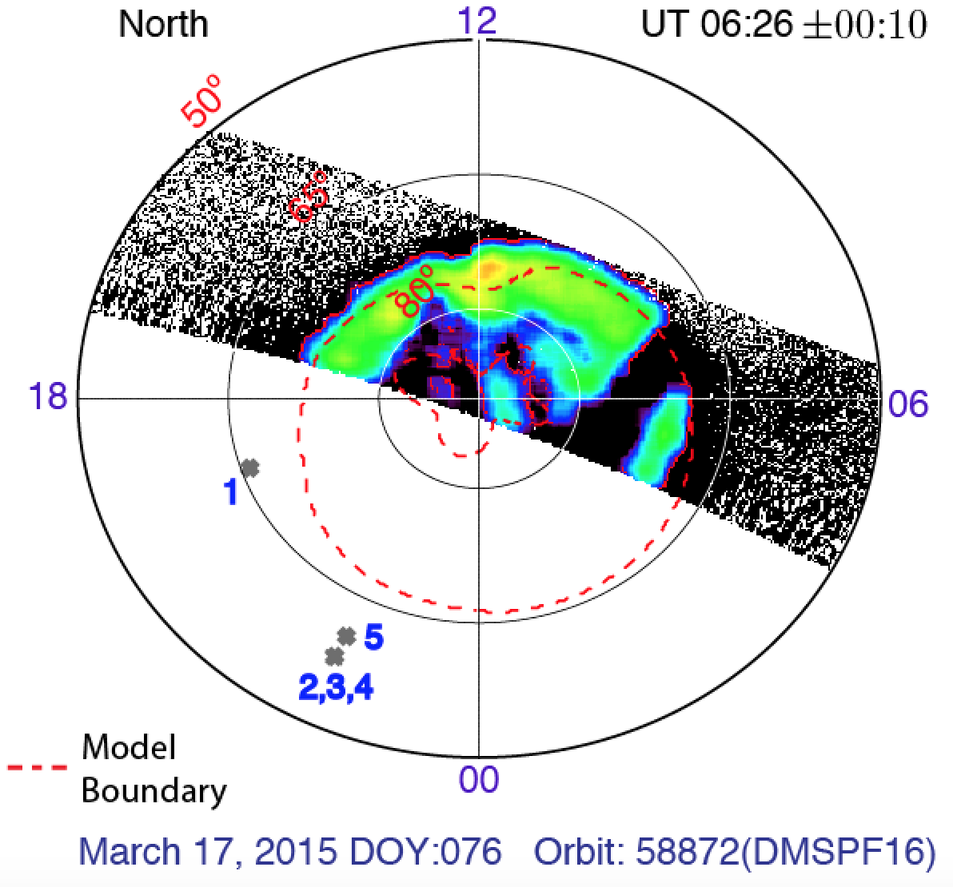
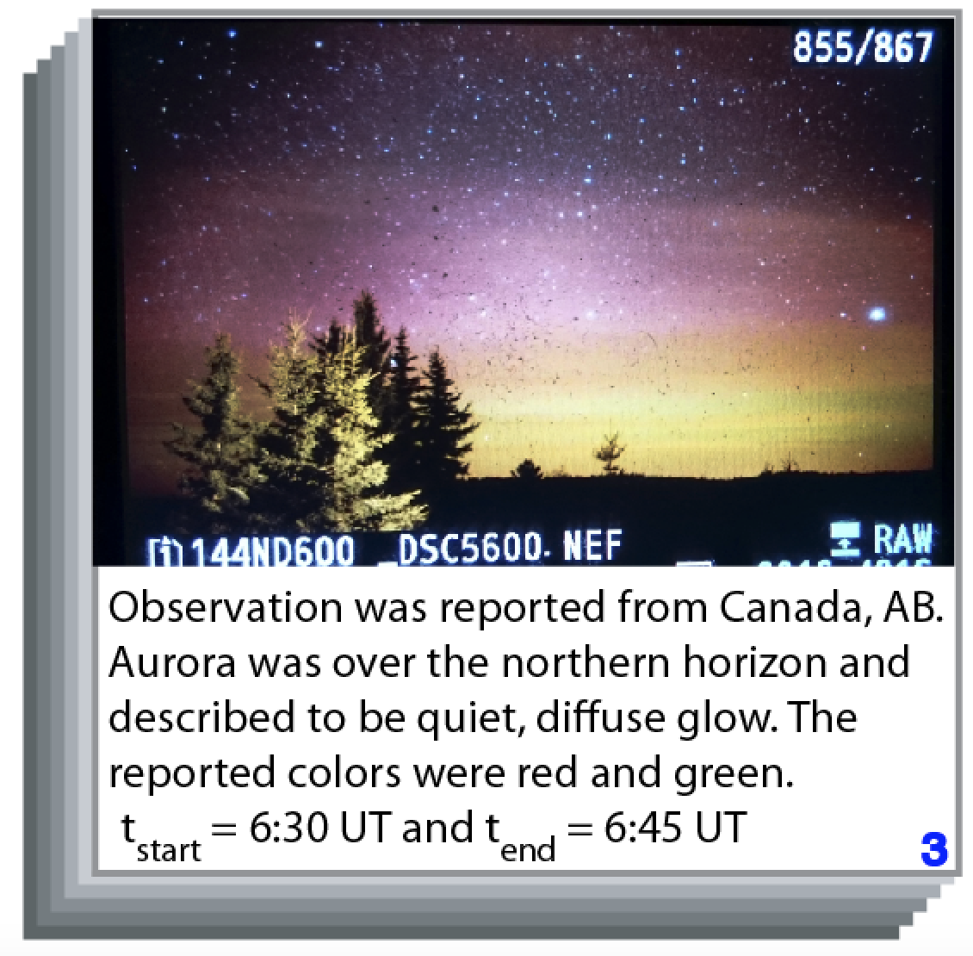
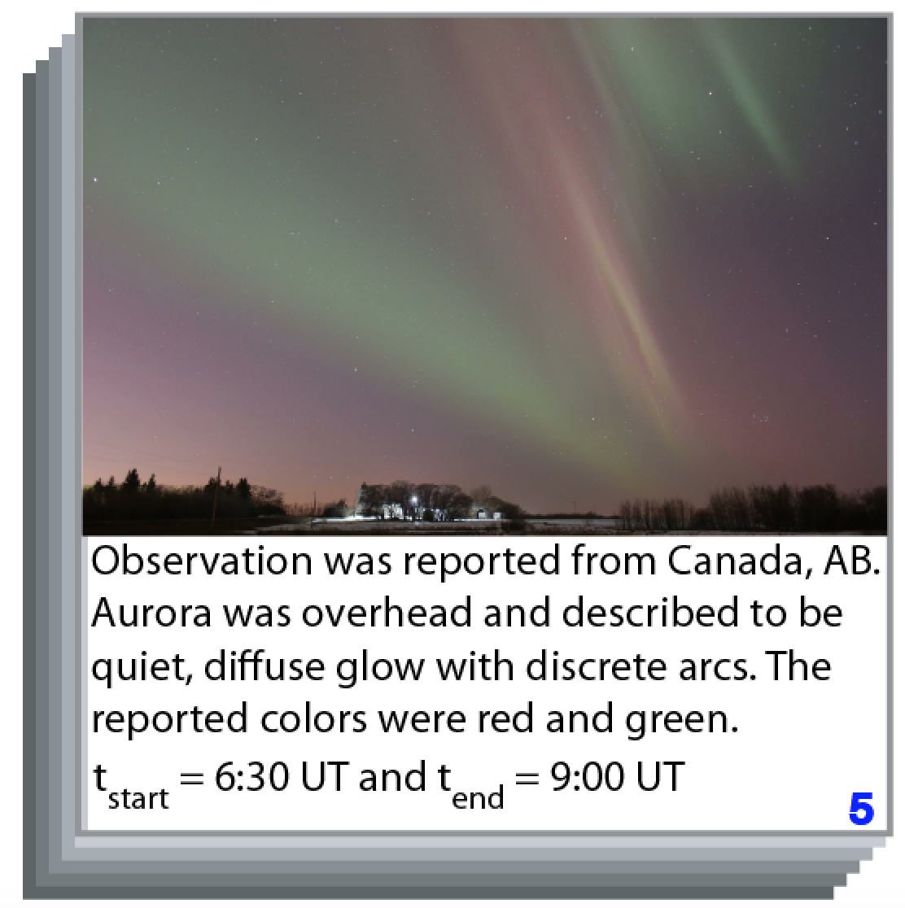
Citizen Science Data and DMSP/SSUSI Auroral Energy Flux
March 17-18, 2015 Geomagnetic Storm
4/5 citizen science observations described aurora as overhead,
inconsistent with model boundary.
Important caveats: 1st example examined, variations amongst observations Aurora moves quickly!

Slide 6
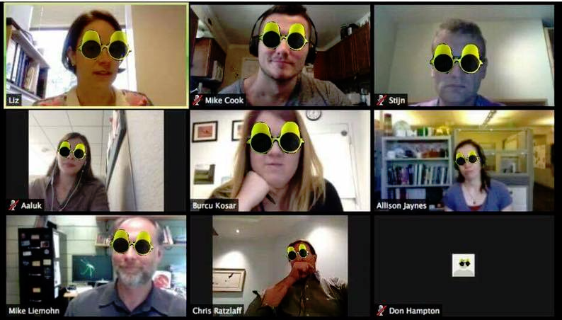
WHERE ARE WE GOING WITH THIS?
  Examine the rest of the observations that are in conjunction with SSUSI satellite passes for the case study
  Compare SSUSI with Ovation Prime/Aurorasaurus boundary
  Extend the study to the whole database
THANK YOU FOR YOUR ATTENTION!
CEDAR IT Poster Session - (Polar Aeronomy - POLA-03)
Tuesday, June 21, 2016 (16:00-19:00)
Please come find me ☺

