Slide 1
Over
Summary of space weather and its impacts
For Space Weather Training at KSC

Slide 2
Main Drivers of Space weather: Flares/CMEs/high speed solar wind streams
2

Slide 3
Solar Flares radiation across the electromagnetic spectrum most pronounced in EUV (extreme ultraviolet) and soft X-ray
3

Slide 4
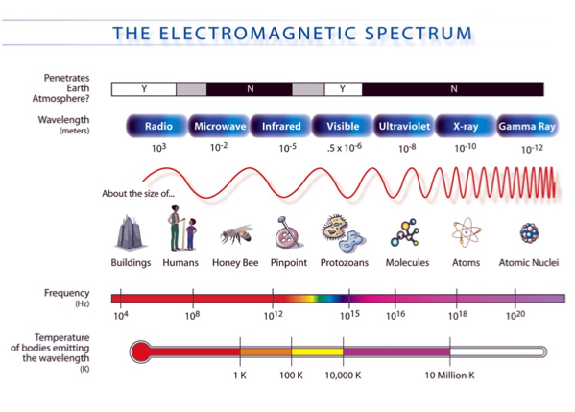

Slide 5
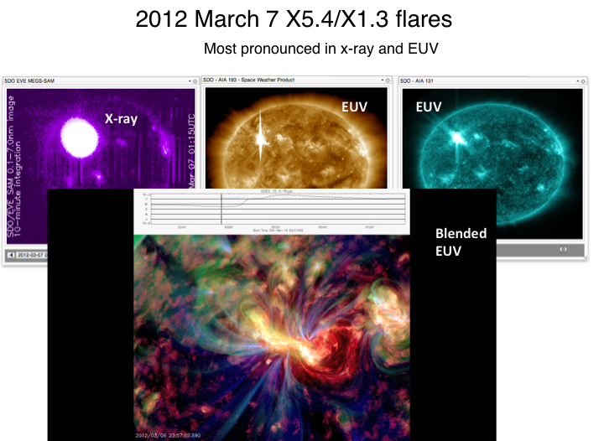
2012 March 7 X5.4/X1.3 Flares
Flares radiate throughout the electromagnetic spectrum
Solar Flare:
sudden brightening on the sun's surface
Most pronounced in x-ray and EUV
Notes:
Solar flares represent one type of solar eruptive event, appearing as a sudden brightening on the sun's surface. You can see them in the beautiful high spatial and temporal AIA (Atmospheric Imaging Assembly) images obtained from the NASA SDO (Solar Dynamics Observatory) mission. For a powerful solar flare event, such as the two X class ones here, the radiation energy is on the order of 10^25 Joule. Such flares radiate throughout the electromagnetic spectrum, from gamma rays to x-rays, through visible light to kilometer-long radio waves.

Slide 6
Flare: SWx impacts
Cause radio blackout through changing the structures/composition of the ionosphere (sudden ionospheric disturbances) – x ray and EUV emissions, lasting minutes to hours and dayside
Affect radio comm., GPS, directly by its radio noises at different wavelengths
Contribute to SEP (solar energetic particles) – proton/ion radiation (lasting a couple of days)

Slide 7
Coronal Mass Ejections (CMEs)
7

Slide 8

CME
Massive burst of solar materials/charged particles and magnetic field/flux into the interplanetary space: 10^15 g
Kinetic energy 10^32 erg (1 erg = 10^-7 joules)
Yashiro et al. (2006) find that virtually all X-class flares have accompanying CMEs
Notes:
http://1.usa.gov/1e5ZBDW
March 7 2012 event

Slide 9
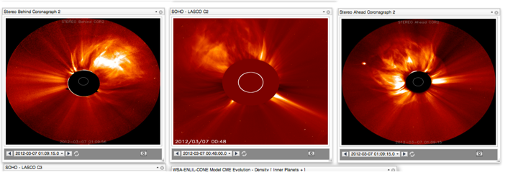
CME viewed by coronagraph imagers
Eclipses allow corona to be better viewed
  Does not happen often
Modern coronagraph imager is inspired by that: occulting disk blocks the bright sun so we can observe corona features better

Slide 10
SWx Impacts of a CME
Contribute to SEP (proton/ion radiation): 20-30 minutes from the occurrence of the CME/flare
Result in a geomagnetic storm: takes 1-4 days arriving at Earth
Result in electron radiation enhancement in the near-Earth space (multiple CMEs): takes 1-3 days
Affecting spacecraft electronics – surfacing charging/internal charging, single event upsets (via SEPs)
Radio communication, navigation
Power grid, pipelines, and so on
Notes:
http://1.usa.gov/1e5ZBDW
March 7 2012 event

Slide 11
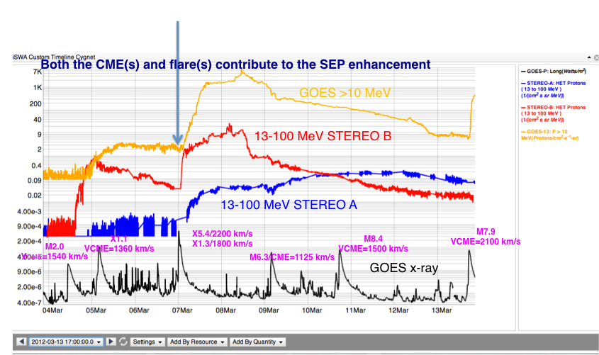
SEP (solar energetic particle) radiation

Slide 12
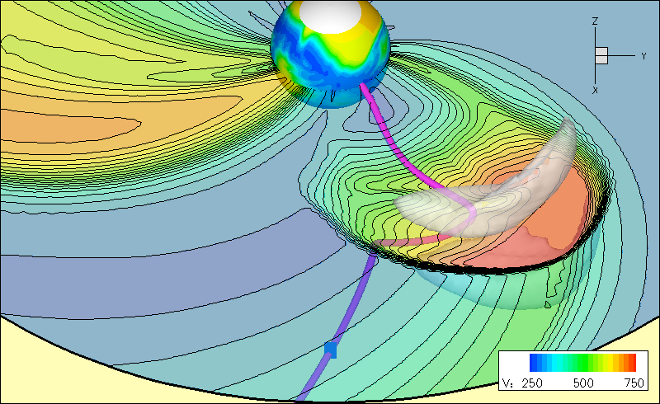
CME and SEP path are different
CME
CME
Courtesy: Odstrcil
SEPs
CME: could get deflected, bended, but more or less in the radial direction

Slide 13
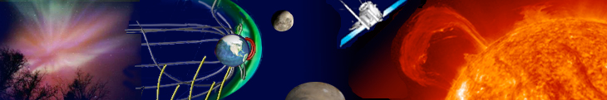
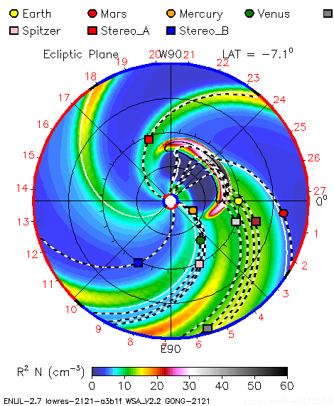
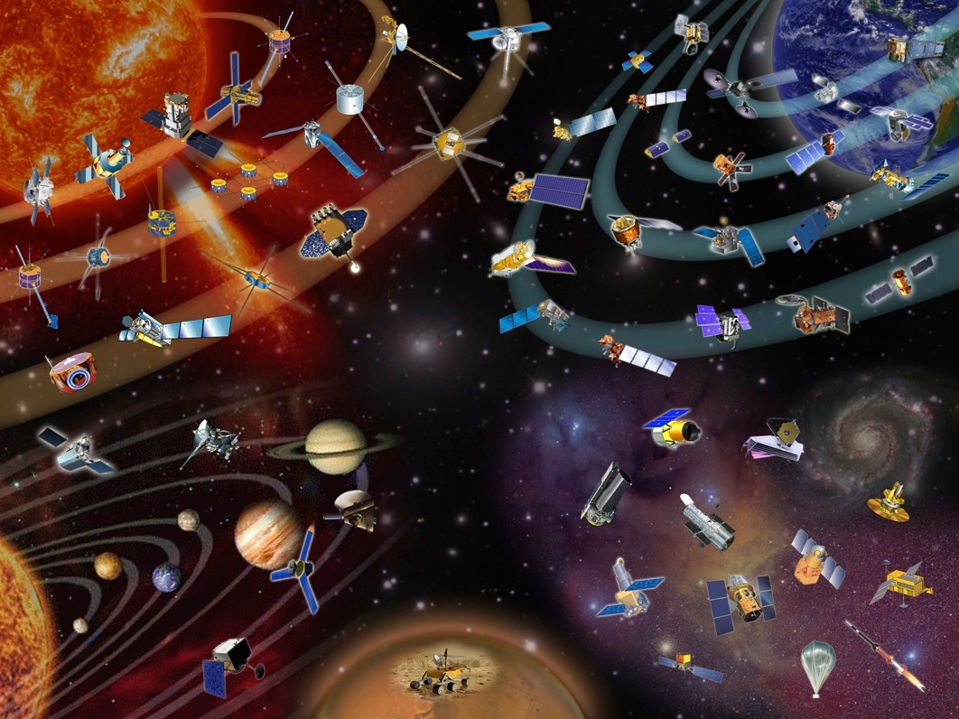
Important distinction
Ion Radiation storm vs Geomagnetic storm
CME impact and SEP (Solar Energetic Particle) impact are different
CME
CME impact @ Earth: Geomagnetic Storm
Radiation storm @ Earth from SEPs
CME speed: 300 – 3500 km/s
SEPs: fraction of c
Light speed c: 3 x10^5 km/s

Slide 14
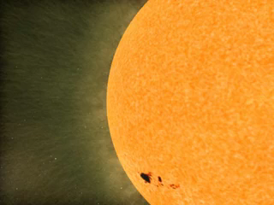
SEPs: ion radiation storms
Potentially affect everywhere in the solar system
Courtesy: SVS@ NASA/GSFC
14
Notes:
SEPs: applicable and potentially damaging everywhere that they have influence

Slide 15
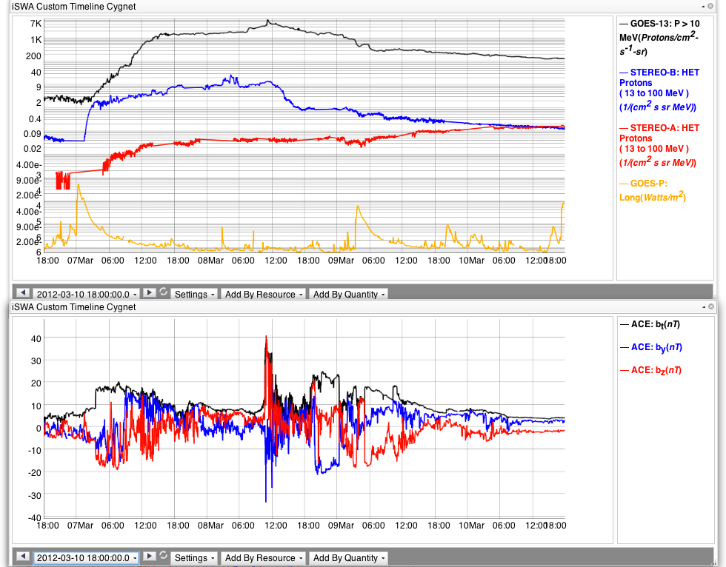
Space Weather Effects and Timeline
(Flare and CME)
Flare effects at Earth:
~ 8 minutes (radio blackout storms)
Duration: minutes to hours
SEP radiation effects reaching Earth: 20 minutes – 1hour after the event onset
Duration: a few days
Two X-class flares/Two fast wide CMEs
CME effects arrives @ Earth: 1-2 days (35 hours here)
Geomagnetic storms: a couple of days
15

Slide 16
west
east

Slide 17
SWx Consequences of CIR (corotating interaction region) HSS (high speed solar wind streams)
CIR HSS: usually long-duration (3-4 days)
  Radiation belt electron flux enhancement
  Surface charging
  Geomagnetic disturbances (moderate at most)
  heating of upper atmosphere: satellite drag
Energetic electron radiation: ( the >0.8 MeV electron flux exceeding 10^5 pfu alert threshold): takes 2-3 days from the CIR interface
Although geomagnetic activity (due to CIR HSS) during the declining and
minimum phases of the solar cycle appears to be relatively benign (especially in comparison to the dramatic and very intense magnetic storms caused by interplanetary coronal mass ejections (ICMEs) that predominate during solar maximum), this is misleading. Research has shown that the time-averaged, accumulated energy input into the magnetosphere and ionosphere due to high speed streams can be greater during these solar phases than due to ICMEs during solar maximum!
Tsurutani et al., 2006
Notes:
High-Intensity, Long-Duration, Continuous AE Activity (HILDCAA) events are studied using long-term geomagnetic and solar wind/interplanetary databases. We use the strict definition of a HILDCAA event, that it occurs outside of the main phase of a magnetic storm, the peak AE is >1000 nT, and the duration is at least 2 days long.
The overwhelmed majority (94%) of these latter cases were associated with high-speed solar wind stream (HSS) events. The remaining 6% of the cases occurred after the passage of interplanetary coronal mass ejections (ICMEs).

Slide 18
In-situ signatures of CME and CIR HSS at L1 (Lagrangian 1)
ACE and WIND spacecraft

Slide 19
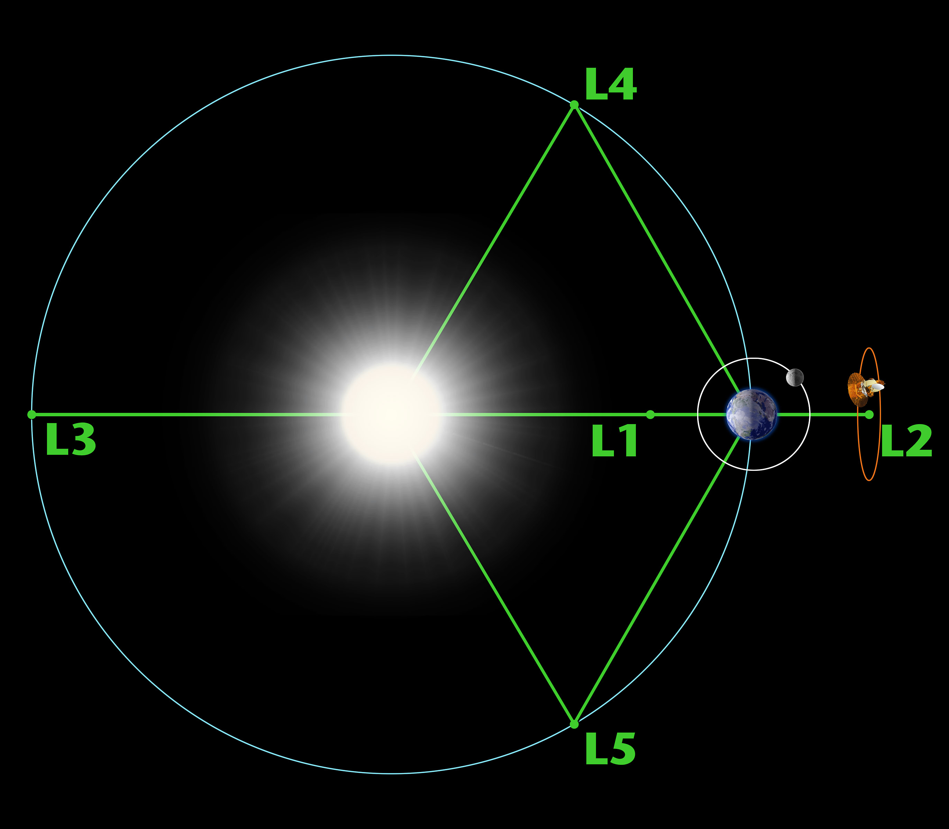
Lagrangian points

Slide 20
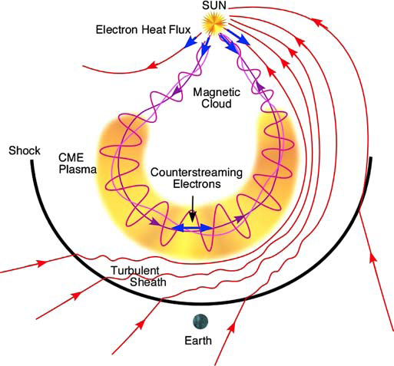
Schematic of the three-dimensional structure of an ICME and upstream shock

Slide 21
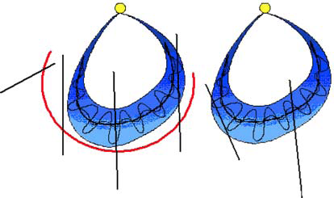
In-Situ signature can be quite complex
1: shock only
2: shock+sheath
5: ejecta?
4: ejecta?
3: shock+sheath+MC
6: MC only
Notes:
Six possible tracks of an observing spacecraft through an MC with a leading shock (left)
and another without (right). Tracks 1 and 2 never encounter the MC proper. They pass through the
shock and the compressed ambient medium in one of the flanks of the MC. Track 4 passes through
the nose of the MC. This situation arises when the observing spacecraft is along the Sun-Earth line
and a fast and wide CME erupts from close to the Sun center. Trajectory 4 passes through the shock,
sheath, and through the edge of the MC. Tracks 5 and 6 are similar to 4 and 3, respectively, except that
the MC is slow and hence it does not drive a shock. Trajectories 4 and 5 are not expected to observe
an MC structure.

Slide 22
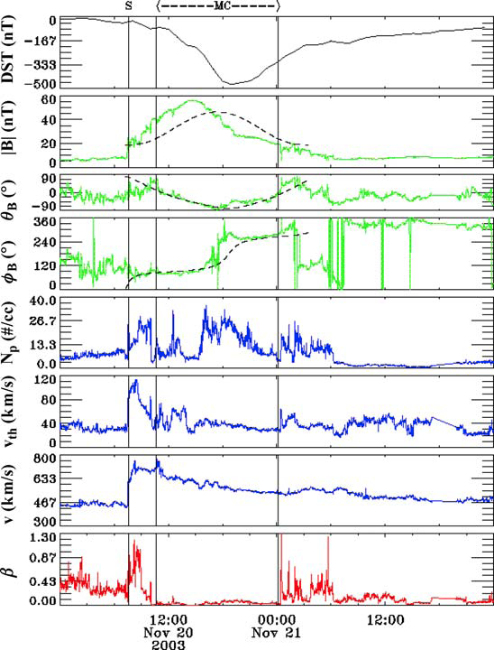
Textbook example of ICME in-situ signature
Gopalswamy, SSR, 2006
shock
sheath
Magnetic cloud
About 2 days of data are shown here
Notes:
Gopalswamy, N., PROPERTIES OF INTERPLANETARY CORONAL MASS EJECTIONS, Space Science Reviews (2006) 124: 145–168
A magnetic cloud is a transient ejection in the solar wind defined by relatively strong magnetic fields, a large and smooth rotation of the magnetic field direction over approximately 0.25AU at 1AU, and a low proton temperature [Burlaga et al., 1981]. Magnetic clouds are ideal objects for solar-terrestrial studies because of their simplicity and their extended intervals of southward and northward magnetic fields [Burlaga et al., 1990].

Slide 23
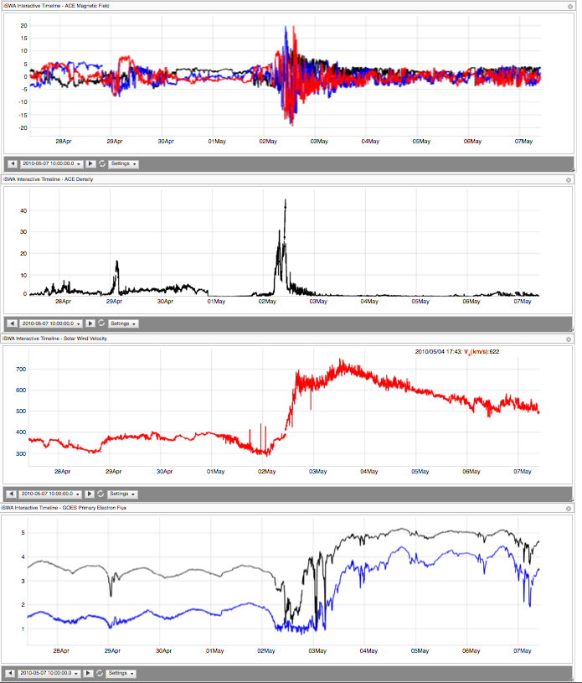
Clean HSS (high speed solar wind stream)
May 2, 2010
Dense (20-30 cc), HSS
IMFBz: -18 nT
may be more hazardous to Earth-orbiting satellites than ICME-related magnetic storm particles and solar energetic particles
Electron radiation
10 day data

Slide 24
Space Weather in a nutshell

Slide 25
Space Weather Overview
Types of Storms
Coronal Hole High Speed solar wind Streams (HSS)
Radiation storms
Drivers
Sun
Dynamic Radiation Belts Environment
Geomagnetic storms
Ionospheric storms
CMEs
Solar Energetic Particles (SEPs)
Outside the solar system
GCRs (Galactic Cosmic Rays)
Solar Flares
Radio blackout storms

Slide 26
Storms and Effects
Radiation hazards to humans
SEEs on spacecraft components and electronics
PCA on radio waves
Event total dose
Radiation Storms
Geomagnetic Storms
Ionospheric Storms
Radio Blackouts due to flares
Energetic ions
Energetic electrons
Internal charging of electronics
Large/rapid variations/disturbances in space and time (in fields and plasma/neutral distribution)
Enhancement in currents
Affect
Communication
Navigation
Surface charging
Radio wave propagation
Radio emissions/noise associated with flares (direct impacts)
Radio wave blackouts
(dayside ionosphere)
X-ray/EUV emission altering ionospheric structure/composition (indirect)

Slide 27
SWx Impacts on Satellites Electronics/Components hazards presented by the radiation and plasma environment in space
Single Event Effects (affect all SC)
  caused by protons and heavy ions with energies of 10s of MeV/amu
Internal Charging (those in radiation belt)
  caused by electrons with energies above about 100 keV that penetrate inside a vehicle
Surface Charging (all in Earth’s environment)
  caused by electrons with energies of 10s of keV that interact with spacecraft surfaces
Event Total Dose (all SC)
  caused primarily by solar protons and possibly also by transient belts of trapped particles, typically protons with energies near 10 MeV

Slide 28
Effects on Satellite Orbit
Satellite drag (LEO)
Orientation effects (spacecraft that use Earth’s magnetic field for orientation)

Slide 29
Effects on Satellite Communication
During strong solar flares (strong radio noise)
  Directly cause interference via solar radio noise
  Through modification of the ionosphere
Scintillation effects during geomagnetic storms

Slide 30
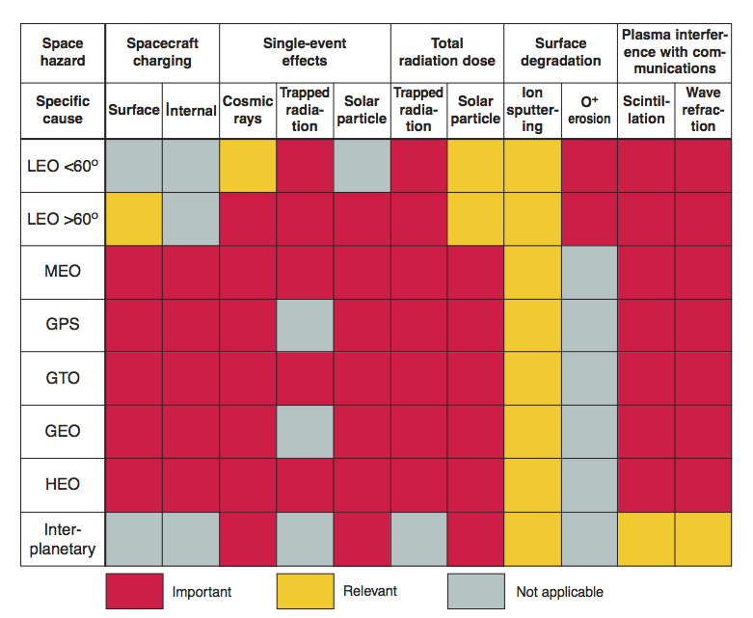
Environment Hazards for different orbits
Joe Mazur

Slide 31
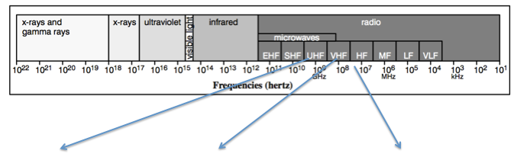

Types of space weather events affecting nav and commu

Slide 32
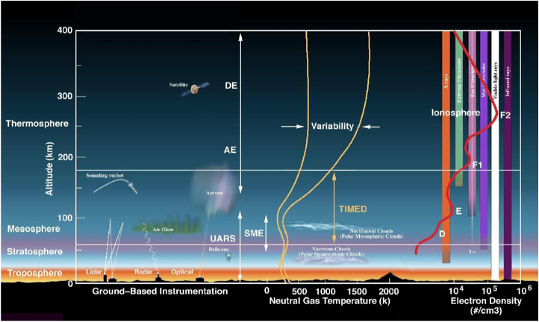
Ionosphere - Thermosphere Overview
Notes:
The ionosphere is a highly variable and complex physical system. It is produced by ionizing radiation from the sun
and controlled by chemical interactions and transport by diffusion and neutral wind.

Slide 33

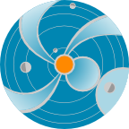
Energy Flow to the Thermosphere
Sun
Shortwave Photons (Radiation)
Index = F10.7
Particles and
Electromagnetic Fields Index = Ap
Ionosphere/
Thermosphere
Solar Wind
Magnetosphere
Tides and Waves
Atmosphere Below
Knipp 2011 Understanding Space Weather and the Physics Behind It
Notes:
Energy paths/sources for the thermosphere

Slide 34
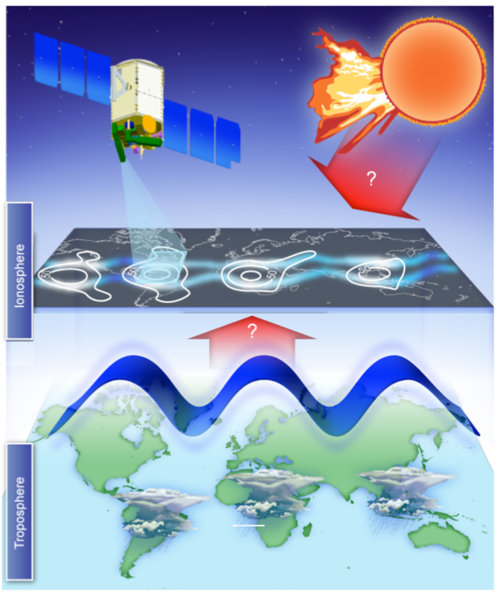
The ionosphere is the densest plasma between the Earth and Sun, and is traditionally believed to be
mainly influenced by forcing from above (solar radiation, solar wind/magnetosphere)
Recent scientific results show that the ionosphere
is strongly influenced by forces acting from below.
Research remains to be done:
How competing influences from above and below shape our space environment.
Text
Courtesy: ICON
Notes:
A nice summary of our current understanding

Slide 35
Tsunami’s impact on the ionosphere-thermosphere
the Tohoku-Oki tsunami of 11 March 2011 is modeled.
It is shown that gravity wave-induced variations in the neutral wind lead to plasma velocity variations both perpendicular and parallel to the geomagnetic field. Moreover, the electric field induced by the neutral wind perturbations can map to the conjugate hemisphere. Thus, electron density variations can be generated in both hemispheres which impact the total electron content (TEC) and 6300 Å airglow emission. It is found that the TEC exhibits variations of total electron content unit (1 TECU = 10¹⁶ el m⁻²) and the 6300 Å airglow emission variation is up to ∼±2.5% relative to the unperturbed background airglow.
Huba, J. D., D. P. Drob, T.-W. Wu, and J. J. Makela (2015), Modeling the ionospheric impact of tsunami-driven gravity waves with SAMI3: Conjugate effects, Geophys. Res. Lett., 42, 5719–5726, doi:10.1002/2015GL064871.
Notes:
Rolland, L. M., Occhipinti, G., Lognonné, P. & Loevenbruck, A. Geophys. Res. Lett. 37, L17101 (2010).
| Article | OpenURLPeltier, W. R. & Hines, C. O. J. Geophys. Res. 81, 1995-2000 (1976).
| Article | OpenURLLiu, J.-Y. et al. J. Geophys. Res. 111, A05303 (2006). | Article | OpenURL

Slide 36
Solar /Solar Wind Energy Deposition
Magnetospheric Effects
High-latitude, auroral
~20%,
Solar wind
Matter
and Fields
but highly variable and may reach 50%
Photons
EUV
and UV
Radiation
Dayside
Energy
Deposition
~80%
After Prolss, 2011
Notes:
Energy deposition variability
Most energy from solar photons, however during times with many strong CMEs, the energy from CME/magnetosphere interaction can equal that from photons (Knipp et al, 2004)

Slide 37
Summary
Significant Challenges are posed by satellite drag
    Track and identify active payloads and debris
    Collision avoidance and re-entry prediction
    Attitude Dynamics
    Constellation control
    “Drag Make-Up” maneuvers to keep satellite in control box
    Delayed acquisition of SATCOM links for commanding /data transmission
    Mission design and lifetime

Slide 38
Flare impact on neutral density (sat. drag)
Solar flares can cause abrupt changes in dayside neutral density – as shown in the left panel with the X17 flare.
Neutral density response to a flare depends on the spectral characteristics of the emission enhancement – which is location dependent. Flare emission in the EUV range (~25 nm – 120 nm) is optically thick so a limb flare’s influence on the neutral density is weaker – which explains why the X28 flare didn’t make much enhancement in neutral density as it originated near the solar limb region.
Qian and Solomon (2011), Space Sci Rev
DOI 10.1007/s11214-011-9810-z
Notes:
Title: Thermospheric density: An overview of temporal and spatial variations.

Slide 39

CHAMP Density Extrapolated to 400 km (ng/m³)
CME 1
CME 2
CME 3
Dayside Density
Nightside
Density
203 204 205 206 207 208 209 210
Knipp, 2013
Energy deposition causes atmospheric expansion; Heated molecules and atoms, fighting for more room, migrate upward
Notes:
Density inferred from s/c acceleromter
Typical global response time is 6-8 hours
Energy arrives first in auroral zones….can begin disturbing mid latitudes within an hour

