Slide 1
CCMC and SWRC space weather forecasting services for NASA robotic mission operators
Pulkkinen, A. (antti.a.pulkkinen@nasa.gov), M. Kuznetsova, Y. Zheng and M. Maddox
NASA Goddard Space Flight Center

Slide 2
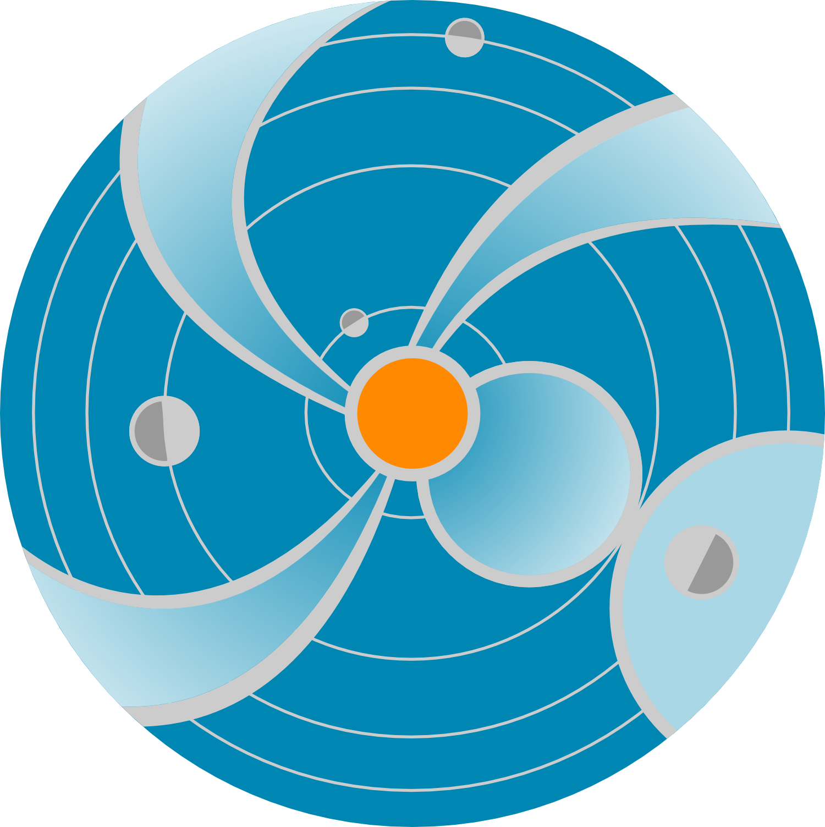
Activities behind the acronyms
CCMC = Community Coordinated Modeling Center (http://ccmc.gsfc.nasa.gov)
SWRC = Space Weather Research Center (http://swrc.gsfc.nasa.gov)

Slide 3
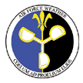
NASA
NSF
“CCMC is a US multi-agency partnership to enable, support, and perform the research and development for next generation space science and space weather models”
AFRL
AF/XOW - AFWA
NOAA/SWPC
AF SMC/CI
ONR
AFOSR

Slide 4
CCMC-SWRC relationship
Facilitate
Community Research
& Development
Support
R2O Transition
Address Unique
Space Weather Needs
of NASA
Space Weather
Research Center
CCMC in-house
research-based SW analysis & prototyping team

Slide 5
SWRC mission
“Addressing the space weather needs of NASA's robotic missions through experimental research forecasts, notification, analysis, and education. Bringing space weather knowledge to the public.”

Slide 6
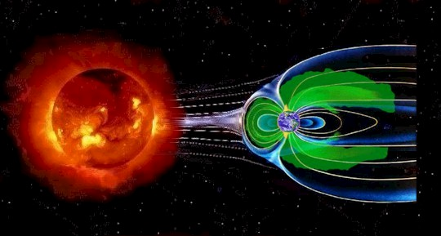
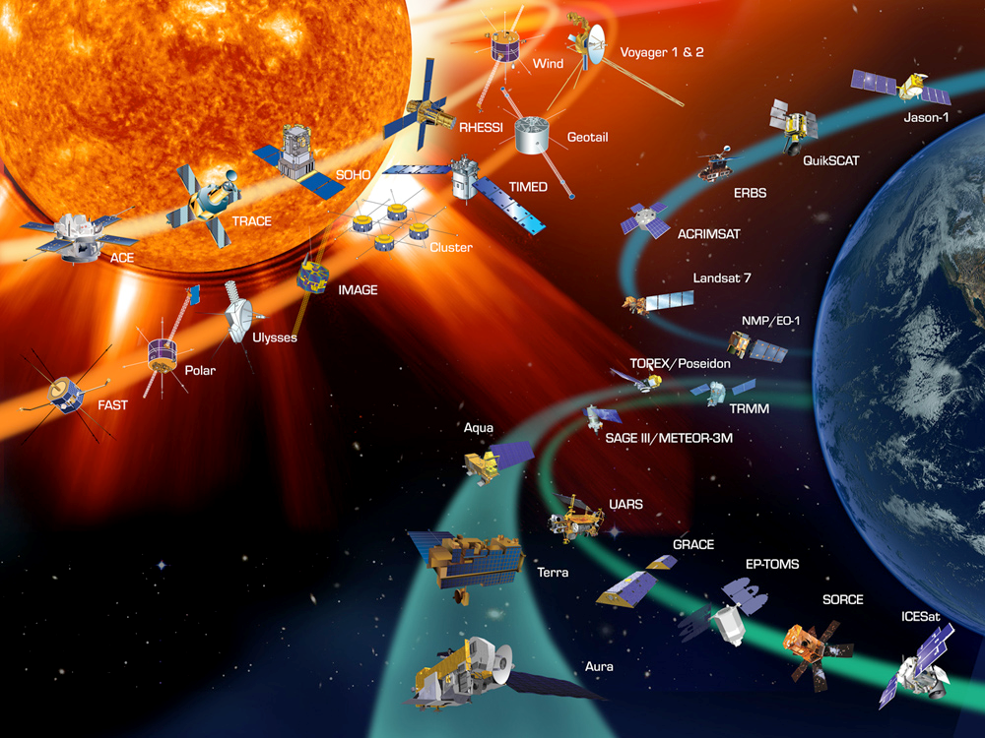
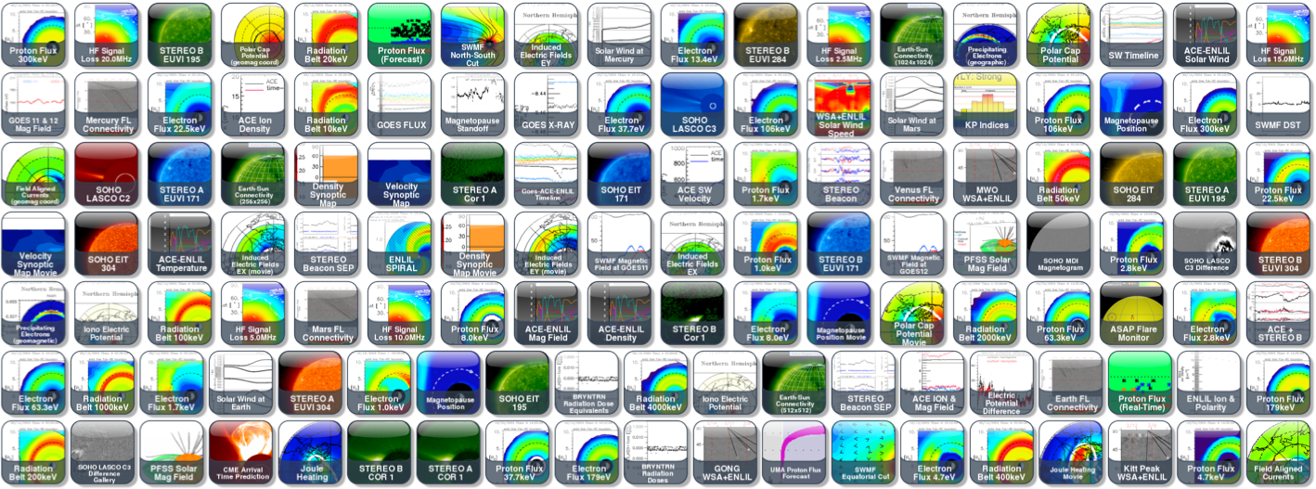
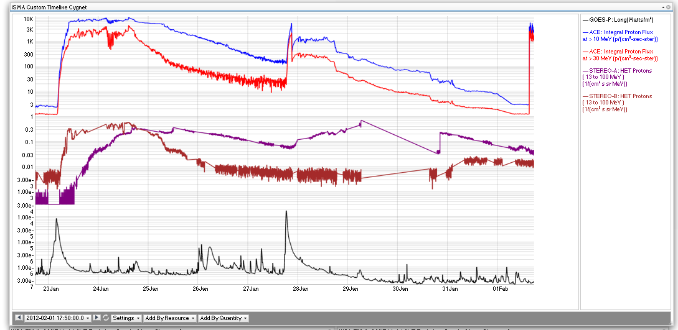
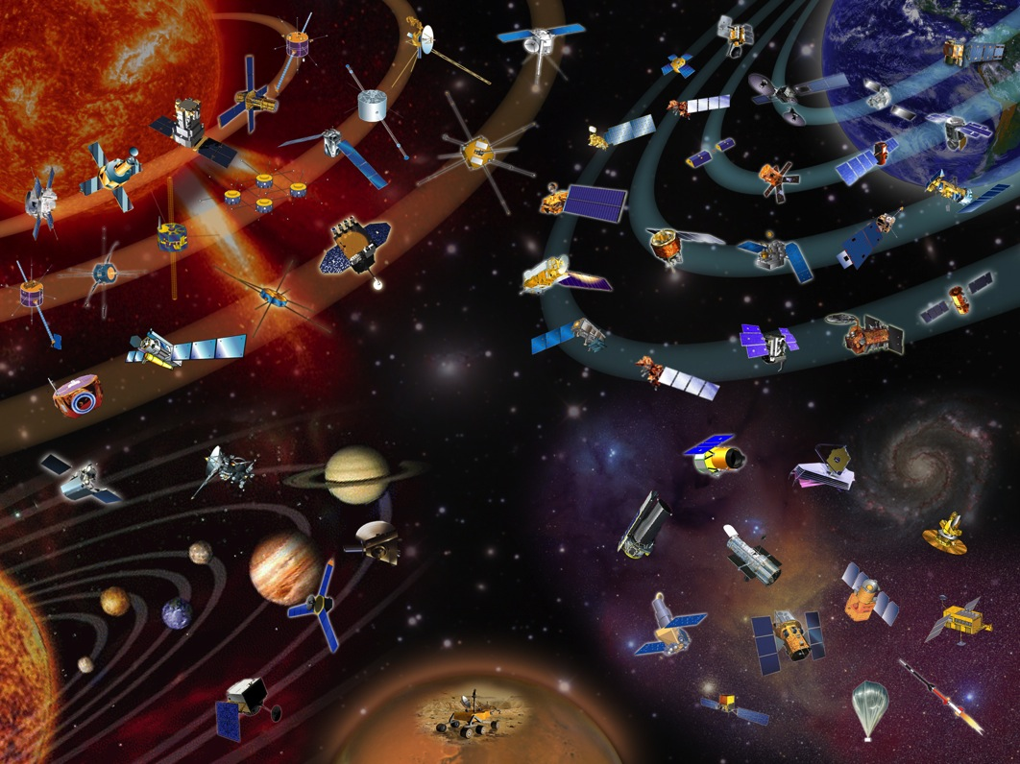
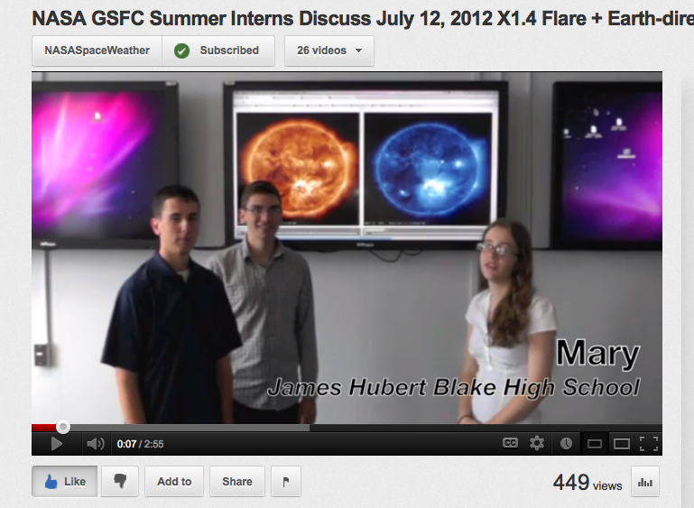
SWRC Concept of Operations
Notifications
Weekly Reports
Anomaly Analysis Support
Workshops
n Scientists
Space Weather Research Center
World-leading Modeling
Protecting NASA’s Missions
SWx Tools
Building space weather knowledge bases
n Scientists
Partnering
Space Weather Related Research and Prototyping
NASA, Other,
Data Streams
Education and Training
Notes:
SWRC addressed unique NASA need by providing unique space weather information and services.

Slide 7
SWRC’s NASA role
Solar-system-wide space weather services for NASA missions = a unique need SWRC addresses
Prototyping of new real-time models and analysis tools such as iSWA = a key element of R2O
Space weather training for a broad spectrum of students and NASA personnel
Hands on real-time analysis is an important part of training.
Building of space weather knowledge base for scientific discovery and anomaly resolution
Notes:
- Service to robotic missions started as a request from NASA HQ.
SWx Workshops provide opportunity for folks at different centers to interact and communicate with each other.
SWRC showcases how important heliophysics is to the entire agency.

Slide 8
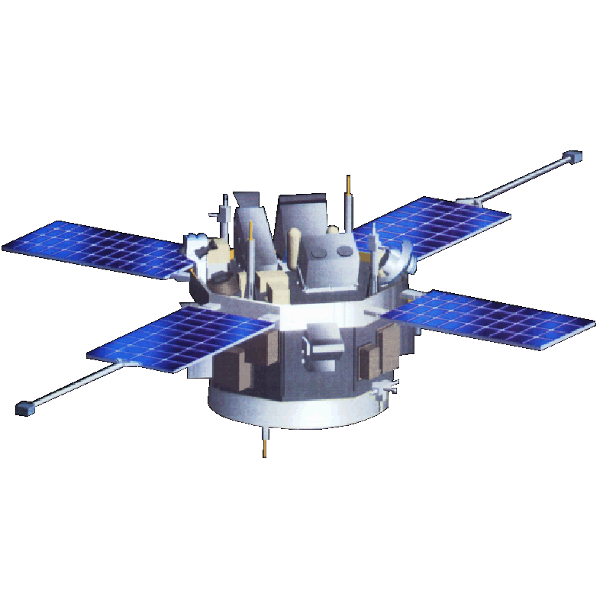
Key services to NASA robotic missions
Daily service to all NASA missions/centers
Real-time space weather analysis
Notifications
Weekly reports
Since March 2010
600+ forecaster generated notifications
200+ weekly reports issued
3000+ individual entries into the DONKI space weather database since March 2010.
NASA Goddard Space Flight Center, Space Weather Research Center ( SWRC )
Message Type: Space Weather Alert - SEP
Message Issue Date: 2013-08-21T13:07:00Z
Message ID: 20130821-AL-001
Summary:
Solar energetic particle event detected by STEREO B.
The flux of 13-100 MeV protons exceeds 10^(-1) pfu/MeV starting at 2013-08-21T06:57Z.
STEREO B can be impacted.
At STEREO A an SEP event continues with the 13-100 MeV protons flux
exceeding 10^(-1) pfu/MeV (Activity ID: 2013-08-20T05:54:24-SEP-001).
Activity ID: 2013-08-21T06:57:10-SEP-001.

Slide 9
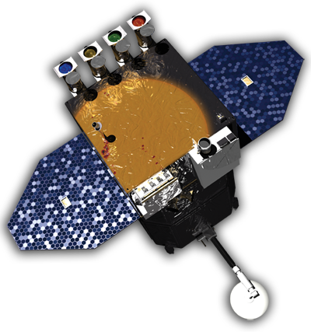
Key services to NASA robotic missions
Spacecraft anomaly analysis support
Supported missions such as Dawn, EO-1, GALEX, MRO, SWIFT, IBEX, Kepler, SOHO and Fermi.
Quick and cost-effective assessment of space weather’s role in the anomalies.
Conducted annual NASA Robotic Mission Ops & Space Weather Workshops since 2009
Facilitated agency-wide education about space weather and its impacts.
Allowed exchange of information between operators and tailoring of space weather services to meet the NASA robotic fleet needs.
NASA Goddard Space Flight Center, Space Weather Research Center ( SWRC )
Message Type: SWRC response to S/C anomaly request.
Message Issue Date: 2010-11-30T20:10:00Z.
Message ID: 20101130-RE-001
Summary.
Impacted spacecraft: Fermi.
Anomaly date and time:
Association with space weather event (YES/POSSIBLE/NO): POSSIBLE.
Supporting data:

Slide 10
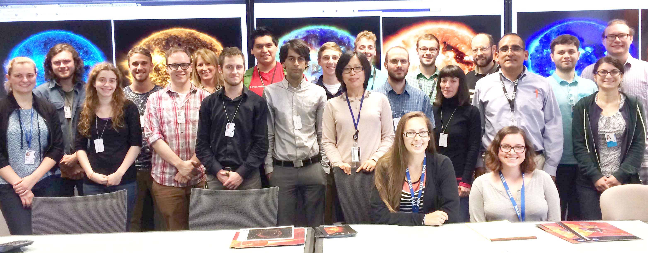
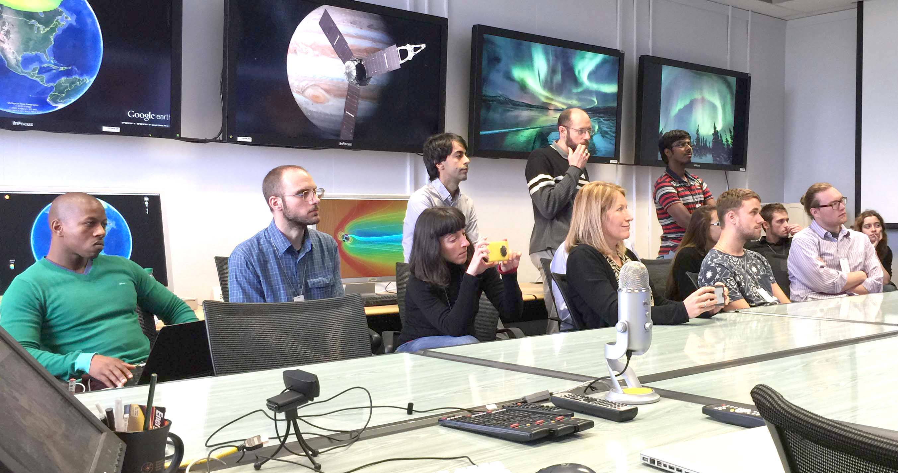
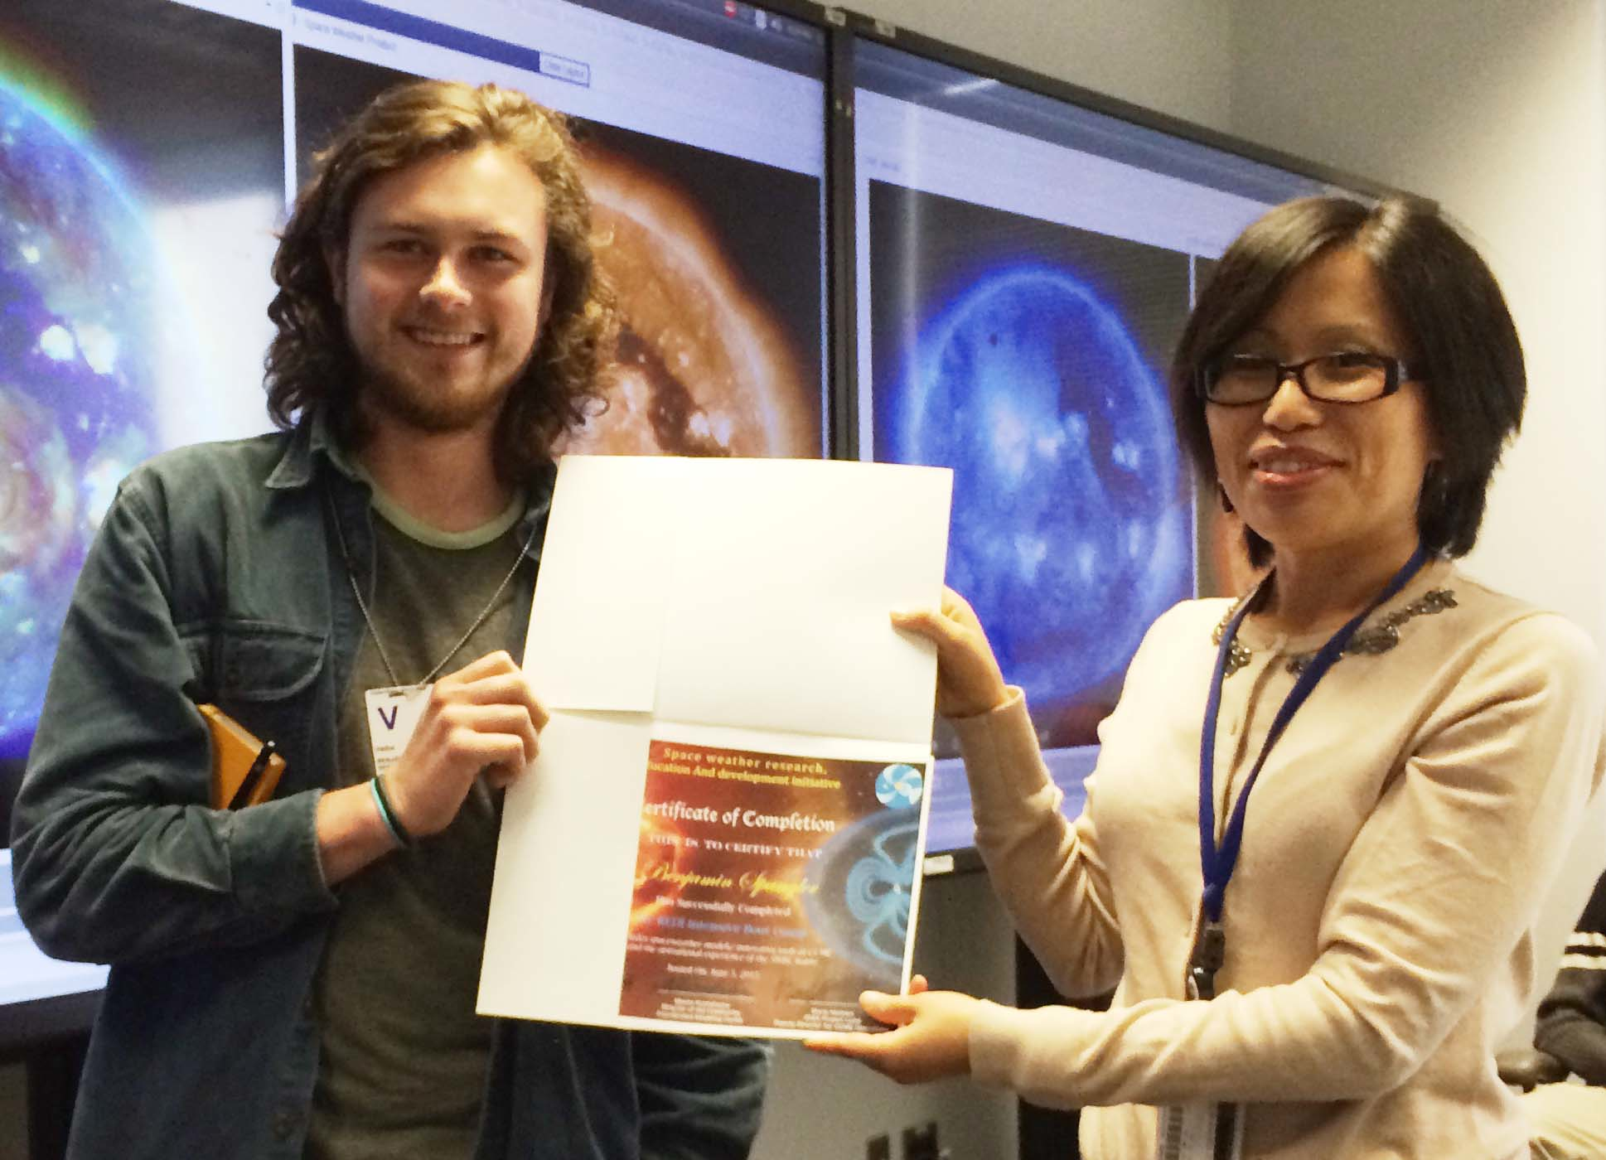
Key services to NASA robotic missions
Space Weather Research, Education and Development Initiative (REDI) summer bootcamps 2013-2015.
SW REDI bootcamp 2015
Notes:
- SWRC also promotes space weather awareness at NASA.
- CCMC/SWRC educational material used for educating and training NASA robotic mission operators and involved personnel.

Slide 11
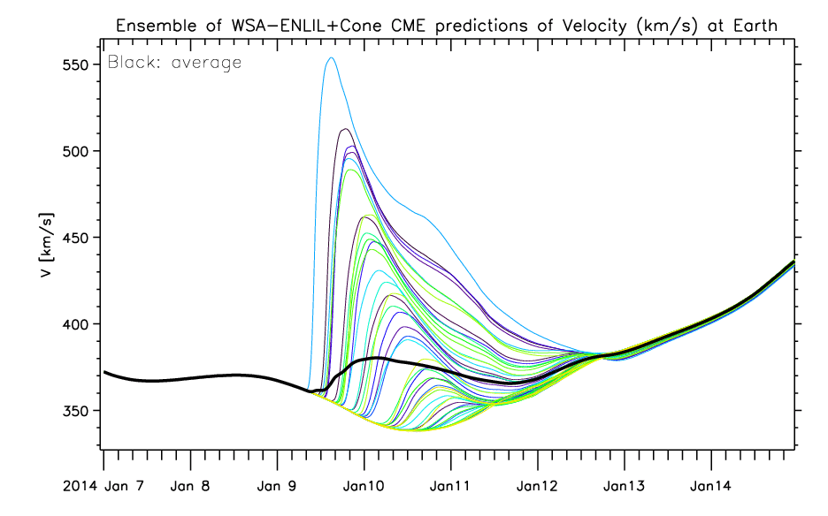
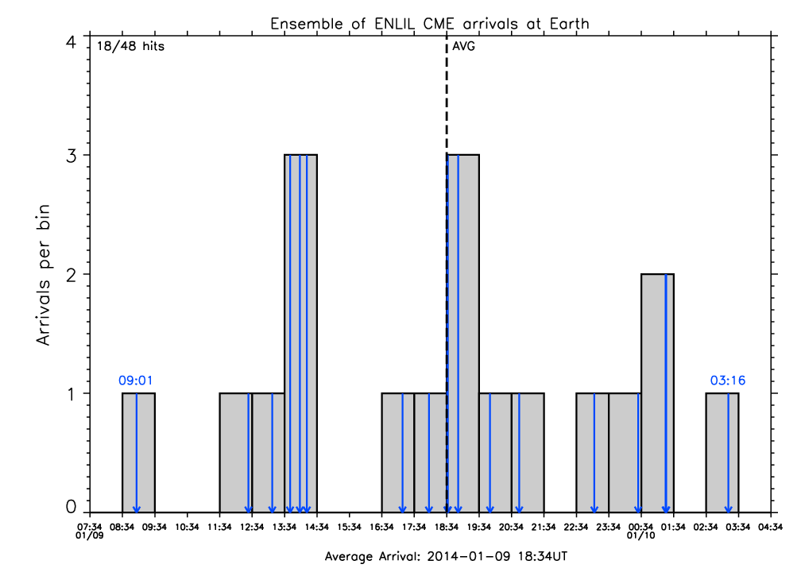
Examples of unique space weather products
Ensemble CME modeling product.
5.5 AU CME products.

Slide 12
Examples of unique space weather products
A group of international flare models hosted at CCMC: ASAP, MAG4 and ASSA*.
These model displays are available via iSWA.
CCMC/SWRC is in the process of investigating how information from the models can be turned into a prototype ensemble flare product.
*by University of Bradford, University of Alabama and Korean Space Weather Center, respectively.

Slide 13
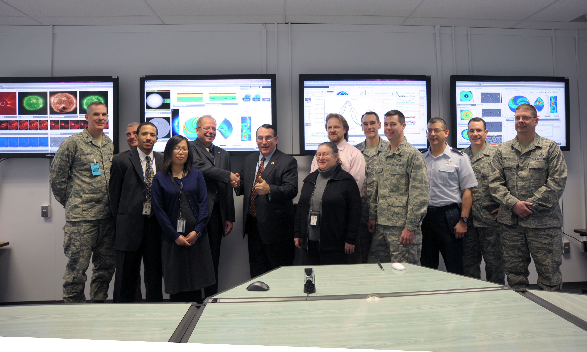
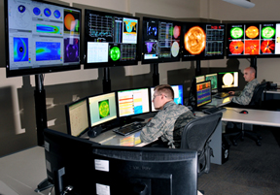
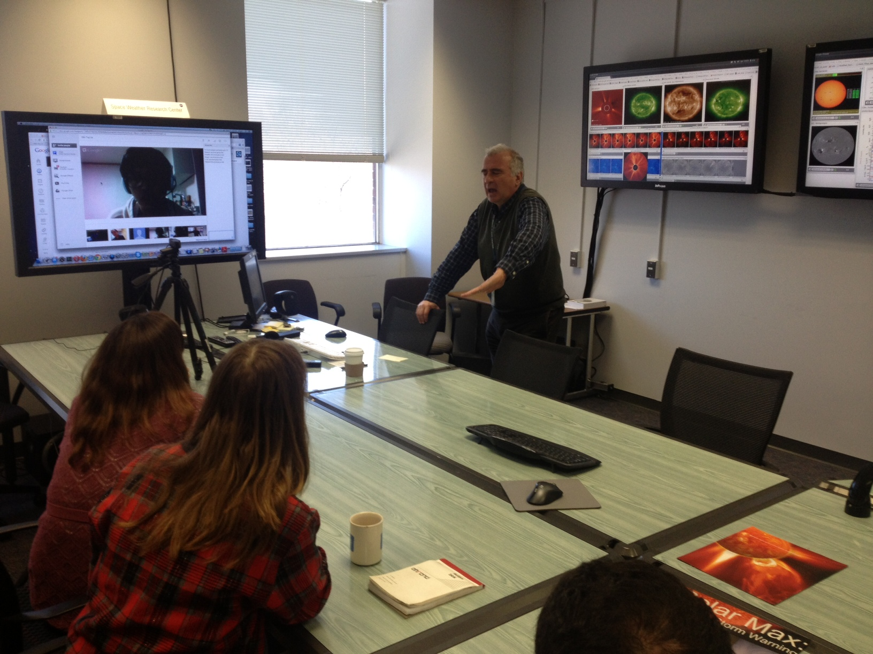
Examples of benefits beyond NASA
CCMC/SWRC real-time analyses allow:
Space weather tool testing for the benefit of the entire community
Generation of public information into databases (DONKI and Space Weather Scoreboard)
Large number of real-time WSA-Enlil simulation results submitted to US Air Force Weather Agency, per their requests.
International real-time analysis partnering. Close collaboration, for example, with Technical University of Denmark.
Notes:
Only through SWRC space weather forecasting experience are we able to provide the broad understanding of the space weather topic that feeds into support of other agencies.

Slide 14
Additional information and resources
Space Weather REDI: http://ccmc.gsfc.nasa.gov/support/SWREDI/swredi.php
DONKI space weather database: https://kauai.ccmc.gsfc.nasa.gov/DONKI
Integrated Space Weather Analysis System (iSWA): http://iswa.gsfc.nasa.gov
Space Weather Scoreboard: https://kauai.ccmc.gsfc.nasa.gov/SWScoreBoard

