Slide 1
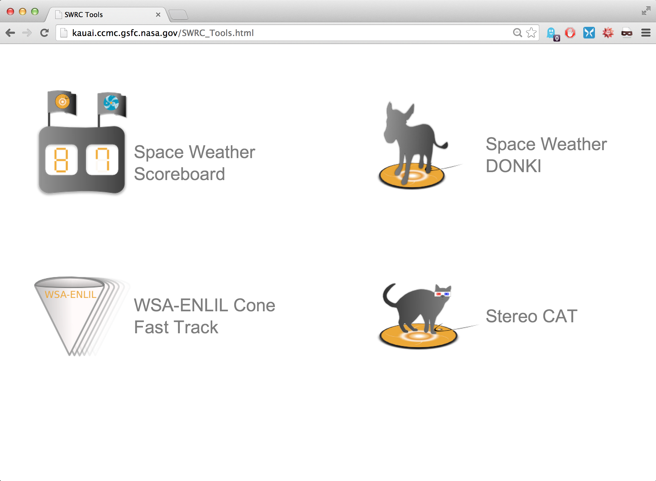
Space Weather Web Tools from CCMC/SWRC:
http://kauai.ccmc.gsfc.nasa.gov/
Notes:
This is a screenshot of the kauai CCMC webpage, which shows some of the space weather web tools available from the CCMC/SWRC. Today we are going to look at the Space Weather Scoreboard.

Slide 2
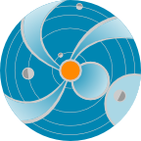
CME Arrival Time Scoreboard developed at the CCMC
The CME scoreboard is a research-based forecasting methods validation activity which provides a central location for the community to:
submit their forecast in real-time
quickly view all forecasts at once in real-time
compare forecasting methods when the event has arrived
http://swrc.gsfc.nasa.gov/main/cmemodels
http://kauai.ccmc.gsfc.nasa.gov/CMEscoreboard
Please join! All prediction methods are welcome and all are encouraged to participate. Currently registered models include:
Anemomilos, ESA Model, H3DMHD (HAFv.3 +3DMHD), HAFv.3, STOA, WSA-Enlil + Cone Model, BHV Model, DBM, ECA Model, Expansion Speed Prediction Model, HelTomo, HI J-map technique, SARM, SPM, SPM2, TH Model
The scoreboard also includes predictions from the SWRC (Space Weather Research Center) which is a CCMC branch carrying out in-house research-based space weather ops team

Slide 3
http://kauai.ccmc.gsfc.nasa.gov/SWScoreBoard
Anyone can view predictions, please register to submit predictions.
Notes:
This is the view of the Space Weather Scoreboard homepage, showing a brief description and instructions at the top. Anyone can view predictions without logging in. Those who would like submit predictions can register.

Slide 4
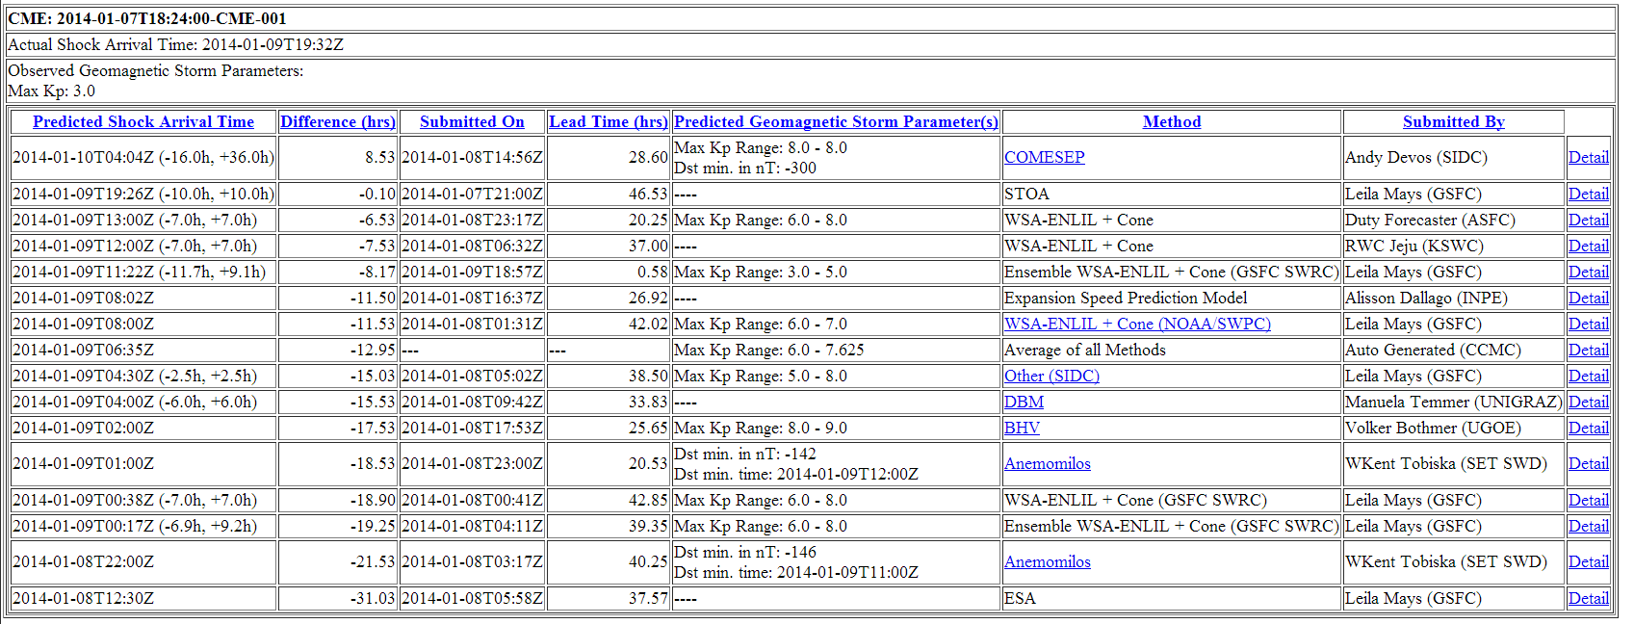
Community predictions for the
January 7, 2014 CME (X1.2 flare):
Columns are sortable!(click column headings)
Average of all predictions is calculated for the user
http://kauai.ccmc.gsfc.nasa.gov/SWScoreBoard
Notes:
Here is another screenshot of the Space Weather scoreboard which shows an example of an event table of predictions. The CME is identified at the top by the start time (observed by coronagraphs). After the CME arrives at Earth, the “actual shock arrival time” and “observed geomagnetic storm parameters” can be be submitted by anyone. On the left side of the table there is the predicted arrival times with error bars (if submitted). The next column shows the difference between the predicted arrival time and actual arrival time (negative indicates the prediction is earlier than what was observed. The third column shows the prediction submission time, which is used to calculate the lead time (fourth column) together with the actual arrival time. The fifth column shows the predicted geomagnetic storm parameters, either Kp or Dst. In the sixth column shows the prediction method which links to the model/method homepage (if available). The seventh column shows who submitted the prediction. The last column is a link to a page that shows any prediction details (such as input parameters, simulation links) that the user submitted along with their forecast.
All columns are sortable. The average of all predictions is automatically calculated by the system, highlighted here in green.
This particular event was interesting in that almost all users predicted an early and strong impact. This CME was probably deflected by a coronal hole and therefore only resulted in a glancing blow arrival at Earth.

Slide 5
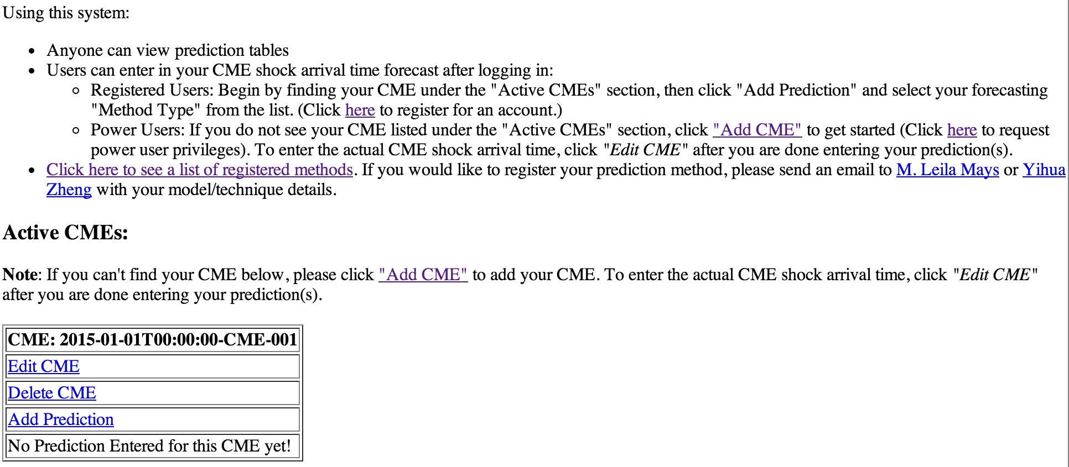
Begin by clicking Add Prediction under the "Active CMEs" section and select your forecasting "Method Type" from the list.
While logged in, if you do not see any CMEs listed under the "Active CMEs" section, click Add CME to get started.
http://kauai.ccmc.gsfc.nasa.gov/SWScoreBoard
Notes:
If you would like to add your prediction for a CME event, this is a screenshot of what the scoreboard page will look like if you are logged in and there is an “Active CME” on the page. If the CME event you are interested in is not listed as an “active CME” (or if there are no active CMEs), please click “Add CME” to enter your CME start time (taken from coronagraph images).
Once you find your CME on the active CME page, click “Add prediction” to be taken to the form to enter your predicted arrival time.
If the CME has already arrived, you can enter the actual arrival time by clicking “Edit CME” and entering the time there.

Slide 6
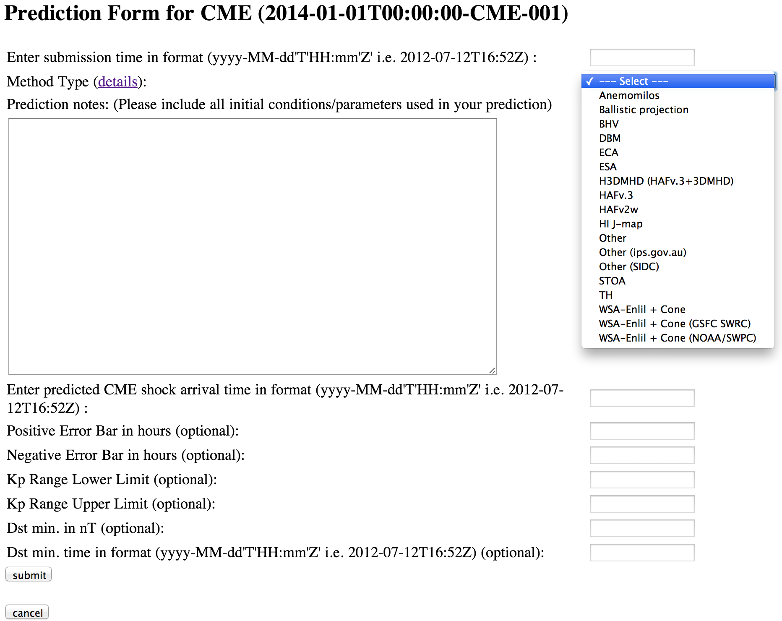
http://kauai.ccmc.gsfc.nasa.gov/SWScoreBoard
Notes:
When you click “Add prediction” you are taken to a prediction form that looks like this.
Select your “Method Type” from the drop down menu. In the “prediction notes” box (optional) please enter your CME input parameters, or other assumptions made in making your prediction. Finally Enter your predicted CME shock arrival time. All other boxes are optional and include your prediction error bar, predicted Kp, Dst, or minimum Dst time.
Notice at the top of the page you can enter your prediction submission time, if you made your forecast earlier than the date/time you filled out the form. Preferably your forecast will be timestamped with this earlier time.

Slide 7
Scoreboard – Future Improvements
Automatically accepting and parsing predictions (less work for groups who can populate directories with their predictions)
Manually created predictions (e.g. from SIDC)
Automatically created predictions (e.g. from Anemomilos, SARM).
Challenges: filtering out non-CME related predictions, matching predictions with CME start time.
Showing table data in dynamic plot form, e.g. Prediction Error vs. Time of Prediction, Prediction Error vs Input parameters.
Suggestions: We can add an “analysis” field to provide a few sentences about the arrival and predictions. This can also be found in DONKI as notes/comments. We can add the ability for users to also submit their prediction “confidence”.
Any interest in including STEREO A and B predictions?
Your suggestions?
Notes:
We welcome your suggestions in the development of the this community validation effort.
Here are some future improvements we are considering:
Automatically accepting and parsing predictions (less work for groups who can populate directories with their predictions)
Manually created predictions (e.g. from SIDC)
Automatically created predictions (e.g. from Anemomilos, SARM).
Challenges: filtering out non-CME related predictions, matching predictions with CME start time.
Showing table data in dynamic plot form, e.g. Prediction Error vs. Time of Prediction, Prediction Error vs Input parameters.
Suggestions: We can add an “analysis” field to provide a few sentences about the arrival and predictions. This can also be found in DONKI as notes/comments. We can add the ability for users to also submit their prediction “confidence”.
Any interest in including STEREO A and B predictions?
Your suggestions?

Slide 8
CME Arrival Time Scoreboard developed at the CCMC
The CME scoreboard is a research-based forecasting methods validation activity which provides a central location for the community to:
submit their forecast in real-time
quickly view all forecasts at once in real-time
compare forecasting methods when the event has arrived
http://swrc.gsfc.nasa.gov/main/cmemodels
http://kauai.ccmc.gsfc.nasa.gov/CMEscoreboard
Please join! All prediction methods are welcome and all are encouraged to participate. Currently registered models include:
Anemomilos, ESA Model, H3DMHD (HAFv.3 +3DMHD), HAFv.3, STOA, WSA-Enlil + Cone Model, BHV Model, DBM, ECA Model, Expansion Speed Prediction Model, HelTomo, HI J-map technique, SARM, SPM, SPM2, TH Model
The scoreboard also includes predictions from the SWRC (Space Weather Research Center) which is a CCMC branch carrying out in-house research-based space weather ops team

