Slide 1
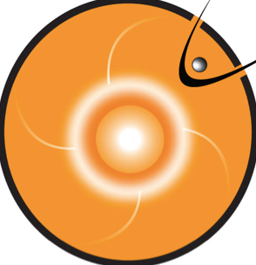
Monitoring Space Weather with iSWA
Yihua Zheng
SW REDI Bootcamp 2019
Acknowledge: Alex Wold, Mary Aronne and Hayley Austin

Slide 2
Introduction
Monitoring Space Weather with iSWA
iSWA — Integrated Space Weather Analysis System
Allows forecasters to customize a space weather monitoring layout
https://iswa.gsfc.nasa.gov

Slide 3
Introduction
iSWA Imagers
SDO AIA for the earth facing solar surface
SOHO LASCO coronagraphs for CMEs
STEREO-A EUVI for far-sided solar surface
STEREO-A coronagraphs
Magnetic Connectivity Solarscape Viewer
https://www.nasa.gov/content/goddard/how-sdo-sees-the-sun
https://www.nasa.gov/mission_pages/sunearth/news/light-wavelengths.html
Notes:
How SDO sees the sun

Slide 4
Introduction
iSWA Graphs/Timelines
GOES (X-ray, Proton, & Electron Fluxes)
SOHO/COSTEP Proton Flux (Real-time & Forecast)
DSCOVR Solar Wind (Speed, Magnetic Field, Temperature, & Density)
SWMF Magnetopause Standoff Position
Kp (Observed & Predicted)
STEREO Beacon (Solar Wind & SEPs)
…and more!
Super Timeline under ‘bETA’ tab

Slide 5
Outline
Solar Cygnets
Monitoring flares, eruptions, & CMEs
Heliosphere Cygnets
Monitoring solar energetic particles, CME arrivals, and high speed stream arrivals
Magnetosphere Cygnets
Monitoring geomagnetic storms, radiation belt enhancements, and magnetopause crossings
Demonstration
Following the course of the June 21st 2015 CME
Notes:
There is a layout for the June 21, 2015 CME

Slide 6
Solar Cygnets:
Solar Flares
GOES 0.1-0.8 nm X-rays — flares
Threshold: 5x10⁻⁵ W/m² (M5.0)
SDO AIA imagery — flares, eruptions, & coronal holes
193 Å — 1 million Kelvin, EUV waves, dimming, post-eruption arcades, off limb (field lines), coronal holes
171 Å — off limb (field lines), post-eruption arcades
131 Å — flares (10 million Kelvin)
211 Å — 2 million Kelvin, active region (coronal holes)
304 Å — 50K kelvin, filaments
Magnetic Connectivity Solarscape Viewer
SDO backgrounds, lat/lon grid, active region labels, and magnetic connectivity
A strong flare can exhibit signatures in all wavelengths
e.g, the X9 class flare on 2017-09-06

Slide 7
Solar Cygnets:
Eruptions & Coronal Holes
GOES 0.1-0.8 nm X-rays — flares
Threshold: 5x10⁻⁵ W/m² (M5.0)
SDO AIA imagery — flares, eruptions, & coronal holes
193 Å — 1 million Kelvin, EUV waves, dimming, post-eruption arcades, off limb (field lines), coronal holes
171 Å — off limb (field lines), post-eruption arcades
131 Å — flares (10 million Kelvin)
211 Å — 2 million Kelvin, active region (coronal holes)
304 Å — 50K kelvin, filaments
Magnetic Connectivity Solarscape Viewer
SDO backgrounds, lat/lon grid, active region labels, and magnetic connectivity

Slide 8
Solar Cygnets:
Coronal Mass Ejections (CMEs)
SOHO LASCO C2 & 3 imagery — CMEs
C2 — 1.5 to 6 solar radii
C3 — 3.7 to ~30 solar radii
Threshold: measured >=500 km/s and modeled to impact Earth OR measured >= 800 km/s and modeled to impact other location
Any CME heading towards Parker Solar Probe
STEREO A EUVI 195 Å imagery — flares, eruptions, & coronal holes
STEREO A COR2 imagery — CMEs
Threshold: measured >=500 km/s and modeled to impact Earth OR measured >= 800 km/s and modeled to impact other location
Any CME heading towards Parker Solar Probe
www.SolarMonitor.org (not on iSWA)
lat/lon grid and active regions

Slide 9
Solar Cygnets:
STEREO-A
SOHO LASCO C2 & 3 imagery — CMEs
C2 — 1.5 to 6 solar radii
C3 — 3.7 to ~30 solar radii
Threshold: measured >=500 km/s and modeled to impact Earth OR measured >= 800 km/s and modeled to impact other location
Any CME heading towards Parker Solar Probe
STEREO A EUVI 195 Å imagery — flares, eruptions, & coronal holes
STEREO A COR2 imagery — CMEs
Threshold: measured >=500 km/s and modeled to impact Earth OR measured >= 800 km/s and modeled to impact other location
Any CME heading towards Parker Solar Probe
www.SolarMonitor.org (not on iSWA)
lat/lon grid and active regions

Slide 10
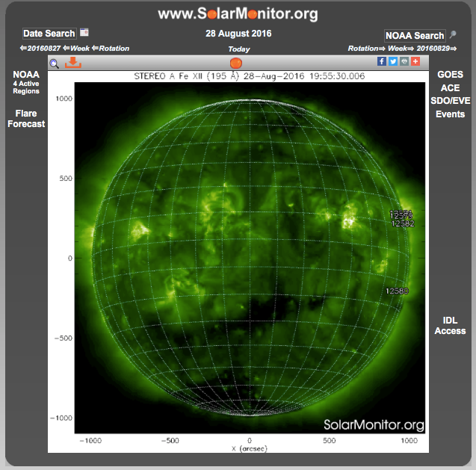
Solar Cygnets:
STEREO-A
SOHO LASCO C2 & 3 imagery — CMEs
C2 — 1.5 to 6 solar radii
C3 — 3.7 to ~30 solar radii
Threshold: measured >=500 km/s and modeled to impact Earth OR measured >= 800 km/s and modeled to impact other location
Any CME heading towards Parker Solar Probe
STEREO A EUVI 195 Å imagery — flares, eruptions, & coronal holes
STEREO A COR2 imagery — CMEs
Threshold: measured >=500 km/s and modeled to impact Earth OR measured >= 800 km/s and modeled to impact other location
Any CME heading towards Parker Solar Probe
www.SolarMonitor.org (not on iSWA)
lat/lon grid and active regions

Slide 11
Heliosphere Cygnets: Solar Energetic Particles
GOES > 10 MeV and > 100 MeV protons
Threshold: > 10 MeV above 10 pfu and/or > 100 MeV above 1 pfu
SOHO COSTEP > 15.8 MeV proton channels
Threshold: 10^(-1) pfu/MeV
RELEASE forecast for > 15.8 MeV proton channels
Threshold: 10^(-1) pfu/MeV
STEREO A and B 13-100 MeV protons
Threshold: 10^(-1) pfu/MeV

Slide 12
Heliosphere Cygnets: Interplanetary Shocks/Arrivals
DSCOVR/ACE
speed, magnetic field, temperature, & density
Threshold: significant shock passage at L1 (about >=10 nT amplitude jump)
STEREO A IMPACT/PLASTIC
speed, magnetic field, temperature, & density

Slide 13
Magnetosphere Cygnets:
Geomagnetic Storms
Kp index
level (0 to 9) of geomagnetic activity in the Earth's magnetosphere
Threshold: >=6 (or larger than previous alert)
GOES > 0.8 MeV electrons
state of the Earth's outer radiation belt
Threshold: 10⁵ pfu (or 70-80 % from the threshold two days after)
Modeled magnetopause standoff distance
location of the boundary between magnetospheric and solar wind plasma
Threshold: 6.6 Re

Slide 14
Magnetosphere Cygnets:
Radiation Belt Enhancement
Kp index
level (0 to 9) of geomagnetic activity in the Earth's magnetosphere
Threshold: >=6 (or larger than previous alert)
GOES > 0.8 MeV electrons
state of the Earth's outer radiation belt
Threshold: 10⁵ pfu (or 70-80 % from the threshold two days after)
Modeled magnetopause standoff distance
location of the boundary between magnetospheric and solar wind plasma
Threshold: 6.6 Re

Slide 15
Magnetosphere Cygnets:
Magnetopause Crossing
Kp index
level (0 to 9) of geomagnetic activity in the Earth's magnetosphere
Threshold: >=6 (or larger than previous alert)
GOES > 0.8 MeV electrons
state of the Earth's outer radiation belt
Threshold: 10⁵ pfu (or 70-80 % from the threshold two days after)
Modeled magnetopause standoff distance
location of the boundary between magnetospheric and solar wind plasma
Threshold: 6.6 Re

Slide 16
Other Useful Cygnets
CCMC SWAN Space Weather Timeline Ensemble
Quick check of flare, SEP, radiation belt, and solar wind conditions
iSWA Super Timeline
Make interactive plots of static cygnets
Plot SWMF Magnetopause Standoff Position with geosynchronous orbit
Plot CCMC-Predicted Kp with NOAA-Kp

Slide 17
Other Useful Cygnets
CCMC SWAN Space Weather Timeline Ensemble
Quick check of flare, SEP, radiation belt, and solar wind conditions
iSWA Super Timeline
Make interactive plots of static cygnets
Plot SWMF Magnetopause Standoff Position with geosynchronous orbit
Plot CCMC-Predicted Kp with NOAA-Kp

Slide 18
Activities
iSWA basics demo
adding cygnets and navigating category tabs, using the super timeline, setting time periods locally and globally, and saving your layout
Event walkthrough/chain of events

