Slide 1
Space Weather
In the Ionosphere
and Upper Atmosphere
Robert Pfaff
NASA/Goddard Space Flight Center,
Space Weather “Bootcamp”
June 6, 2018

Slide 2
Goals of this talk…
  Provide an overview of the earth’s ionosphere and upper atmosphere, including how dynamic and unpredictable they are…
  Outline some of the main Space Weather processes that are intrinsic to the ionosphere/upper atmosphere
  Underscore how poorly these regions are understood and why observations are needed to improve our knowledge and space weather models
  We focus on the region of 50 to 500 km

Slide 3
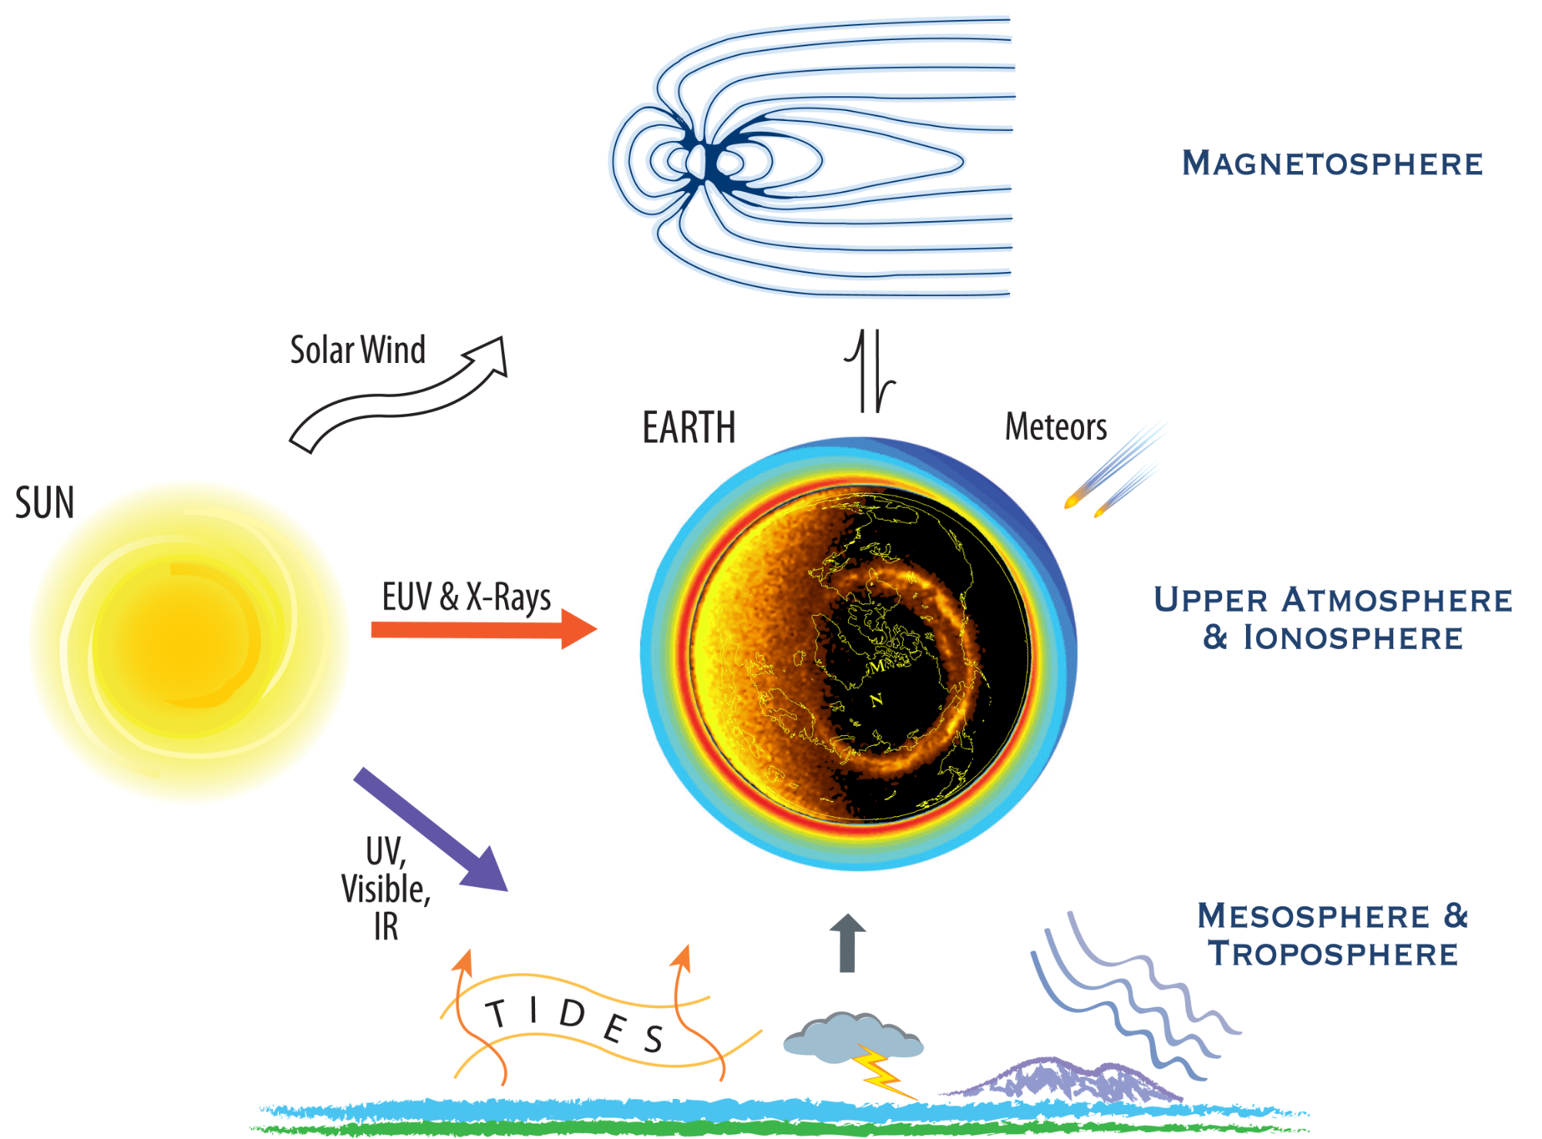
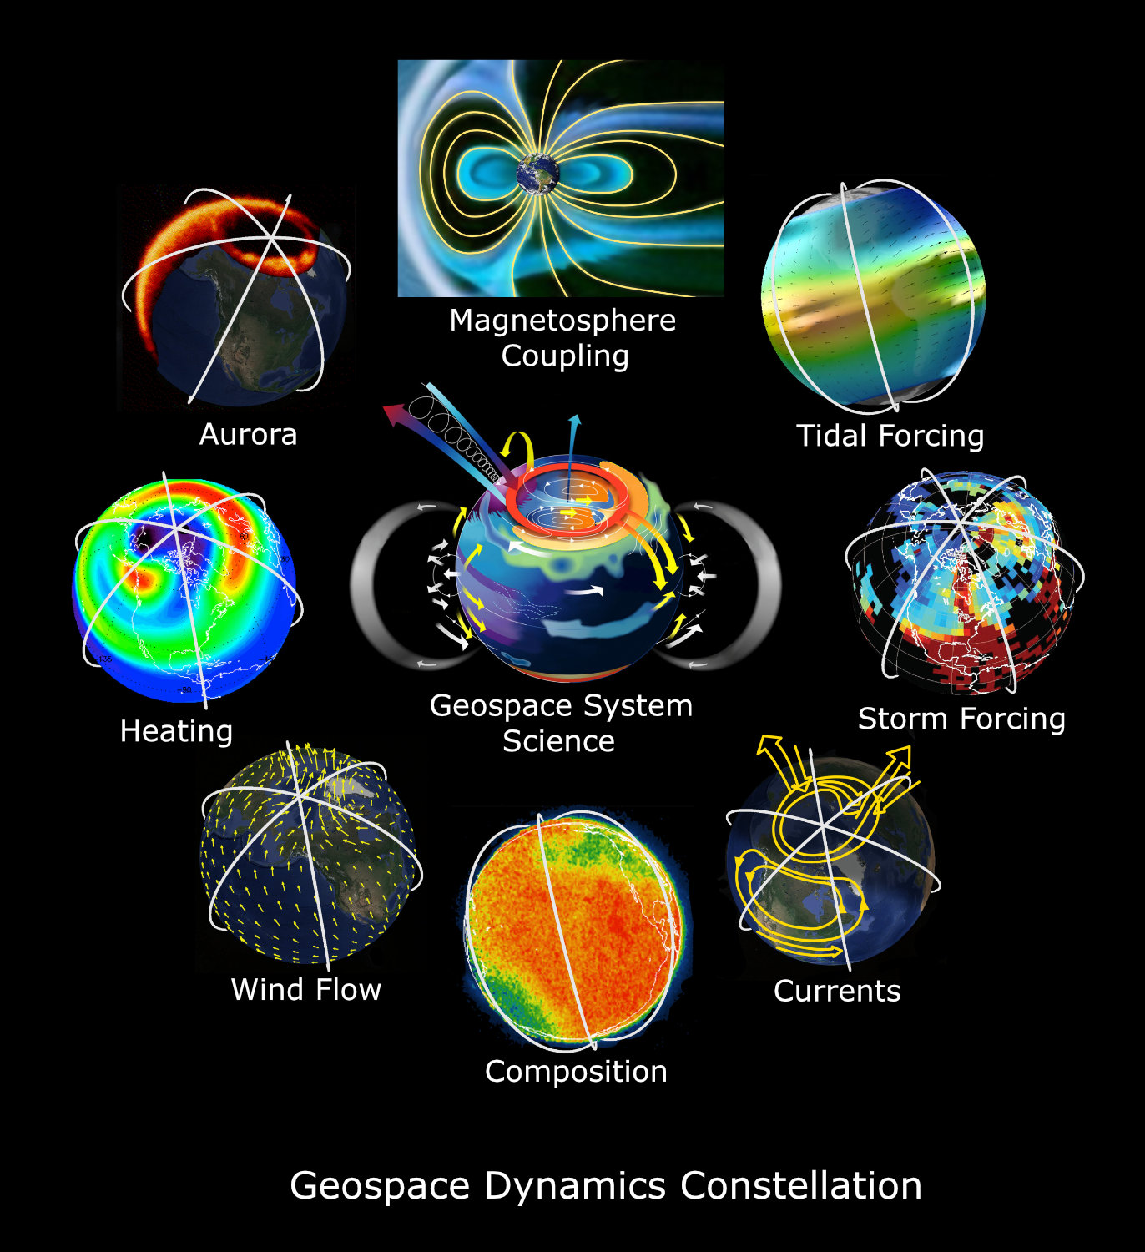
Pathways of solar energy to the Upper Atmosphere and Ionosphere

Slide 4

How high does the atmosphere extend?

Slide 5
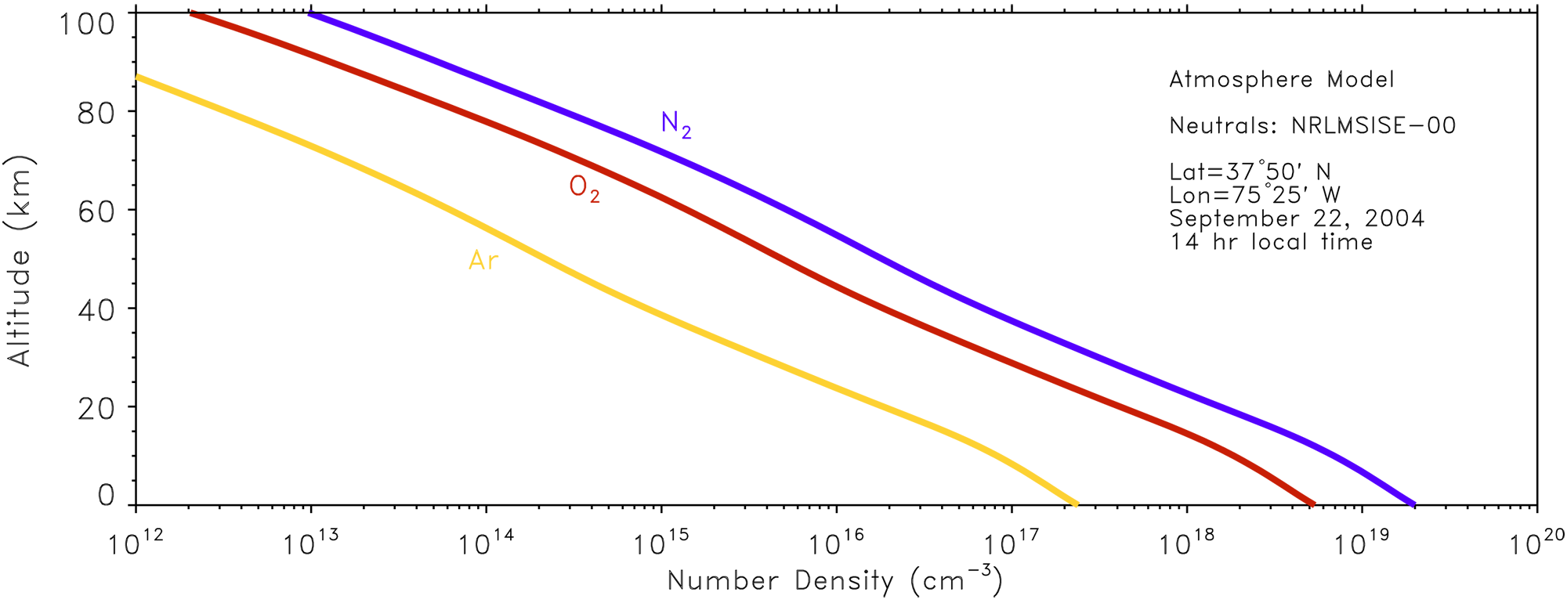
The atmosphere at the surface of the earth is 78% nitrogen, 21% oxygen, and 1% argon and other gases.
This mixture extends in altitude until…?

Slide 6
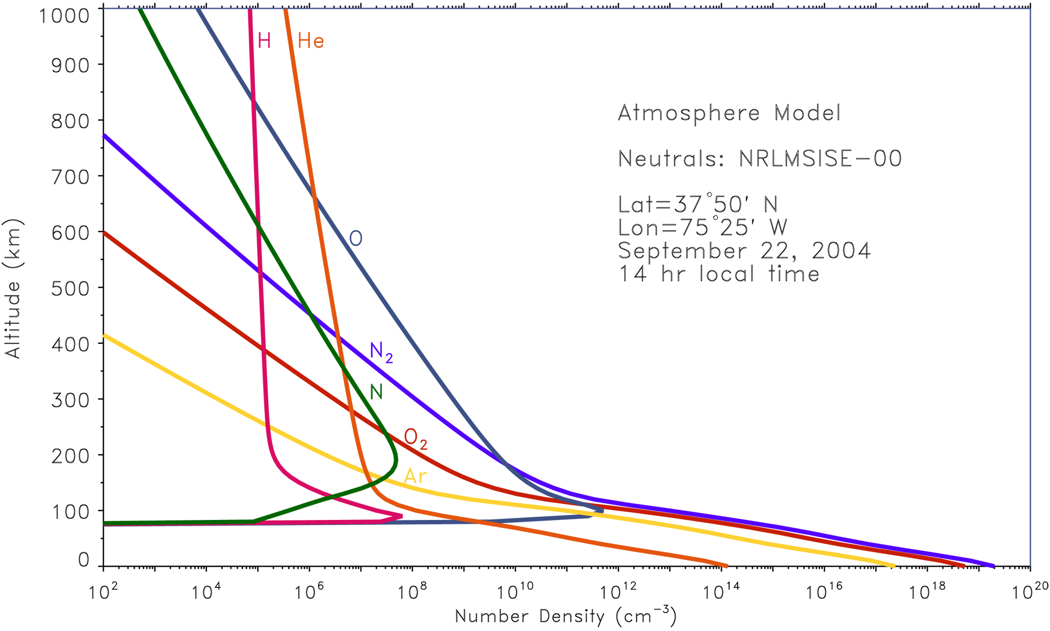

Slide 7

Graphic shows atmosphere extending to 1000 km

Slide 8
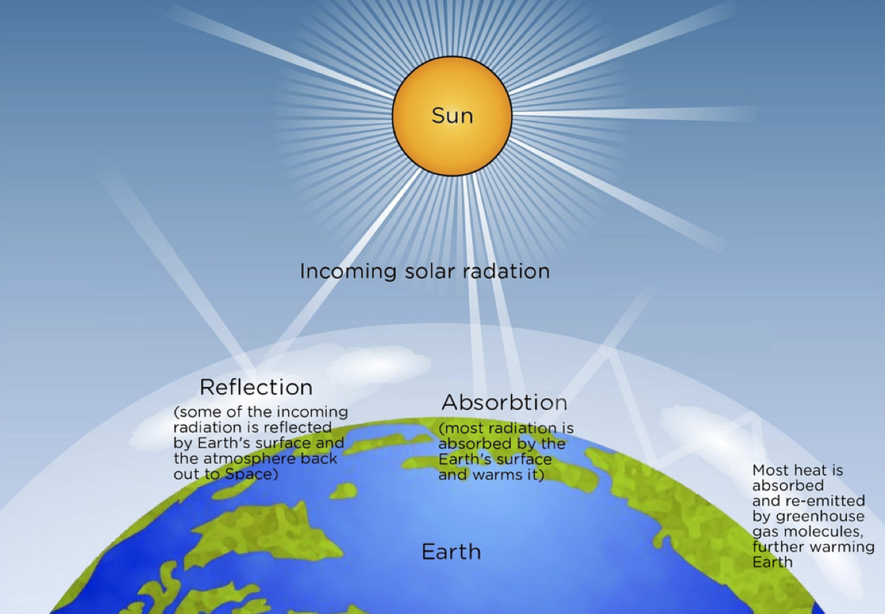
EUV radiation absorbed in Upper Atmosphere!

Slide 9
EUV radiation absorbed in Upper Atmosphere!
Heats the upper atmosphere (via dissociation of O₂ → O + O)
→ and thereby sets it in motion
Ionizes a small fraction
Key Space Weather Effect!

Slide 10
Earth’s Upper Atmosphere Density
→ Life’s “Shield”
Key Space Weather variable
• Absorbs solar EUV and hence protects life
• Very important for understanding life on other planets such as Mars

Slide 11
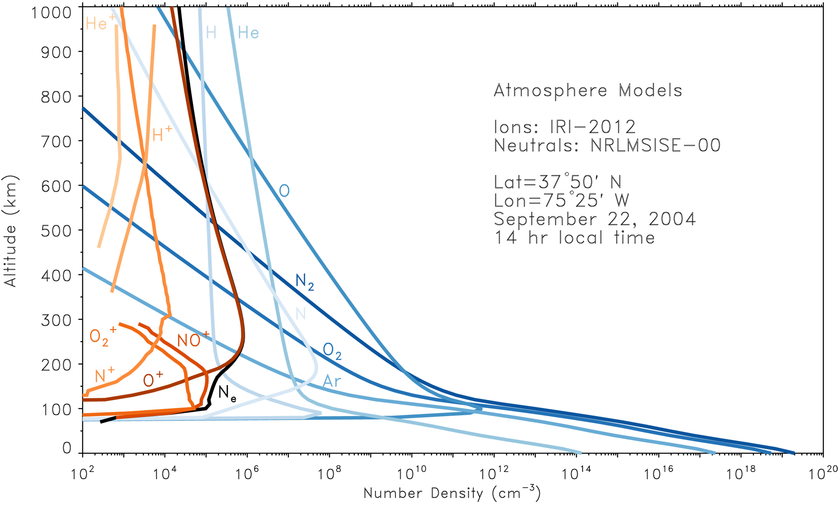
Solar EUV radiation ionizes a small fraction of certain neutral density constituents above about 100 km

Slide 12
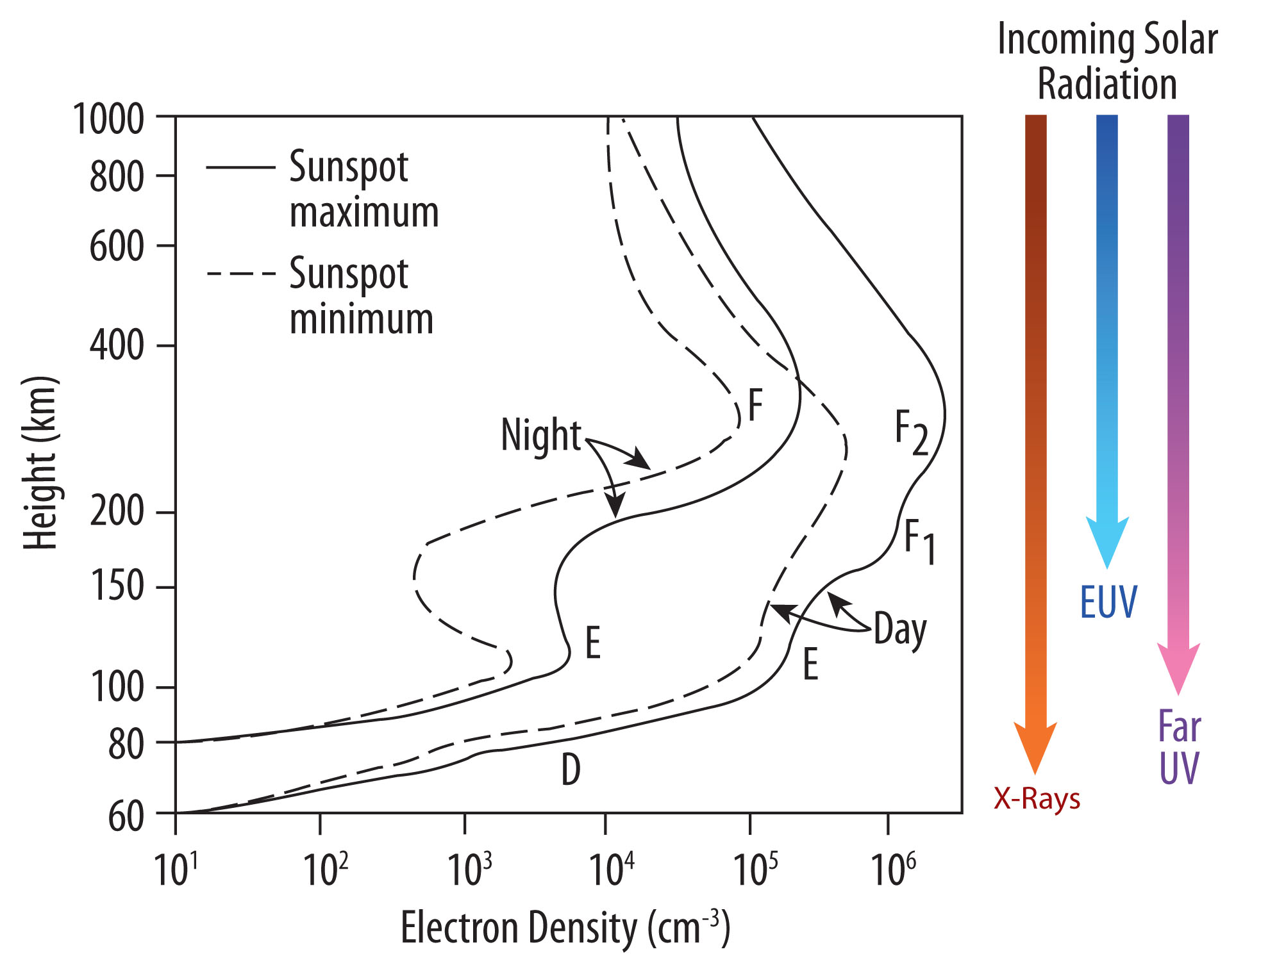

Slide 13
Earth’s Upper Atmosphere Density → Absorbs solar EUV
The main process by which the upper atmosphere absorbs EUV energy from the sun is that of photo-dissociation. Diatomic oxygen is the primary molecule in the upper atmosphere that dissociates. This occurs when it is struck by photons with wavelengths of 242 nm or less, as as expressed by the reaction
O₂ + hv (λ < 242 nm) → O + O + energy
The main mechanism that creates the ionosphere is the photo-ionization of a tiny fraction of the earth’s extended, tenuous neutral upper atmosphere during the daytime. Essentially, incoming solar EUV and X-ray radiation penetrate the upper atmosphere with sufficient energy to detach an electron from a neutral atom to create an ion and electron pair, as depicted here for oxygen, the main atmospheric gas that is ionized in this manner:
O + hv → O⁺ + e–
Charge exchange readily occurs between the oxygen ions and the ambient nitrogen and oxygen molecules (N₂ and O₂), creating NO⁺ and O₂⁺:
O⁺ + N₂ → NO⁺ + N
O⁺ + O₂ → O₂⁺ + O
Dissociative recombination which is important for the E-region molecular ions and greatly reduces the density of the low altitude (< 250 km) nighttime ionosphere:
O₂⁺ + e– → O + O
NO⁺ + e– → N + O
Remember: Ionosphere is charge neutral → Ne = Ni

Slide 14
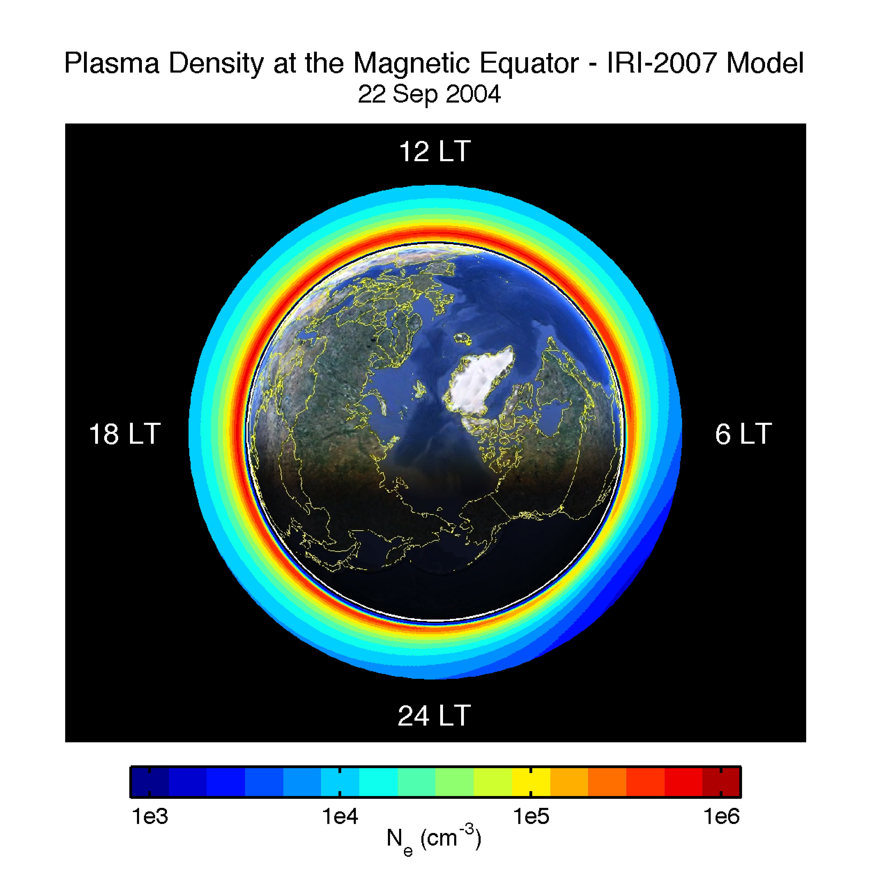

Slide 15
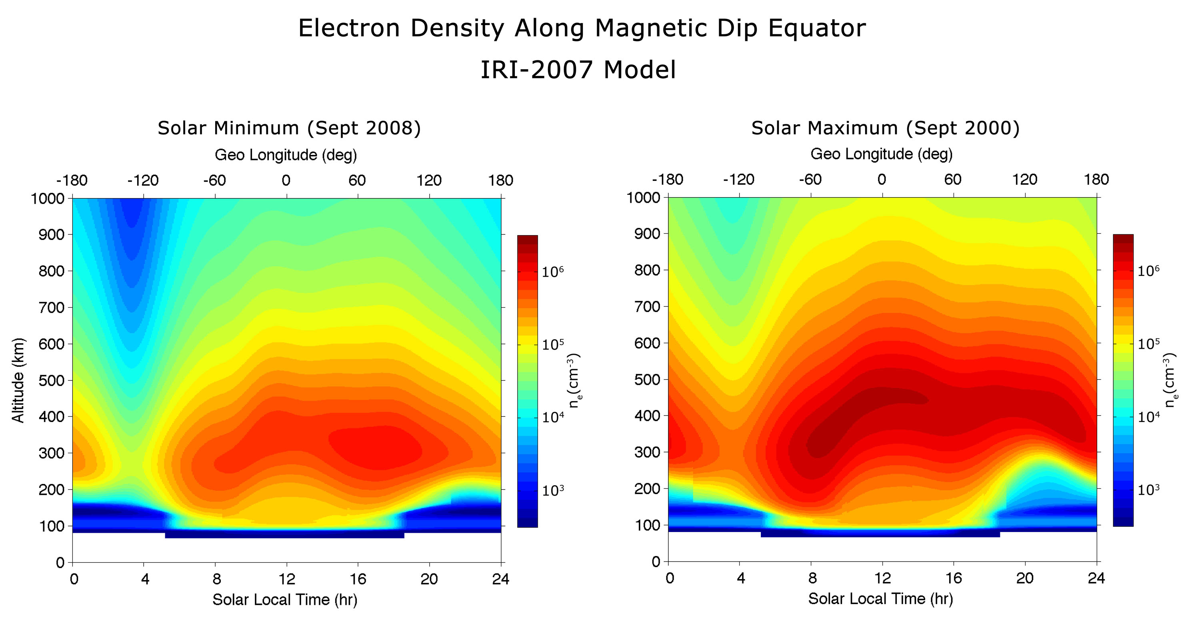

Slide 16
Ionospheric Density
Key Space Weather variable
→ • Affects radiowave propagation, particularly below several MHz
• Affects ionosphere/atmosphere “coupling” everywhere

Slide 17
The ionosphere reflects radio waves below the plasma frequency (about 10 MHz) and allows higher frequencies (microwaves) to pass through!
AM Radio (< a few MHz) is trapped in the earth’s “waveguide”
FM Radio + TV (< a few 100 MHz) passes through the ionosphere as do satellite communications!

Slide 18
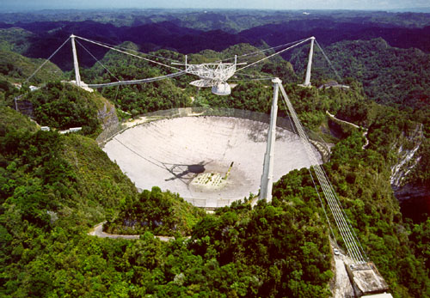
Arecibo Observatory
Provides exceedingly high quality measurements of the ionospheric density versus altitude

Slide 19
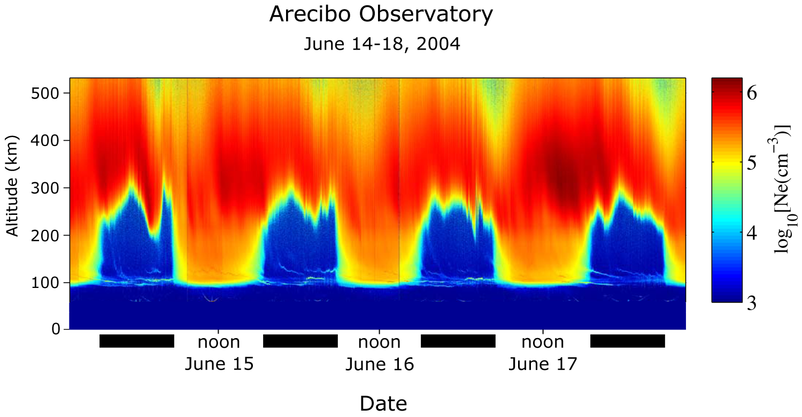
d
d
d
d

Slide 20
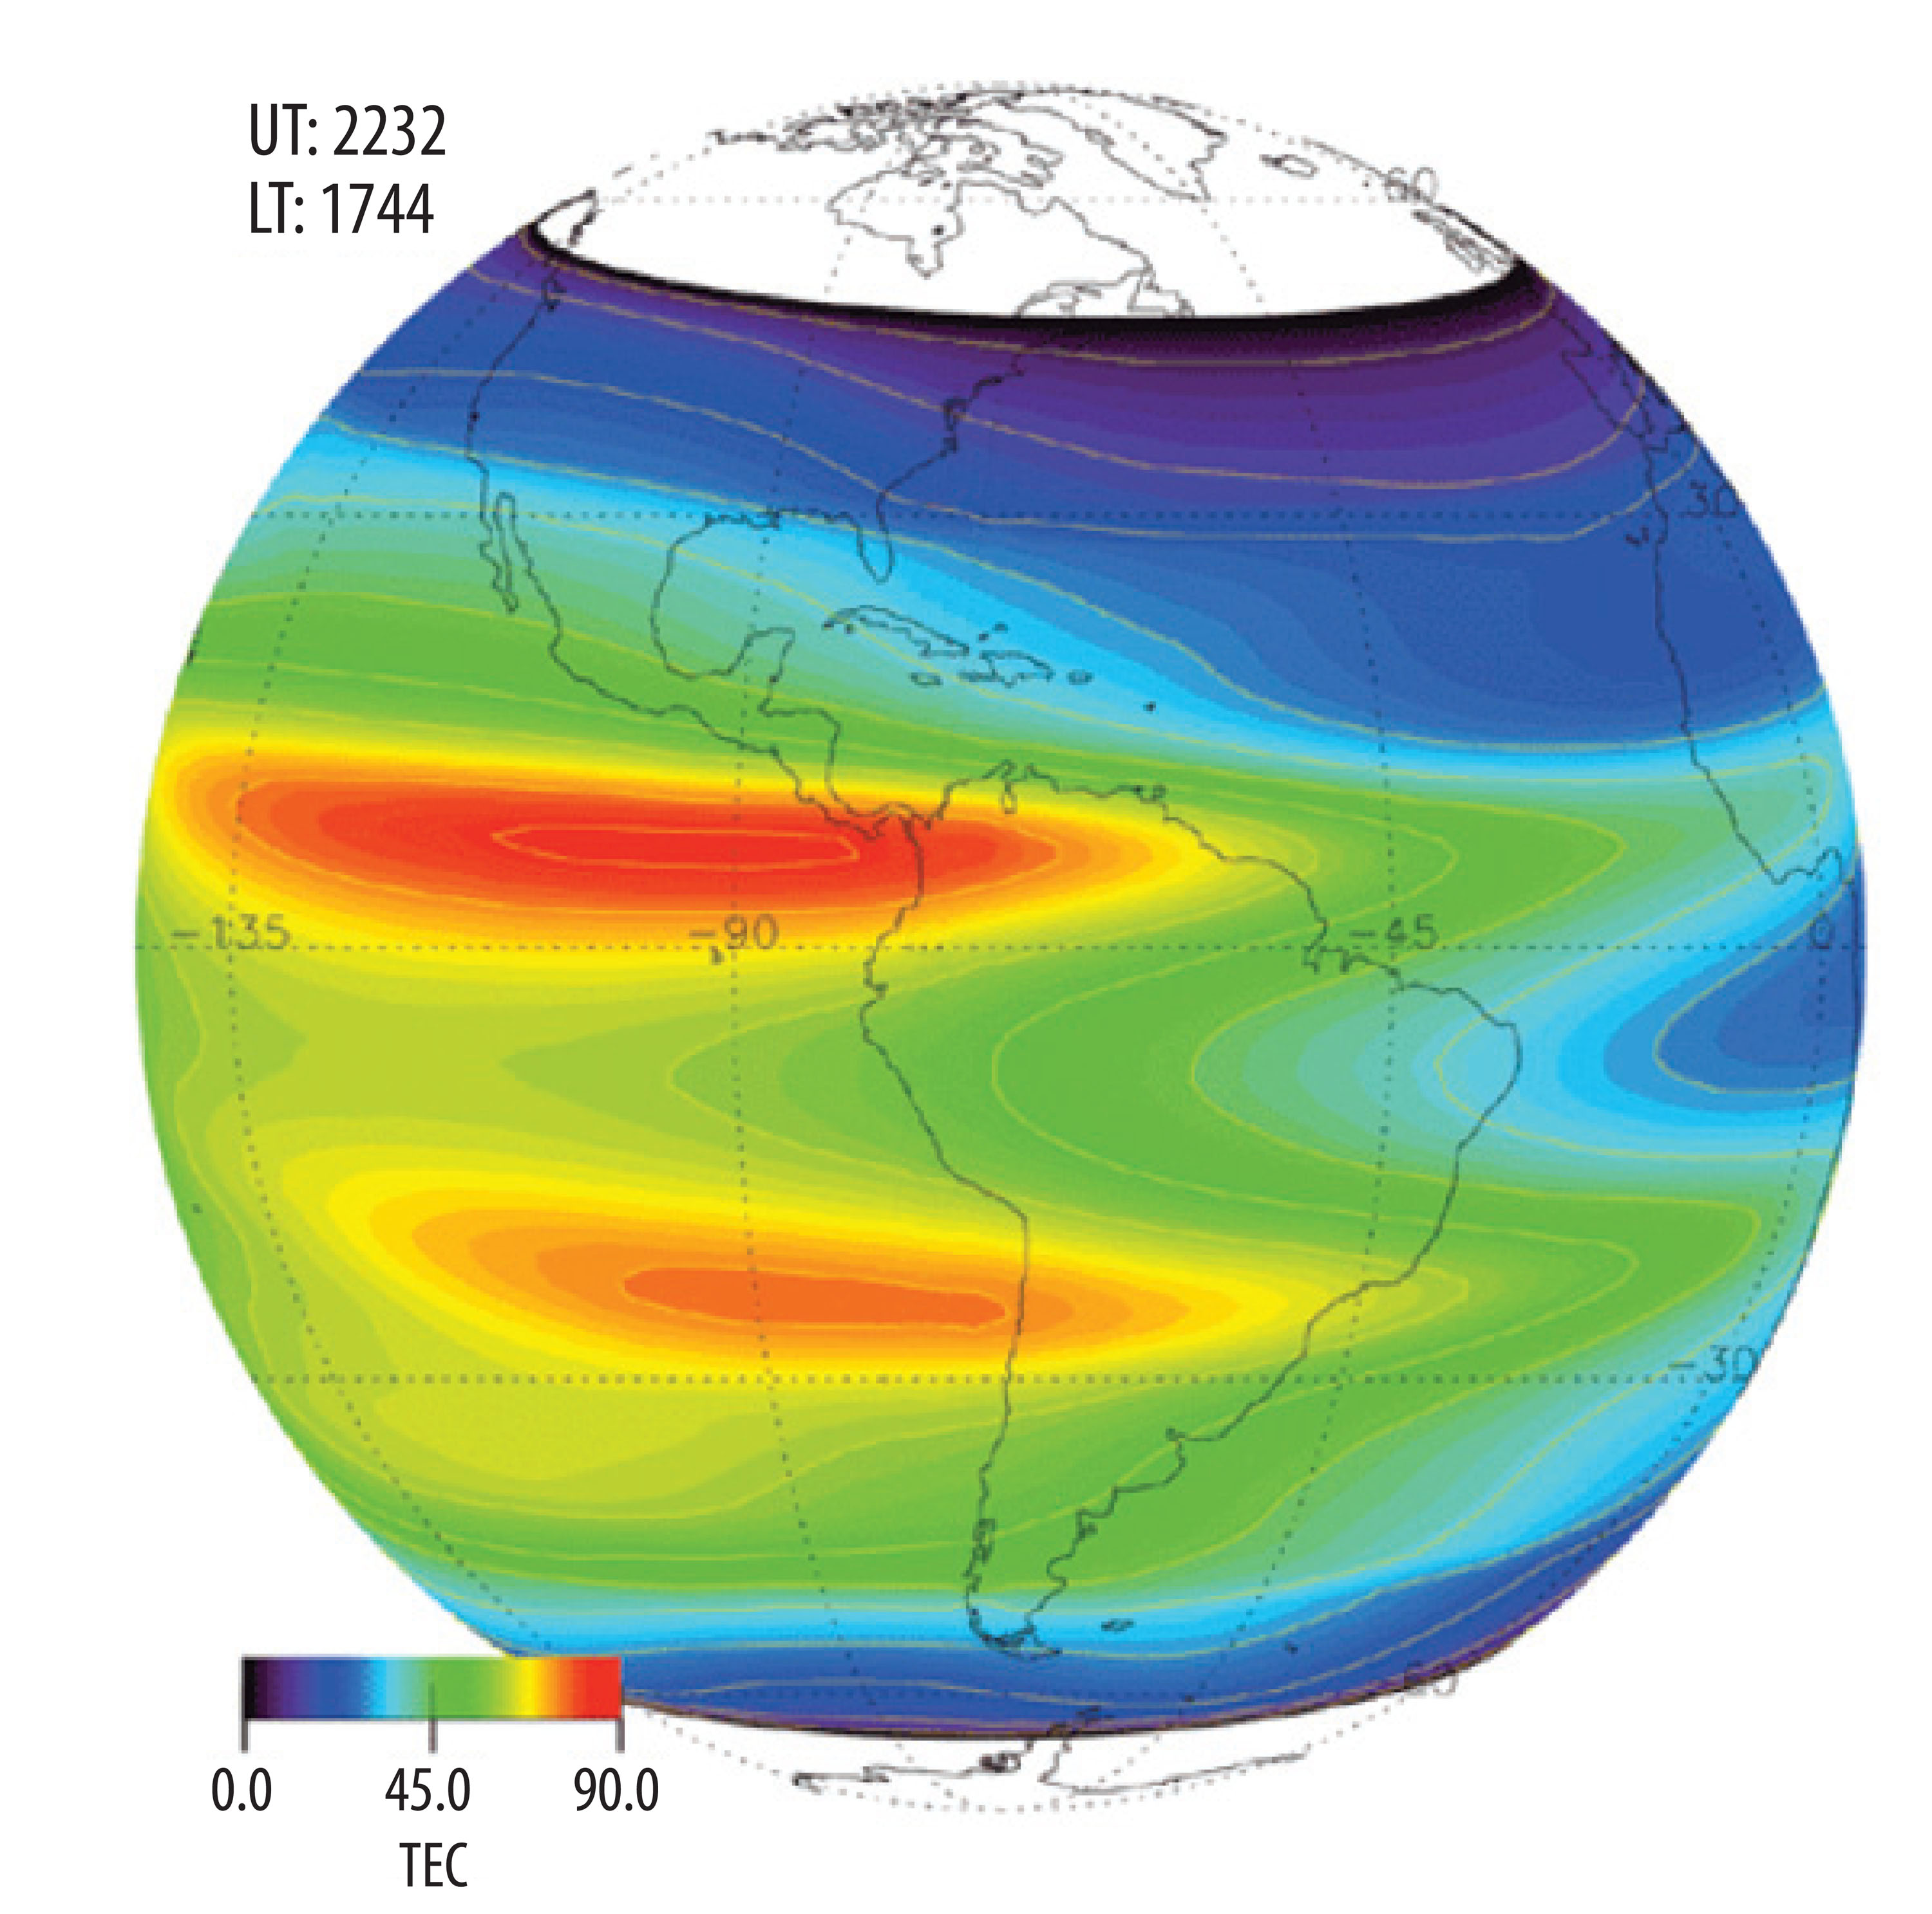
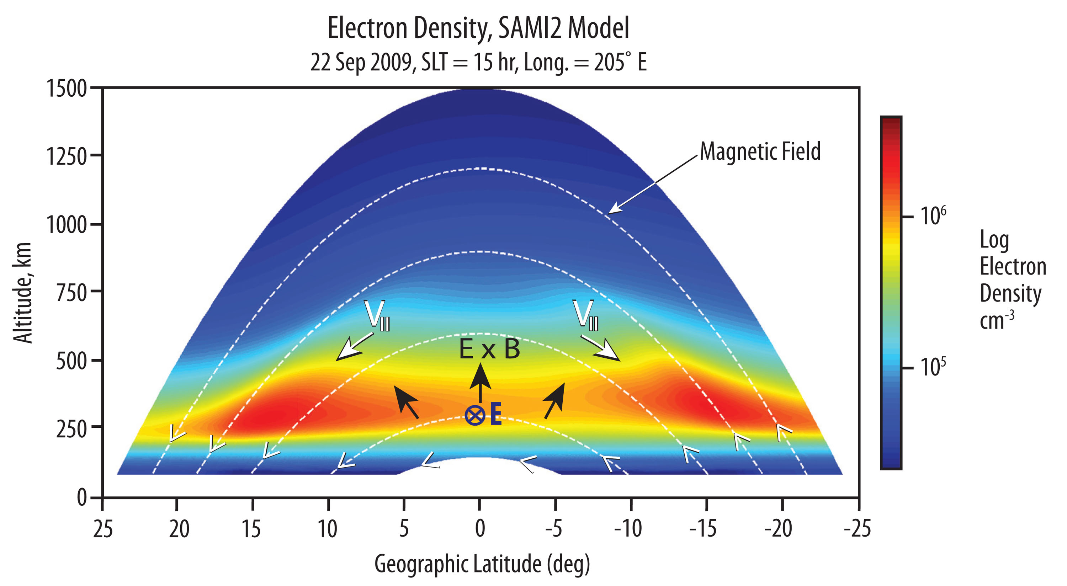
The earth’s ionosphere is not strongest at the sub-solar point!
Electric fields at the magnetic equator drive the ionosphere where it then “slides” down magnetic fields lines (the “Fountain Effect”

Slide 21
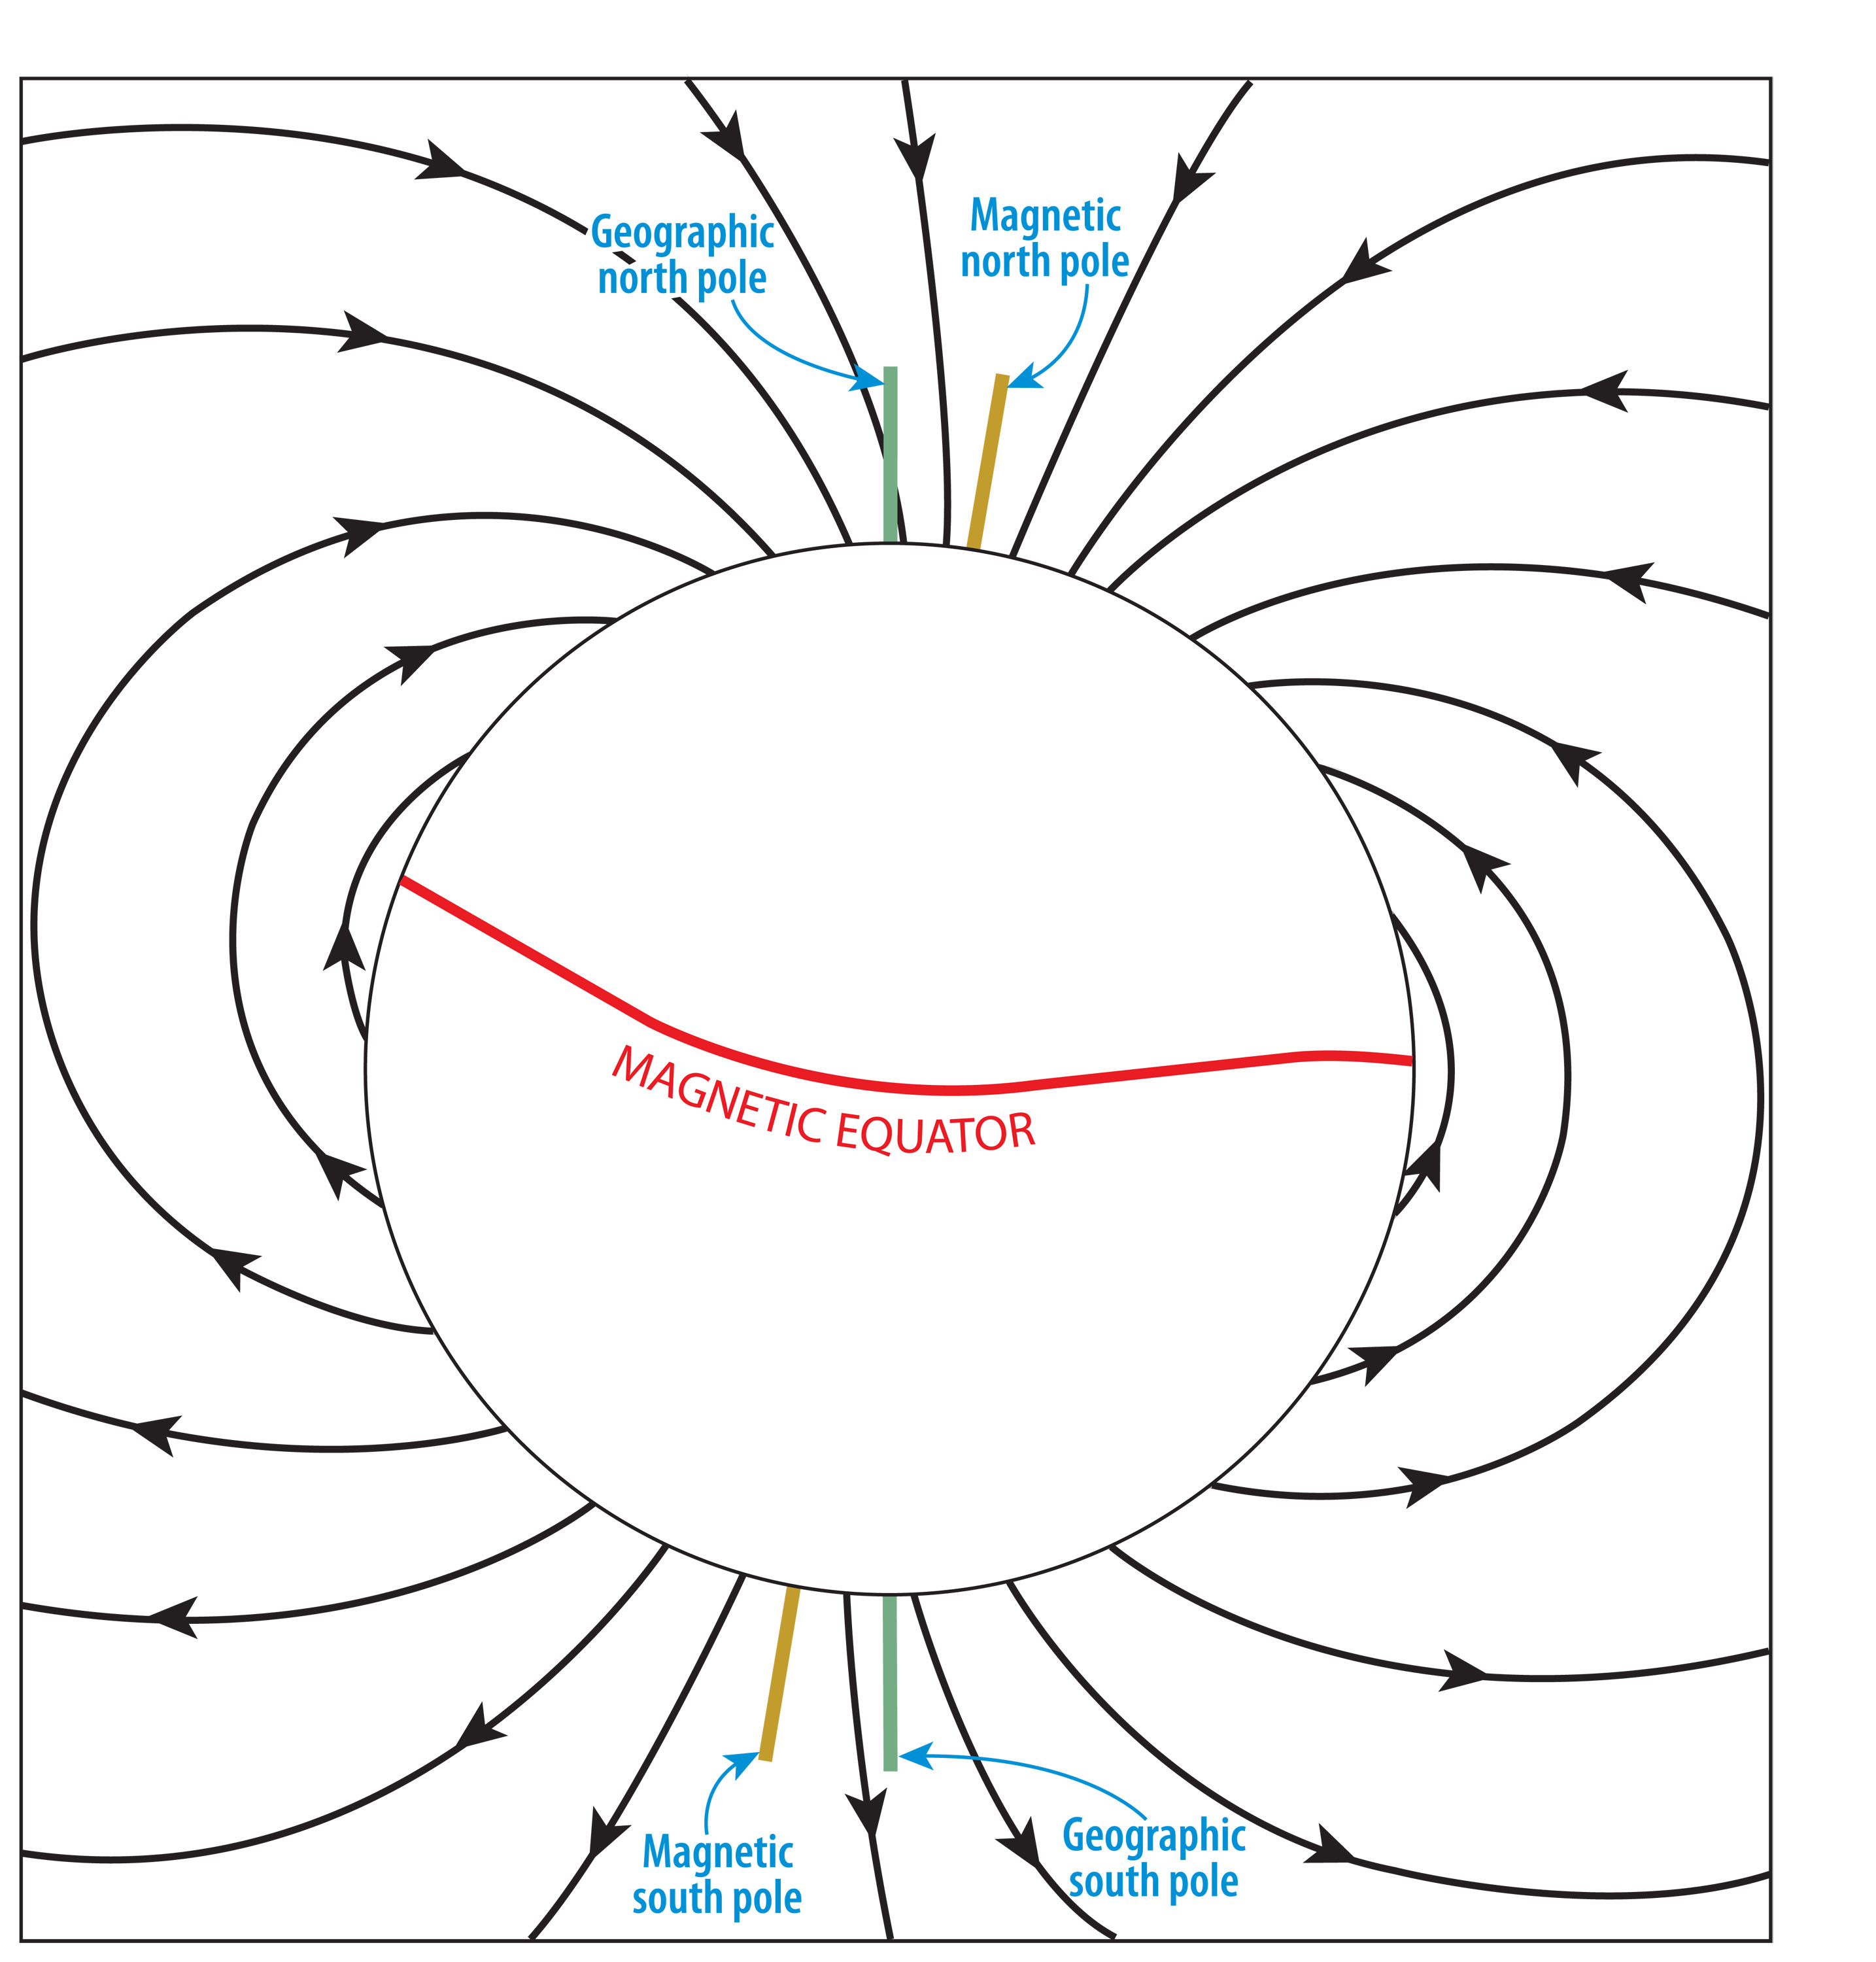

Slide 22
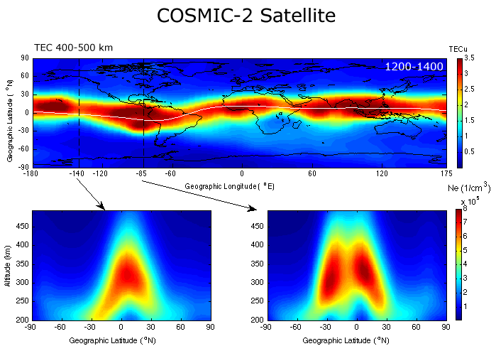
But the plasma density is shown to vary with longitude!
Perhaps the electric field (or neutral winds?) that drives the Fountain Effect varies with longitude? → tidal effects from below?
COSMIC-2 Satellite (Lin et al., 2007)

Slide 23
Ionospheric Density Irregularities
Key Space Weather variable
→ • Affects communication/navigation systems, particularly above several MHz

Slide 24
Jicamarca Radio Observatory, Peru
Premier scientific facility in the world for studying the equatorial ionosphere
• 50 MHz
• 18432 three-meter crossed dipoles
• 288m by 288m

Slide 25
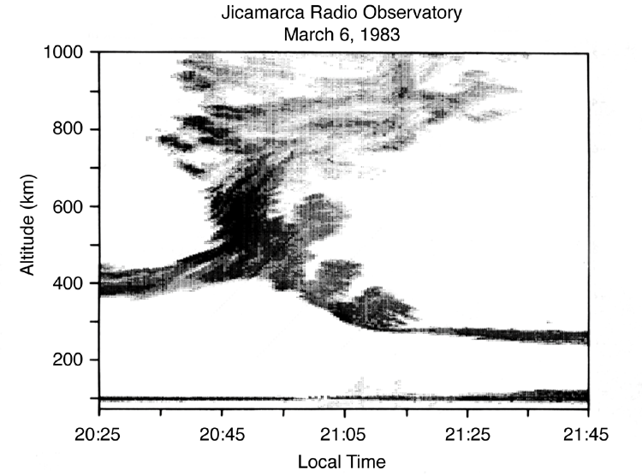
Backscatter radar shows the ionosphere is highly irregular
particularly at the magnetic equator after sunset
Kelley et al., 1986

Slide 26
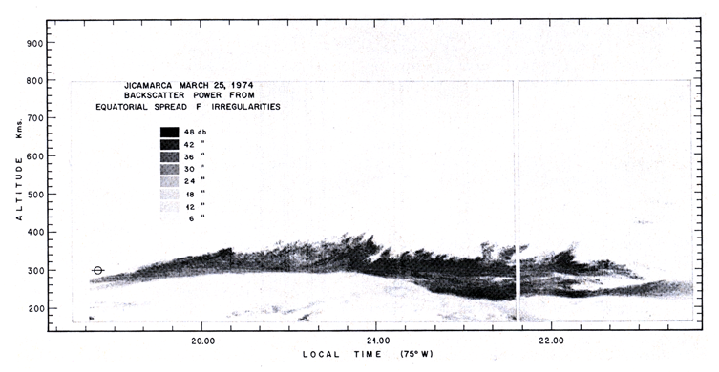
Sometimes the irregularities are only present at the bottom of the ionosphere
Jicamarca Radio Observatory
25 March 1974
Woodman and LaHoz, 1976

Slide 27
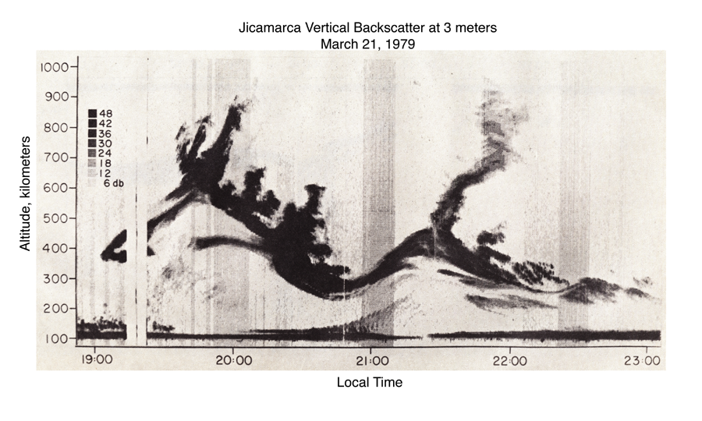
Spread-F radar displays are often very dramatic -- indicating plasma density is disturbed on planetary scales.
Kelley et al., 1981

Slide 28
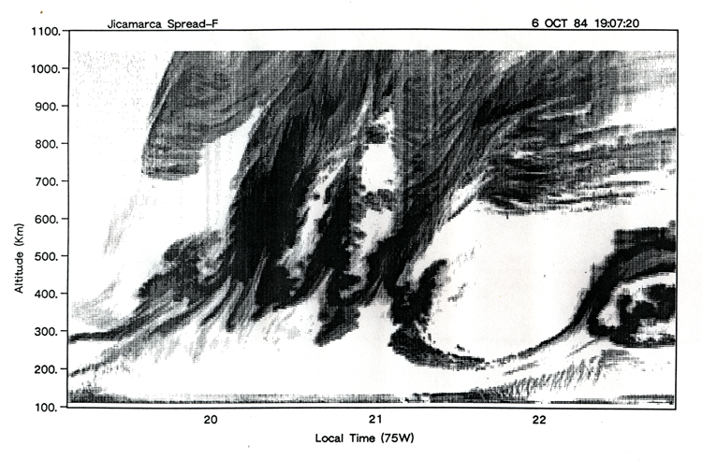
Spectacular Spread-F radar displays from Jicamarca associated with magnetic storm
Data courtesy R. Woodman, JRO

Slide 29
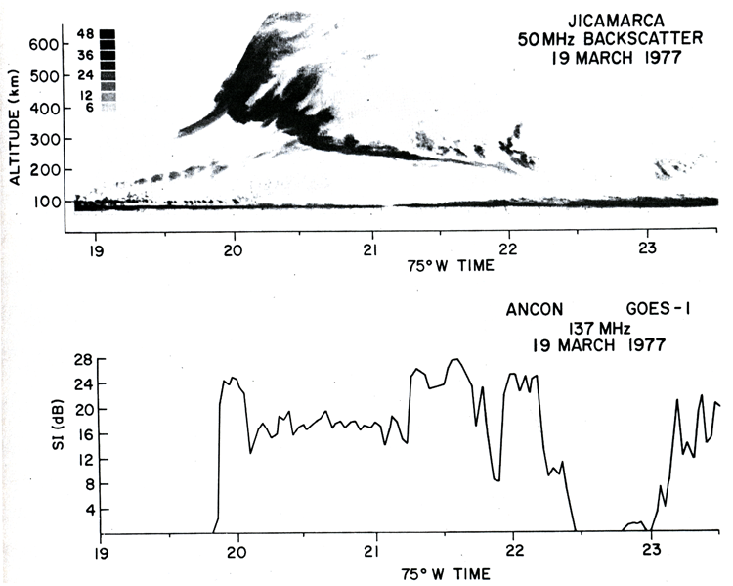
Irregularities disrupt radiowaves, particularly at high frequencies!
Scintillation Index
Basu et al., 1978

Slide 30
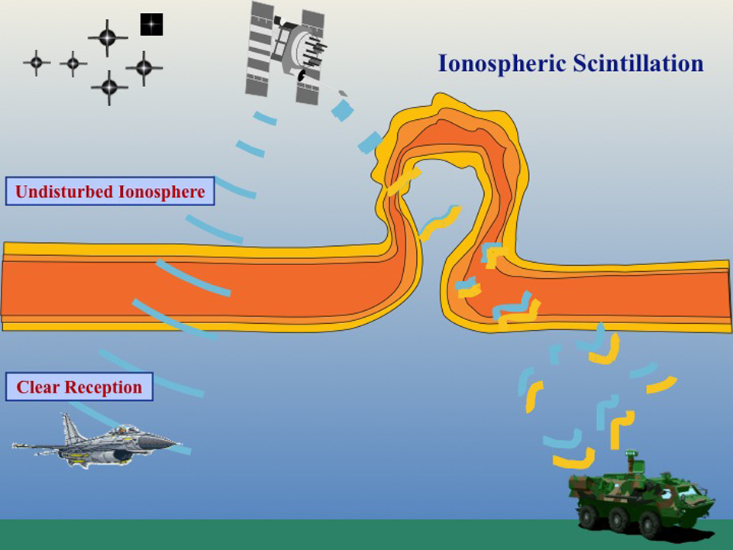

Slide 31
GPS Navigation Signals are Susceptible to Errors due to Ionospheric Scintiallations

Slide 32
Fresnel scattering
Plasma density irregularities with horizontal scale lengths of 100 m in a thin screen at 400 km altitude create scattering effects at GHz radio wave frequencies.

Slide 33
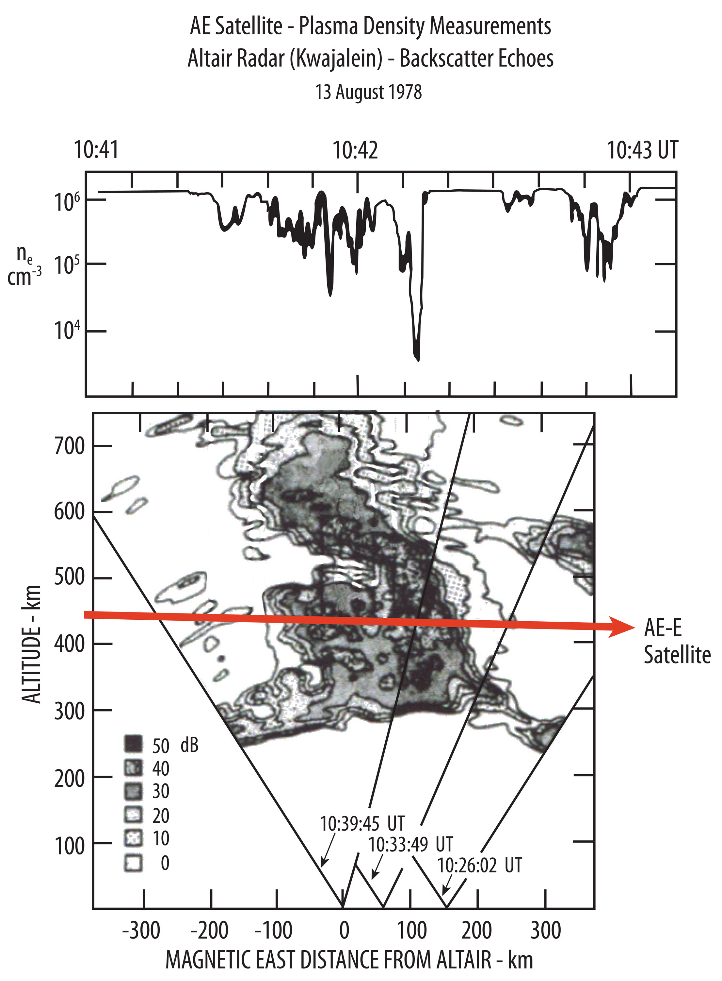
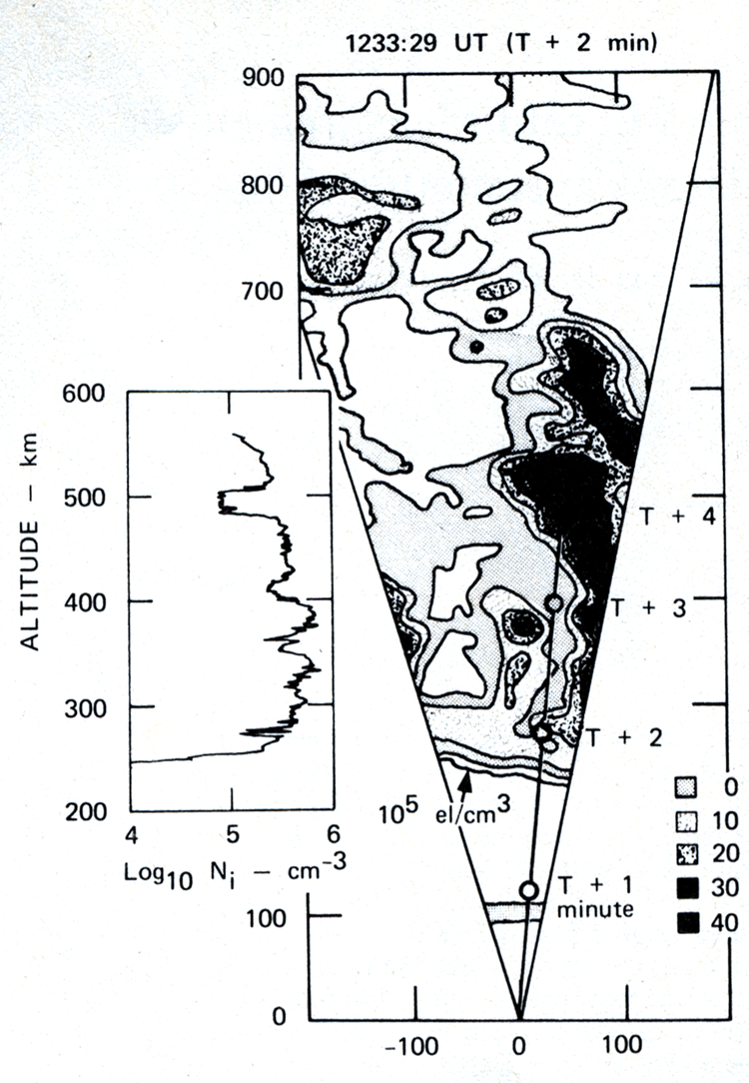
In situ measurements (satellites, rockets) reveal deep plasma depletions associated with spread-F backscatter
Magnetic East distance, km
After Tsunoda et al., 1982
Rino et al., 1981

Slide 34
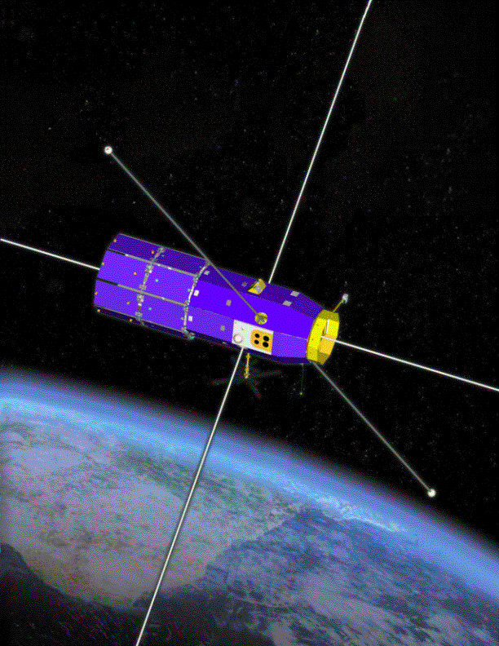
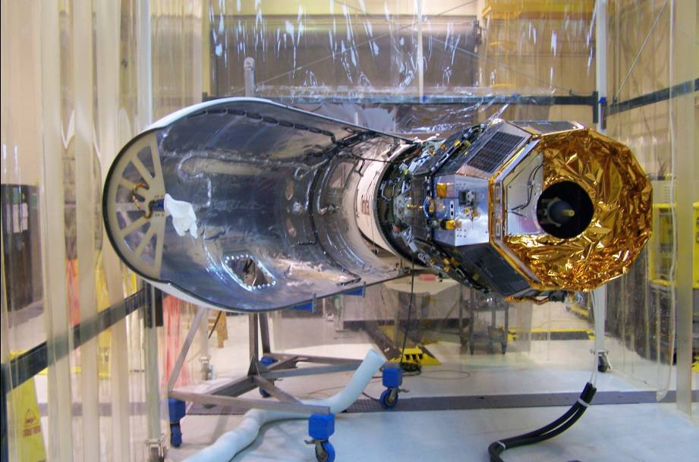
Communications/Navigation Outage Forecast System Satellite (C/NOFS) designed and built to study equatorial scintillation → a space weather satellite!
Air Force C/NOFS Satellite

Slide 35
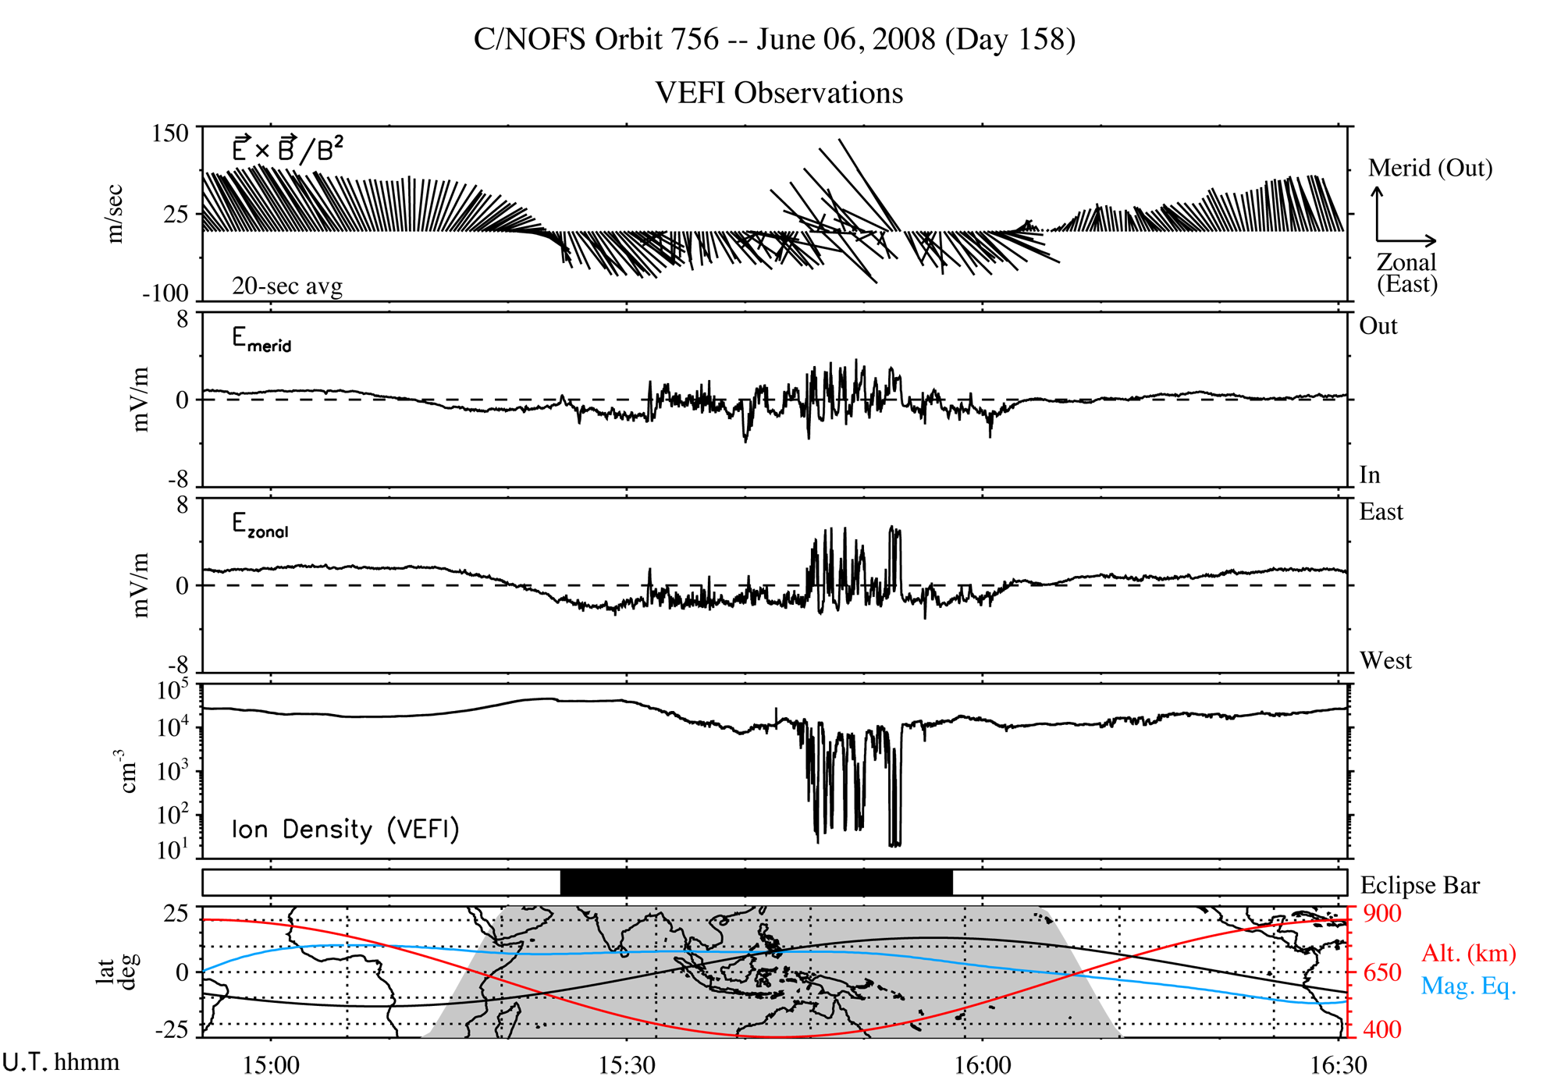
Full Orbit of C/NOFS electric field and plasma density measurements
Notice large plasma depletions at night with large electric fields!

Slide 36
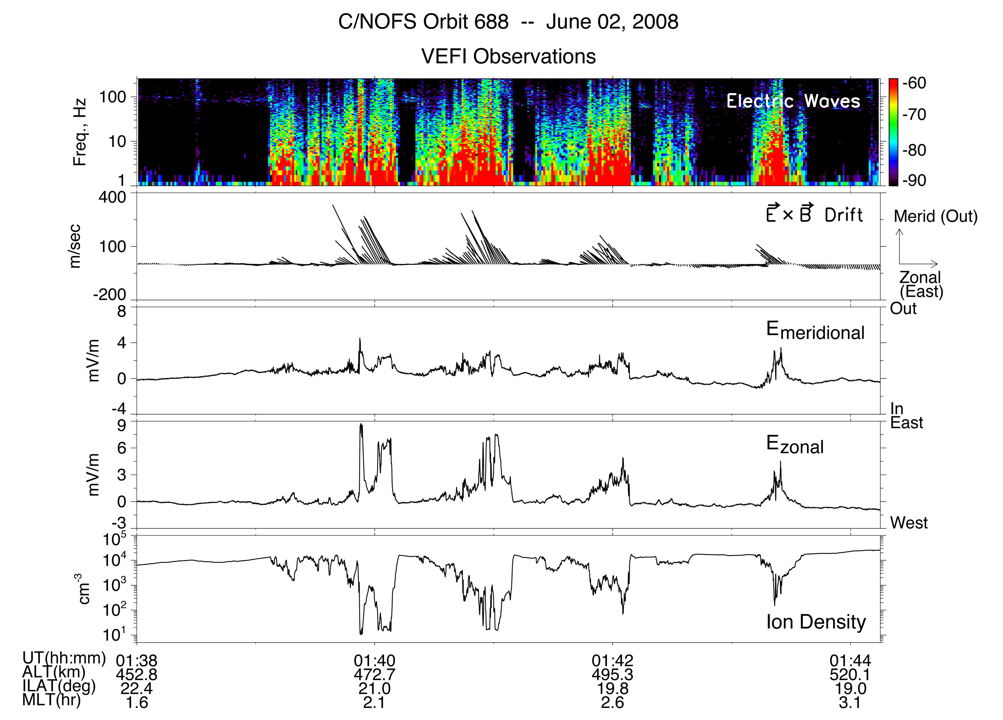
High resolution measurements show irregularities, highly correlated fields and density depletions

Slide 37
Spacecraft traversals below the Base of the F-region Reveals new physics
Ionosphere Density Model
Ionosphere peak
C/NOFS Orbit
Local Time
Ionosphere density is elevated at sunset

Slide 38
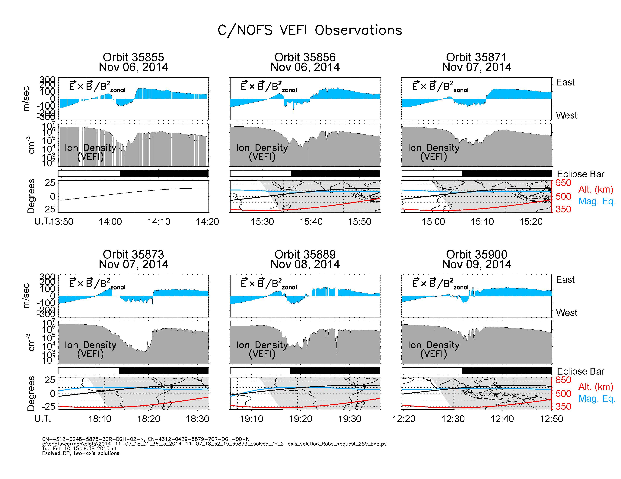
Notes:
6 examples of drifts and density at sunset when the ionosphere has risen above the satellite

Slide 39
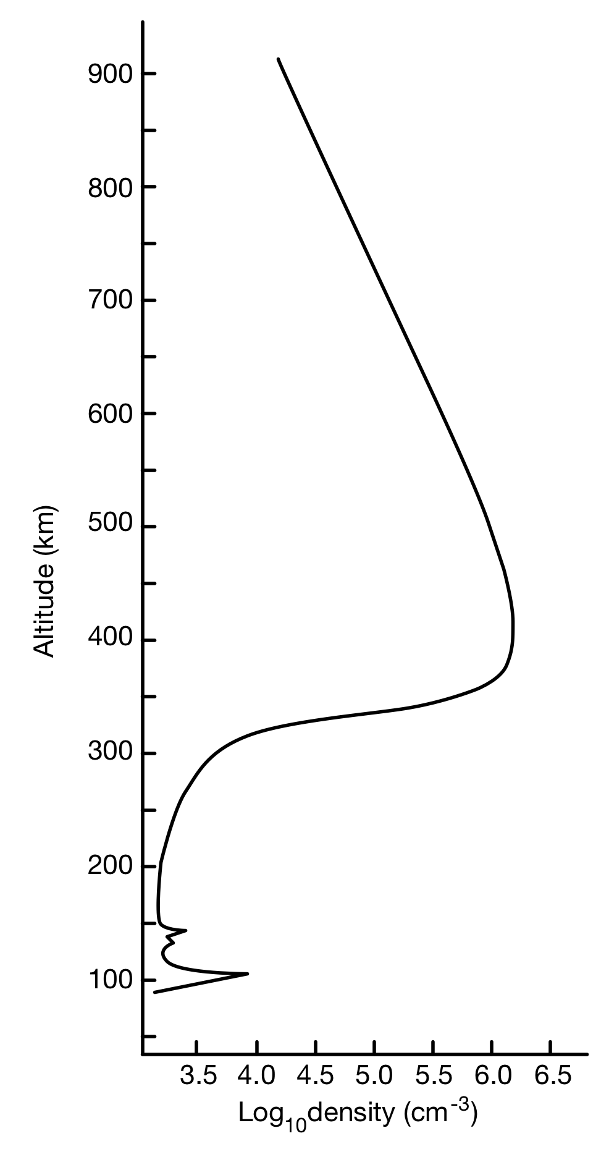
At sunset, the ionosphere below the F-peak flows in a reversed zonal direction than the topside.
The implications for the creation of instabilities are very important…
Does the shear drive instabilities?
Search for large scale undulations on bottomside…

Slide 40
Evidence of 400-500 km “Undulations” Below F-peak
Shears in the “Background” Zonal E x B Drifts suggest Kelvin-Helmholtz Instability Seeds Spread-F Depletions
Plasma density
• Data support theories (e.g., Hysell and Kudeki, 2004) that Kelvin-Helmholtz shear drives bottomside F-region unstable, “seeding” the formation of spread-F depletions, irregularities.
• Explanation also accounts for regular spacing of spread-F depletions

Slide 41
Upper Atmosphere Density
Key Space Weather variable
• Creates drag on satellites
• Affects attitude and “pointing” of satellites (particularly non-symmetric ones) and can re-direct sun-pointing solar arrays
• Affects incoming meteoroids and debris

Slide 42
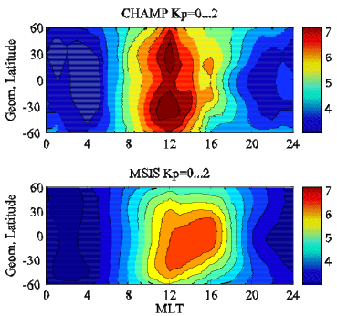
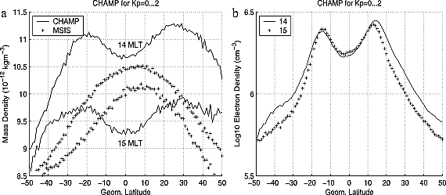
Few Existing Neutral density measurements don’t agree at all with models!
Neutral Density Variations CHAMP Satellite
Statistical Survey and Comparison with MSIS Model

Slide 43
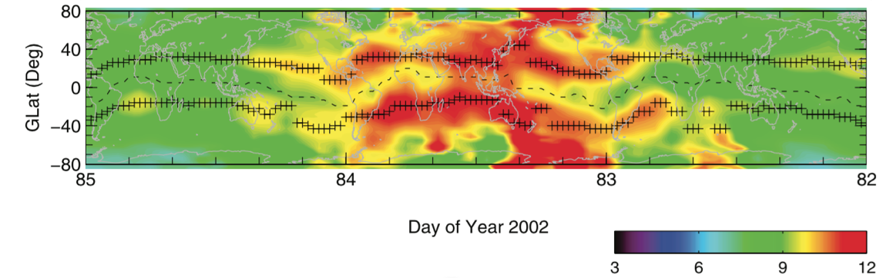
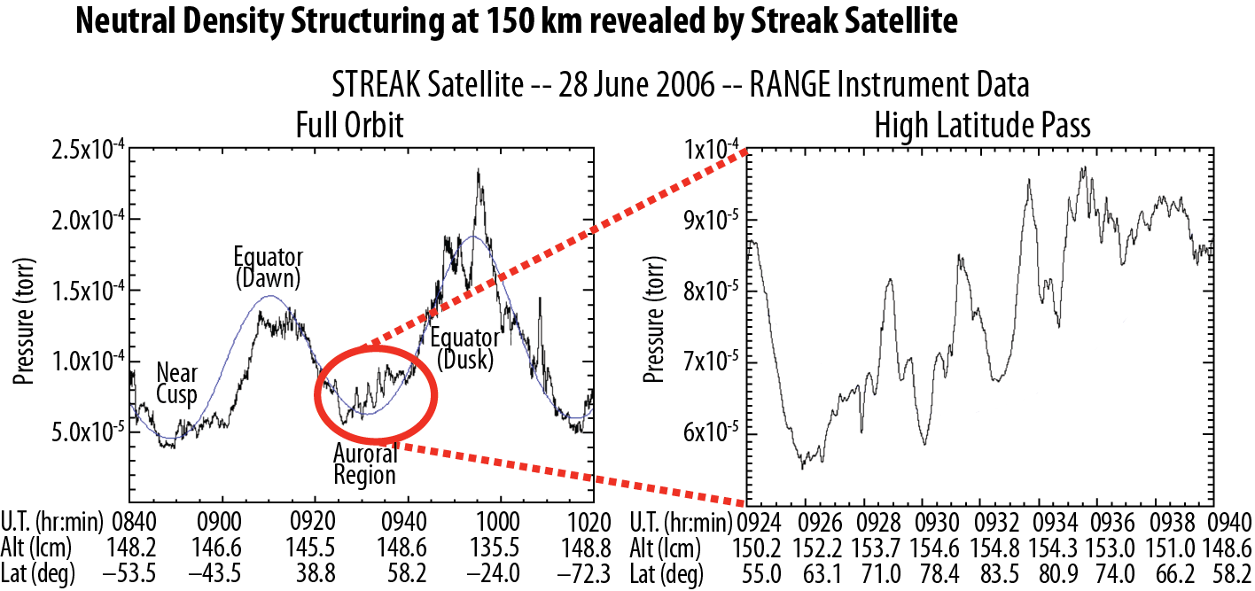
Neutral density is highly structured! Why?
CHAMP Neutral density variations near 400 km
Day of Year
STREAK Satellite -- 28 June 2006
This affects ionospheric structure → affects radiowaves

Slide 44
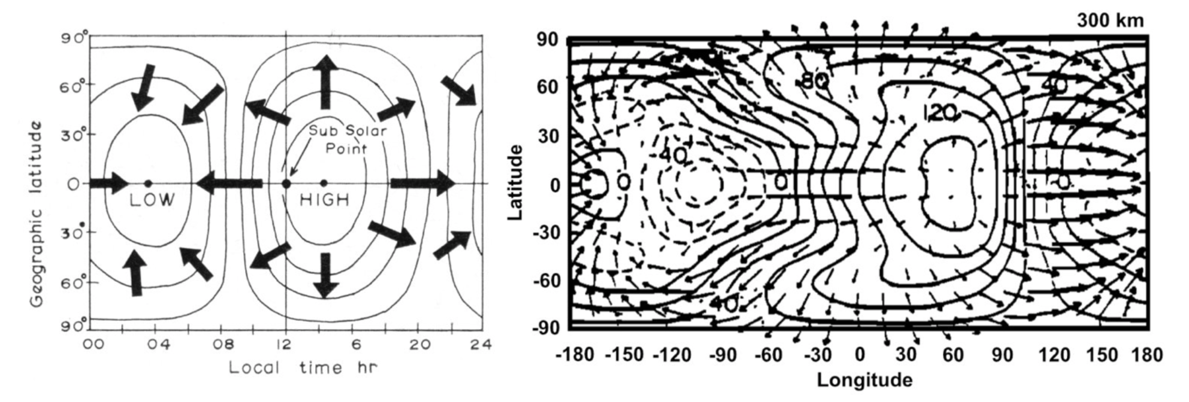
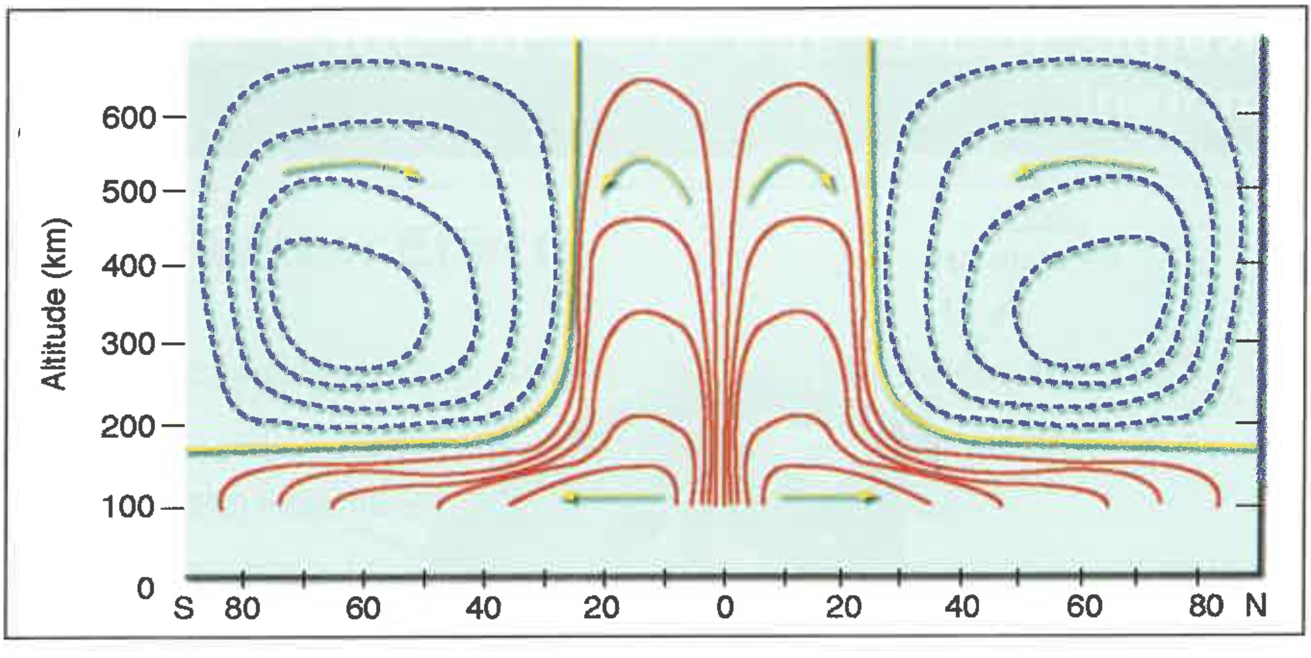
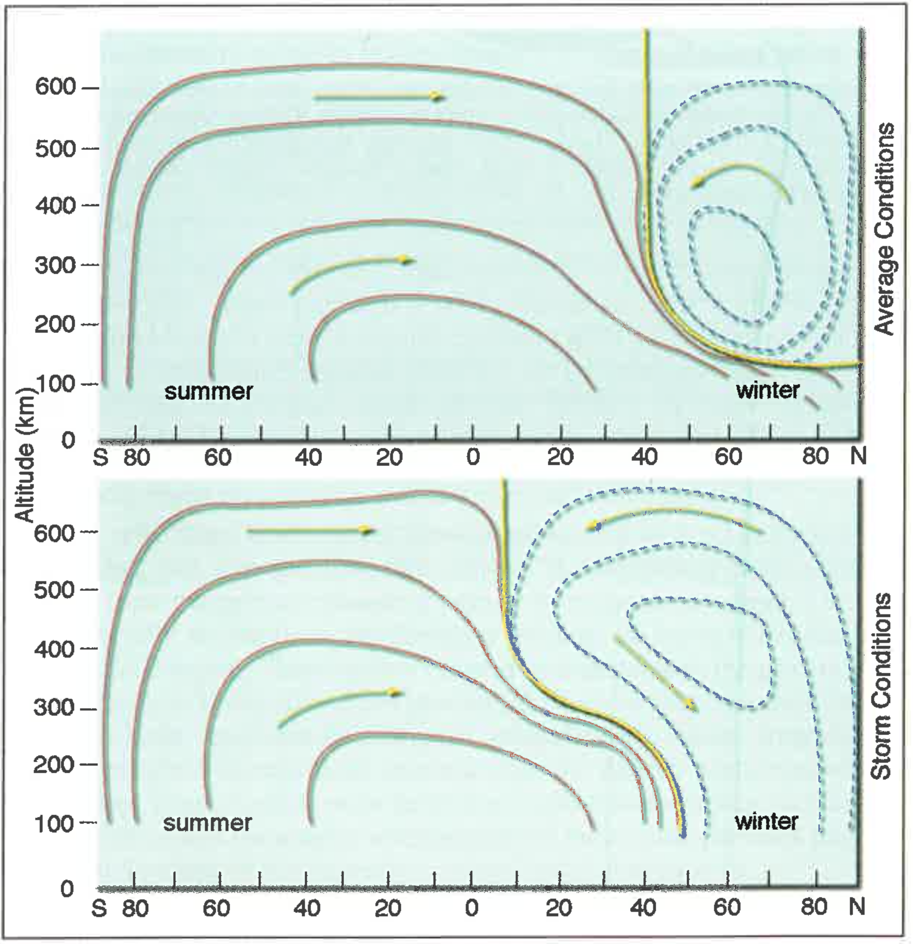
Motions of Upper Atmosphere (winds) affects ionosphere, creates electric fields
Beer [1976]
Fesen et al. [1986]
These are all models… We lack systematic, vector wind measurements
Lower panels from Ray Roble, NCAR

Slide 45
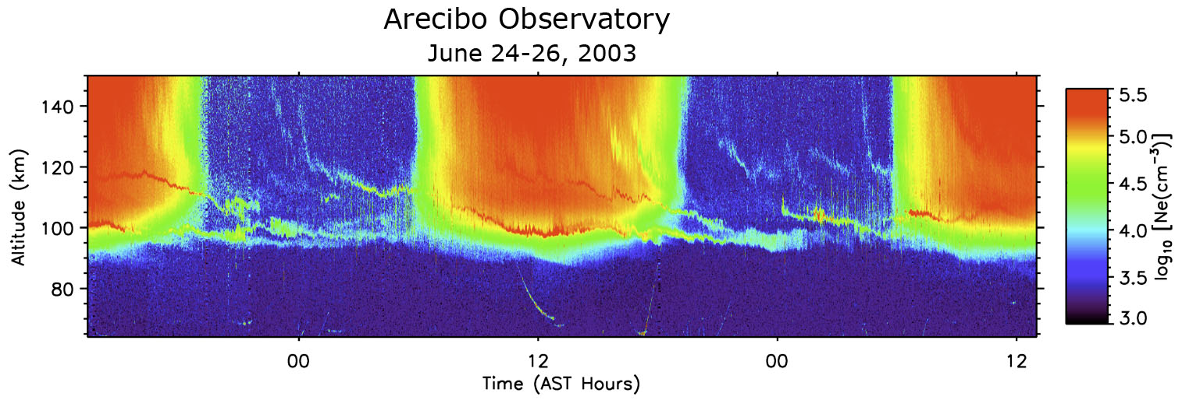
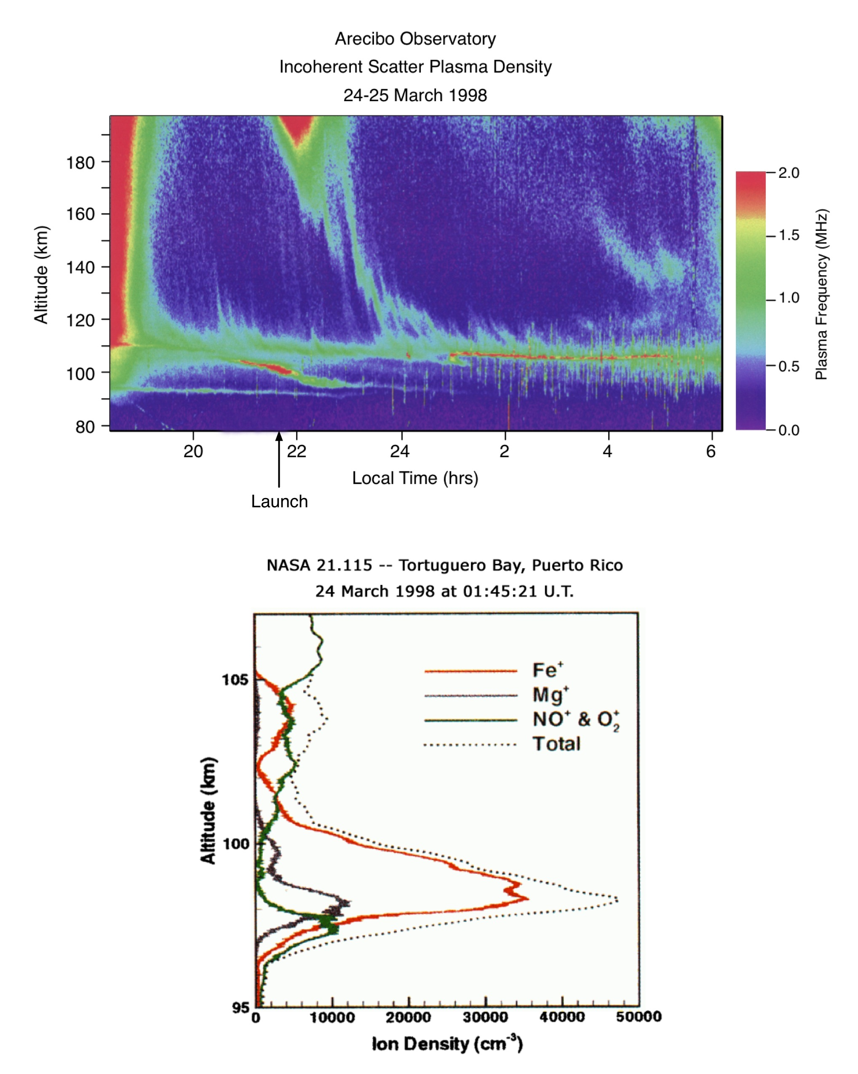
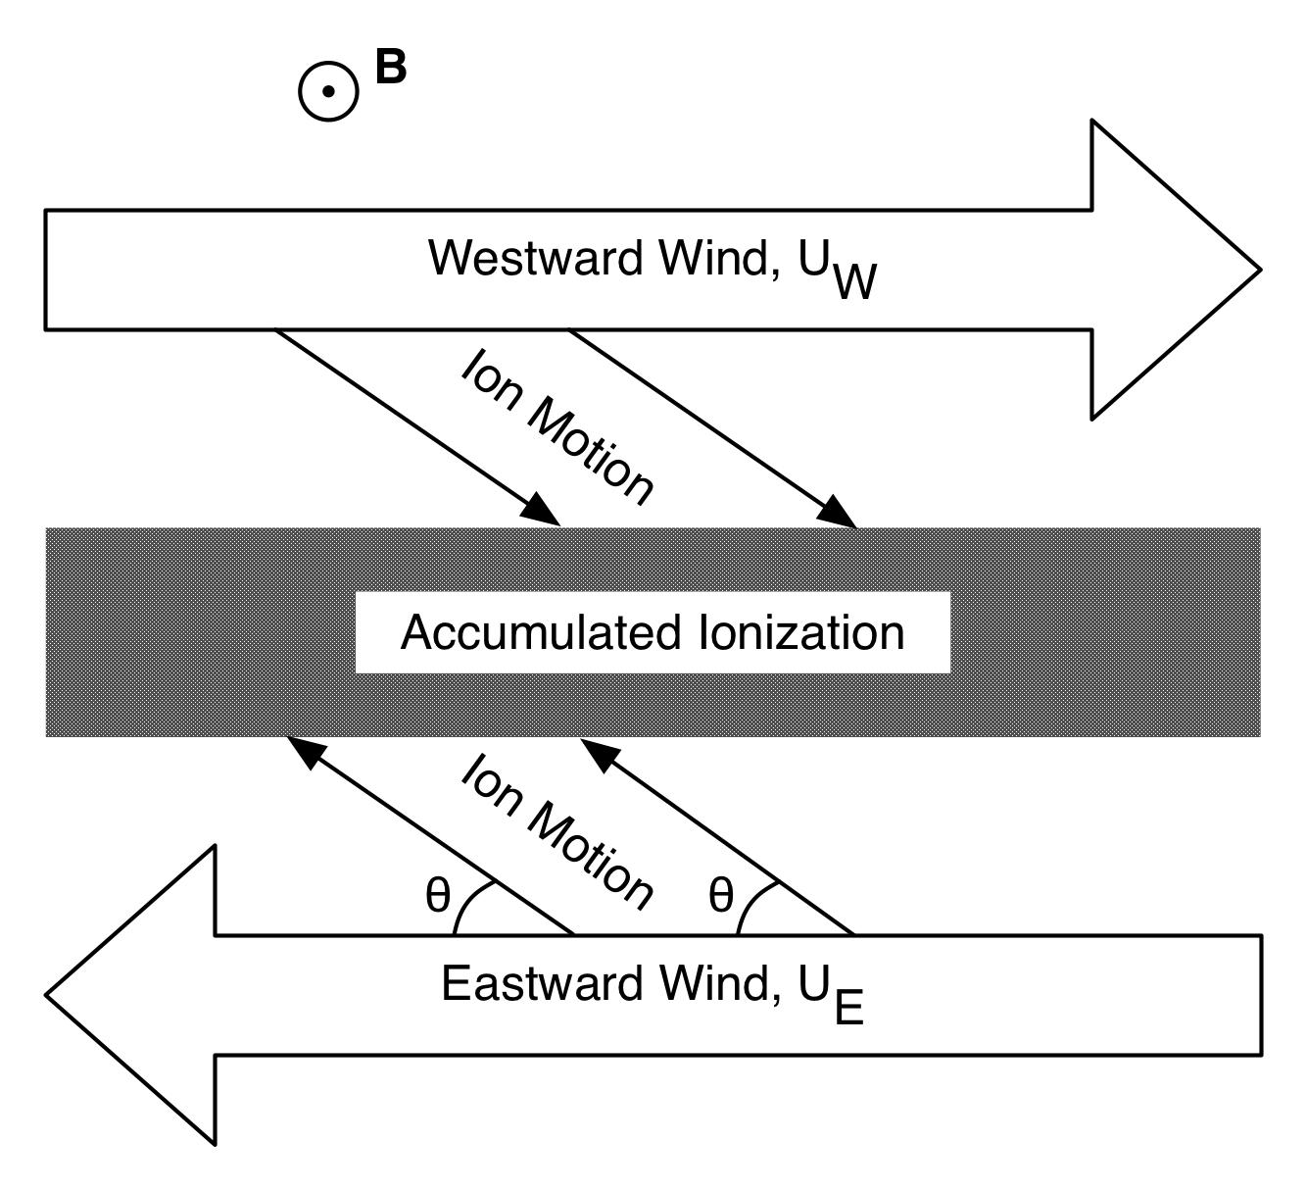
Wind shears create enhanced layers of metallic ions from meteoric input
Rocket measurements show thin layers of metallic ions
Earle et al. [2000]
Hines [1964]

Slide 46
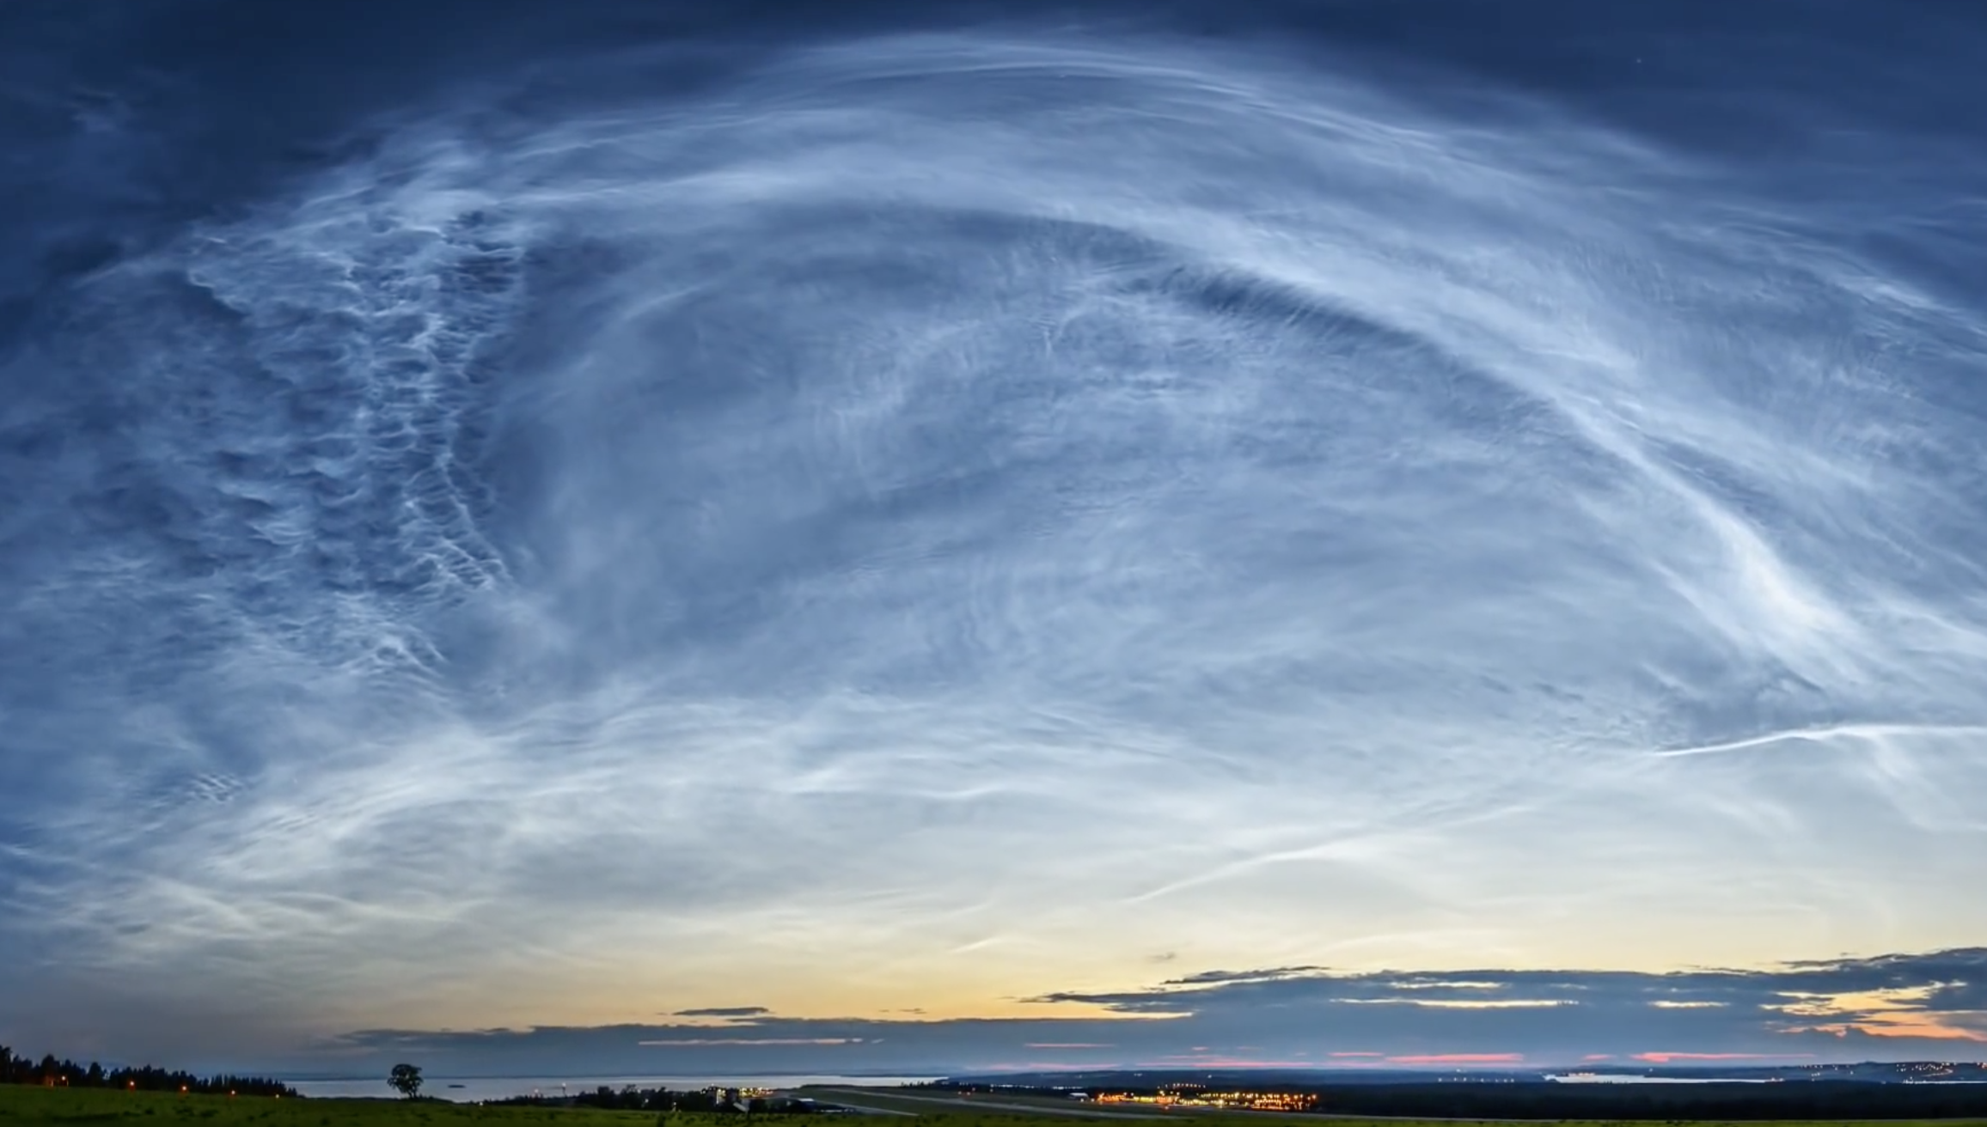
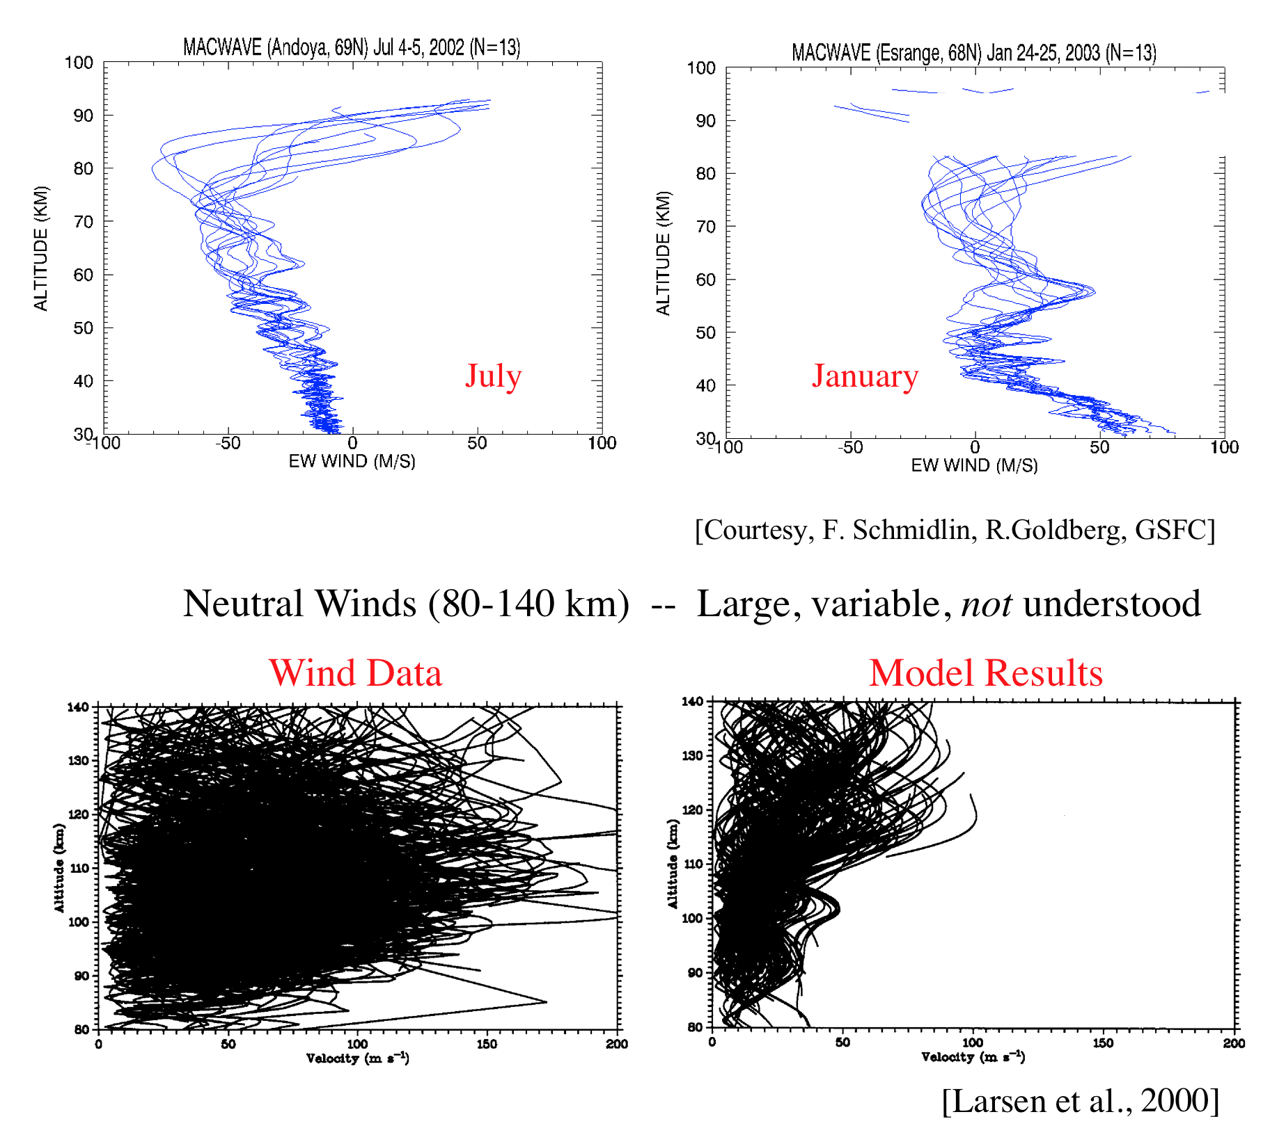
Upper atmosphere winds also affect aerosols, explosion material, exhaust…
Krakatoa Volcanic Eruption, 1883
Noctilucent Clouds (~84 km)
Shuttle Exhaust
Fotograf Göran Strand, 2014
Lithograph, 1888
Nuclear Explosion

Slide 47
Upper Atmosphere Winds
Key Space Weather variable
→ Affects plasma distribution, sets up electric fields
Also affects distribution of:
-- aerosols
-- volcanic material
-- nuclear explosion material
-- rocket exhaust (e.g., from the Shuttle)
-- meteoroids
-- other

Slide 48
Key Features of the Earth’s Upper Atmosphere/Ionosphere
• Neutral and Ionized gases co-exist in the same volume, with the neutral density far exceeding that of the ionized gas below 1000 km
• Ionosphere lower edge extends to ~100 km during day, but recombines at night, with a lower altitude of ~275 km (dependent on solar activity)
• Equal number of ions and electrons, though ion mass varies with altitude
• Plasma gyrates about earth’s magnetic field lines, controlled by electric fields with drive currents
• Neutral gases have a complex motions; Collide with ions, set up electric fields, currents…
• Partially ionized upper atmosphere has a fascinating physics that we are still in the throes of discovering and understanding…

Slide 49
Now…Switch to high latitudes
→ Earth’s magnetic field “connects” the upper atmosphere/ionosphere with magnetosphere and ultimately the solar wind energy

Slide 50
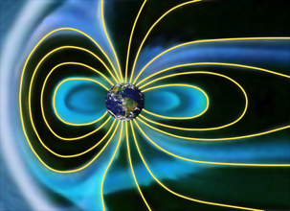
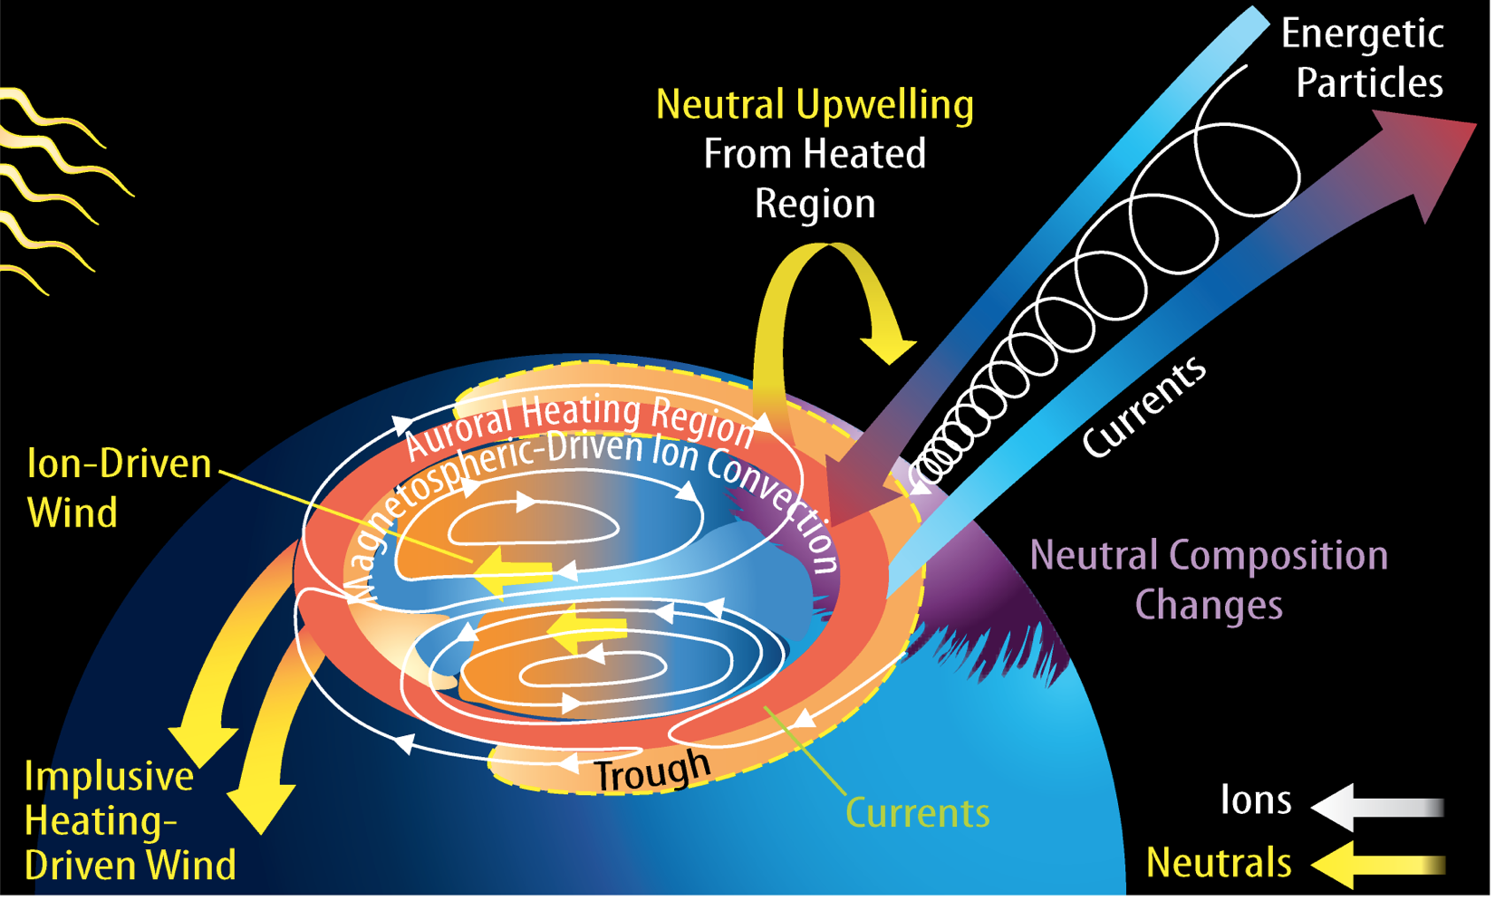
Solar wind/magnetosphere “drives” high latitude Ionosphere/Thermosphere ”system”
which then feeds back on the magnetosphere!

Slide 51
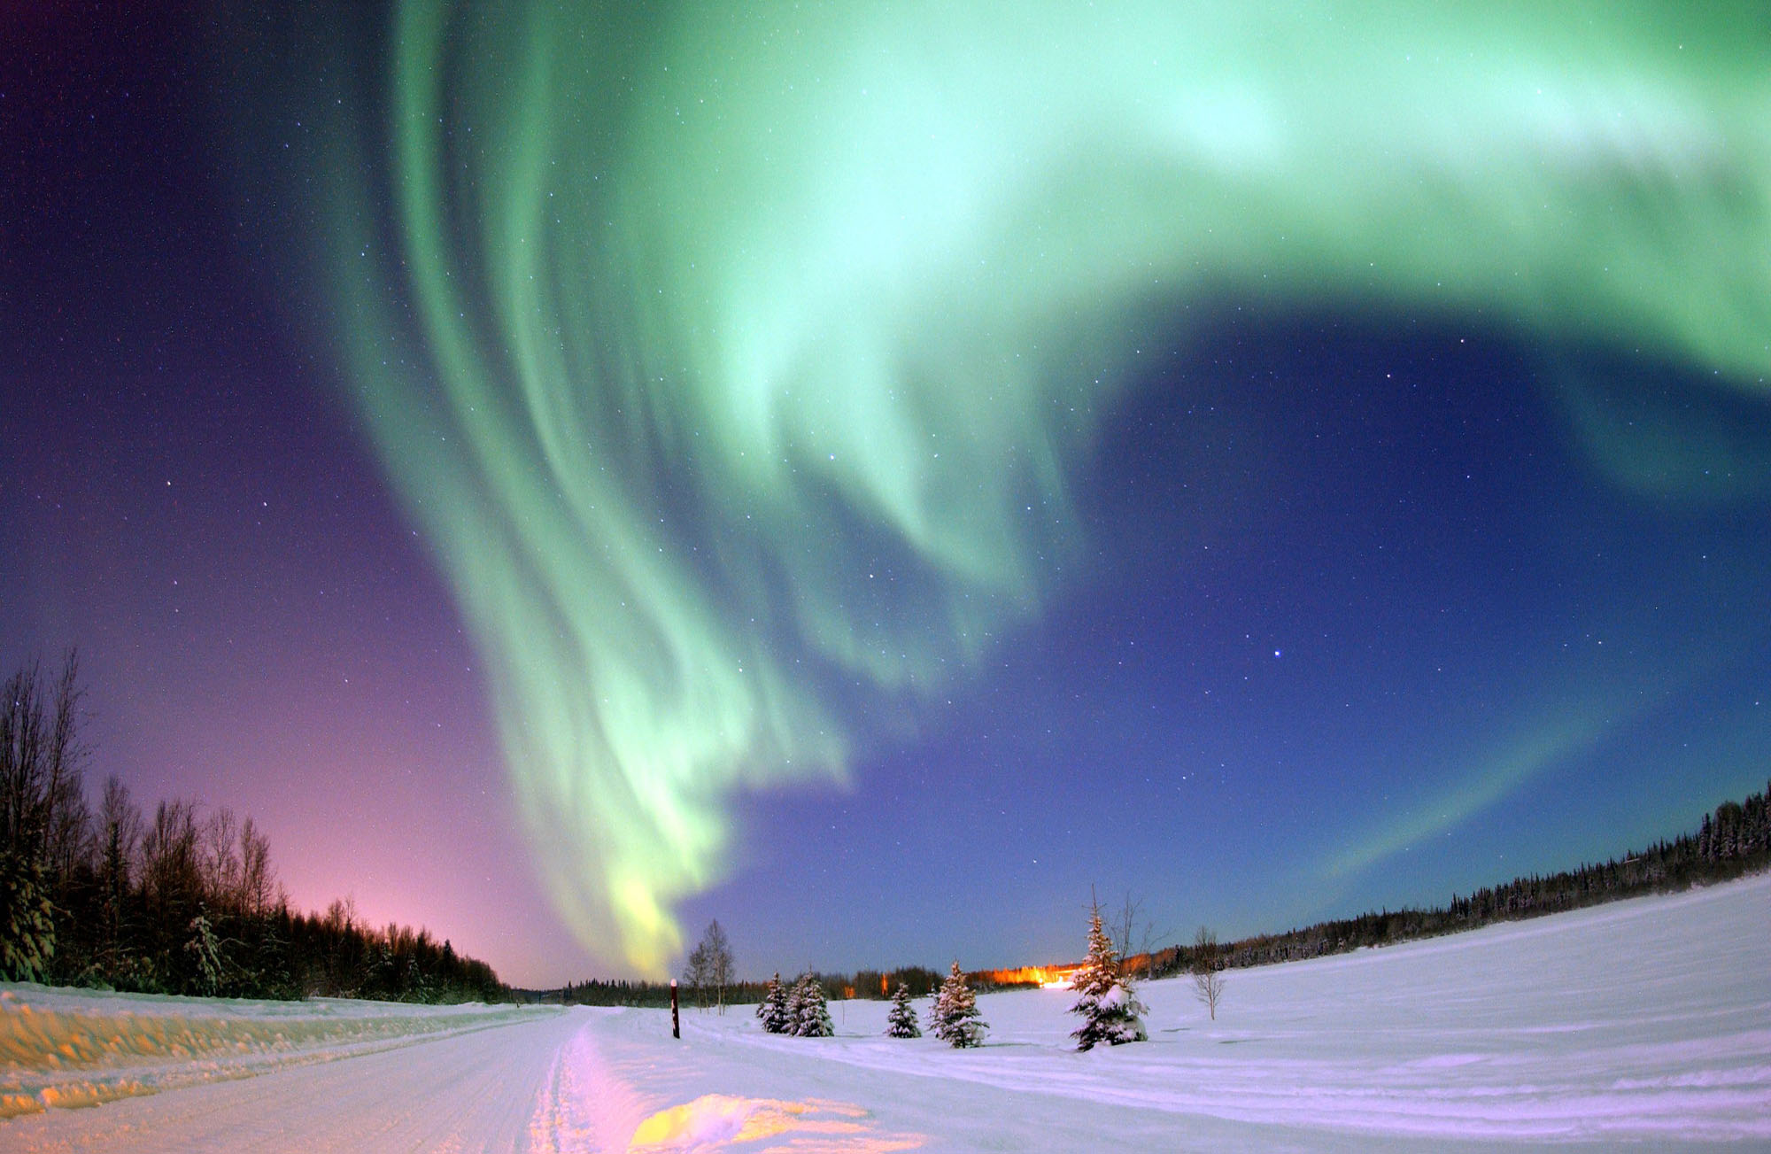
Aurora from the ground…

Slide 52
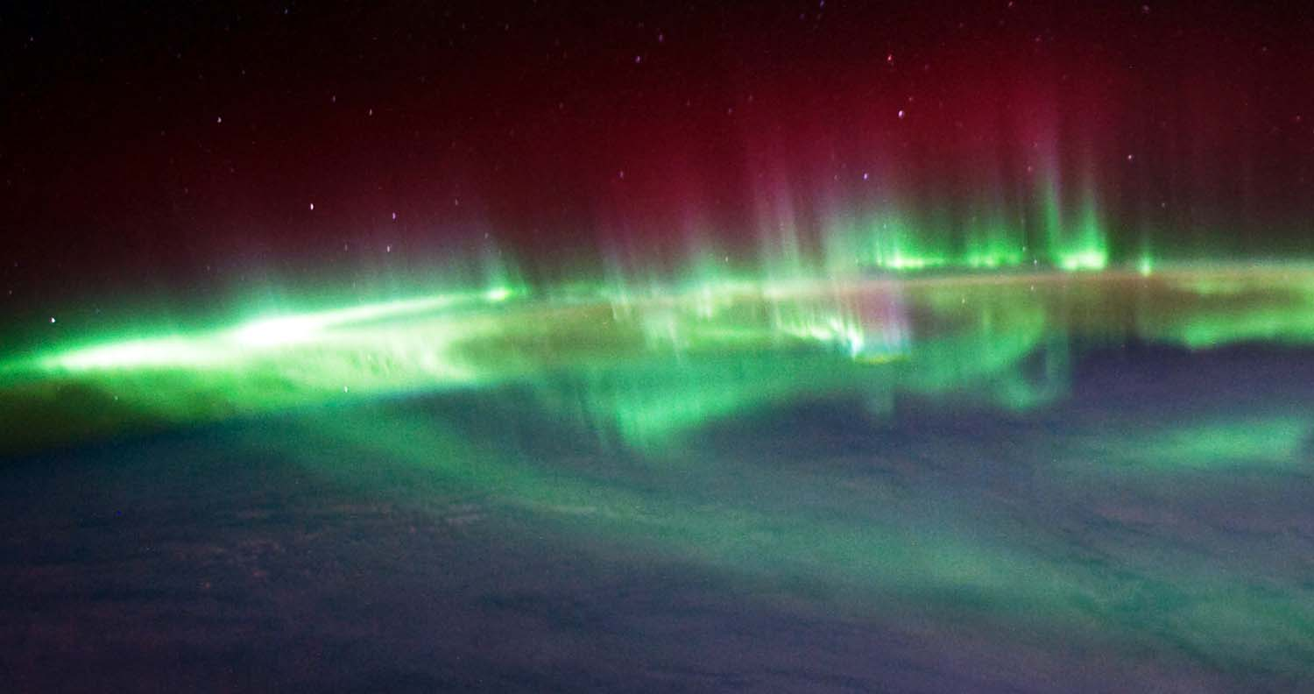
Aurora from space from the side…
Astronaut photograph

Slide 53
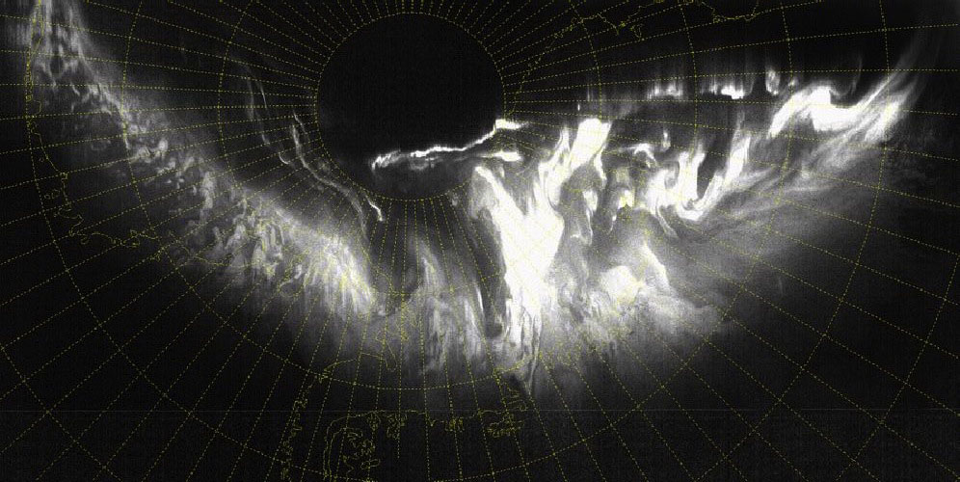
Aurora from satellite looking down…

Slide 54
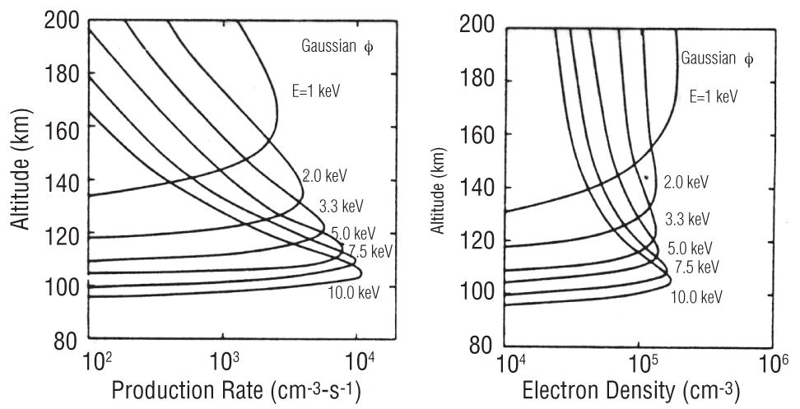
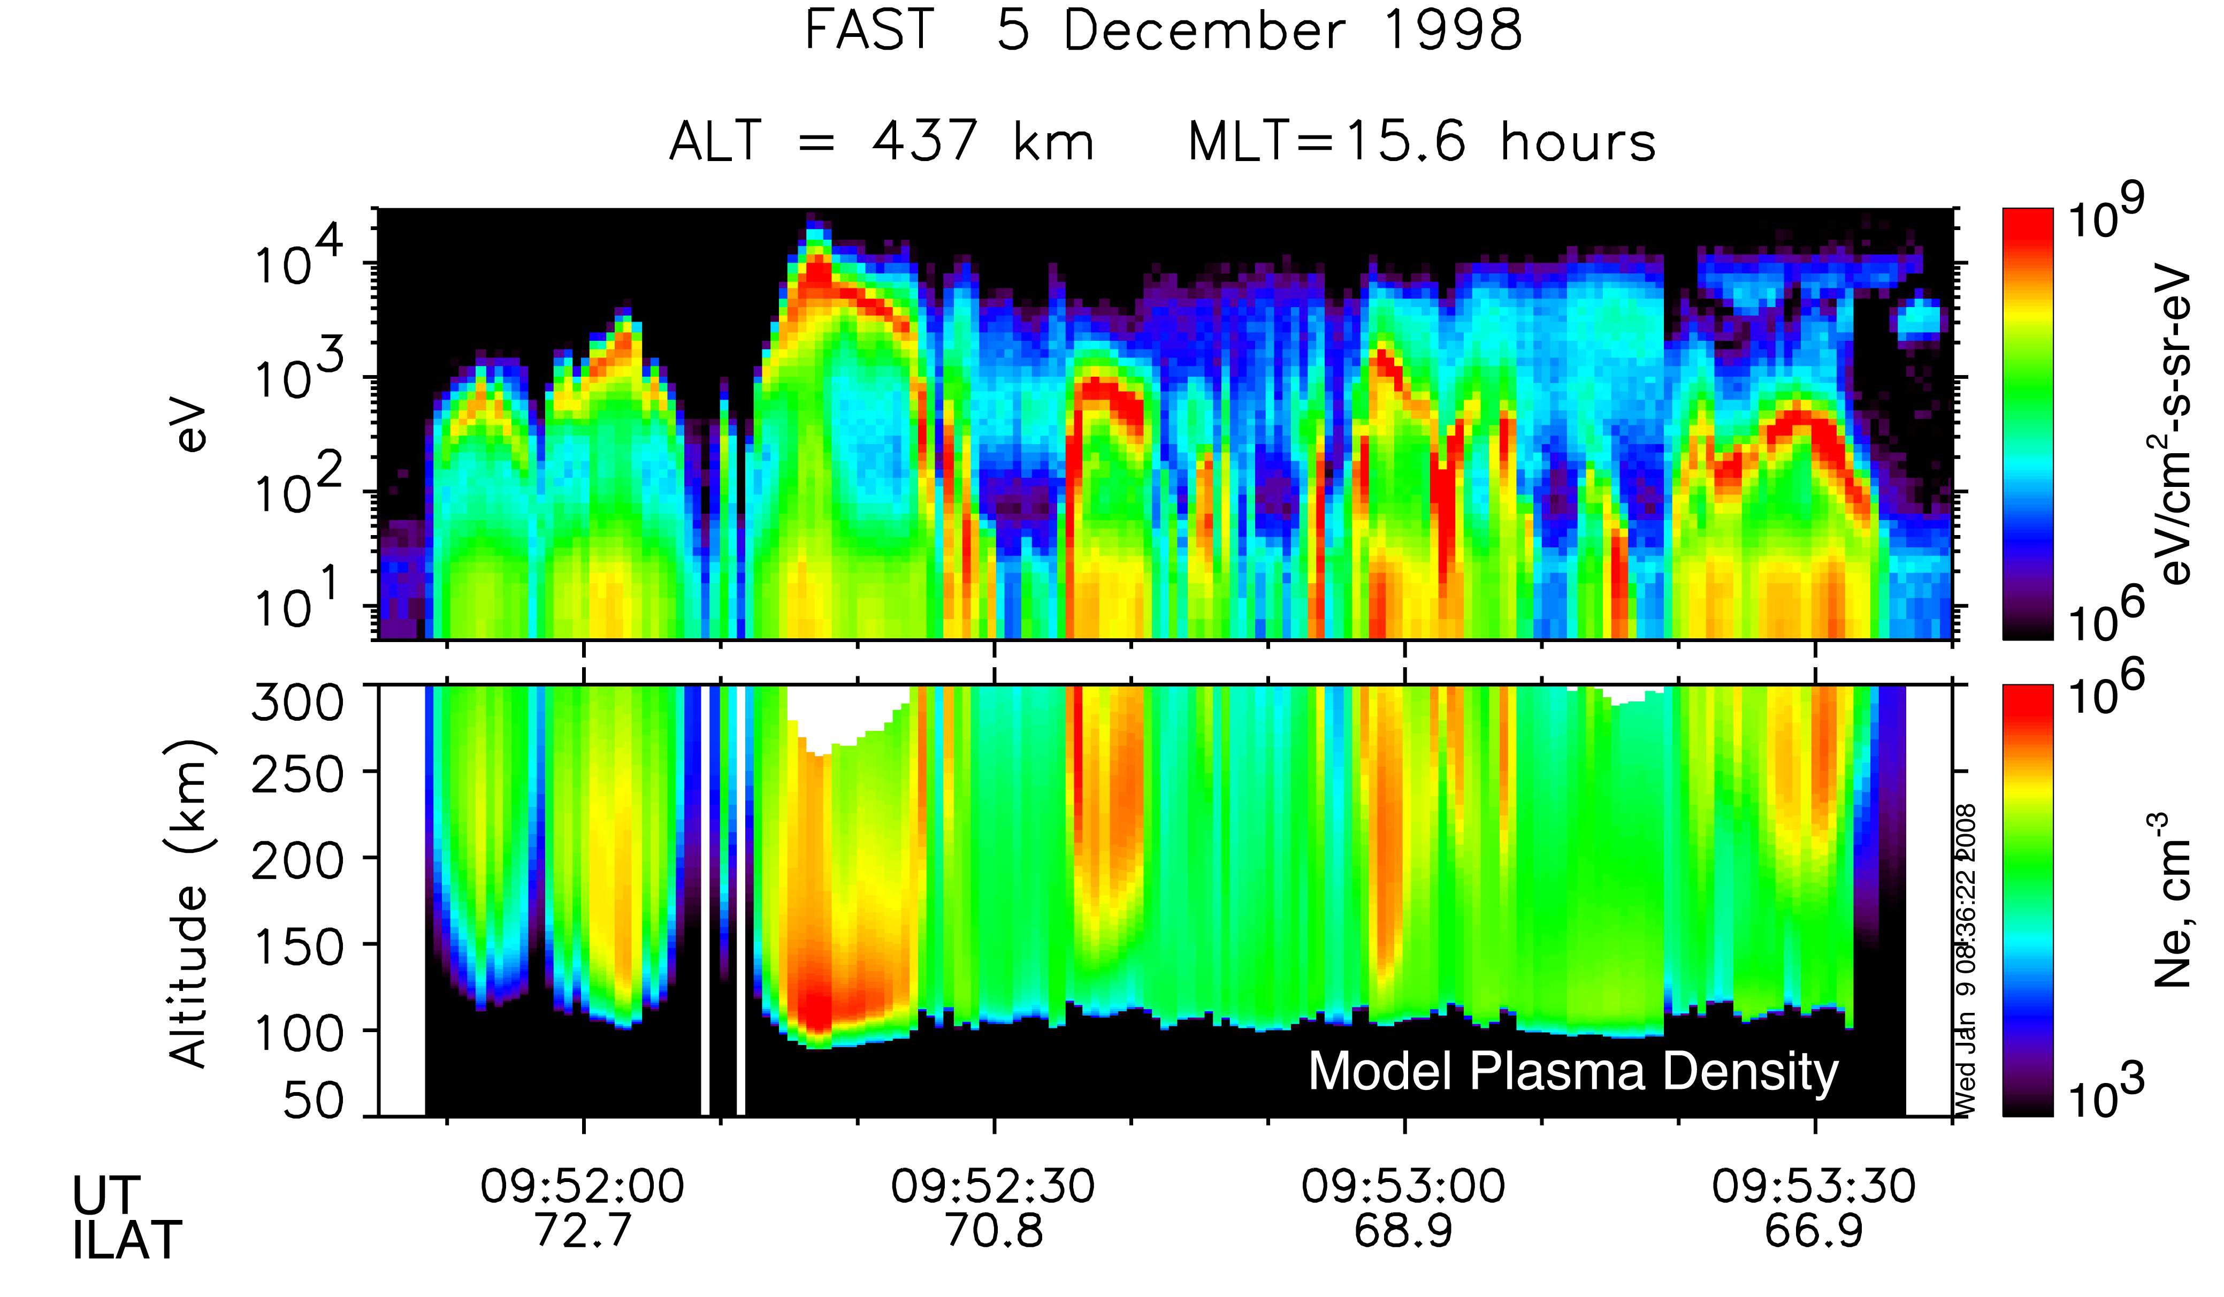
Energetic auroral electrons are “braked” by the upper atmosphere, create thermal plasma
Strickland et al., [1983]
Pfaff [2012]

Slide 55
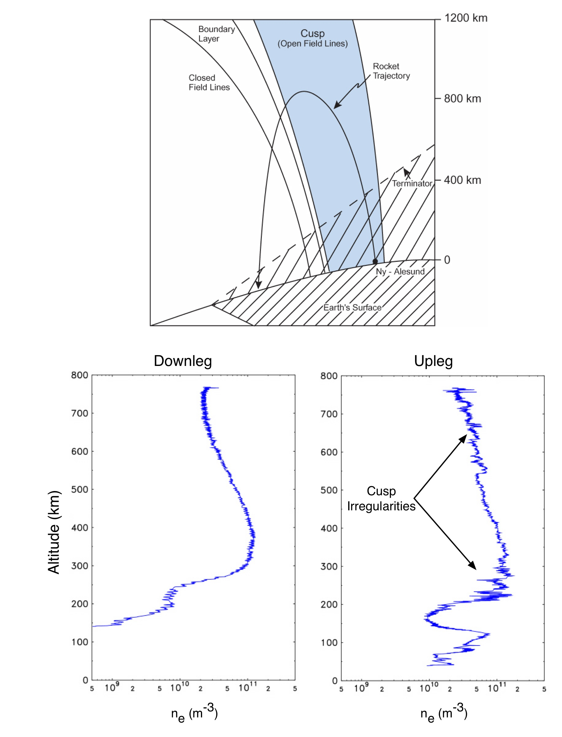
Ionosphere at high latitudes is replete with density irregularities (causing scintillations) as shown here measured with rocket probes in the cusp…

Slide 56
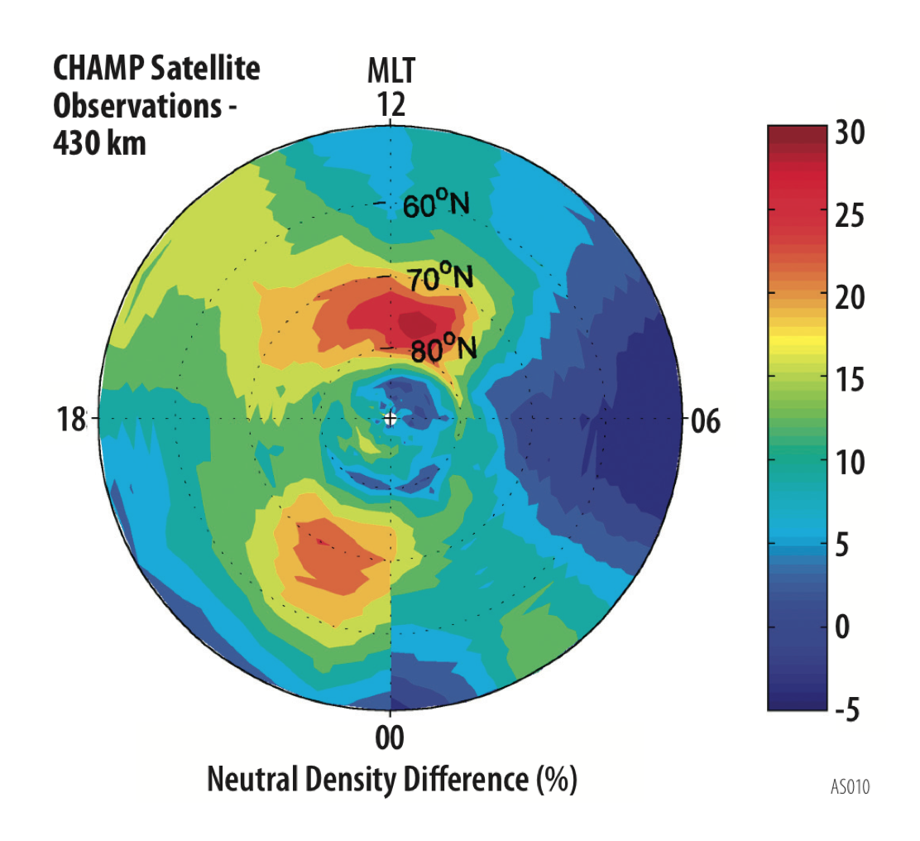
High Latitude Upper Atmosphere shows strong neutral density variations associated with the cusp, aurora…
%
[Luhr et al., 2004]
Neutral density variations at high latitudes are poorly understood -- Thermospheric Upwelling? Driven by Joule Heating?
Notes:
All instruments high time resolution (1 s/sec is nominal or 8 km spatial scale.)

Slide 57



Magnetospheric electric fields drive plasma which drives winds
CTIPe
200 km
Neutral
Winds
Ion Drifts
Killeen et al., 1984

Slide 58

  Field aligned currents, electric fields, conductivity combine to create Geomagnetically Induced Currents (GIC)

Slide 59
Electrical Currents in the Ionosphere
Key Space Weather variable
• Induces Currents in the ground
• Affects power systems and grids
(See Talk by Antti Pulliken!)

Slide 60
When solar activity becomes strong…
Magnetic “Storms” result that profoundly effect the entire (global!) upper atmosphere and ionosphere in ways we do not understand

Slide 61

Earth’s Upper Atmosphere is thrust into motion by the magnetosphere!
See in particular
In particular, notice effects of Geomagnetic Storms!
[Killeen and Roble, 1988]
Notes:
What is the global neutral circulation pattern and how does it change in response to magnetospheric forcing?
What are the coupling time constants and how do they depend on thermosphere and ionosphere state and past forcing?
What is the contribution of small and medium scale, and short-lived (minutes to hour) energy inputs to the total energy budget?
What are the feedback mechanisms (modified conductivity, neutral flywheel, etc.) that feed back to the magnetosphere?

Slide 62

Heating due to particles, electric fields can be intense during storms
[Richmond and Lu, 2000]

Slide 63

Winds at high latitudes driven by magnetospheric electric fields keep going to middle and low latitudes!

Slide 64

Upper atmosphere composition greatly altered during storms
from Sigwarth and Kozyra

Slide 65

During magnetic storms, the low latitude ionosphere often rises above 840 km (as shown by DMSP satellites)
Ionospheric plasma is greatly affected by magnetic storms
Ionosphere “disappears” at low latitudes
Why? Penetration Electric fields?
What happens at other local times?
What about the upper atmosphere?
4 consecutive DMSP passes
(100 minutes apart) near 21:30 L.T. show ionosphere rising above 840 km during magnetic storm
[Greenspan et al., 1991]
Notes:
Same instruments observe at mid and low latitudes
Chose to highlight storm effects (mention ITSP)
Also, need to know what’s going during quiet times! Neutral wind and ion drift patterns

Slide 66


Ionospheric plasma is greatly affected by magnetic storms;
Here GPS shows strong increases in TEC, “structure”
Courtesy, A. Coster
Mannucci et al., 2005

Slide 67

The ionosphere/upper atmosphere is highly complex, dynamic, and variable, and is strongly coupled the magnetosphere above and the troposphere below.
Studying this region, rich with fascinating physics and important, undiscovered processes, is among the most rewarding fields of space research

Slide 68
Ionosphere/Upper Atmosphere -- Key Space Weather Processes
1) Absorption of solar EUV radiation by the upper atmosphere — protects life on Earth
2) Ionospheric Density -- affects radiowave propagation
3) Ionospheric scintillations associated with ionospheric gradients and plasma depletions — affects communications, navigation (e.g., GPS), radar, etc.
4) Neutral density and its variations, gradients — affects orbital drag and spacecraft attitude, affects meteoroids and other debris, “brakes” energetic particles
5) Atomic oxygen in upper atmosphere — erodes coatings, adversely effects satellites
6) Energy inputs at high latitudes (electric fields, Joule heating, particle precipitation, etc.) — moves plasma, drives winds that propagate to low latitudes affecting ionosphere, affects composition
7) Upper atmosphere winds between 50 km to 600 km — moves ionosphere, sets up electric fields, affects composition, distribution of aerosols, volcanic and other explosion material, exhaust…
8) Geomagnetic induced currents (GIC) by high latitude magnetospheric coupling — affects power grids

