Slide 1
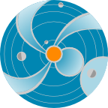
RT Modelling of CMEs Using WSA-ENLIL Cone Model
A. Taktakishvili
CCMC/SWRC
NASA Goddard Space Flight Center
Notes:
In this presentation we will make an introduction to the
WSA-ENLIL Cone model, used at SWRC to model propagation
of coronal mass ejections (CMEs) in the heliosphere.

Slide 2
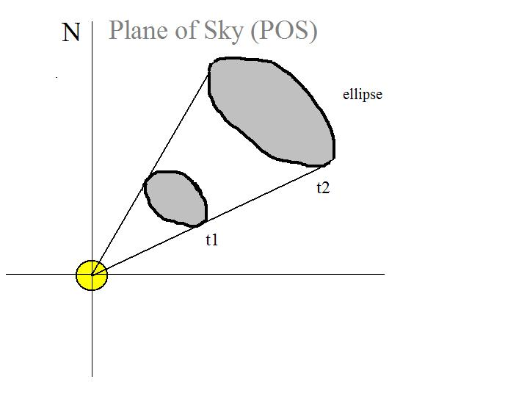
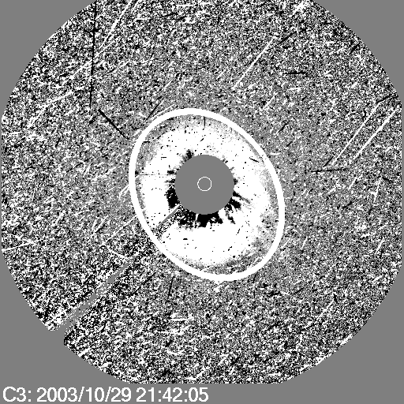
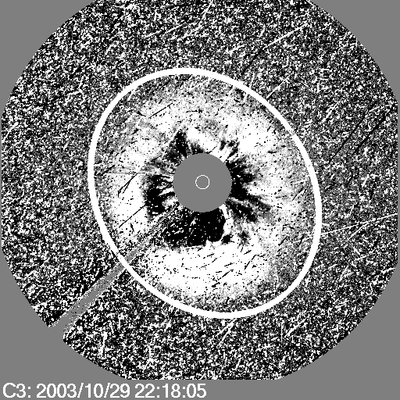
Cone Model for CMEs
Zhao et al, 2002, Cone Model:
The CME cone model is based on observational evidence that CME has more or less constant angular diameter in corona, being confined by the external magnetic field, so that CME does not expand in latitude in the lower corona, but expands in interplanetary space because of the weaker external field
CME propagates in a radial direction
CME bulk velocity is radial and the expansion is isotropic
The projection of the cone on
the POS is an ellipse
CME V and orientation
Input to WSA-ENLIL
Notes:
Zhao was the first to come up with the Cone model of CME. The CME
cone model is based on observational evidence that CME has more
or less constant angular diameter in corona, being confined by the
external magnetic field, so that CME does not expand in latitude in the lower
corona, but expands in interplanetary space because of the weaker
external field. The assumptions are the following:
CME propagates with nearly constant angular width in a radial direction
CME bulk velocity is radial and the expansion is isotropic

Slide 3
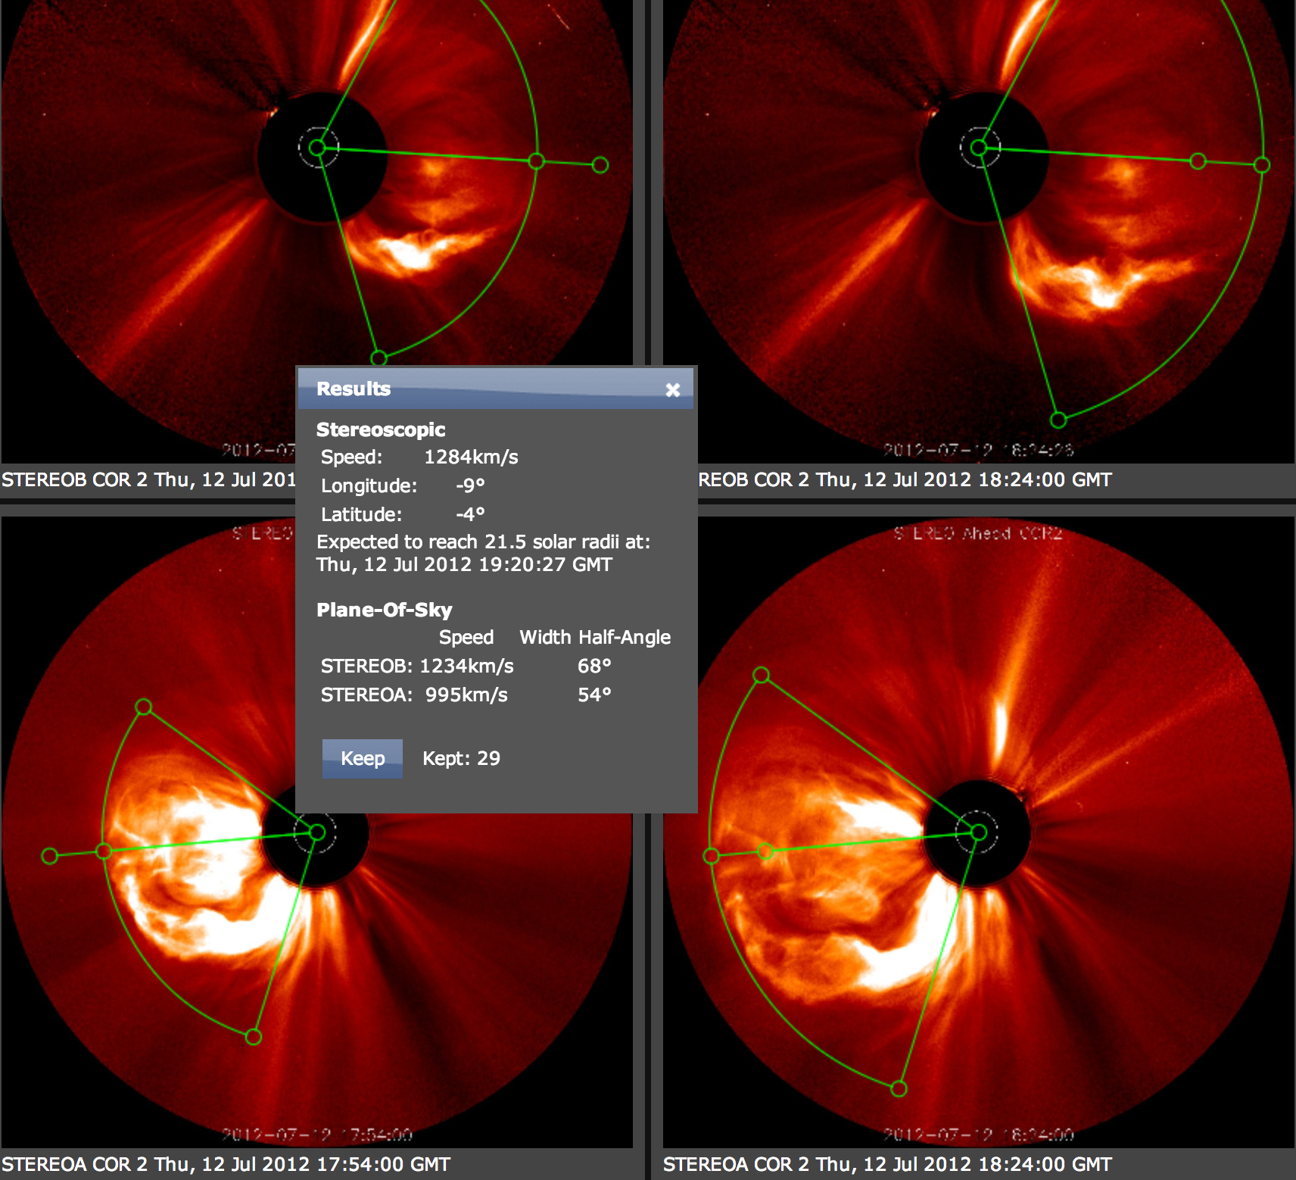
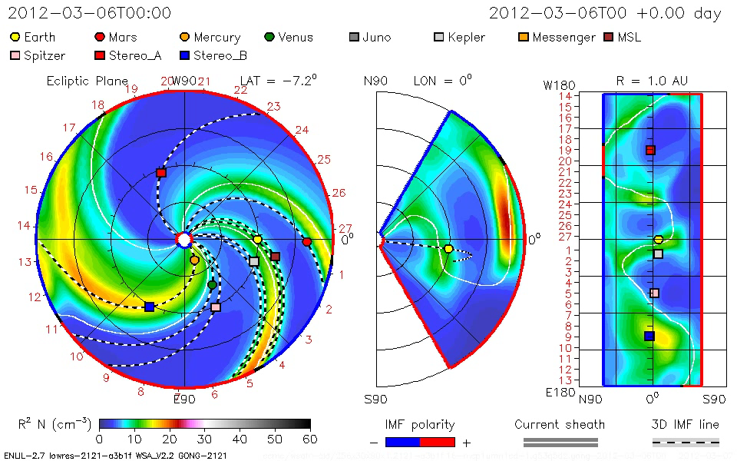
WSA-ENLIL Cone Model
Parameters Defined with CCMC CME Triangulation Tool
CME Parameters: Input To WSA-ENLIL Cone Model
Notes:
Parameters defined with CCMC CME Triangulation Tool
(CAT) or other tools are used as input CMEpParameters
to WSA-ENLIL Cone Model.

Slide 4
SWPC CME Analysis Tool

Slide 5
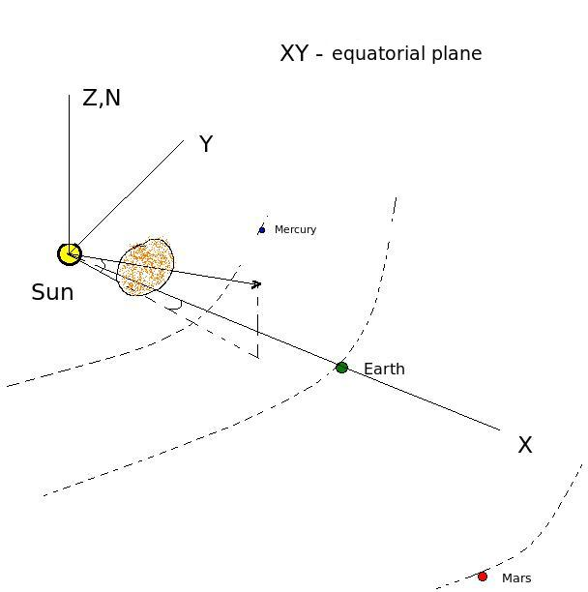
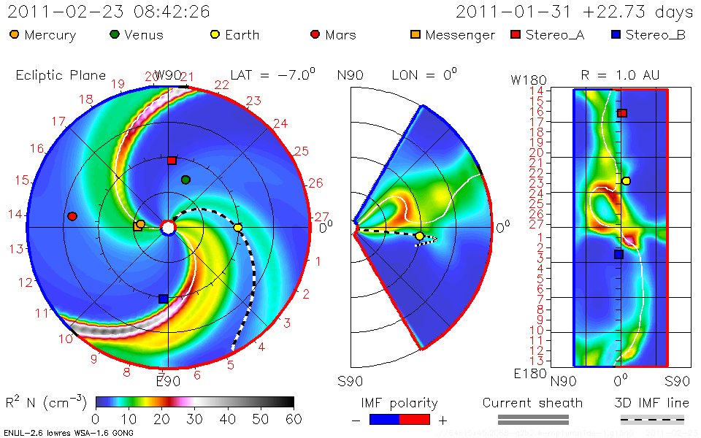
Sun, Planets, CME
Heliocentric Earth Equatorial Coordinates -
Heliographic
Constant
Latitude Plane
passing through
Earth
Meridional
Plane
1AU
quasi-
sphere
Notes:
This schematic shows CME in global perspective and explains coordinate system of the
WSA-ENLIL model.
XY is the equatorial plane (plane of the Sun equator). Z axis points to to
north pole of the Sun. Earth is located in the ecliptic plane, which forms
some variable angle with the equatorial plane (changes from -7.5 deg to 7.5 deg).
The first panel in WSA-ENLIL plot shows a plane passing through the
Earth and is parallel to equatorial plane. The second panel is a meridianal cut passing
through the Earth. The latitude goes from -60 to 60 degrees.
The third panel shows Longitude-Latitude map of a quasi sphere at 1 AU and with
The cut off for Latitude > |60 deg| .

Slide 6
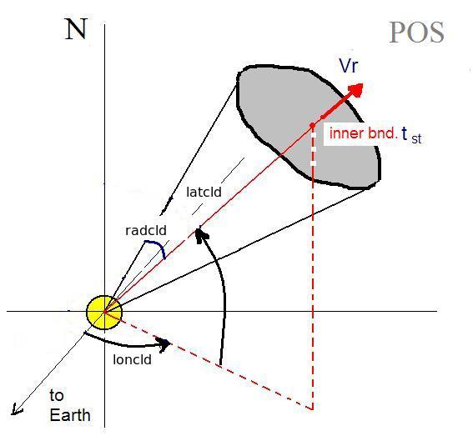
Cone model parameters
tstart - when cloud at 21.5Rs
Latitude
Longitude
Radius (angular width)‏
Vr - radial velocity
Input to ENLIL cone model run
Notes:
Parameters defined with CCMC CME Triangulation or other Tools yield CME
Parameters: Input To WSA-ENLIL Cone Model. These parameters are:
1- start time of CME at 21.5 Rs (inner boundary of the ENLIL model)
2- Cone axis latitude
3- Cone axis longitude
5- Cone Radius – half angle of the cone angular width
6- Radial Velocity

Slide 7
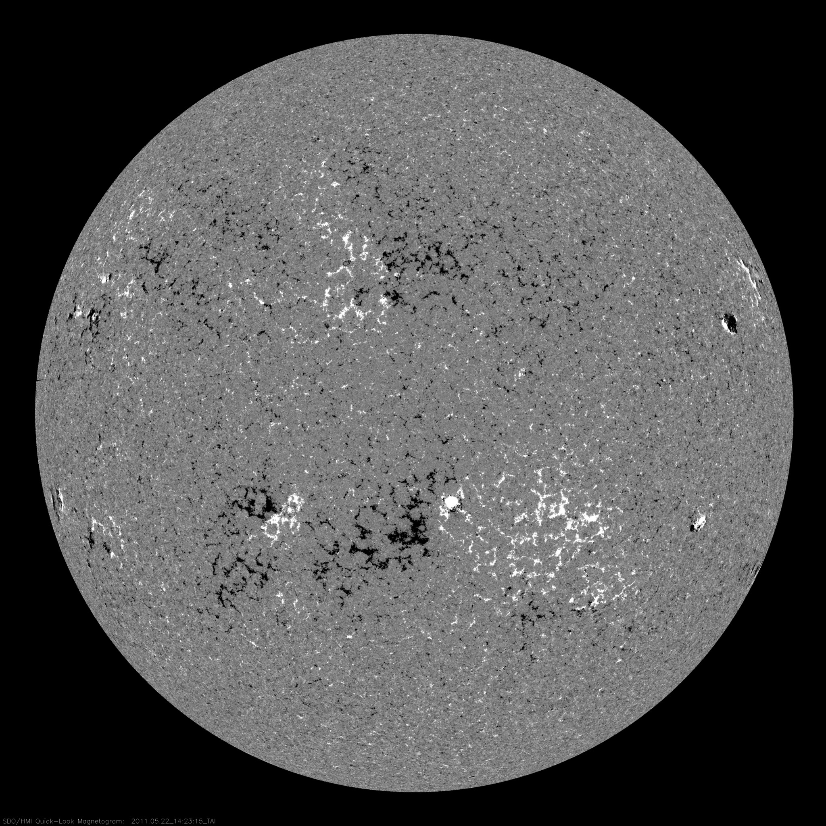
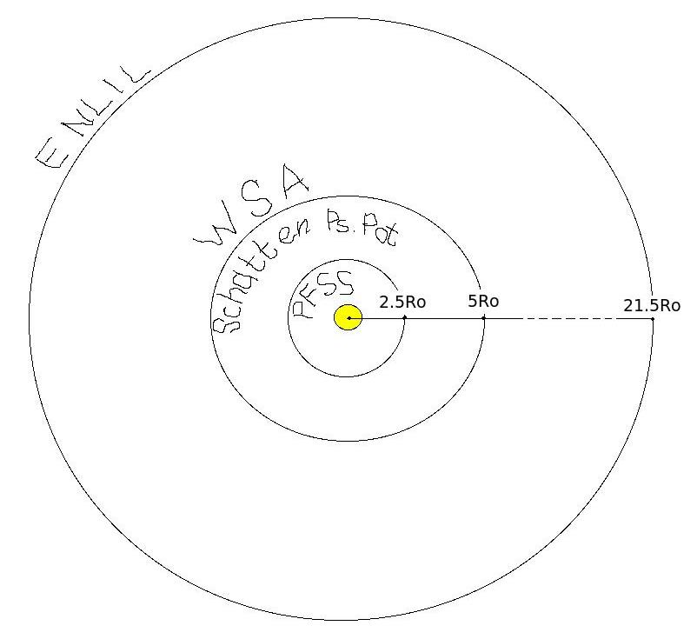
Wang Sheely Arge model (WSA)
- Input to ENLIL
PFSS (Potential Field Source Surface).
Input: synoptic map photospheric magnetogram.
Force free (even current free) solution with radial
field at 2.5 Ro.
Schatten Current Sheet.
Input: PFSS.
Modifies the sign of radial field to positive to
prevent reconnection, creates potential solution
with radial boundary conditions, restores the sign in
the new solution at 5 Ro.
Assuming radial constant speed flow at 5 Ro
uses empirical formula for speed, determined by the
rate of divergence of the magnetic field at 5 Ro and
proximity of the given field line to the coronal hole
boundary. WSA produces Br and Vr – input to ENLIL
Notes:
Wang-Sheeley-Arge model WSA (Wang-Sheeley-Arge, AFRL)
is the input model to the ENLIL at it’s inner boundary of 21.5Rs.
The input to the WSA is daily magnetograms of the solar surface,
that describe the magnetic field of the photosphere.
WSA model itself consists of different models
PFSS (Potential Field Source Surface).
Input: synoptic map photospheric magnetogram.
Force free (even current free) solution with radial
field at 2.5 Ro.
Schatten Current Sheet.
Input: PFSS.
Modifies the sign of radial field to positive to
prevent reconnection, creates potential solution
with radial boundary conditions, restores the sign in
the new solution at 5 Ro.
WSA.
Input: Schatten CS.
Assuming radial constant speed flow at 5 Ro uses
empirical formula for speed, determined by the
rate of divergence of the magnetic field at 5 Ro
and proximity of the given field line to the coronal
hole boundary.

Slide 8
ENLIL - Schematic Description
ENLIL – Sumerian God of Winds and Storms
Dusan Odstrcil, GMU & GSFC
Input: WSA (coronal maps of Br and Vr updated 4 times a day). For toroidal
components at the inner boundary- Parker spiral.
ENLIL’s inner radial boundary is located beyond the sonic point: the solar wind flow is
supersonic in ENLIL.
Computes a time evolution of the global solar wind for the inner heliosphere, driven by
corotating background structure and transient disturbances (CMEs) at it’s inner radial
boundary at 21.5 Ro.
Solves ideal fully ionized plasma MHD equations in
3D with two additional continuity equations: for
density of transient and polarity of the radial
component of B.
Notes:
ENLIL – Sumerian God of Winds and Storms
Dusan Odstrcil, GMU & GSFC
Input: WSA (coronal maps of Br and Vr updated 4
times a day). For toroidal components at the inner
boundary- Parker spiral.
ENLIL’s inner radial boundary is located beyond
the sonic point: the solar wind flow is supersonic in
ENLIL.
Computes a time evolution of the global solar
wind for the inner heliosphere, driven by corotating
background structure and transient disturbances
(CMEs) at it’s inner radial boundary at 21.5 Ro.
Solves ideal fully ionized plasma MHD equations in
3D with two additional continuity equations: for
density of transient and polarity of the radial
component of B.

Slide 9
ENLIL Schematic Description (cont.)
ENLIL model does not take into account the realistic
complex magnetic field structure of the CME magnetic
cloud and the CME as a plasma cloud has a uniform
velocity.
It is assumed that the CME density is 4 times larger than the ambient fast solar wind density, the temperature is the same. Thus, the CME has about four times larger pressure than the ambient fast wind. Launching of an over pressured plasma cloud at 21.5 Rs, roughly represents CME eruption scenario
Output:
3D distribution of the SW parameters at
spacecraft and planets and topology of IMF.
Notes:
Limitation of the ENLIL model:
It does not take into account the realistic complex magnetic field structure
of the CME magnetic cloud and the CME as a plasma cloud has a uniform velocity.
It is assumed that the CME density is 4 times larger than the ambient fast solar wind
density, the temperature is the same. Thus, the CME has about four times larger
pressure than the ambient fast wind. Launching of an over pressured plasma cloud
at 21.5 Rs, roughly represents CME eruption scenario
Output:
3D distribution of the SW parameters at
spacecrafts and planets and topology of IMF.

Slide 10
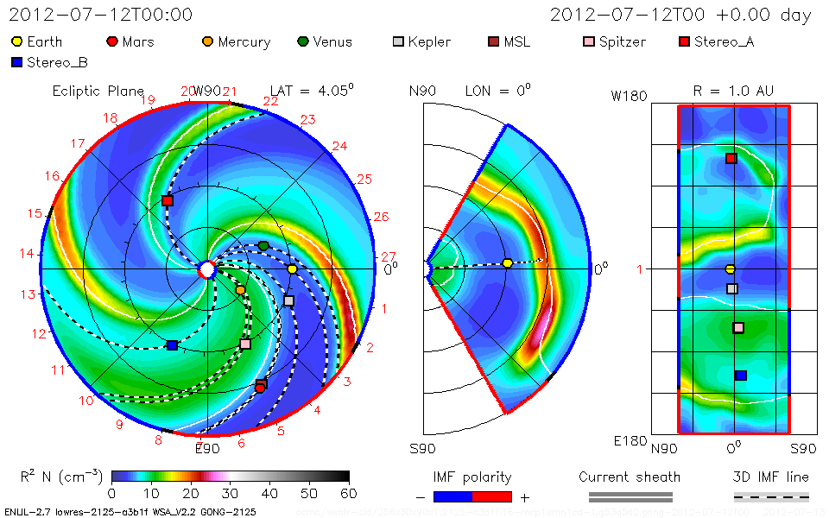
CME modeling
Notes:
After we define the CME parameters we run the WSA-ENLIL cone model.

Slide 11
CME Impact – arrival, duration,
MP standoff distance
CME shock arrival –
a sharp jump in the dynamic pressure
Duration of the disturbance – duration
of the dynamic
pressure hump
Magnetic field
required
to stop SW
Magnetopause standoff distance
Notes:
After the run is done, we estimate the CME impact on planets, satellites.
CME shock arrival – a sharp jump in the dynamic pressure.
2. Duration of the disturbance – duration of the dynamic pressure hump.
3. In case of the Earth we estimate also the degree of compressing of the
magnetosphere: when the CME mass reaches the magnetosphere it
pushes it inward and the magnetic field of the Earth is stressed like
a spring to stop the CME motion.

Slide 12
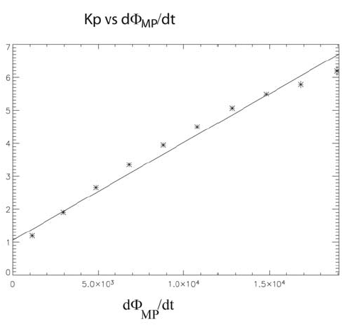
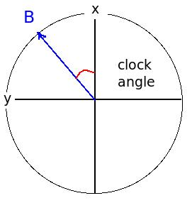
Kp Index – P. Newel’s Empirical Expression
Magnetic flux opening
rate at the magnetopause
Z
Notes:
In case of the Earth we estimate also the Kp index – a measure of the disturbance of the magnetosphere.
We use Pat Newel’s empirical formula for the Magnetic flux opening
rate at the magnetopause for that and an empirical relation between
Kp and d(Phi)/dt.

Slide 13
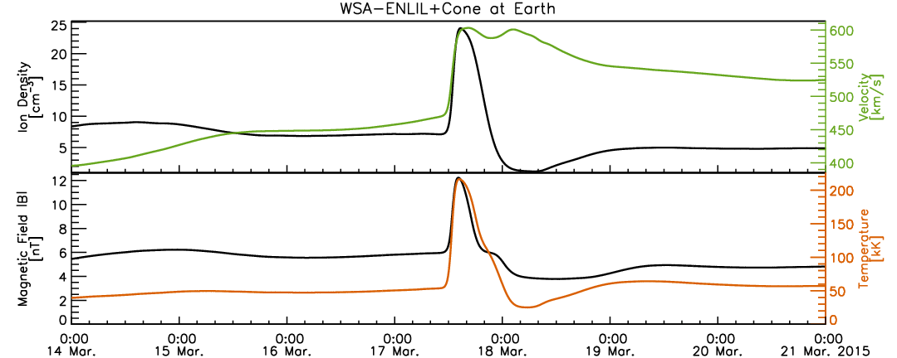
Determination of the
CME Arrival Time – clear arrival
Notes:
But we are not monitoring only Earth impact. Being responsible for
providing space weather assessment to NASA robotic mission operators,
we are monitoring possible impact of the CME on NASA missions.
So we send out another e-mail, that shows this estimate.

Slide 14
Determination of the CME Arrival Time from Timelines and Movies
Notes:
But we are not monitoring only Earth impact. Being responsible for
providing space weather assessment to NASA robotic mission operators,
we are monitoring possible impact of the CME on NASA missions.
So we send out another e-mail, that shows this estimate.

Slide 15
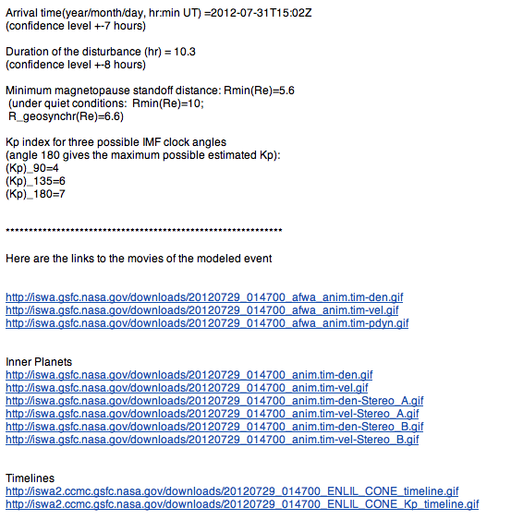
e-mail with CME impact
estimate at Earth
Notes:
And here is our response e-mail the them in details.
It contains the CME impact estimate for the Earth
(arrival time, magnetopause standoff distance,
Kp estimate for three possible clock angles of the IMF),
and links to the modeling animation and timelines.

Slide 16
e-mail for NASA missions
Notes:
But we are not monitoring only Earth impact. Being responsible for
providing space weather assessment to NASA robotic mission operators,
we are monitoring possible impact of the CME on NASA missions.
So we send out another e-mail, that shows this estimate.

Slide 17
Part 2:
RT Ensemble Modelling of CMEs Using WSA-ENLIL Cone Model
Notes:
In this presentation we will make an introduction to the
WSA-ENLIL Cone model, used at SWRC to model propagation
of coronal mass ejections (CMEs) in the heliosphere.

Slide 18
Ensemble Modeling
Ensemble modeling is used in weather forecasting to quantify prediction uncertainties and determine forecast confidence
Individual forecasts which constitute an ensemble forecast represent possible scenarios which reflects forecasting uncertainties.
Uncertainties can be from initial conditions, observation error, and techniques and models.
Different forecasts in the ensemble can start from different initial conditions and/or be based on different forecasting models/procedures.
Ensemble modeling conveys the level of uncertainty in a given forecast in contrast to a categorical yes/no forecast

Slide 19
Ensemble Modeling with WSA-ENLIL+Cone
The current version of real-time ensemble modeling at the CCMC/SWRC evaluates the sensitivity of CME arrival time predictions from the model to initial CME parameters.
Measure a set of n CME input parameters. Typically n=36 to 48 provides an adequate spread of input parameters, and this number can be increased as needed.
These are used as input to an ensemble of n WSA-ENLIL+Cone model runs.
This gives an ensemble of n profiles of MHD quantities and n CME arrival time predictions at locations of interest.

Slide 20
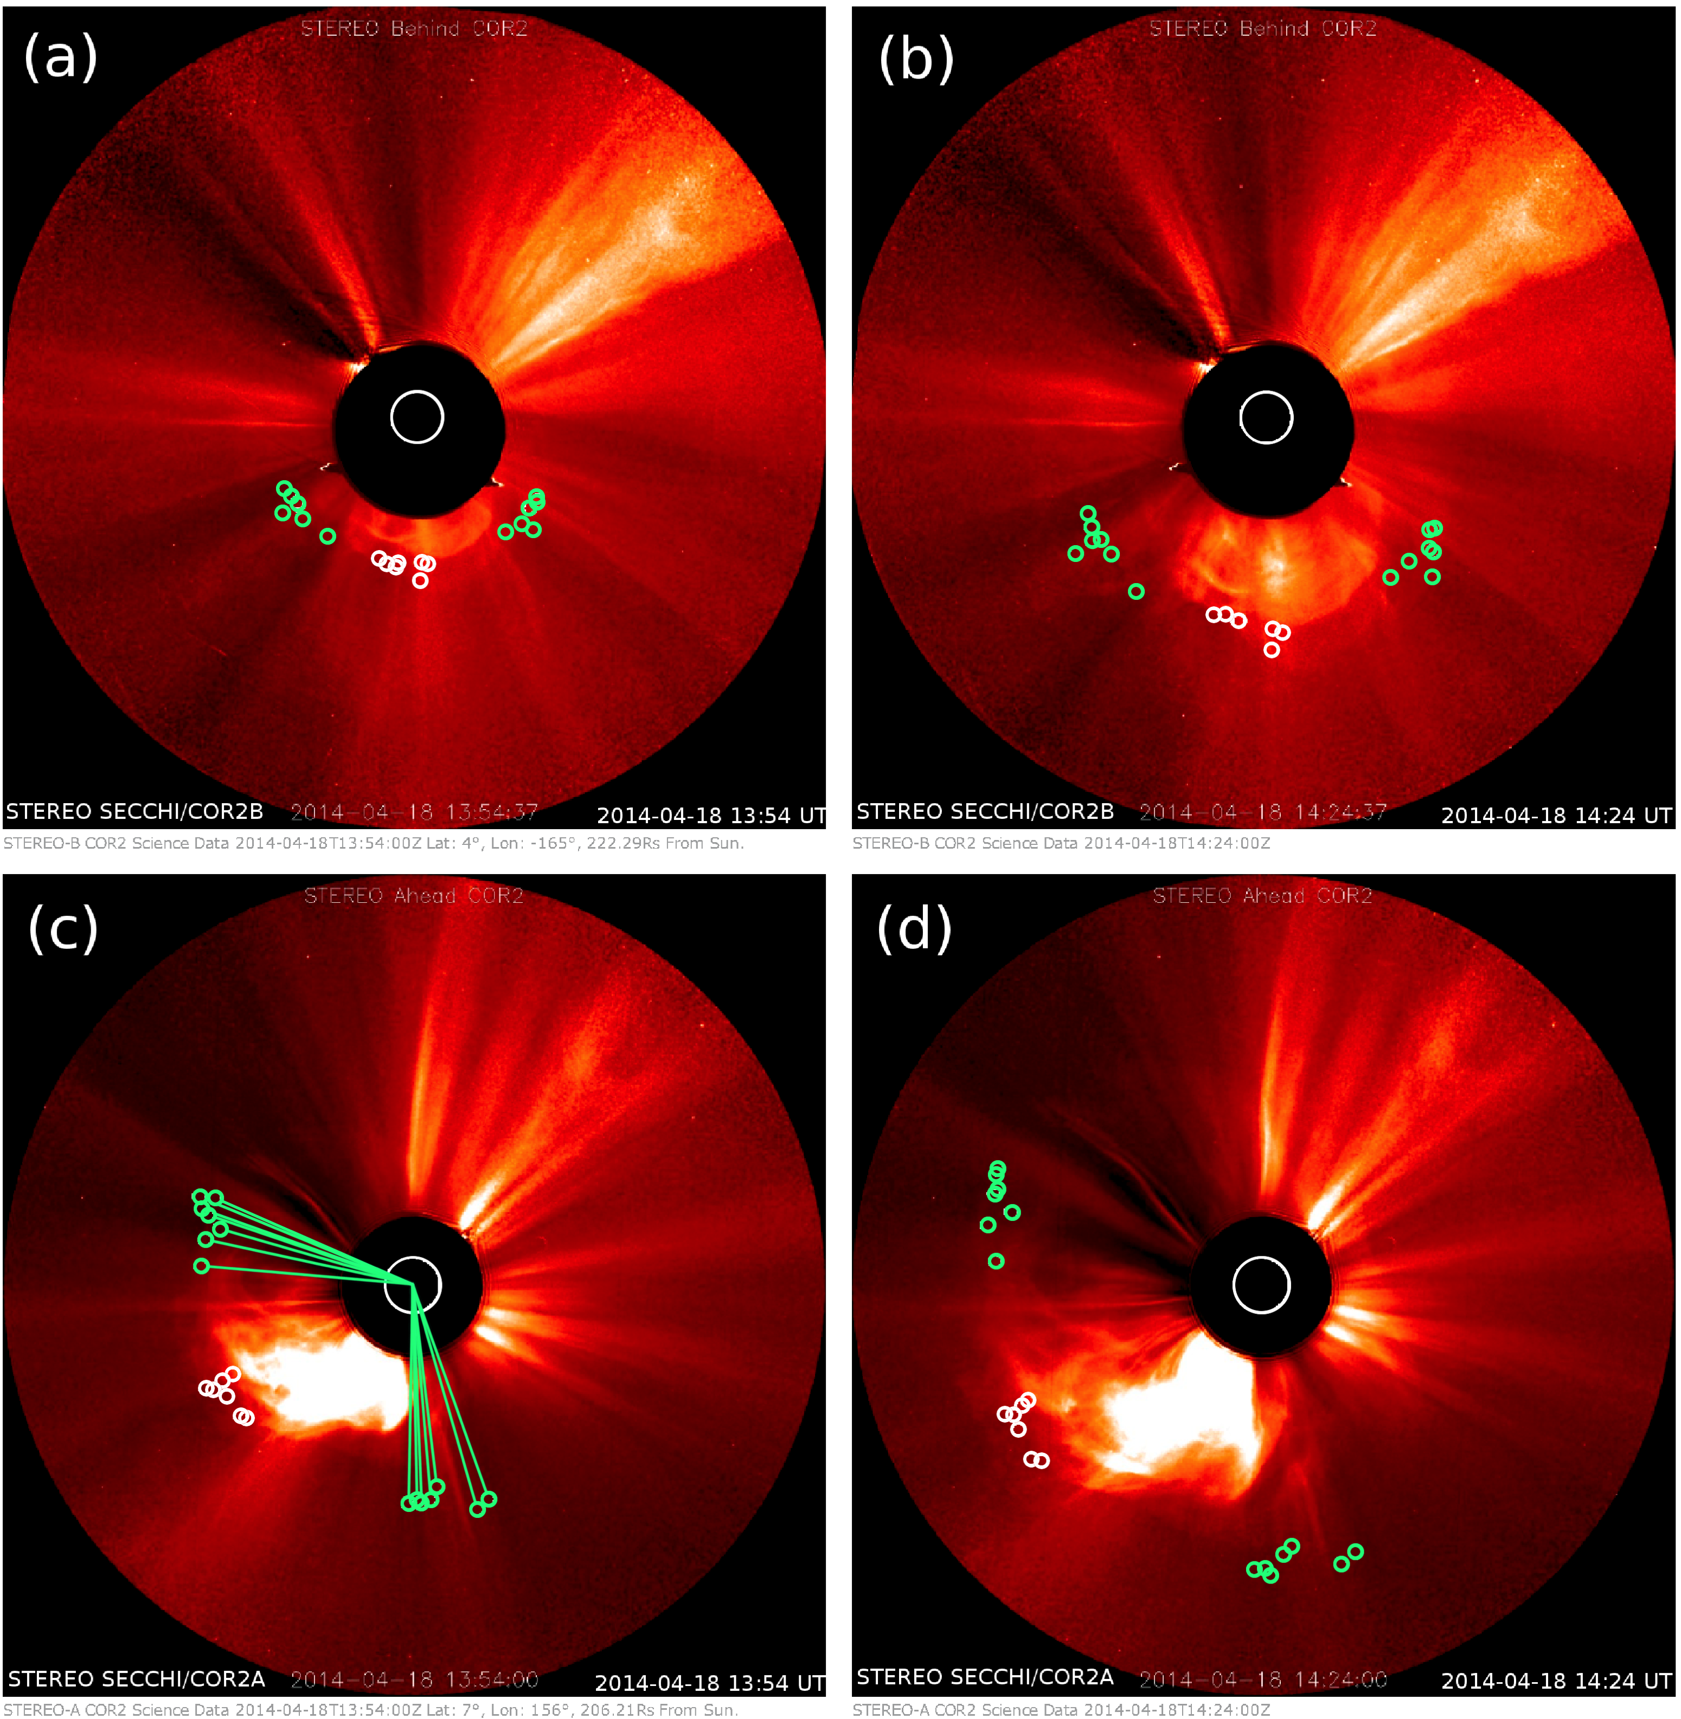
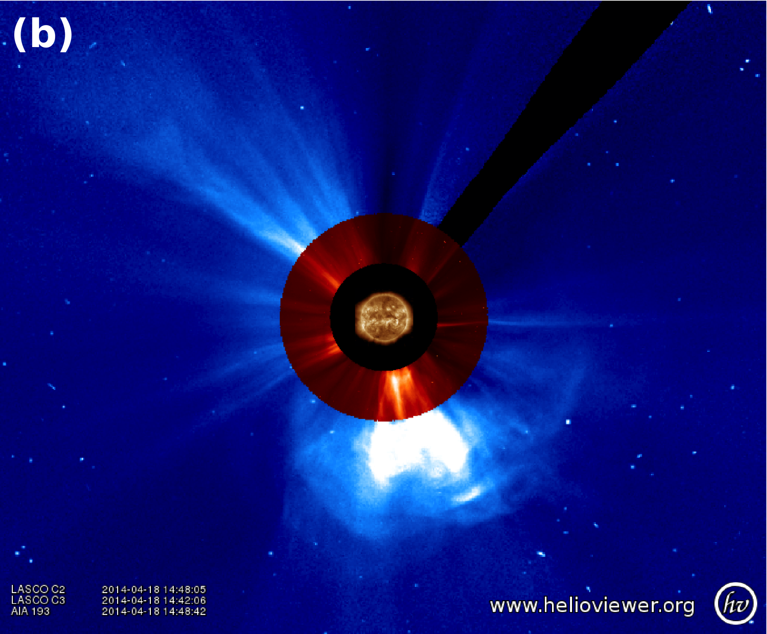
Example ensemble simulation: 18 April 2014 CME
Halo CME associated with M7.3 flare, coronal wave visible south of the AR
Ensemble of input CME parameters obtained by measuring the same feature using StereoCAT, which employs geometric triangulation techniques.
Notes:
Earth-directed partial halo CME that was first observed at 13:09 UT on 18 April 2014 by by SECCHI/COR2A. This CME was associated with an M7.3 class solar flare from Active Region 12036 located at S18°W29° with peak at 13:03 UT.
Eruption and a coronal wave were visible south of the AR in SDO/AIA 193 Å and a nearby filament eruption was visible in AIA 304Å.
Subsequently starting at 13:35 UT, an increase in solar energetic particle proton flux above 0.1 pfu/MeV observed by GOES Earth orbit.
Ensemble of input CME parameters obtained by measuring the same feature using StereoCAT which employs geometric triangulation techniques. The circles indicate the 6 individual leading edge (white circles near the center of the CME front) and width measurements (green circles marking the CME edges). The leading edge measurements (central circles) are later combined together to generate 6²=36 ensemble members.

Slide 21
18 April 2014 CME:
WSA-ENLIL+Cone modeled magnetic field, velocity, density, and temperature profiles at Earth for 36 ensemble.
Clear ICME arrival with enhanced post-shock temperatures, enhanced magnetic field with rotations in direction, and declining solar wind speed.
Notes:
18 April 2014 CME:
WSA-ENLIL+Cone modeled magnetic field, velocity, density, and temperature profiles at Earth for 36 ensemble members (traces color coded by input speed), with the observed in-situ L1 observations from ACE (black, red for Bz).
Observations show clear signatures of the arrival of an ICME, including a leading shock (abrupt increase in all the solar wind parameters at around 10:20 UT) with enhanced post-shock temperatures, enhanced magnetic field with rotations in direction, and declining solar wind speed.

Slide 22
18 April 2014 CME: Histogram distribution
of arrival time predictions at Earth
-5.2 hours prediction error for average predicted CME arrival
Notes:
Shows a normal distribution with 50% of the predicted arrivals within one hour of the mean.
The prediction error Δt_{error}=t_{predicted}-t_{observed} for the mean predicted CME arrival time was -5.2 hours and the observed arrival time was just within the ensemble predicted spread.

