Slide 1
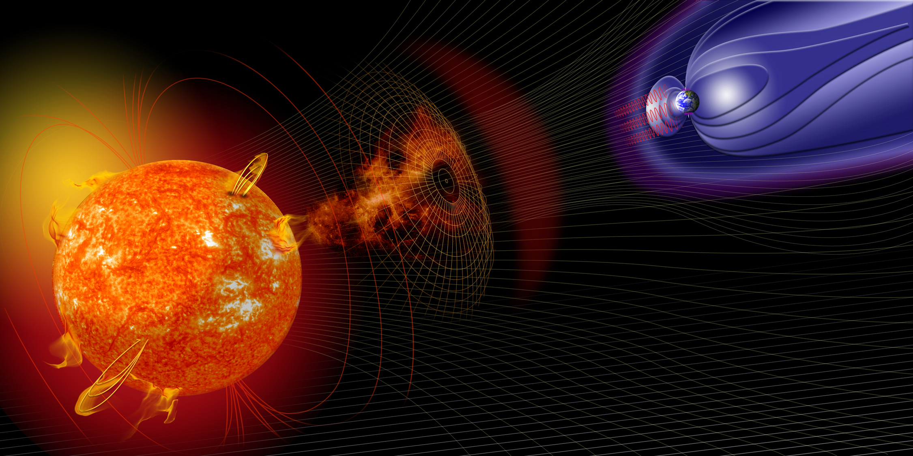
Solar Energetic Particles (SEPs)
Barbara J. Thompson
Goals: identify SEPs in data, connect to drivers, identify characteristics of SEPs
Acknowledgements: Rebekah Evans,
Leila Mays, Yihua Zheng
June 7, 2016 SW REDI Boot Camp
Notes:
LOOK FOR AN SVS MOVIE!

Slide 2
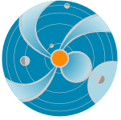
SEPs: What are they?
Definition:
Energetic charged particles (such as electrons protons and other heavy ions) traveling much faster than ambient particles in the space plasma, at a fraction of the speed of light (relativistic!).
They can travel from the Sun to the Earth in one hour or less!
The term “SEP” usually refers to protons.
Notes:
An SEP event is an enhancement in the radiation evironment.
Summarize effects again.

Slide 3


Slide 4
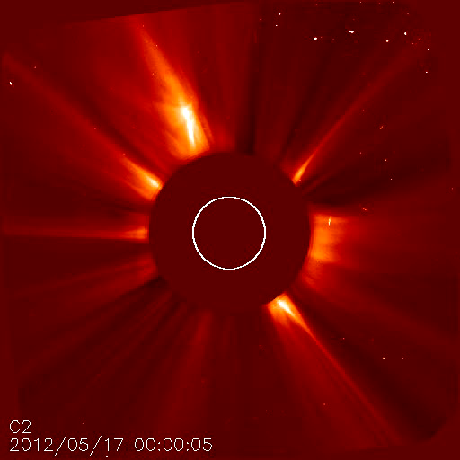
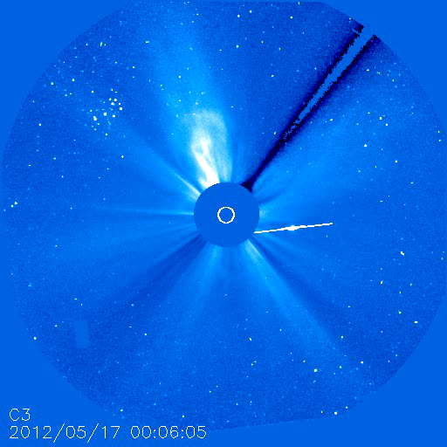
Let it snow³

Slide 5
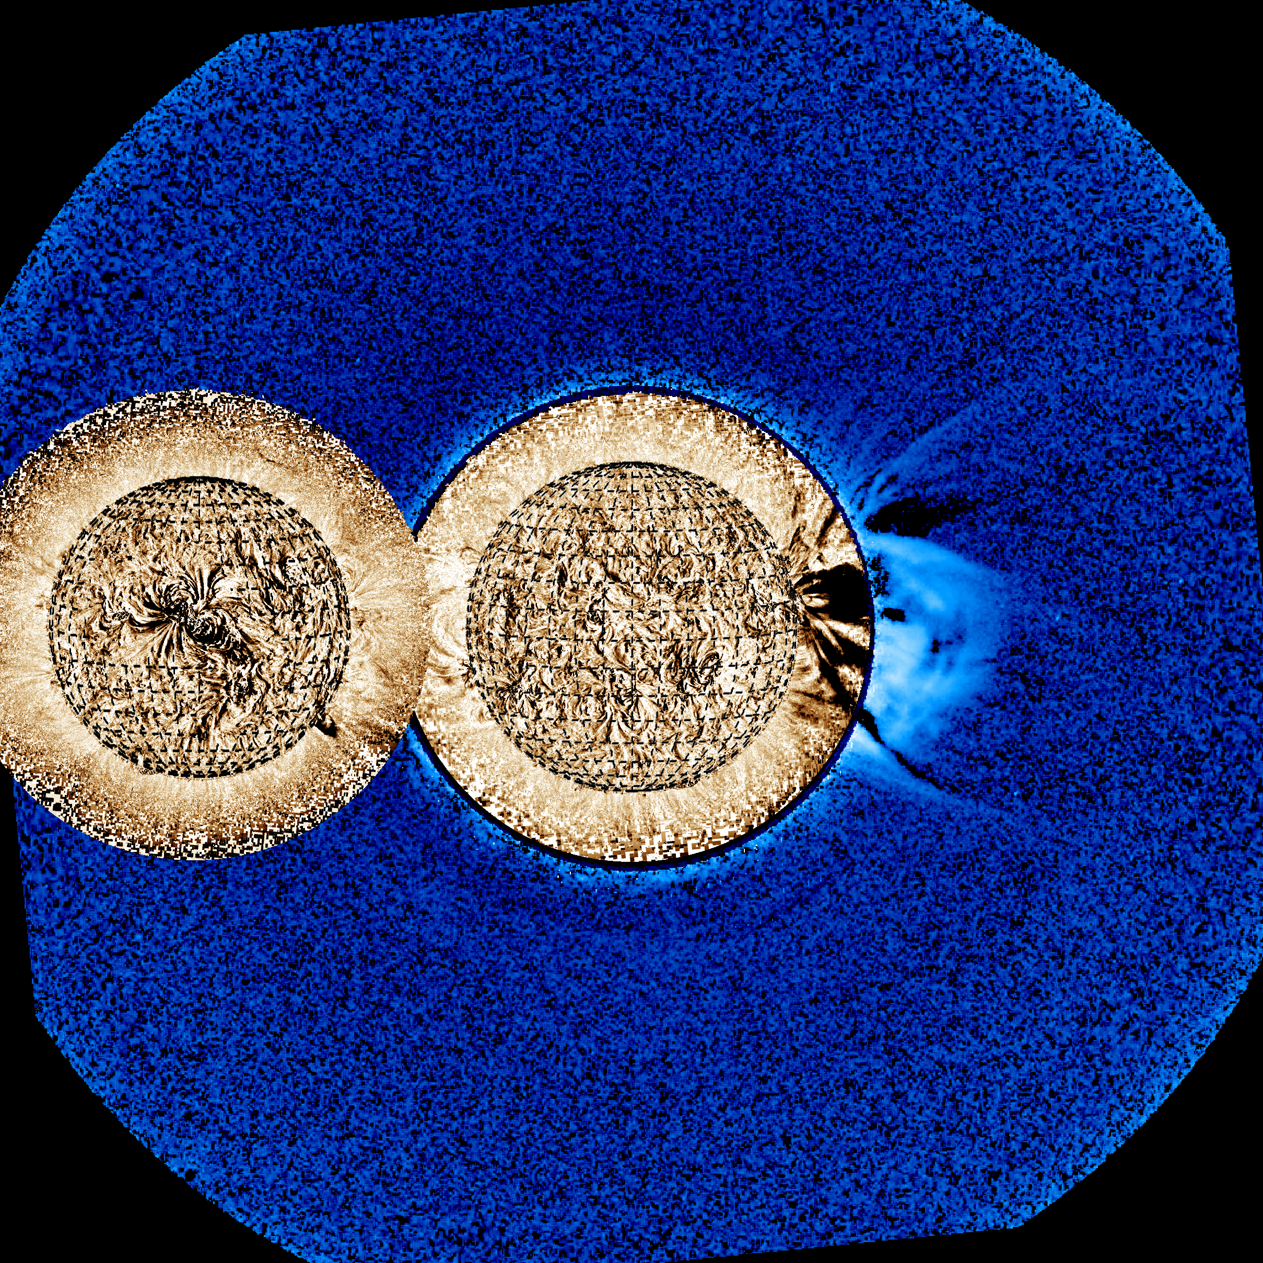
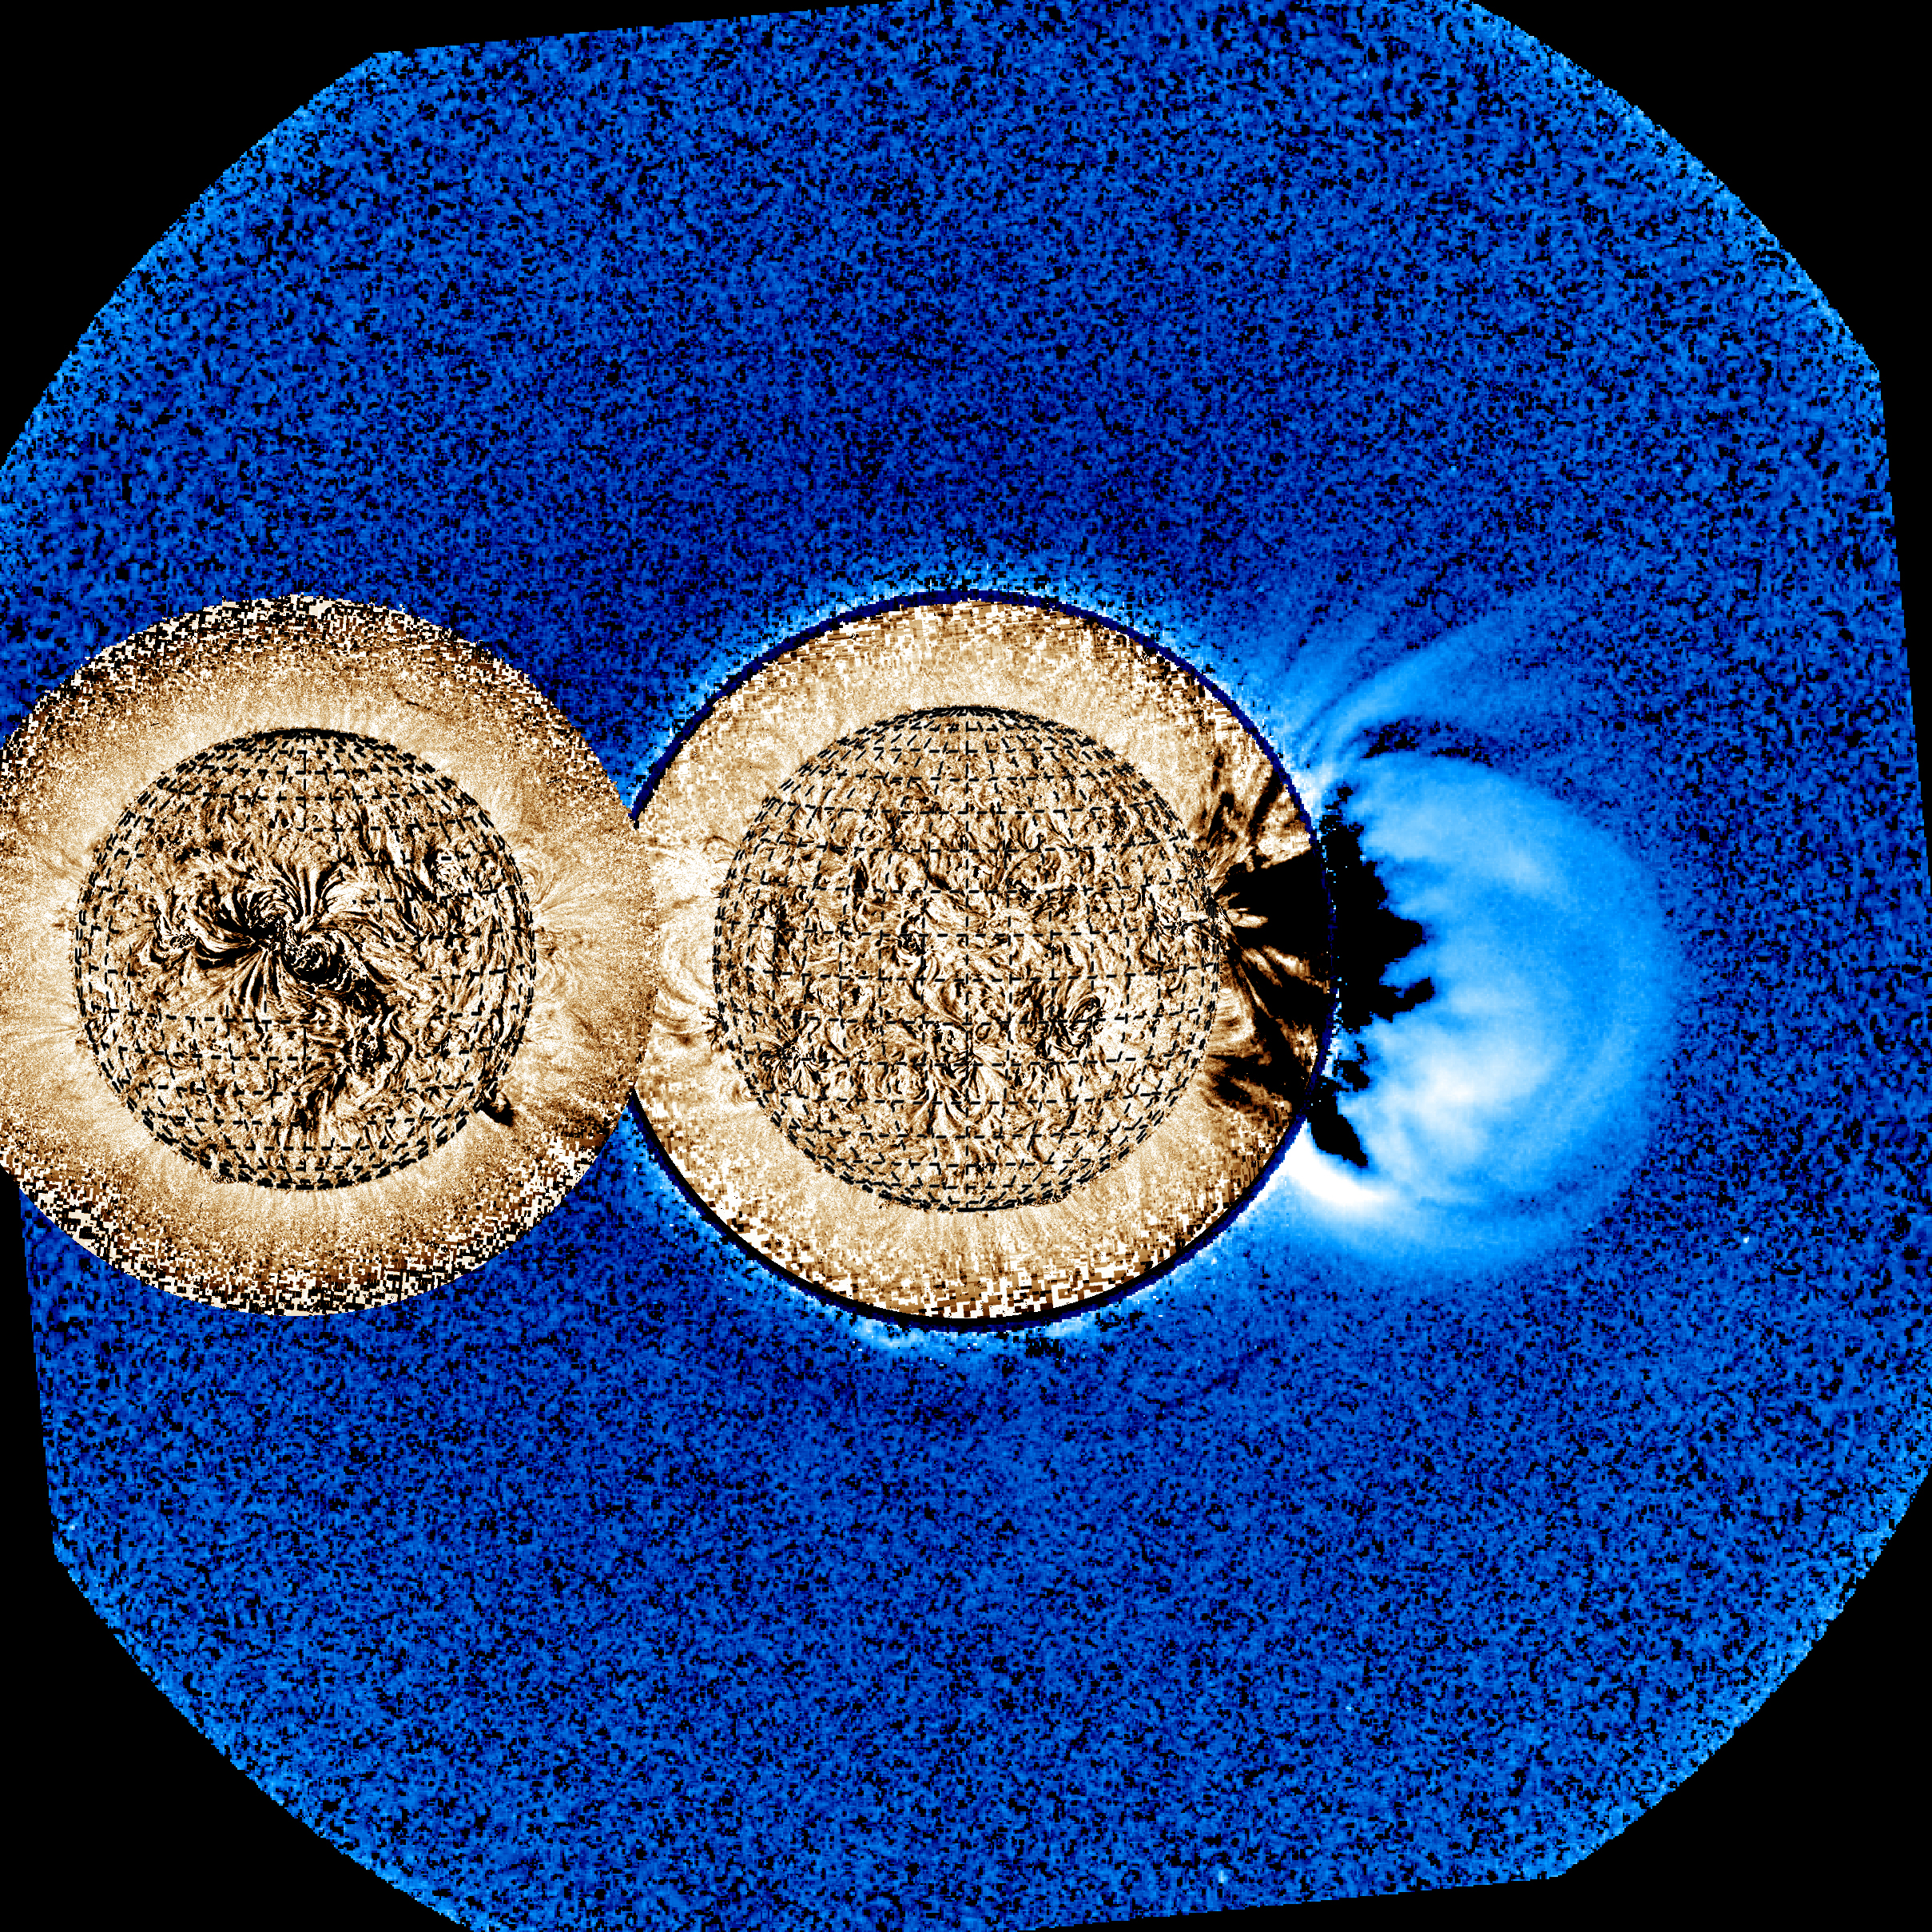
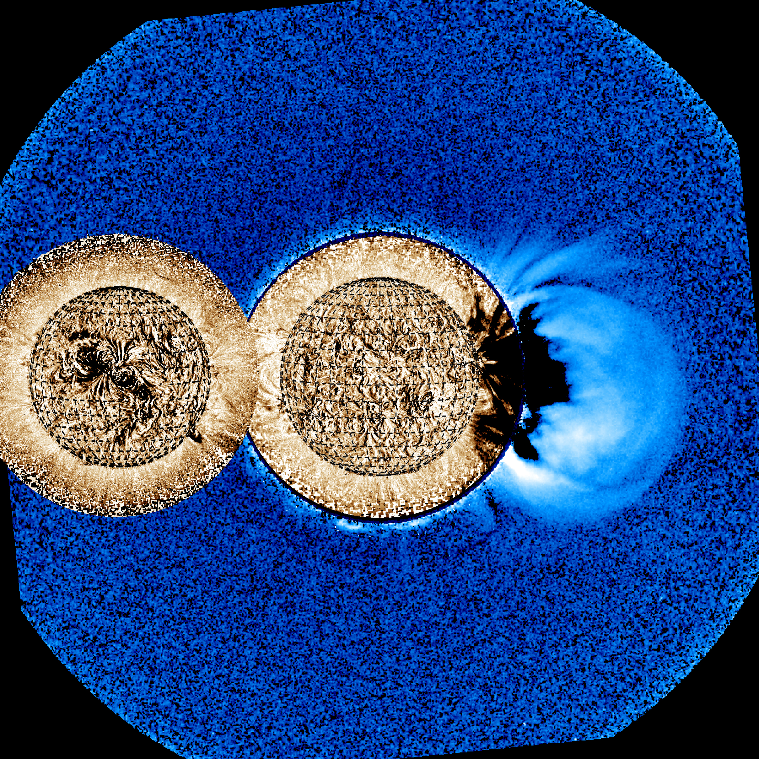
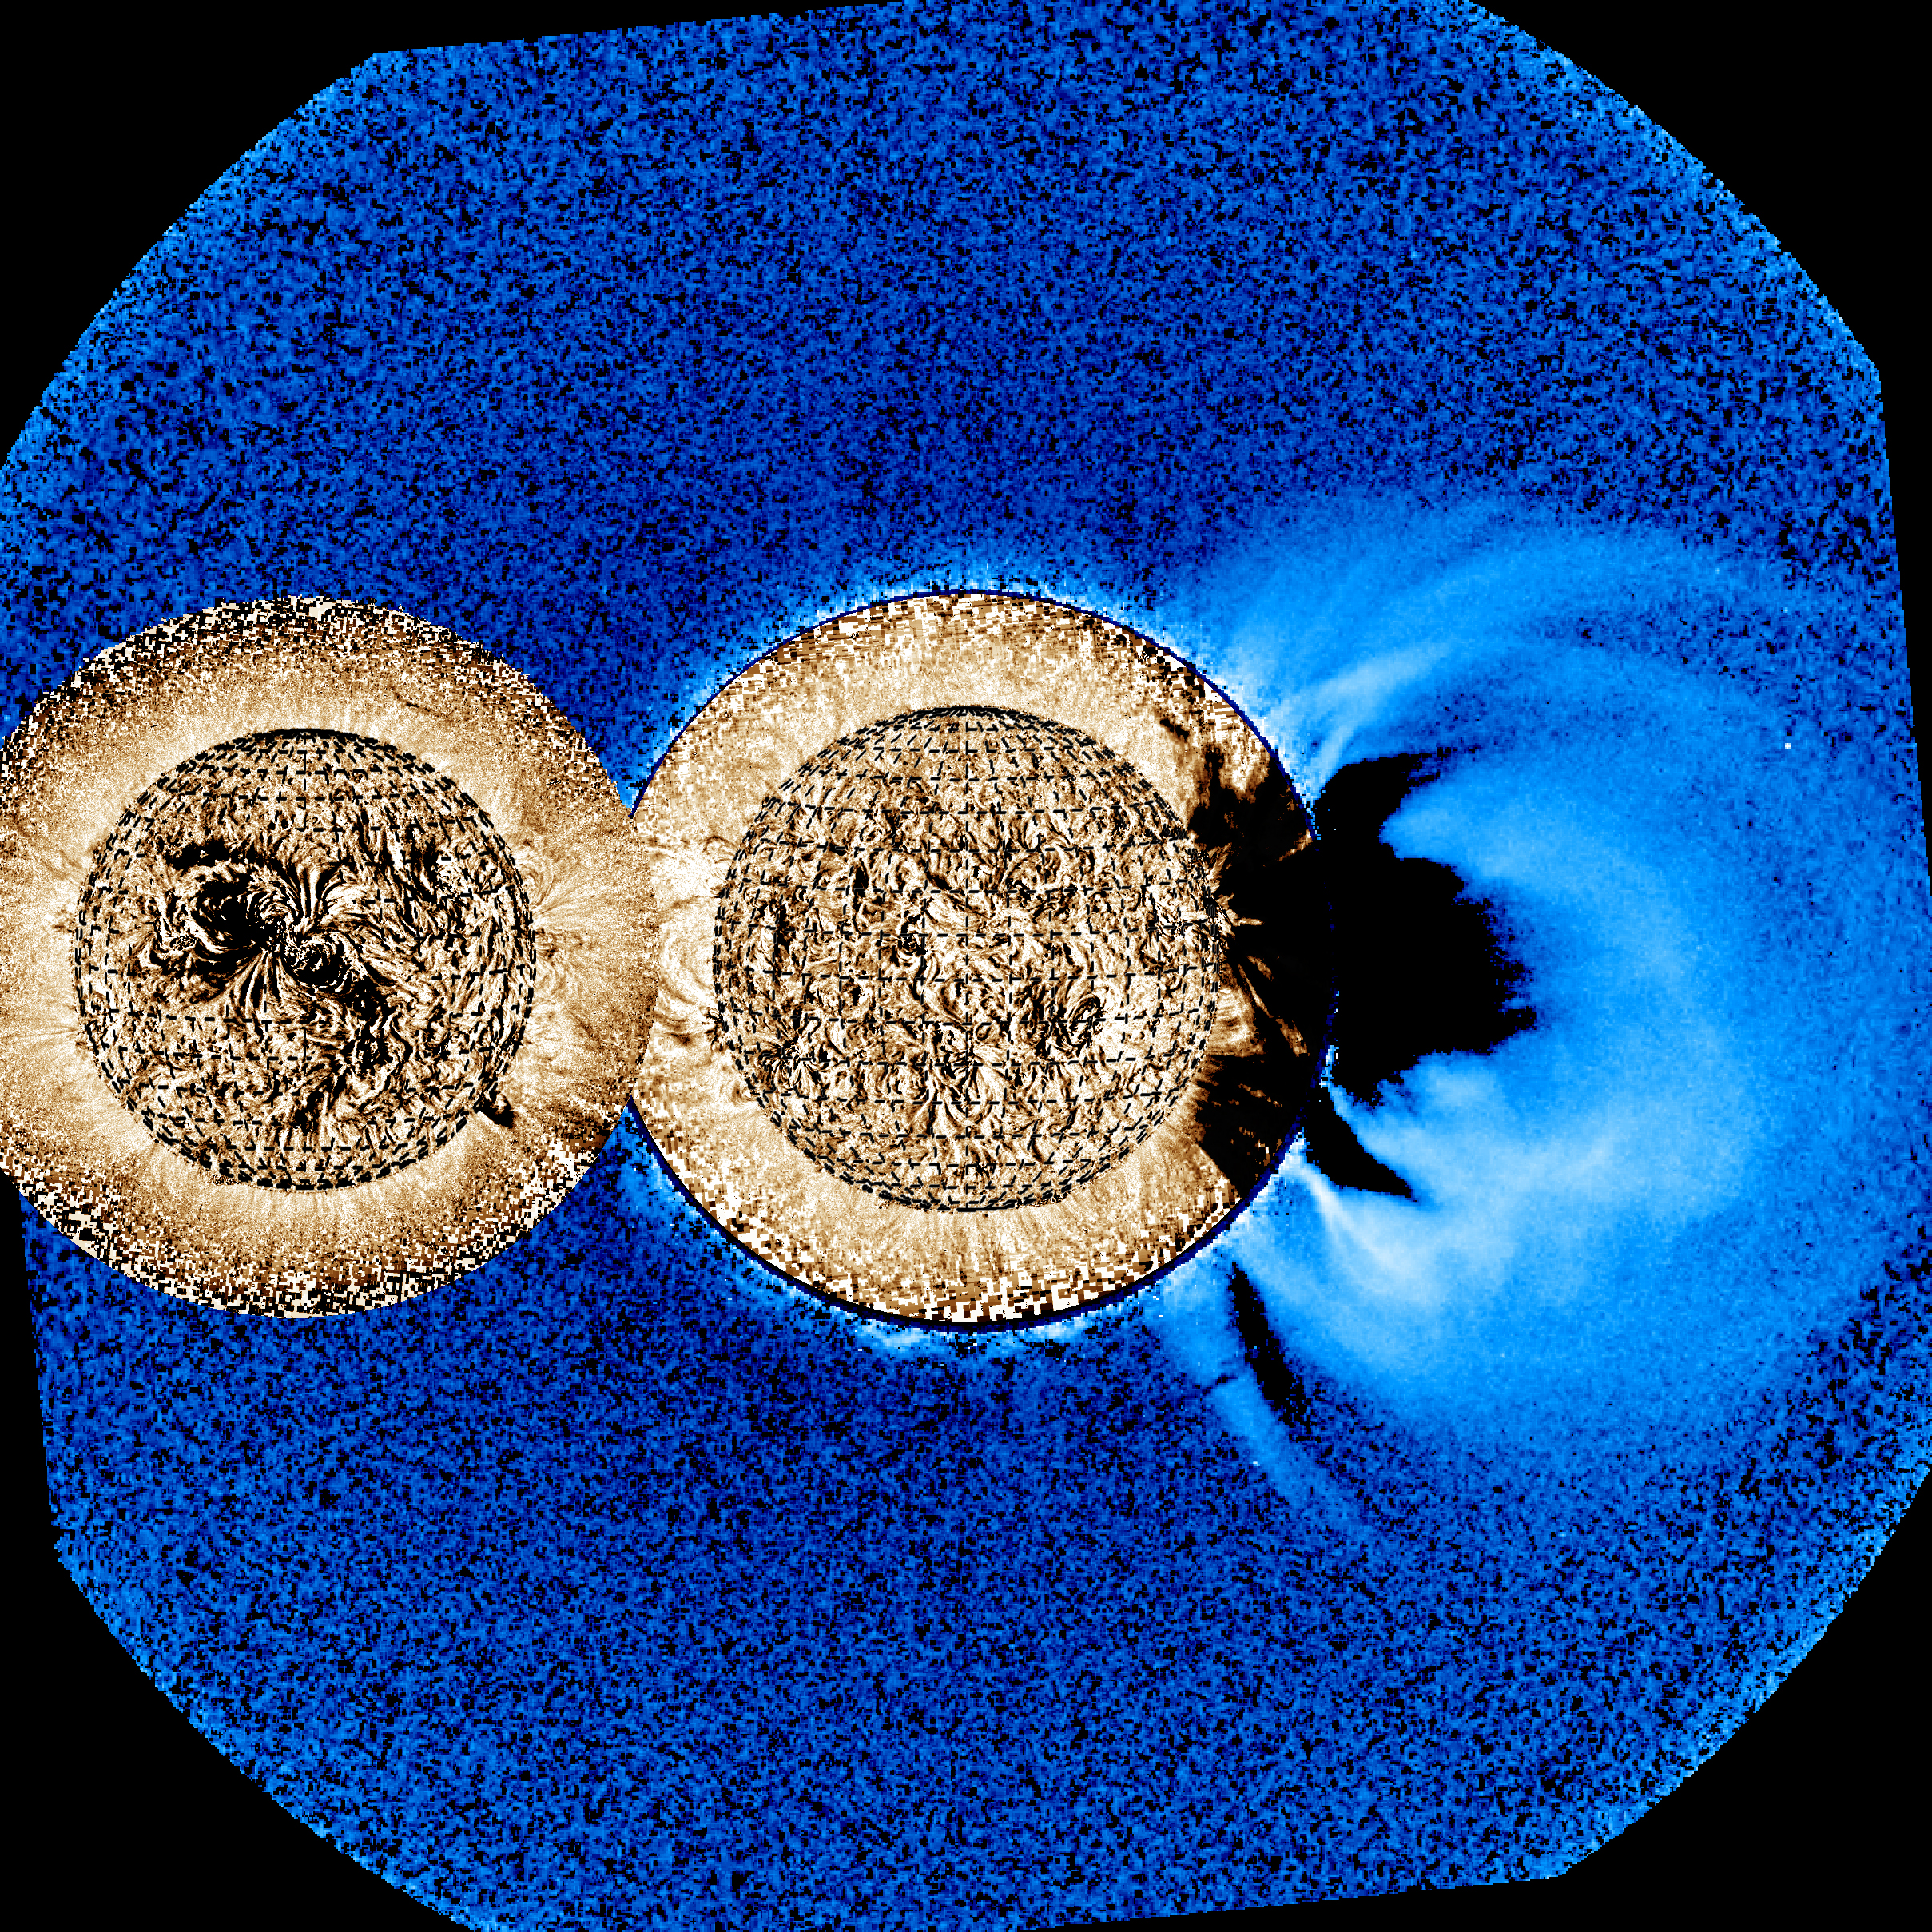
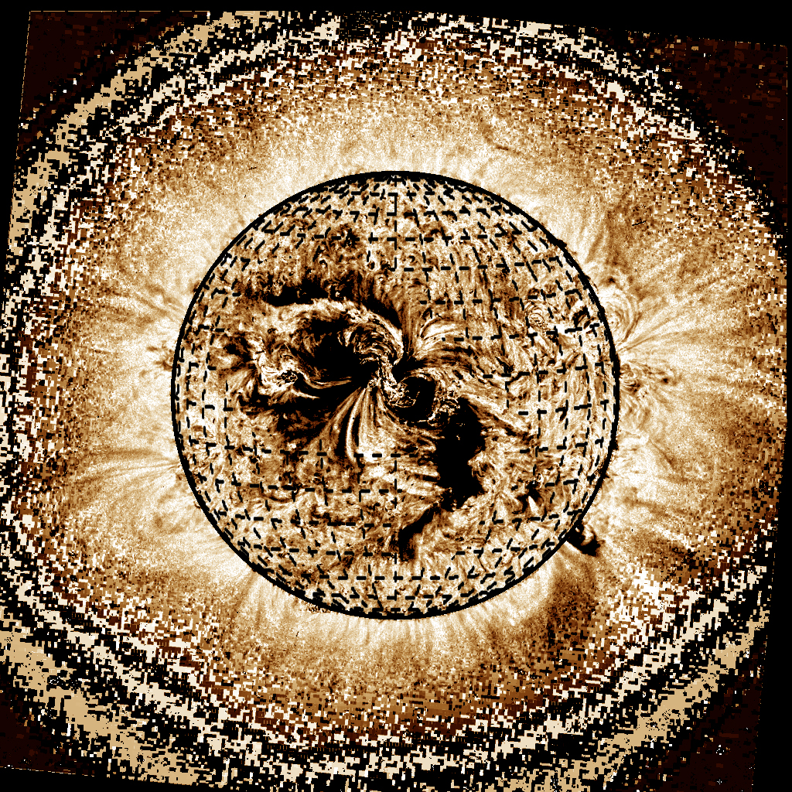
2013-03-05 05:16
2013-03-05 05:09

Slide 6
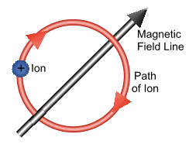
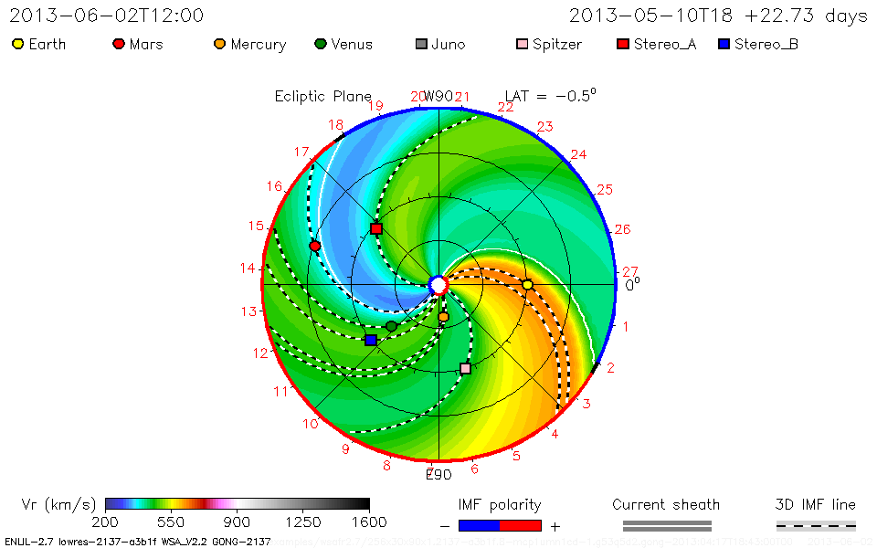
Magnetic fields guide SEPs/magnetic connectivity
Charged particle motion* is confined by the magnetic field.
+90°
This means that the source is very important.
0°
-90°
*in a substantially strong B
Notes:
ENLIL
Charged particles, when the magnetic field is above some certain threshold, are tied to magnetic field lines. They will propagate along the magnetic field lines.
As we discussed earlier, because the Sun rotates, the interplanetary magnetic field takes a spiral shape in the equatorial plane. Use these lines to see where the soure regions can be for these spacecraft.
Just flares/source region connection

Slide 7
Magnetic fields guide SEPs/magnetic connectivity
Charged particle motion* is confined by the magnetic field.
+90°
This means that the source is very important.
0°
-90°
*in a substantially strong B
Notes:
ENLIL
Charged particles, when the magnetic field is above some certain threshold, are tied to magnetic field lines. They will propagate along the magnetic field lines.
As we discussed earlier, because the Sun rotates, the interplanetary magnetic field takes a spiral shape in the equatorial plane. Use these lines to see where the soure regions can be for these spacecraft.
Just flares/source region connection

Slide 8
Magnetic fields guide SEPs
Best connected field line varies, if solar wind speed is faster then connection is closer
+90°
This means that the source is very important.
0°
-90°
*in a substantially strong B
Notes:
ENLIL
Charged particles, when the magnetic field is above some certain threshold, are tied to magnetic field lines. They will propagate along the magnetic field lines.
As we discussed earlier, because the Sun rotates, the interplanetary magnetic field takes a spiral shape in the equatorial plane. Use these lines to see where the soure regions can be for these spacecraft.
Just flares/source region connection

Slide 9
Magnetic fields guide SEPs
One spacecraft can be well connected, while the other two can observe different levels
+90°
This means that the source is very important.
0°
-90°
*in a substantially strong B
Notes:
ENLIL
Charged particles, when the magnetic field is above some certain threshold, are tied to magnetic field lines. They will propagate along the magnetic field lines.
As we discussed earlier, because the Sun rotates, the interplanetary magnetic field takes a spiral shape in the equatorial plane. Use these lines to see where the soure regions can be for these spacecraft.
Just flares/source region connection

Slide 10
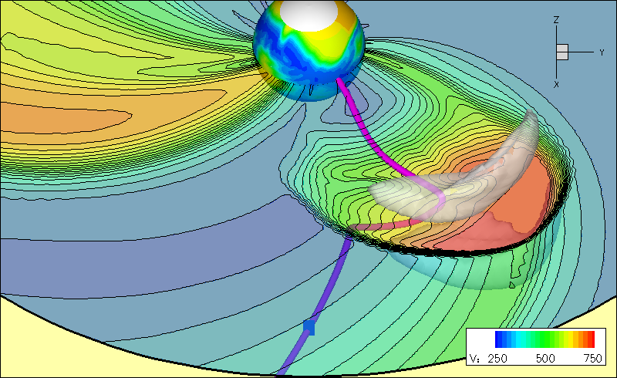
Wide Longitudinal Extent of SEP Events
Magnetic field lines are the road for charged particles
Notes:
If particles do not easily cross from one magnetic field line to another, it may seem like all SEP events would then be very narrow in longitude.
However, a CME can play a role not only in accelerating the particles, but also in distributing them over a wide range of longitudes, as we can see here in this simulation.
Here is a simulation that shows us what that might look like.
So, remember, when there is a cme, it can widen the area of the SEPs.

Slide 11
Wide Longitudinal Extent of SEP Events
Notes:
If particles do not easily cross from one magnetic field line to another, it may seem like all SEP events would then be very narrow in longitude.
However, a CME can play a role not only in accelerating the particles, but also in distributing them over a wide range of longitudes, as we can see here in this simulation. Sandro said how CMEs can be greater than 100 in width, so it is possible for the same SEP event to be seen at multiple locations.
Here is a simulation that shows us what that might look like.
So, remember, when there is a cme, it can widen the area of the SEPs.

Slide 12
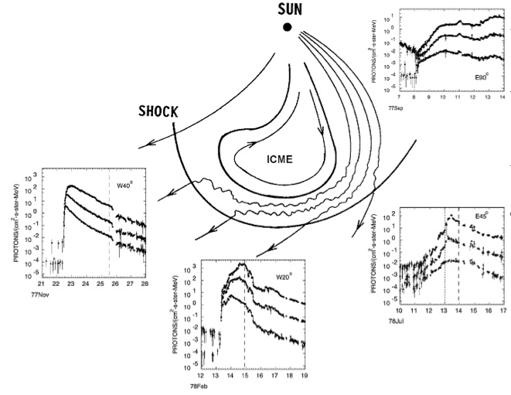
Recognizing profile shapes of SEP flux and associating it with the source/driver
Lario & Cane, 2006

Slide 13
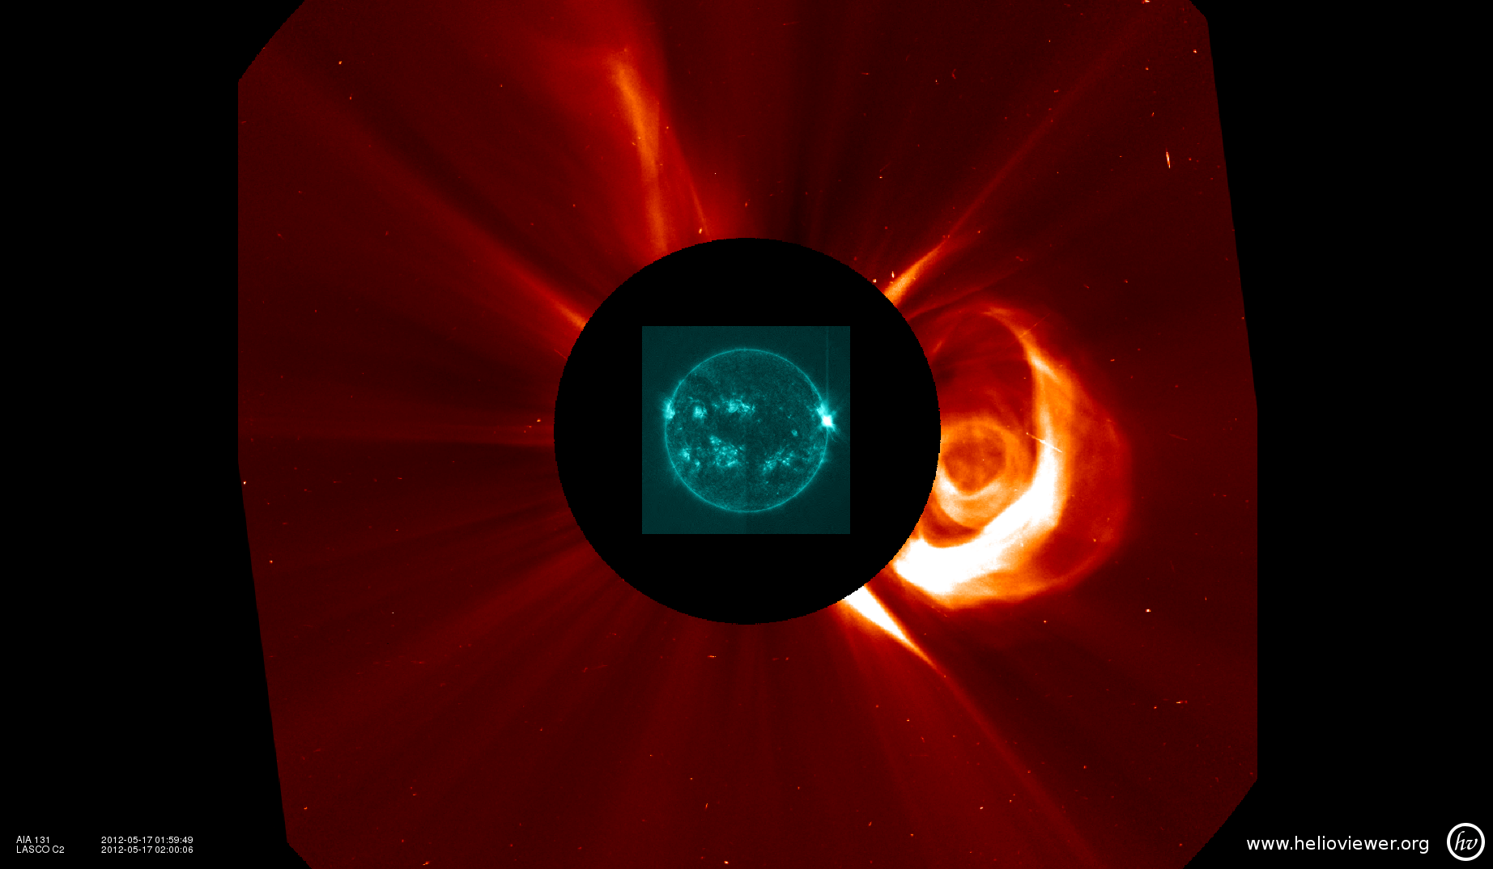
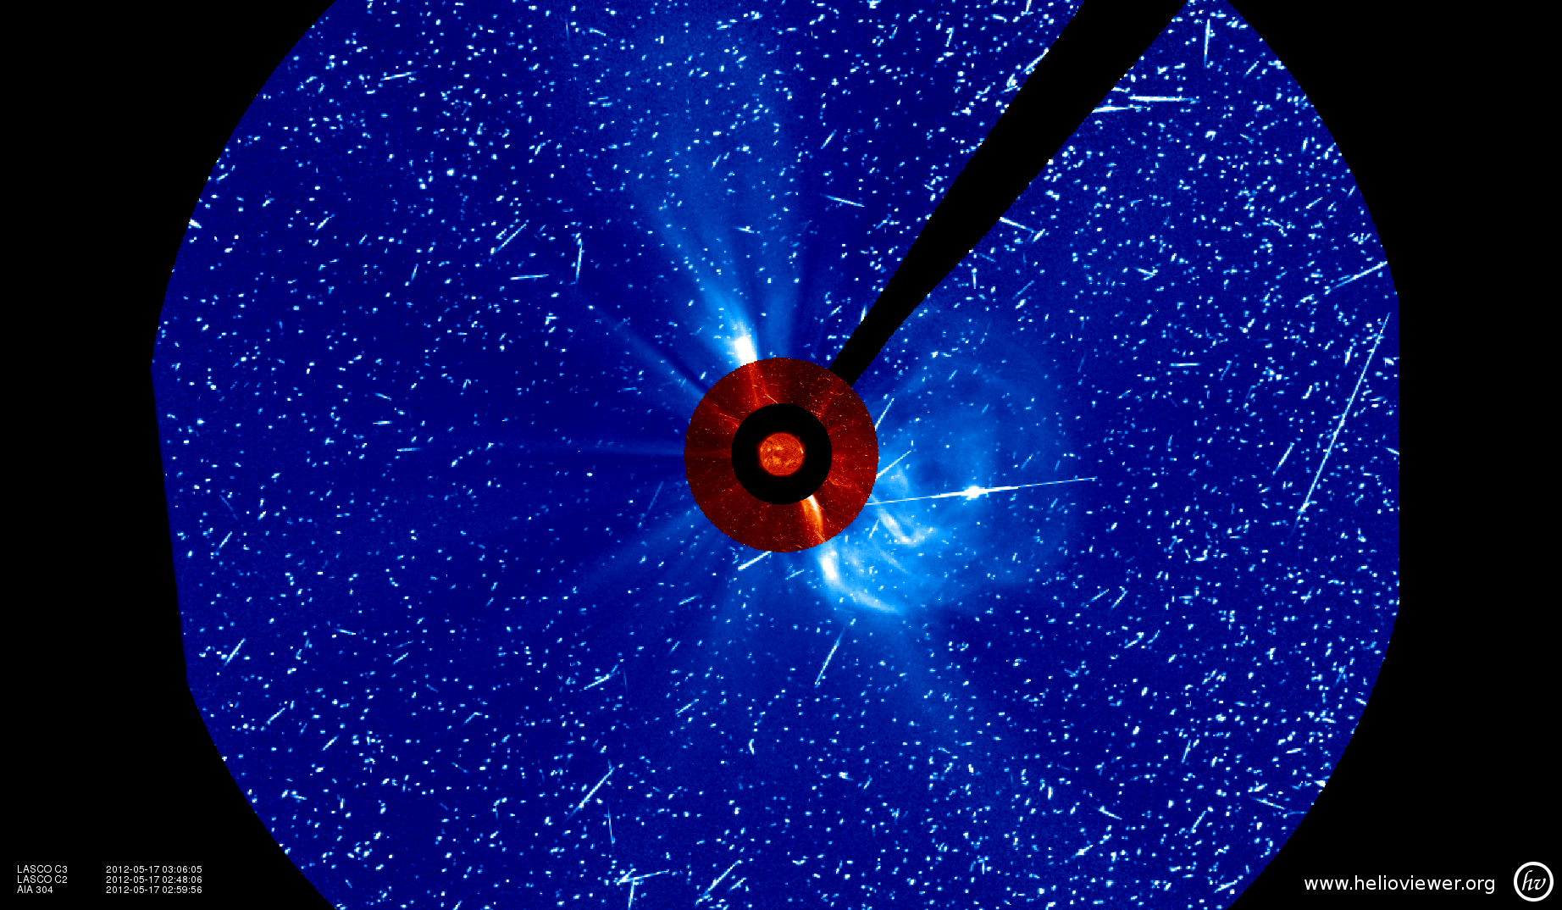
PARTICLE SNOW!
Imagers can act as particle detectors
Flare peaked at 01:47 UT
One hour later
SDO AIA 131 Å + SOHO/LASCO C2
May 17 02:00 UT
SOHO/LASCO C3
May 17 03:00 UT
Notes:
Another way that we “see” SEPs are in images, for example, coorngraphs. Here you can see the ‘snow’ of particles hitting the detector.

Slide 14
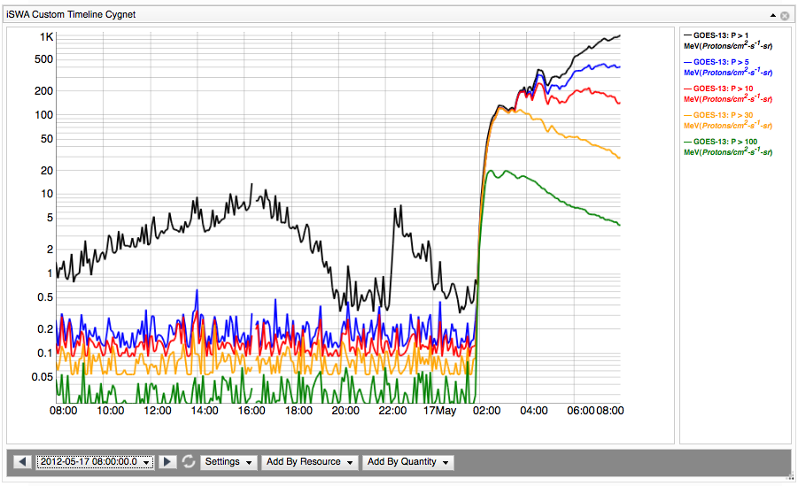
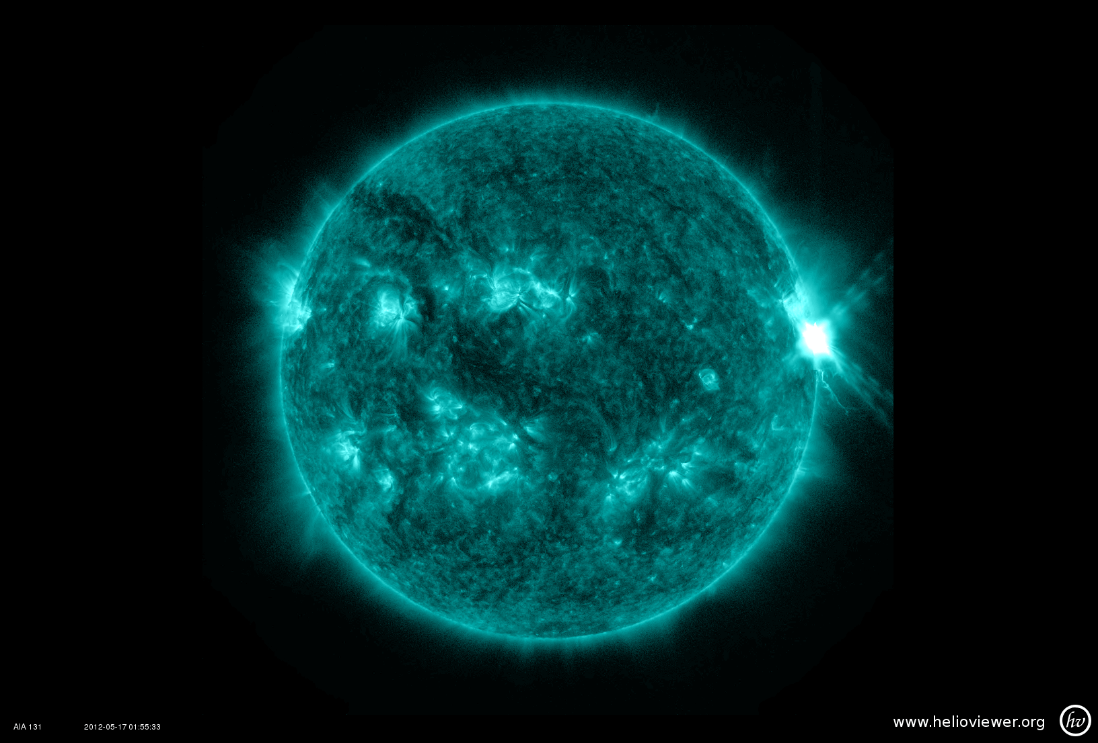
For Earth – Best Connection is 45-60 degree west
GOES-13
01:55 UT
Energetic proton fluxes
elevated for >12 hours
SDO AIA 131 Å
Notes:
Not only were the >10 Mev channel elevated well above our threshold, but the >50 and >100 channels as well, which tell us that this event was very efficient at accelerating the highest energy particles.

Slide 15
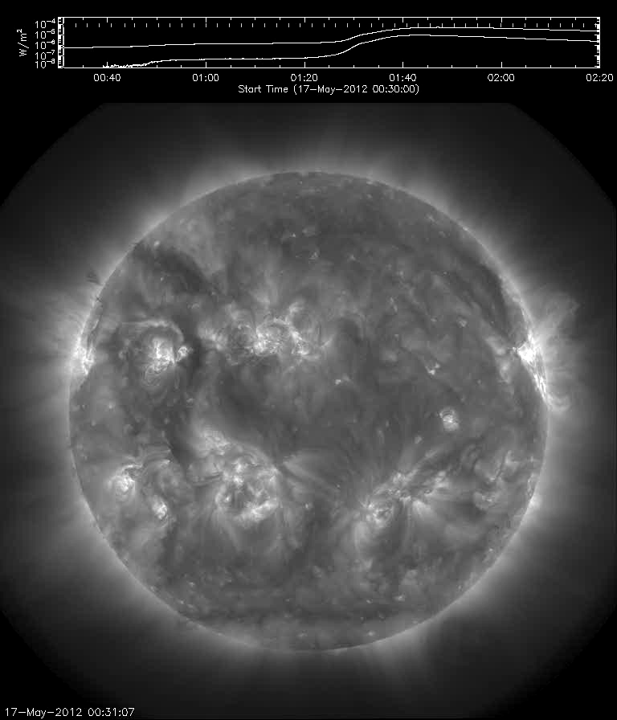
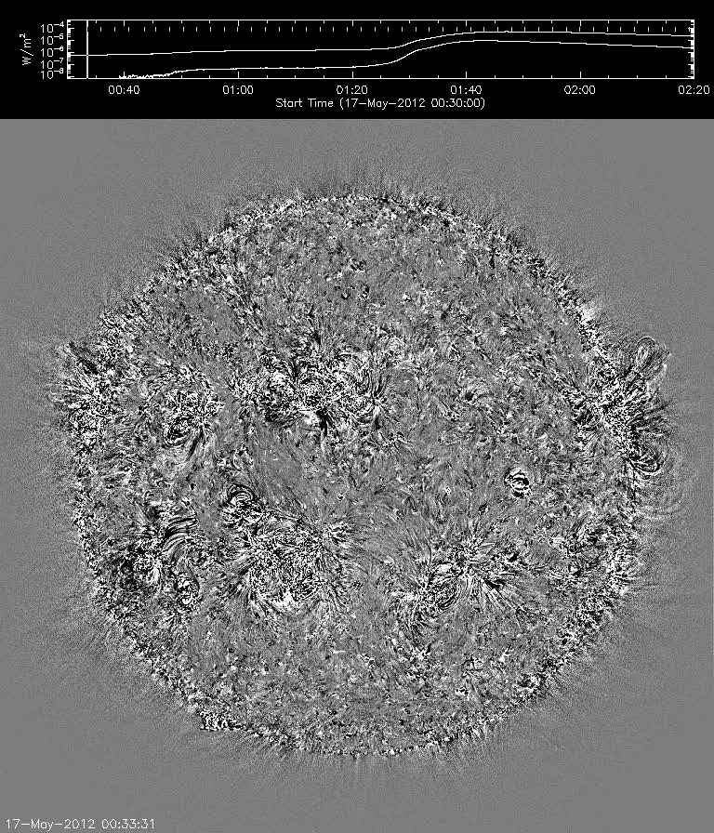
An example
Notes:
Credit: Nariaki Nitta, LMSAL

Slide 18
SEPs – important source of space radiation: hard to predict
Galactic Cosmic Radiation (another source)

Slide 19
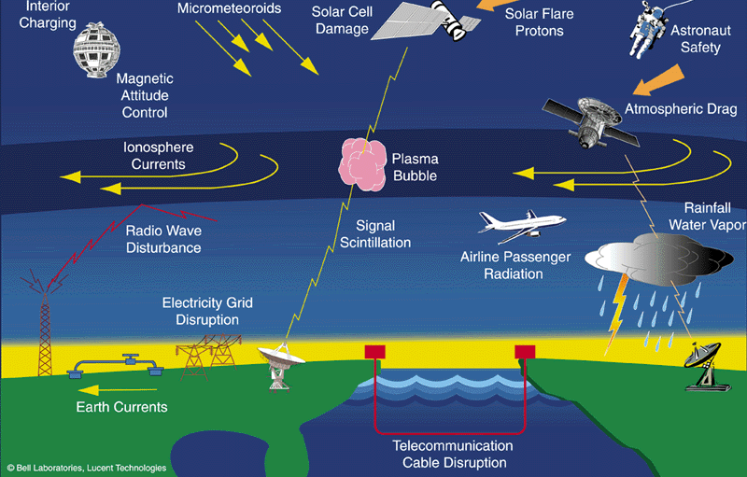
What's affected?
Radiation hazards for spacecraft,
human in space and airline passenger safety, PCA (polar cap absorption)
PCA: https://www.windows2universe.org/spaceweather/polar_com.html
Notes:
An SEP event is an enhancement in the radiation environment.
Summarize effects again.
For this effect and the biological/ human radiation risk hazard, we partner with the Space Rad Analysis Group NASA JSC.
Definition:
Energetic charged particles charged particles such as energetic electrons that are traveling much faster than ambient electrons in the space plasma and have the potential for causing ionizing radiation damage to spacecraft and

Slide 20
Space Environments and Effects on Spacecraft
Plasma
Particle
radiation
Neutral
gas particles
Ultraviolet & X-ray
Micro-
meteoroids & orbital debris
Ionizing &
Non-Ionizing
Dose
Single
Event
Effects
Surface
Erosion
Charging
Drag
Impacts
Biasing of instrument readings
Pulsing
Power drains
Physical damage
Degradation of micro-
electronics
Degradation of optical components
Degradation of solar cells
Data corruption
Noise on Images
System shutdowns
Circuit damage
Torques
Orbital decay
Degradation of thermal, electrical, optical properties
Degradation of structural integrity
Structural damage
Decompression
Space Radiation Effects
Shaded in yellow
after J. Barth

Slide 21
How Do We Monitor SEP Levels?
(1 pfu = 1 particle flux unit= 1/cm^2/sec/sr)
Track the particle flux at different locations.
Flux units: pfu, pfu/MeV
  Heliosphere with STEREO In-situ Measurements of Particles and CME Transients (IMPACT)
    Differential energy band; Units measured, some energy ranges are:
  Upstream of Earth with ACE, SOHO/COSTEP
    Units measured, some energy ranges are:
  Geostationary Orbit with GOES
    Integral flux, Units measured, some energy ranges are: pfu particle flux unit
    Inside the Earth's magnetosphere (usually)
Another useful quantity:
Fluence = flux integrated over the entire event.
Important for biological effects (flights)
Notes:
Converting between the two is important to know in order to quantify the relative strengths.

Slide 22
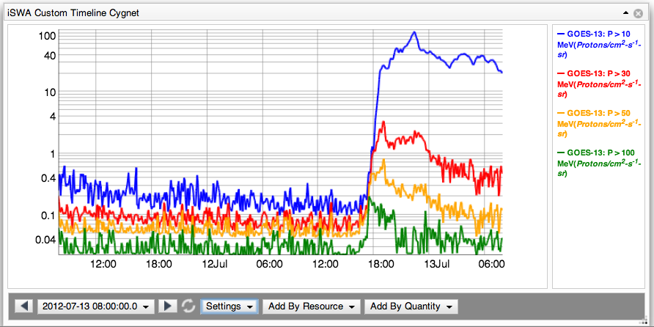
How do we define an SEP Event?
SWRC: SEP event detections are defined as:
GOES Proton E > 10 MeV channel > 10 pfu
GOES Proton E > 100 MeV channel > 1 pfu
Notes:
Here is an example of an event where the 10 MeV limit was met, but not the 100 MeV.
SOHO: > 15.8 MeV proton channels 0.1 pfu/MeV.

Slide 23
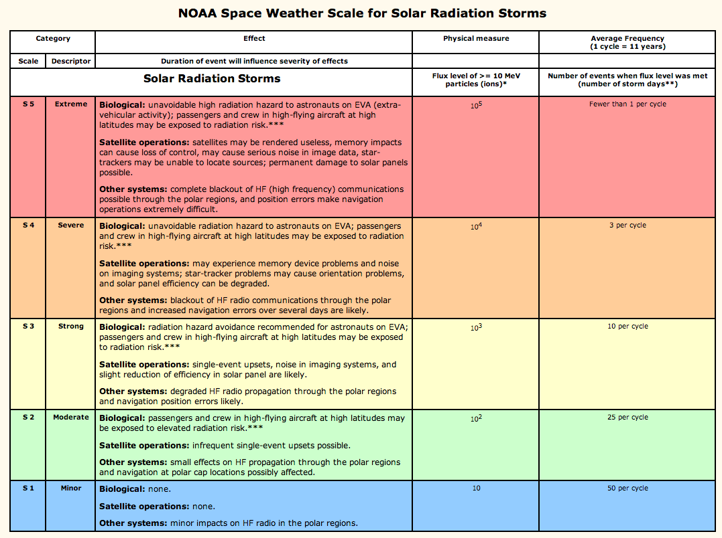
How Do We Quantify an SEP Event?
Notes:
Fluence is also important

Slide 24
Human Safety in Space
GCR
SEP
Johnson Space Center/Space Radiation Analysis Group (SRAG)
Limit: the > 100 MeV flux exceeding 1pfu
(1 pfu = 1 particle flux unit= 1/cm^2/sec/sr)
All clear (EVA –extravehicular activity)

Slide 25
Can we predict SEP events?

Slide 26
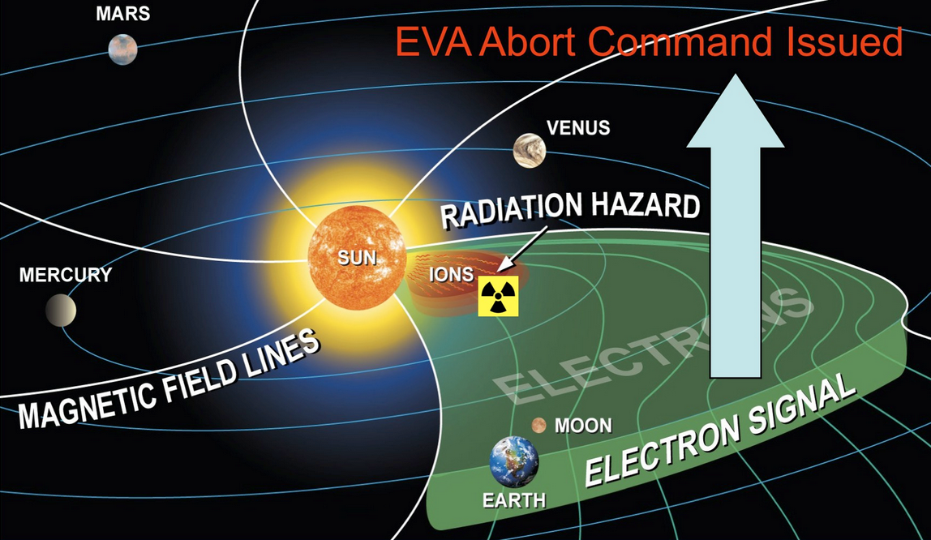
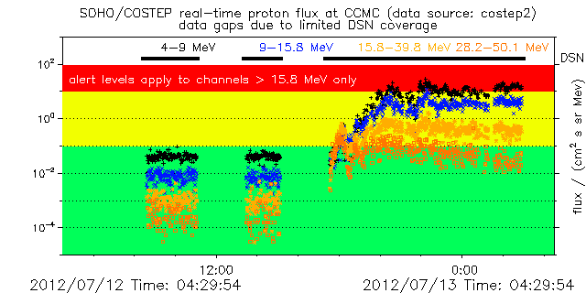
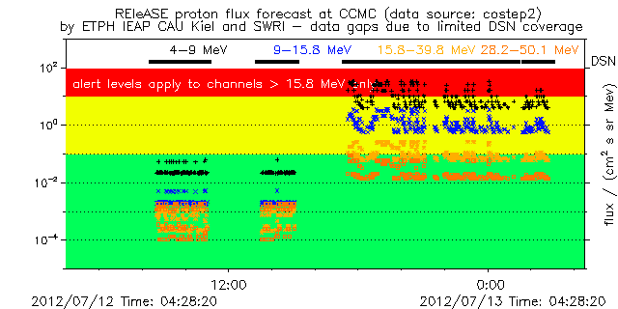
Can we predict SEP events?
Uses detection of high energy *electrons* to predict arrival of high energy *protons*
Data source: SOHO COSTEP
REleASE Model
Notes:
http://iswa.gsfc.nasa.gov/wiki/index.php/SOHO/Costep_Proton_Flux_-_Forecast

Slide 27
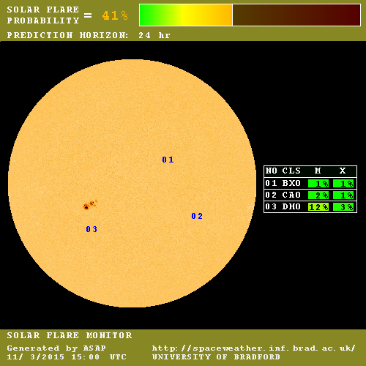
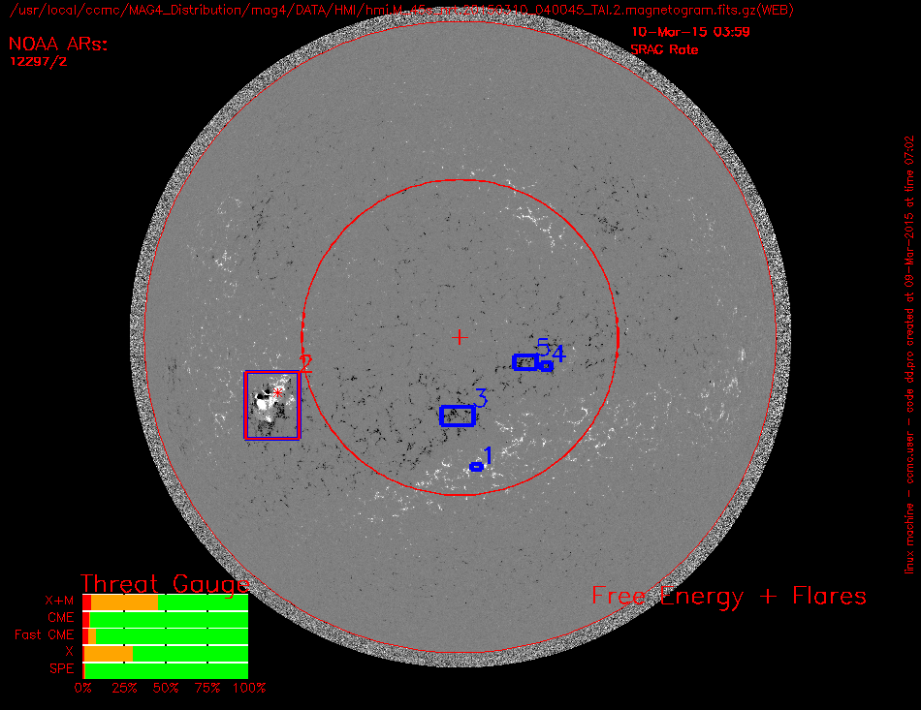
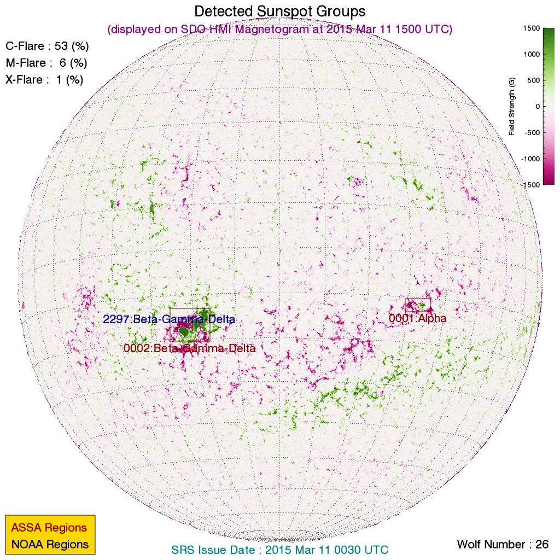
SEP prediction (active region)
x2.2 flare on March 11, 2015
MAG4
ASAP
ASSA

Slide 28
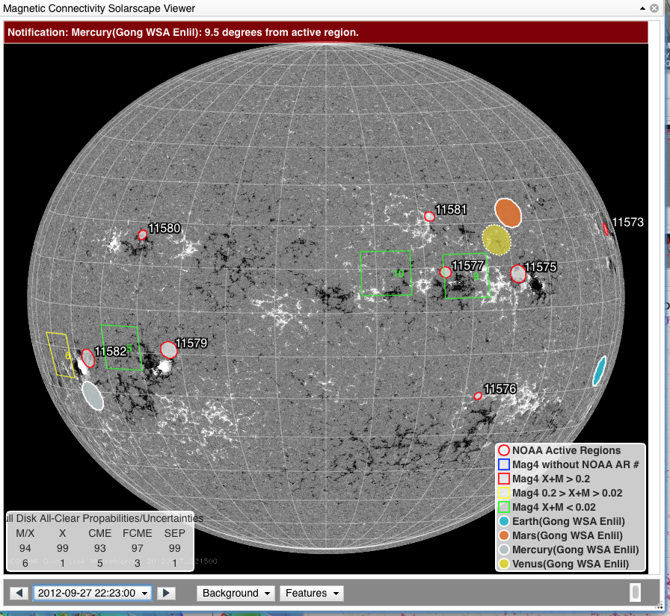
Solarscape/magnetic connectivity
C3.7 class flare
AR 11577
Notes:
20120927_2336 2012/09/27 23:36:00 00:34:00 23:57:00 C3.7 N09W32 ( 1577 ) LDE longduration event N09W32
Earth-directed. Hemispheric wave, asymmetric halo

Slide 29
Recognizing profile shapes of SEP flux and associating it with the source/driver
Lario & Cane, 2006

Slide 30
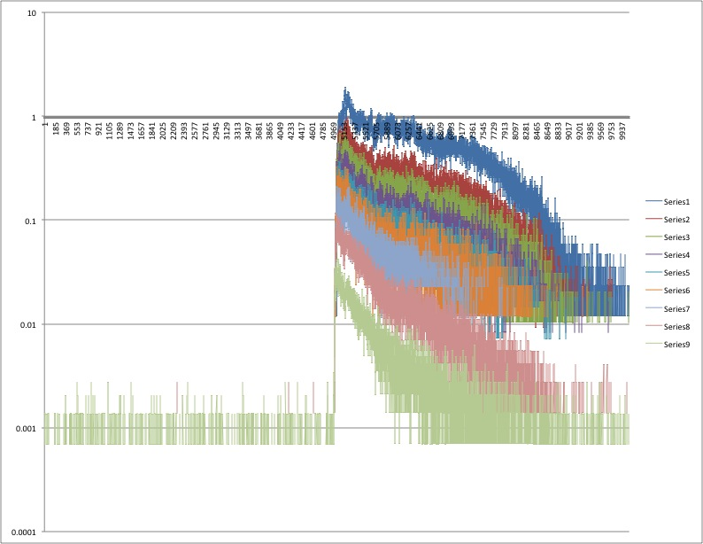
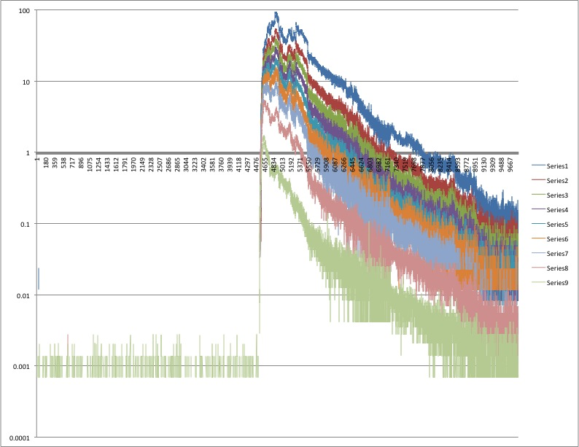
Impulsive: The “peak at the beginning, rapid fall off” – indicates how well connected you are to the source

Slide 31
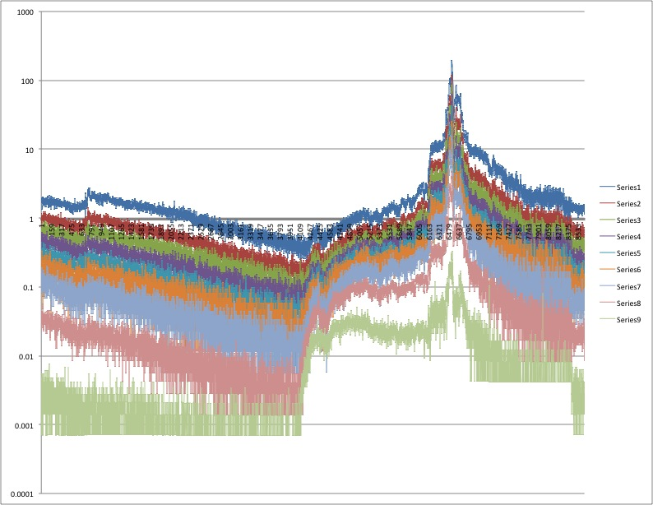
Gradual: The “slow rise after eruption, then peak when the ICME passes the spacecraft”

Slide 32
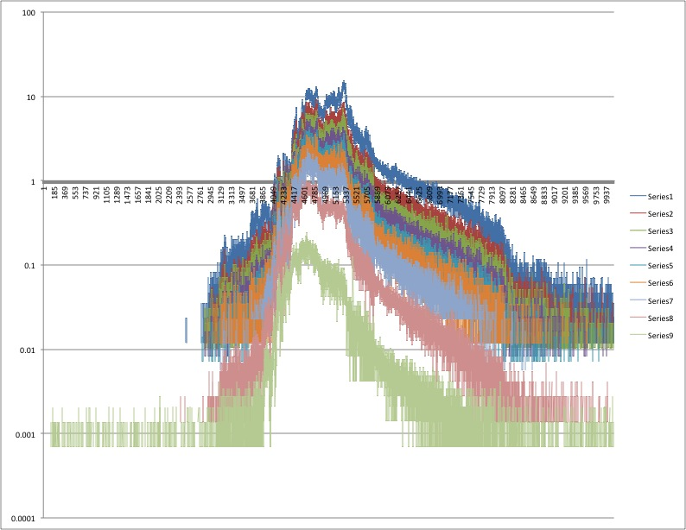
The “slow rise then peak, (slow rise can let you know that you are not well connected
ICME doesn’t hit spacecraft so falls off”

Slide 33
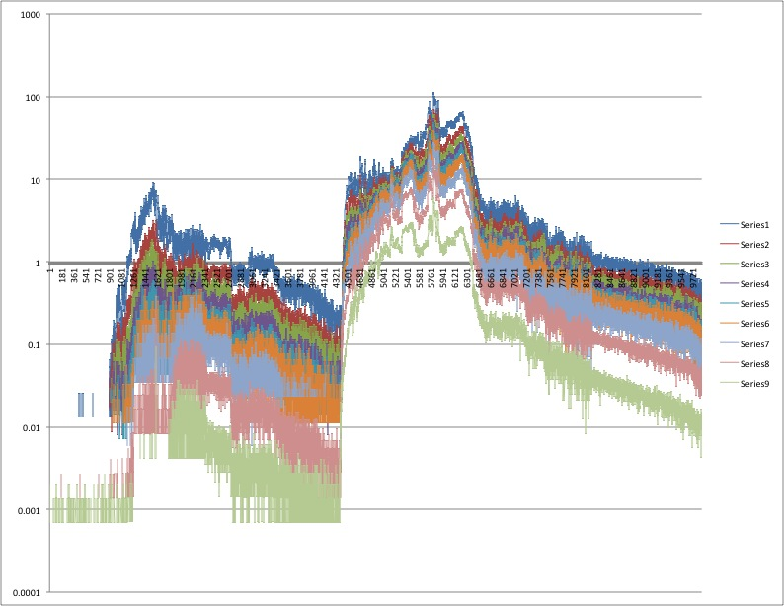
Multiple events can compound impact

Slide 34
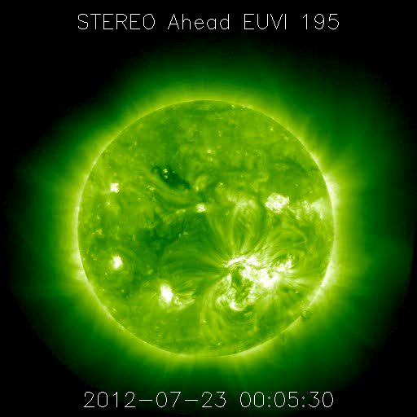
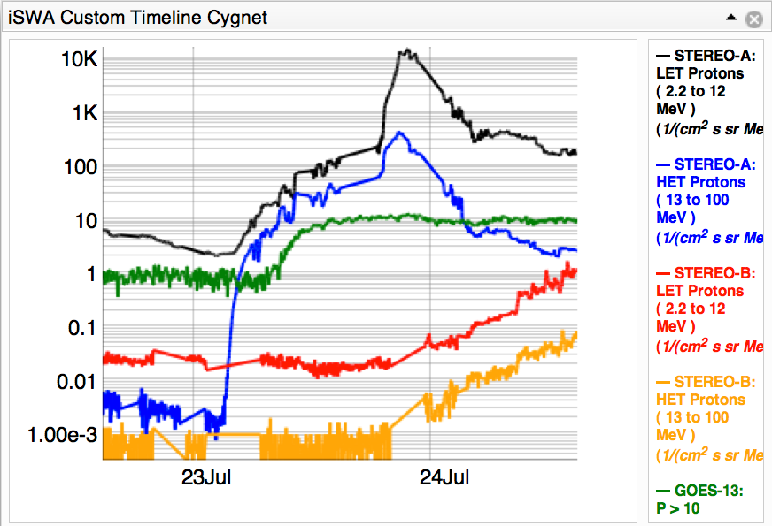
July 23, 2012
It reaches one spacecraft, then later another…
Increase of more than 5 orders of magnitude at STEREO A
SEP event also detected by GOES, and later enhancement seen at STEREO B
July 23 flare as seen in STEREO A EUVI 195
Notes:
On July 23rd it really put on a show.

Slide 35
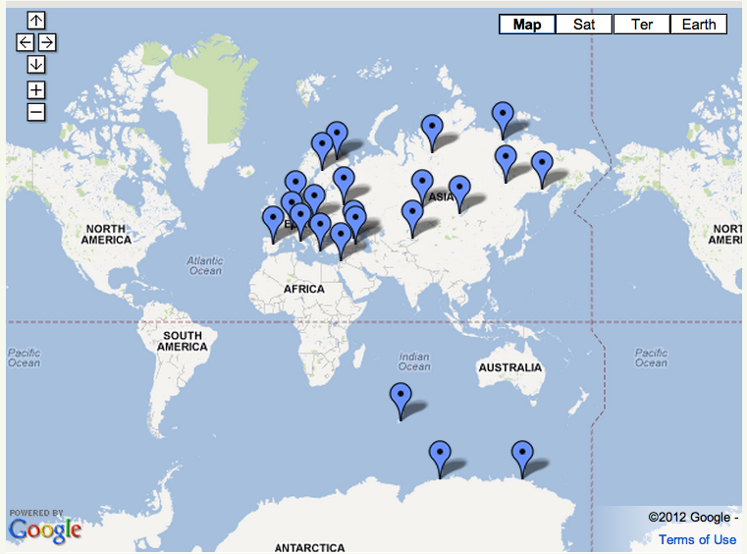
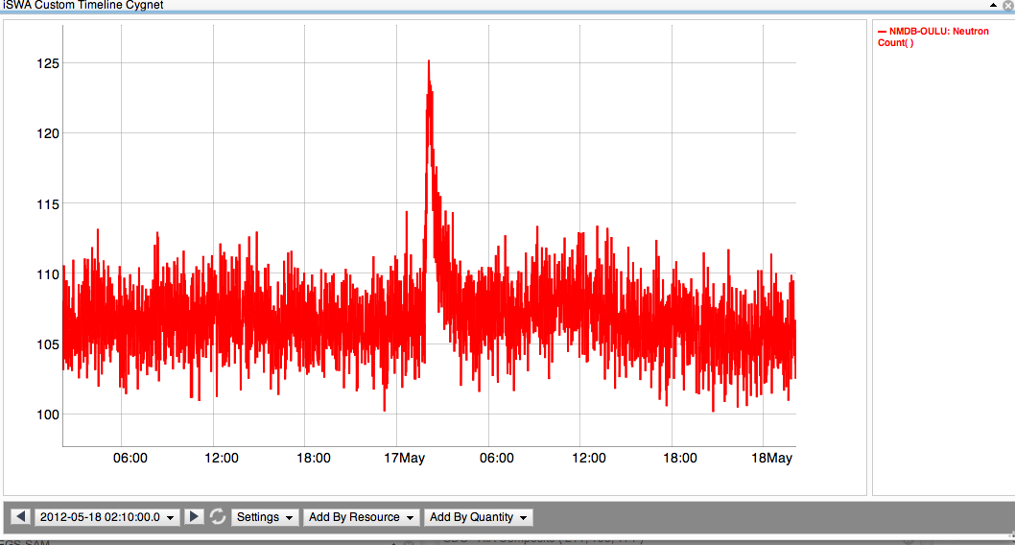
Ground Level Enhancement
A subset of SEP events, a GLE event occurs when extremely high energy protons (>500 MeV/nuc) penetrate all the way to the Earth's surface. Collisions with atoms generate secondary particles that are measured at neutron monitoring (NM) stations on the ground.
Neutron Monitoring Station in Oulu, Finland
Enhancement to ~125
NM Stations (http://www.nmdb.eu)
Background ~105
Notes:
The most extreme events…
This suspicious was confirmed by the detection of neutron enhancement at 4 stations. Those neutrons are reaction particles from relativistic protons
Add arrows to mark stations that observed May 17 GLE – what WAS THE TIME????
Save discussion of GLE events in SC 23 and characteristics of GLEs until 2nd half of talk. First half should only be observations!

Slide 36
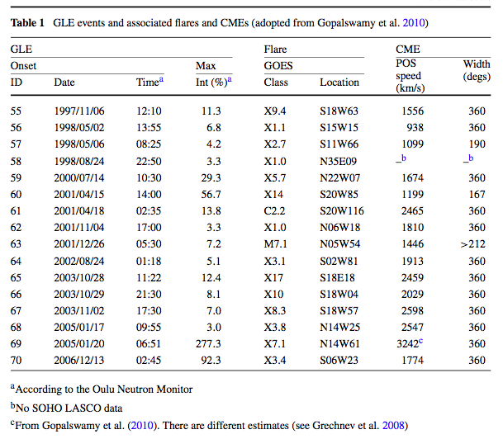
What causes strongest SEP events?
Or, how do the drivers relate to the SEP Flux?
Many factors!!!
Complexity of Active Region (AR)
  Most young, more compact
Magnetic connectivity of AR
  About ~50% are well connected
Magnitude of flare
  Average X3.8, but as low as M7.1
  Long duration
Magnitude of CME
  Range of speeds (~2,000 km/s average, but four events <1,500 km/s)
Local speed of solar wind
  CME Mach number
Seed particles
  Known to have harder spectrum
Sol
Nitta et al. 2012
Gopalswamy et al. 2012, Li et al. 2012, Mewaldt et al. 2012
Notes:
Like I said, these events prompt more questions and more questions, so we want to look at all of the extreme events (GLE) and see if any characteristics of the solar part of the storm can tell us about what is happening. And the answer is that while there are trends, it’s not true that strong flare cause GLEs, as you saw only M5 cause the May event, it’s not the fastest and biggest CMEs.
Again I want to emphasize that these are all just speculations because most of the interesting stuff is happening in a region that is not well covered by coronagraphs.
End with: And so we are motivated to model the acceleration of particles by CME driven shocks in the low corona…
Comparing to previous AR1476 flares: Longer duration, but similar magnitude
March 7th event: flare and CME weaker, SEPs at Earth 20x weaker
Solar Cycle 23 GLE events: no CME in previous 24 hours (to generate seed particles)
What was special about this flare and CME to generate a GLE?
Timing: CME erupted during rise time of flare
Connectivity: AR well connected to Earth
CME speed 1,500 km/s sufficient to drive shock in low corona (Evans et al. 2008)
Must have been very wide CME (to impact STEREO A and Earth)
As is common, they were not geoeffective (Kp max =4)
Possible Type II radio burst indicates CME driven shock

Slide 37
Exceptions to every rule!
September 28, 2012 – whole heliosphere event – C3.7 flare
Notes:
20120927_2336 2012/09/27 23:36:00 00:34:00 23:57:00 C3.7 N09W32 ( 1577 ) LDE longduration event N09W32
Earth-directed. Hemispheric wave, asymmetric halo

Slide 38
SEP Layout
http://bit.ly/alert_SEP_layout

