Slide 1
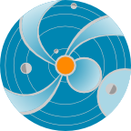
Sun and Its Activity
A. Taktakishvili
CCMC/SWRC
NASA Goddard Space Flight Center
NASA
Space
Weather
Research
Center
Notes:
In this presentation I will be talking about the Sun and its activity in relations to the space weather
(http://iswa3.ccmc.gsfc.nasa.gov/wiki/index.php/Glossary/_space_weather)

Slide 2
What is Space Weather?
“Space Weather refers to conditions on the Sun and in the space environment that can influence the performance and reliability of space-borne and ground-based technological systems and can endanger human life or health.”
National Space Weather Program Web site:
www.nswp.gov
Notes:
What is the Space Weather?
The definition given at the National Space Weather Program website is the following:
“Space Weather refers to conditions on the Sun and in the space environment that can influence the performance and reliability of space-borne and ground-based technological systems and can endanger human life or health.”
So, to be able to predict the space weather we have to learn more about our Sun.

Slide 3
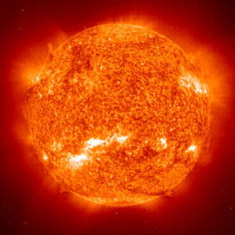
Sun - Space Weather Driver
Notes:
The Sun is the driver of the Space Weather.
This is an image of the Solar atmosphere from the Solar Dynamics Observatory (SDO, http://iswa3.ccmc.gsfc.nasa.gov/wiki/index.php/Glossary)
Solar image is obtained by Atmospheric Imaging Assembly (AIA) instrument in 30.4 nm wavelength
(http://iswa3.ccmc.gsfc.nasa.gov/wiki/index.php/SDO_AIA_304) .
Color is artificial - this part of the spectrum is not visible for the human eye. The bright areas mean higher and darker areas mean lower temperature. You can see that the solar atmosphere is rather inhomogeneous. Those is the very regions where the future space weather conditions are created.

Slide 4
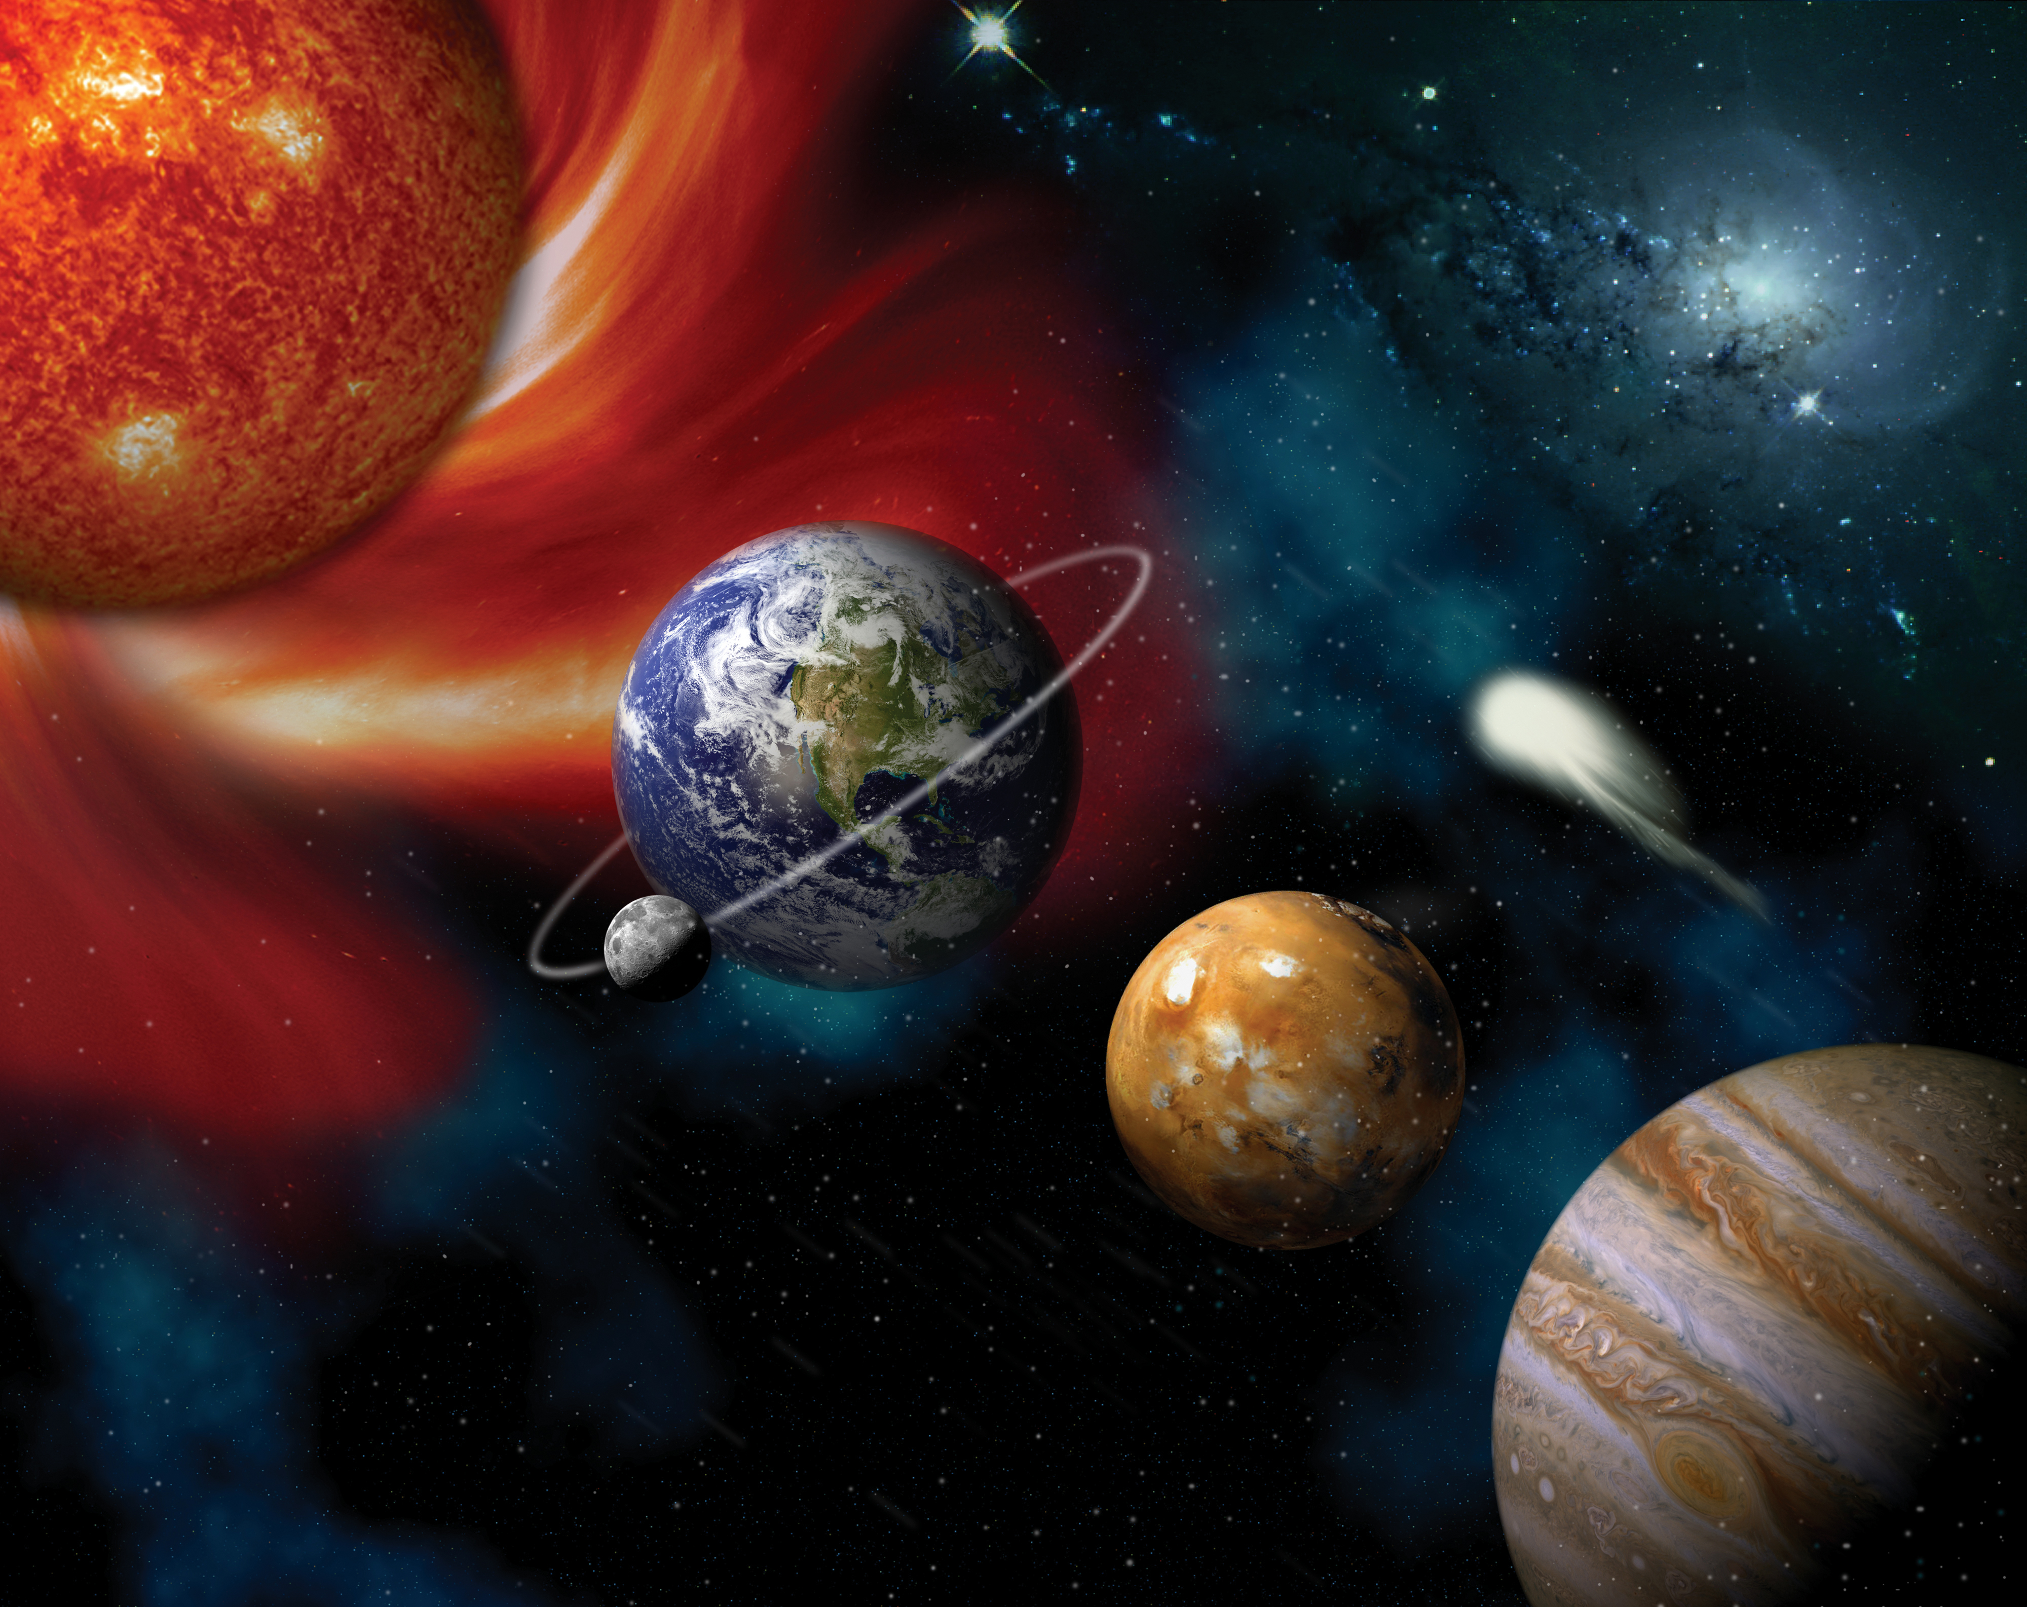
Solar Wind, Heliosphere
Solar Wind – Reaches the Earth in 4-5 days
Notes:
Let us start to describe the main solar phenomena related to the space weather with the solar wind (http://iswa3.ccmc.gsfc.nasa.gov/wiki/index.php/Glossary/_solar_wind).
The Sun constantly blows low density magnetized plasma – an ionized gas that consists mostly of charged particles, electrons and ions - from it’s outer atmosphere . This is called solar wind. The region dominated by solar plasma is called heliosphere. The edge of the heliosphere is a magnetic bubble-like medium and is located far beyond the orbit of Pluto.
In a collage of real images and artist’s depiction to the left is shown the Sun, Earth, Mars and Jupiter (out of scale naturally).
Solar wind usually reaches the Earth in 4-5 days. Space weather conditions vary depending on the physical properties of the solar wind: speed, density, magnetic field it carries. Very fast solar wind carrying strong magnetic field of certain configuration can cause strongly variable space weather conditions or geomagnetic storms (http://iswa3.ccmc.gsfc.nasa.gov/wiki/index.php/Glossary/)

Slide 5
Solar Wind Model
Sun like a rotating hose
Notes:
In this slide is shown a CCMC model visualization of the solar wind. The model is called ENLIL, in Sumerian=God of Wind). The view is from the north down to the ecliptic plane (http://iswa3.ccmc.gsfc.nasa.gov/wiki/index.php/Glossary). The sun is in the center and planets and satellites are shown with different symbols. Color coded is the solar wind density which has a spiral shape due to the effect similar to a rotating hose.

Slide 6
Solar Flare
2012 July 12
X1.4 class flare
X ray
EUV
EUV
Notes:
Another solar phenomenon important to the space weather is solar flare, a sudden brightening observed over the Sun's surface or the solar limb, which is interpreted as a large energy release. Flares are mainly followed by a mass ejections from the solar atmosphere called coronal mass ejections (next slide). The flare ejects clouds of electrons, ions, and atoms through the corona of the sun into space.
In this slide is shown the solar flare of 2012 July 12.
In the upper panel is shown GOES satellite time line for the X-ray intensity (http://iswa3.ccmc.gsfc.nasa.gov/wiki/index.php/GOES_X-RAY) in two different wave length intervals . A strong flare usually manifests itself by a sudden a jump of the X-ray intensity.
The lower panel shows SDO satellite (http://iswa3.ccmc.gsfc.nasa.gov/wiki/index.php/Glossary) images of the same flare in three different wave length intervals: 1) the left is SDO EVE X-ray image (http://iswa3.ccmc.gsfc.nasa.gov/wiki/index.php/Full_iSWA_Cygnet_List
The central panel shows SDO AIA extreme ultraviolet image for 19.3 nm http://iswa3.ccmc.gsfc.nasa.gov/wiki/index.php/SDO_AIA_193 and the right panel - for a shorter wave length of 13.1 nm
http://iswa3.ccmc.gsfc.nasa.gov/wiki/index.php/SDO_AIA_131

Slide 7
Coronal Mass Ejection
Coronal Mass Ejection – Reaches the Earth in 1-3 days
Notes:
From time to time huge mass of solar plasma can erupt from the solar atmosphere. This phenomenon is called coronal mass ejection (CME,
http://iswa3.ccmc.gsfc.nasa.gov/wiki/index.php/Glossary ).
If CME is directed towards Earth, depending on it’s speed and size, it can reach the Earth in 1-3 days. CMEs are usually causing the strongest geomagnetic storms.

Slide 8
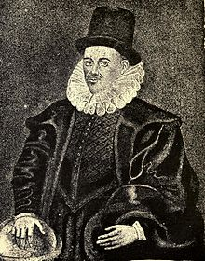
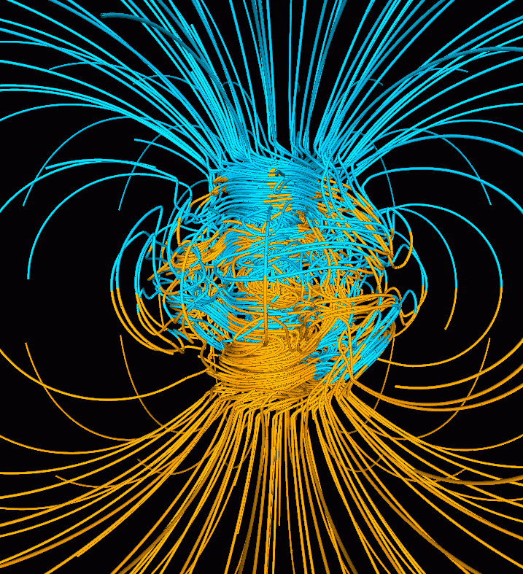
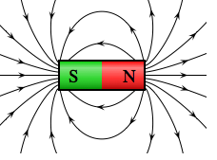
Earth Is a Giant Magnet
William Gilbert (1544 – 1603)
Notes:
Magnetic field plays very important role in solar and space physics in general and space weather in particular. William Gilbert in the 16th century discovered that the Earth is a giant magnet.
We all know from a school coarse of physics that magnetic field lines, forming closed loops, are coming out of the north magnetic pole of a simple magnet and entering the southern pole. On the right is shown model Earth’s magnetic field, which close to the Earth resembles the field of a simple magnet.

Slide 9
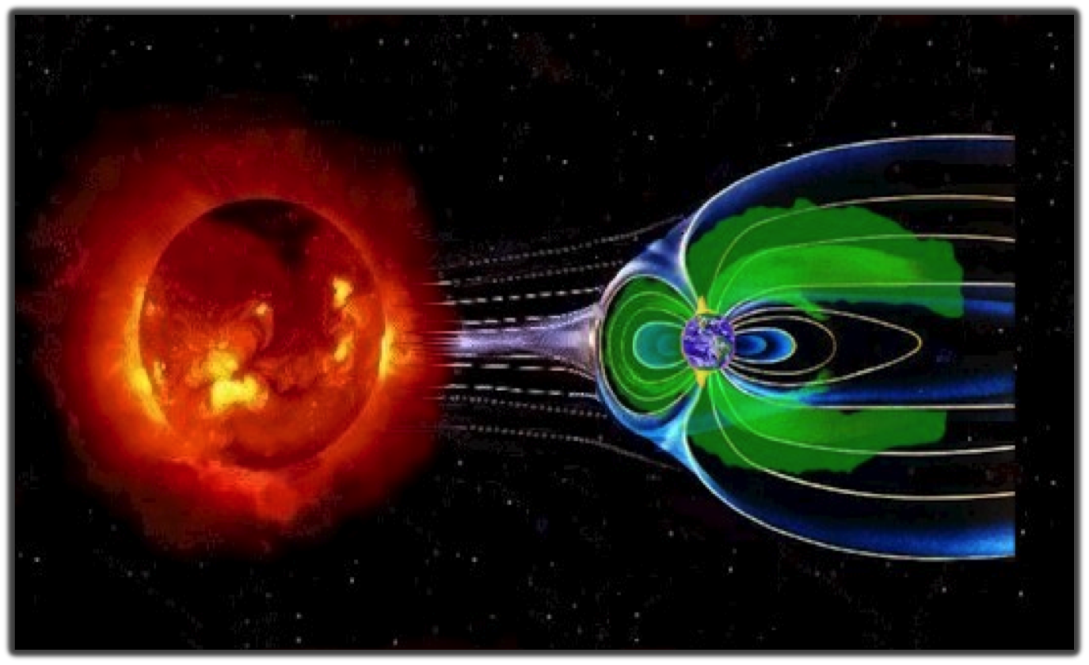
Earth’s Magnetic Field – Our Shield
Notes:
On a large scale the Earth’s magnetic field looks more like a comet with the stretched tail. This shape is a result of the interaction between the solar wind and Earth’s magnetic field.
The magnetic field is the shield that protects the Earth from the solar plasma particles because they have difficulty in moving across the magnetic field lines.
If the Earth did not have the magnetic field, continuously blowing solar wind and CMEs would most likely wipe out all the life forms on the Earth. Scientists speculate that something like this could have happened on Mars, who lost its magnetic field over the time.

Slide 10
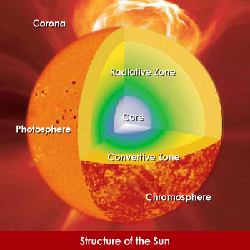
Structure of the Sun
Core (up to ~ 0.25 Rs): T ~15 MK and very dense. Nuclear fusion.
Radiation Zone (0.25 – 0.7Rs): transparent for photons. T ~ 7 – 2 MK
Convective zone: (0.7 – 1.0 Rs):
T is lower. Energy is transported outward mostly by convection.
Photosphere (surface): 6000 K
Sunspot (typical) 4200 K
(~100 km thick).
Chromosphere: 20,000K (1.0Rs-2000km)
Transition region: 20000K – 1-2 MK (above 2000 km - no clear range)
Corona: 2 MK
Notes:
Let’s go back to the Sun. In this picture schematically is shown the structure of the Sun and it’s regions. 1) In the center there is very hot and dense solar core (http://iswa3.ccmc.gsfc.nasa.gov/wiki/index.php/Glossary)
where all the solar energy is created. The energy equivalent to billions of hydrogen bomb explosions is released each second. 2) Above the core there is a cooler and less dense radiation zone (http://iswa3.ccmc.gsfc.nasa.gov/wiki/index.php/Glossary)
which is transparent for photons. 3) Higher up is the convective zone (http://iswa3.ccmc.gsfc.nasa.gov/wiki/index.php/Glossary), where energy is transported by circular motion of the heated material. 4) Above the convective zone is coolest (~ 6000 K only) solar region called photosphere (http://iswa3.ccmc.gsfc.nasa.gov/wiki/index.php/Glossary) - or solar “surface”.
5-6) Above the photosphere is hotter chromosphere (http://iswa3.ccmc.gsfc.nasa.gov/wiki/index.php/Glossary) and above the chromosphere, more hot transition region (http://iswa3.ccmc.gsfc.nasa.gov/wiki/index.php/Glossary).
7) The outer part of the solar atmosphere is called solar corona. The temperature reaches millions of Kelvin there. Scientists are still debating what mechanisms heat the corona.

Slide 11
Photosphere
The photosphere is the visible surface of the Sun that we are most familiar with.
A layer about 100 km thick (very thin compared to the 700,000 km radius of the Sun).
T ~ 6000 K
Sunspot (typical)
~ 4200 K
Visible spectrum:
390 - 700 nm
Notes:
The photosphere is the visible surface of the Sun that we are most familiar with. A layer about 100 km thick (very thin compared to the 700,000 km radius of the Sun). The temperature is about 6000 degrees
and in relatively darker sunspots about 4000 K.
(http://iswa3.ccmc.gsfc.nasa.gov/wiki/index.php/Glossary/photosphere)

Slide 12
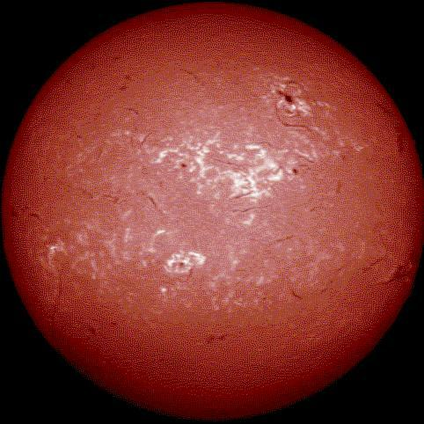
Chromosphere
Irregular layer above the photosphere ~ 2000 km deep. The temperature rises to ~ 20,000°. Hydrogen emits light that gives off a reddish color (H-alpha emission) which can be seen in prominences that project above the limb of the sun during total solar eclipses. The chromosphere is also the site of variation in solar flares, prominence and filament eruptions, flow of material in post-flare loops.
656.3 nm
T ~ 20 000 K
Notes:
Chromosphere is an irregular layer above the photosphere ~ 2000 km deep. The temperature rises to ~ 20,000°. Hydrogen emits light that gives off a reddish color (H-alpha emission) which can be seen in prominences that project above the limb of the sun during total solar eclipses. The chromosphere is also the site of changes in solar flares, prominence and filament eruptions, flow of material in post-flare loops.
(http://iswa3.ccmc.gsfc.nasa.gov/wiki/index.php/Glossary/_chromosphere)

Slide 13
Transition Region
The temperature rises to from 20000 to ~ 1-2 MK. Below, gravity dominates the shape of most features, so that the Sun may be described in terms of layers and horizontal features (like sunspots); above, dynamic forces dominate the shape of most features, so that the transition region itself is not a well-defined layer at a particular altitude.
17.1 nm
T ~ 20 000 K to ~ 1-2 MK
Notes:
Above the chromosphere there is a transition region. The temperature from 20000 to ~ 1-2 MK. Below, gravity dominates the shape of most features, so that the Sun may be described in terms of layers and horizontal features (like sunspots); above, dynamic forces dominate the shape of most features, so that the transition region itself is not a well-defined layer at a particular altitude.
( http://iswa3.ccmc.gsfc.nasa.gov/wiki/index.php/Glossary)

Slide 14
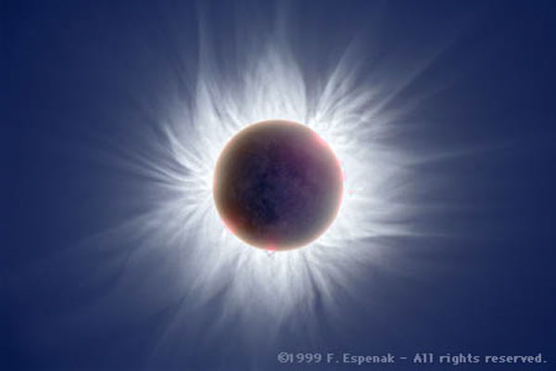
Corona
The Corona is the Sun's outer atmosphere. It is visible during total eclipses of the Sun as a pearly white crown surrounding the Sun.
T ~ 2 MK
The heating of
corona is an ongoing research area
Notes:
The Corona is the Sun's outer atmosphere. It is visible during total eclipses of the Sun as a pearly white crown surrounding the Sun. The temperature is about 2 million K.
The heating of corona is an ongoing research area
http://iswa3.ccmc.gsfc.nasa.gov/wiki/index.php/Glossary/_solar_corona

Slide 15
Solar Activity seen by HINODE satellite
Notes:
Solar material is in constant, active motion. Plasma motion in the convective zone generates the magnetic field which plays a crucial role in the physical processes on the Sun and it’s activity.
In this slide is shown solar atmosphere relatively close to the photosphere seen by the Japanese HINODE satellite. You can notice constantly “boiling” surface, together with numerous small eruptions, brightening, fountains of the solar material. In the left corner solar plasma is flowing along the arcade shaped magnetic field line loops (http://iswa3.ccmc.gsfc.nasa.gov/wiki/index.php/Glossary). This flow happens because, although charged particles experience difficulty in moving across, they can almost freely move along the magnetic field lines.

Slide 16
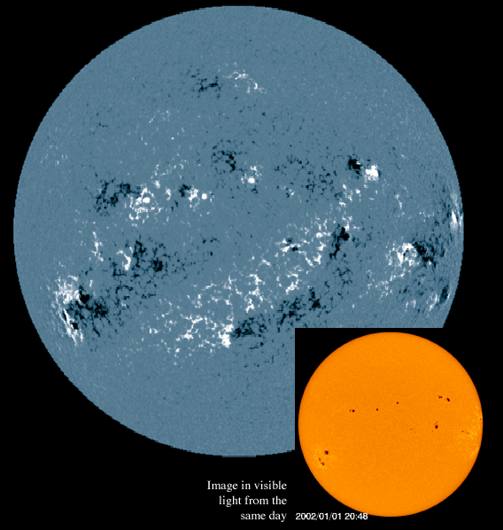
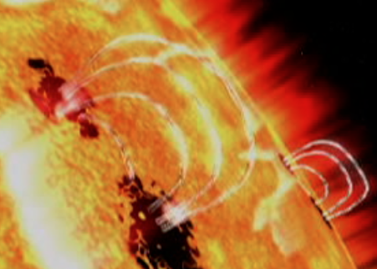
Magnetic Field, Active Regions, Sunspots
More sunspots mean more activity on the Sun.
Notes:
As I mentioned earlier, solar magnetic field plays a crucial role in the processes on the Sun and solar activity. In this slide is shown a magnetogram (
http://iswa3.ccmc.gsfc.nasa.gov/wiki/index.php/Glossary) - magnetic field map - of the solar photosphere. The black and white spots describe the concentration of relatively strong magnetic field with different polarity for each color. This is called an active region. Most of the flares and CMEs originate from active regions. In the right upper corner is an artists depiction of a part of photosphere and solar atmosphere for an active region (
http://iswa3.ccmc.gsfc.nasa.gov/wiki/index.php/Glossary). In this depiction two sunspots have opposite magnetic polarity, connected to each other with magnetic field loops. At the photospheric level strong magnetic field of a sunspot prevents particles from being heated easily, so the temperature of the sunspot is lower than the temperature of ambient material. Hence the name “sunspot”, which looks darker in the visible part of the spectrum. See the insertion of the solar disc image in the visible light for the same day as the magnetogram.

Slide 17
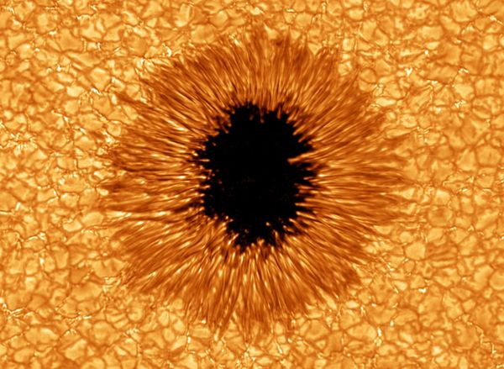
Sunspot Close Up
Sunspots are caused by intense magnetic field inhibiting convection and leaving their temperature (~ 3000–4500 K) lower than the temperature of surrounding material ( ~ 6000) K. This makes them visible as dark spots. Size varies from 16 km to 160,000 km in diameter. Sunspots host coronal loops and reconnection events. Most solar flares and CMEs originate in magnetically active regions around sunspot groups.
Notes:
Here is a close look to a sunspot (http://iswa3.ccmc.gsfc.nasa.gov/wiki/index.php/Glossary.
) given by HINODE satellite.
As I said earlier, sunspots are caused by intense magnetic field, which inhibits convection, leaving their temperature (~ 3000–4500 K) lower than the temperature of surrounding material ( ~ 6000) K and makes them visible as dark spots. Sunspot sizes vary from 16 km to 160,000 km in diameter. Sunspots host coronal loops
(http://iswa3.ccmc.gsfc.nasa.gov/wiki/index.php/Glossary)
and magnetic reconnection events
(http://iswa3.ccmc.gsfc.nasa.gov/wiki/index.php/Glossary ).
Most solar flares and CMEs originate in magnetically active regions around sunspot groups.

Slide 18
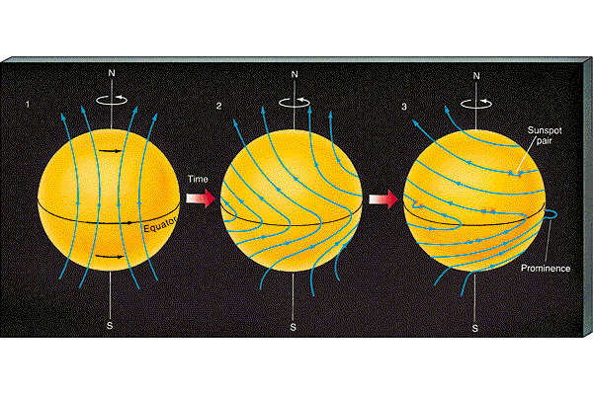
Solar Magnetic Field
-The Sun is permeated by global roughly dipole magnetic field;
-The field is produced by a circular electric current flowing deep within the Sun;
-The current is produced by shear (stretching of material) between different parts of the Sun that rotate at different rates, and the fact that the Sun itself is a very good electrical conductor;
- The field, as plasma moves, changes constantly due to plasma motion
Notes:
What is the mechanism that creates solar magnetic field?.
The overall picture is the following:
-The Sun is permeated by overall roughly dipole magnetic field, similar to the Earth.
-The dipole field is produced by a circular electric current flowing deep within the star.
-The current is produced by shear (stretching of material) between different parts of the Sun that rotate at different rates, and the fact that the Sun itself is a very good electrical conductor.
Those are the basic principles everybody agrees on. Then, there are different theories and models that describe solar magnetic field, but similar to coronal heating problem, this is still ongoing research area.

Slide 19
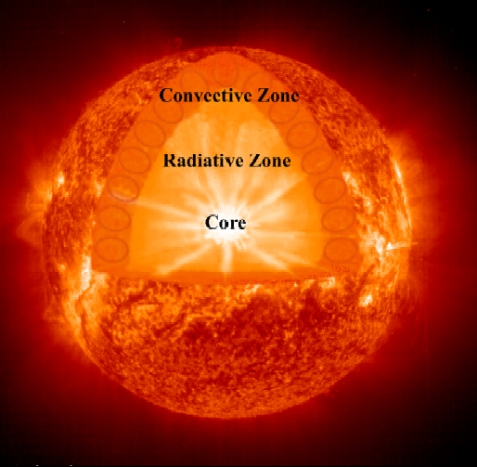
Solar Activity is Related to
Magnetic field
It is believed that solar magnetic field, while changing its configuration in a constantly varying solar atmosphere, releases energy, accelerating solar plasma and causing flares and CMEs.
Magnetic field is believed to be generated at the base of the convective zone
Fields are stressed and pushed to surface, leading to flares and eruptions.
Notes:
What is known for sure, is that solar activity is related to its magnetic
field. It is believed that when the magnetic field changes its configuration
in a constantly varying solar atmosphere, this leads to release of energy
and accelerating of solar plasma, causing flares and CMEs.
Solar magnetic field is believed to be generated at the base of the
Convective zone. Fields are stressed and pushed to surface.

Slide 20
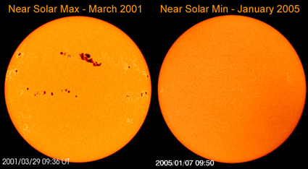
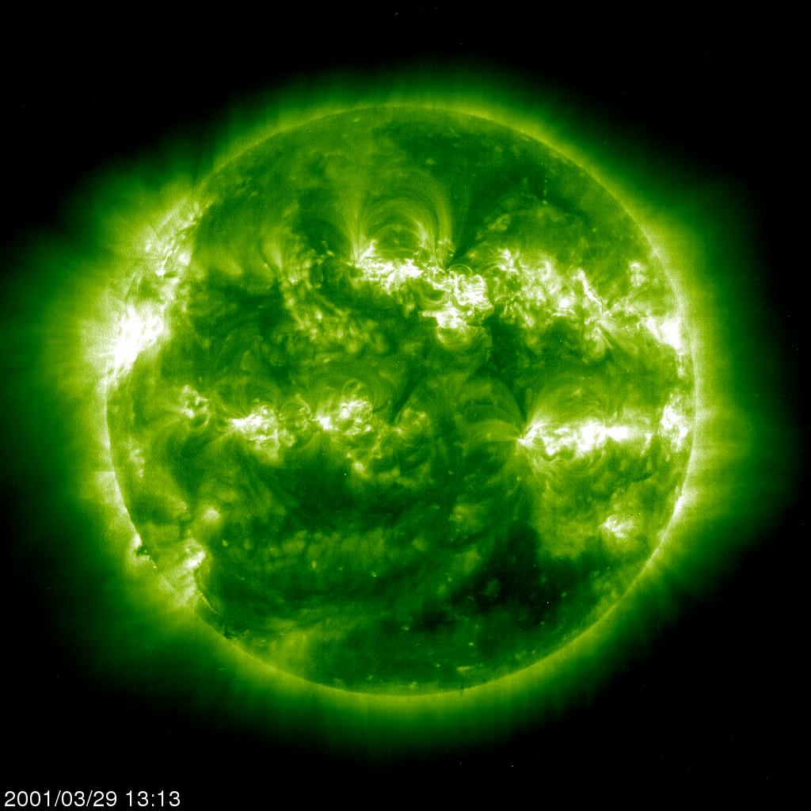
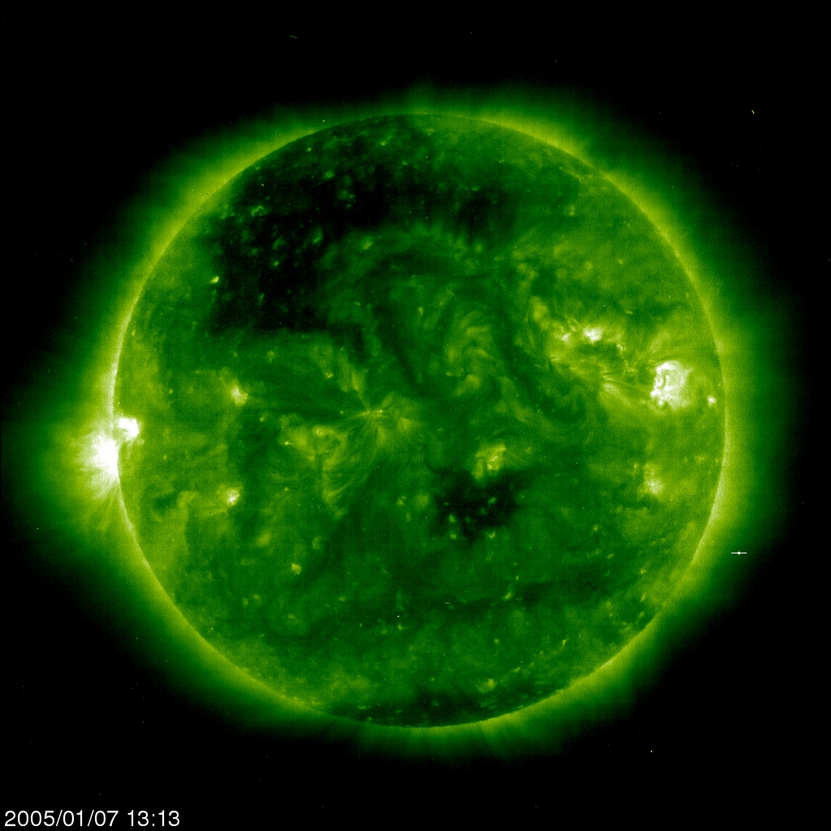
Solar Activity
Varies on a Large Time Scale
Notes:
So, more sunspots, or more regions of concentrated strong magnetic field are on the solar surface, more active is the sun in producing flares and CMEs. Solar activity varies on a large time scale. This slide shows variation of the solar magnetic field and related solar activity in time.
Left row – near solar activity maximum (March, 2001), right row – near solar activity minimum (January, 2005). The upper panel shows the photosphere in visible part of the spectrum, the lower – solar atmosphere in ultraviolet wavelength 19.5 nm.
You can see a number of sunspots in photosphere and corresponding bright areas in the solar atmosphere during the solar maximum, and almost spotless photosphere and much darker atmosphere during the solar minimum.
Statistics shows that during the solar activity maximum for example there are about 5 CMEs per day, and during the solar minimum few CMEs a week (the ratio is of the order of 10).

Slide 21
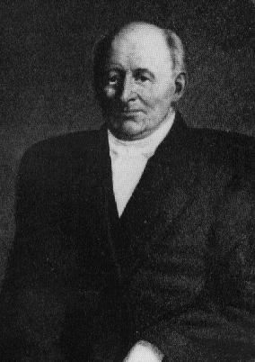
Solar Cycles
Samuel Heinrich Schwabe
(1789 – 1875)
High and low sunspot activity repeats about every 11 years
Notes:
German pharmacist Samuel Shcwabe, observing Sun as an amateur astronomer in the 19 century, discovered accidentally solar cycles
(http://iswa3.ccmc.gsfc.nasa.gov/wiki/index.php/Glossary/solar_cycle_of_magnetic_activity)
He was recording sunspots each day and after almost 20 years of observations discovered that high and low sunspot number repeats about every 11 years.

Slide 22
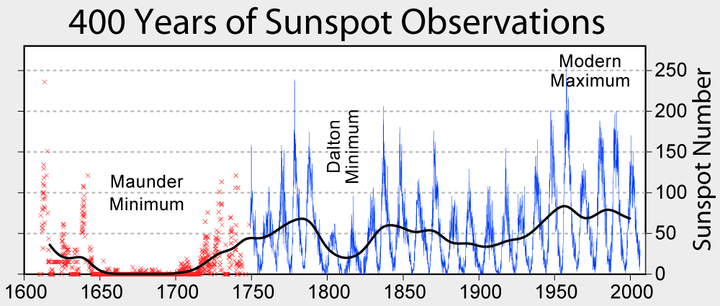
Variation on Larger Time Scales
.
Notes:
Here is presented ~ 400 years of sunspot observations. Old data was reconstructed, so the plot goes back to the early 17 th century. Besides 11 year cycle, solar activity experiences variation on a larger scale time scale - it goes up and down. For example, starting from the mid 17 th century, for about 70 years there was extremely low solar activity (Maunder Minimum). The last significant drop in the solar activity was recorded in the early 19 th century. In the 20 century and the beginning of the current century the solar activity has been growing (this is called Modern Maximum).

Slide 23
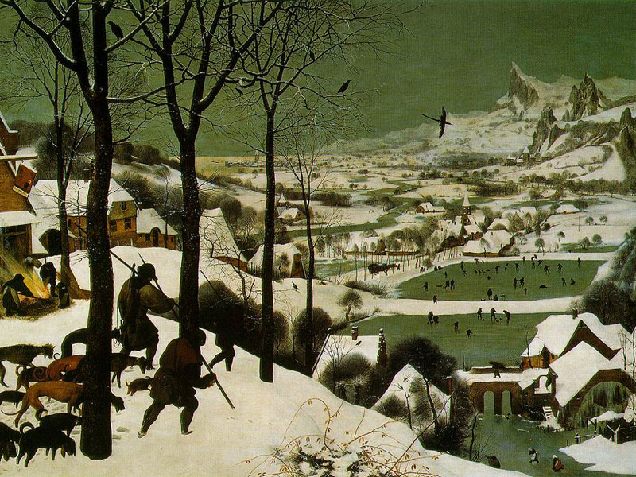
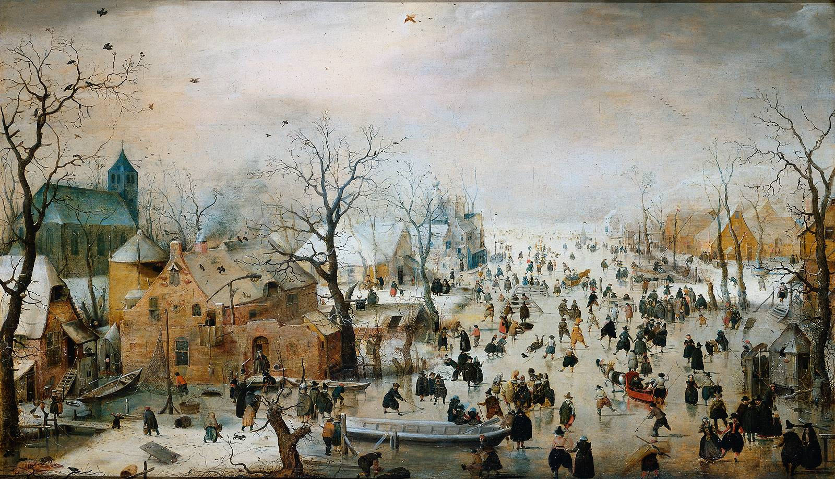
Little Ice Age
Pieter Brueghel the Elder
Hendrick Avercamp
Notes:
Variability of the Solar activity affects the climate variation, but on time scale much larger then the regular weather variation time scale. During and later the Maunder Minimum it was very cold in Europe and this is reflected in the works of great Dutch and Flemish painters.

Slide 24
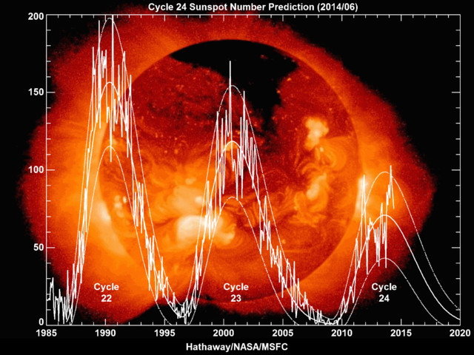
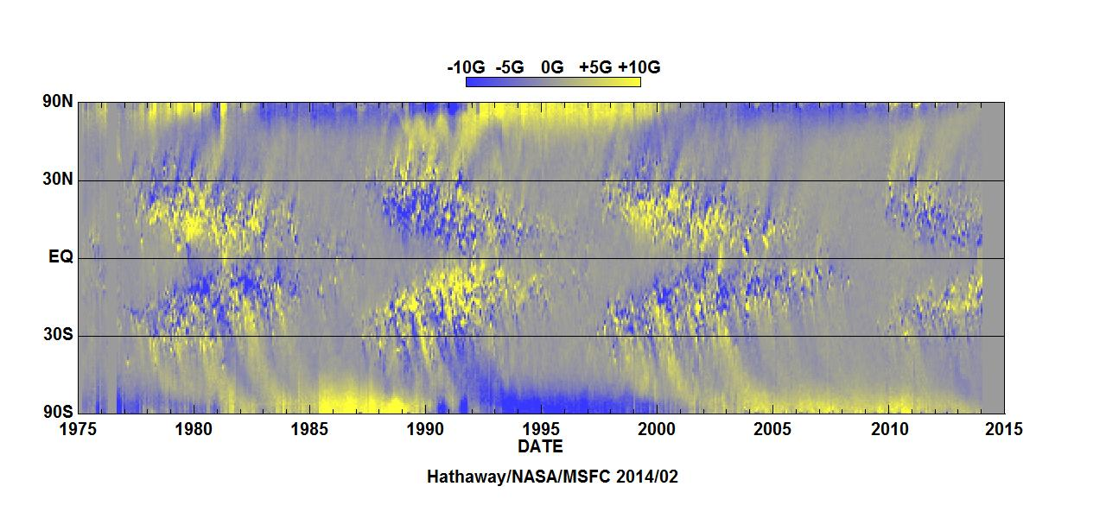
Solar Cycles are related to variation
of Solar global magnetic field
Notes:
Scientists know now that the solar rotation results into a solar magnetic field variation cycle with the period of about 22 years. The inversion of solar global poloidal (meridional) field component happens every 11 years at the moment of maximum activity. The scenario of the solar cycle is the following:
Solar minimum occurs when the magnetic field is concentrated in the polar regions with a certain polarity of the global poloidal magnetic field component. At this time there are very few sunspots on the solar disk.
Then, over the coarse of the time, the number of sunspots increases and they are traveling towards the equatorial regions. There number reaches maximum in about 5.5 years.
Over the coarse of the next ~ 5.5 years, the magnetic field gradually becomes larger at the polar regions again, but with the different polarity of the global poloidal field component. At the end of the 11 year cycle, the number of sunspots is very low again.
Then the cycle repeats itself and the initial poloidal field direction becomes the same as ~ 22 years ago.

Slide 25
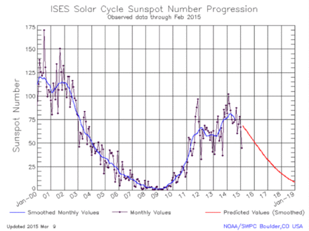
Current Solar Cycle 24
4-th slowest growth from the minimum ever.
Notes:
The current solar cycle 24 is characterized by very slow growth starting from the minimum in 2007-2008 (4-th slowest growth ever) and relatively low activity.
Could it be that we are heading towards another minimum?
The answer is: we do not know.
We know very little about how does the solar magnetic field creation works in reality.

