Slide 1
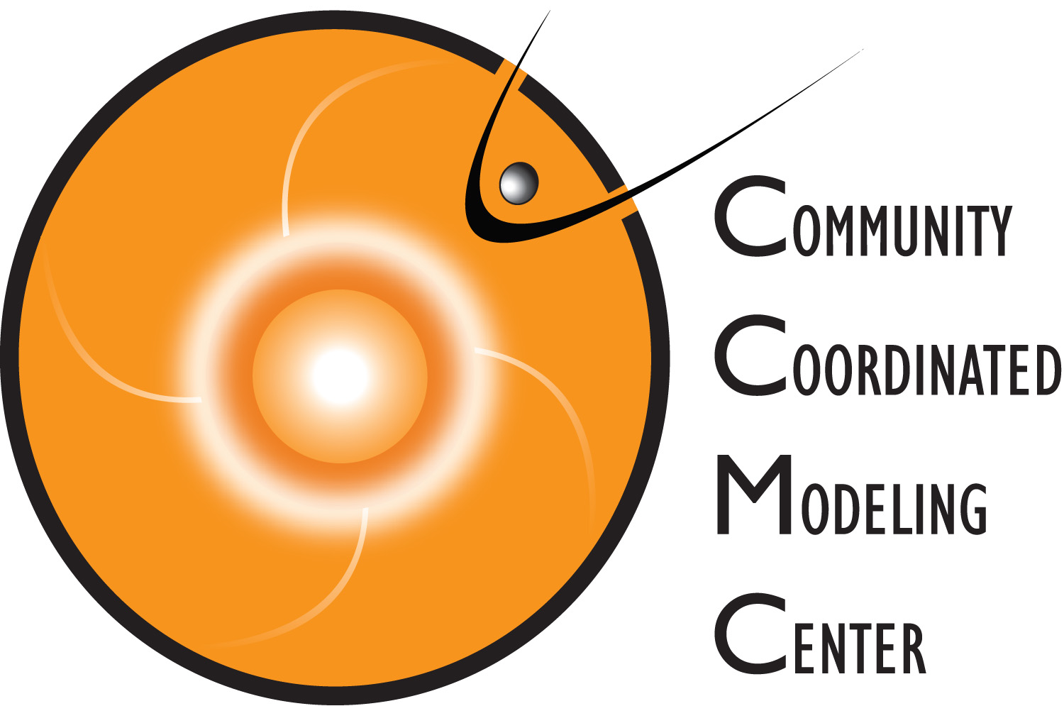
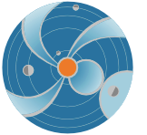
CME Analysis with StereoCAT for Space Weather: Part 1
SOHO/LASCO C2
M. Leila Mays (NASA/GSFC and CUA) m.leila.mays@nasa.gov
Barbara Thompson (NASA/GSFC) barbara.j.thompson@nasa.gov
SW REDI June 2015
Notes:
This is part 1 of two lessons on determining the 3D parameters of CMEs using the CCMC/SWRC developed tool called StereoCAT (Stereo CME Analysis Tool). In part 2 of this lesson we will discuss the limitations of this method and how to combine all available data and observations to make your best estimate of CME parameters.

Slide 2
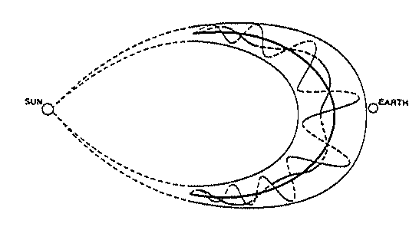
Coronal Mass Ejections are important drivers of space weather activity. Their shocks can accelerate particles (SEPs). Earth directed CMEs (CMEs that propagate towards Earth’s location) produce the majority of geomagnetic storms.
Purpose of this lesson: Learn how to measure the kinematic properties of CMEs (CME parameters) and determine their qualitative features.
Motivation: CME parameters are used as initial conditions of CME propagation models. These models are used to estimate the CME path and arrival time at various locations.
Notes:
Coronal Mass Ejections are important drivers of space weather activity. Their shocks can accelerate particles (SEPs). Earth directed CMEs (CMEs that propagate towards Earth’s location) produce the majority of geomagnetic storms.
Purpose of this lesson: Learn how to measure the kinematic properties of CMEs (CME parameters) and determine their qualitative features.
Motivation: CME parameters are used as initial conditions of CME propagation models. These models are used to estimate the CME path and arrival time at various locations.

Slide 3
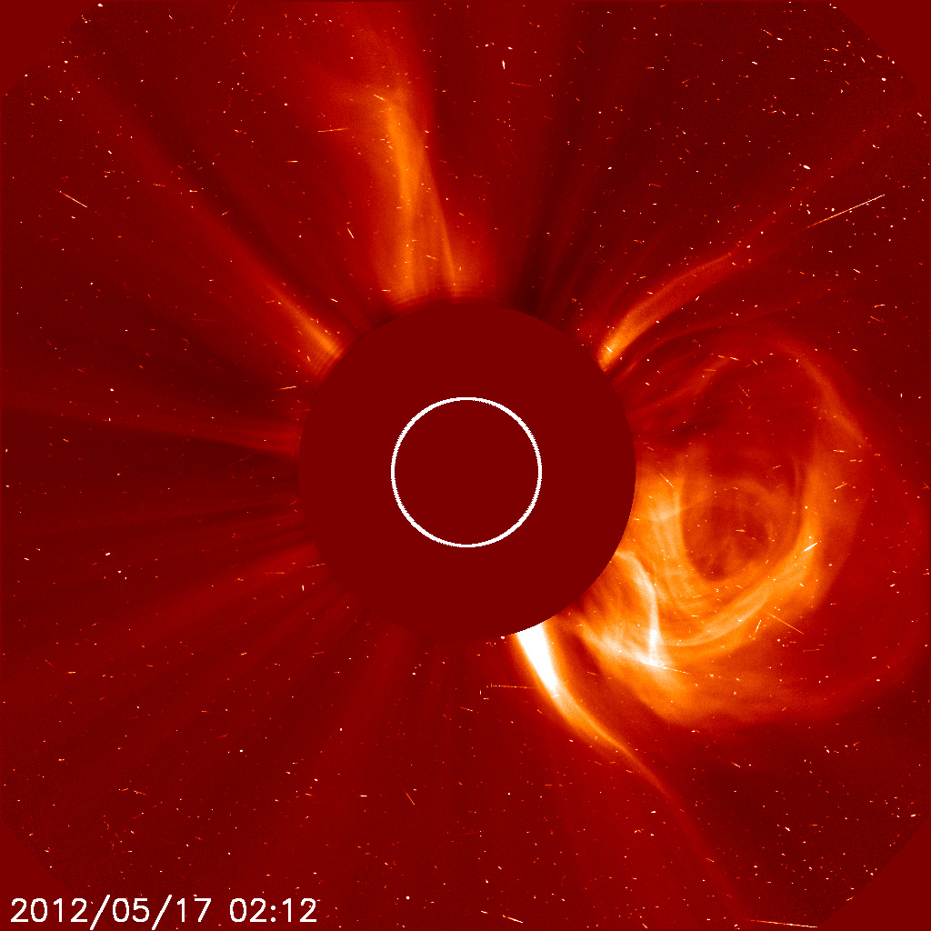
Coronal Mass Ejections
Removal of magnetic field and mass from the solar corona – clouds of magnetized plasma
10¹² – 10¹³ kg mass
CMEs originate from closed magnetic field regions, such as active regions, filament regions.
Appear as bright loops moving away from sun in coronagraphs
Notes:
CMEs are:
Removal of magnetic field and mass from the solar corona – clouds of magnetized plasma. They are eruptions of magnetic field from the sun, which carries the plasma along with it.
10¹² – 10¹³ kg mass
CMEs originate from closed magnetic field regions, such as active regions, filament regions.
Appear as bright loops moving away from sun in coronagraphs

Slide 4
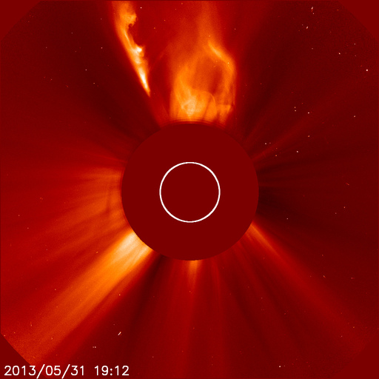
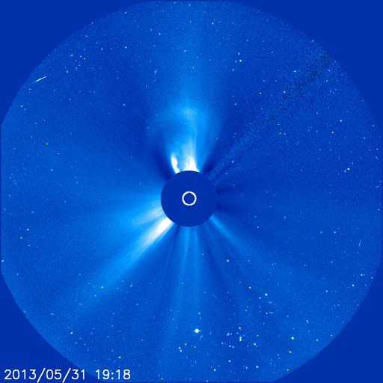
Coronagraphs block out the direct light of the Sun in order to view the faint corona.
They are white light images, line of sight integrated scattered light from the Sun from the coronal electrons (Thomson scattering). You are seeing the CME projected onto the plane of the sky
The plane of sky is the instrument image plane seen here
Example movies
Notes:
Coronagraphs block out the direct light of the Sun in order to view the faint corona, which is like the sun’s atmosphere. The corona is made up of plasma which is an ionized gas. The solar magnetic field permeates through the corona and heliosphere. They are white light images, line of sight integrated scattered light from the Sun from the coronal electrons (Thomson scattering). You are seeing the CME projected onto the plane of the sky. The plane of the sky is the instrument image plane seen here.

Slide 5
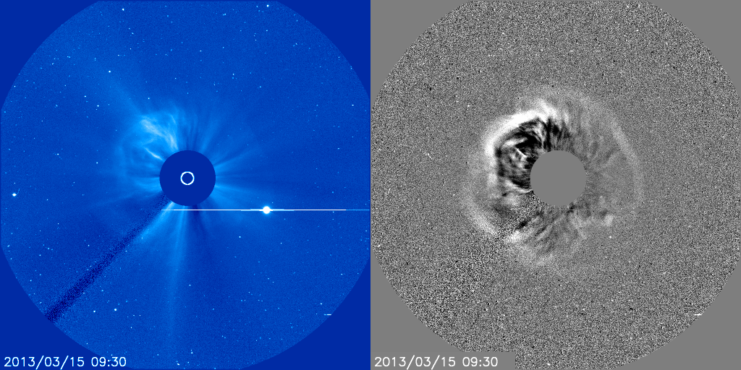
Halo CMEs are CMEs that appear to surround the occulting disk of the coronagraph. The CME can originate from the front or back side of the Sun, and therefore are travelling either towards or away from the observer.
Due to scattering and projection, the CME sides or flanks are detected in these images
Notes:
Halo CMEs are CMEs that appear to surround the occulting disk of the coronagraph. The CME can originate from the front or back side of the Sun, and therefore are travelling either towards or away from the observer.
Here is an example of a halo CME in SOHO LASCO C3, direct image on the left, difference image on the right. The difference image was created by subtracted the previous frame from the current frame. Some differences are subtracted from a “base” frame a few hours prior to the event.
Due to scattering and projection, the CME sides or flanks are detected in these images, not the leading edge (nose) of the CME.

Slide 6
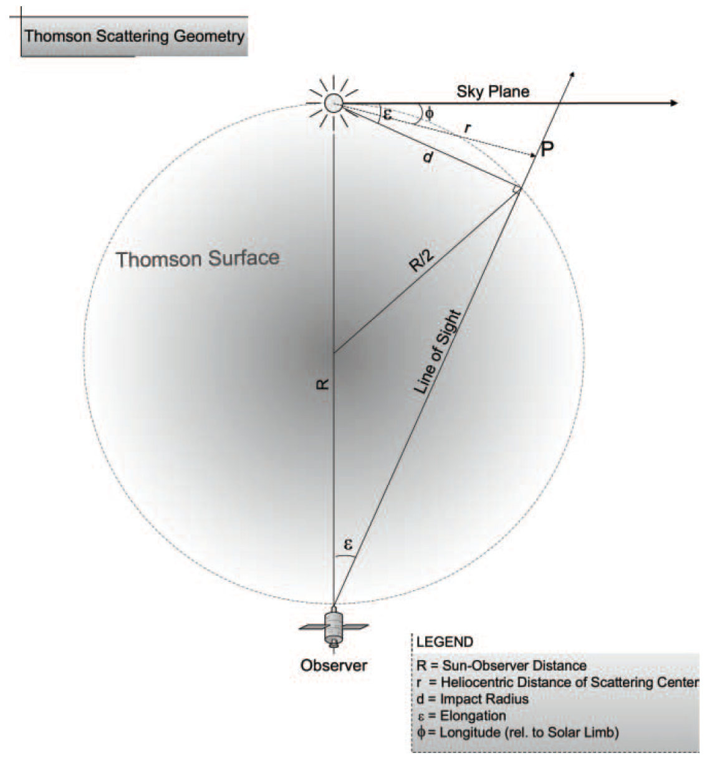
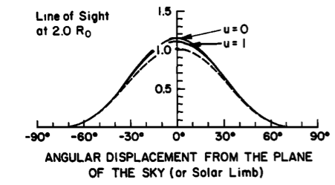
How CMEs appear in coronagraphs depend on projection effects and Thomson scattering amplitudes (more on this in part 2). * In general, close to the Sun, CMEs which are far from the plane of sky are less visible, but the CME width should be considered. * The most brightness is visible near “Thomson surface”.
Scattering efficiency closer to the Sun (Hundhausen et al. 1993):
Vourlidas & Howard, 2006
Notes:
How CMEs appear in coronagraphs depend on projection effects and scattering amplitudes (more on this in part 2).
In general, close to the Sun, CMEs which are far from the plane of sky are less visible, but the CME width should be considered. This is because most of the scattering occurs in the plane of sky. So if narrow CME is 60 degrees from the plane of sky, only the flank or sides of it may appear very faintly in the image. But if a wide CME is 60 degrees from of sky, it will appear more clearly and brightly in the image, but it will still be the flanks that are visible.
* The most brightness is visible near “Thomson surface”. As you move away from the sun, most of the contribution to the brightness in the images will come from the Thomson surface (due the angle of incident light from the Sun.
The Thomson surface is depicted in the graphic on the left from Vourlidas & Howard, 2006

Slide 7
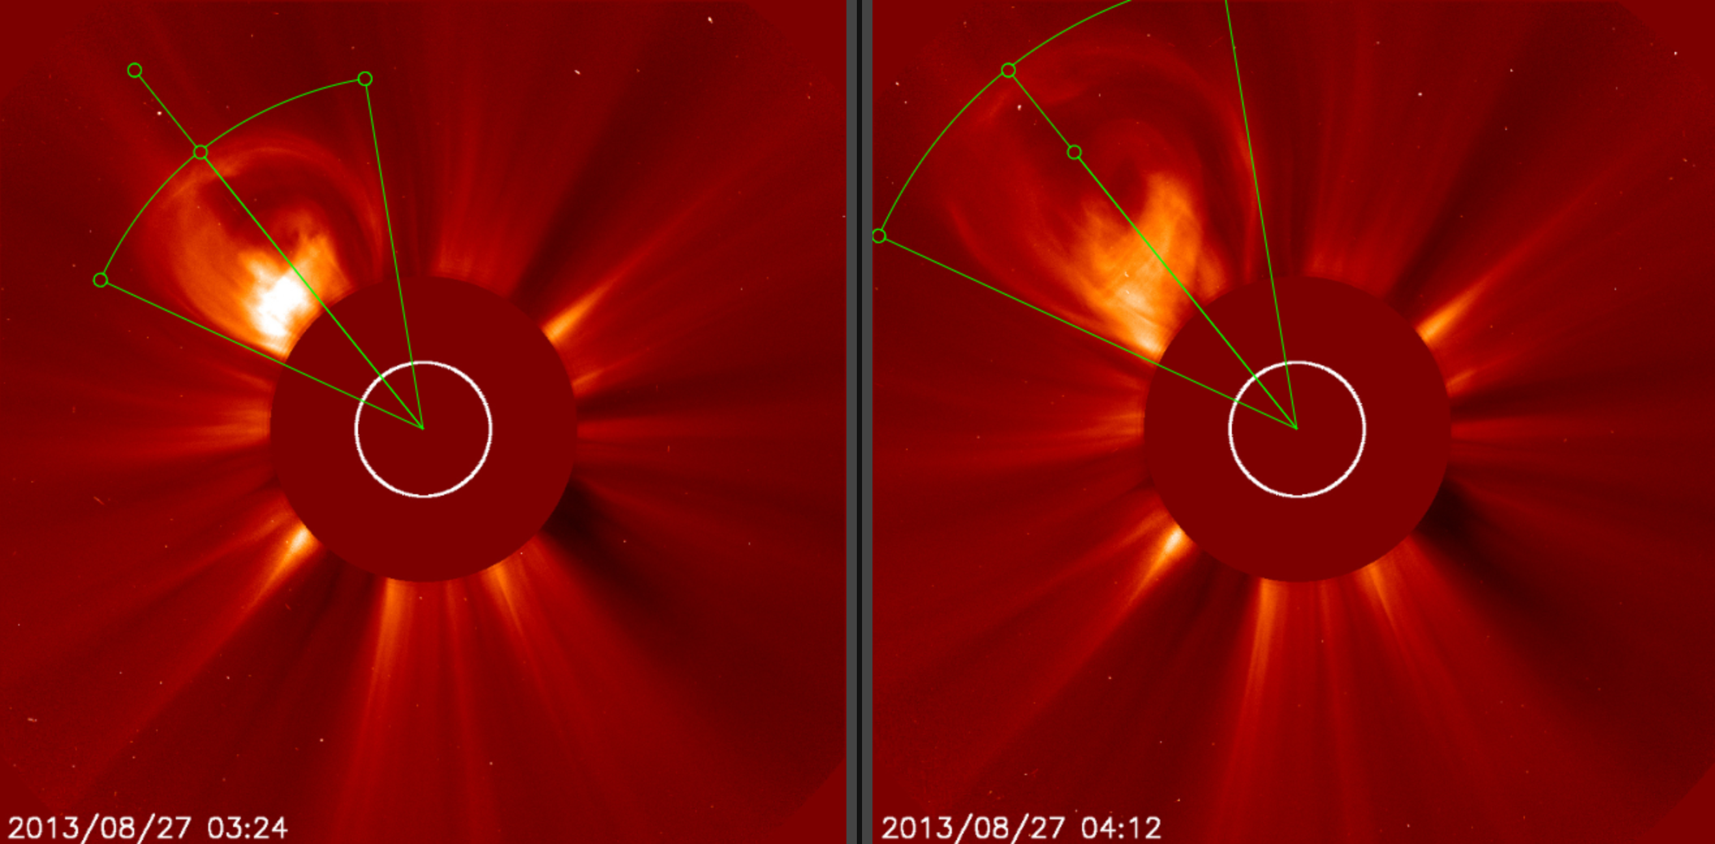
With coronagraph data you can measure the leading of the CME at different times. From this you can determine the “plane-of-sky” speed by measuring the position of the leading edge of the CME at two times. By using coronagraphs on various spacecraft, you can get a measurements of this projected speed from various viewpoints.
north
east
west
south
Notes:
With coronagraph data you can measure the leading of the CME at different times. From this you can determine the “plane-of-sky” speed by measuring the position of the leading edge of the CME at two times. By using coronagraphs on various spacecraft, you can get a measurements of this projected speed from various angles.
Here are coronagraph images from STEREO Ahead COR2, at two different times. You can the leading edge has been marked in each image. By knowing the height of the CME leading edge at two times, the speed in the plane of the image can be determined.

Slide 8
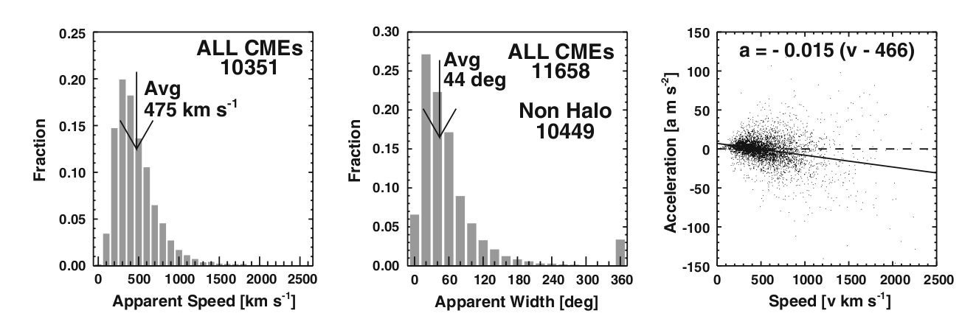
Coronal Mass Ejection Parameters
Average speed ~475 km/s, width~44 deg
(Gopalswamy et al., 2010)
SOHO LASCO CME Catalog
Notes:
We can us coronagraph data to determine CME parameters. The SOHO LASCO CME catalog is a large catalog of CME measurements using SOHO images. The graphs from the paper by Gopalswamy et al., 2010 show the distribution of the CME parameters. You can see in the left graph that the most common speed are between 300 and 600 km/s or so, with the average speed at 475 km/s. The faster CMEs are less common. The middle graph show the CME apparent width, which is on average 44 degrees, with most common widths near 30 degrees or so. 360 degree widths are designated for halo CMEs. The right graph show the CME acceleration as a function of CME speed, showing that most CMEs decelerate, but there is some scatter. Slower CMEs generally accelerate towards the ambient solar wind speed and faster CMEs decelerate.

Slide 9
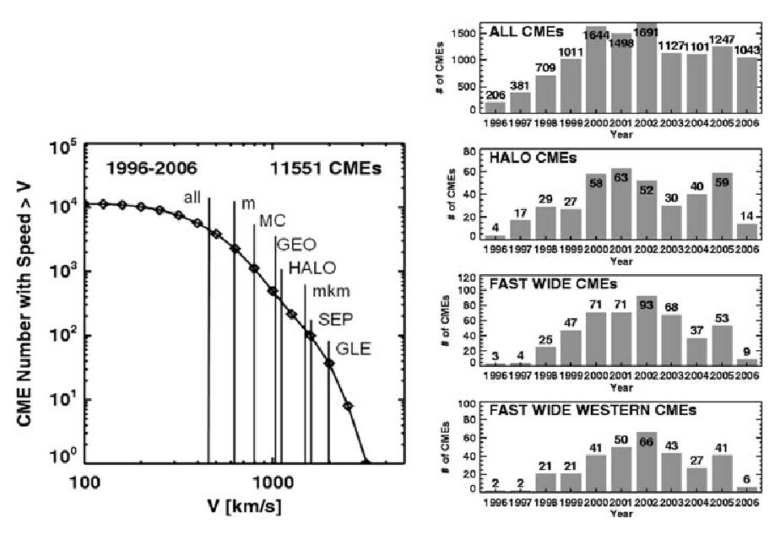
Annual number of different CMEs
Cumulative distribution of CME speeds
(Gopalswamy et al., 2010)
Notes:
From the same paper the cummulative distribution of CME speeds is shown for the catalog (left image). The faster speeds are associated with metric radio bursts (m), GEO (geomagnetic storms), halo CMEs (HALO), mkm radio bursts, SEPs, and GLEs (ground level events).
The histograms on the right show how CMEs vary throughout the solar cycle. At the top all CMEs are included, and you can see there are fewer CMEs during solar minimum, but there are still a few per few days, during solar maximum there are few CMEs per day. These are further broken down by Earth-directed Halo CMEs, and fast wide CMEs, and fast-wide western CMEs. These follow roughly the same distrubution with some variations. Fast wide western CMEs are of special interest for solar energetic particle events.

Slide 10
http://swrc.gsfc.nasa.gov/main/score
Notes:
SCORE indicates the type of the detected CME based on the transient speed (see PDF chart). Typification is based on the rate of occurrence of CMEs and thus gives the user a quick idea about the likelihood of the observed event.
The different SCORE CME types are:
S-type: CMEs with speeds less than 500 km/s
C-type: Common 500-999 km/s
O-type: Occasional 1000-1999 km/s
R-type: Rare 2000-2999 km/s
ER-type: Extremely Rare >3000 km/s
Evans, R. M., A. A. Pulkkinen, Y. Zheng, M. Leila Mays, A. Taktakishvili, M. M. Kuznetsova, and M. Hesse (2013), The SCORE Scale: A Coronal Mass Ejection Typiﬁcation System Based On Speed, Space Weather, 11, doi:10.1002/swe.20058.
View a video describing SCORE: http://youtu.be/hN5bChbdky8

Slide 11
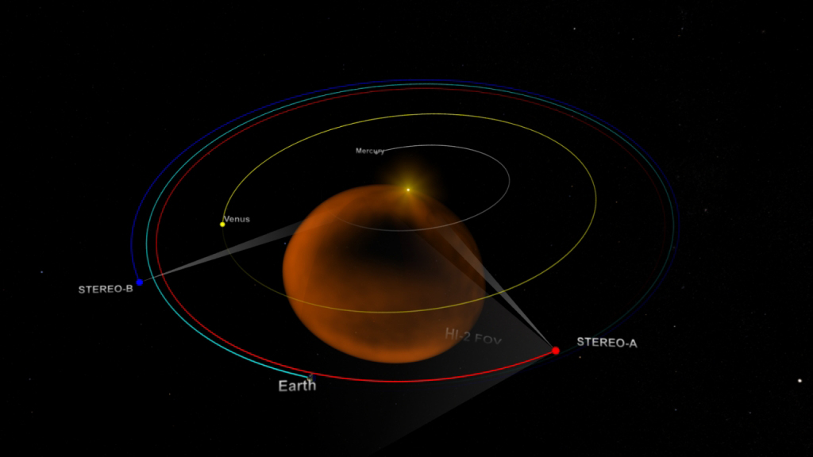
The two STEREO spacecraft observe the sun from two viewpoints
View the STEREO spacecraft orbits movie: https://www.youtube.com/watch?v=VzhMvEkK0gA
Notes:
The two STEREO spacecraft observe the sun from two viewpoints.
This image and movie shows the viewpoint of the two STEREO spacecraft, A is ahead of Earth and B is trailing behind Earth.
Link: View the STEREO spacecraft orbits movie https://www.youtube.com/watch?v=VzhMvEkK0gA

Slide 12
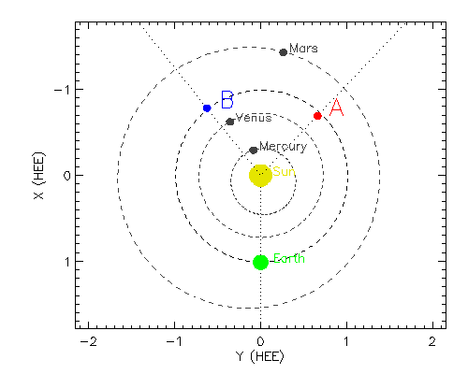
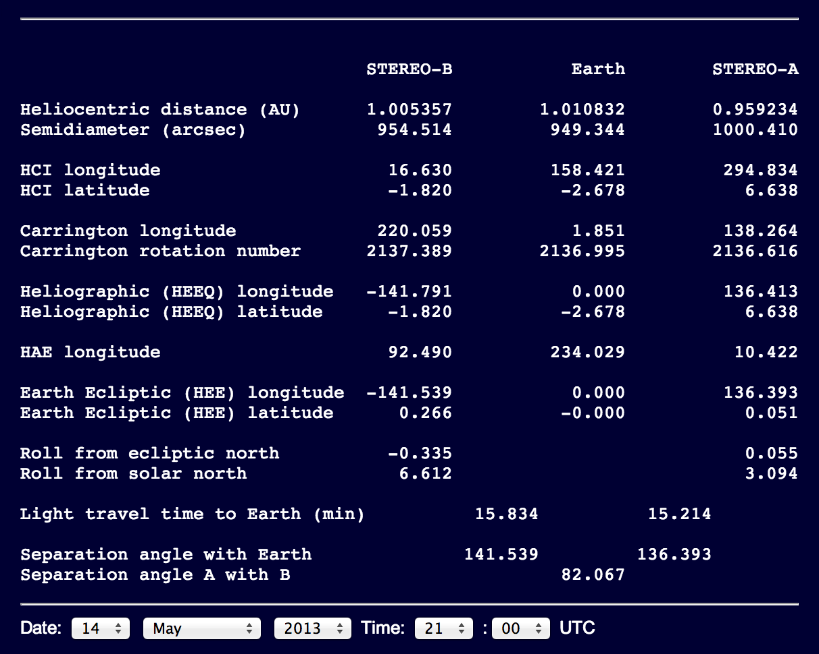
Where is STEREO?
http://stereo-ssc.nascom.nasa.gov/where.shtml
Click “STEREO Orbit Tool”
Longitude is measured
0 to 180˚ counterclockwise
0 to -180˚ clockwise
HEEQ:
Heliocentric Earth Equatorial
Z=North pole of solar rotation axis
X=intersection between solar equator and solar central meridian as seen from Earth
Notes:
Use there STEREO website orbit tool (http://stereo-ssc.nascom.nasa.gov/where.shtml) to find the HEEQ coordinates of the STEREO spacecraft and see a graph. This will help you determine which quadrants the CME longitude could be in just by looking at the geometry.
HEEQ coordinates is defined as:
X=intersection between solar equator and solar central meridian as seen from Earth
Z= North Pole of the solar rotation axis.
Earth is at 0 degrees longtiude in this coordinate system. Longitude is measure from 0 to 180 degrees counterclockwise and 0 to -180 degrees clockwise.
For example, on this date (14 May 2013) STEREO A is at 136 degrees longitude. A CME seen going to the right (west) in a SOHO LASCO image which is seen going to the left (east) in a STEREO COR2A image, must have a longitude between these two spacecraft, so between 0 and 136 longitude. If this CME is also observed by STEREO COR2B as moving to the left (east), this further constrains the longitude to be the eastern side of STEREO B’s view. STEREO B is at -141 degrees longitude on this date, so the eastern quadrant is between 39 degrees and -141 degrees. So putting this all together, the CME longitude must be between 39 and 136 degrees longitude.
Example 2: (On this date) if you view a full symmetric halo in SOHO LASCO and the source location is on the backside of the Sun, the longitude is likely near 180 degrees. If you view a full symmetric halo in STEREO A, but the source is on the front side of the sun (visible in SDO), the the longitude is likely near the opposite of STEREO A (located at 136 deg), so about -44 degrees.

Slide 13
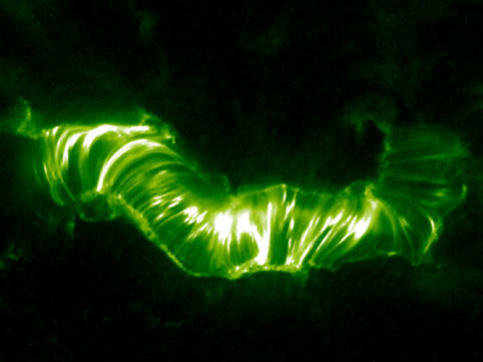
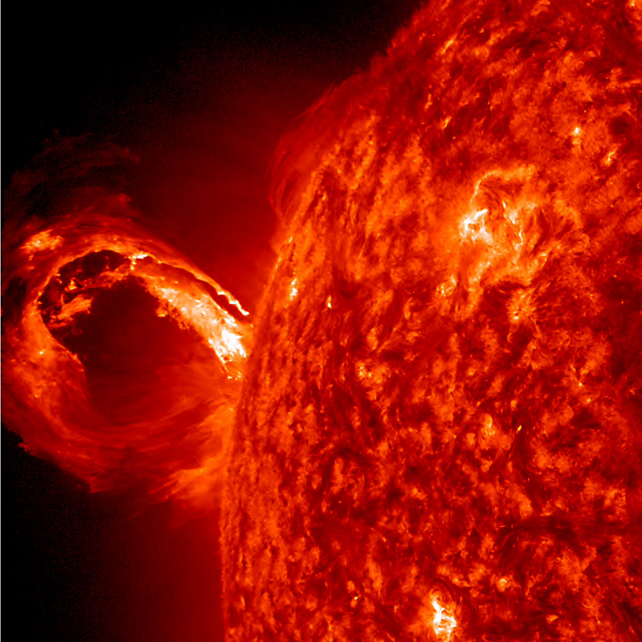
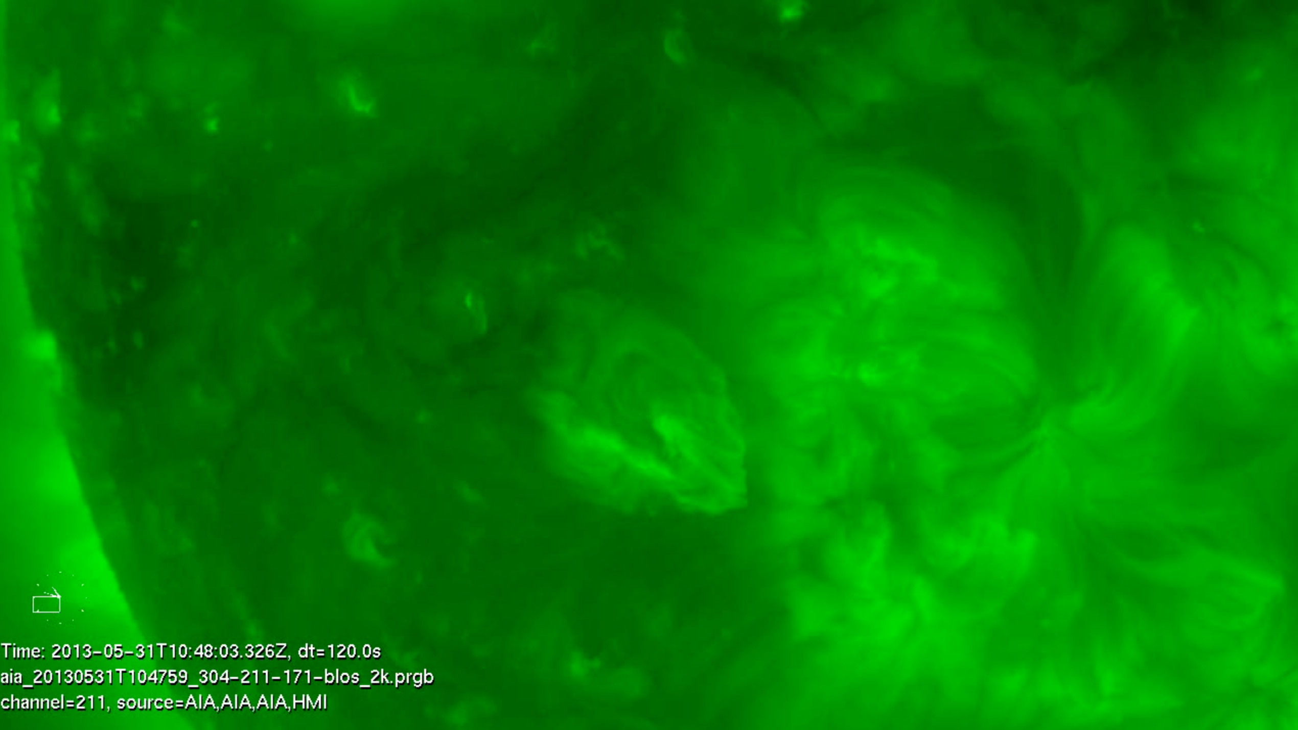
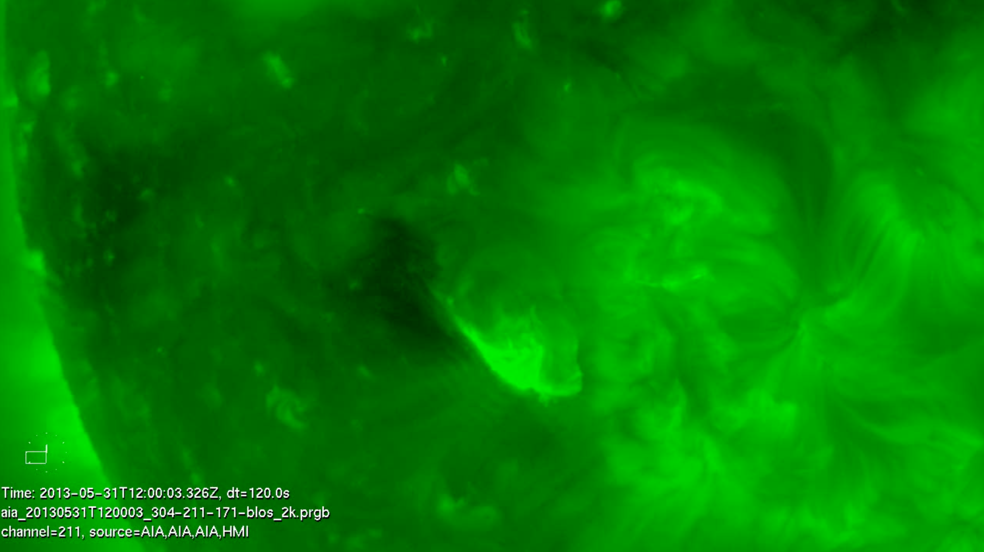
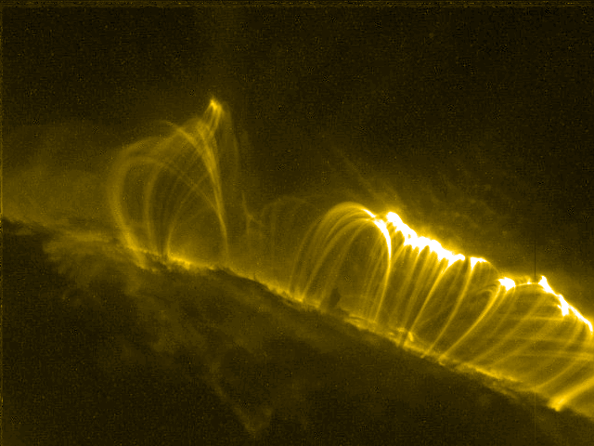
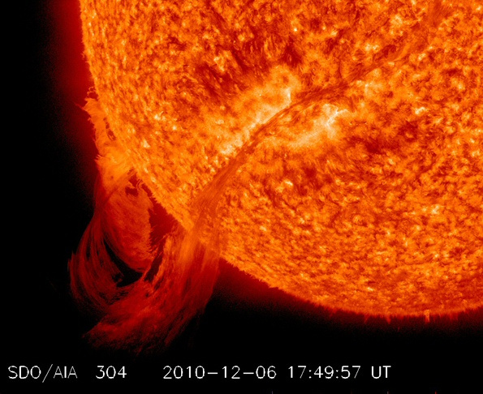
CME source locations/EUV lower coronal signatures of CMEs
* CMEs can originate from active regions and/or from filament eruptions.
* Some CMEs are associated with flares.
* EUV signatures include post eruption arcades, rising loops, coronal dimming, and prominence eruptions (click for example movies).
Important! Always determine the source location of every CME you analyze.
This can help you decide which coronagraph combinations to choose, and assess the accuracy of the CME parameters you obtain.
Sun Primer: Why NASA Scientists Observe the Sun in Different Wavelengths
post eruption arcade
prominence eruption
coronal dimmings.
filament eruption
More on this topic next Thursday!
Notes:
CME source locations/EUV lower coronal signatures of CMEs
* CMEs can originate from active regions and/or from filament eruptions.
* Some CMEs are associated with flares.
EUV signatures include post eruption arcades, rising loops, coronal dimming, and prominence eruptions (click for example movies).
Important! Always determine the source location of every CME you analyze.
This can help you decide which coronagraph combinations to choose, and assess the accuracy of the CME parameters you obtain.
Sun Primer: Why NASA Scientists Observe the Sun in Different Wavelengths
EUV lower coronal signatures of CMEs movies
post eruption arcadehttp://cdaw.gsfc.nasa.gov/movie/make_javamovie.php?img1=sta_e195&img2=sta_cor2&stime=20130526_1500&etime=20130527_0000
prominence eruptions http://go.nasa.gov/19Dni3v
http://cdaw.gsfc.nasa.gov/movie/make_javamovie.php?img1=lasc2rdf&img2=sdo_a304&stime=20130430_2200&etime=20130501_0800
filament eruptions http://go.nasa.gov/12qcWDO
http://www.lmsal.com/hek/gallery/podimages/2013/06/01/pod_malanushenko_anna_2013-06-01T02:24:03.851/anny_AIA-304_20130531T113203-20130531T185203_120s_made_20130601T022253_720p.mpg
coronal dimmingshttp://www.lmsal.com/hek/gallery/podimages/2013/06/01/pod_malanushenko_anna_2013-06-01T00:52:07.870/anny_AIA-211_20130531T094003-20130531T145203_120s_made_20130601T005102_720p.mpg
http://cdaw.gsfc.nasa.gov/movie/make_javamovie.php?img1=stb_cor2&img2=stb_e195&stime=20120527_0300&etime=20120527_1600

Slide 14
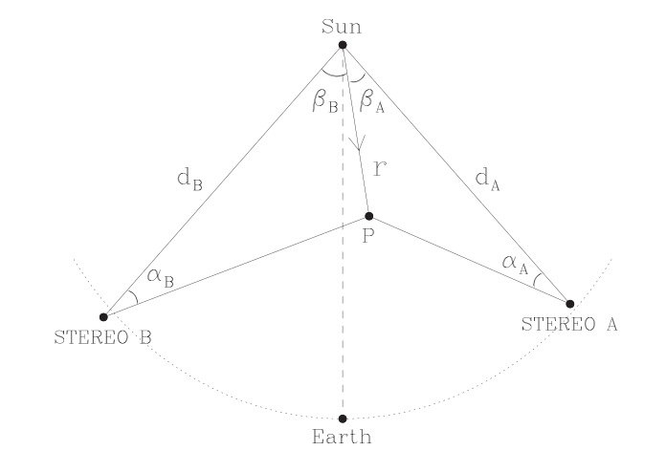
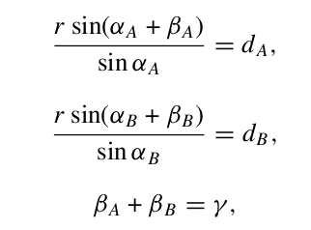
Geometric Triangulation
Measuring the same feature (assumption) in two coronagraphs and using simple geometric relations to derive CME position and speed
Observations are integrated line-of sight information through a 3D structure – projection effects, and scattering amplitudes impact the feature being measured!
Note: StereoCAT does not use the edge locations (width) when triangulating the feature.
Notes:
Very important! The main assumption of geometric triangulation is that you are measuring the same feature (assumption) in two coronagraphs and using simple geometric relations to derive CME position and speed. But remember observations are integrated line-of sight information through a 3D structure – projection effects, and scattering amplitudes impact the feature being measured!

Slide 15
CME analysis Procedure with StereoCAT
* Identify the CME and the start time. (The CME start time is the time it is first observed by any of the four coronagraphs)
* Observe all available coronagraph images in motion. Look for the same CME leading edge feature in various spacecraft.
* Look at EUV images in motion near the CME start time and identify the source location and any lower coronal signatures (post eruption arcade, dimming, rising loops, filament eruption).
Go to StereoCAT: http://ccmc.gsfc.nasa.gov/analysis/stereo/
* Select two overlapping times for each spacecraft pair available. Times should be around 45-75 minutes apart, and try to choose times just before the CME leading edge has left the field of view. It is useful to refer back to the CME movies while selecting images.
* Perform plane of sky measurements CME leading edge and obtain triangulation results if appropriate. Determine final CME parameters (radial speed, half width, longitude, latitude, and time at 21.5 Rs (solar radii)).
Resources & iSWA layouts
* StereoCAT: http://ccmc.gsfc.nasa.gov/analysis/stereo/
* 40 Frame coronagraph and EUV movies http://go.nasa.gov/16bTvzK
* Where is STEREO? http://stereo-ssc.nascom.nasa.gov/where.shtml
and http://stereo-ssc.nascom.nasa.gov/cgi-bin/make_where_gif
* Solar Images with grid overlays http://www.solarmonitor.org/
Notes:
CME analysis Procedure
* Identify the CME and the start time. (The CME start time is the time it is first observed by any of the four coronagraphs)
* Observe all available coronagraph images in motion. Look for the same CME leading edge feature in various spacecraft.
* Look at EUV images in motion near the CME start time and identify the source location and any lower coronal signatures (post eruption arcade, dimming, rising loops, filament eruption).
Go to StereoCAT: http://ccmc.gsfc.nasa.gov/analysis/stereo/
* Select two overlapping times for each spacecraft pair available. Times should be around 45-75 minutes apart, and try to choose times just before the CME leading edge has left the field of view. It is useful to refer back to the CME movies while selecting images.
* Perform plane of sky measurements CME leading edge and obtain triangulation results if appropriate. Determine final CME parameters (radial speed, half width, longitude, latitude, and time at 21.5 Rs (solar radii)).

Slide 16
CME analysis with StereoCAT tips/notes
* Make sure you are measuring the same feature in each spacecraft.
* If you cannot see the leading edge of the CME in image (halo), then it is not appropriate to use the triangulation method. In this case, estimate the plane of sky speed. It may be cautiously used for an asymmetric halo.
* Don’t forget to determine the source location and signatures. Use these to assess the accuracy of your results (which spacecraft pairs will give the best results), or to derive the radial velocity from the plane of sky speed.
* Measure each CME about 10 times with various time and spacecraft pairs to get a feel for the parameters and the measurement error.
* The two selected times should be around 45-75 minutes apart for each spacecraft.
* The time between each spacecraft pair should be less than 10 minutes.
* Keep in mind that the goal is to determine the parameters at 21.5 Rs, not necessarily the fastest or earliest speed. Try to choose times just before the CME leading edge is closest to 21.5 Rs.
* Bear in mind that plane of sky speeds should always be lower than the derived radial velocity.
Notes:
CME analysis tips/notes
* Make sure you are measuring the same feature in each spacecraft.
* If you cannot see the leading edge of the CME in image (halo), then it is not appropriate to use the triangulation method. In this case, estimate the plane of sky speed. It may be cautiously used for an asymmetric halo.
* Don’t forget to determine the source location and signatures. Use these to assess the accuracy of your results (which spacecraft pairs will give the best results), or to derive the radial velocity from the plane of sky speed.
* Measure each CME about 10 times with various time and spacecraft pairs to get a feel for the parameters and the measurement error.
* The two selected times should be around 45-75 minutes apart for each spacecraft.
* The time between each spacecraft pair should be less than 10 minutes.
* Try to choose times just before the CME leading edge has left the field of view.
Bear in mind that plane of sky speeds are always lower than the derived radial velocity.
Resources & iSWA layouts
* CME analysis tool: http://ccmc.gsfc.nasa.gov/analysis/stereo/
* 40 Frame coronagraph and EUV movies http://go.nasa.gov/16bTvzK
* Where is STEREO? http://stereo-ssc.nascom.nasa.gov/where.shtml
and http://stereo-ssc.nascom.nasa.gov/cgi-bin/make_where_gif
* Solar Images with grid overlays http://www.solarmonitor.org/

Slide 17
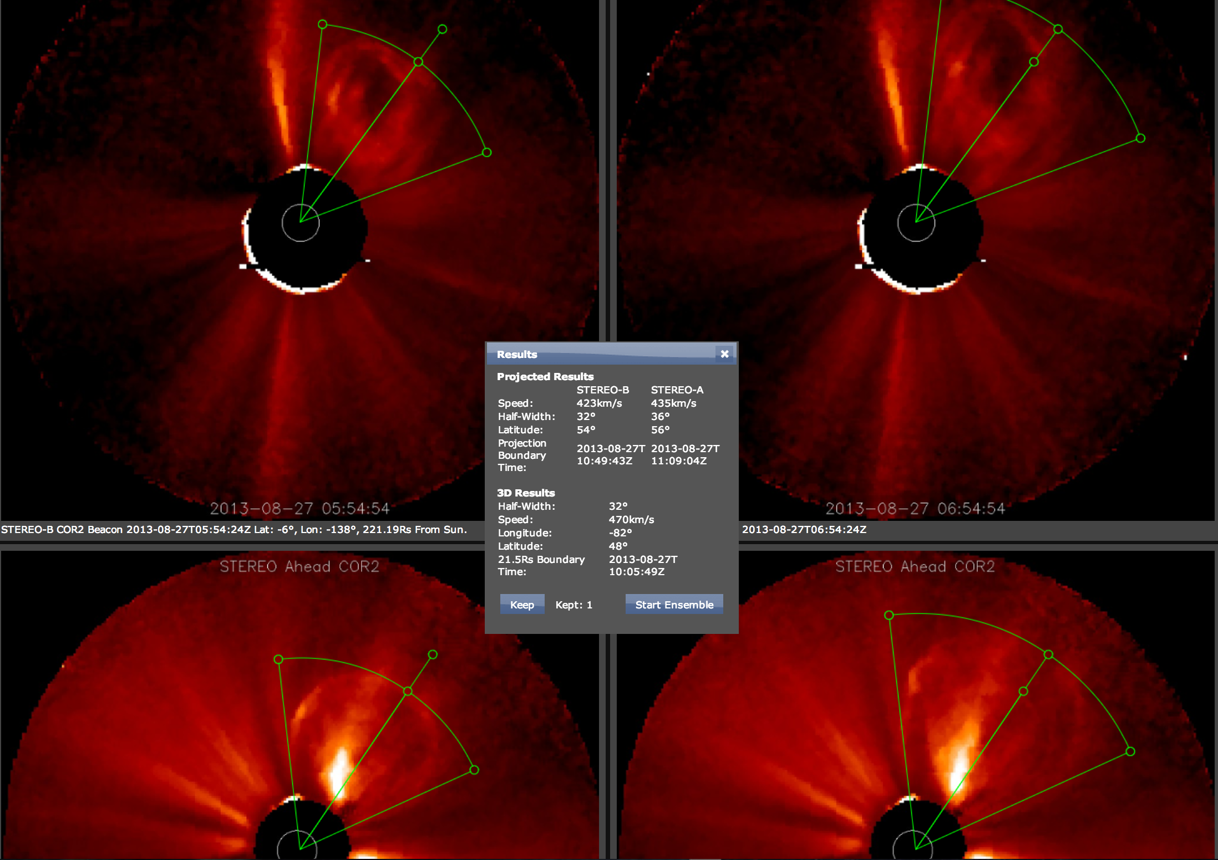
CME starting at
2013-08-27T01:25Z
Movies: 1, 2, 3, 4
Example of a two-timepoint measurement (click here to see in StereoCAT)
Notes:
Example of a two-timepoint measurement using StereoCAT for the CME starting at 2013-08-27T01:25Z
The leading edge of the CME is measured at two different matching times in COR2A and B. Link to view measurement in StereoCAT:
http://ccmc.gsfc.nasa.gov/analysis/stereo/?s=iswa.ccmc.gsfc.nasa.gov&v=3&c=_0_0_0_0_--_t__t_OFgzJ5c_OFhEJN2_0_0_0_-6F6_0_0_0_6F6_0_0_0_6F6__5_t__t_OFgzJ5c_OFhEJN2_0_0_0_-6F6_0_0_0_6F6_0_0_0_6F6__5_V0_V0_88xO_w2_88xO_1SO_88xO_MC_V0_V0_9ny2_w2_9ny2_1SO_9ny2_MC_V0_V0_7MI4_yN_7MI4_1gQ_7MI4_Qa_V0_V0_94FJ_yN_94FJ_1gQ_94FJ_Qa_t__1___
Context movies of this event:
http://cdaw.gsfc.nasa.gov/movie/make_javamovie.php?img1=sdo_a304&img2=sdo_a193&stime=20130826_2300&etime=20130827_0500
http://cdaw.gsfc.nasa.gov/movie/make_javamovie.php?img1=stb_e195&img2=sta_e195&stime=20130826_2300&etime=20130827_0500
http://cdaw.gsfc.nasa.gov/movie/make_javamovie.php?img1=stb_cor2&img2=sta_cor2&stime=20130827_0100&etime=20130827_1000
http://cdaw.gsfc.nasa.gov/movie/make_javamovie.php?img1=lasc2rdf&img2=lasc3rdf&stime=20130827_0100&etime=20130827_1100
EUV signatures: Rising loops can be seen near the AR in the NE and off of NE limb in SDO. In EUVIA and B rising loops and opening in the lower corona can be seen in the NW.

Slide 18
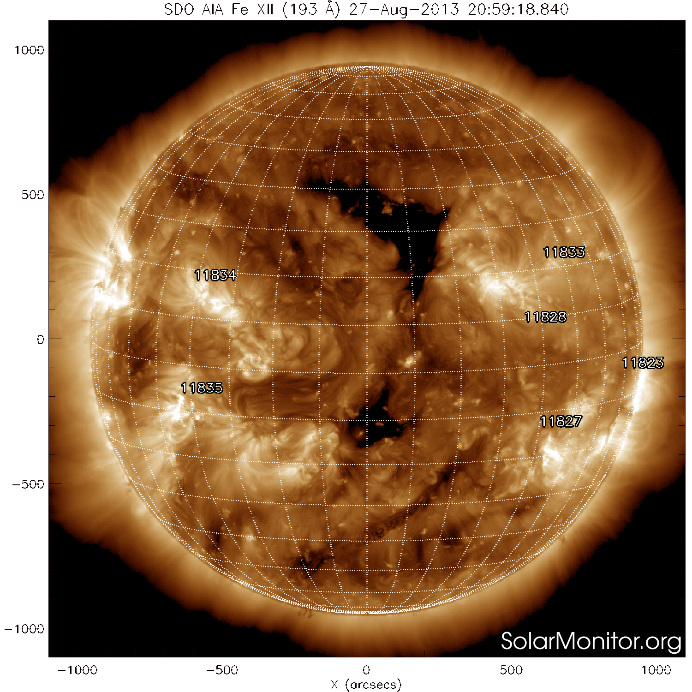
north
You can determine the source region coordinates using a grid overlay from solarmonitor.org or the magnetic connectivity cygnet in iSWA. (Each grid cell is 10 degrees).
Remember that east is to the left!
N30E80
east
west
south
Notes:
You can determine the source region coordinates using a grid overlay from solarmonitor.org or the magnetic connectivity cygnet in iSWA. (Each grid cell is 10 degrees).
Remember that east is to the left!
In the example of the 2013-08-27 CME the source region is N20E80.

Slide 19
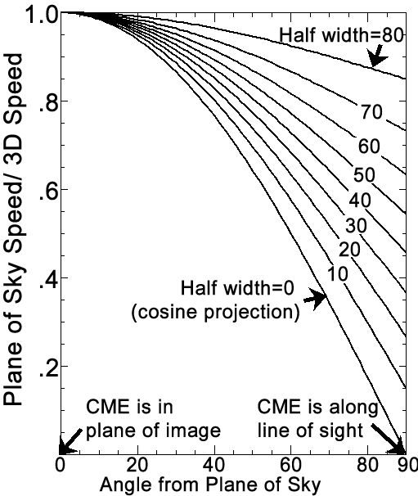
StereoCAT: Single spacecraft mode
* If data from only one spacecraft is available, first measure the plane of sky speed
* Use the CME source location, signatures and qualitative information from other coronagraphs to determine the CME longitude
* Using this longitude, determine the angle the CME makes with the plane of sky (positive towards observer).
* If this angle is < 30 deg enter it at the bottom of the measurement screen, which does a simple cos(theta) approximation.
* If the angle compared to the plane of sky is larger, or the CME is very wide, use the CME Projection Graph to determine the approximate 3D speed.
Use your width and source longitude to look up the ratio of the plane of sky speed to the true speed on the y axis.
Divide your measured plane of sky speed by the ratio you looked up to obtain the true 3D speed.
CME Projection Graph
EXAMPLE in StereoCAT (or next slide)
Notes:
Single spacecraft mode
* If data from only one spacecraft is available, first measure the plane of sky speed
* Use the CME source location, signatures and qualitative information from other coronagraphs to determine the CME longitude
* Using this longitude, determine the angle the CME makes with the plane of sky (positive towards observer).
* If this angle is < 30 deg enter it at the bottom of the measurement screen, which does a simple cos(theta) approximation.
* If the angle compared to the plane of sky is larger, or the CME is very wide, use this graph to determine the approximate 3D speed:

Slide 20
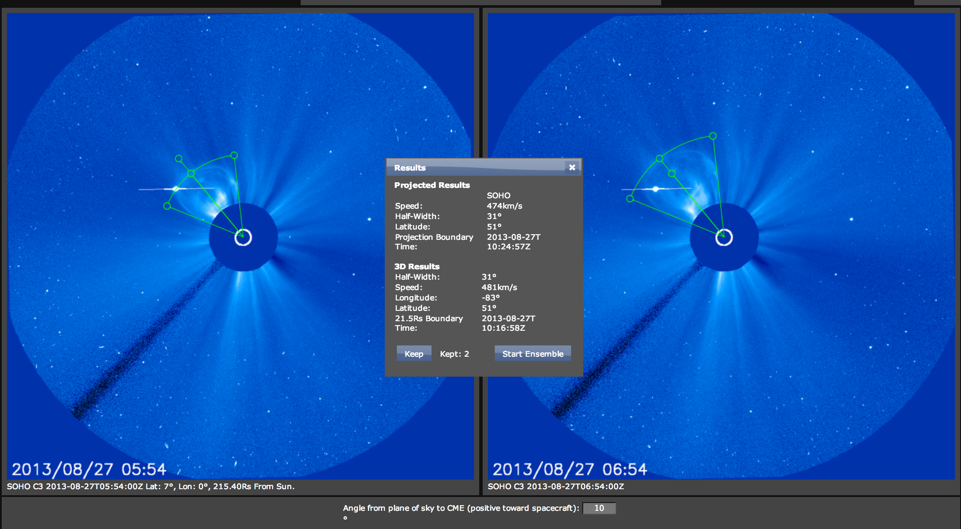
Example of a single spacecraft two-time point measurement (click here to see in StereoCAT)
CME starting at
2013-08-27T01:25Z
Notes:
Example of a two-timepoint single spacecraft measurement using StereoCATfor the CME starting at 2013-08-27T01:25Z. After determining he CME source location using EUV images, you can determine the angle from the plane of sky, in this case about 10 degrees. If the angle is less than 30 degrees you can use the calculator a the bottom of the screen to enter your angle from the plane of sky. This will give approximate 3D results using a cosine approximation. See previous slide, and part of this lesson, for important caveats.
Link to view measurement in StereoCAT:
http://ccmc.gsfc.nasa.gov/analysis/stereo/?s=iswa.ccmc.gsfc.nasa.gov&v=3&c=_0_0_0_0_--__t__OFgzJ5c_OFhEJN2_0_0_0_-6F6_0_0_0_6F6_0_0_0_6F6__5__t__OFgzJ5c_OFhEJN2_0_0_0_-6F6_0_0_0_6F6_0_0_0_6F6__5_VN_Tl_7uGY_2G5_7uGY_2kq_7uGY_1gI_VN_Tl_9lms_2G5_9lms_2kq_9lms_1gI_--_Ap_t__1___

Slide 21
Advanced Users: StereoCAT Frameseries mode
* The same procedure and factors apply to frameseries mode. This mode allows you to measure multiple coronagraph images at once to create a height-time plot, see the manual for usage details. * As usual, be careful about the spacecraft pairs you use. By looking at the different graphs, you can see what the plane of sky heights and triangulated heights are for each measurement. This can help you determine when the triangulation is not accurate. * This mode offers a linear fit, quadratic fit, and an average over all points. All of these results are dependent on which points you measure and how long your time range is. Be sure to carefully study all information under “Frameseries Results”, and compare to your two-timepoint measurements.
Notes:
Advanced Users: Frameseries mode
* The same procedure and factors apply to frameseries mode. This mode allows you to measure multiple coronagraph images at once to create a height-time plot, see the manual for usage details. * As usual, be careful about the spacecraft pairs you use. By looking at the different graphs, you can see what the plane of sky heights and triangulated heights are for each measurement. This can help you determine when the triangulation is not accurate. * This mode offers a linear fit, quadratic fit, and an average over all points. All of these results are dependent on which points you measure and how long your time range is. Be sure to carefully study all information under “Frameseries Results”, and compare to your two-timepoint measurements.

Slide 22
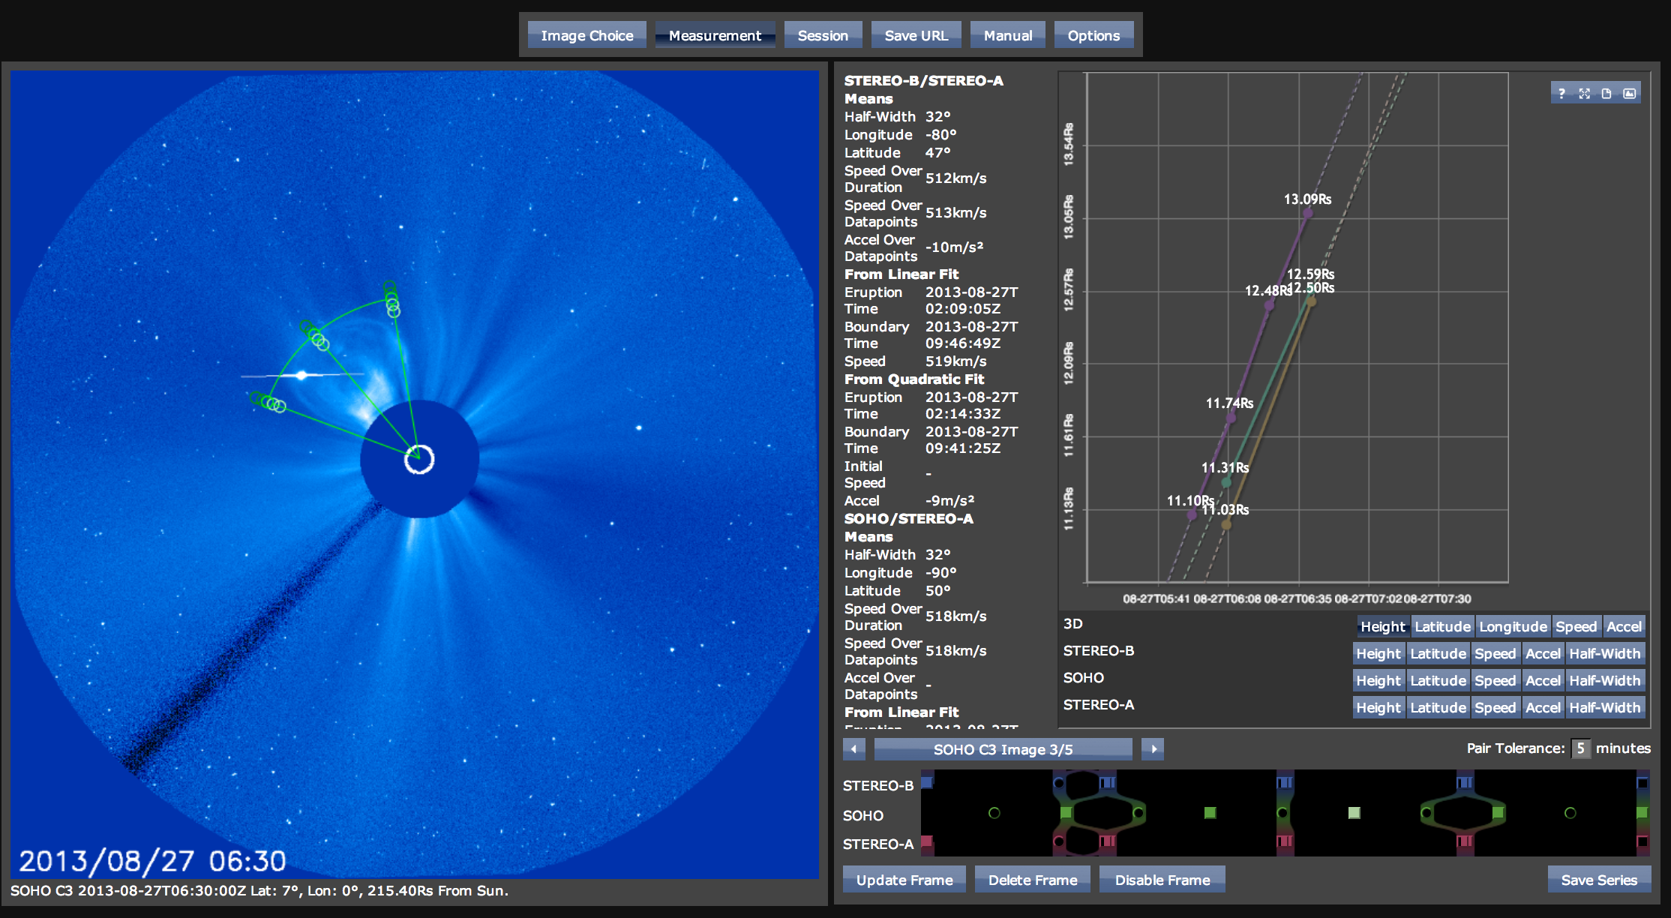
Example of frameseries measurement (click here to see in StereoCAT)
CME starting at
2013-08-27T01:25Z
Notes:
Example of a frameseries measurement using StereoCAT for the CME starting at 2013-08-27T01:25Z. In this mode you can measure all available images between two time steps. Images that are within the chosen matching tolerance (image choice screen) will be triangulated and will show up in the 3D graph, and triangulation results table. The table shows mean values for each spacecraft, and then combines as many pairs of spacecraft as are possible and shows linear and quadratic fits. Carefully inspect this data, as it is very rare for all three spacecraft to be appropriate for pairing a given CME given projection effects. You can disable data points from the graph by clicking on them. Check your results against two-timepoint measurements to make sure you are correctly using this frameseries mode.
Link to view measurement in StereoCAT:
http://ccmc.gsfc.nasa.gov/analysis/stereo/?s=iswa.ccmc.gsfc.nasa.gov&v=3&c=_0_0_0_1_t_t_t_OFgzJ5c_OFhEJN2_0_0_0_-6F6_0_0_0_6F6_0_0_0_6F6_t_5__4_0_t_V0_V0_8139_vl_8139_1PS_8139_NJ_0_3ozY_t_V0_V0_8S34_w4_8S34_1PS_8S34_NJ_0_7YGG_t_V0_V0_8pJ4_w3_8pJ4_1PS_8pJ4_NJ_0_BKOO_t_V0_V0_9D4E_wN_9D4E_1PS_9D4E_NJ_0_5_2v3o_t_VN_Tl_8NhX_2GI_8NhX_2mg_8NhX_1k8_0_5wMi_t_VN_Tl_8fHC_2Fm_8fHC_2mg_8fHC_1k8_0_8xfc_t_VN_Tl_8u1M_2GI_8u1M_2mg_8u1M_1k8_0_ByyW_t_VN_Tl_9Ifb_2Ft_9Ifb_2mg_9Ifb_1k8_0_F0HQ_t_VN_Tl_9jSX_2GT_9jSX_2mg_9jSX_1k8_0_4_0_t_V0_V0_7DXa_yY_7DXa_1fC_7DXa_P6_0_3ozY_t_V0_V0_7hsH_yp_7hsH_1fC_7hsH_P6_0_7YGG_t_V0_V0_8H4V_z7_8H4V_1fC_8H4V_P6_0_BKOO_t_V0_V0_8mcu_z7_8mcu_1fC_8mcu_P6_0_--_0_t_t_t_OFgzJ5c_OFhEJN2_0_0_0_-6F6_0_0_0_6F6_0_0_0_6F6_t_5_t_t_t_OFgzJ5c_OFhEJN2_0_0_0_-6F6_0_0_0_6F6_0_0_0_6F6_t_5_V0_V0_8139_vl_8139_1PS_8139_NJ___t_t_t_OFgzJ5c_OFhEJN2_0_0_0_-6F6_0_0_0_6F6_0_0_0_6F6_t_5__4_0_t_V0_V0_8139_vl_8139_1PS_8139_NJ_0_3ozY_t_V0_V0_8S34_w4_8S34_1PS_8S34_NJ_0_7YGG_t_V0_V0_8pJ4_w3_8pJ4_1PS_8pJ4_NJ_0_BKOO_t_V0_V0_9D4E_wN_9D

Slide 23
CME Analysis Resources & iSWA layouts
* StereoCAT: http://ccmc.gsfc.nasa.gov/analysis/stereo/
* 40 Frame coronagraph and EUV movies http://go.nasa.gov/16bTvzK
* Where is STEREO? http://stereo-ssc.nascom.nasa.gov/where.shtml
and http://stereo-ssc.nascom.nasa.gov/cgi-bin/make_where_gif
* Solar Images with grid overlays http://www.solarmonitor.org/
* http://cdaw.gsfc.nasa.gov/movie/
Notes:
CME Analysis Resources & iSWA layouts
* CME analysis tool: http://ccmc.gsfc.nasa.gov/analysis/stereo/
* 40 Frame coronagraph and EUV movies http://go.nasa.gov/16bTvzK
* Where is STEREO? http://stereo-ssc.nascom.nasa.gov/where.shtml
and http://stereo-ssc.nascom.nasa.gov/cgi-bin/make_where_gif
* Solar Images with grid overlays http://www.solarmonitor.org/
* http://cdaw.gsfc.nasa.gov/movie/

Slide 24
CME assignment zero (in-class workshop Fri 6/5) complete by Mon 6/8
For the CMEs listed below, follow the CME analysis procedure described in the lesson and also submit answers to the following questions for each CME:
Fill out the form: http://bit.ly/2015cme0
a) What is the source location for this CME? (list the location e.g. N15E20, instrument/wavelength, and time of the observation).
b) Describe the EUV lower coronal signature for this CME (e.g. flare, post eruption arcade/loops, rising loops, dimming, filament eruption).
c) Is the CME a halo in any of the coronagraphs? If so, is it moving away from or towards the observer?
d) Which coronagraph instrument first observed the CME at the start time?
e) What are your final CME parameters (radial speed, half width, longitude, latitude, and time at 21.5 Rs (solar radii)).
f) Compare your EUV source location obtained in (a) with the parameters obtained in (e). Discuss why they might be different.
g) Submit your “Save URL” of your measurements.
HW#0 CMEs starting at
1) 2014-05-12T12:18Z
2) 2012-10-05T03:24Z
3) 2012-07-12T16:54Z
4) 2013-02-26T14:06Z
Resources & iSWA layouts
* StereoCAT: http://ccmc.gsfc.nasa.gov/analysis/stereo/
* 40 Frame coronagraph and EUV movies http://go.nasa.gov/16bTvzK
* Where is STEREO? http://stereo-ssc.nascom.nasa.gov/cgi-bin/make_where_gif
* http://cdaw.gsfc.nasa.gov/movie/
* Solar Images with grid overlays http://www.solarmonitor.org/

Slide 25
CME assignment one (Mon 6/8 workshop, due 6/9)
For the CMEs listed below, follow the CME analysis procedure described in the lesson and also submit answers to the following questions for each CME:
Fill out the form: http://bit.ly/2015cme1
a) What is the source location for this CME? (list the location e.g. N15E20, instrument/wavelength, and time of the observation).
b) Describe the EUV lower coronal signature for this CME (e.g. flare, post eruption arcade/loops, rising loops, dimming, filament eruption).
c) Is the CME a halo in any of the coronagraphs? If so, is it moving away from or towards the observer?
d) Which coronagraph instrument first observed the CME at the start time?
e) What are your final CME parameters (radial speed, half width, longitude, latitude, and time at 21.5 Rs (solar radii)).
f) Compare your EUV source location obtained in (a) with the parameters obtained in (e). Discuss why they might be different.
g) Submit your “Save URL” of your measurements.
HW#1 CMEs starting at
1) 2013-10-22T04:36Z
2) 2013-11-07T00:00Z
3) 2013-11-07T10:39Z
4) 2012-07-17T14:25Z
5) 2013-01-13T07:24Z
Resources & iSWA layouts
* StereoCAT: http://ccmc.gsfc.nasa.gov/analysis/stereo/
* 40 Frame coronagraph and EUV movies http://go.nasa.gov/16bTvzK
* Where is STEREO? http://stereo-ssc.nascom.nasa.gov/cgi-bin/make_where_gif
* http://cdaw.gsfc.nasa.gov/movie/
* Solar Images with grid overlays http://www.solarmonitor.org/

Slide 26
CME assignment two (Mon 6/8, due 6/10)
For the CMEs listed below, follow the CME analysis procedure described in the lesson and also submit answers to the following questions for each CME. (Fill out the form: http://bit.ly/2015cme2)
Part 1: a) What is the source location for this CME? (list the location e.g. N15E20, instrument/wavelength, and time of the observation).
b) Describe the EUV lower coronal signature for this CME (e.g. flare, post eruption arcade/loops, rising loops, dimming, filament eruption).
c) Is the CME a halo in any of the coronagraphs? If so, is it moving away from or towards the observer?
d) Which coronagraph instrument first observed the CME at the start time?
e) What are your final CME parameters (radial speed, half width, longitude, latitude, and time at 21.5 Rs (solar radii)).
f) Compare your EUV source location obtained in (a) with the parameters obtained in (e). Discuss why they might be different.
g) Submit your “Save URL” of your measurements.
Part 2: Reanalyze the CMEs above using single spacecraft mode and the CME Projection Graph:
h) Single Spacecraft mode: for both spacecraft chosen in Part 1 use your longitude derived in (e) to determine the “angle from plane of the sky” for each measurement. Use this in single spacecraft mode to get the 3D speed.
i) Now use the CME projection graph with your width and your 3D longitude from (e) to derive two estimates of the 3D speed for each spacecraft viewpoint.
j) Now do the same (j), only using the source longitude from (a) instead of the longitude from (e).
k) You now have determined the 3D speed with several different methods. How much do they match? Why are there differences?
HW#2 CMEs starting at
1) 2013-03-15T06:54Z
2) 2012-09-28T00:12Z
3) 2012-09-28T10:54Z
4) 2013-01-21T08:48Z
Resources & iSWA layouts
* StereoCAT: http://ccmc.gsfc.nasa.gov/analysis/stereo/
* 40 Frame coronagraph and EUV movies http://go.nasa.gov/16bTvzK
* Where is STEREO? http://stereo-ssc.nascom.nasa.gov/cgi-bin/make_where_gif
* http://cdaw.gsfc.nasa.gov/movie/
* Solar Images with grid overlays http://www.solarmonitor.org/

Slide 27
CME assignment three (Thu 6/11, due 6/12)
For the CMEs listed below, follow the SWPC_CAT CME analysis procedure described in the lesson and also submit answers to the following questions for each CME:
Fill out the form: http://bit.ly/2015cme3
a) What is the source location for this CME? (list the location e.g. N15E20, instrument/wavelength, and time of the observation).
b) Describe the EUV lower coronal signature for this CME (e.g. flare, post eruption arcade/loops, rising loops, dimming, filament eruption).
c) Is the CME a halo in any of the coronagraphs? If so, is it moving away from or towards the observer?
d) Which coronagraph instrument first observed the CME at the start time?
e) What are your final CME parameters (radial speed, half width, longitude, latitude, and time at 21.5 Rs (solar radii)).
f) Compare your EUV source location obtained in (a) with the parameters obtained in (e). Discuss why they might be different.
g) Export your measurements from SWPC_CAT
HW#3 CMEs starting at
1) 2014-06-24T06:12Z
2) 2014-07-01T12:39Z
3) 2013-04-11T07:36Z
4) 2015-03-15T02:00Z
Resources & iSWA layouts
* 40 Frame coronagraph and EUV movies http://go.nasa.gov/16bTvzK
* Where is STEREO? http://stereo-ssc.nascom.nasa.gov/cgi-bin/make_where_gif
* http://cdaw.gsfc.nasa.gov/movie/
* Solar Images with grid overlays http://www.solarmonitor.org/

Slide 28
Summary of CME Assignments
CME Assignment Instructions:
For the CMEs listed below, follow the CME analysis procedure described in the lesson and also submit answers to the following questions for each CME (fill out the forms):
a) What is the source location for this CME? (list the location e.g. N15E20, instrument/wavelength, and time of the observation).
b) Describe the EUV lower coronal signature for this CME (e.g. flare, post eruption arcade/loops, rising loops, dimming, filament eruption).
c) Is the CME a halo in any of the coronagraphs? If so, is it moving away from or towards the observer?
d) Which coronagraph instrument first observed the CME at the start time?
e) What are your final CME parameters (radial speed, half width, longitude, latitude, and time at 21.5 Rs (solar radii)).
f) Submit your “Save URL” of your measurements.
Note: HW#2 has extra steps, HW#3 uses SWPC_CAT
Due 6/8
HW#0 CMEs starting at
1) 2014-05-12T12:18Z
2) 2012-10-05T03:24Z
3) 2012-07-12T16:54Z
4) 2013-02-26T14:06Z
Due 6/9
HW#1 CMEs starting at
1) 2013-10-22T04:36Z
2) 2013-11-07T00:00Z
3) 2013-11-07T10:39Z
4) 2012-07-17T14:25Z
5) 2013-01-13T07:24Z
Resources & iSWA layouts
* StereoCAT: http://ccmc.gsfc.nasa.gov/analysis/stereo/
* 40 Frame coronagraph and EUV movies http://go.nasa.gov/16bTvzK
* Where is STEREO? http://stereo-ssc.nascom.nasa.gov/cgi-bin/make_where_gif
* http://cdaw.gsfc.nasa.gov/movie/
* Solar Images with grid overlays http://www.solarmonitor.org/
Due 6/10
Due 6/12
HW#2 CMEs starting at
1) 2013-03-15T06:54Z
2) 2012-09-28T00:12Z
3) 2012-09-28T10:54Z
4) 2013-01-21T08:48Z
HW#3 CMEs starting at
1) 2014-06-24T06:12Z
2) 2014-07-01T12:39Z
3) 2013-04-11T07:36Z
4) 2015-03-15T02:00Z
Assignment forms:
http://bit.ly/2015cme0
http://bit.ly/2015cme1
http://bit.ly/2015cme2
http://bit.ly/2015cme3
HW#2 and #3 is optional, except forecasting interns

Slide 29
StereoCAT tips * Preferred browser is chrome. * See the StereoCAT manual: explains the GUI and more options. * Handy keyboard shortcuts are listed at the end of the manual * If your measurement is not centered on the LASCO image (because LASCO rolls a few times a year), click on “Options”, then “Enable Sun Point Handles”, then “Okay”. Now you can center the measurement correctly. * To see where the CME projection is relative to 21.5Rs in LASCO, click on “Options”, then “Enable Boundary Rings”, then “Okay”. * If images are not loading in StereoCAT, try changing the server. Click on “Options”, in the server box it says “iswa.ccmc.gsfc.nasa.gov”. You can try changing this to “iswa.gsfc.nasa.gov”, “iswa3.gsfc.nasa.gov”, “iswax.ccmc.gsfc.nasa.gov”. Click okay, then search again for the date/times.
* Remember to click “save series” when you are done with your frameseries measurements, clicking away from this screen will lose them.
Notes:
http://ccmc.gsfc.nasa.gov/analysis/stereo/manual.pdf
StereoCAT tips * Preferred browser is chrome. * See the StereoCAT manual, explains the GUI and more options: * Handy keyboard shortcuts are listed at the end of the manual * If your measurement is not centered on the LASCO image (because LASCO rolls a few times a year), click on “Options”, then “Enable Sun Point Handles”, then “Okay”. Now you can center the measurement correctly. * To see where the CME projection is relative to 21.5Rs in LASCO, click on “Options”, then “Enable Boundary Rings”, then “Okay”. * If images are not loading in StereoCAT, try changing the server. Click on “Options”, in the server box it says “iswa.ccmc.gsfc.nasa.gov”. You can try changing this to “iswa.gsfc.nasa.gov”, “iswa3.gsfc.nasa.gov”, “iswax.ccmc.gsfc.nasa.gov”. Click okay, then search again for the date/times.
* Remember to click “save series” when you are done with your frameseries measurements, clicking away from this screen will lose them.

Slide 30
Slide link summary
Resources & iSWA layouts
* CME analysis tool: http://ccmc.gsfc.nasa.gov/analysis/stereo/
* 40 Frame coronagraph and EUV movies http://go.nasa.gov/16bTvzK
* Where is STEREO? http://stereo-ssc.nascom.nasa.gov/cgi-bin/make_where_gif
* http://cdaw.gsfc.nasa.gov/movie/
* Solar Images with grid overlays http://www.solarmonitor.org/
SW REDI website
http://ccmc.gsfc.nasa.gov/support/SWREDI/swredi.php
iSWA http://iswa.gsfc.nasa.gov
iSWA Cygnet Glossary http://iswa3.ccmc.gsfc.nasa.gov/wiki/index.php/Full_iSWA_Cygnet_List
iSWA Space Weather Glossary http://iswa3.ccmc.gsfc.nasa.gov/wiki/index.php/Glossary
Example CME movie
http://cdaw.gsfc.nasa.gov/movie/make_javamovie.php?img1=stb_cor2&img2=sta_cor2&stime=20120712_1500&etime=20120712_2000
http://helioviewer.org/?movieId=zZv95 http://helioviewer.org/?movieId=tZv95
Helioviewer solar visualization tool http://www.helioviewer.org/
SOHO LASCO CME Catalog http://cdaw.gsfc.nasa.gov/CME_list/
SWRC SCORE CME scale http://swrc.gsfc.nasa.gov/main/score
STEREO orbit movie https://www.youtube.com/watch?v=VzhMvEkK0gA
Sun Primer: Why NASA Scientists Observe the Sun in Different Wavelengths
http://www.nasa.gov/mission_pages/sunearth/news/light-wavelengths.html
EUV lower coronal signatures of CMEs movies
post eruption arcadehttp://cdaw.gsfc.nasa.gov/movie/make_javamovie.php?img1=sta_e195&img2=sta_cor2&stime=20130526_1500&etime=20130527_0000
prominence eruptions http://go.nasa.gov/19Dni3v
http://cdaw.gsfc.nasa.gov/movie/make_javamovie.php?img1=lasc2rdf&img2=sdo_a304&stime=20130430_2200&etime=20130501_0800
filament eruptions http://go.nasa.gov/12qcWDO
http://www.lmsal.com/hek/gallery/podimages/2013/06/01/pod_malanushenko_anna_2013-06-01T02:24:03.851/anny_AIA-304_20130531T113203-20130531T185203_120s_made_20130601T022253_720p.mpg
coronal dimmingshttp://www.lmsal.com/hek/gallery/podimages/2013/06/01/pod_malanushenko_anna_2013-06-01T00:52:07.870/anny_AIA-211_20130531T094003-20130531T145203_120s_made_20130601T005102_720p.mpg
http://cdaw.gsfc.nasa.gov/movie/make_javamovie.php?img1=stb_cor2&img2=stb_e195&stime=20120527_0300&etime=20120527_1600
Notes:
SW REDI website
http://ccmc.gsfc.nasa.gov/support/SWREDI/swredi.php
iSWA http://iswa.gsfc.nasa.gov
iSWA Cygnet Glossary http://iswa3.ccmc.gsfc.nasa.gov/wiki/index.php/Full_iSWA_Cygnet_List
iSWA Space Weather Glossary http://iswa3.ccmc.gsfc.nasa.gov/wiki/index.php/Glossary
Example CME movie
http://cdaw.gsfc.nasa.gov/movie/make_javamovie.php?img1=stb_cor2&img2=sta_cor2&stime=20120712_1500&etime=20120712_2000
http://helioviewer.org/?movieId=zZv95 http://helioviewer.org/?movieId=tZv95
Helioviewer solar visualization tool http://www.helioviewer.org/
SOHO LASCO CME Catalog http://cdaw.gsfc.nasa.gov/CME_list/
SWRC SCORE CME scale http://swrc.gsfc.nasa.gov/main/score
STEREO orbit movie http://www.nasa.gov/multimedia/videogallery/index.html?media_id=59559661
Sun Primer: Why NASA Scientists Observe the Sun in Different Wavelengths
http://www.nasa.gov/mission_pages/sunearth/news/light-wavelengths.html
EUV lower coronal signatures of CMEs movies
post eruption arcadehttp://cdaw.gsfc.nasa.gov/movie/make_javamovie.php?img1=sta_e195&img2=sta_cor2&stime=20130526_1500&etime=20130527_0000
prominence eruptions http://go.nasa.gov/19Dni3v
http://cdaw.gsfc.nasa.gov/movie/make_javamovie.php?img1=lasc2rdf&img2=sdo_a304&stime=20130430_2200&etime=20130501_0800
filament eruptions http://go.nasa.gov/12qcWDO
http://www.lmsal.com/hek/gallery/podimages/2013/06/01/pod_malanushenko_anna_2013-06-01T02:24:03.851/anny_AIA-304_20130531T113203-20130531T185203_120s_made_20130601T022253_720p.mpg
coronal dimmingshttp://www.lmsal.com/hek/gallery/podimages/2013/06/01/pod_malanushenko_anna_2013-06-01T00:52:07.870/anny_AIA-211_20130531T094003-20130531T145203_120s_made_20130601T005102_720p.mpg
http://cdaw.gsfc.nasa.gov/movie/make_javamovie.php?img1=stb_cor2&img2=stb_e195&stime=20120527_0300&etime=20120527_1600
Resources & iSWA layouts
* CME analysis tool: http://ccmc.gsfc.nasa.gov/analysis/stereo/
* 40 Frame coronagraph and EUV movies http://go.nasa.gov/16bTvzK
* Where is STEREO? http://stereo-ssc.nascom.nasa.gov/cgi-bin/make_where_gif
* http://cdaw.gsfc.nasa.gov/movie/
* Solar Images with grid overlays http://www.solarmonitor.org/

