Slide 1

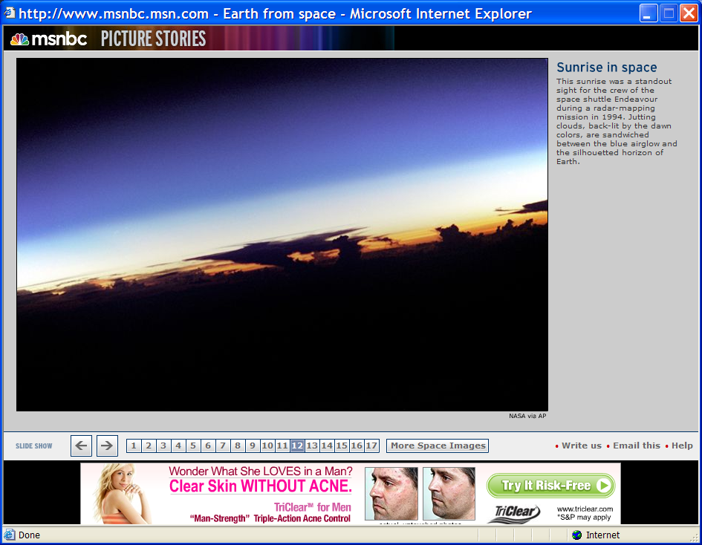
Space Weather in the Thermosphere:
Satellite Drag
Thermosphere
Mesosphere
Stratosphere
Troposphere
Given by Yihua Zheng for 2014 summer bootcamp
Prof . Delores Knipp
University of Colorado Boulder
*Developed by members of the Department of Physics, USAFA and
the NCAR High Altitude Observatory
Space Weather Training for Mission Operators and Engineers, January 2014

Slide 2


Space Weather in the Thermosphere:
Satellite Drag
Motivation:
    Track and identify active payloads and debris
    Collision avoidance and re-entry prediction
    Attitude Dynamics
    Constellation control
    “Drag Make-Up” maneuvers to keep satellite in control box
    Delayed acquisition of SATCOM links for commanding /data transmission
    Mission design and lifetime
    Study the atmosphere’s density (and temperature) profiles

Slide 3
Overview
    Fundamentals of Satellite Drag
    Thermosphere and Its Characteristics
    Dynamic Space Weather Drivers
    Collision Avoidance
    Help from CCMC

Slide 4
Spacecraft Drag
Spacecraft in LEO experience periods of increased drag that causes them to speed-up, lose altitude and finally reenter the atmosphere. Short-term drag effects are generally felt by spacecraft <1,000 km altitude in an atmospheric region called the thermosphere.
Drag increase is well correlated with solar Ultraviolet (UV) output, and atmospheric heating that occurs during geomagnetic storms. Recently lower atmospheric tidal effects have been modeled in satellite drag response.
Most drag models use solar radio flux at 10.7 cm wavelength as a proxy for solar UV flux. Kp/Ap are the indices commonly used as a surrogate for short-term atmospheric heating due to geomagnetic storms. In general, 10.7 cm flux >250 solar flux units and Kp>=6 result in detectably increased drag on LEO spacecraft.
Very high UV/10.7 cm flux and Kp/Ap values can result in extreme short-term increases in drag. During the great geomagnetic storm of 13-14 March 1989, tracking of thousands of space objects was lost. One LEO satellite lost over 30 kilometers of altitude, and hence significant lifetime, during this storm.

Slide 5
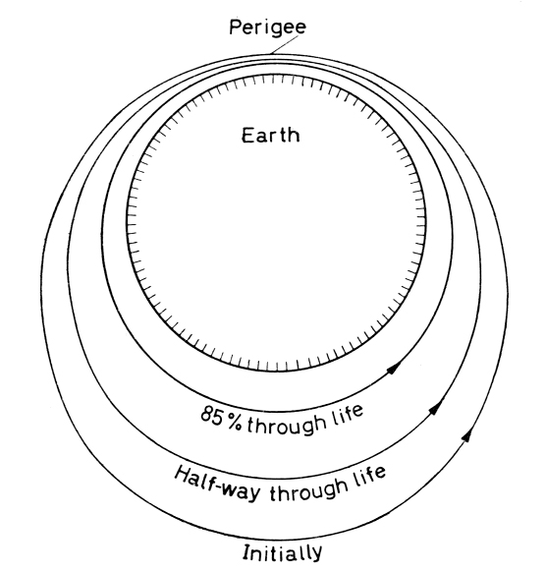
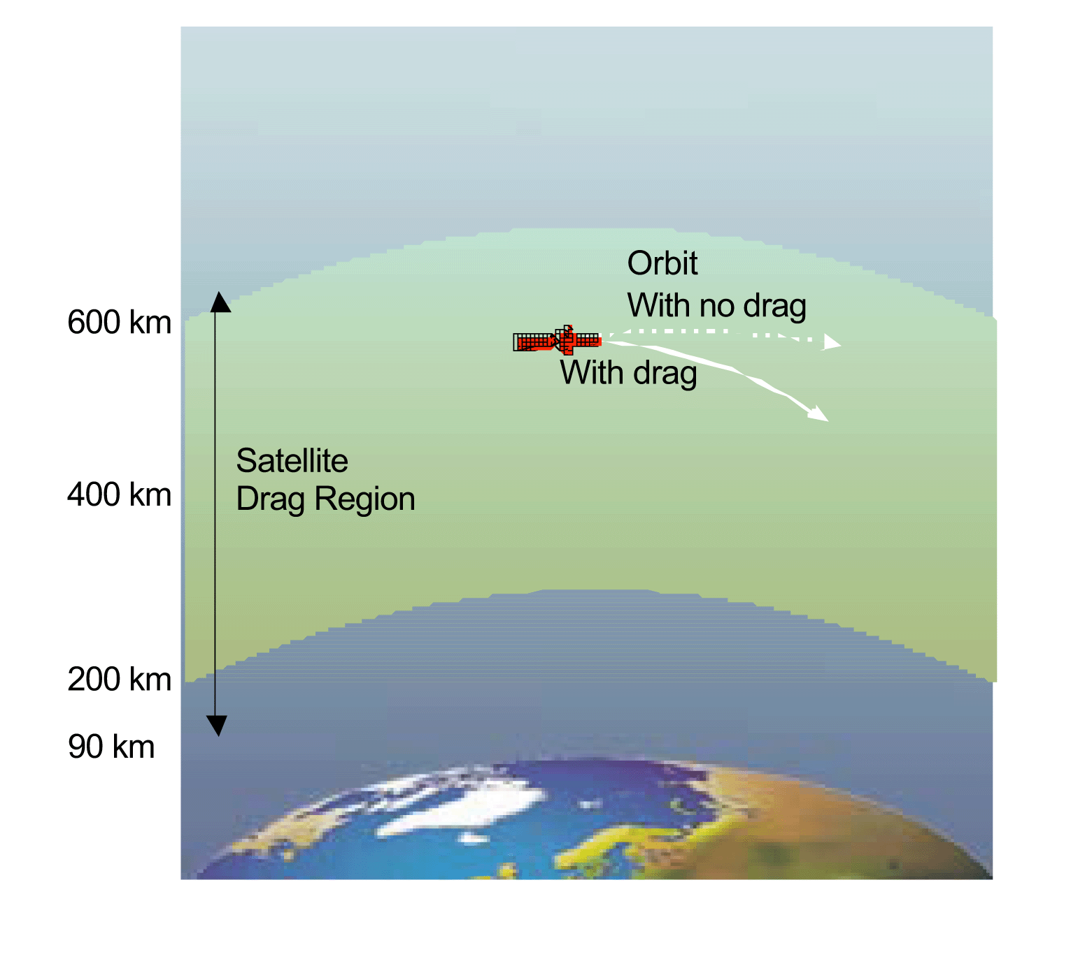
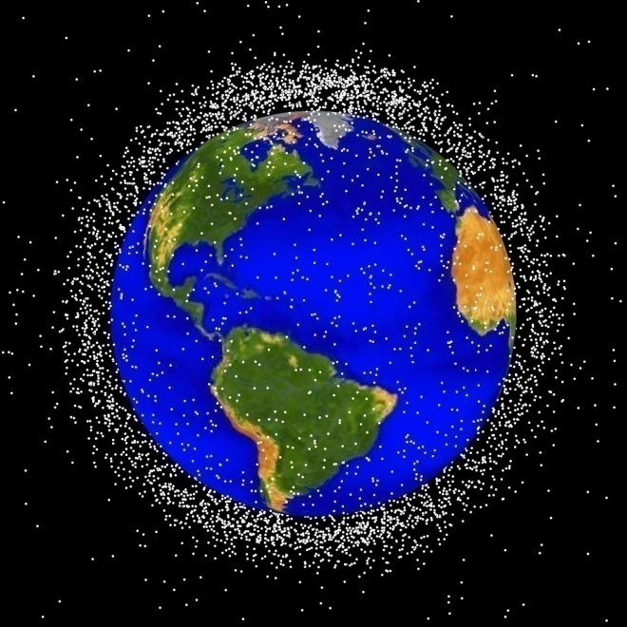


Atmospheric Drag on Satellites
Orbital Elements
Satellite
Lifetime
PREDICTED
ACTUAL
Collision
Avoidance
Satellite
Tracking
Notes:
Four impacts of satellite drag:
Sudden change in s/c altitude/speed
Impede ability to locate/track s/c
Change s/c orbit “circularization of orbit’
Change in collision parameters

Slide 6
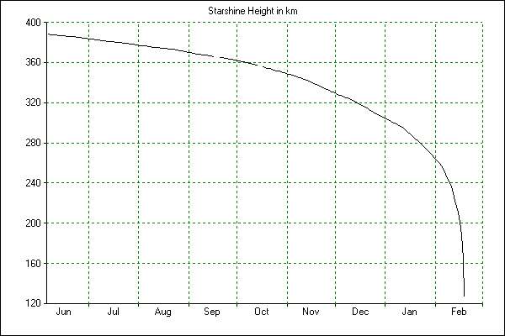
STARSHINE-1 Height vs Time Profile
km
1999 2000
Notes:
https://directory.eoportal.org/web/eoportal/satellite-missions/s/starshine

Slide 7
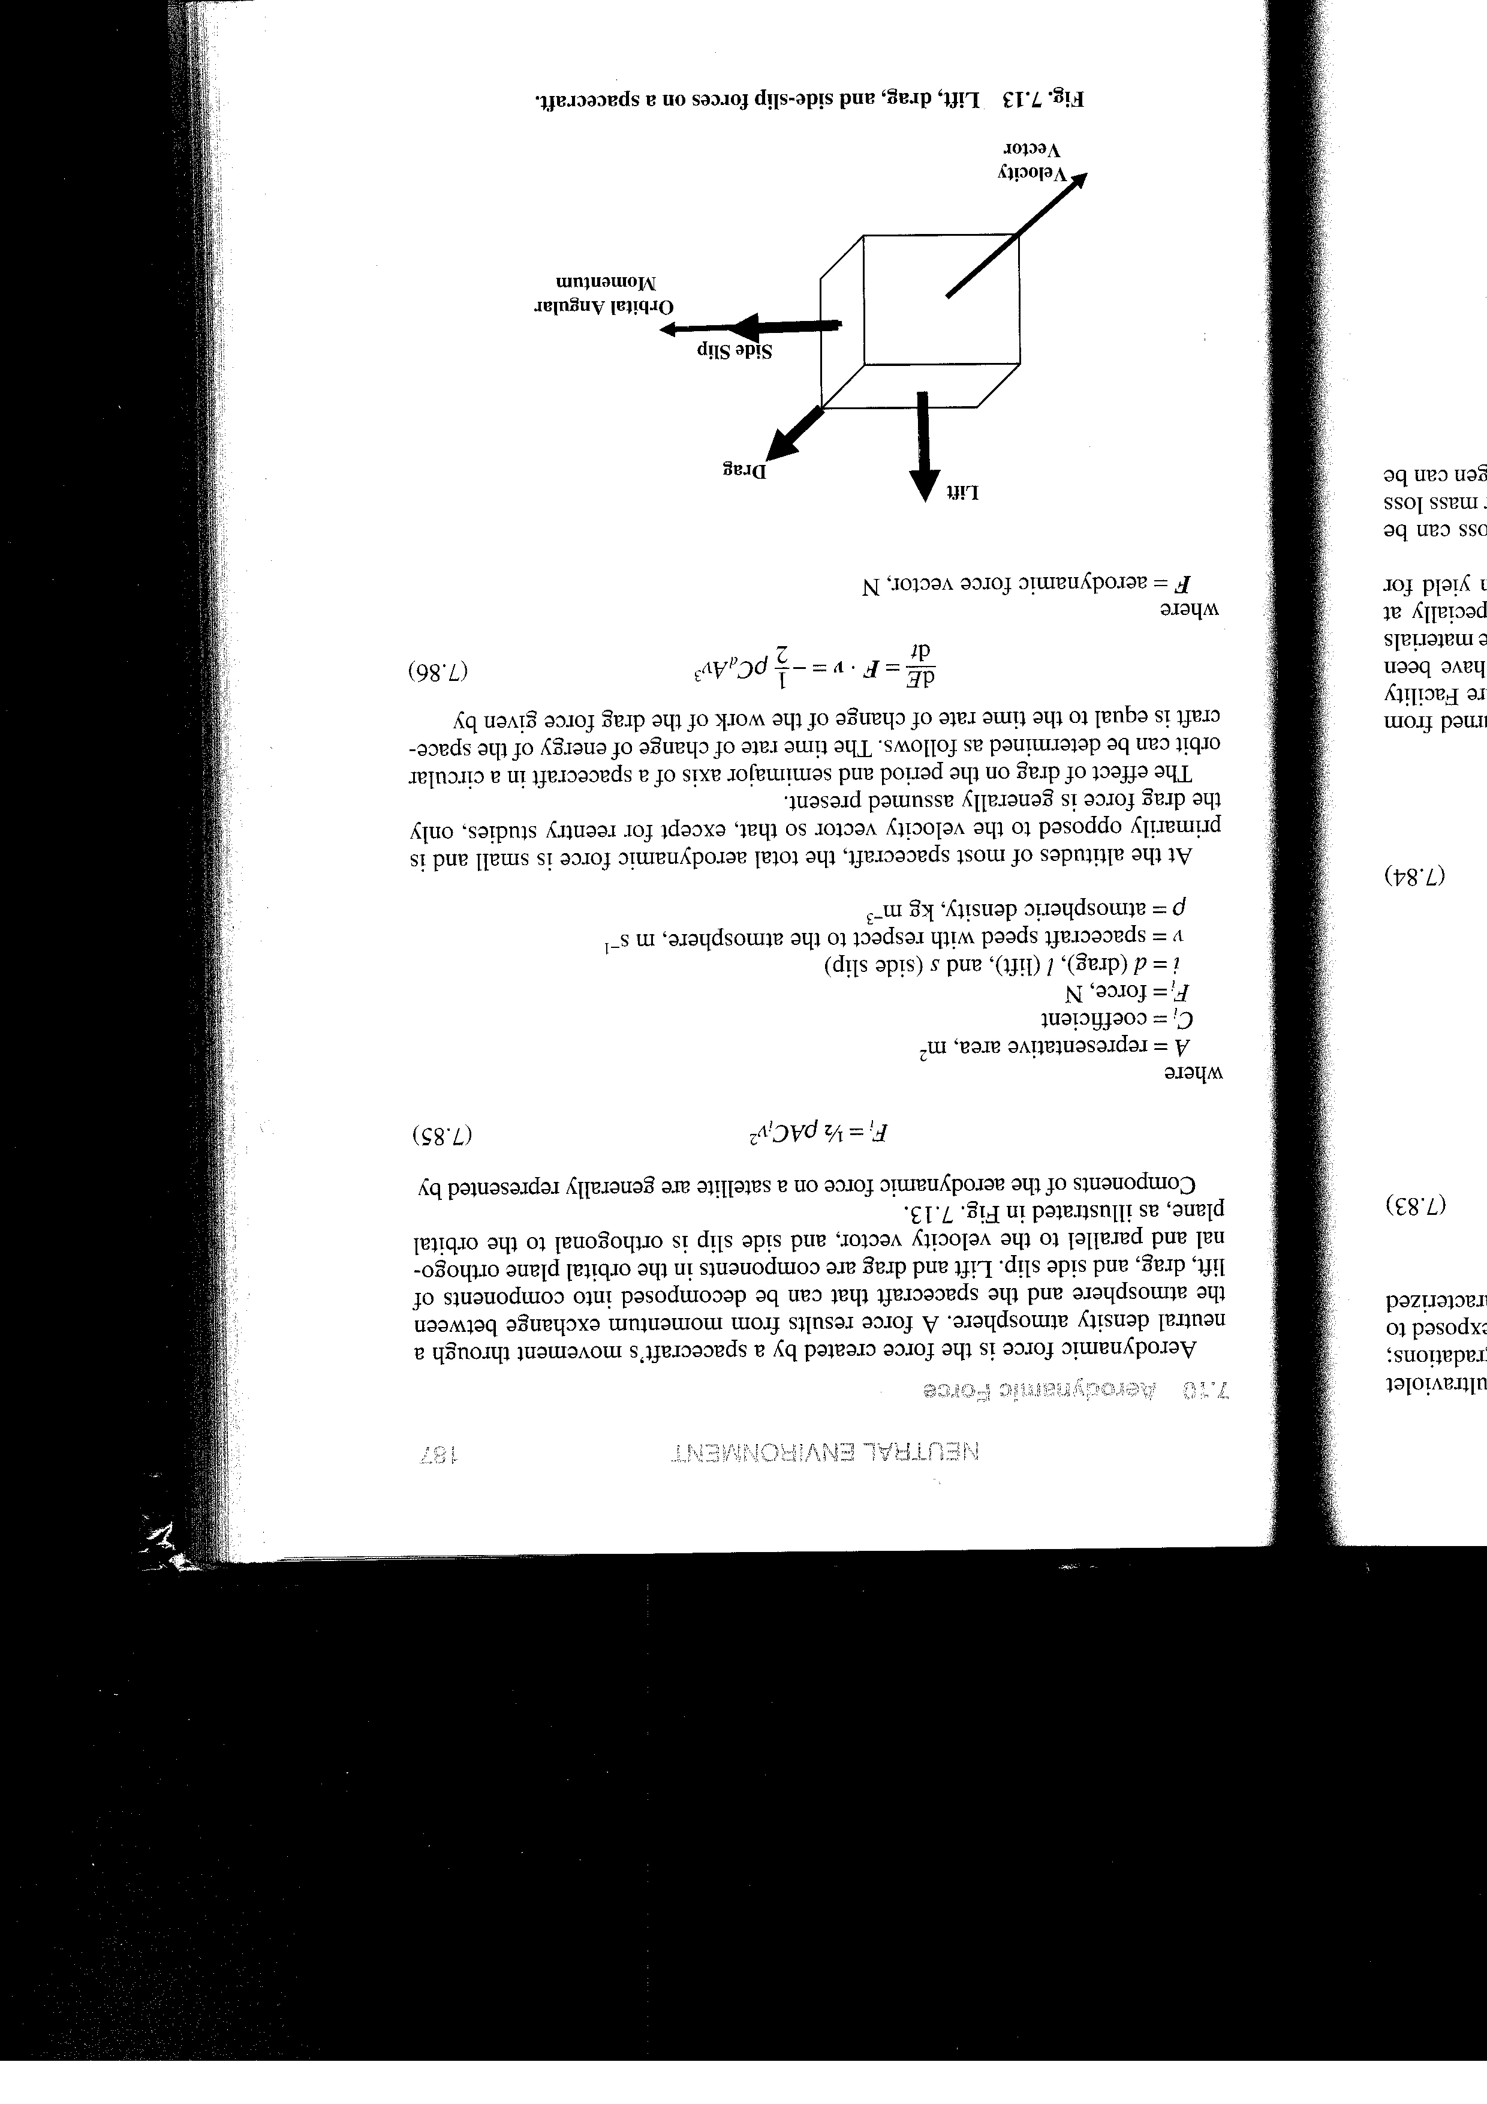
Satellite Drag and Thermosphere Density
Aerodynamic forces are the forces created by a spacecraft’s movement through a neutral density atmosphere. The forces result from momentum exchange between the atmosphere and the spacecraft and can be decomposed into components of lift, drag, and side slip.
In the thermosphere the density is a function of temperature
Notes:
Several aerodynamic forces
Drag is dominant
Drag is highly dependent of density of medium in which s/c operates

Slide 8
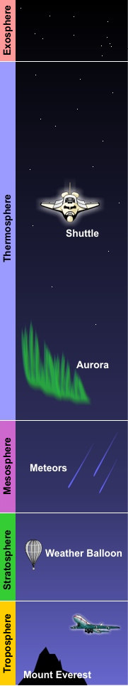
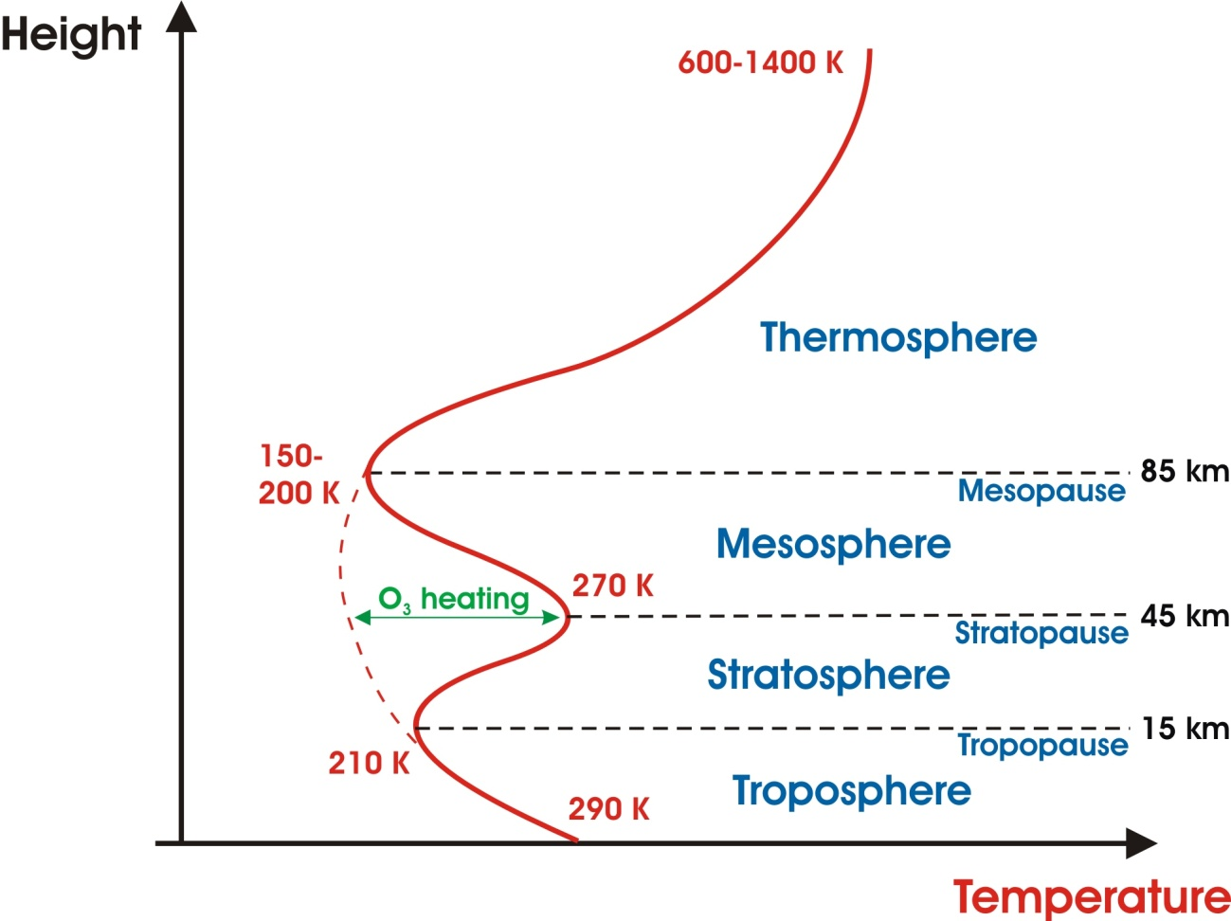
Upper Atmosphere – Thermosphere
The outer gaseous shell of a planet’s atmosphere that exchanges energy with the space plasma environment: Thermosphere
Energy sources:
  Absorption of Extreme UV radiation (10 -200nm)
  Joule heating by electrical currents
  Particle precipitation from the magnetosphere
  Dissipation of upward propagating waves (tides,
  planetary waves, gravity waves)
Energy sinks:
  Thermal conduction into the mesosphere
  IR cooling by CO₂ NO, O
  Chemical reactions
Notes:
CU Aersopace Engineering 5335

Slide 9
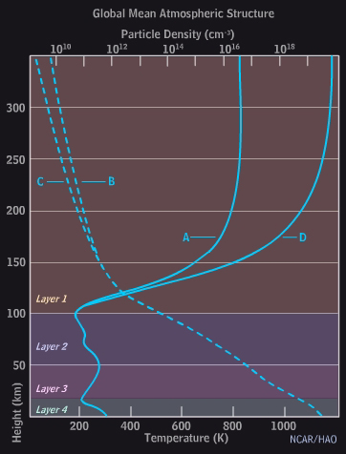
Thermosphere Variability and Time Scales
Thermosphere:
Characteristics
  Very high temperatures, often exceeding 1000 k
  Low neutral density
  Matter sorted by gravity—heavier material at base
  Dominated by atomic oxygen
Time Scales
  Solar cycle
  Annual
  27 day
  Equinoctal
  Day /night
A Solar Min Temperature
B Solar Max Temperature
C Solar Min Density
D Solar Max Density
Courtesy of UCAR COMET
Notes:
Plot axes are typical of meteorology. Dependent variable is on the horizontal, independent (Height) is on vertical to correspond with our sense of “up”

Slide 10
Ideal and Model Atmosphere Neutral Density
Knipp et al., 2005
http://ccmc.gsfc.nasa.gov/modelweb/models/nrlmsise00.php
Notes:
Law of atmospheres comes from simple barometric or hydrostatic assumption
MSIS = semi empirical Mass Spectrometer Incoherent Scatter model from Naval Research Lab
Note strong temperature dependence

Slide 11
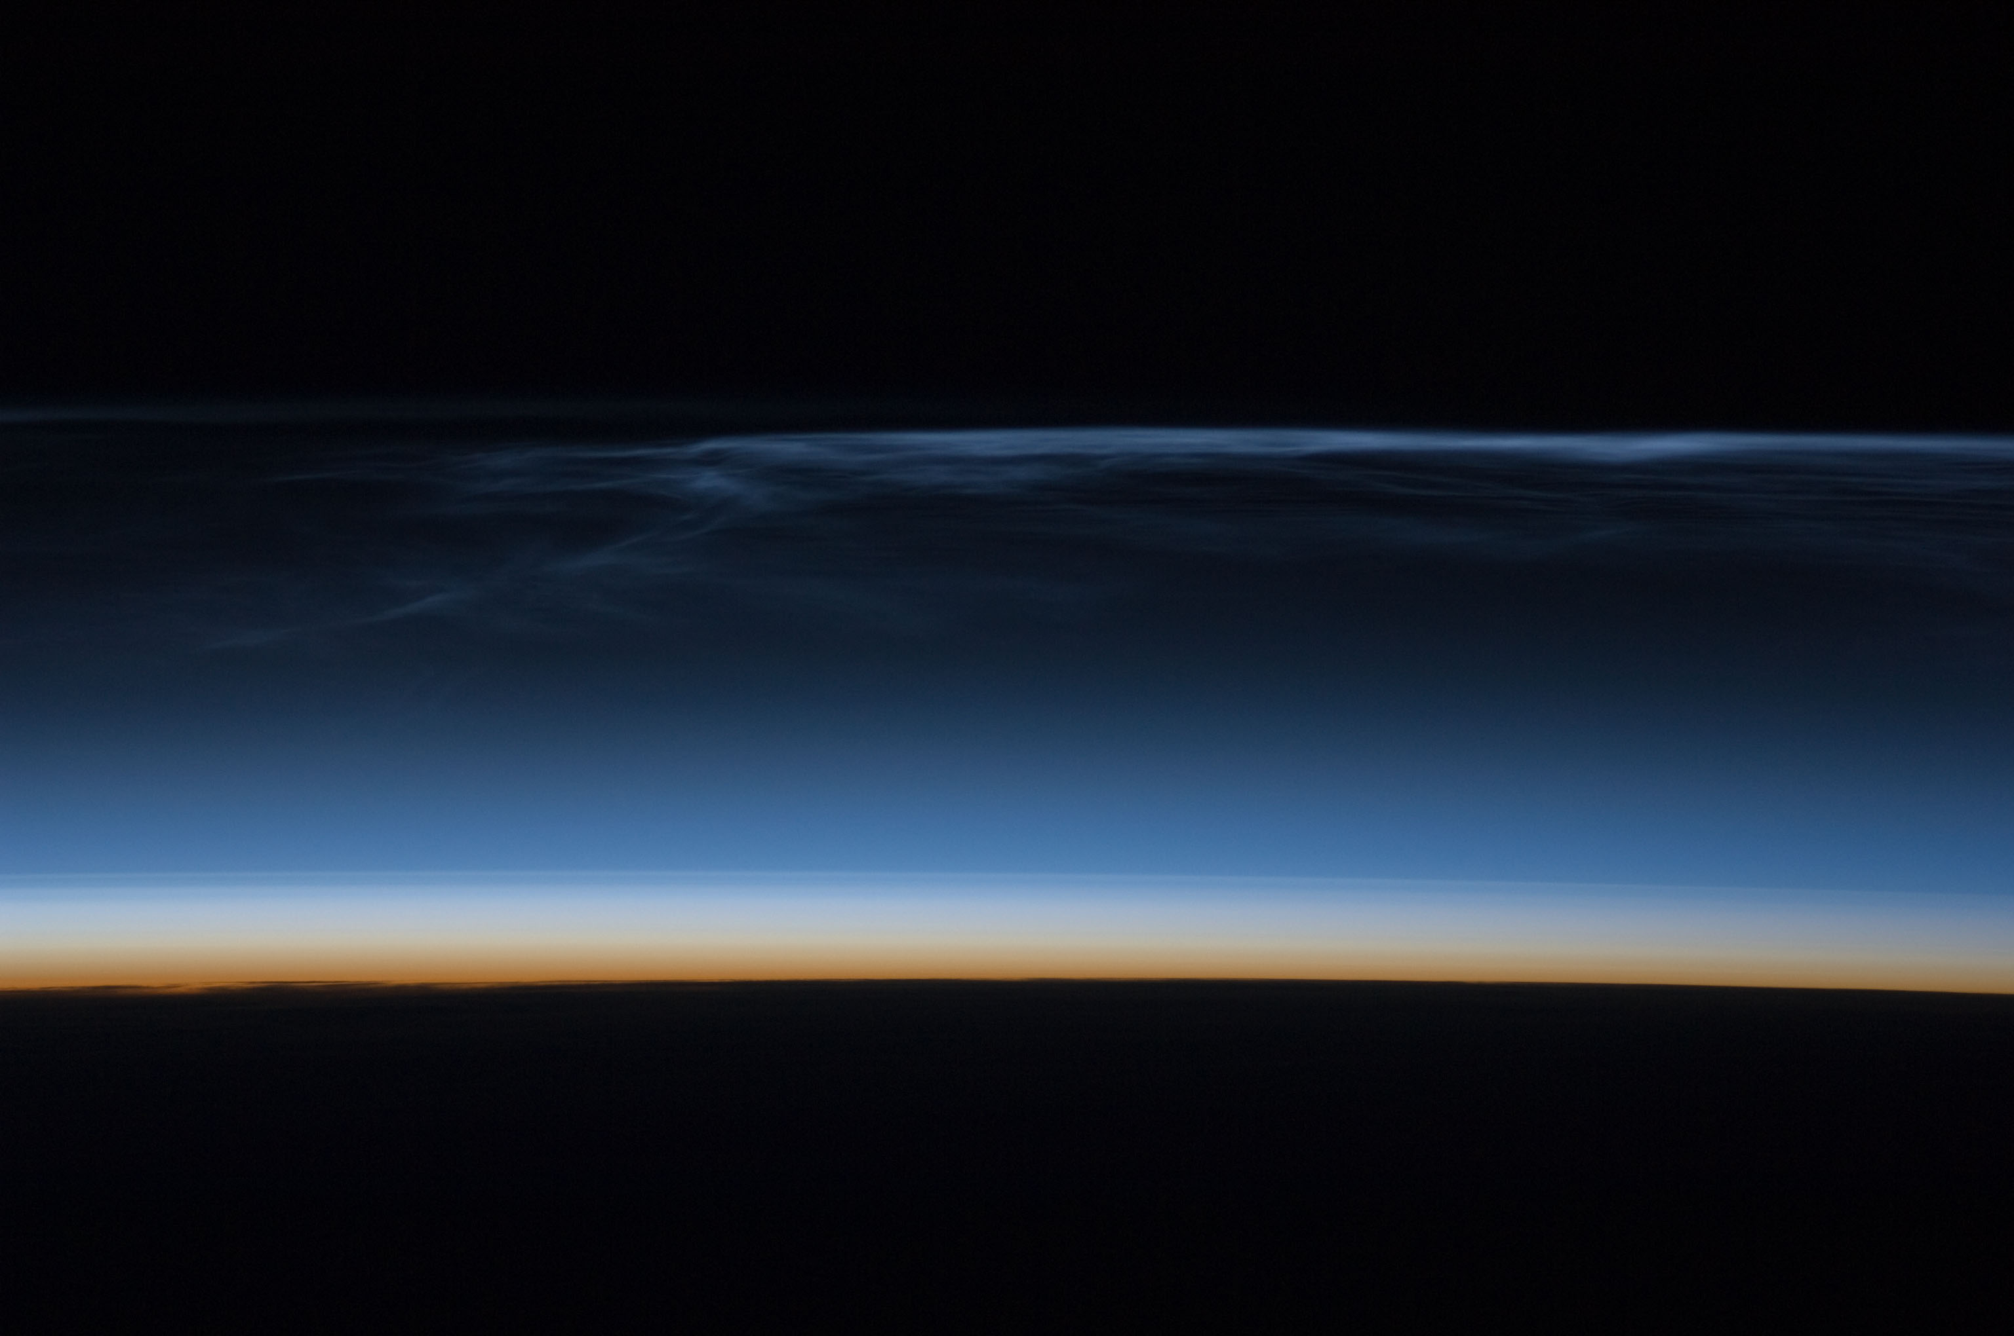
Thermosphere
Thermosphere
Exponential Atmosphere
Mesosphere
Polar Mesospheric Clouds 80-85 km
Stratosphere
Troposphere
You are here
Notes:
Iss017e011632.jpg
Cartoon of mass concentration

Slide 12
Thermosphere
Thermosphere
Hotter Exponential Atmosphere
Mesosphere
Polar Mesospheric Clouds 80-85 km
Stratosphere
Troposphere
You are here
Notes:
In hotter atmosphere mass from below migrates upward. This increases drag

Slide 13
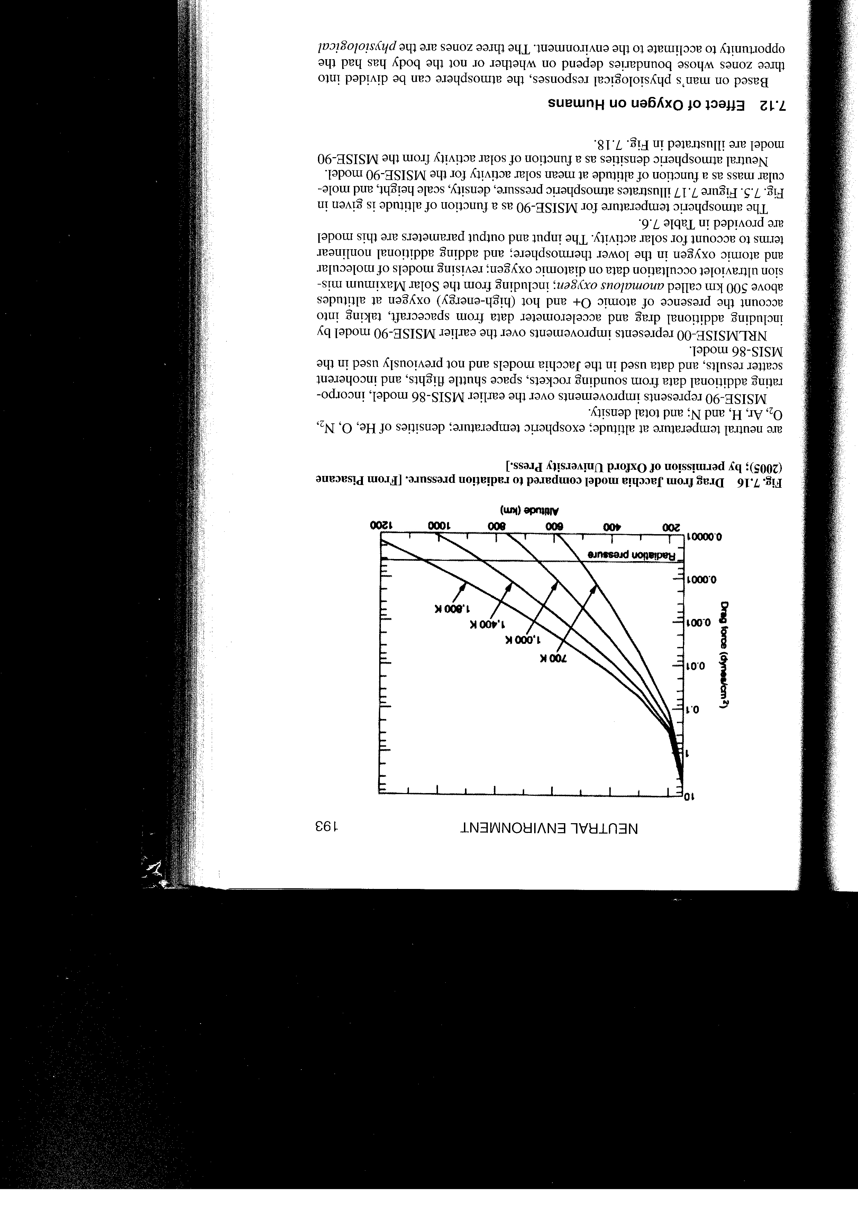
Satellite Drag and Thermosphere Density
The drag force is considered the most dominant force on low-earth orbiting spacecraft and serves to change the energy of the spacecraft through the work done by the drag force.

Slide 14
“Toy” Model Satellite Altitude vs Time
Cold Thermosphere
Hot Thermosphere
Longer on-orbit lifetime in “cold” thermosphere

Slide 15
“Toy” Model Satellite Speed vs Time
Hot Thermosphere
Cold Thermosphere
Large reservoir of potential energy, some is converted to kinetic energy

Slide 16
“Toy” Model Satellite Mechanical Energy vs Time
Cold Thermosphere
Hot Thermosphere

Slide 17
ISS Altitude Oct-Nov 2003

Slide 18
Orbital Period Dependence on Thermosphere Density
Through Kepler's laws, one can derive the rate of change of orbital period ( T ) in terms of the atmospheric density:
where B = B-factor (ballistic coefficient) =
ρ_{P} = density at perigee
ρ = density
s = satellite path
From radar tracking, one can derive the thermosphere density
From satellite accelerometers, one can derive the thermosphere density

Slide 19
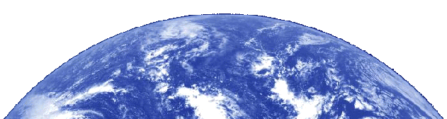
Atmospheric Drag = Space Object Positioning Error
EXPECTED POSITION
ACTUAL POSITION
Satellite will be some distance below and ahead of its expected position when a ground radar or optical telescope attempts to locate it.
Radar
Receiver
Notes:
24. -- A source for space object positioning errors is either more or less atmospheric drag than expected on low orbiting objects (generally those at less than about 1000 km altitude). Energy deposited in the Earth’s upper atmosphere by EUV, X-ray, and charged particle bombardment heats the atmosphere, causing it to expand outward. Low earth-orbiting satellites and other space objects then experience denser air and more drag than expected. This drag decreases the object’s altitude and increases its orbital speed. The result is the satellite will be some distance below and ahead of its expected position when a ground radar or optical telescope attempts to locate it. (Conversely, less atmospheric heating and drag than expected will cause a low orbiting object to be some distance above and behind its expected position.)
-- The consequences of drag-induced orbital changes include:
(1) Delayed acquisition of SATCOM links for commanding or data transmission. (NOTE: The impact of drag is greatest on low orbiting satellites--the very satellites that spend the least amount of time above the horizon and for which we can least afford delays in acquisition.)
(2) Costly orbit maintenance maneuvers become necessary.
(3) De-orbit predictions become unreliable. (NOTE: A classic case was Sky Lab. Geomagnetic activity was so severe, for such an extended period, that Sky Lab burned-in before a planned Space Shuttle rescue mission was ready to launch.)

Slide 20
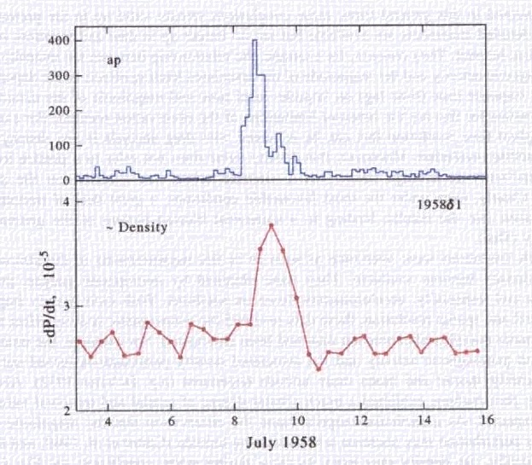
First Observation of Satellite Drag Associated with Neutral Density Enhancement
Extreme Geomagnetic Activity Indicated by Auroral Currents
Rate of Orbital Period Change
Sputnik Orbital Period Variation vs Day of July 1958
From Prolss (2011) after Data from Jacchia 1959
Notes:
New generation model: Moving to JBH09 (2009) atmospheric density model
Uses solar data from SET web sites
Includes 11 indices F10, S10, M10, Y10, F10-bar, S10-bar, M10-bar, Y10-bar, ap, Dst, Dtc

Slide 21
Thermosphere
Thermosphere
Hotter Exponential Atmosphere
Mesosphere
Polar Mesospheric Clouds 80-85 km
Stratosphere
Troposphere
You are here

Slide 22
Energy Flow to the Thermosphere
Sun
Shortwave Photons (Radiation)
Index = F10.7
Particles and
Electromagnetic Fields Index = Ap
Ionosphere/
Thermosphere
Solar Wind
Magnetosphere
Tides and Waves
Atmosphere Below
Knipp 2011 Understanding Space Weather and the Physics Behind It
Notes:
Energy paths/sources for the thermosphere

Slide 23
Solar /Solar Wind Energy Deposition
Magnetospheric Effects
High-latitude, auroral
~20%,
Solar wind
Matter
and Fields
but highly variable and may reach 50%
Photons
EUV
and UV
Radiation
Dayside
Energy
Deposition
~80%
After Prolss, 2011
Notes:
Energy deposition variability
Most energy from solar photons, however during times with many strong CMEs, the energy from CME/magnetosphere interaction can equal that from photons (Knipp et al, 2004)

Slide 24
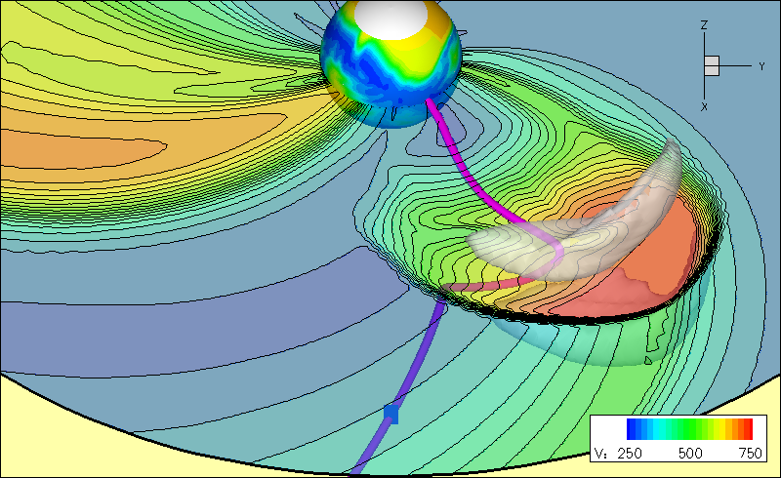
CMEs and HSS Indirectly Heat
the Thermosphere
High Speed Stream
CME
CME
Courtesy: Odstrcil
CMEs: extreme short-lived heating, HSSs: Moderate long-lived heating

Slide 25

CHAMP Density Extrapolated to 400 km (ng/m³)
CME 1
CME 2
CME 3
Dayside Density
Nightside
Density
203 204 205 206 207 208 209 210
Knipp, 2013
Energy deposition causes atmospheric expansion; Heated molecules and atoms, fighting for more room, migrate upward
Notes:
Density inferred from s/c acceleromter
Typical global response time is 6-8 hours
Energy arrives first in auroral zones….can begin disturbing mid latitudes within an hour

Slide 26
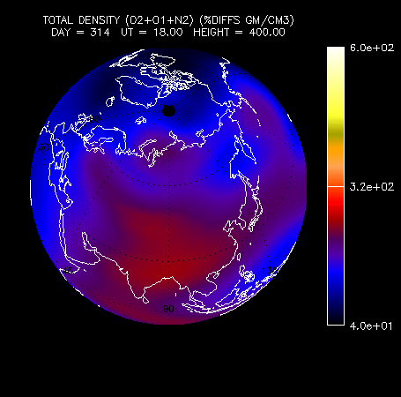
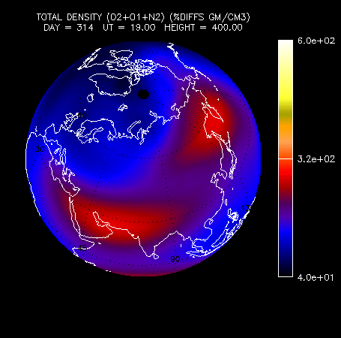
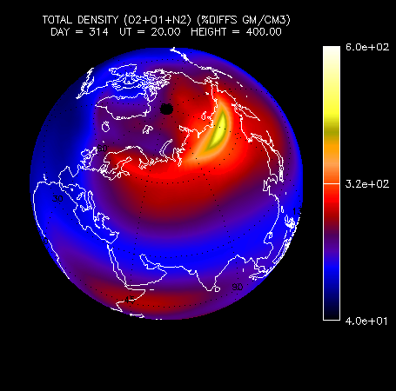
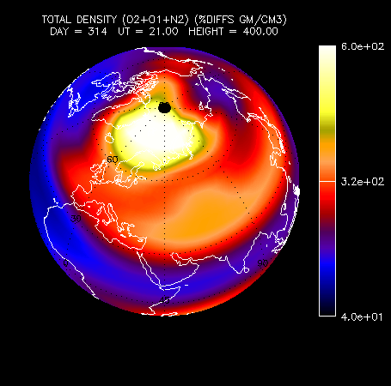
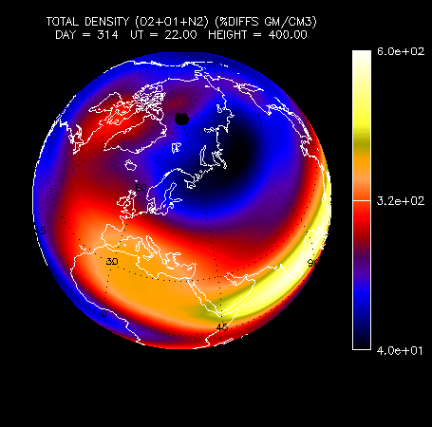
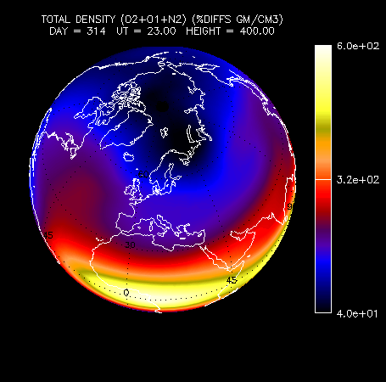
Model output of neutral density change (in %) at 400 km in northern hemisphere during a storm
Atmosphere becomes structured at a fixed altitude. Courtesy of G. Lu, NCAR
Notes:
Visualization of numerical model output from TIEGCM
View from northern hemisphere each hour Nov 2004

Slide 27
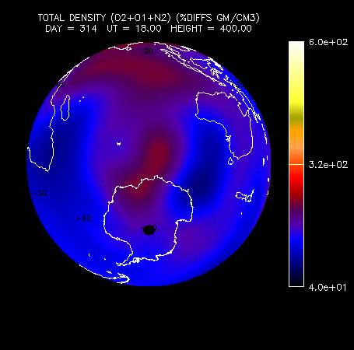
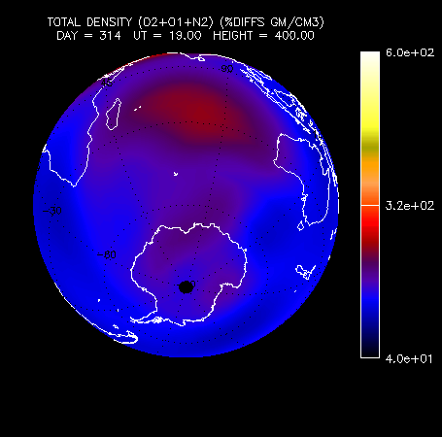
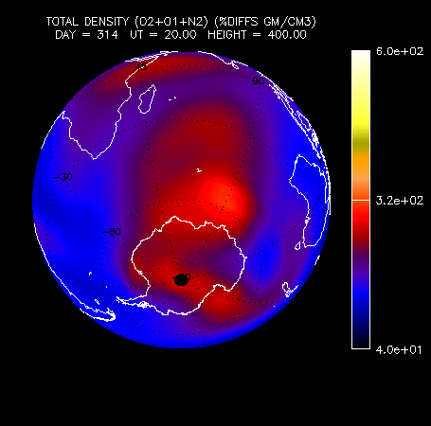
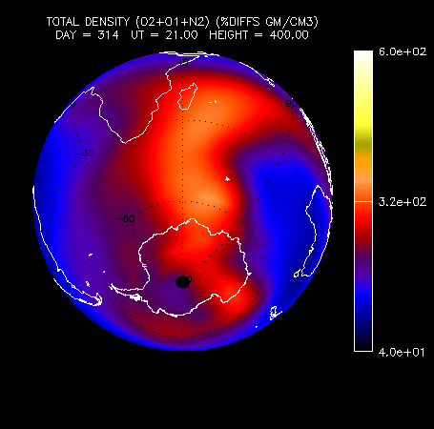
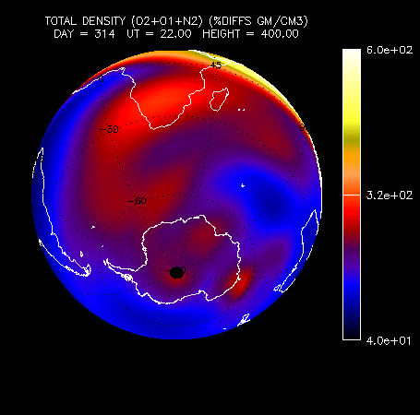
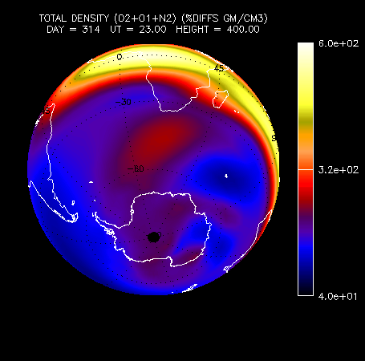
Model output of neutral density change (in %) at 400 km in southern hemisphere during a storm
Atmosphere becomes structured at a fixed altitude. Courtesy of G. Lu, NCAR
Notes:
Visualization of numerical model output from TIEGCM
View from southern hemisphere each hour Nov 2004

Slide 28
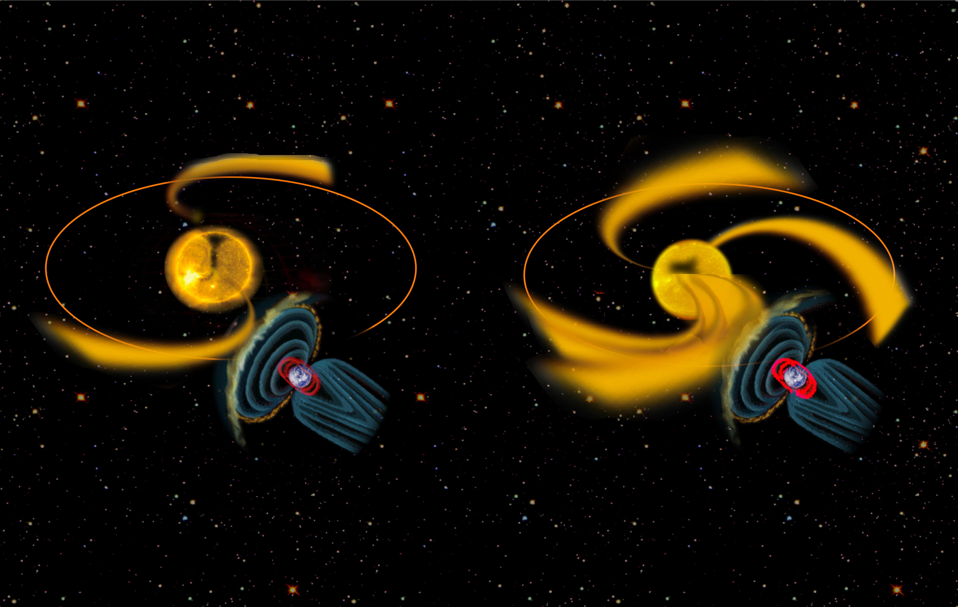
High Speed Streams Repetitively Heat
the Thermosphere
Gibson et al., 2009
Notes:
Coronal holes produce moderate but repetitive density perturbations

Slide 29
2005 Periodograms – High Speed Streams
Subharmonics of a Solar Rotationn
Density - 400km altitude
Solar EUV flux index
Solar wind speed
Geomagnetic Activity Index
27 days/3
Thayer et al., 2008
Notes:
In 2005 the disturbances repeated every nine days

Slide 30
Atmospheric Drag on Satellites
Orbital Elements
Satellite
Lifetime
PREDICTED
ACTUAL
Collision
Avoidance
Satellite
Tracking

Slide 31
Collision Avoidance
If a predicted conjunction between orbiting objects and the ISS yields a probability of collision greater than 10⁻⁴, official flight rules call for the execution of a collision avoidance maneuver by the ISS. Conjunction volume is: 4km x 50km x 50km box
During its first 15 years of operations, the ISS successfully conducted 16 collision avoidance maneuvers, and on a separate occasion in 1999 a planned maneuver attempt failed.
In addition, three incidents arose when insufficient time permitted a collision avoidance maneuver, forcing the crew of the ISS to retreat to the Soyuz return craft where they were prepared to undock from the ISS quickly in the event of a collision.
In total, the collision avoidance maneuver threshold level has been reached only 20 times for an average of once per year.
www.nasa.gov http://orbitaldebris.jsc.nasa.gov/
Notes:
See also
NASA’S ORBITAL DEBRIS CONJUNCTION ASSESSMENT
AND COLLISION AVOIDANCE STRATEGY
Richard T. Gavin
NASA Johnson Space Center
Flight Dynamics Division

Slide 32
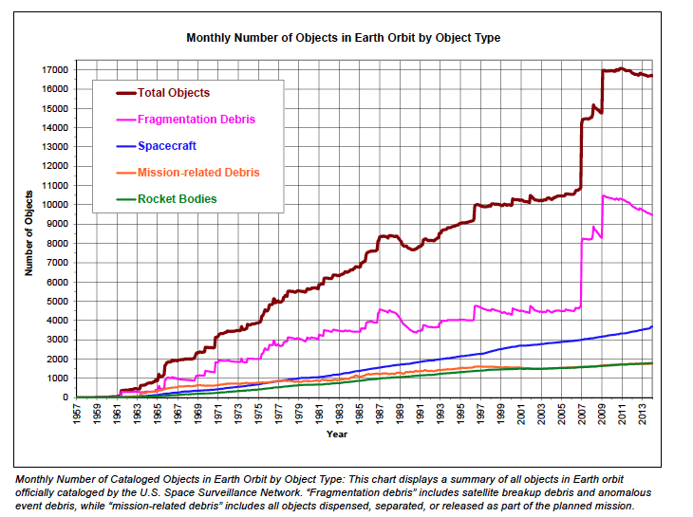
Orbital Debris Quarterly News Vol 18, Jan 2014
Solar Cycle
Removal
Mitigation
Iridium
Cosmos
90% of cataloged Fengyun‐1C debris remain in orbit

Slide 33
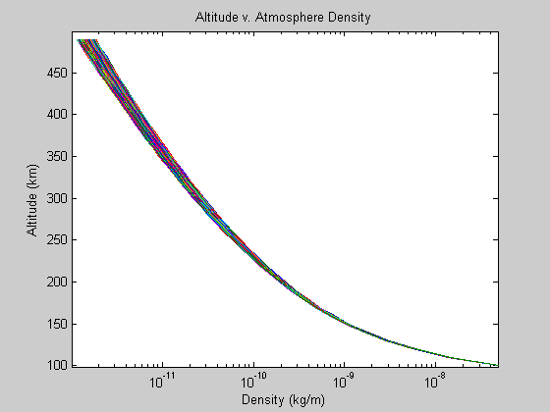
TIEGCM Density Profile
Model output from Thermosphere Ionosphere Electrodynamics General Circulation Model Available from CCMC
Notes:
Student run of multiple instances of TIEGCM

Slide 34
Jacchia Bowman 2008 Geomagnetic Storm Model Errors
Notes:
The great improvement for the JB2008 model is for the major storms
MSIS models the moderate storms well using a 54-hour ap averaging algorithm
HASDM (real time monitoring) does very well across the board for all storms

Slide 35
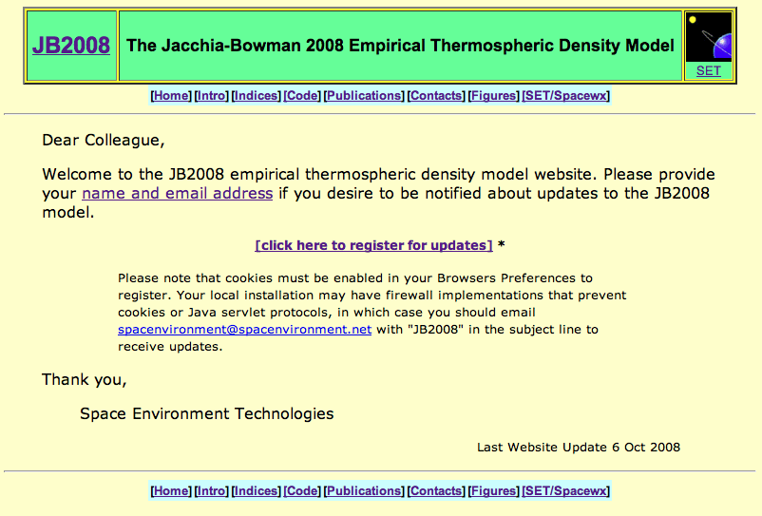
JB2008 Web Site
Jacchia Bowman 2008 Model Information
Notes:
New generation model: Moving to JBH09 (2009) atmospheric density model
Uses solar data from SET web sites
Includes 11 indices F10, S10, M10, Y10, F10-bar, S10-bar, M10-bar, Y10-bar, ap, Dst, Dtc

Slide 36
Summary
Significant Challenges are posed by satellite drag
    Track and identify active payloads and debris
    Collision avoidance and re-entry prediction
    Attitude Dynamics
    Constellation control
    “Drag Make-Up” maneuvers to keep satellite in control box
    Delayed acquisition of SATCOM links for commanding /data transmission
    Mission design and lifetime

Slide 37
JB2008 Geomagnetic Storm Modeling
All previous empirical models use ap geomagnetic index for storm modeling
The 3-hour ap is a measure of general magnetic activity over the Earth, and responds primarily to currents flowing in the ionosphere and only secondarily to magnetospheric variations
The ap index is determined by observatories at high latitudes which can be blind to energy input during large storms (Huang and Burke, 2004)
The Disturbance Storm Time (Dst) index is primarily used to indicate the strength of the storm-time ring current in the inner magnetosphere
During the main phase of magnetic storms, the ring current becomes highly energized and produces a southward-directed magnetic field perturbation at low latitudes on the Earth’s surface
The Dst index is determined from hourly measurements of the magnetic field made at four points around the Earth’s equator
Notes:
New generation model: Moving to JBH09 (2009) atmospheric density model
Uses solar data from SET web sites
Includes 11 indices F10, S10, M10, Y10, F10-bar, S10-bar, M10-bar, Y10-bar, ap, Dst, Dtc

Slide 38
JB2008 Dst Equation Development
The thermosphere acts during storm periods as a driven-but-dissipative system whose dynamics can be represented by a differential equation
The driver is the magnetospheric electric field. Burke (2008) determined the relationship for the exospheric temperature responses as a function of Dst:
τ parameters are empirically determined relaxation constants
The above equation must be integrated from storm beginning throughout the entire storm period in-order to compute ΔTc at every point during the storm
The above equation was optimized to fit the CHAMP and GRACE accelerometer density data, along with HASDM global densities.
Additional optimized equations based on different τ values were developed for use during the Dst recovery phase period

