Slide 1
SW REDI Review
Yihua Zheng
SW REDI
June 9, 2014

Slide 2
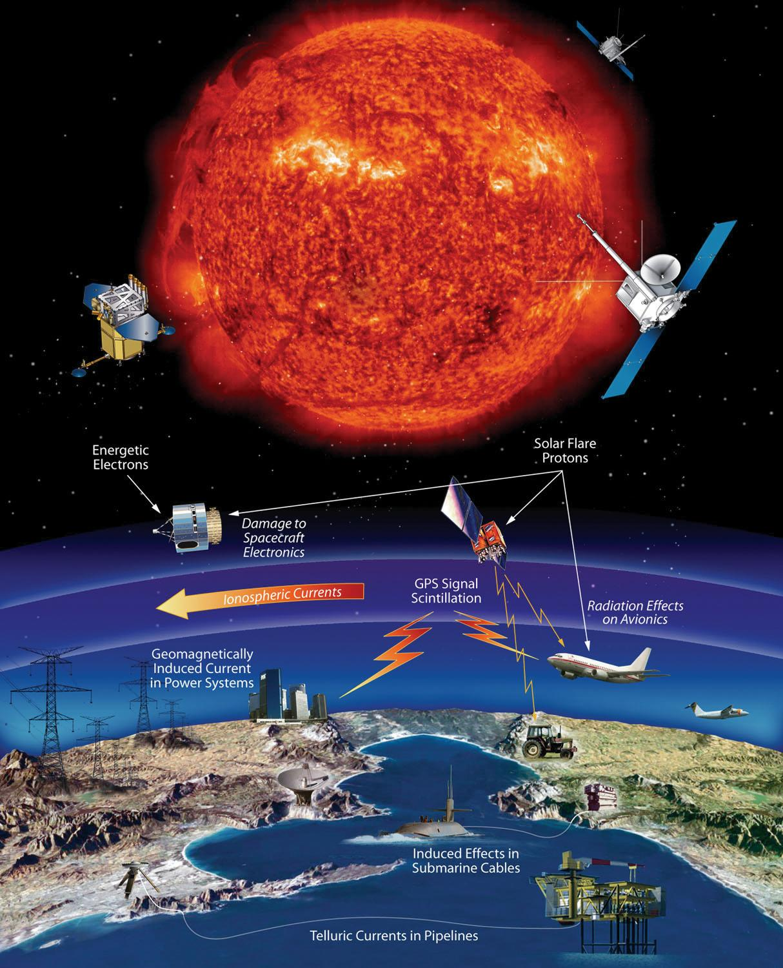
Recap
CME, Flares, and Coronal Hole HSS
The Sun
maker of space weather
Solar energetic protons
CME, Flares, and Coronal Hole HSS
Three very important solar wind disturbances/structures for space weather
Radiation storm
  proton radiation (SEP) <flare/CME>
  electron radiation <CIR HSS/CME>
Radio blackout storm <flare>
Geomagnetic storm
  CME storm (can be severe)
  CIR storm (moderate)

Slide 3
Flares
Most pronounced in X-ray or Extreme Ultraviolet
Flares occurring on the Earth-facing solar disk classified by GOES X-ray measurement in the 0.1-0.8 nm (1-8 A)
Measured by SDO EUV wavelengths
Farside flares – Can be seen in STEREO EUV images

Slide 4
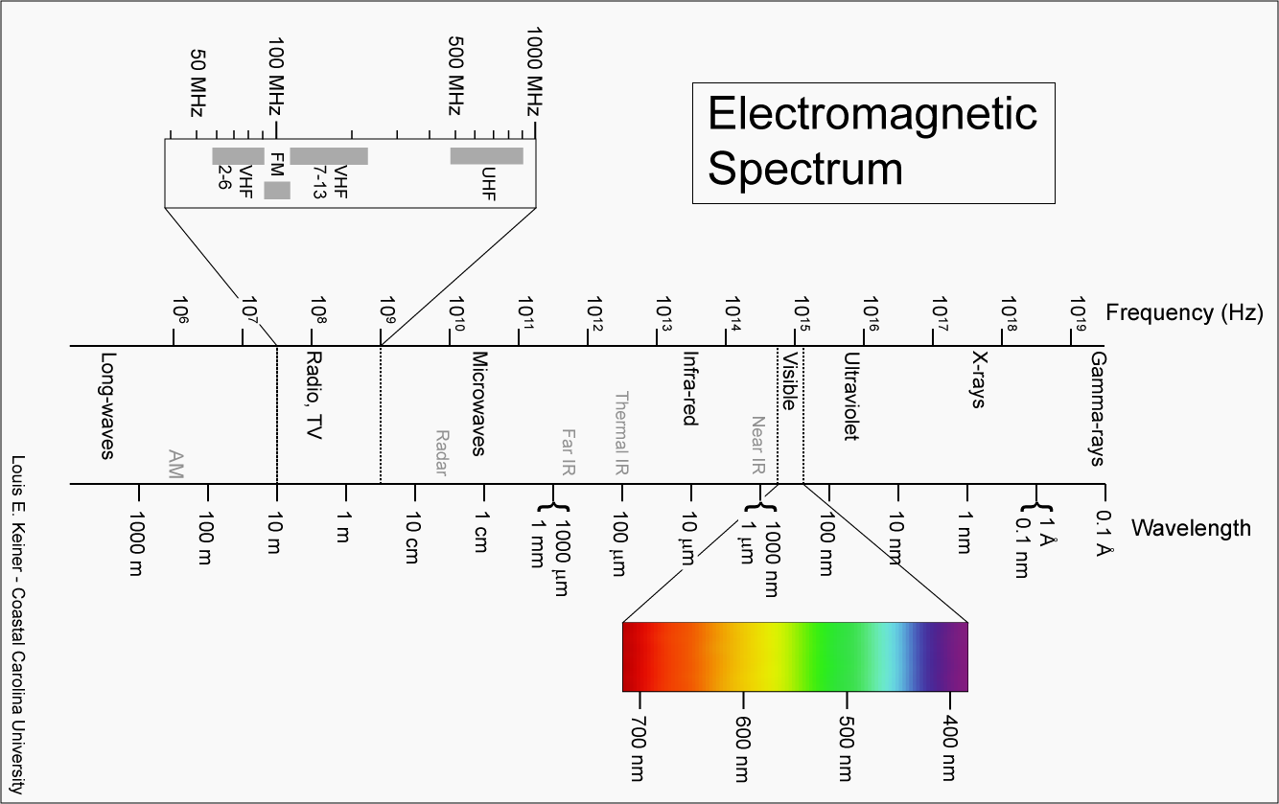
Electromagnetic Spectrum

Slide 5
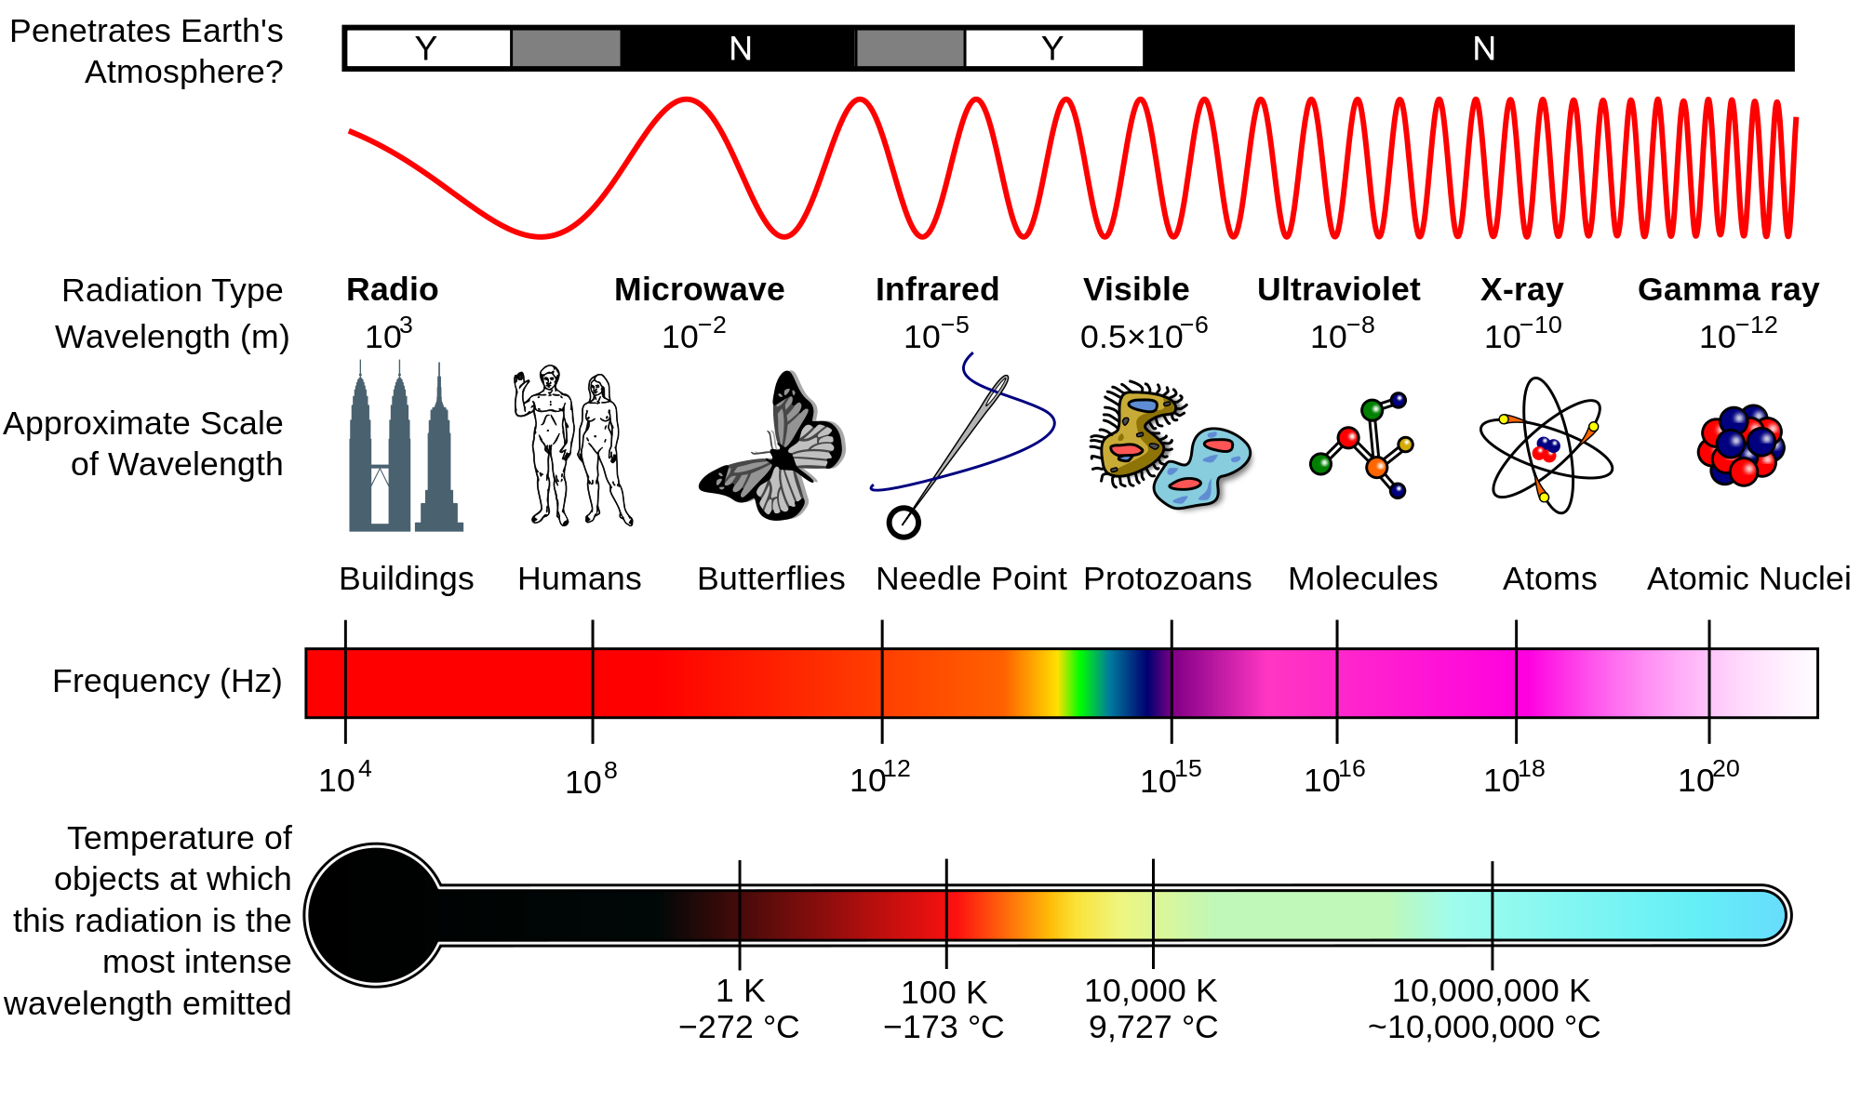
Electromagnetic Spectrum

Slide 6
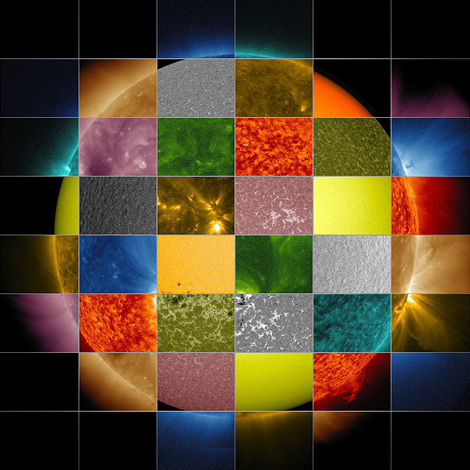
Flares
Sun Primer: Why NASA Scientists Observe the Sun in Different Wavelengths
http://www.nasa.gov/mission_pages/sunearth/news/light-wavelengths.html
Different SDO Wavelengths

Slide 7
Flare: SWx impacts
Cause radio blackout through changing the structures/composition of the ionosphere (sudden ionospheric disturbances) – x ray and EUV emissions, lasting minutes to hours and dayside
Affect radio comm., GPS, directly by its radio noises at different wavelengths
Contribute to SEP – proton radiation, lasting a couple of days

Slide 8
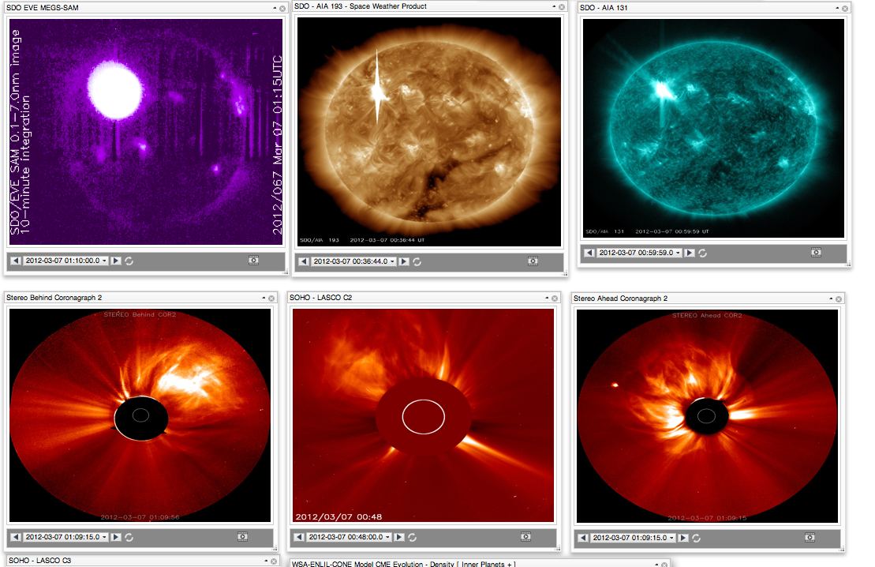
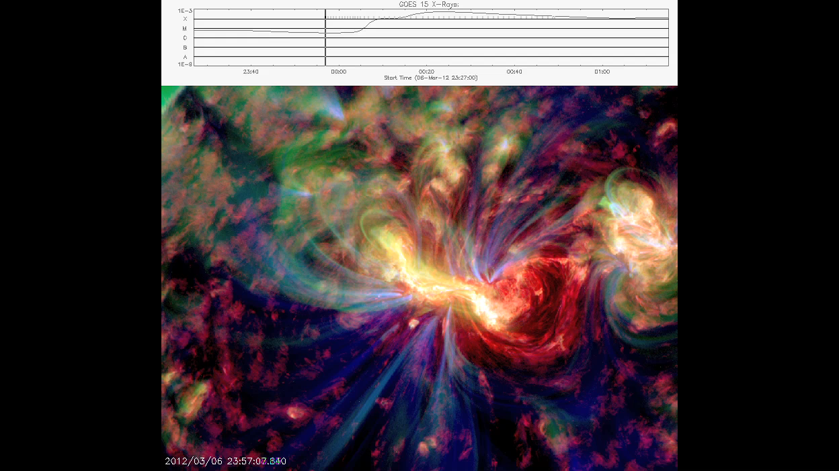
2012 March 7 X5.4/X1.3 flares
Most pronounced in x-ray and EUV
EUV
EUV
X-ray
Blended
EUV

Slide 9
Solar Flare Consequences
1: ionospheric dynamics
X-ray and EUV
The extreme Halloween solar flares are shown to have extreme ionospheric effects. Enhancements in ionospheric total electron content of 30% nominal values were noted for the 28 October 2003 event. These changes occurred on timescales of 5 min. The enhanced ionospheric TEC lasts for hours after the flares.
The 260–340 A ° portion of the flare spectra through photoionization creates electron-ion pairs at altitudes >160 km, where the recombination rates are long. The x-ray portion of the flare spectra, on the other hand, creates ionization at 95–110 km altitude, where the recombination timescales are only approximately tens of seconds.
There is a wide variation in flare spectra from event to event. It was shown that although the 4 November flare (X28) was almost double the intensity of the 28 October flare (X17) in 1–8 A ° x-rays. The 28 October flare was more than double the 4 November flare peak intensity in the 260–340 A ° EUV wavelength band.
Tsurutani, B. T., et al. ( 2006 ), Extreme solar EUV flares and ICMEs and resultant extreme ionospheric effects: Comparison of the Halloween 2003 and the Bastille Day events , Radio Sci. , 41 , RS5S07, doi:10.1029/2005RS003331.

Slide 10
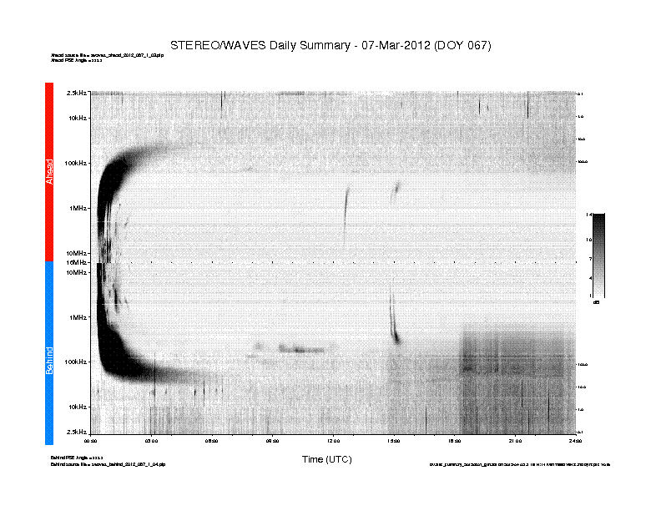
Type II Radio Emission

Slide 11
Solar Flare: radio noise
SUMMARY: 10cm Radio Burst
Begin Time: 2012 Mar 07 0007 UTC
Maximum Time: 2012 Mar 07 0117 UTC
End Time: 2012 Mar 07 0210 UTC
Duration: 123 minutes
Peak Flux: 7200 sfu
Latest Penticton Noon Flux: 138 sfu
This noise is generally short-lived but can cause interference for sensitive receivers including radar, GPS, and satellite communications.

Slide 12
Solar radio bursts affect GPS directly
This event exceeded 1,000,000 solar flux unit and was about 10 times larger than any previously reported event.
Cerruti, A. P., P. M. Kintner Jr., D. E. Gary, A. J. Mannucci, R. F. Meyer, P. Doherty, and A. J. Coster (2008), Effect of intense December 2006 solar radio bursts on GPS receivers, Space Weather, 6, S10D07, doi:10.1029/2007SW000375.

Slide 13
Coronal Mass Ejection (CME)

Slide 14
SWx impacts of CME
Contribute to SEP (particle radiation): 20-30 minutes from the occurrence of the CME/flare
Result in a geomagnetic storm: takes 1-2 days arriving at Earth
Result in electron radiation enhancement in the near-Earth space (multiple CMEs): takes 1-3 days
Affecting spacecraft electronics – surfacing charging/internal charging, single event upsets
Radio communication, navigation
Power grid, pipelines, and so on

Slide 15
CME
Massive burst of solar materials into the interplanetary space: 10^15 g
Kinetic energy 10^32 erg
Yashiro et al. (2006) find that virtually all X-class flares have accompanying CMEs

Slide 16
CME viewed by coronagraph imagers
Eclipses allow corona to be better viewed
Does not happen often
Modern coronagraph imager is inspired by that
Occulting disk blocks the bright sun so we can observe corona features better

Slide 17
CME Example
March 7, 2012 CMEs associated with two x-class flares
iSWA layout
Associated with an Active Region

Slide 18
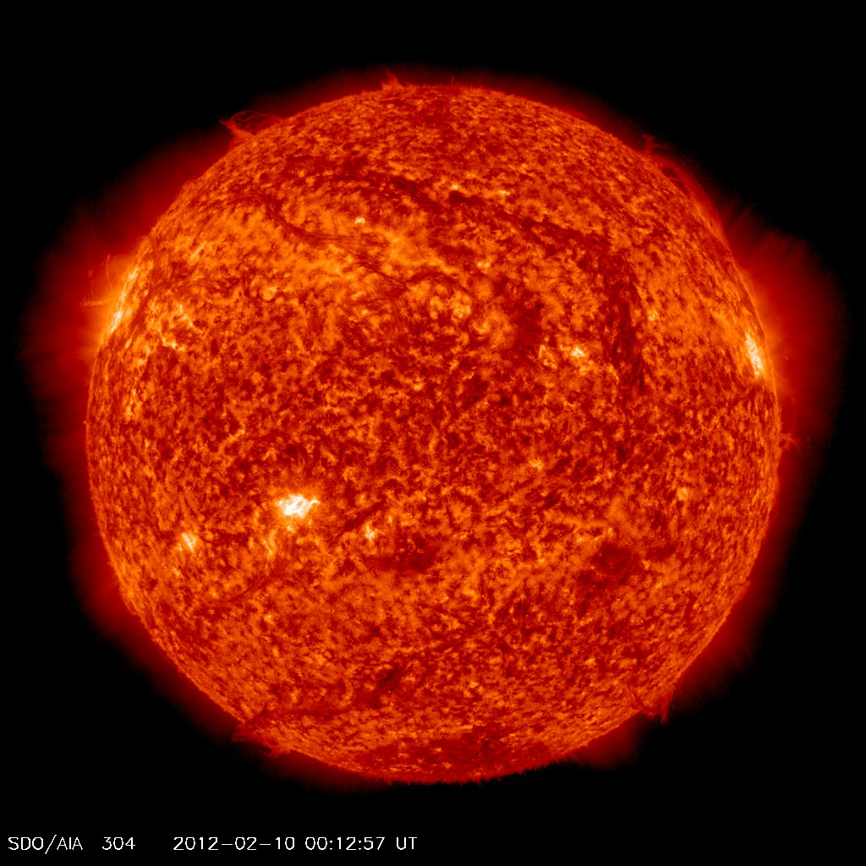
CME from Filament eruption
A movie
Northeast (upper left) quadrant starting around 19:00 UT on Feb 10, 2012
Notes:
Not associated with a specific active region – from a large scale filament eruption

Slide 19
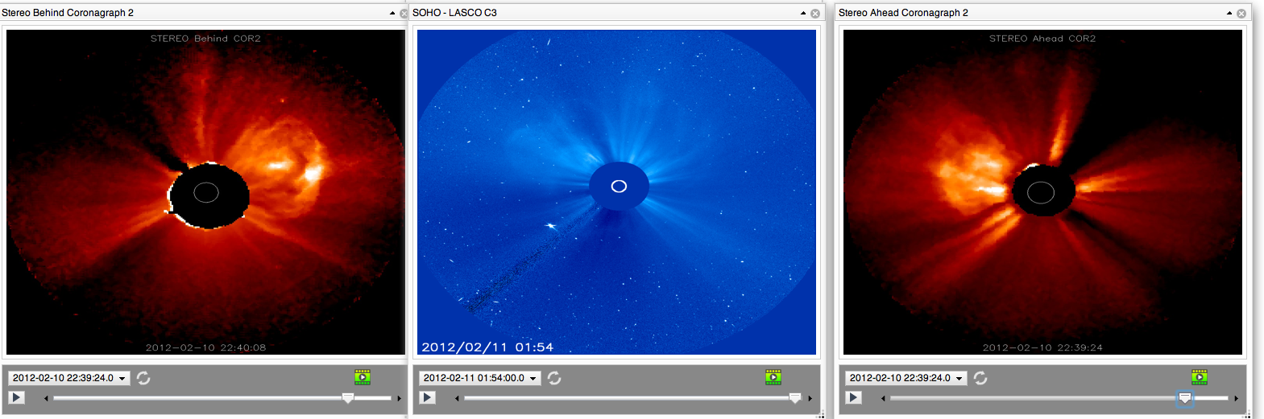
The associated CME
STEREO B
SOHO
STEREO A
Heart-shaped

Slide 20
Coronal Hole HSS
Is one important space weather contributor too!
Particularly for its role in enhancing electron radiation levels near GEO orbit and for substantial energy input into the Earth’s upper atmosphere
May be more hazardous to Earth-orbiting satellites than CME-related magnetic storm particles and solar energetic particles (SEP)

Slide 21
CIR and HSS
Co-rotating Interactive Regions (CIRs) are regions within the solar wind where streams of material moving at different speeds collide and interact with each other. The speed of the solar wind varies from less than 300 km/s (about half a million miles per hour) to over 800 km/s depending upon the conditions in the corona where the solar wind has its source. Low speed winds come from the regions above helmet streamers while high speed winds come from coronal holes.
As the Sun rotates these various streams rotate as well (co-rotation) and produce a pattern in the solar wind much like that of a rotating lawn sprinkler. However, if a slow moving stream is followed by a fast moving stream the faster moving material will catch-up to the slower material and plow into it. This interaction produces shock waves that can accelerate particles to very high speeds (energies).

Slide 22
west
east

Slide 23
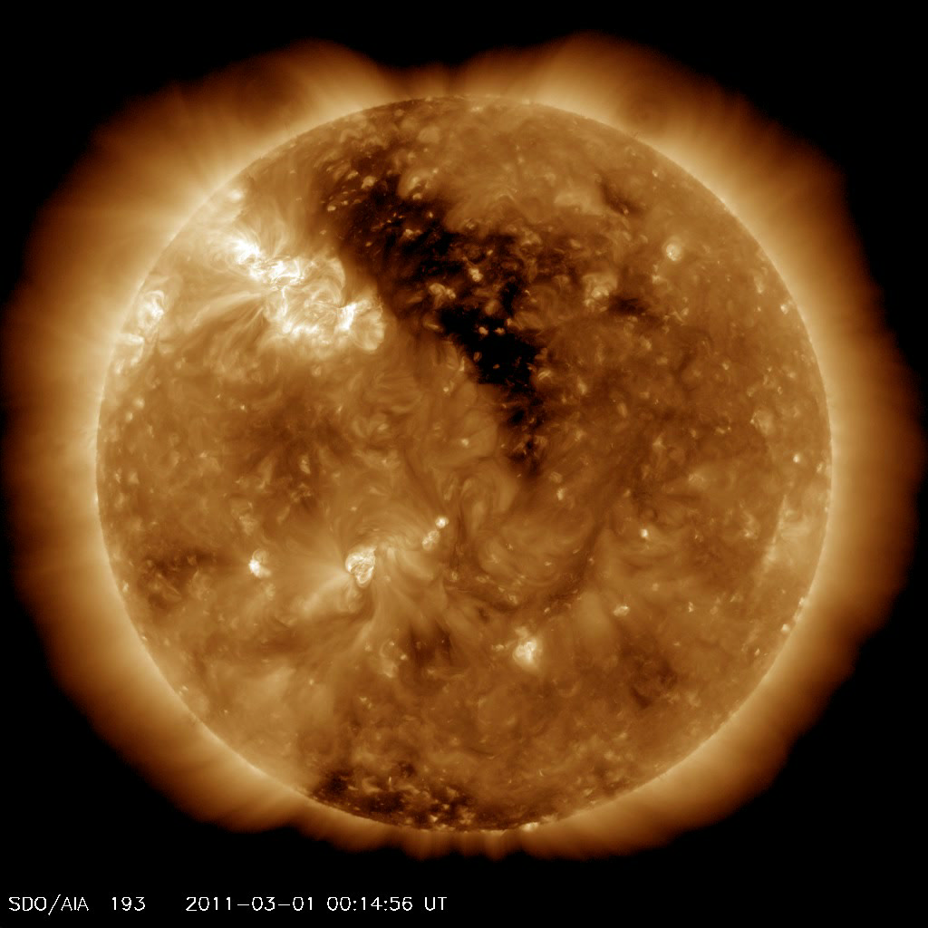
Coronal Hole HSS
Mar 1, 2011
June 4, 2012

Slide 24
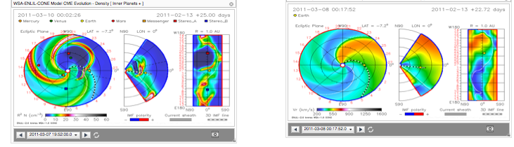
Forecasting capability enabled by ENLIL
WSA+ENLIL+cone
WSA+ENLIL
Predicting impacts of CMEs
Modeling and predicting the ambient solar wind

Slide 25
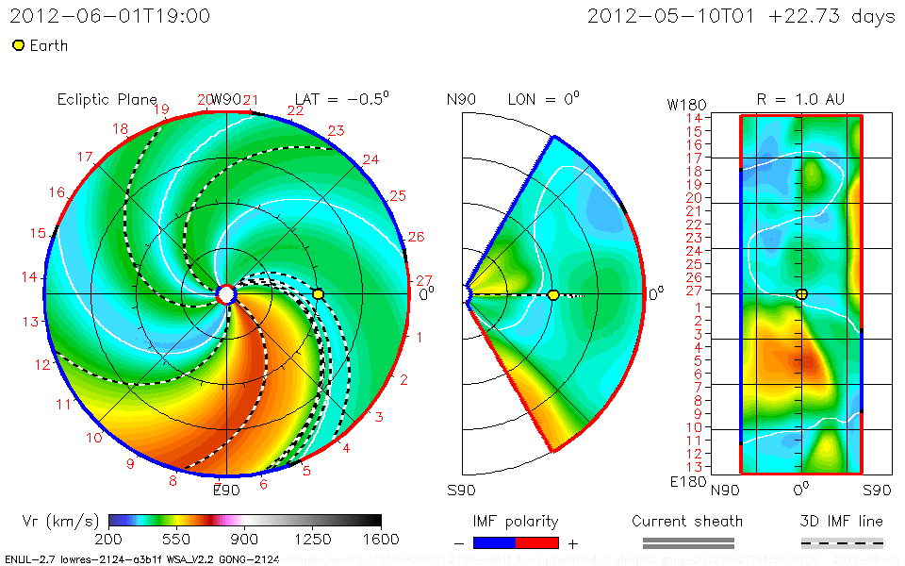
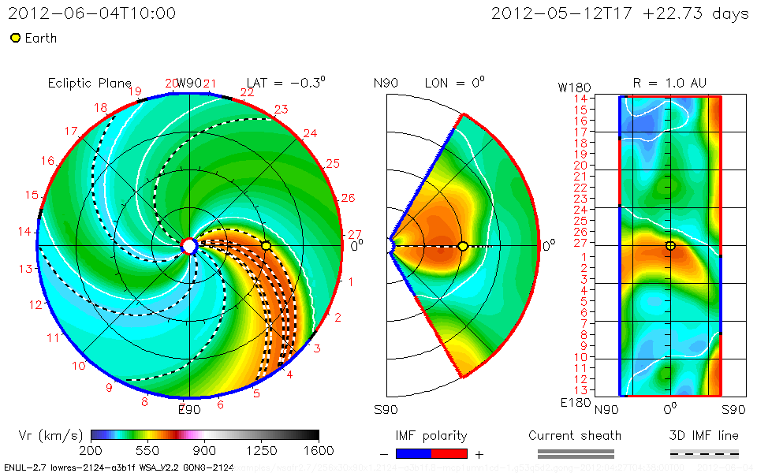
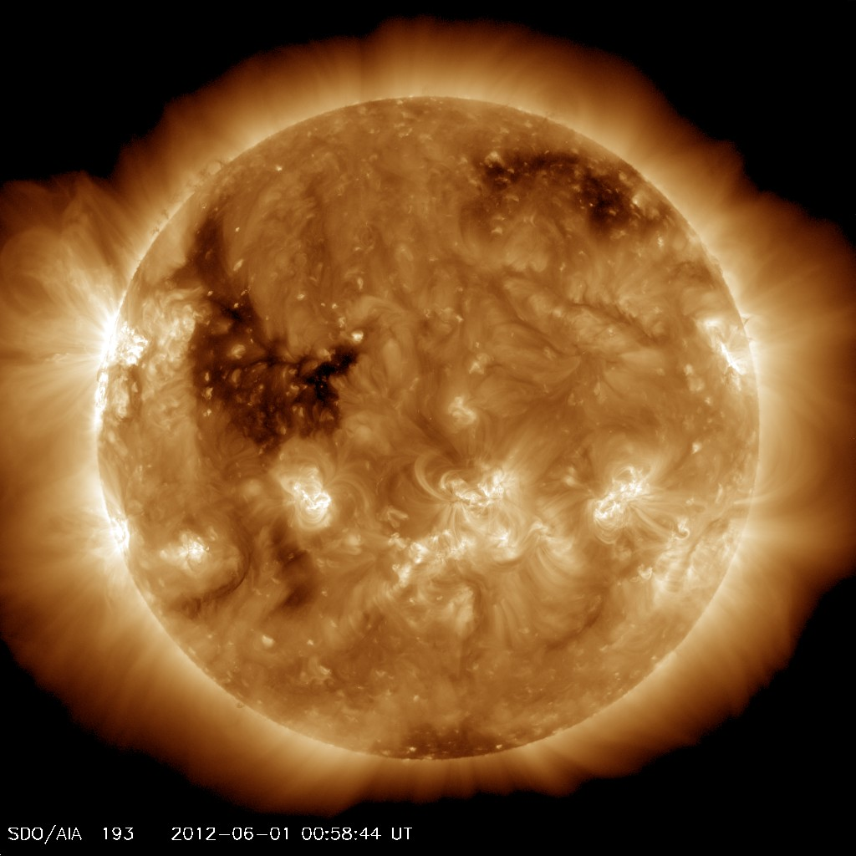
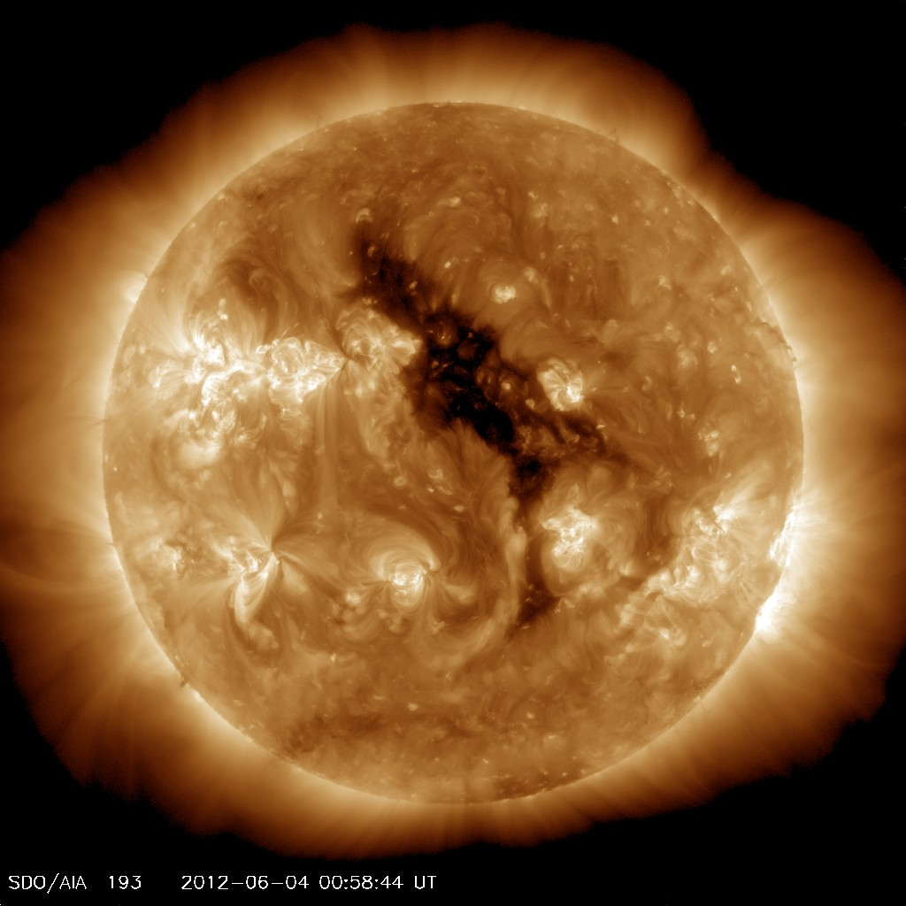

Slide 26
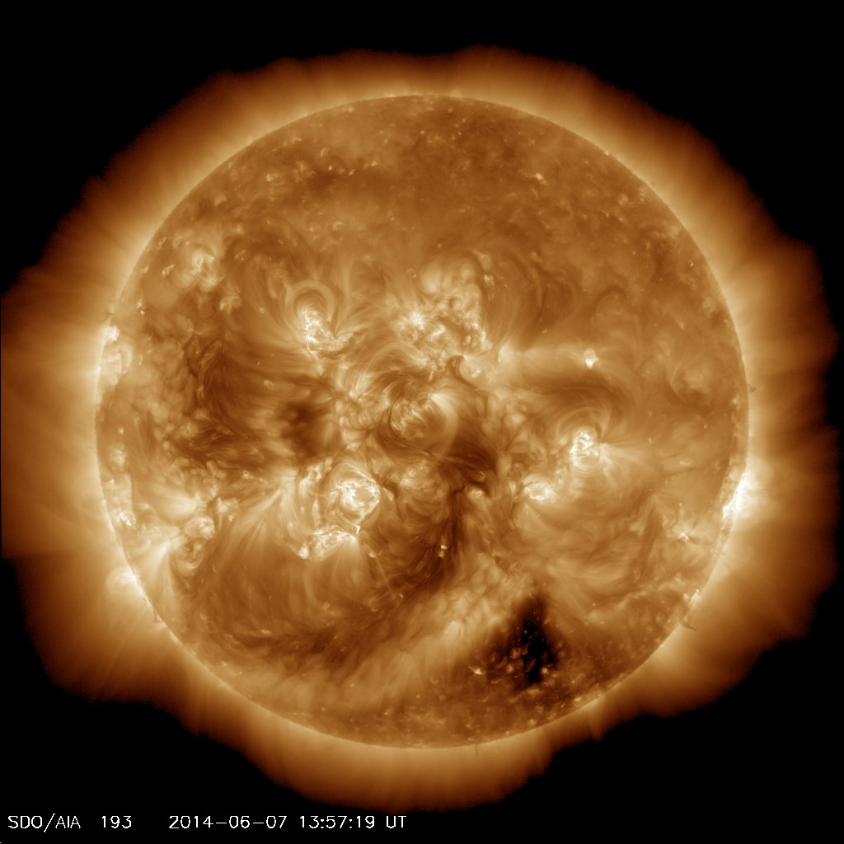
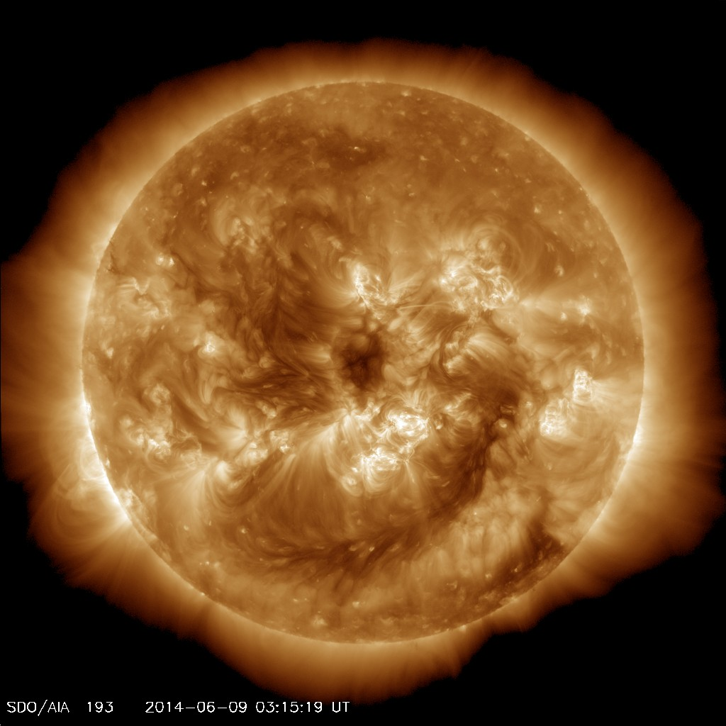
Current coronal hole
June 7, 2014
June 9, 2014

Slide 27
In-situ signatures of CME and CIR HSS at L1
ACE and WIND

Slide 28
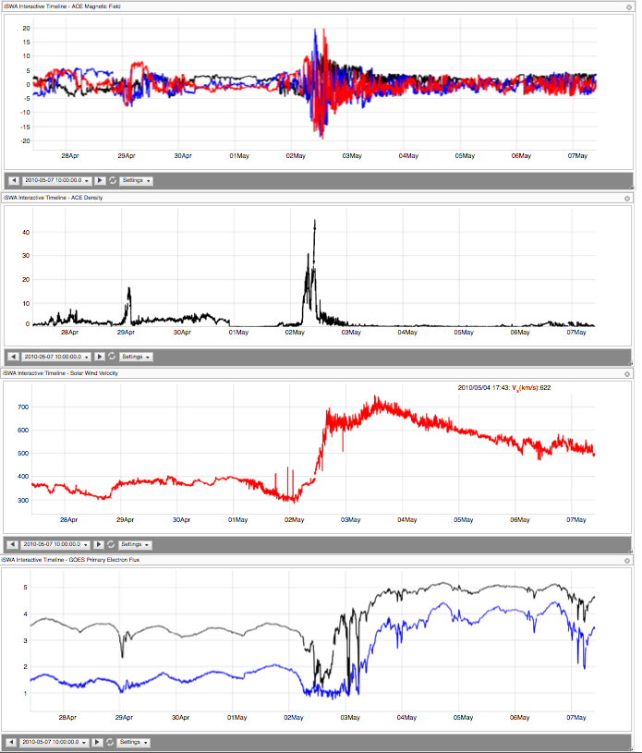
Clean HSS
May 2, 2010
Dense (20-30 cc), HSS
IMFBz: -18 nT
may be more hazardous to Earth-orbiting satellites than ICME-related magnetic storm particles and solar energetic particles
Electron radiation

Slide 29
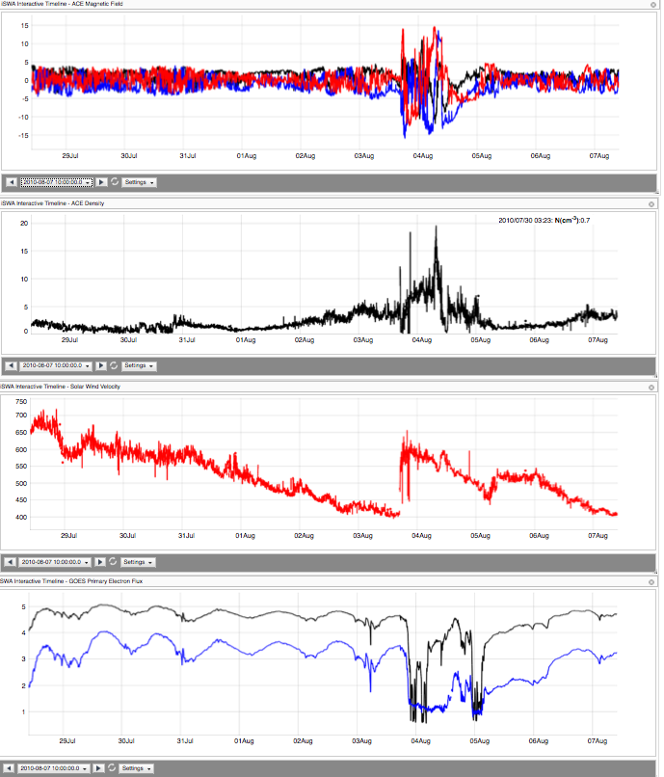
Aug 3, 2010

Slide 30
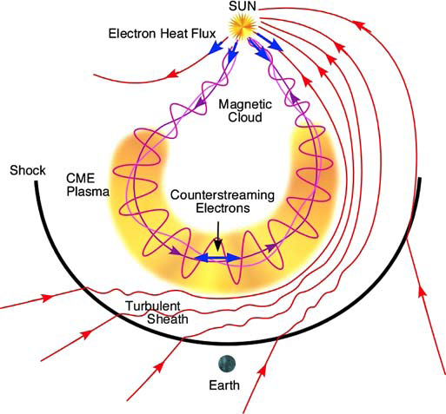
Schematic of the three-dimensional structure of an ICME and upstream shock

Slide 31
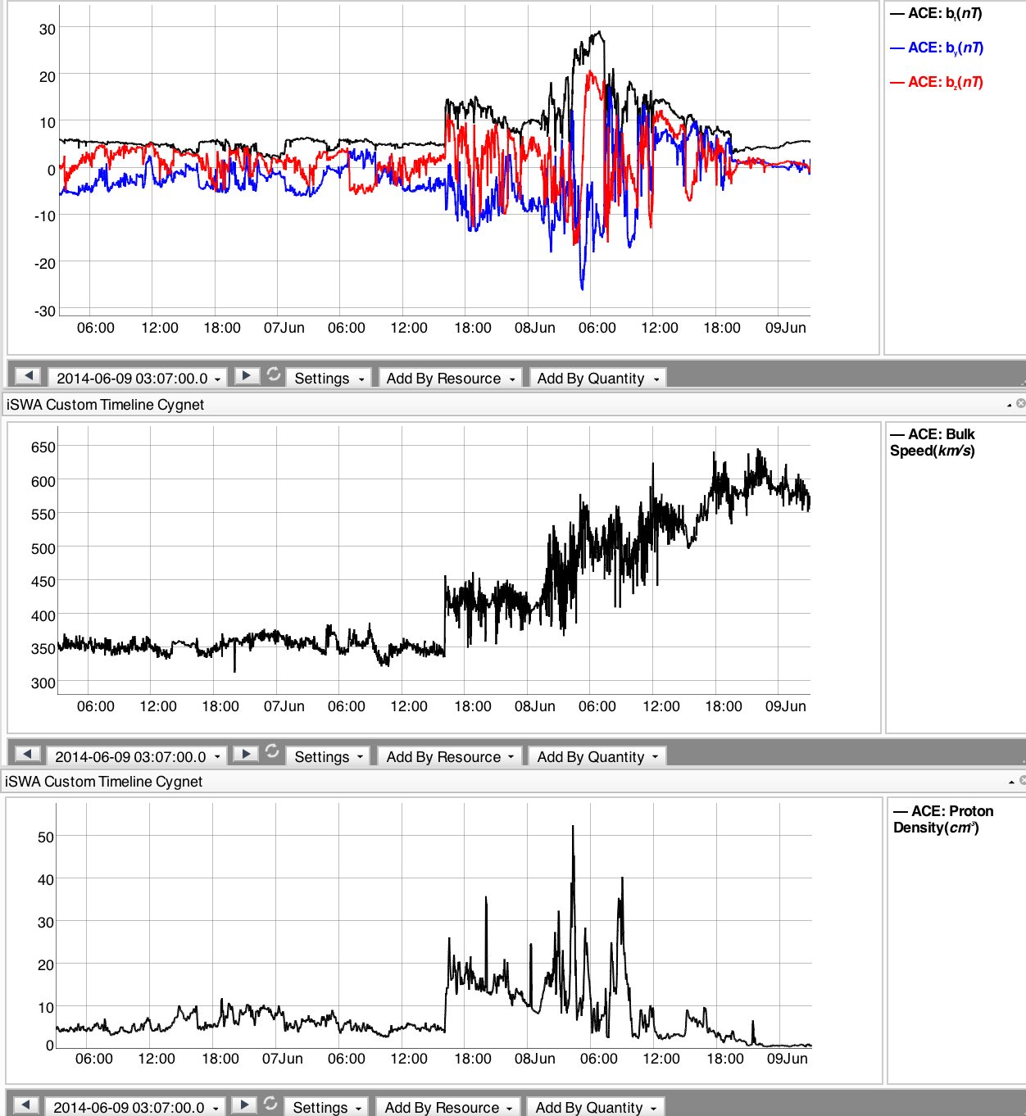
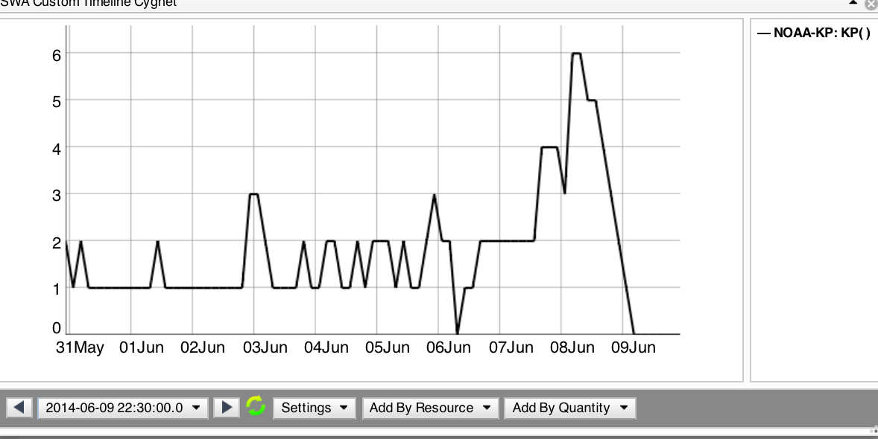
Current storm
Kp=6

Slide 32

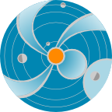
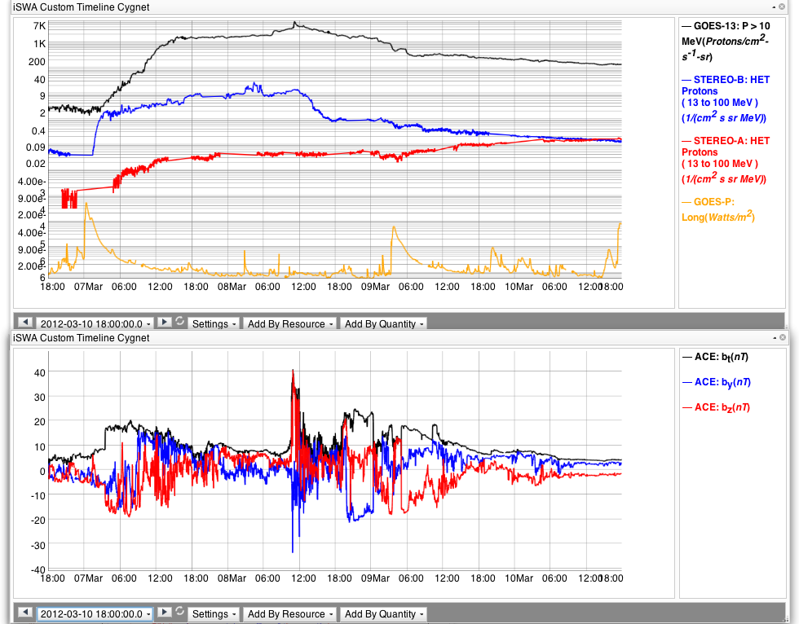
Space Weather Effects and Timeline
(Flare and CME)
Flare effects at Earth:
~ 8 minutes (radio blackout storms)
Duration: minutes to hours
SEP radiation effects reaching Earth: 20 minutes – 1hour after the event onset
Duration: a few days
Two X-class flares/Two fast wide CMEs
CME effects arrives @ Earth: 1-2 days (35 hours here)
Geomagnetic storms: a couple of days

Slide 33
Types of Storms

Slide 34
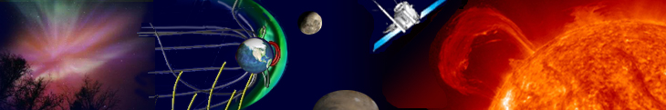
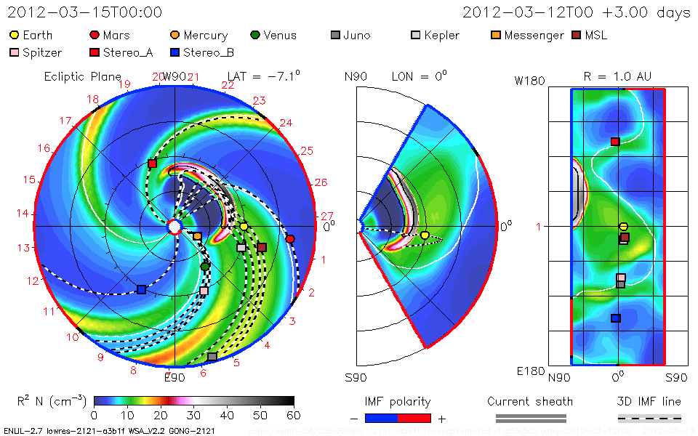
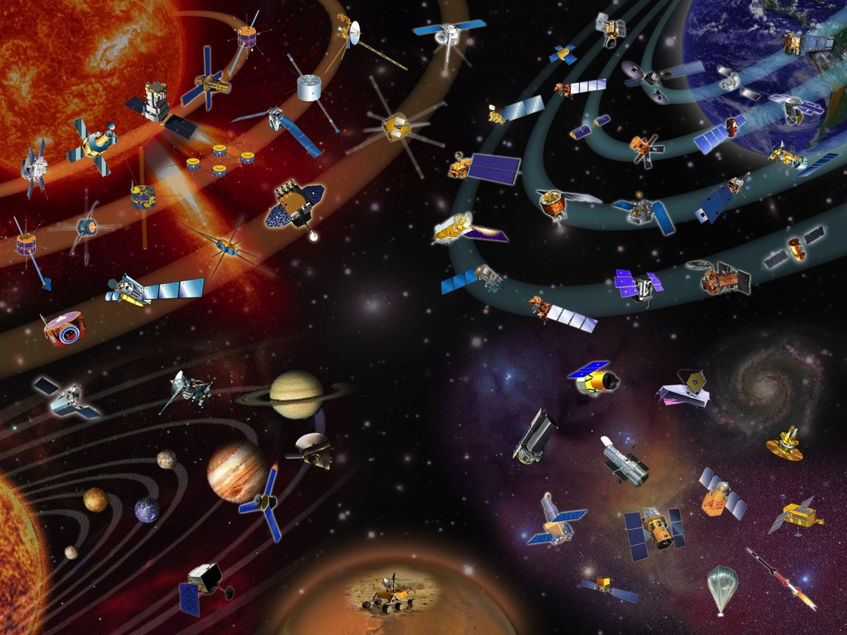
STEREO A
CME
Orientation
SOHO/ACE
*
SDO
Earth
STEREO B

Slide 35
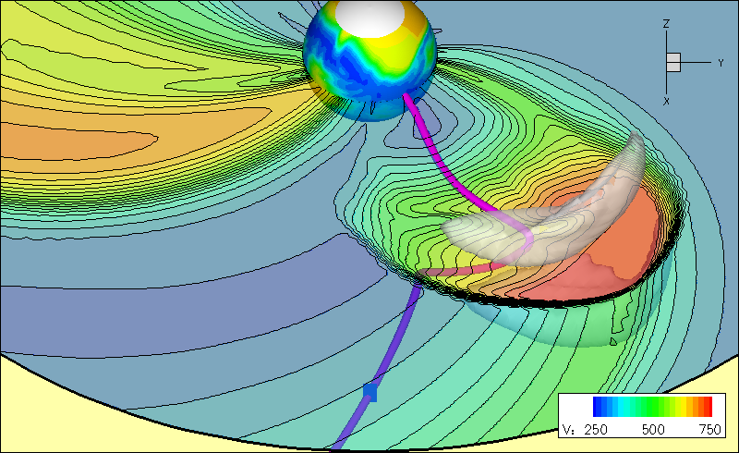
CME and SEP path are different
CME
CME
Courtesy: Odstrcil
SEPs
CME: could get deflected, bended, but more or less in the radial direction

Slide 36
Important distinction
Ion Radiation storm vs Geomagnetic storm
CME impact and SEP (Solar Energetic Particle) impact are different
CME
CME impact @ Earth: Geomagnetic Storm
Radiation storm @ Earth from SEPs
CME speed: 300 – 3500 km/s
SEPs: fraction of c
Light speed c: 3 x10^5 km/s

Slide 37
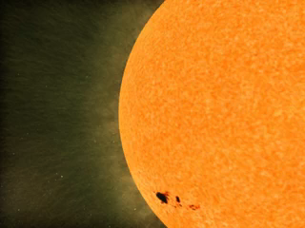
SEPs: ion radiation storms
Potentially affect everywhere in the solar system
Courtesy: SVS@ NASA/GSFC
Notes:
SEPs: applicable and potentially damaging everywhere that they have influence

Slide 38
Two Main Drivers for the Magnetosphere
CME (you have seen plenty of them already)
CIR (Corotating Interaction Region) High Speed solar wind Stream (HSS)
Geomagnetic storm
  CME storm (can be severe) Kp can reach 9
  CIR storm (moderate) Kp at most 6

Slide 39
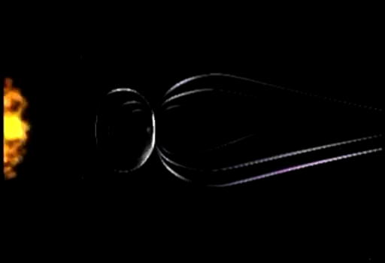
Geomagnetic Storms:
CME interaction with Earth (magnetic field)
Courtesy: SVS@ NASA/GSFC
Geomagnetic storms due to CIRs are at most moderate

Slide 40
SWx in the near-Earth environment
Solar wind +magnetosphere interactions
CIR/HSS and CME impacts on Earth
Importance of magnetosphere in space weather
Geomagnetic storm
  CME storm (can be severe)
  CIR storm (moderate)

Slide 41
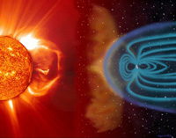
The solar wind pushes and stretches Earth’s magnetic field into a vast, comet-shaped region called the magnetosphere. The magnetosphere and Earth’s atmosphere protect us from the solar wind and other kinds of solar and cosmic radiation.
Flares/CME/High-Speed Streams
Earth’s magnetosphere
Sun

Slide 42
Different impacts on RB
CME vs CIR storms
CME geomagnetic storms: RB flux peak inside geosynchronous orbit. The peak locations moves inward as storm intensity increases
CIR geomagnetic storms: More responsible for the electron radiation level enhancement at GEO orbit

Slide 43
HSS and radiation belt electron flux enhancement
GOES data of energetic electron fluxes
ACE measurements of Solar Wind Speed
Notes:
CIR geomagnetic storms – more responsible for the radiation level enhancement at/near GEO orbit

Slide 44
Ionospheric Dynamics/Storms

Slide 45
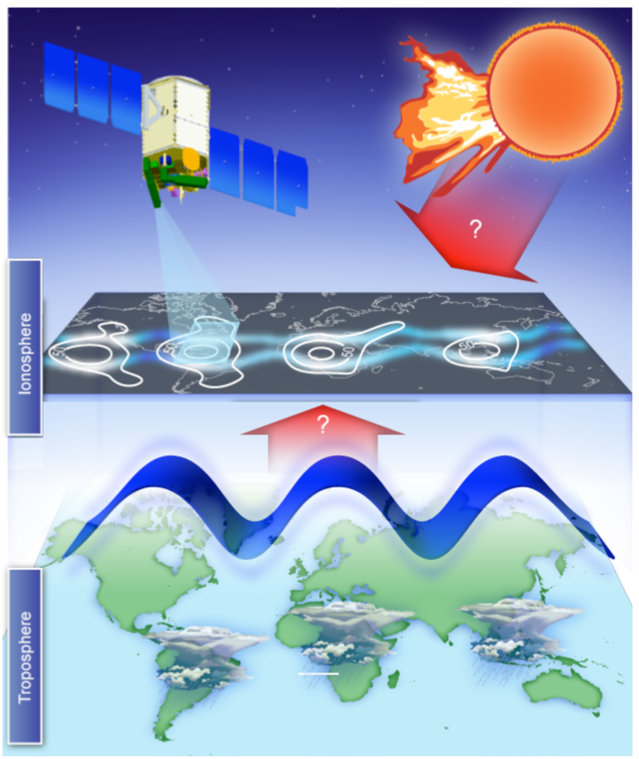
The ionosphere is the densest plasma between the Earth and Sun, and is traditionally believed to be
mainly influenced by forcing from above (solar radiation, solar wind/magnetosphere)
Recent scientific results show that the ionosphere
is strongly influenced by forces acting from below.
Research remains to be done:
How competing influences from above and below shape our space environment.
Text
Courtesy: ICON
Notes:
A nice summary of our current understanding

Slide 46
iSWA layouts
-

Slide 47
layouts
Monitoring of space weather activities
Events
Anomaly
Comparative study
Weekly summary and highlights of specifics

Slide 48
Layouts - examples
http://1.usa.gov/1rQXhWK - x1.4 flare on April 25, 2014
http://1.usa.gov/1kr0842 - summary 20140430
http://1.usa.gov/1i2Qemt scintillation with Kp
http://1.usa.gov/1gPzEKM scintillation
http://1.usa.gov/1deGdXC anomaly resolution
http://1.usa.gov/1fk5Fv6 coronal hole responsible for Saturn aurora

Slide 49
Layouts - examples
http://1.usa.gov/1e5ZBDW - march 7, 2012 event
http://1.usa.gov/LSfnaC - evolution of March 2013 coronal hole in SDO, STA and STB
http://1.usa.gov/1lZjWeD - SDO view of the coronal hole when it arrived at ACE
http://1.usa.gov/1c51alC - layout of the 2013-09-29 CME and its impacts
http://1.usa.gov/HUue2U - summary_20131113
http://1.usa.gov/172TYTB - 20131107 CME highlight

