Slide 1
Space Weather impacts on satellites at different orbits
Outline
Prelude
Orbits
Different types of SWx effects on satellites
Satellite anomalies from the recent March 2012 SWx events
Yihua Zheng
June, 2014
Internal Use Only
Please do not distribute
Notes:
Growing reliance on space technology

Slide 2
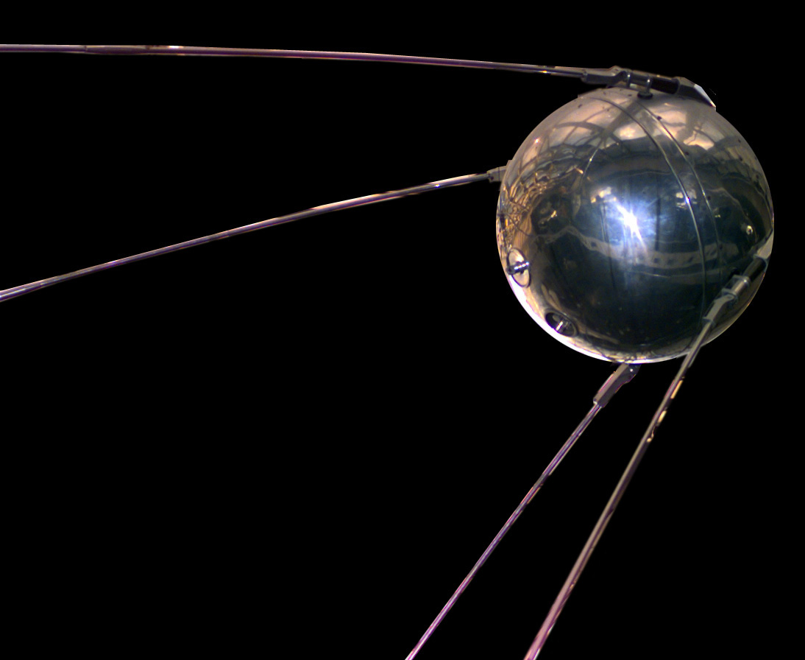
1st satellite launched into space
The world's first artificial satellite, the Sputnik 1, was launched by the Soviet Union in 1957.
marking the start of the Space Age
4 October, 1957
International Geophysical Year: 1957

Slide 3
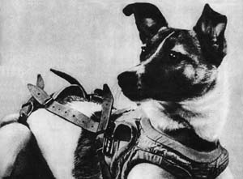
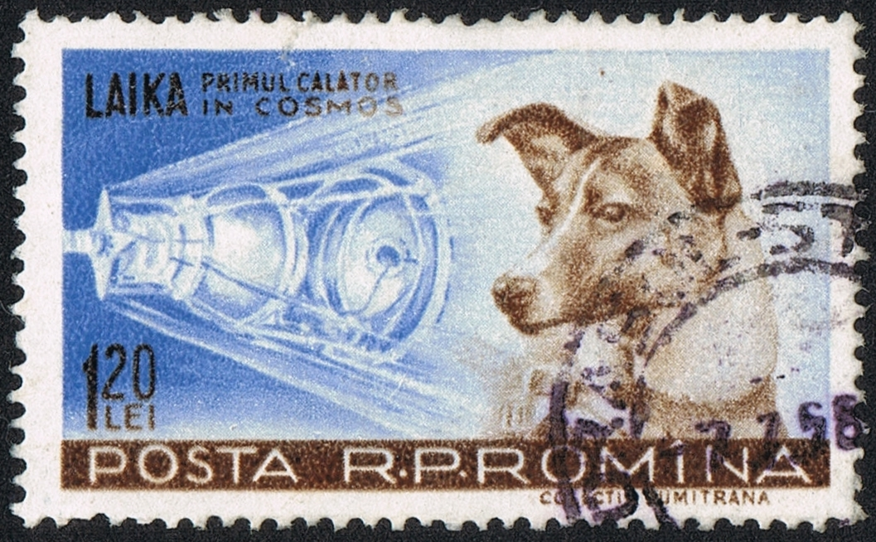
Space dog - Laika
the occupant of the Soviet spacecraft Sputnik 2 that was launched into outer space on November 3, 1957
Paving the way for human missions

Slide 4
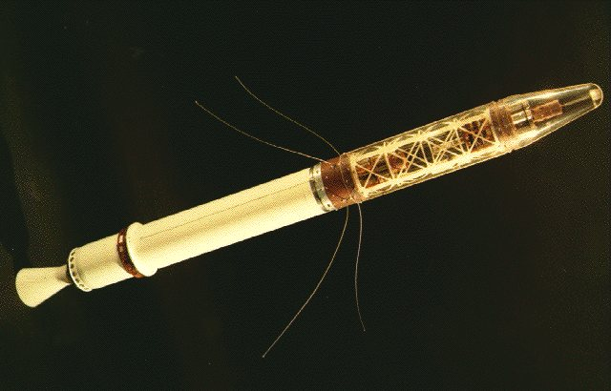
Explorer I – 1st U.S. Satellite
Explorer 1, was launched into Earth's orbit on a Jupiter C missile from Cape Canaveral, Florida, on January 31, 1958 - Inner belt

Slide 5
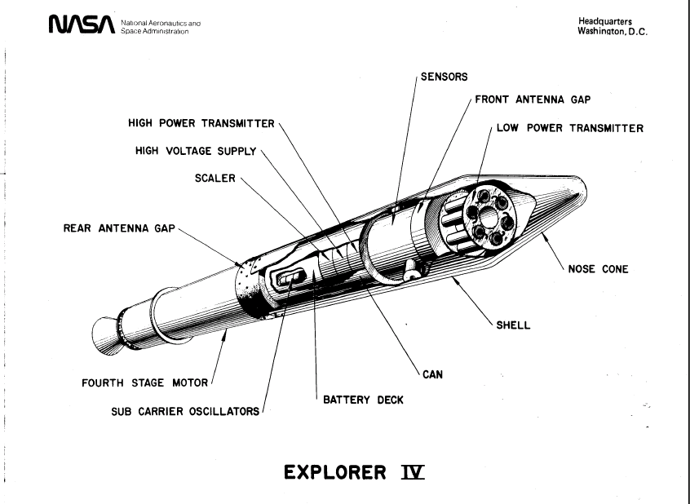
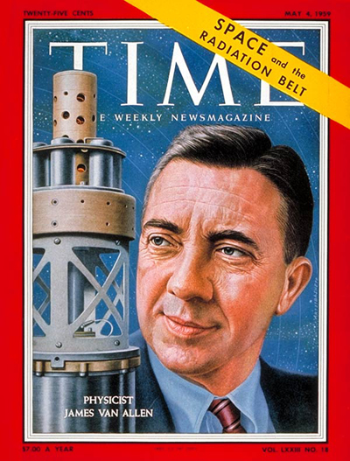
Discovery of the outer Van Allen RB
Pioneer 3 (launched 6 December 1958) and Explorer IV (launched July 26, 1958) both carried instruments designed and built by Dr. Van Allen. These spacecraft provided Van Allen additional data that led to discovery of a second radiation belt

Slide 6
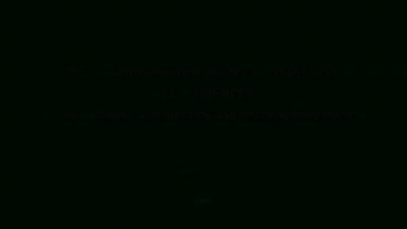
RBSP – more than half-century later

Slide 7
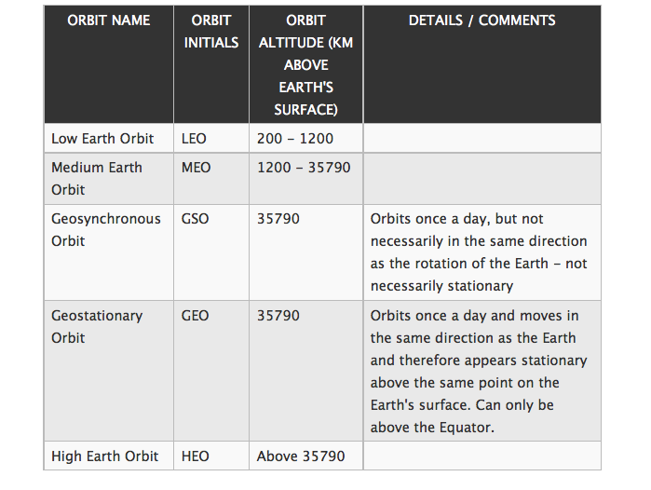
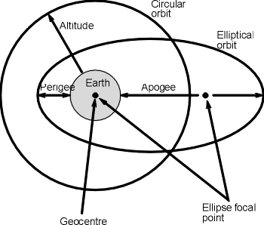
Orbits

Slide 8
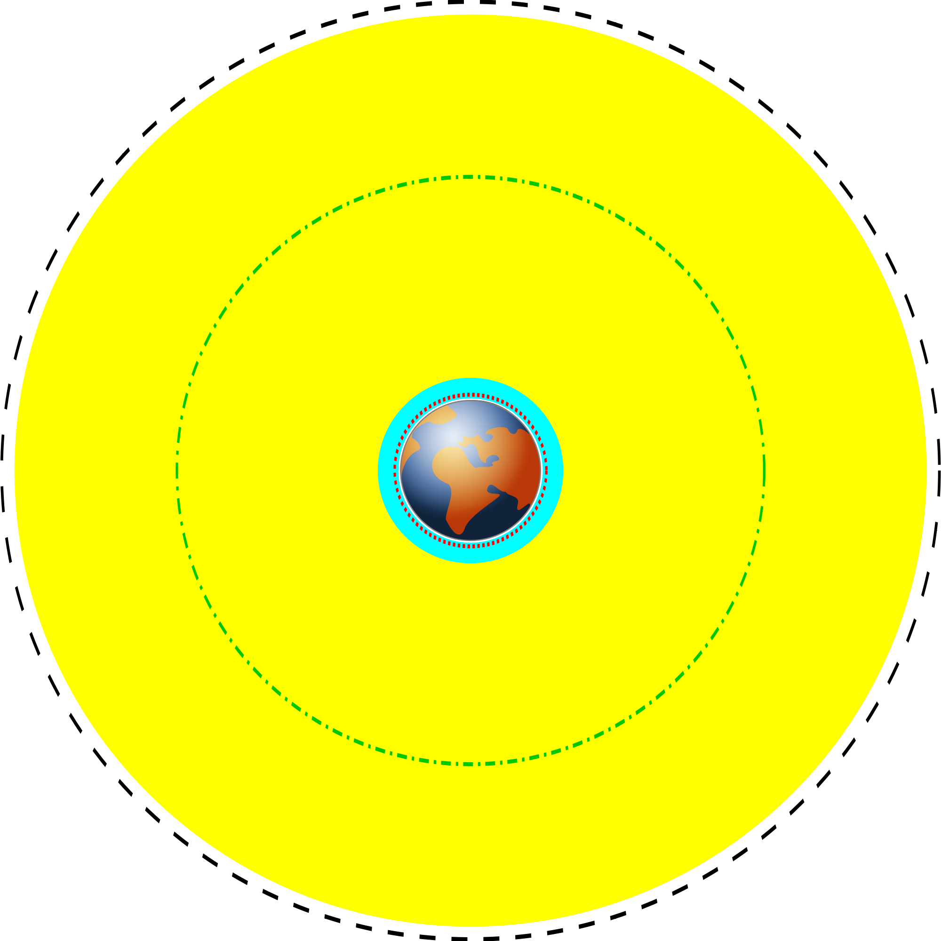
orbits
GEO
Yellow: MEO
Green-dash-dotted line: GPS
Cyan: LEO
Red dotted line: ISS

Slide 9
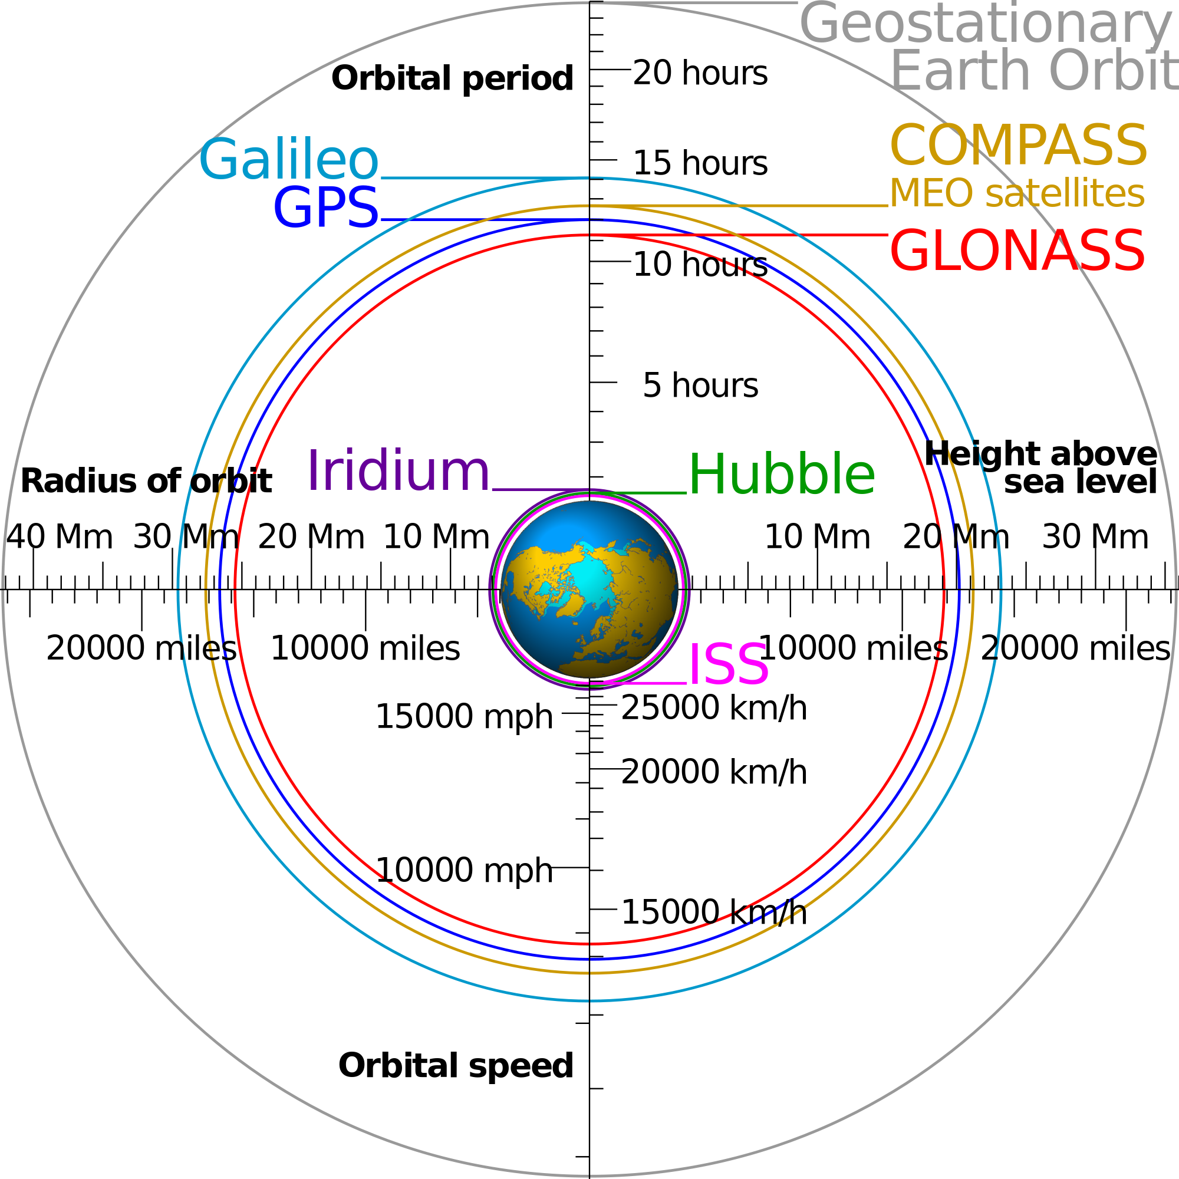
orbits

Slide 10
Orbits
A low Earth orbit (LEO) is generally defined as an orbit below an altitude of 2,000 km. Given the rapid orbital decay of objects below approximately 200 km, the commonly accepted definition for LEO is between 160–2,000 km (100–1,240 miles) above the Earth's surface.
Medium Earth orbit (MEO), sometimes called intermediate circular orbit (ICO), is the region of space around the Earth above low Earth orbit (altitude of 2,000 kilometres (1,243 mi)) and below geostationary orbit (altitude of 35,786 km (22,236 mi)).

Slide 11
Orbit classification based on inclination
Inclined orbit: An orbit whose inclination in reference to the equatorial plane is not zero degrees.
  Polar orbit: An orbit that passes above or nearly above both poles of the planet on each revolution. Therefore it has an inclination of (or very close to) 90 degrees.
  Polar sun synchronous orbit: A nearly polar orbit that passes the equator at the same local time on every pass. Useful for image taking satellites because shadows will be nearly the same on every pass.
DMSP satellites

Slide 12
GTO
A geosynchronous transfer orbit or geostationary transfer orbit (GTO) is a Hohmann transfer orbit used to reach geosynchronous or geostationary orbit.^{[1]} It is a highly elliptical Earth orbit with apogee of 42,164 km (26,199 mi).^{[2]} (geostationary (GEO) altitude, 35,786 km (22,000 mi) above sea level) and an argument of perigee such that apogee occurs on or near the equator. Perigee can be anywhere above the atmosphere, but is usually limited to only a few hundred km above the Earth's surface to reduce launcher delta-v (V) requirements and to limit the orbital lifetime of the spent booster.
SDO
The rapid cadence and continuous coverage required for SDO observations led to placing the satellite into an inclined geosynchronous orbit

Slide 13
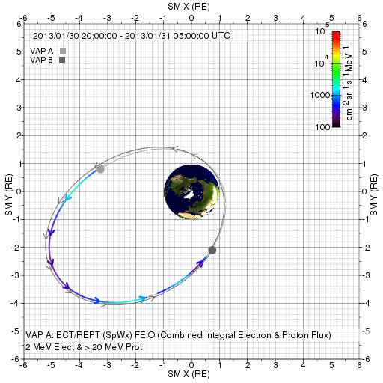
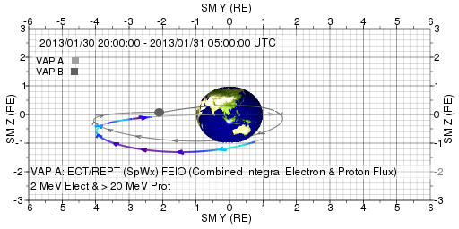
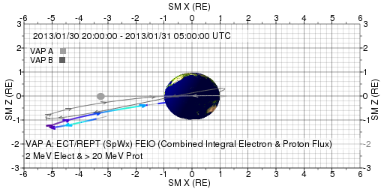
Van Allen Probes

Slide 14
Other types of orbits
Heliocentric orbit: An orbit around the Sun.
STEREO A and STEREO B
Interplanetary space
At different planets

Slide 15
Orbit/Mission Design
New Horizon to Pluto
http://www.jhu.edu/jhumag/1105web/pluto.html
Dr. Yanping Guo, a mission design specialist at APL
Reduce the journey by three years

Slide 16

Space Weather impacts on spacecraft operation
Yihua Zheng
NASA/GSFC Space Weather Center
For Earth System Science Pathfinder (ESSP) Program Office
May 15, 2012

Slide 17
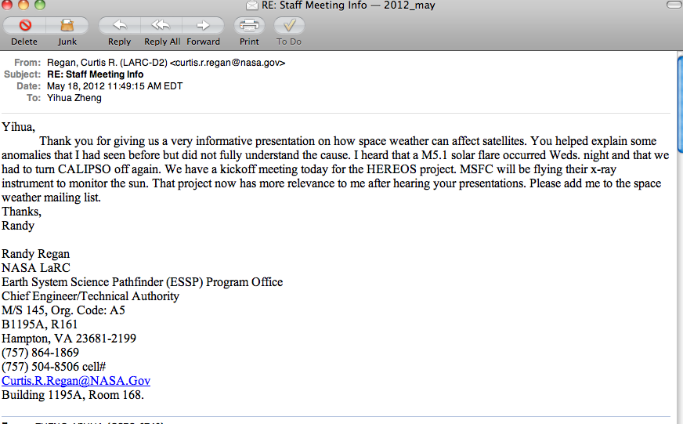
Importance of SWx Services

Slide 18
Space Environment Model Use in Mission Life Cycle
Mission Concept
Mission Planning
Design
Launch
Operations
Anomaly Resolution
Space Climate
Minimize Risk
NASA SWx services
Space Weather
Manage Residual Risk
Both
+
in situ
measurements
Acknowledge: Mike Xapsos

Slide 19
SWx Services provided by NASA/SWC

Slide 20

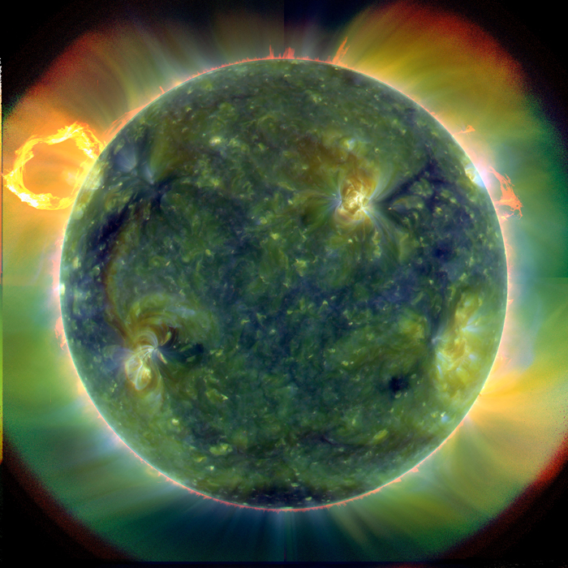
NASA SWC: Types of SWx Services
Providing assistance in spacecraft anomaly resolution by assessing whether space weather has any role in causing the observed anomaly/anomalies.
Sending out weekly space weather reports/summaries to NASA mission operators, NASA officials and involved personnel.
Space Weather

Slide 21
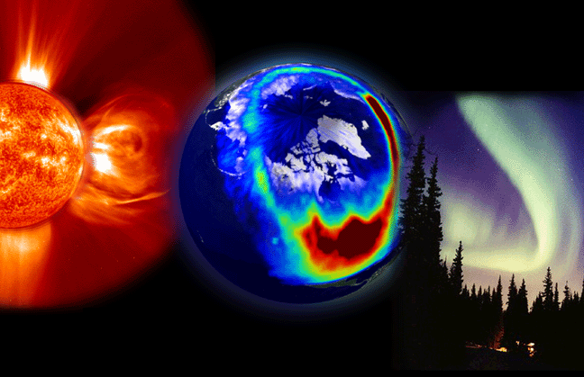
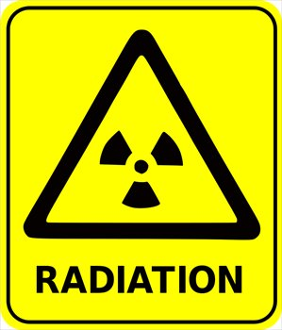

Types of SWx Services
- continued
3. Sending out timely space weather alerts/forecasts regarding adverse conditions throughout the solar system, such as significant CME events, elevated radiation levels, etc.
4. Providing general space weather support for NASA customers.

Slide 22
Seven types SWx impacts for robotic missions
Spacecraft surface charging caused by low-energy (< 100 keV) electrons, which are abundant, for example, in the inner magnetosphere during magnetospheric substorms.
Spacecraft internal electrostatic discharge caused by high-energy electrons (> 100 keV) that exist, for example, in the dynamic outer radiation belt of the Earth.
Single event effects due to high-energy (> 10 MeV) protons and heavier ions generated, for example, in solar flares and in coronal mass ejection (CME) shock fronts.
Total dosage effects caused by cumulative charged particle radiation received by spacecraft.
Increased spacecraft drag caused by the thermal expansion of the Earth’s upper atmosphere during space weather storms.
Communication disruptions between ground stations and spacecraft due to ionospheric irregularities
Attitude control disruptions caused, for example, by large storm-time magnetic field fluctuations in the geostationary orbit.
Feedback from our annual SWx workshop for robotic missions

Slide 23
SWx impacts on sc (cont’d)
low-energy protons (< 10 MeV) pose a problem due to trapping into charge-coupled device (CCD) substrates.
➔ virtually any part of electron and ion spectra ranging from low to relativistic energies can impact spacecraft operations.

Slide 24
Space Environment Anomalies
According to a study by the Aerospace Corporation the 2 most common types of spacecraft anomalies by far are due to electrostatic discharge (ESD) and single event effects (SEE)
Reported results*:
Anomaly Type: | Number of Occurrences:
ESD | 162
SEE | 85
Total Dose and Damage | 16
Miscellaneous | 36
* H.C. Koons et al., 6th Spacecraft Technology Conference, AFRL-VS-TR-20001578, Sept. 2000

Slide 25
surface charging: which can lead to electrostatic discharges (ESD),
ESD: can lead to a variety of problems, including component failure and phantom commands in spacecraft electronics [Purvis et al., 1984].
Surface Charging
Purvis, C. K., H. B. Garrett, A. C. Wittlesey, and N. J. Stevens (1984),
Design guidelines for assessing and controlling spacecraft charging
effects, NASA Tech. Pap. 2361
https://standards.nasa.gov/documents/detail/3314877

Slide 26
Surface Charging (SC)
Commercial satellite anomaly
More often in the midnight to morning sector
<100 keV e- distribution: similar behavior as SC anomalies
=> Surface charging might be the main cause of the anomalies.
Choi, H.‐S., J. Lee, K.‐S. Cho, Y.‐S. Kwak, I.‐H. Cho, Y.‐D. Park, Y.‐H. Kim, D. N. Baker, G. D. Reeves, and D.‐K. Lee (2011), Analysis of GEO spacecraft anomalies: Space weather relationships, Space Weather, 9, S06001,doi:10.1029/2010SW000597.
Substorm injections ( Aurora)

Slide 27
Surface Charging Hazards distribution

Slide 28
NASA Doc on Mitigating charging effects
Title: Mitigating In-Space Charging Effects-A Guideline
Document Date: 2011-03-03
Revalid and Reaffirmed Date: 2016-03-03
Revision: A
Organization: NASA

Slide 29
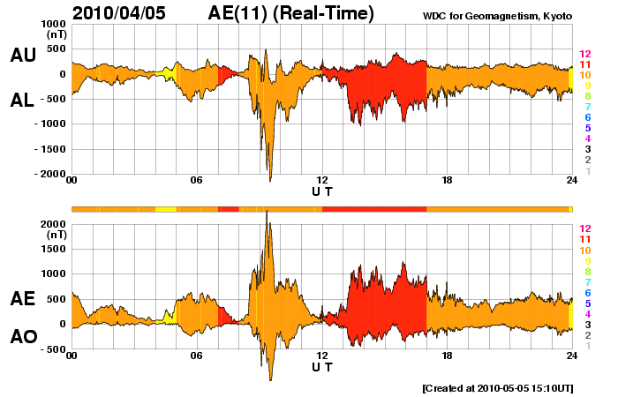
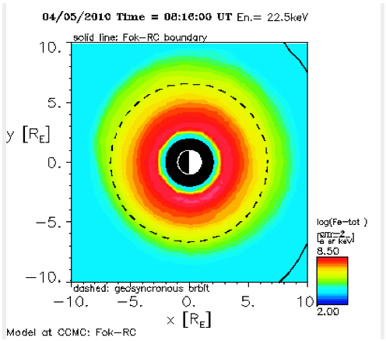
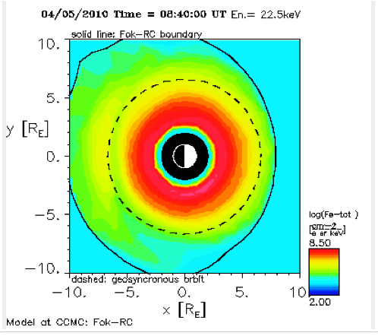
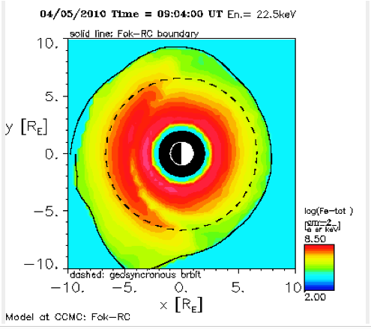
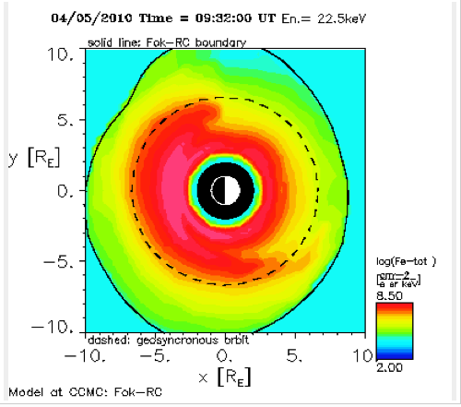
Galaxy 15 failure on April 5, 2010
- surface charging might play a role
22keV electrons 4/5, 8:16-9:32Z
Galaxy 15 failed approx 9:48Z
Ring current model data show same

Slide 30
Environmental Source of SEEs
Single Event Environments in Space
  Galactic Cosmic Rays
  Solar Particle Events (flare/CME)
  Trapped Protons in the inner belt (1 – 3 RE)

Slide 31
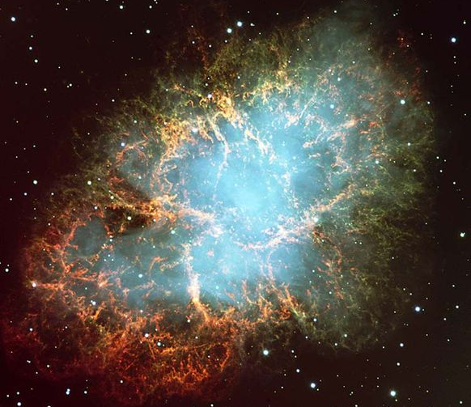
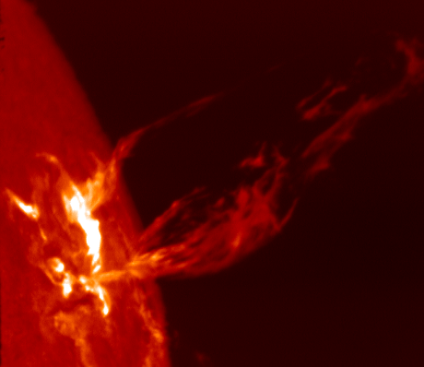
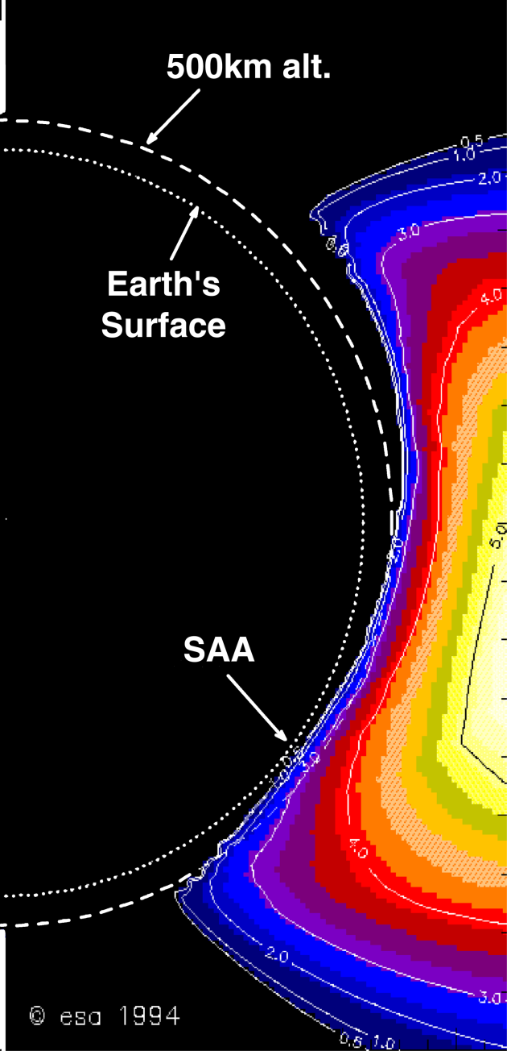
SEE source in Space
High Energy
Particle
Radiation
Galactic
Cosmic Rays
Solar Particle
Events (flare/CME)
Trapped
Particles (SAA)
Most unpredictable

Slide 32
Galactic Cosmic Rays
Galactic cosmic rays (GCR) are high-energy charged particles that originate outside our solar system.
Supernova explosions are a significant source
Anticorrelation with solar activity
More pronounced/intense during solar minimum

Slide 33
South Atlantic Anomaly
Dominates the radiation environment for altitudes less than about 1000 km.
Caused by tilt and shift of geomagnetic axis relative to rotational axis.
Inner edge of proton belt is at lower altitudes south and east of Brazil.
E.J. Daly et al., IEEE TNS, April 1996

Slide 34
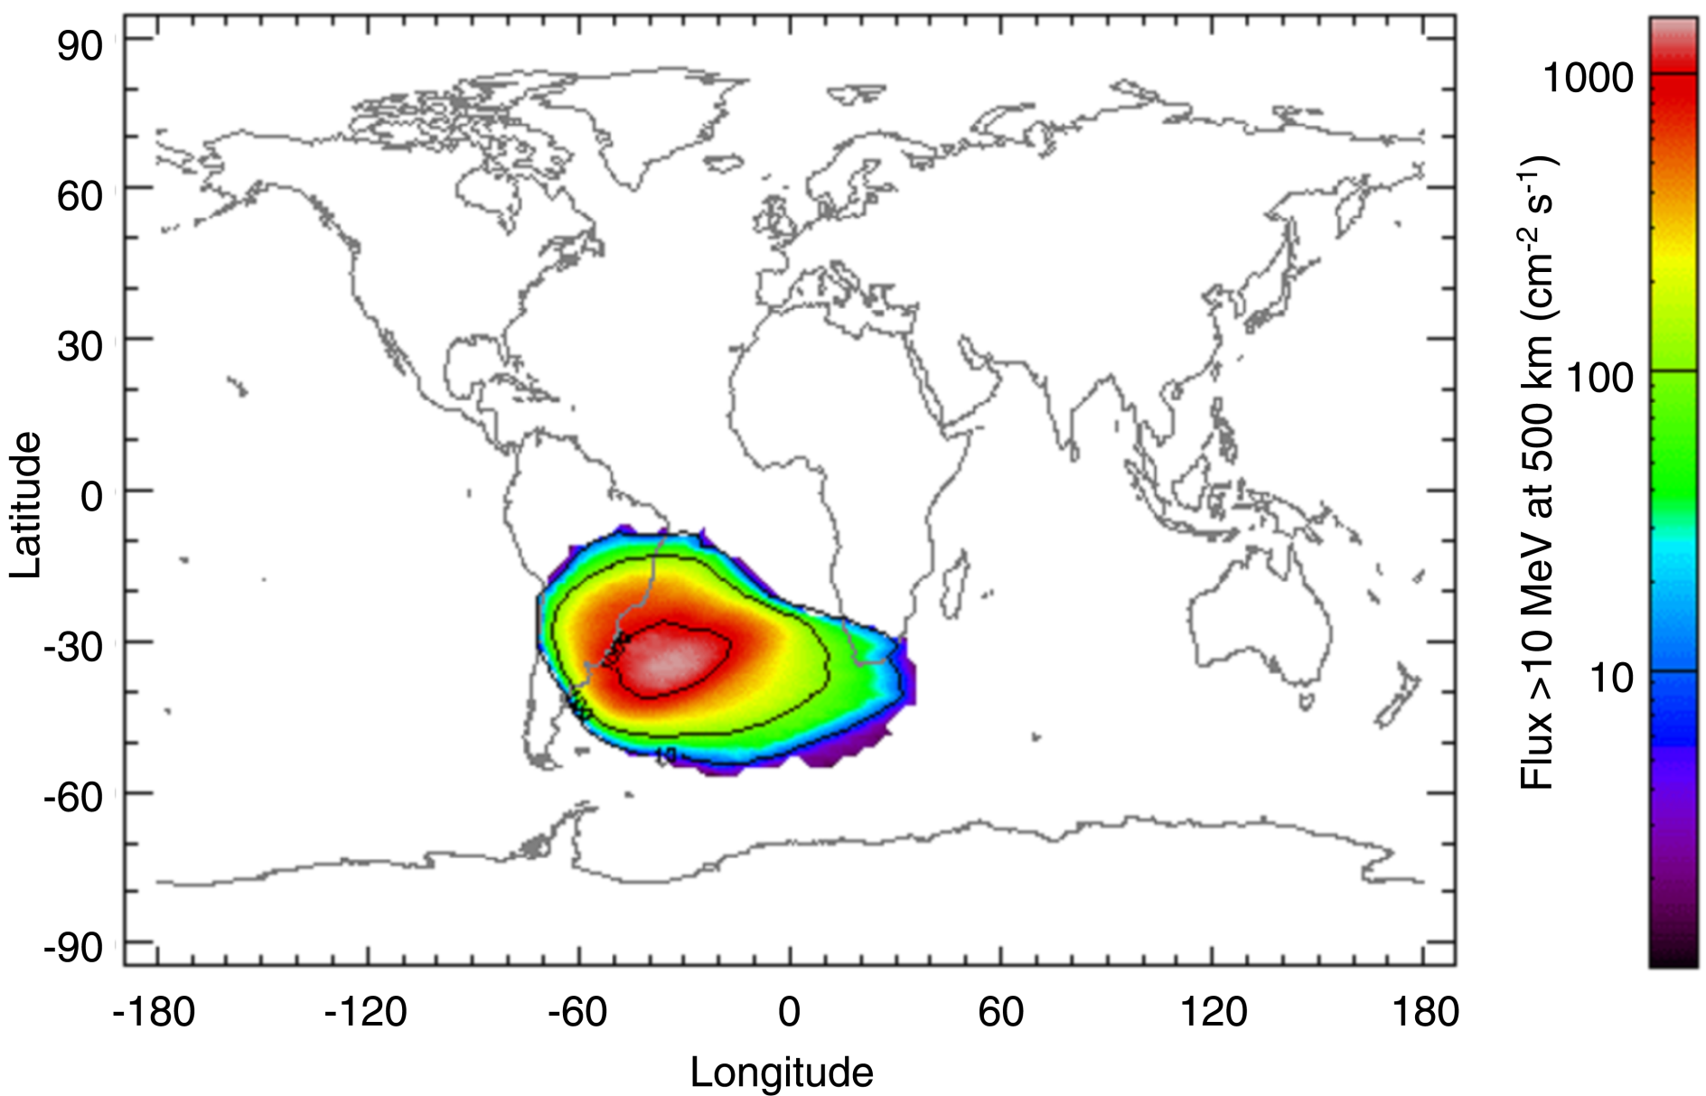
South Atlantic Anomaly
Solar Maximum
From SPENVIS, http://www.spenvis.oma.be/

Slide 35
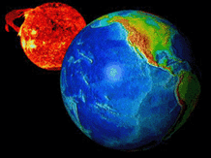
Solar Particle Events
Caused by flare/CME

Slide 36
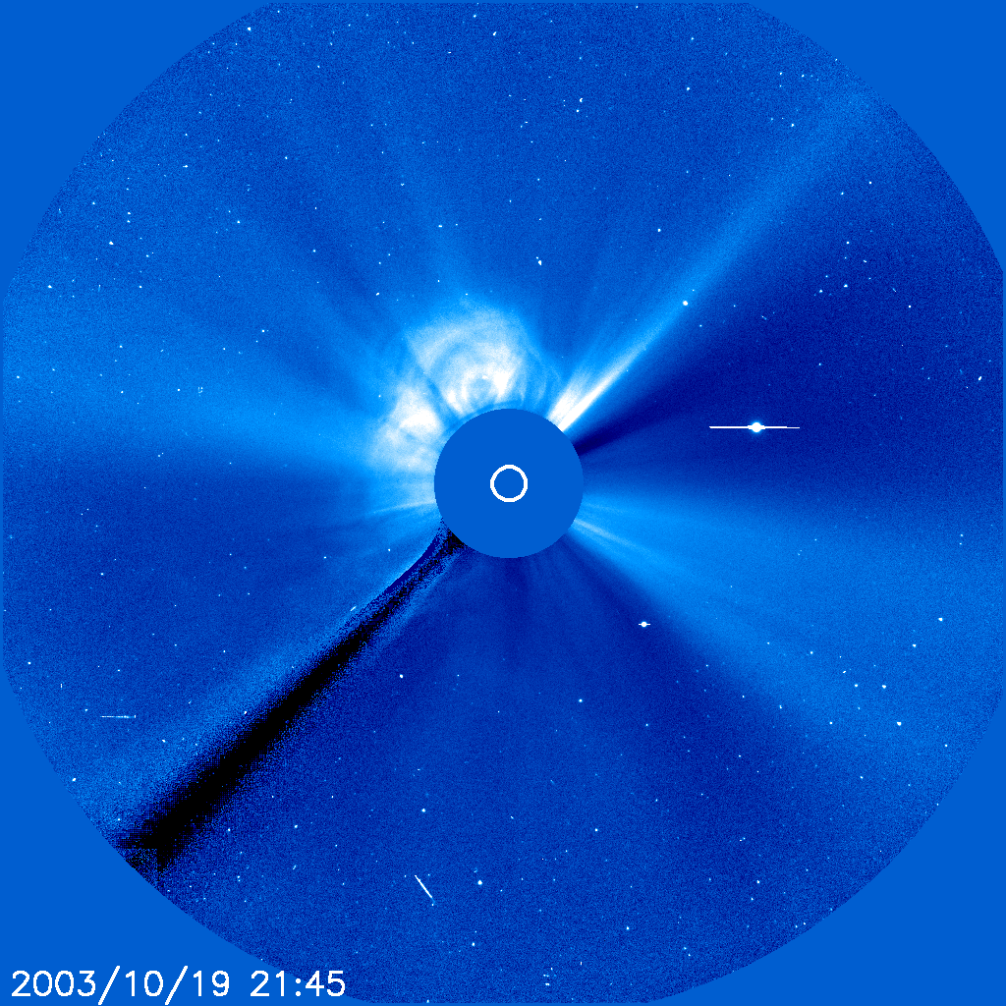
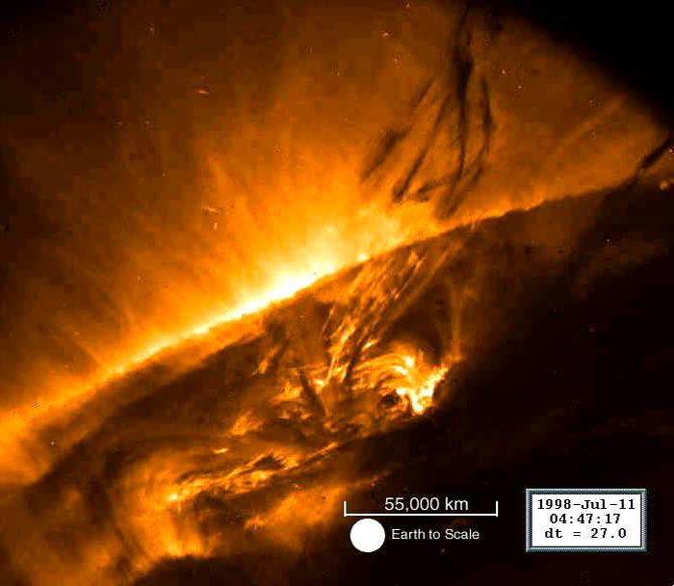
Characteristics of SEPs
Elemental composition* (may vary event by event)
  96.4% protons
  3.5% alpha particles
  0.1% heavier ions (not to be neglected!)
Energies: up to ~ GeV/nucleon
Event magnitudes:
  > 10 MeV/nucleon integral fluence: can exceed 10⁹ cm⁻²
  > 10 MeV/nucleon peak flux: can exceed 10⁵ cm⁻²s⁻¹

Slide 37
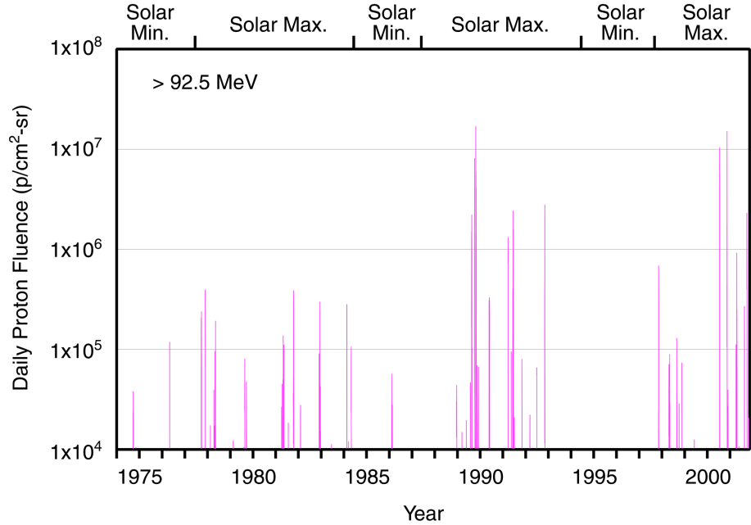
Solar Cycle Dependence
Most unpredictable

Slide 38
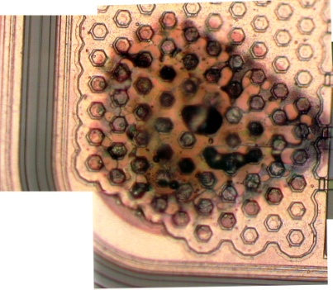
What is a Single Event Effect?
Single Event Effect (SEE) – any measureable effect in a circuit caused by single incident ion
  Non-destructive – SEU (Single Event Upset), SET (single event transients), MBU (Multiple Bit Upsets), SHE (single-event hard error)
  Destructive – SEL (single event latchup), SEGR (single event gate rupture), SEB (single event burnout)
Destructive event
in a COTS 120V
DC-DC Converter
(credit: M.Xapsos)

Slide 39
Single Event Upsets
SEUs: are soft errors, and non-destructive. They normally appear as transient pulses in logic or support circuitry, or as bitflips in memory cells or registers.

Slide 40
Destructive SEEs
Several types of hard errors, potentially destructive, can appear:
Single Event Latchup (SEL) results in a high operating current, above device specifications, and must be cleared by a power reset.
Other hard errors include Burnout of power MOSFETS (Metal Oxide Semiconductor Field-Effect Transistor) , Gate Rupture, frozen bits, and noise in CCDs.

Slide 41
Anomalies March 2012 SWx events
SEEs dominate
Quite a few NASA spacecraft experienced anomalies, majority of which are SEEs. Some of them required reset/reboot.
Details to be discussed later.

Slide 42
Internal Charging
- energetic electrons in the outer radiation belt
CIR HSS geomagnetic storm
CME geomagnetic storms

Slide 43
Operator response to SWx impacts spacecraft specific/instrument specific

Slide 44
Human Safety in Space
GCR
SEP
Johnson Space Center/Space Radiation Analysis Group (SRAG)
Limit: the > 100 MeV flux exceeding 1pfu
(1 pfu = 1 particle flux unit= 1/cm^2/sec/sr)
All clear (EVA –extravehicular activity)

Slide 45
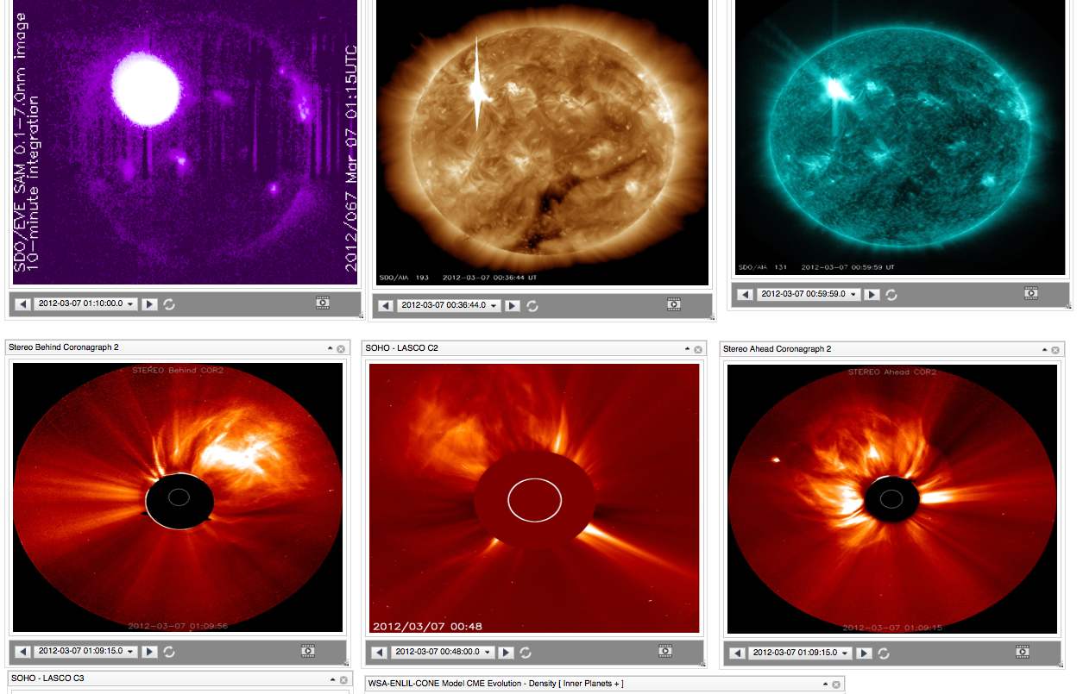
March 7 flares/CMEs

Slide 46
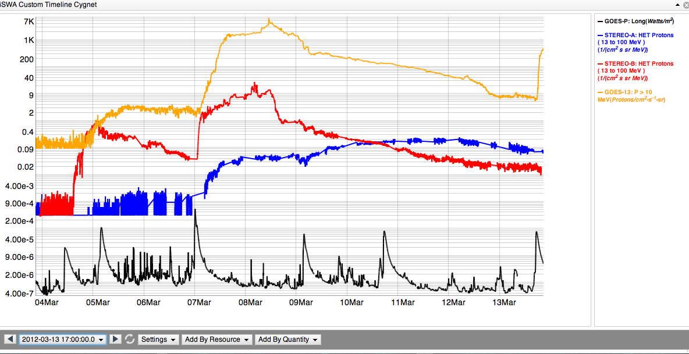
SEP: proton radiation (flare and CME)
GOES >10 MeV
13-100 MeV STEREO B
13-100 MeV STEREO A
X5.4/2200 km/s
X1.3/1800 km/s
M7.9
VCME=2100 km/s
X1.1
VCME=1360 km/s
M8.4
VCME=1500 km/s
M2.0
VCME=1540 km/s
M6.3/CME=1125 km/s
GOES x-ray

Slide 47
Major events from the long-lasting AR1429 during March 4 – 28, 2012

Slide 48
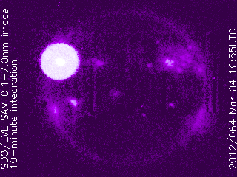
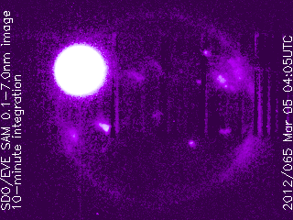
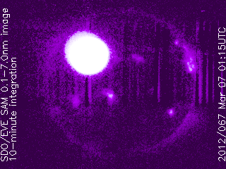
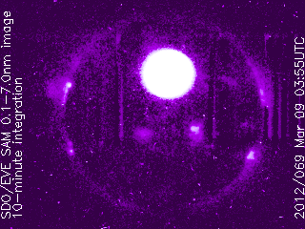
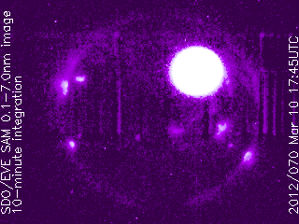
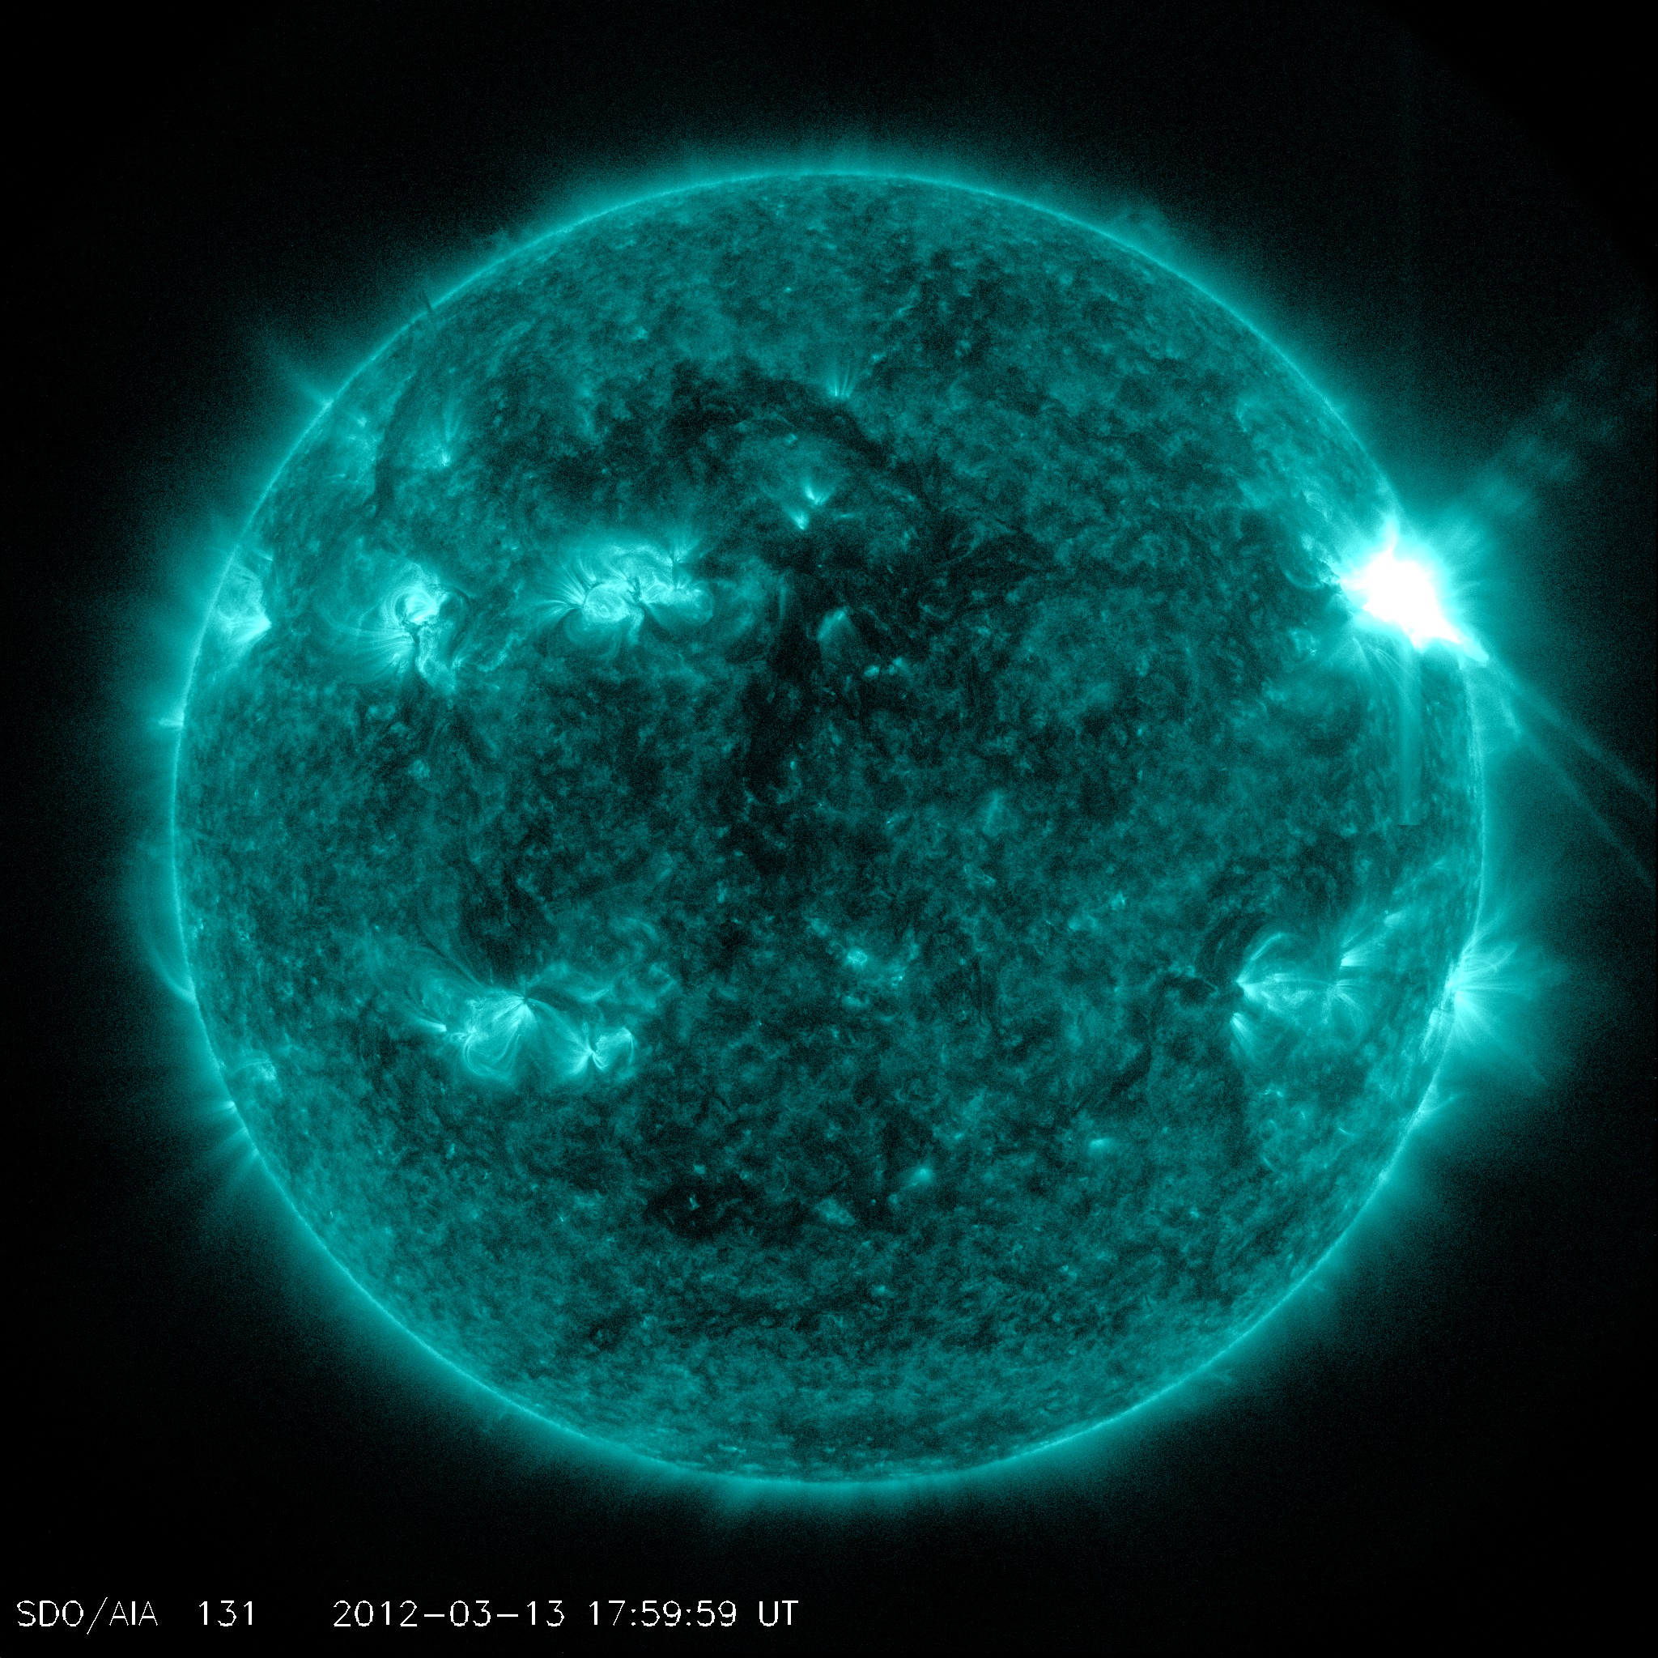
Flares of the Major Earth-Facing Events viewed by SDO EVE (x-ray)
M2.0, 2012-03-04
X1.1, 2012-03-05
X5.4/X1.3 2012-03-07
M6.3, 2012-03-09
M8.4, 2012-03-10
M7.9, 2012-03-13

Slide 49
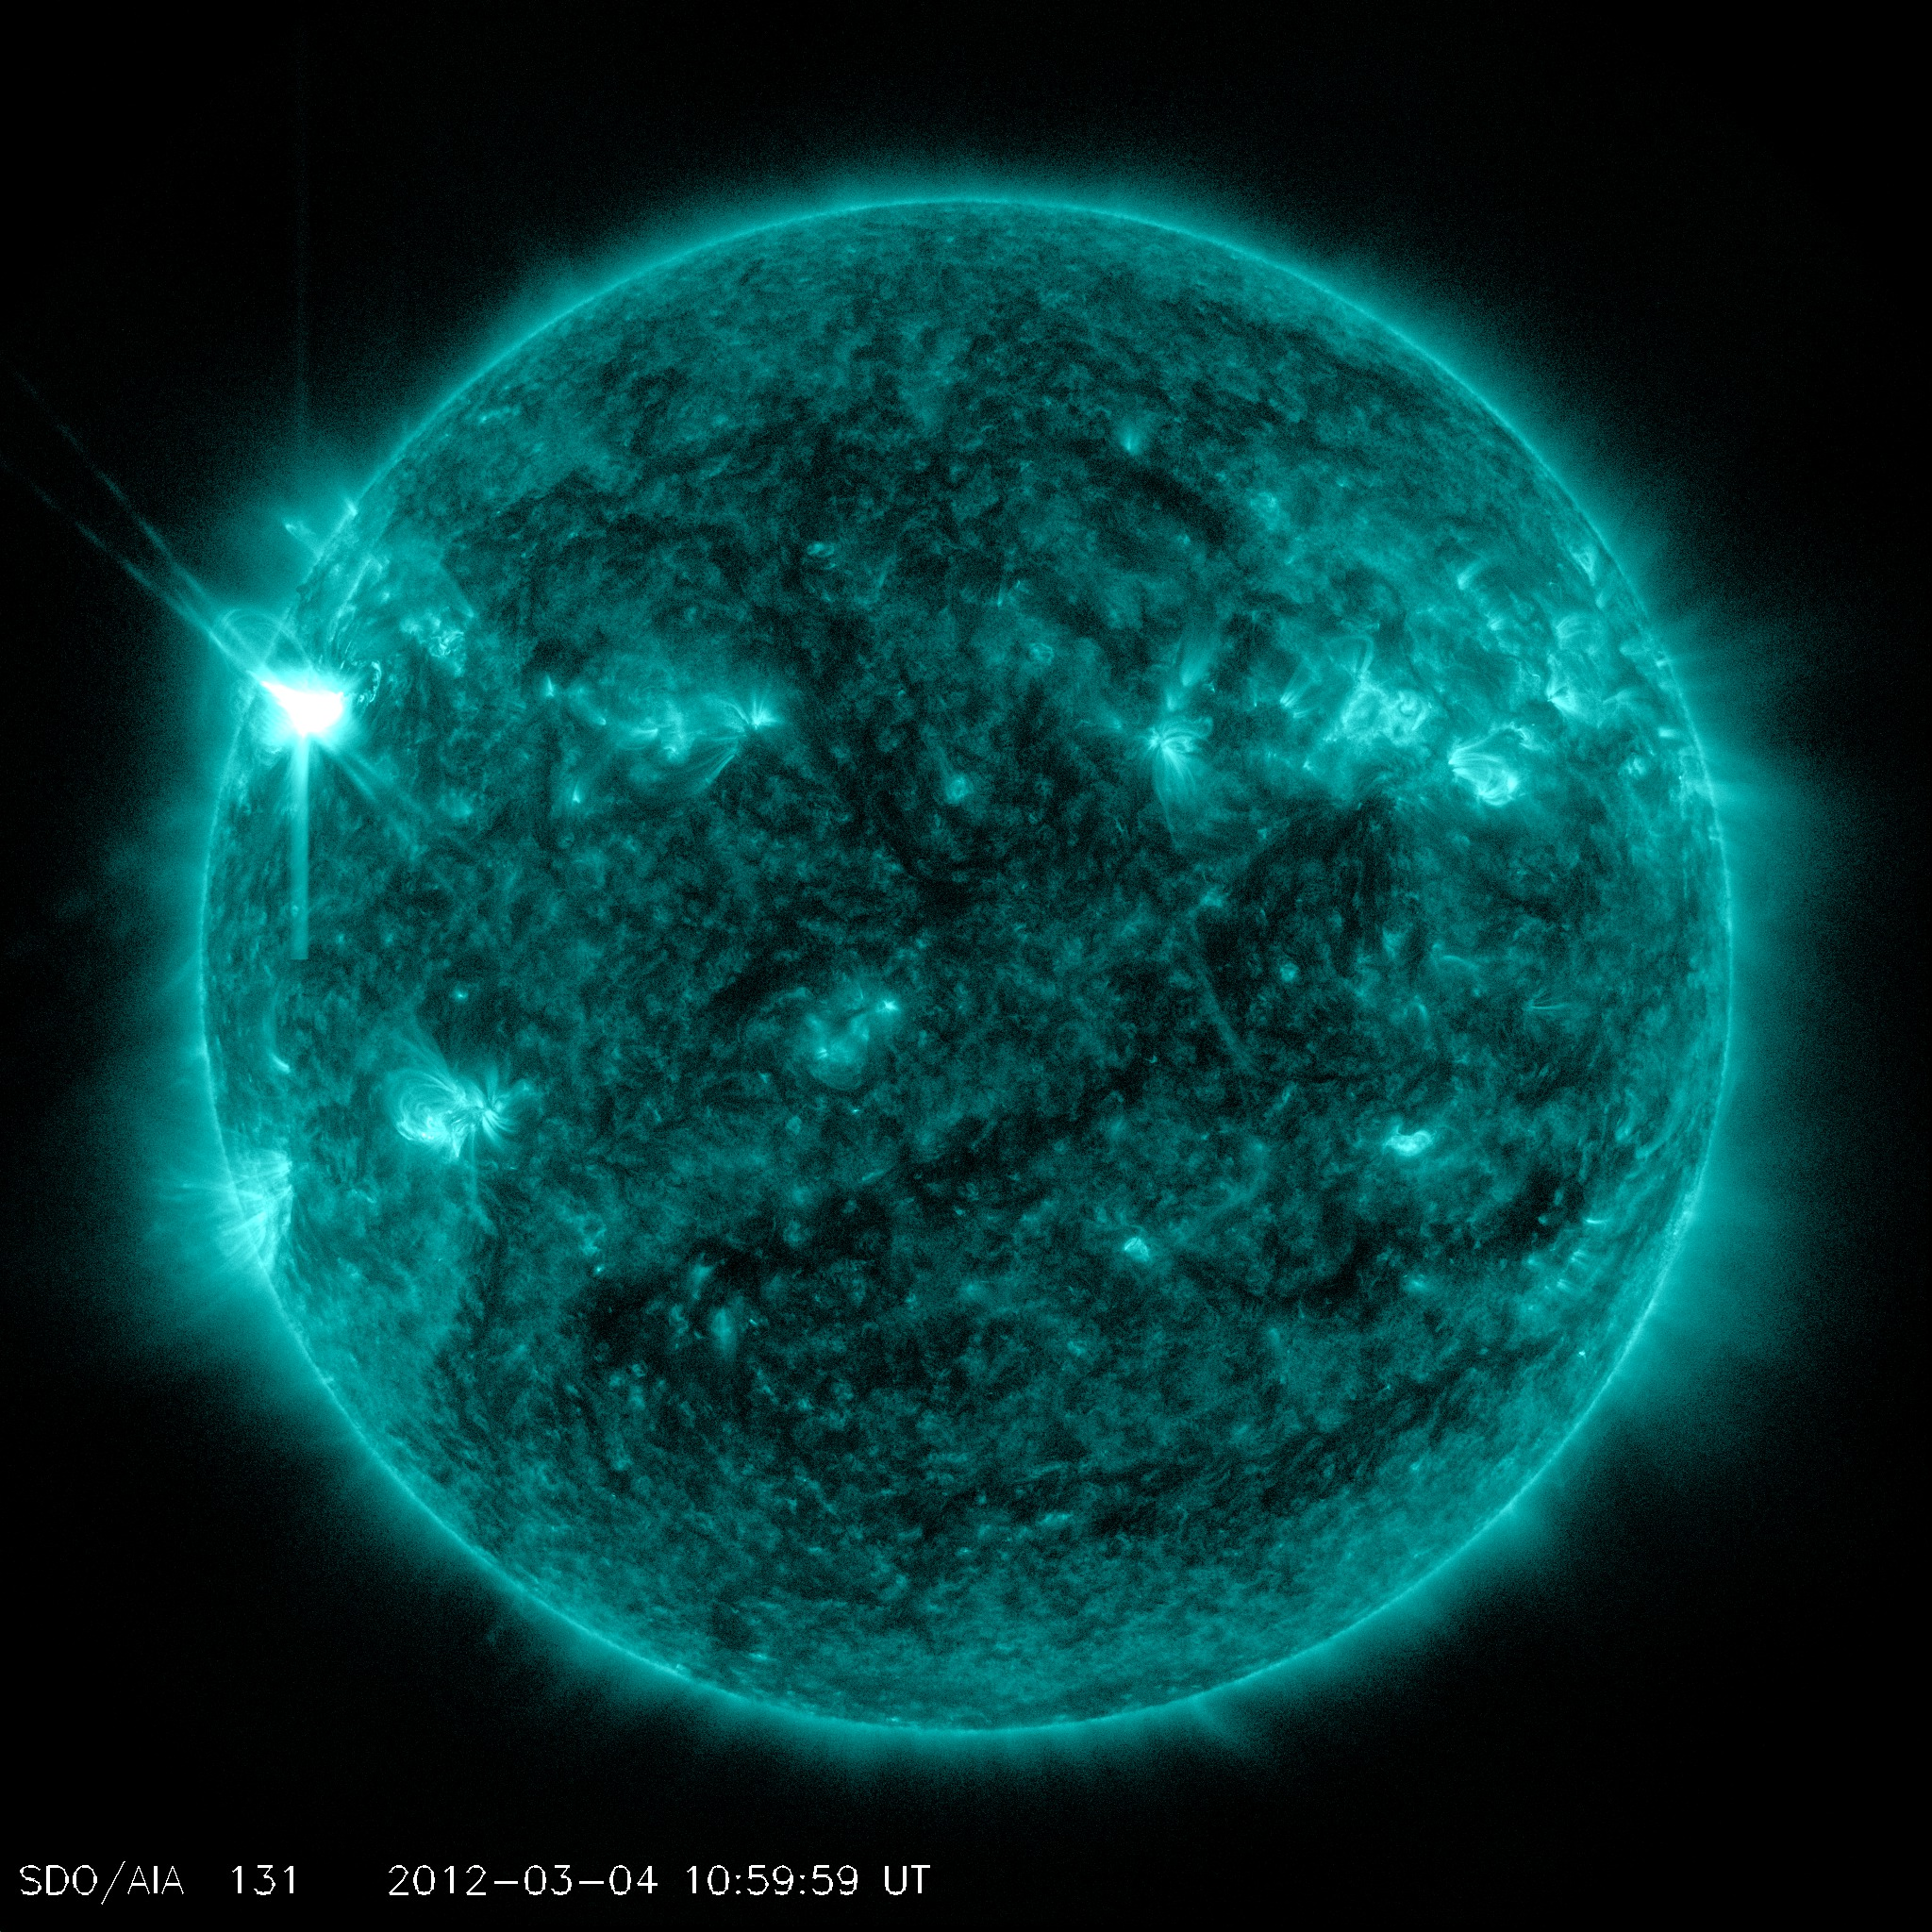
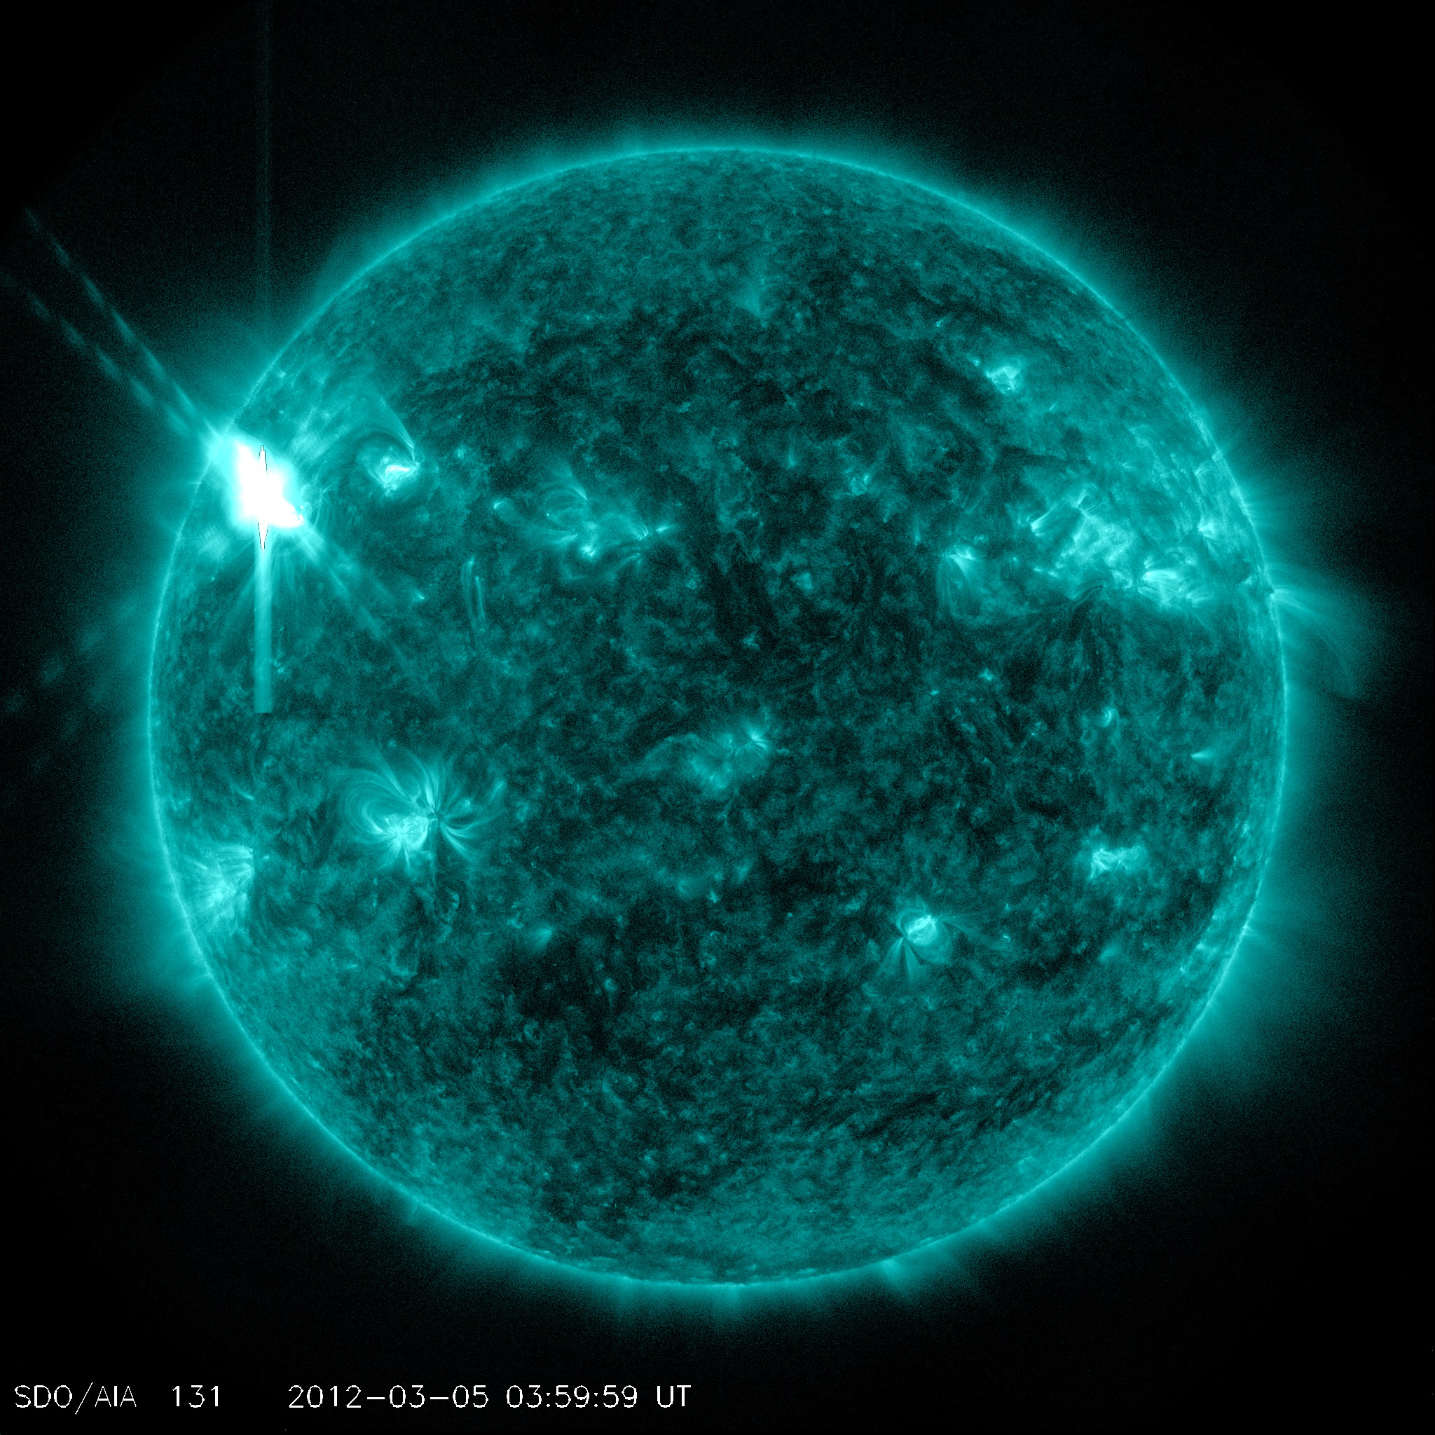
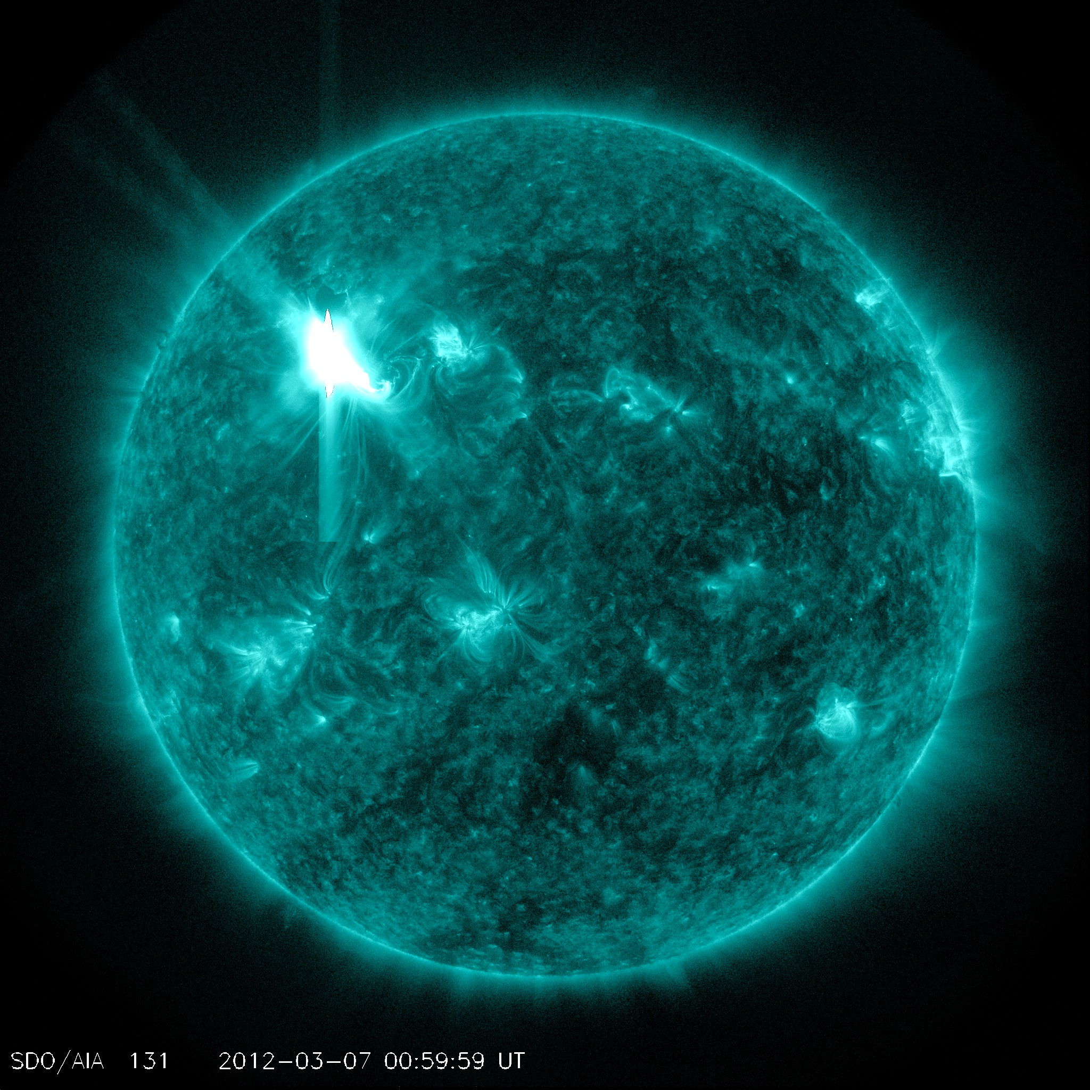
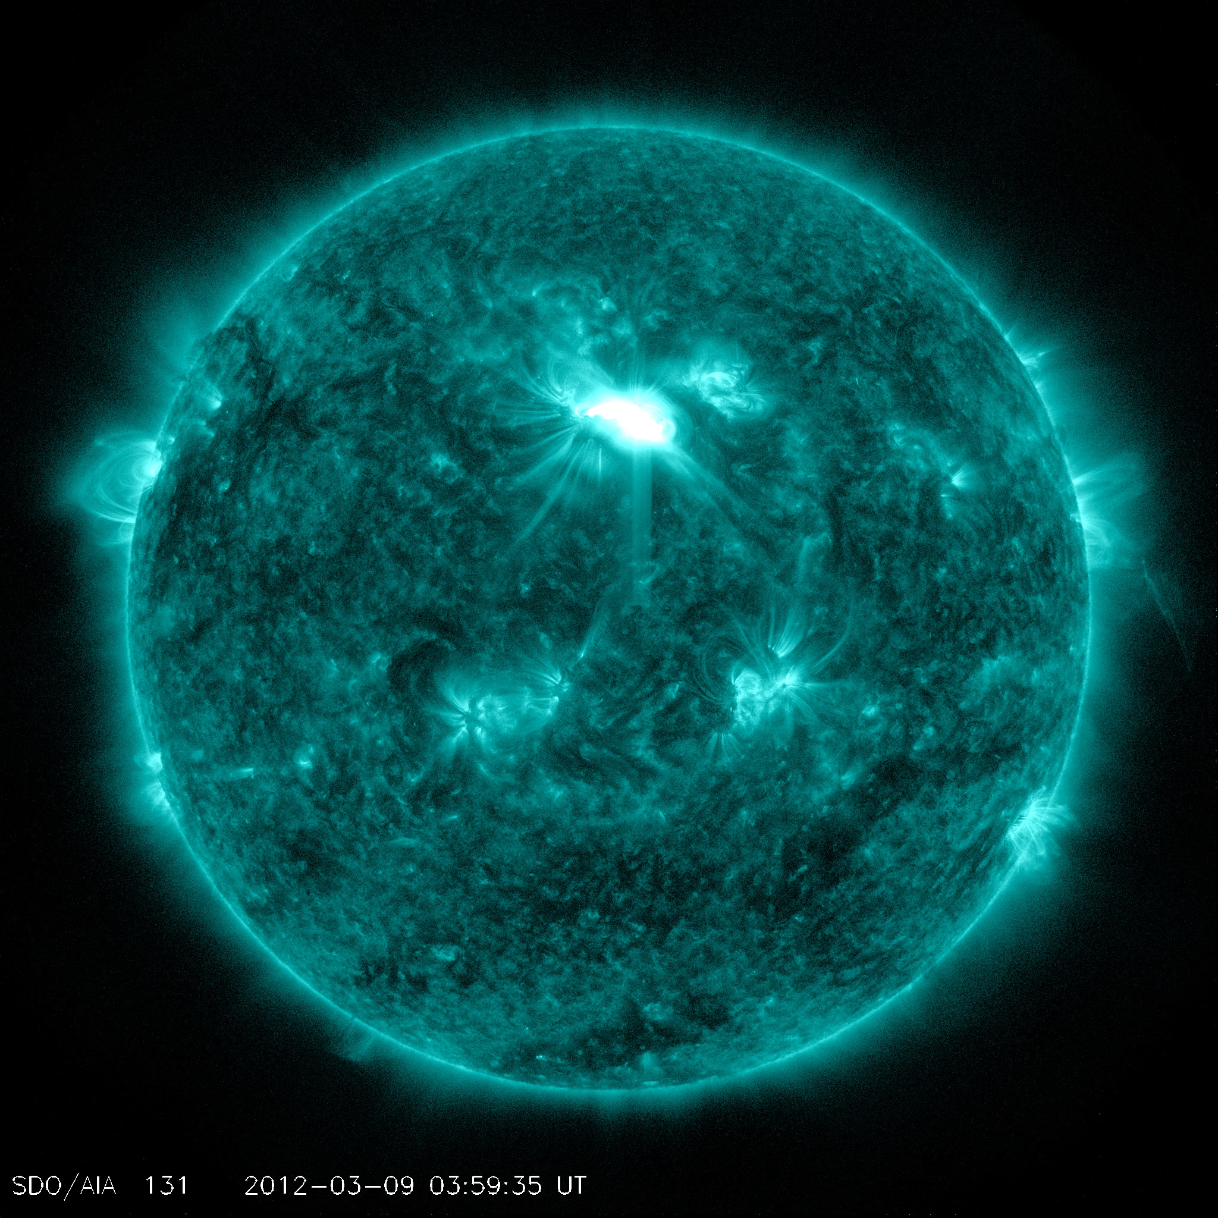
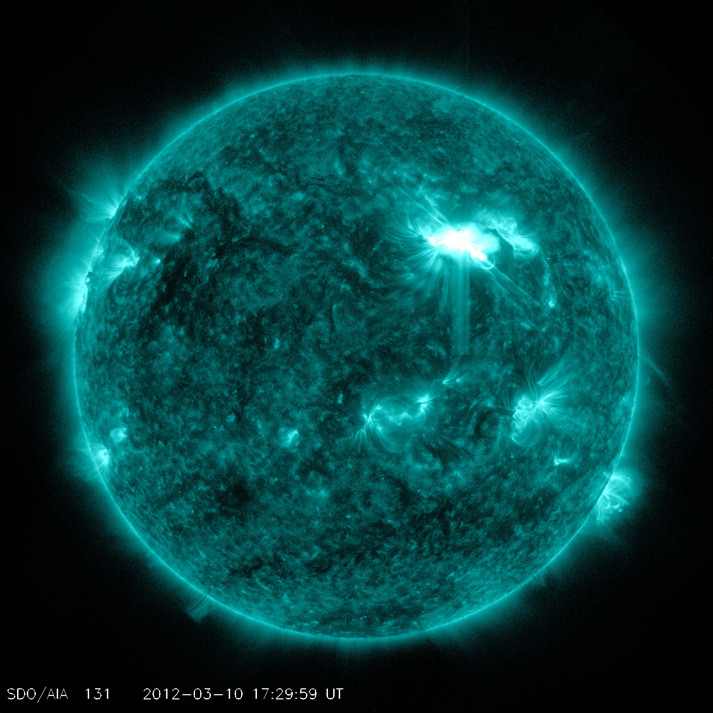
Flares of the Major Earth-Facing Events viewed by SDO AIA 131
M2.0, 2012-03-04
X1.1, 2012-03-05
X5.4/X1.3 2012-03-07
M6.3, 2012-03-09
M8.4, 2012-03-10
M7.9, 2012-03-13

Slide 50
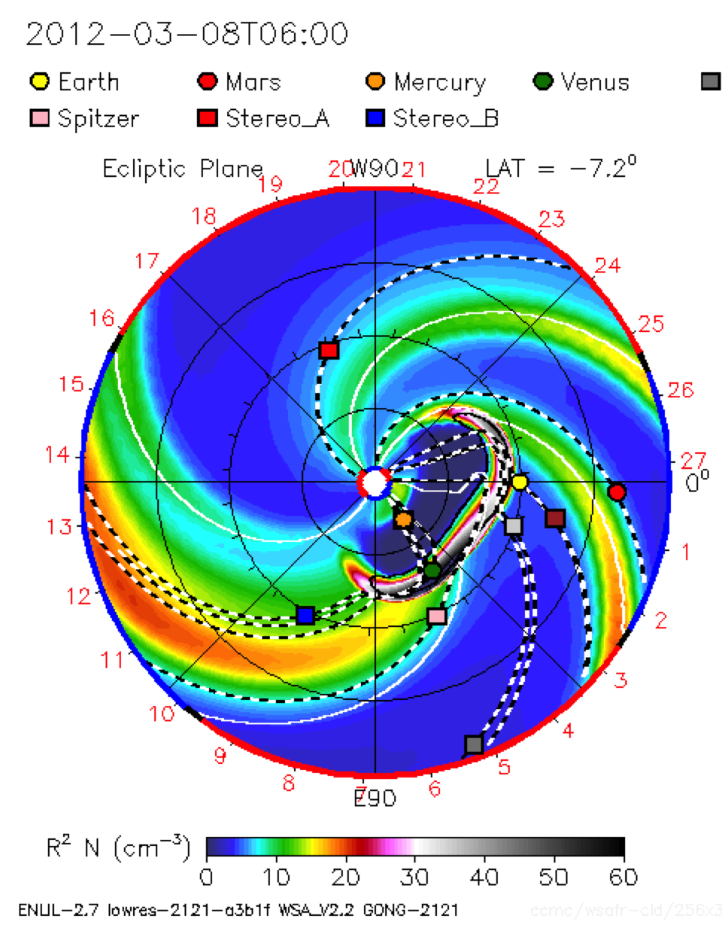
Orientation
West 90
Earth
East 90

Slide 51
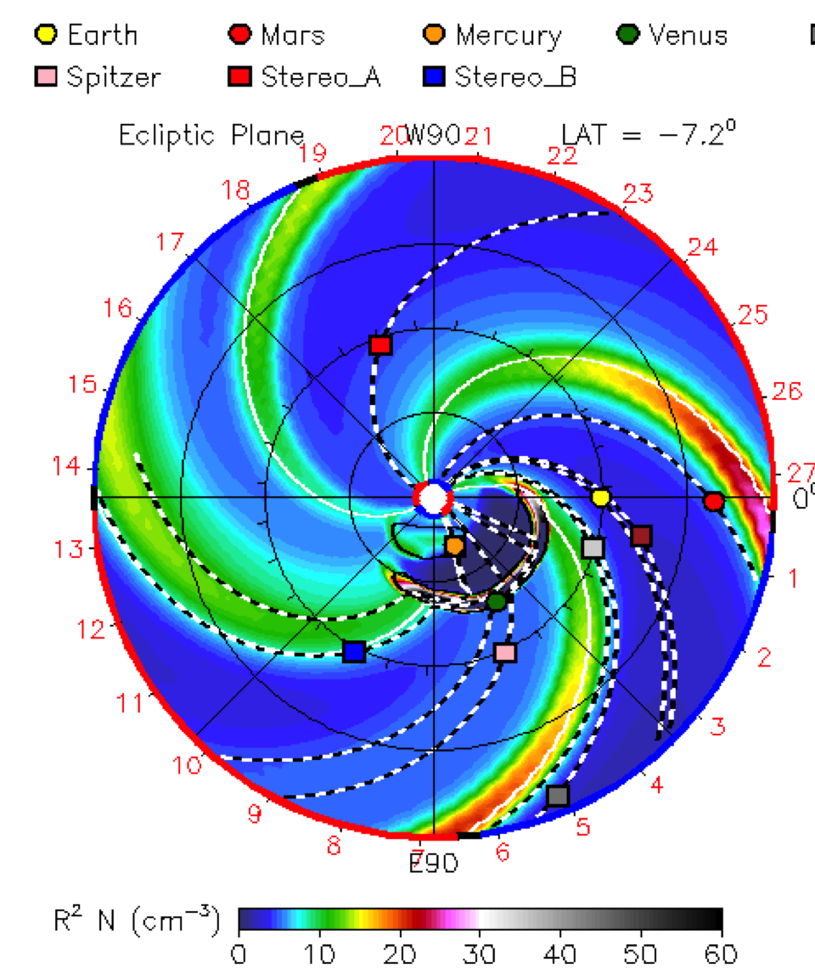
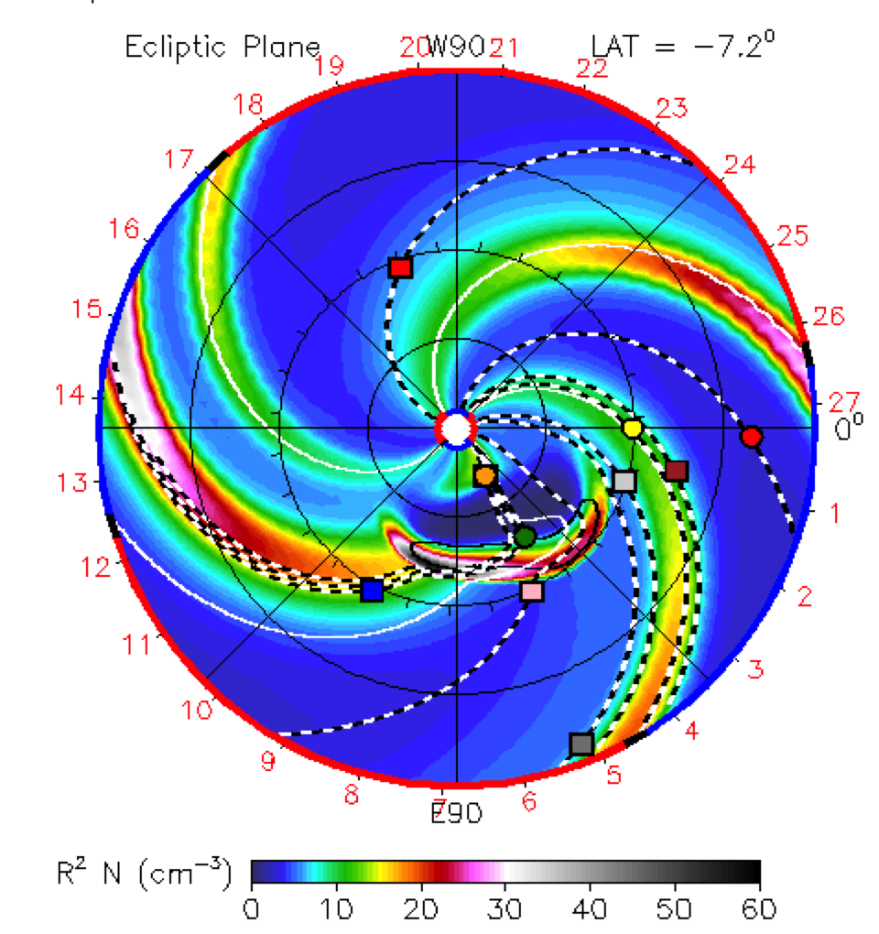
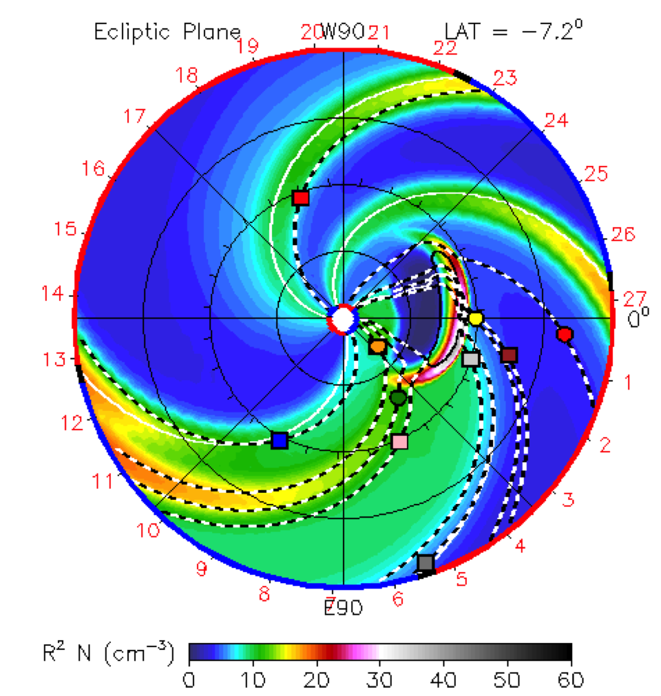
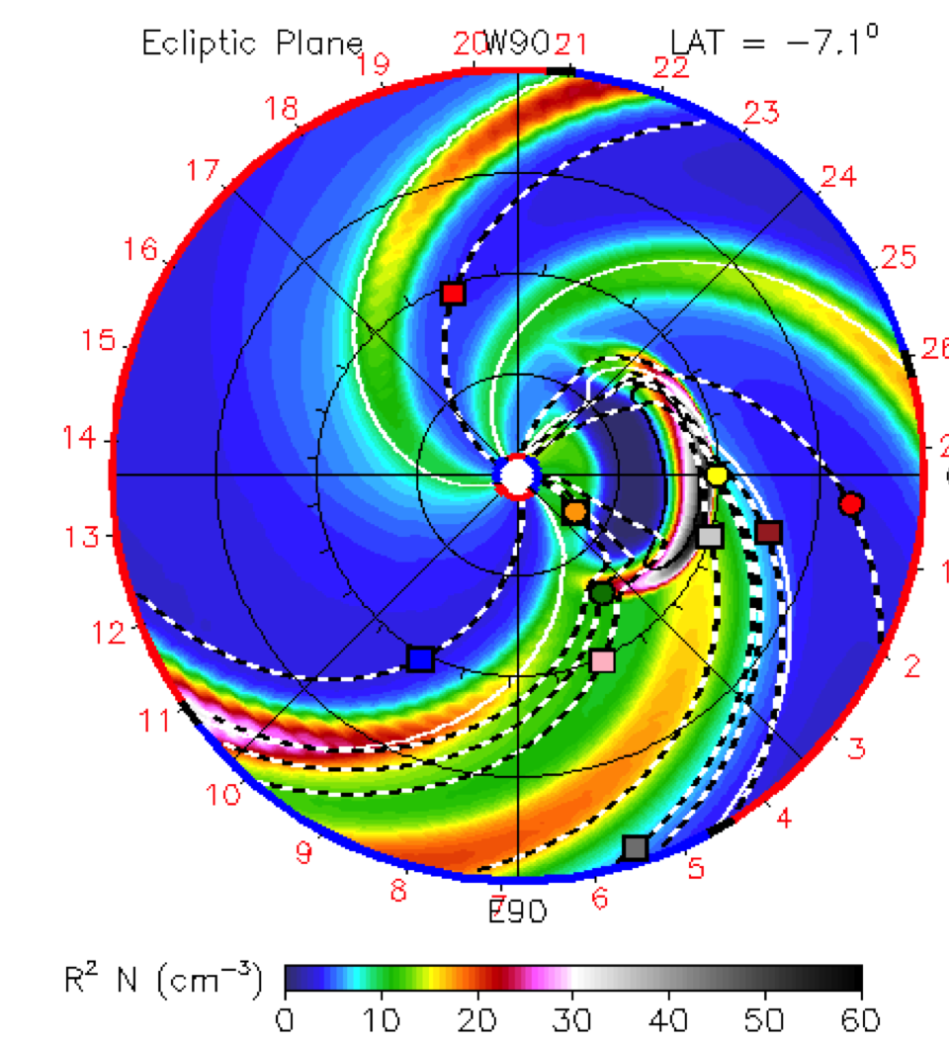

The Corresponding CMEs Associated with the Flares
M2.0, 2012-03-04
X1.1, 2012-03-05
X5.4/X1.3 2012-03-07
M6.3, 2012-03-09
M8.4, 2012-03-10
M7.9, 2012-03-13

Slide 52








STA: 2012-03-18
STA: 2012-03-21
STB: 2012-03-24
STB: 2012-03-26
Backsided events in STEREO EUVI 195A (top) and CME model simulations (bottom)

Slide 53

Enhanced proton radiation at STEREO A and B from the backsided events.
2012-03-21 07:39 UT
VCME=1550 km/s
2012-03-24 00:39UT
VCME=1600 km/s
2012-03-26 23:12UT
VCME=1500 km/s
2012-03-18 00:39UT
VCME=1450 km/s
13-100 MeV STEREO A
13-100 MeV STEREO B
Notes:
Enhanced proton radiation at STEREO A and B from the backsided events.

Slide 54
Space Weather (all in one)
Types of Storms
Drivers and Storms
Coronal Hole High Speed solar wind Streams (HSS)
Radiation storms
Sun
Dynamic Radiation Belts Environment
Space weather drivers
Geomagnetic storms
Ionospheric storms
Solar flares
SPEs
(Solar energetic Particle Events)
CMEs
Radio blackout storms
Outside the solar system
GCRs (Galactic Cosmic Rays)

Slide 55
Storms and Effects
Radiation hazards to humans
SEEs on spacecraft components and electronics
PCA on radio waves
Radiation Storms
Geomagnetic Storms
Ionospheric Storms
Radio Blackouts due to flares
Energetic ions
Energetic electrons
Internal charging of electronics
Large/rapid variations/disturbances in space and time (in fields and plasma/neutral distribution)
Enhancement in currents
Affect communication
Navigation
Surface charging
Radio wave propagation
Radio emissions/noise associated with flares (direct impacts)
Radio wave blackouts
(dayside ionosphere)
X-ray/EUV emission altering ionospheric structure/composition (indirect)

Slide 56
Supplementary Material/contact info
View our video, Incredible Active Region 1429: One for the record books, to learn more about the activities from this region from March 4 – March 28, 2012. http://youtu.be/PbyJswbX4VA
This video has been updated at the following link: http://youtu.be/dxl5drPY8xQ
(And also available on http://vimeo.com/nasaswc/ar1429)
Summary Video of the March 7, 2012 event
    http://youtu.be/HeoKf6NfEJI
    Full text of event summary
    http://goo.gl/dTnfd
NASA Space Weather Center
http://swc.gsfc.nasa.gov/main/

Slide 57
homework
Name all types of space weather impacts on spacecraft and their potential causes
Types of spacecraft orbits
Go over the summary video of the 7 March 2012 event - can you give a 30 seconds – 1minute description of the event to a friend?
Go over the video of ‘Incredible Active Region 1429’ – can you give a 30s – 1min description in your own words?

Slide 58
Supplementary material
Youtube video from Henry Garrett at JPL - http://www.youtube.com/watch?v=NarzGDuYYX4

