Slide 1
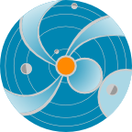
RT Modelling of CMEs Using WSA-ENLIL Cone Model
2014-06-04
Notes:
In this presentation we will make an introduction to the
WSA-ENLIL Cone model, used at SWRC to model propagation
of coronal mass ejections (CMEs) in the heliosphere.

Slide 2
Outline
Basic Principles behind cone modeling of CMEs.
Brief description of the models
Analyzing CME propagation and impact
Operations example: collaboration with AFWA
Notes:
First, I will say few words about basic principles behind cone modeling of CMEs.
Then, I will make a brief description of the WSA and ENLIL models.
After that I will describe how we analyze CME propagation and it’s impact
Finally, I will demonstrate an example of forecasting in operations:
A collaboration with Air Force Weather Agency (AFWA)

Slide 3
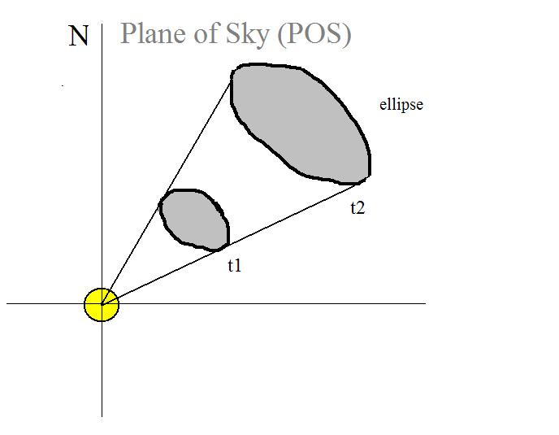
Cone Model for CMEs
Zhao et al, 2002, Cone Model:
The CME cone model is based on observational evidence that CME has more or less constant angular diameter in corona, being confined by the external magnetic field, so that CME does not expand in latitude in the lower corona, but expands in interplanetary space because of the weaker external field
CME propagates with nearly constant angular width in a radial direction
CME bulk velocity is radial and the expansion is isotropic
The projection of the cone on
the POS is an ellipse
Overly simplistic approximation to describe halo CME
Notes:
Zhao was the first to come up with the Cone model of CME. The CME
cone model is based on observational evidence that CME has more
or less constant angular diameter in corona, being confined by the
external magnetic field, so that CME does not expand in latitude in the lower
corona, but expands in interplanetary space because of the weaker
external field. The assumptions are the following:
CME propagates with nearly constant angular width in a radial direction
CME bulk velocity is radial and the expansion is isotropic

Slide 4
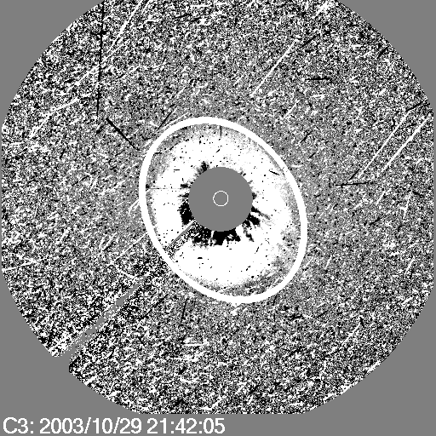
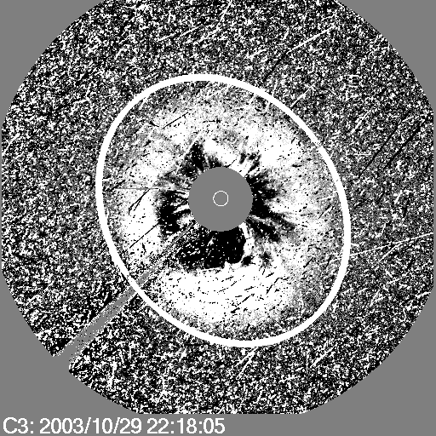
Cone Modelling for Halo CMEs
SOHO LASCO C3 difference images
Xie et al, 2004, Cone Model for Halo CMEs – analytical method
CME V and orientation
A. Pulkkinen, 2010, Cone Model for Halo CMEs – automatic method
Input to WSA-ENLIL
Notes:
CME and its motion in the interplanetary space can be observed in the coronograph
images. Coronographs create an artificial eclipse of the Sun. Eclipses allow corona
to be better viewed. But natural eclipses do not happen often. Occulting disk blocks
the bright sun so we can observe coronal features. Shown in this slide are difference
images.
Xie et al, 2004, developed analytical method of defining Cone Model CME
parameters for Halo CMEs. A. Pulkkinen , 20010 developed automatic method
of defining Cone Model CME parameters for Halo CMEs.

Slide 5
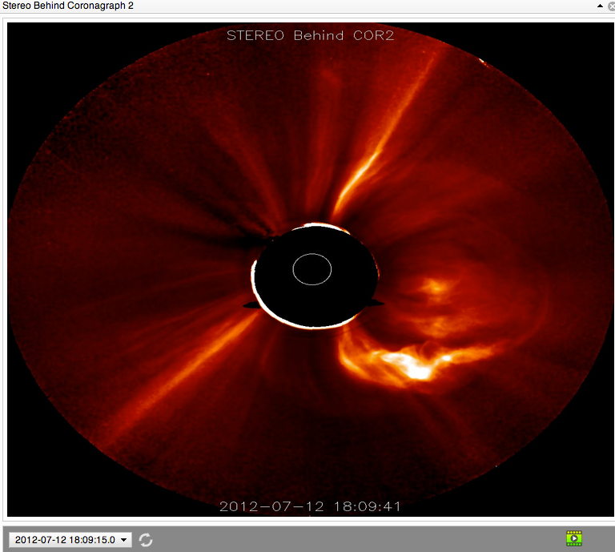
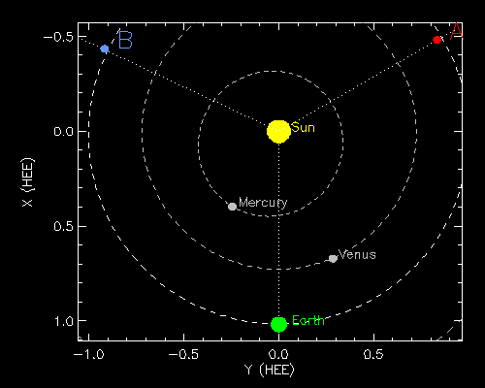
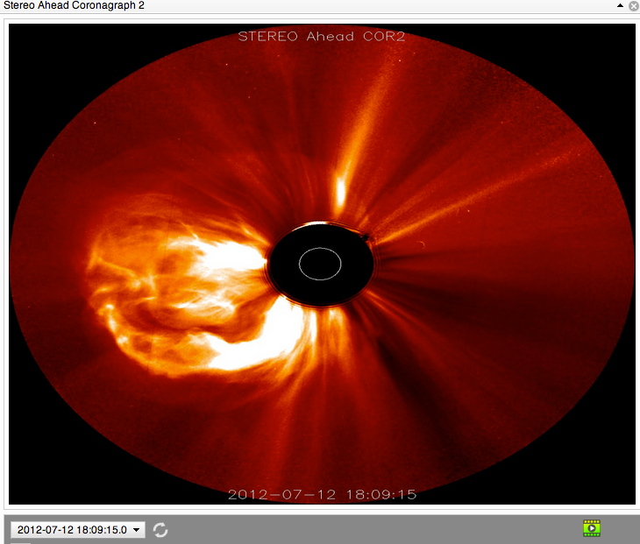
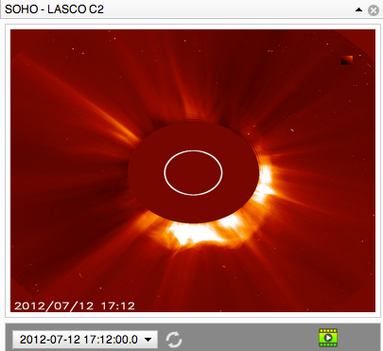
July 12, 2012CME Viewed by
Coronagraph Imagers
Notes:
Another method to derive Cone model parameters is triangulation method.
This slide shows the a CME seen in 3 coronographs located on three
different satellites.
The schematic in the upper center shows the location of STEREO B,
SOHO and STEREO A satellites in the ecliptic plane at the time when the
CME occurred.
The CME was moving sort of towards the Earth, so STB sees it moving to
the right in its plane of sky, for STA it moves to the left and it’s a halo
image for SOHO that is located on a sun-earth line.

Slide 6
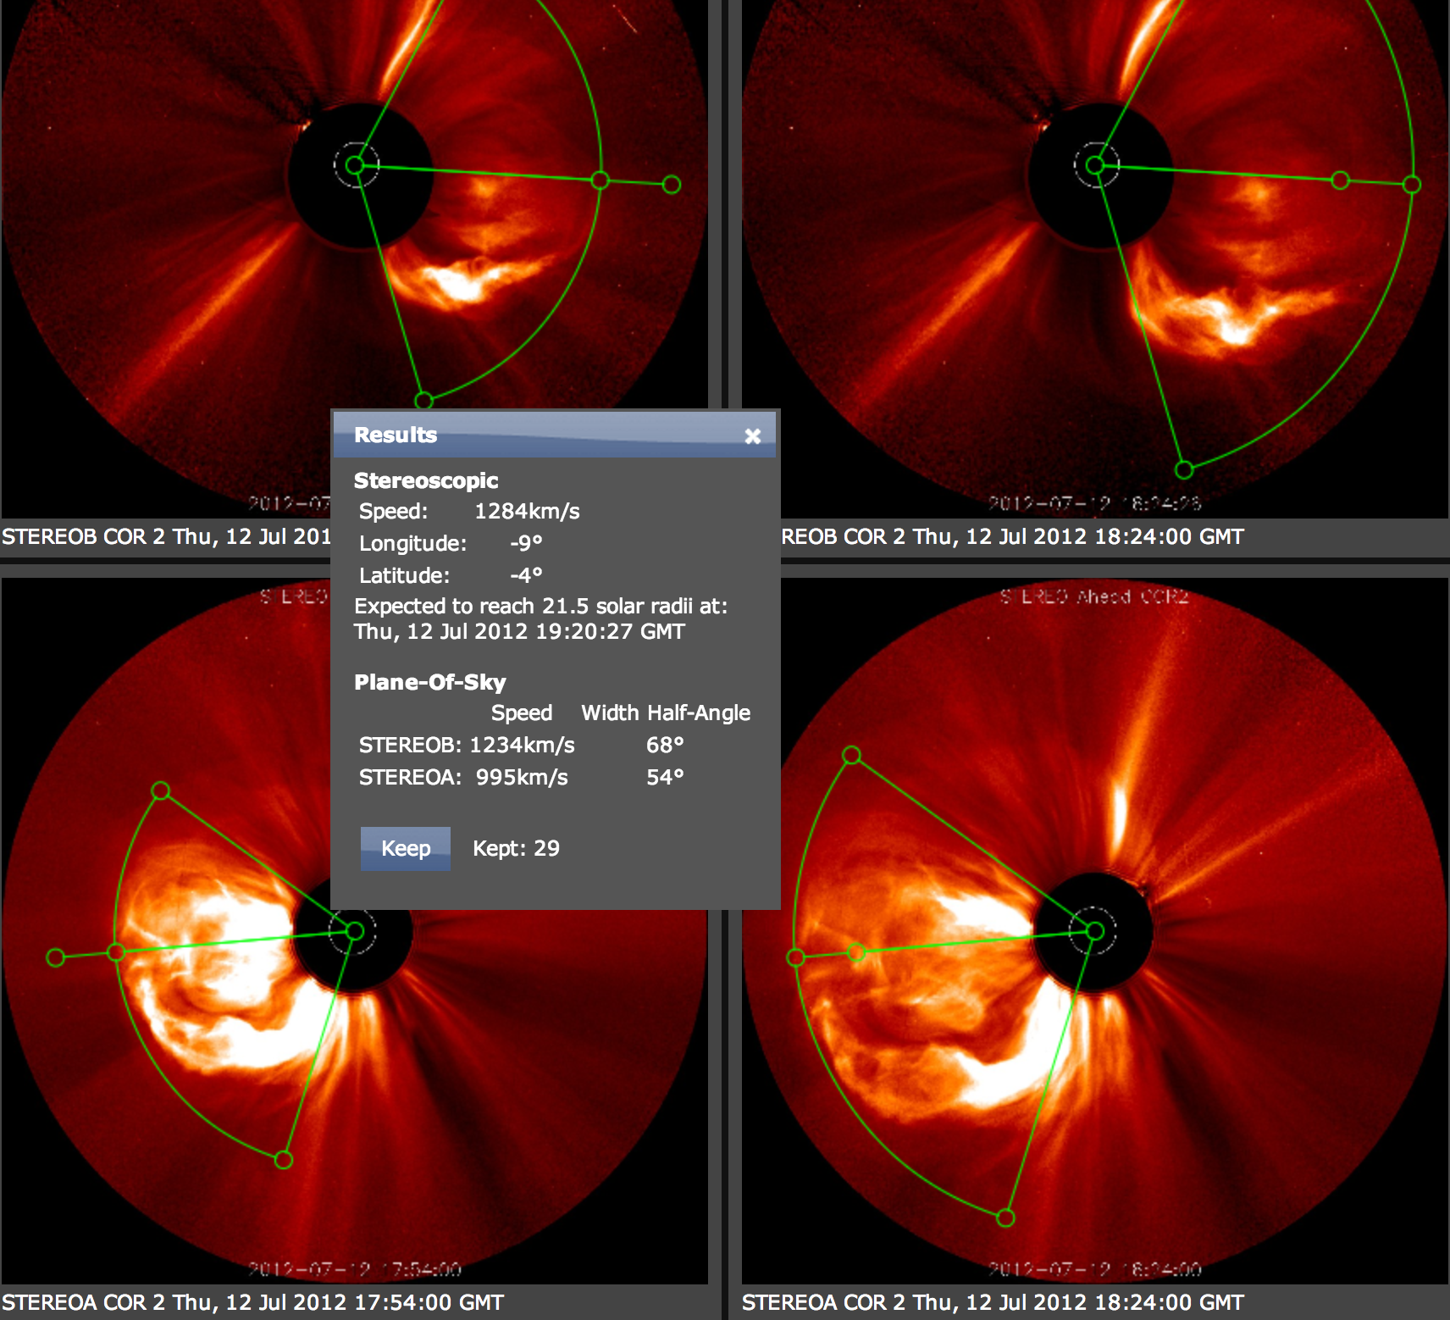
WSA-ENLIL Cone Model
Parameters Defined with CCMC CME Triangulation Tool
CME Parameters: Input To WSA-ENLIL Cone Model
Notes:
Parameters defined with CCMC CME Triangulation Tool
(CAT) or other tools are used as input CMEpParameters
to WSA-ENLIL Cone Model.

Slide 7
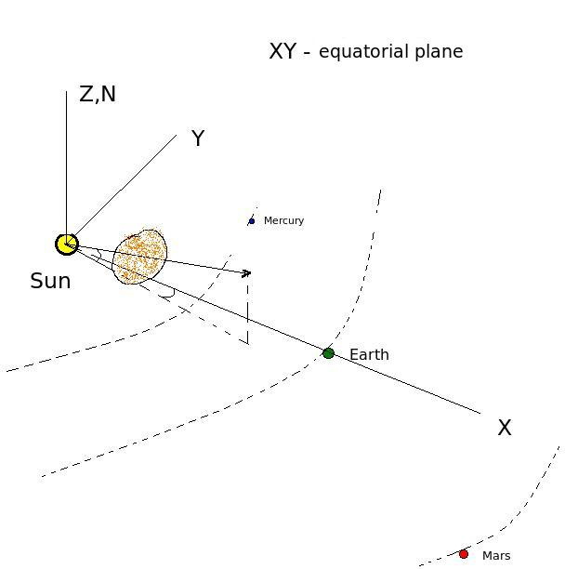
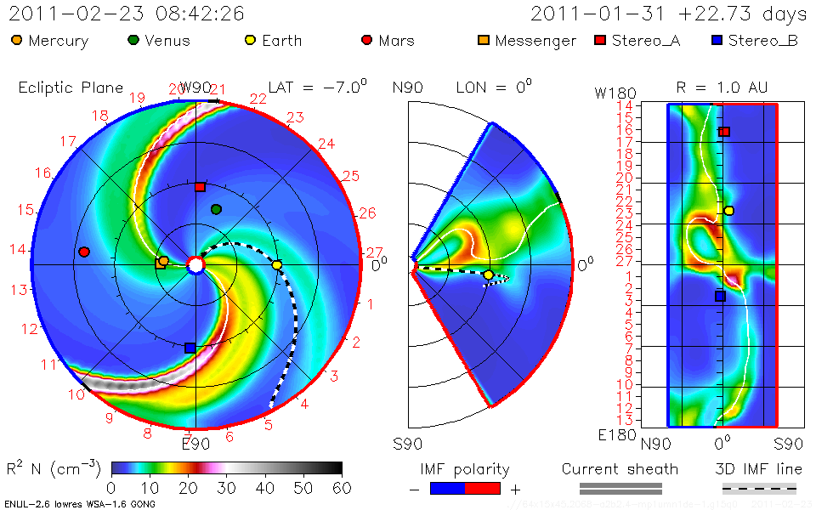
Sun, Planets, CME
Heliocentric Earth Equatorial Coordinates -
Heliographic
Constant
Latitude Plane
passing through
Earth
Meridional
Plane
1AU
quasi-
sphere
Notes:
This schematic shows CME in global perspective and explains coordinate system of the
WSA-ENLIL model.
XY is the equatorial plane (plane of the Sun equator). Z axis points to to
north pole of the Sun. Earth is located in the ecliptic plane, which forms
some variable angle with the equatorial plane (changes from -7.5 deg to 7.5 deg).
The first panel in WSA-ENLIL plot shows a plane passing through the
Earth and is parallel to equatorial plane. The second panel is a meridianal cut passing
through the Earth. The latitude goes from -60 to 60 degrees.
The third panel shows Longitude-Latitude map of a quasi sphere at 1 AU and with
The cut off for Latitude > |60 deg| .

Slide 8
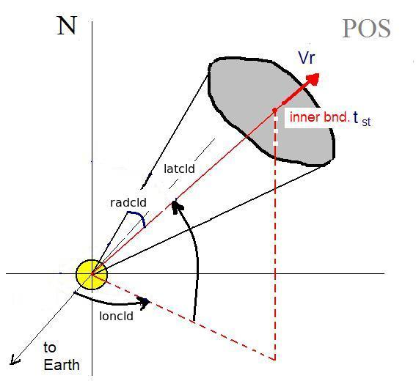
Cone model parameters
tstart - when cloud at 21.5Rs
Latitude
Longitude
Radius (angular width)‏
Vr - radial velocity
Input to ENLIL cone model run
Notes:
Parameters defined with CCMC CME Triangulation or other Tools yield CME
Parameters: Input To WSA-ENLIL Cone Model. These parameters are:
1- start time of CME at 21.5 Rs (inner boundary of the ENLIL model)
2- Cone axis latitude
3- Cone axis longitude
5- Cone Radius – half angle of the cone angular width
6- Radial Velocity

Slide 9
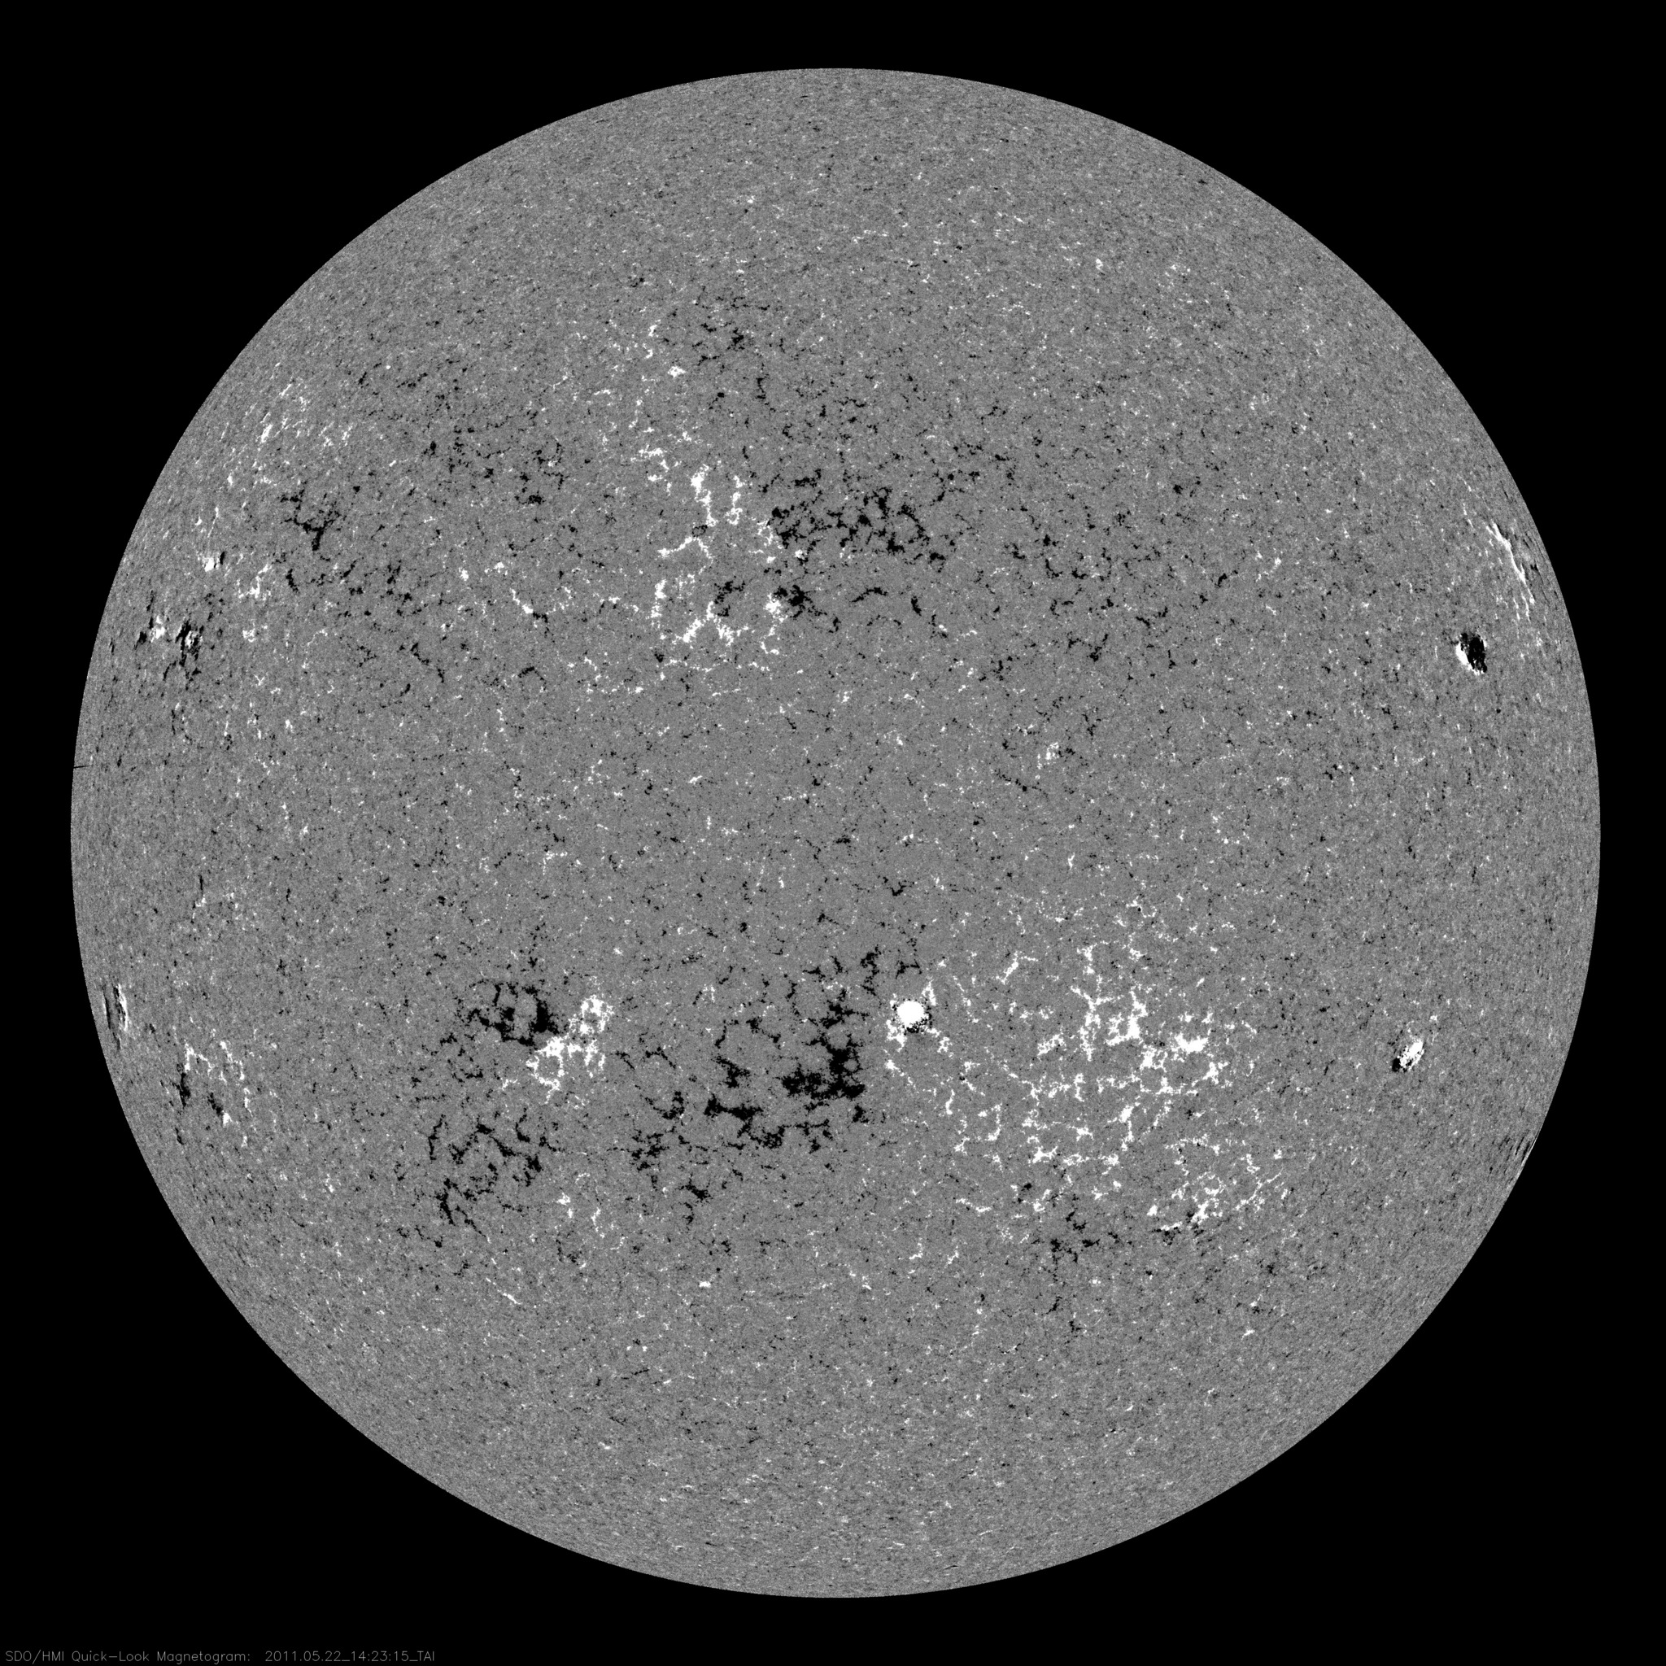
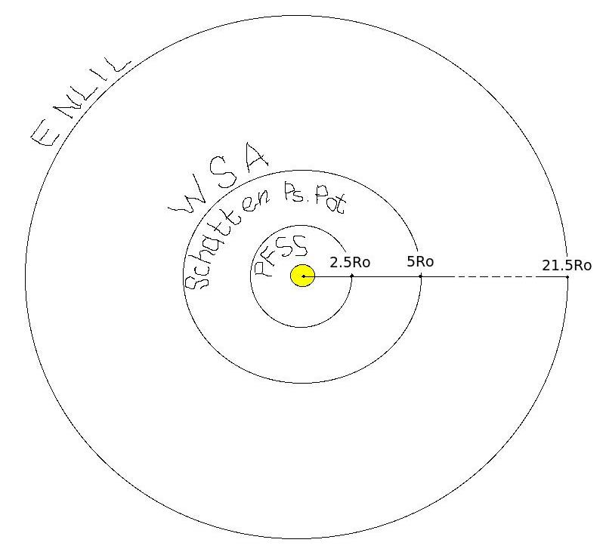
WSA- Input to ENLIL
WSA (Wang-Sheeley-Arge, AFRL):
PFSS (Potential Field Source Surface).
Input: synoptic map photospheric magnetogram.
Force free (even current free) solution with radial
field at 2.5 Ro.
Schatten Current Sheet.
Input: PFSS.
Modifies the sign of radial field to positive to
prevent reconnection, creates potential solution
with radial boundary conditions, restores the sign in
the new solution at 5 Ro.
WSA.
Input: Schatten CS.
Assuming radial constant speed flow at 5 Ro uses
empirical formula for speed, determined by the
rate of divergence of the magnetic field at 5 Ro
and proximity of the given field line to the coronal
hole boundary.
Notes:
Wang-Sheeley-Arge model WSA (Wang-Sheeley-Arge, AFRL)
is the input model to the ENLIL at it’s inner boundary of 21.5Rs.
The input to the WSA is daily magnetograms of the solar surface,
that describe the magnetic field of the photosphere.
WSA model itself consists of different models
PFSS (Potential Field Source Surface).
Input: synoptic map photospheric magnetogram.
Force free (even current free) solution with radial
field at 2.5 Ro.
Schatten Current Sheet.
Input: PFSS.
Modifies the sign of radial field to positive to
prevent reconnection, creates potential solution
with radial boundary conditions, restores the sign in
the new solution at 5 Ro.
WSA.
Input: Schatten CS.
Assuming radial constant speed flow at 5 Ro uses
empirical formula for speed, determined by the
rate of divergence of the magnetic field at 5 Ro
and proximity of the given field line to the coronal
hole boundary.

Slide 10
ENLIL - Schematic Description
ENLIL – Sumerian God of Winds and Storms
Dusan Odstrcil, GMU & GSFC
Input: WSA (coronal maps of Br and Vr updated 4
times a day). For toroidal components at the inner
boundary- Parker spiral.
ENLIL’s inner radial boundary is located beyond
the sonic point: the solar wind flow is supersonic in
ENLIL.
Computes a time evolution of the global solar
wind for the inner heliosphere, driven by corotating
background structure and transient disturbances
(CMEs) at it’s inner radial boundary at 21.5 Ro.
Solves ideal fully ionized plasma MHD equations in
3D with two additional continuity equations: for
density of transient and polarity of the radial
component of B.
Notes:
ENLIL – Sumerian God of Winds and Storms
Dusan Odstrcil, GMU & GSFC
Input: WSA (coronal maps of Br and Vr updated 4
times a day). For toroidal components at the inner
boundary- Parker spiral.
ENLIL’s inner radial boundary is located beyond
the sonic point: the solar wind flow is supersonic in
ENLIL.
Computes a time evolution of the global solar
wind for the inner heliosphere, driven by corotating
background structure and transient disturbances
(CMEs) at it’s inner radial boundary at 21.5 Ro.
Solves ideal fully ionized plasma MHD equations in
3D with two additional continuity equations: for
density of transient and polarity of the radial
component of B.

Slide 11
ENLIL Schematic Description (cont.)
ENLIL model does not take into account the realistic
complex magnetic field structure of the CME magnetic
cloud and the CME as a plasma cloud has a uniform
velocity.
It is assumed that the CME density is 4 times larger than the ambient fast solar wind density, the temperature is the same. Thus, the CME has about four times larger pressure than the ambient fast wind. Launching of an over pressured plasma cloud at 21.5 Rs, roughly represents CME eruption scenario
Output:
3D distribution of the SW parameters at
spacecrafts and planets and topology of IMF.
Notes:
Limitation of the ENLIL model:
It does not take into account the realistic complex magnetic field structure
of the CME magnetic cloud and the CME as a plasma cloud has a uniform velocity.
It is assumed that the CME density is 4 times larger than the ambient fast solar wind
density, the temperature is the same. Thus, the CME has about four times larger
pressure than the ambient fast wind. Launching of an over pressured plasma cloud
at 21.5 Rs, roughly represents CME eruption scenario
Output:
3D distribution of the SW parameters at
spacecrafts and planets and topology of IMF.

Slide 12
CME modeling
Notes:
After we define the CME parameters we run the WSA-ENLIL cone model.

Slide 13
CME Impact – arrival, duration,
MP standoff distance
CME shock arrival –
a sharp jump in the dynamic pressure
Duration of the disturbance – duration
of the dynamic
pressure hump
Magnetic field
required
to stop SW
Magnetopause standoff distance
Notes:
After the run is done, we estimate the CME impact on planets, satellites.
CME shock arrival – a sharp jump in the dynamic pressure.
2. Duration of the disturbance – duration of the dynamic pressure hump.
3. In case of the Earth we estimate also the degree of compressing of the
magnetosphere: when the CME mass reaches the magnetosphere it
pushes it inward and the magnetic field of the Earth is stressed like
a spring to stop the CME motion.

Slide 14
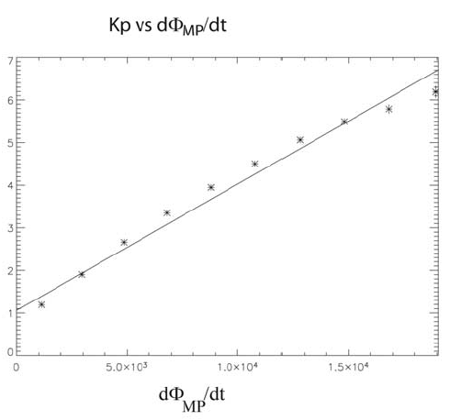
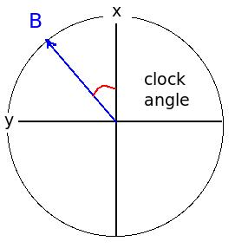
Kp Index – P. Newel’s Empirical Expression
Magnetic flux opening
rate at the magnetopause
Z
Notes:
In case of the Earth we estimate also the Kp index – a measure of the disturbance of the magnetosphere.
We use Pat Newel’s empirical formula for the Magnetic flux opening
rate at the magnetopause for that and an empirical relation between
Kp and d(Phi)/dt.

Slide 15
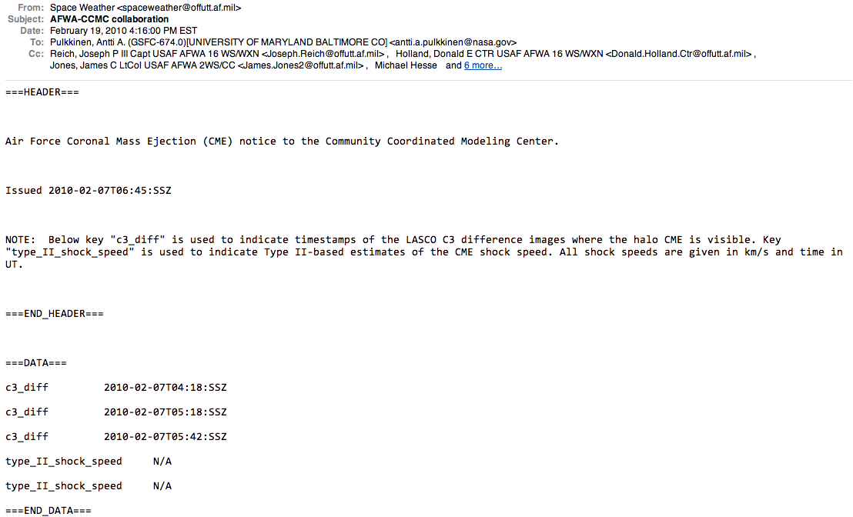
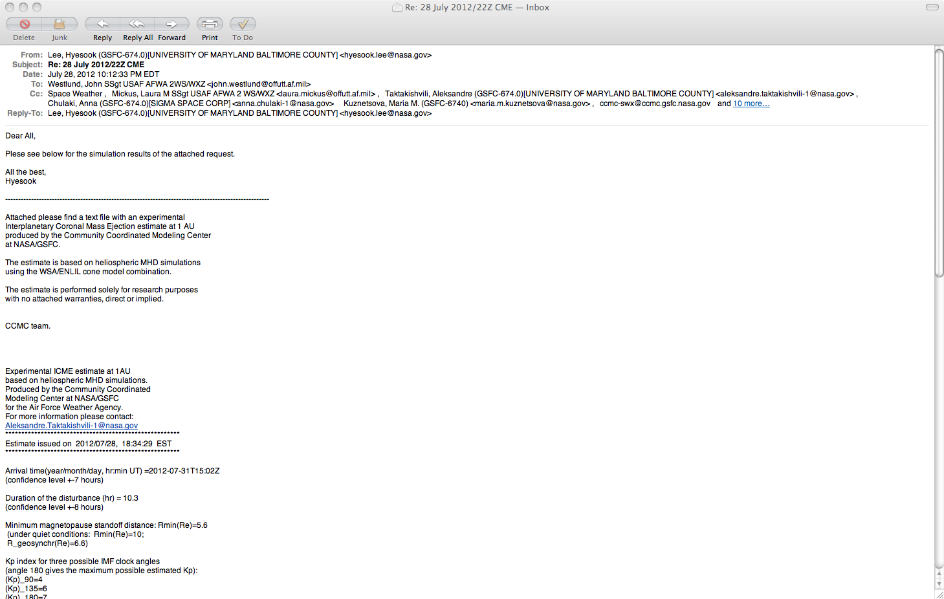
AFWA Collaboration
AFWA
CME alert e-mail based on CCMC iSWA LASCO C3 difference image analysis
CCMC
RT WSA/ENLIL Cone Model run
using the most recently updated
GONG magnetogram
AFWA
Notes:
I will end with an example of operational setup of our cone modeling in
collaboration with the Air Force Weather Agency.
First we get AFWA CME alert e-mail based on CCMC iSWA
LASCO C3 difference image analysis (unlike us, who are not
really an operational center, AFWA is monitoring 24/7 the Space Weather
and Sun.
We perform WSA-ENLIL modeling of the requested CME(s) and send t
hem back the CME impact assessment e-mail.

Slide 16
AFWA Collaboration 2
AFWA e-mail
Notes:
Here is AFWA-s e-mail in detail. The indicate the instrument and time stamps
of the coronograph images when the CME that was observed.

Slide 17
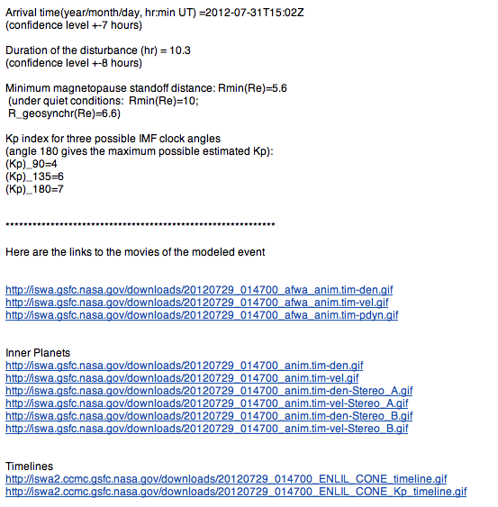
AFWA Collaboration
Estimate e-mail
Notes:
And here is our response e-mail the them in details.
It contains the CME impact estimate for the Earth
(arrival time, magnetopause standoff distance,
Kp estimate for three possible clock angles of the IMF),
and links to the modeling animation and timelines.

Slide 18
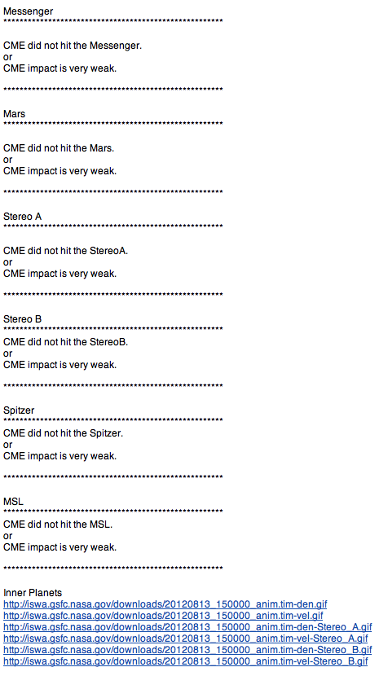
e-mail for NASA missions
Estimate e-mail
Notes:
But we are not monitoring only Earth impact. Being responsible for
providing space weather assessment to NASA robotic mission operators,
we are monitoring possible impact of the CME on NASA missions.
So we send out another e-mail, that shows this estimate.

