Slide 1
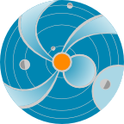
Flares, CMEs and SEPs
A. Taktakishvili
CCMC, SWRC
NASA Goddard Space Flight Center
NASA
Space
Weather
Research
Center
Notes:
In this presentation I will be talking about solar flares and coronal mass ejections and their relation to the space weather

Slide 2
Solar Flare
2012 July 12 X1.4 class flare
X ray
EUV
Notes:
Solar flare is a sudden brightening observed over the Sun's surface or the solar limb, which is interpreted as a large energy release. Flares are mainly followed by a mass ejections from the solar atmosphere called coronal mass ejections. The flare ejects clouds of electrons, ions, and atoms through the corona of the sun into space.
In this slide is shown the solar flare of 2012 July 12.
The three color images show SDO satellite (http://iswa3.ccmc.gsfc.nasa.gov/wiki/index.php/Glossary) images of the same flare in three different wave length intervals: 1) the left is SDO EVE X-ray image (http://iswa3.ccmc.gsfc.nasa.gov/wiki/index.php/Full_iSWA_Cygnet_List
The central panel shows SDO AIA extreme ultraviolet image for 13.1 nm http://iswa3.ccmc.gsfc.nasa.gov/wiki/index.php/SDO_AIA_193 and the right panel - for a shorter wave length of 19.3 nm
http://iswa3.ccmc.gsfc.nasa.gov/wiki/index.php/SDO_AIA_131
In this slide is shown also in the lower left corner a magnetogram (
http://iswa3.ccmc.gsfc.nasa.gov/wiki/index.php/Glossary) - magnetic field map - of the solar photosphere for the same period of time. This flare is associated to the large and magnetically complicated active region in the southern hemisphere of the solar surface as is usually takes place.

Slide 3
Solar Flare Class
2012 July 12 X1.4 class flare
0.1-0.8 nm
0.05-0.4 nm
X (extreme)
log(flux)
[Wm^2]
M (moderate)
C (common)
B (bgrnd)
A
X1.4 class: flux(0.1-0.8nm)[Wm^2]=1.4*10^(-4)
Notes:
In this slide is shown the time line for the X-ray flux intensity
(http://iswa3.ccmc.gsfc.nasa.gov/wiki/index.php/GOES_X-RAY) for the same flare of 2012 July 12, in two different wave length intervals . A strong flare usually manifests itself by a sudden a jump of the X-ray intensity.
The flares are characterized by classes according to their X-ray flux intensity in the 0.1 – 0.8 nm wavelength range.
Flux/Wm^2 > 10^(-4) X - (eXtreme), strong
Flux/Wm^2 > 10^(-5) M – (Moderate)
Flux/Wm^2 > 10^(-6) C – (Common)
Flux/Wm^2 > 10^(-7) B – (Background)
Flux/Wm^2 > 10^(-8) A
M1.4 class flare that at the peak the flare intensity was equal to:
flux/Wm^2=1.4*10^(-4)

Slide 4
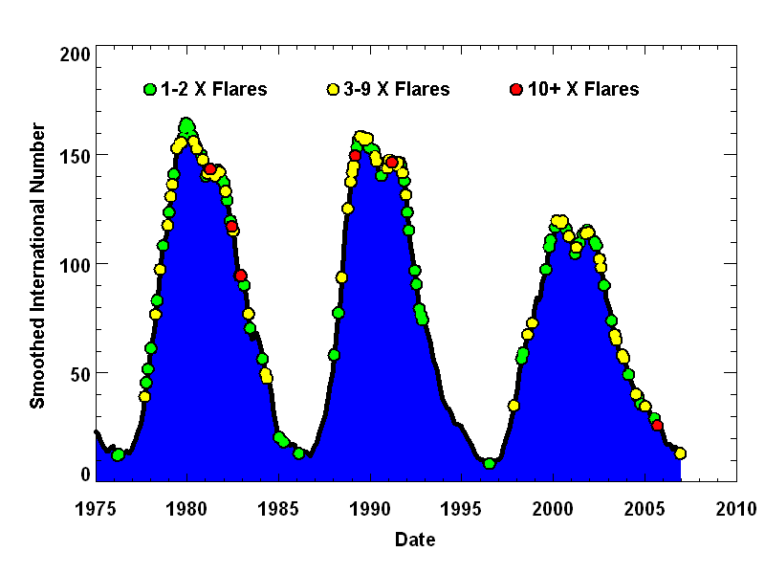
Flares over the Solar cycle
Solar flares have been monitored by x-ray detectors on GOES satellites since 1976. The number of X-Class flares per month increases with the number of sunspots but big flares can occur anytime sunspots are present.
Notes:
Solar flares have been monitored by x-ray detectors on GOES satellites since 1976.
In this plot the frequency of the X-class flares is plotted over the sunspot number plot. Green dots represent 1-2 X-class flares, yellow – 3-9 X-class flares and red – 10+ X class flares.
You can see that the number of X-Class flares per month increases with the number of sunspots, but big flares can occur anytime sunspots are present.

Slide 5
Flare: SWx impacts
Cause radio blackout through changing the structures/composition of the ionosphere (sudden ionospheric disturbances) – X ray and EUV emissions, lasting minutes to hours
Affect radio communications, GPS, directly by its radio noises at different wavelengths
Contribute to SEP – proton radiation, lasting a couple of days
Notes:
Cause radio blackout through changing the structures/composition of the ionosphere (sudden ionospheric disturbances) – x ray and EUV emissions, lasting minutes to hours
Affect radio communications, GPS, directly by its radio noises at different wavelengths
Contribute to SEP – proton radiation, lasting a couple of days

Slide 6
Flare Characteristics
Flares tend to occur in isolation, localized in space and time but with strong correlations; typically one active region will produce dozens of flares, especially during periods of flux emergence (often near the beginning of the lifetime of a given region, but not always). The most powerful events usually occur in active regions.
Notes:
Flares tend to occur in isolation, localized in space and time but with strong correlations; typically one active region will produce dozens of flares, especially during periods of flux emergence (often near the beginning of the lifetime of a given region, but not always). The most powerful events usually occur in active regions.

Slide 7
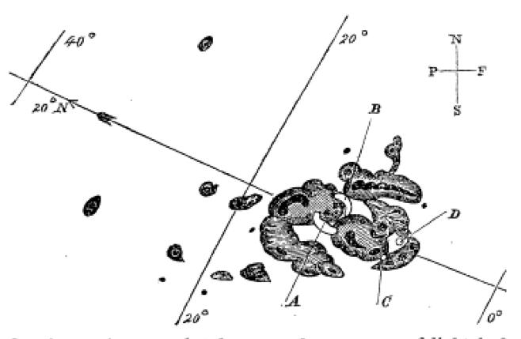
Solar Flare Discovered
In 1859 Richard Carrington reported observing a large sunspot group on the afternoon of September 1st when “…two patches of intensely bright and white light broke out…”
Notes:
In 1859 Richard Carrington reported observing a large sunspot group on the afternoon of September 1st when “…two patches of intensely bright and white light broke out…”. The flare was followed by a major coronal mass ejection (CME) to travel directly toward Earth, taking 17.6 hours. This second CME moved so quickly because the first one had cleared the way of the ambient solar wind plasma.
On September 1–2, 1859, the largest recorded geomagnetic storm occurred. Aurorae were seen around the world, even over the Caribbean; those over the Rocky Mountains were so bright that their glow awoke gold miners, who began preparing breakfast because they thought it was morning. People who happened to be awake in the northeastern US could read a newspaper by the aurora's light.
Telegraph systems all over Europe and North America failed, in some cases shocking telegraph operators. Some telegraph systems continued to send and receive messages despite having been disconnected from their power supplies.

Slide 8
Coronal Mass Ejection
Coronal Mass Ejection – Reaches the Earth in 1-3 days
Notes:
From time to time huge mass of solar plasma can erupt from the solar atmosphere. This phenomenon is called coronal mass ejection (CME,
http://iswa3.ccmc.gsfc.nasa.gov/wiki/index.php/Glossary ).
If CME is directed towards Earth, depending on it’s speed and size, it can reach the Earth in 1-3 days. CMEs are usually causing the strongest geomagnetic storms.

Slide 9
CME/flare
The most energetic CMEs occur in close association with powerful flares. Nevertheless large-scale CMEs do occur in the absence of major flares even though these tend to be slower and less energetic.
When strong flare/CME occurs, it gives off emission across the whole electromagnetic spectrum, at the same time energetic particles
Notes:
The most energetic CMEs occur in close association with powerful flares. Nevertheless large-scale CMEs do occur in the absence of major flares even though these tend to be slower and less energetic.
When strong flare/CME occurs, it gives off emission across the whole electromagnetic spectrum, at the same time energetic particles

Slide 10
Most of the CMEs Originate
From the Active Regions
2012 July 12 X1.4 class flare and a following CME
Notes:
In this slide is shown the solar flare of 2012 July 12 yet again and the following CME in the SDO EUV 193 image.
You can see the motion of the material and opening of the coronal loops in the area adjacent to the flare and the active region.

Slide 11
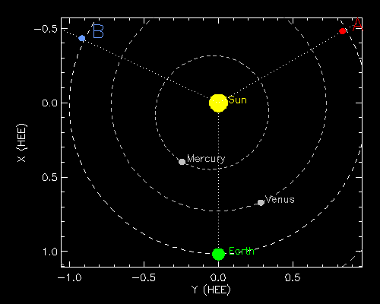
July 12, 2012CME Viewed by
Coronagraph Imagers
Notes:
But the better view of a CME and its motion in the interplanetary space can be obtained from the coronograph images. Coronographs create an artificial eclipse of the sun. Eclipses allow corona to be better viewed, but natural eclipses do not happen often. Occulting disk blocks the bright sun so we can observe corona features.
This slide shows the same CME seen in 3 coronographs located on three different satellites. The schematic in the upper center shows the location of STEREO B, SOHO and STEREO A satellites in the ecliptic plane at the time when the CME occurred.
The CME was moving sort of towards the Earth, so STB sees it moving to the right in its plane of sky, for STA it moves to the left and it’s a halo image for SOHO that is located on a sun-earth line.

Slide 12
CME from a Filament Eruption
Northeast (upper left) quadrant starting around 19:00 UT on Feb 10, 2012
Notes:
Not all CMEs originate from the active regions. Here is shown an example of a CME caused by so called filament eruption. Filaments are formed in magnetic loops that hold relatively cool, dense gas suspended above the surface of the Sun. Magnetic instabilities cause filaments to raise and parts of it disconnect from the solar surface resulting into CMEs.

Slide 13
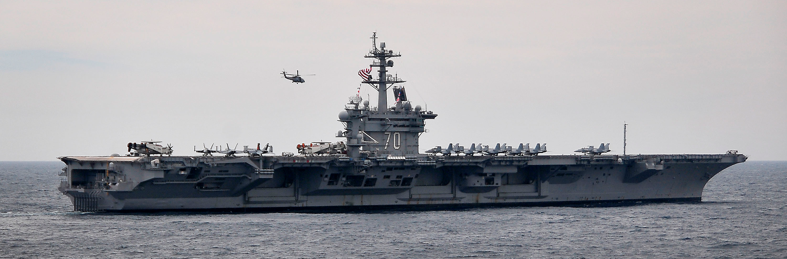
CME Properties
Mass: ~10¹⁵⁻¹⁶ g
Speed: few hundred - 3000km/s
..or
Mass: ~1 million Nimitz-class aircraft carriers
Speed: 1.5 -10 million km/hour
Earth?
Arrives to Earth in 1-2 days
Notes:
CME properties:
Mass: ~10¹⁴kg
Speed: few hundred - 3000km/s
In other words:
Mass: ~1 million Nimitz-class aircraft carriers
Speed: 1.5 -10 million km/hour
If it hits the Earth, it can have a significant impact.

Slide 14
CME SCORE
• A simple new category system for CMEs based on frequency of detection and speed
• Complements Flare Classes
• Applicable in space weather operations and research
Notes:
Recently we, here at SWRC, introduced, as we call it, CME SCORE scale, a simple new category system for CMEs based on frequency of detection and speed.
It Complements Flare Classes and is applicable in space weather operations and research.
The graph here shows the frequency of the CME detection (number of events per year) as a function of the CME speed. Bin size is 100 km/s.
So we have S-typs CMEs with the speed less then 500/km/s, C-type (common) for the range 500-999, O-type (occasional) for 1000-1999, R-type (rare) for 2000-2999 and ER-type (extremely rare) CMEs for CME s with the speed more then 3000 km/s.

Slide 15
SWx impacts of CME
Contribute to SEP (particle radiation): 20-30 minutes from the occurrence of the CME/flare
Result in a geomagnetic storm: takes 1-2 days arriving at Earth
Result in electron radiation enhancement in the near-Earth space: takes 1-3 days
Affecting spacecraft electronics – surfacing charging/internal charging, radio communication, navigation
power grid, pipelines, and so on
Notes:
Contribute to SEP (particle radiation): 20-30 minutes from the occurrence of the CME/flare
Result in a geomagnetic storm: takes 1-2 days arriving at Earth
Result in electron radiation enhancement in the near-Earth space: takes 1-3 days.
Contribute to SEP (particle radiation): 20-30 minutes from the occurrence of the CME/flare
Result in a geomagnetic storm: takes 1-2 days arriving at Earth
Result in electron radiation enhancement in the near-Earth space: takes 1-3 days

Slide 16
Geomagnetic Storm Caused
by the CME Arrival
CME Arrival at ACE
Notes:
When the CME arrived to the ACE satellite, close to the Earth, it caused a shock seen here in the magnetic field and the solar wind speed measurements by ACE. This impact caused a strong disturbance in the Earth’s magnetosphere or as they call it geomagnetic storm.

Slide 17
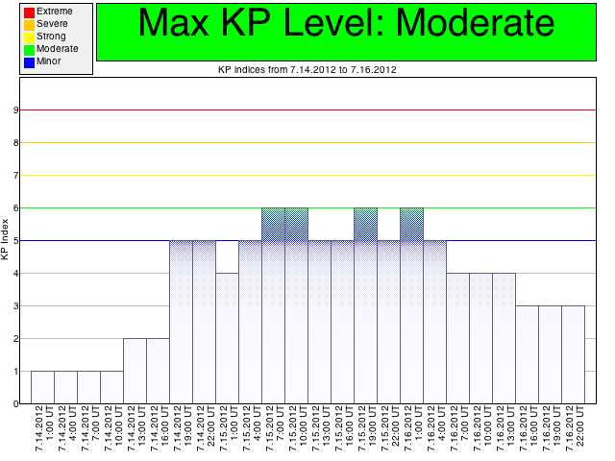
Geomagnetic Storm Caused
by the CME Arrival
Notes:
The strength of the geomagnetic storm is measured by so called Kp index, which characterizes degree of the disturbance of the Earth’ magnetic field ground base measurements. Kp goes from 0 to 9. This storm with Kp=6 is considered to be a moderate one.

Slide 18
Physical Mechanism Behind
the Flares and CMEs
It is believed that solar magnetic field, releases energy, accelerating solar plasma and causing flares and CMEs. Magnetic reconnection.
Notes:
What is the mechanism behind the flares and CMEs. It is believed that the magnetic field can change its configuration in a constantly varying solar atmosphere and during this reconfiguration it releases energy accelerating
solar plasma causing flares and CMEs. The scientists are still debating on the details of the mechanisms, but the fact that the magnetic field is involved somehow is accepted by everybody.

Slide 19
CME Modeling
Notes:
This movie shows ENLIL modeling of the same July 12, 2012 CME. In all three panels normalized solar wind density is plotted.
In the left panel is shown view from the Solar north pole down to the ecliptic plane, where all the planets are moving around the sun. Yellow circle is the Earth, orange (closest to the Sun) – Mercury, green – Venus,
red – Mars, red and blue squares – STEREO A and B satellites respectively.
The second panel is a meridianal cut passing through the Earth trajectory. Te latitude goes from > -60 to < +60 degrees.
The third panel shows Latitude –Longitude map of a sphere at 1 AU, cut for latitudes < -60 and > +60 degrees.
You can see that the CME causes enormous disturbance throughout the whole heliosphere. CMEs are called sometimes Space Hurricanes. For the terrestrial (regular) weather we need to know the possible path of a hurricane and it’s strength. The similar way, for the Space Weather we need to know the CME propagation path and its’ strength (speed, mass content) to estimate it’s possible impact.

Slide 20
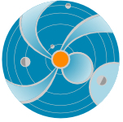
Solar Energetic particles -
What are they?
Definition:
Energetic charged particles (such as electrons and protons) traveling much faster than ambient particles in the space plasma, at a % of the speed of light (relativistic!)
Elemental composition* (may vary event by event)
96.4 % protons
3.5% alpha particles
0.1% heavier ions (not to be neglected!)
Energies: up to ~ GeV/nucleon
They can travel from the Sun to the Earth in one hour or less!
The term SEP usually refers to protons (even though “p” is particle)
Notes:
An SEP event is an enhancement in the radiation evironment.
Summarize effects again.
Elemental composition* (may vary event by event)
96.4% protons
3.5% alpha particles
0.1% heavier ions (not to be neglected!)
Energies: up to ~ GeV/nucleon

Slide 21
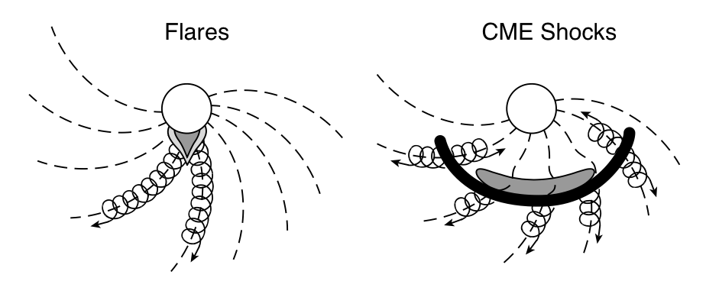
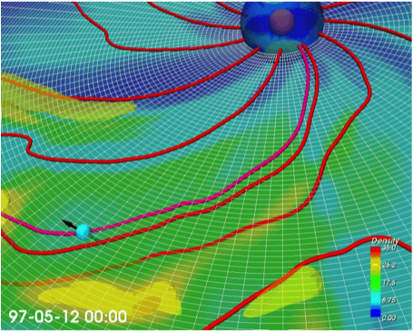
Flares, CMEs and SEPs and the
Magnetic connectivity
When flare and CME occurs accelerated charged particles start to move along the interplanetary
magnetic field lines.
Magnetic connectivity
Notes:
Particles are accelerated during the flares and CMEs. When fast CME movies in the heliosphere it creates a shock. In front of the shock particles are accelerated resulting into SEP events observed at Earth and satellites. Not all the observed flares and CMEs lead to SEP observation. The flare and CME front locations have to be magnetically connected to the observation point.
When flare and CME occurs accelerated charged particles start to move along the magnetic field lines. The field lines are like the railroad for a train, where charged particles depart from the solar atmosphere and whether
they arrive to the Earth or STEREO B, for example, depends on the fact whether if the interplanetary magnetic field they are moving along is connected to the Earth/STEREO B or not.

Slide 22
How do we monitor SEP Levels
Track the particle flux at different locations.
Units: pfu, pfu/MeV
(1 pfu = 1 particle flux unit= 1/cm²/sec/sr)
STEREO In-situ Measurements of Particles and CME Transients (IMPACT)
Differential energy band; example energy range: 13-100 MeV
Upstream of Earth with SOHO/COSTEP
Differential energy bands; example energy range: 15.8-39.8 MeV
Geostationary Orbit with GOES
Integral flux, example energy ranges: >10 MeV, >100 MeV
Fluence = flux integrated over the entire event - dose
Important for biological effects (flights)
Event magnitudes:
> 10 MeV/nucleon integral fluence: can exceed 10⁹ cm⁻²
> 10 MeV/nucleon peak flux: can exceed 10⁵ cm⁻²s⁻¹
Notes:
Converting between the two is important to know in order to quantify the relative strengths.

Slide 23
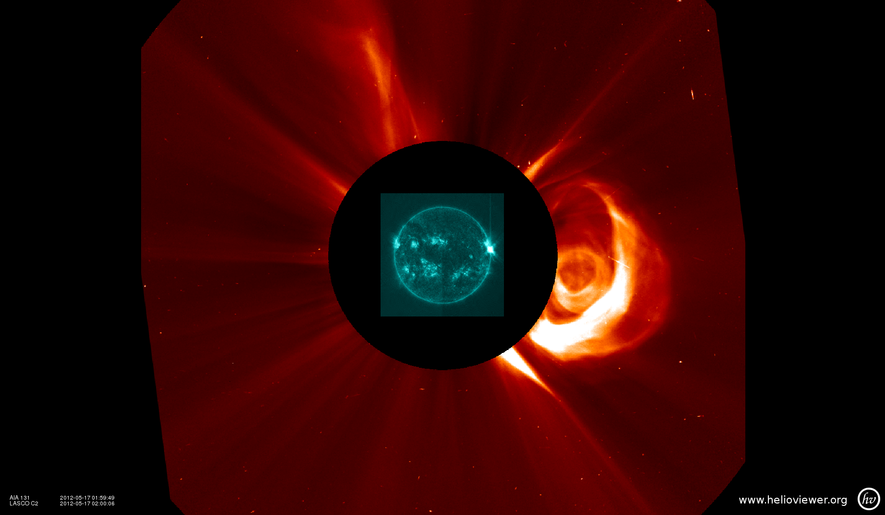
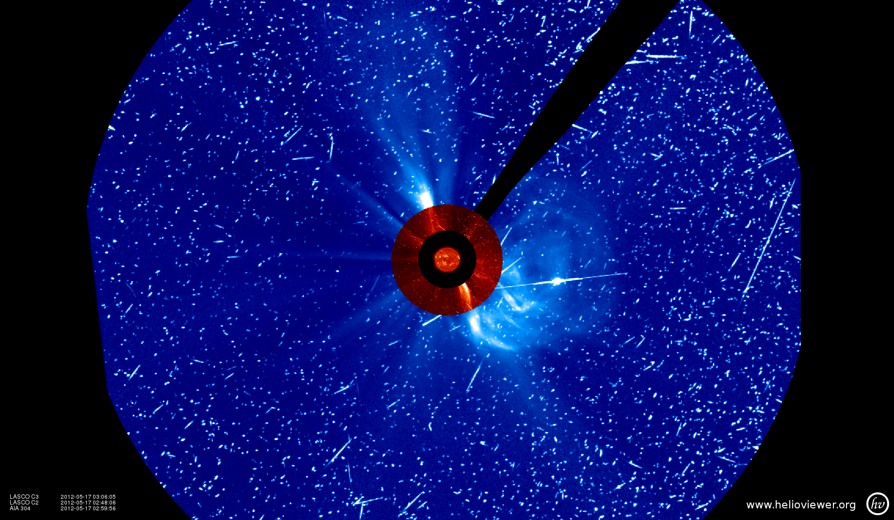
Coronagraph acting as
particle detector – SNOW!
Flare peaked at 01:47 UT
One hour later
SDO AIA 131 Å + SOHO/LASCO C2
May 17 02:00 UT
SOHO/LASCO C3
May 17 03:00 UT
Notes:
Another way that we “see” SEPs are in images, for example, coorngraphs. Here you can see the ‘snow’ of particles hitting the detector.

Slide 24
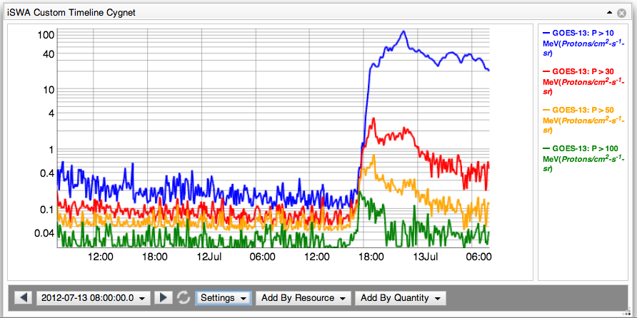
How do we define an SEP Event?
At the SWRC, SEP events are defined as:
GOES Proton E > 10 MeV channel > 10 pfu
GOES Proton E > 100 MeV channel > 1 pfu
SOHO Proton, >15.8 MeV channel > 0.1 pfu/MeV
STEREO Impact 13-100 MeV channel > 0.1 pfu/MeV
Notes:
Here is an example of an event where the 10 MeV limit was met, but not the 100 MeV.
SOHO: > 15.8 MeV proton channels 0.1 pfu/MeV.

Slide 25
How Often Do SEP Events Occur?
SEP event detections in the near-Earth environment
(GOES 13, Proton E > 10 MeV channel)
2007-2009:
Zero Events –
Solar Minimum
Notes:
If you are speaking about one specific location in the heliosphere, for example, just at the Earth, then during solar minimum, there can be only a few or even none in a year. During higher activity times, there can be about one per month or so.
However, there can be many more SEP events happening at other locations, or that we simply are not measuring – remember how that sometimes events can be focused in space!
With only four events in the first 5 months of 2013, things are a little more quiet than we would have guessed.

Slide 26
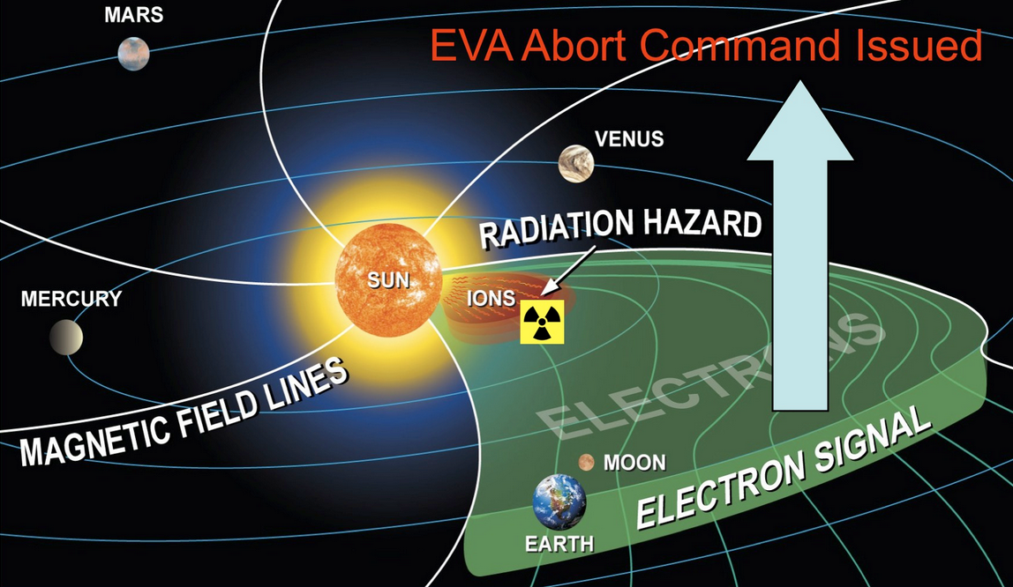
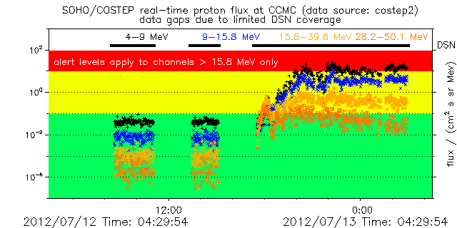
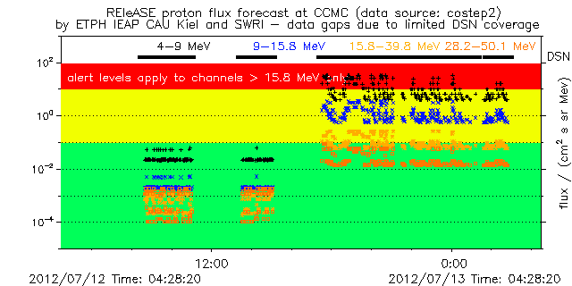
Can we forecast SEP events?
Uses detection of high energy *electrons* to predict arrival of high energy *protons*
Data source: SOHO/ COSTEP
REleASE Model
Notes:
http://iswa.gsfc.nasa.gov/wiki/index.php/SOHO/Costep_Proton_Flux_-_Forecast

Slide 27
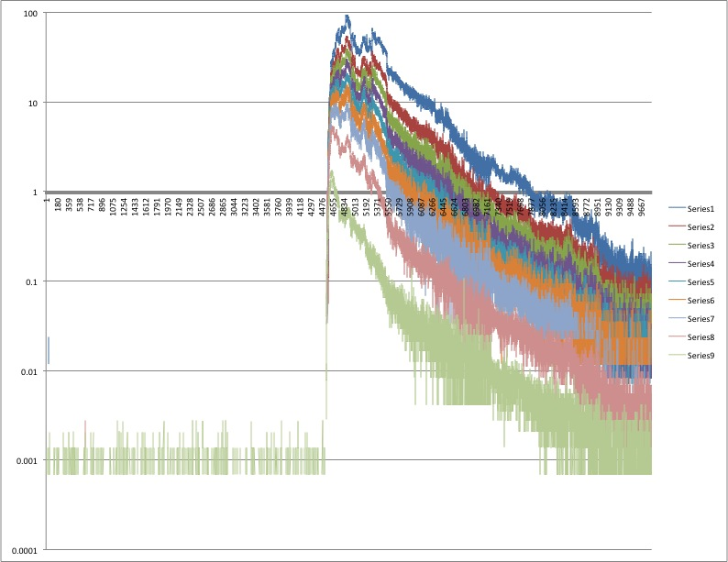
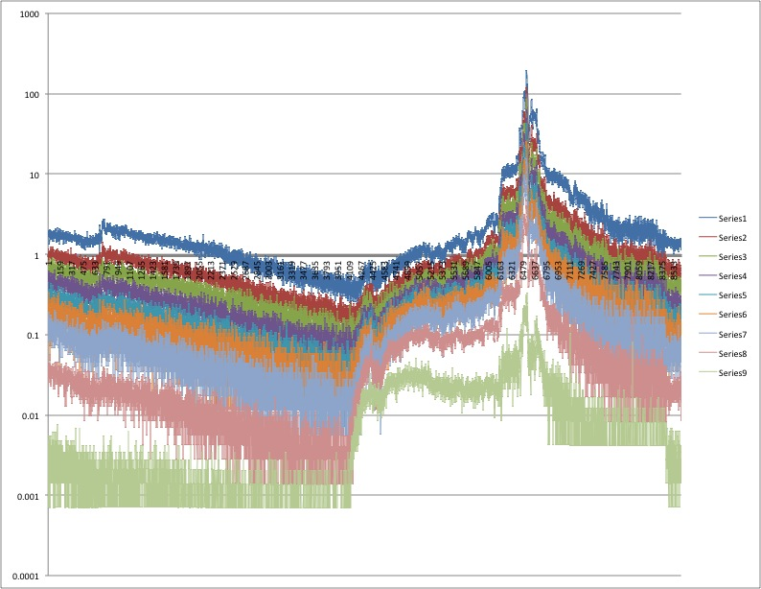
Profile Shapes of SEP Fluxes
Impulsive SEP event - The peak at the beginning due to flare, all off – indicates how well connected you are to the source (timing)
Gradual SEP event - Slow rise, then peak when the ICME passes the spacecraft

Slide 28
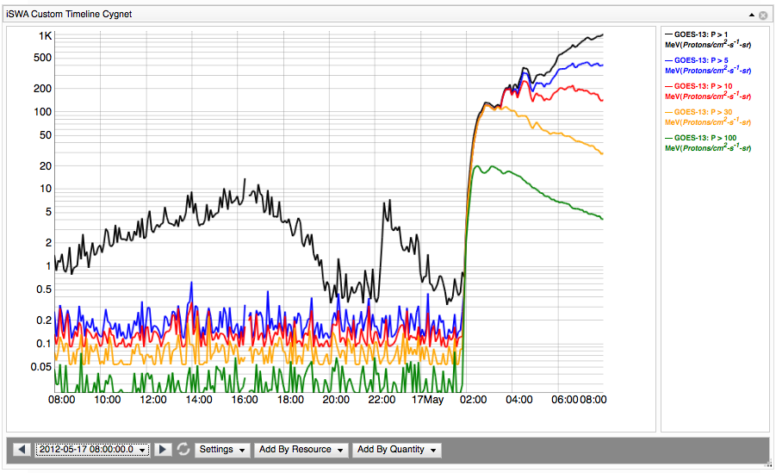
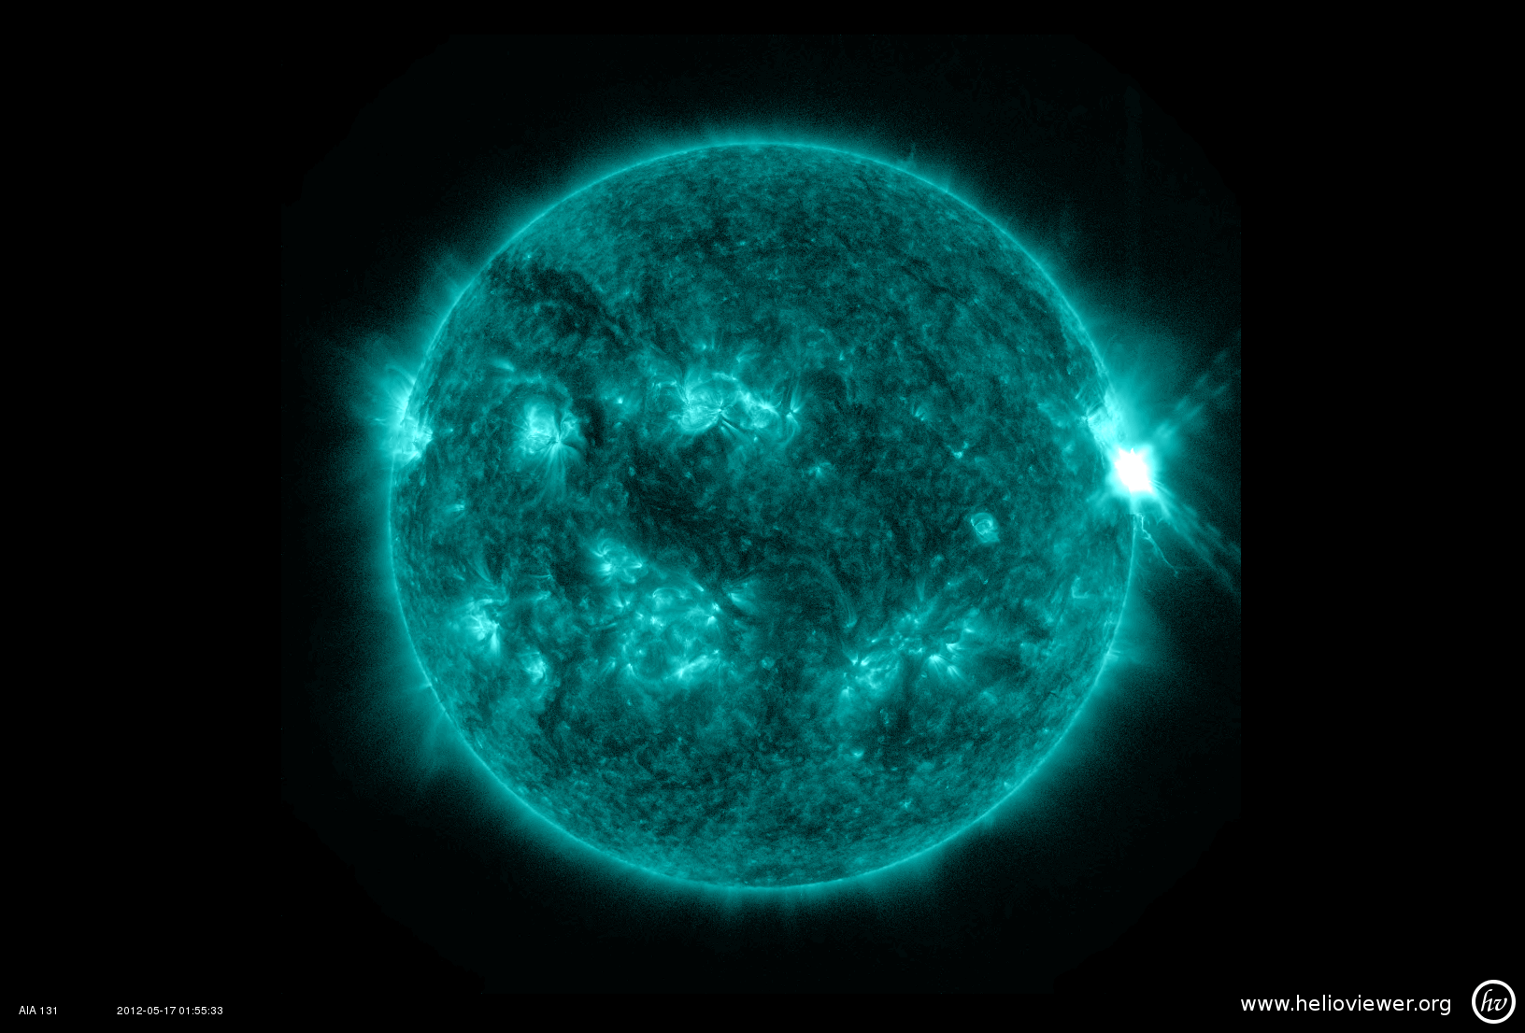
For Earth – Best Connection
is Western Limb
GOES-13
01:55 UT
Energetic proton fluxes
elevated for >12 hours
SDO AIA 131 Å
Notes:
Not only were the >10 Mev channel elevated well above our threshold, but the >50 and >100 channels as well, which tell us that this event was very efficient at accelerating the highest energy particles.
So, we always watch for Active Regions passing on the Western limb, behind the Sun.
This event shown here, May 17, was very very strong…lead into GLE slide

Slide 29
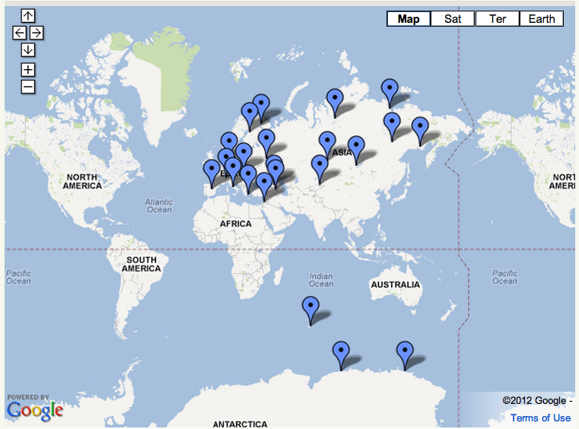
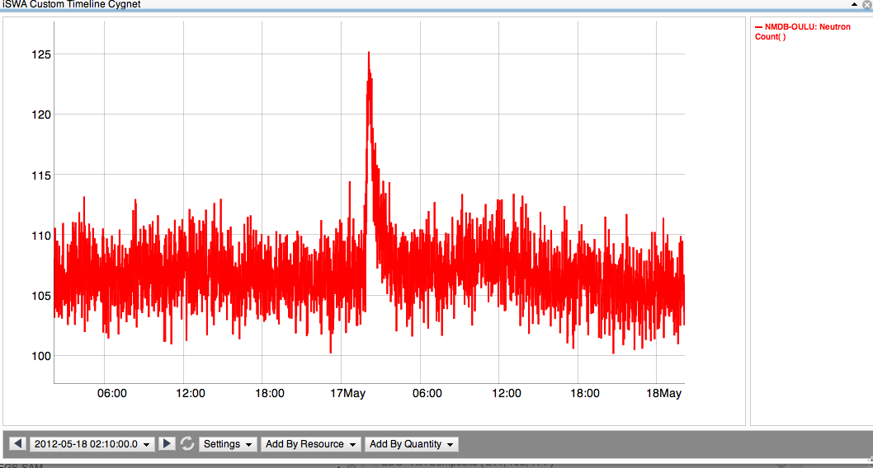
Ground Level Enhancement
A subset of SEP events, a GLE event occurs when extremely high energy protons (>500 MeV/nuc) penetrate the Earth’s atmosphere. Collisions with atoms generate secondary particles that are measured at neutron monitoring (NM) stations on the ground.
Neutron Monitoring Station in Oulu, Finland
Enhancement to ~125
NM Stations (http://www.nmdb.eu)
Background ~105
Notes:
The most extreme events…
This suspicious was confirmed by the detection of neutron enhancement at 4 stations. Those neutrons are reaction particles from relativistic protons
Add arrows to mark stations that observed May 17 GLE – what WAS THE TIME????
Save discussion of GLE events in SC 23 and characteristics of GLEs until 2nd half of talk. First half should only be observations!

Slide 30
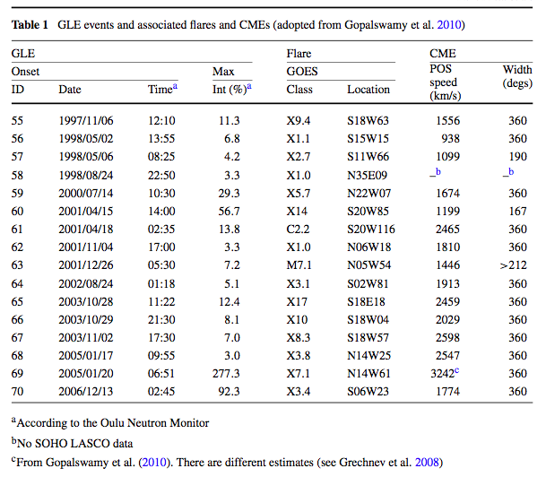
What causes strong SEP events?
Complexity of AR
Most young, more compact
Magnetic connectivity of AR
About ~50% are well connected
Magnitude of flare
Average X3.8, but as low as M7.1
Long duration
Magnitude of CME
Range of speeds (~2,000 km/s average, but four events <1,500 km/s)
Seed particles
Known to have harder spectrum
Sol
Nitta et al. 2012
Gopalswamy et al. 2012, Li et al. 2012, Mewaldt et al. 2012
Notes:
Like I said, these events prompt more questions and more questions, so we want to look at all of the extreme events (GLE) and see if any characteristics of the solar part of the storm can tell us about what is happening. And the answer is that while there are trends, it’s not true that strong flare cause GLEs, as you saw only M5 cause the May event, it’s not the fastest and biggest CMEs.
Again I want to emphasize that these are all just speculations because most of the interesting stuff is happening in a region that is not well covered by coronagraphs.
End with: And so we are motivated to model the acceleration of particles by CME driven shocks in the low corona…
Comparing to previous AR1476 flares: Longer duration, but similar magnitude
March 7th event: flare and CME weaker, SEPs at Earth 20x weaker
Solar Cycle 23 GLE events: no CME in previous 24 hours (to generate seed particles)
What was special about this flare and CME to generate a GLE?
Timing: CME erupted during rise time of flare
Connectivity: AR well connected to Earth
CME speed 1,500 km/s sufficient to drive shock in low corona (Evans et al. 2008)
Must have been very wide CME (to impact STEREO A and Earth)
As is common, they were not geoeffective (Kp max =4)
Possible Type II radio burst indicates CME driven shock

Slide 31
Homework
In SDO AIA 193 image find the location of the flare that started around 2013-03-15T06:00
What was the class of the flare?
Was the flare accompanied by a CME?
If yes, was the CME Earth directed?
What was the start time of the CME in different coronograph images?
Was there an SEP event observed related to the flare and CME?
Did the CME arrive to the Earth (ACE)?
If yes, when did it arrive?
What was the Kp geomagnetic storm index due to the CME arrival?
Was this CME modeled?
When was the predicted arrival of the CME?

