Slide 1
Fast Track WSA-ENLIL + Cone model runs
2014-06-04
Notes:
You have successfully determined the CME parameters using StereoCAT. What next?
In this presentation we show how you can execute a WSA-ENLIL + Cone model simulation using the CCMC Runs on Request system.
This simulation will enable you to see how the CME propagates through heliosphere and to determine the time of its arrival at Earth (or at other planets).

Slide 2
Outline
CCMC Runs on Request System
Submitting your FastTrack ENLIL+Cone model run
Analysing your simulation results
FastTrack DEMO and hands-on practice

Slide 3
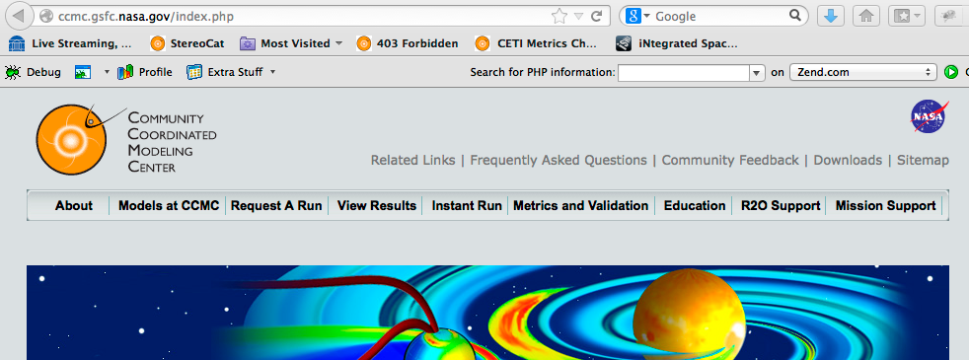
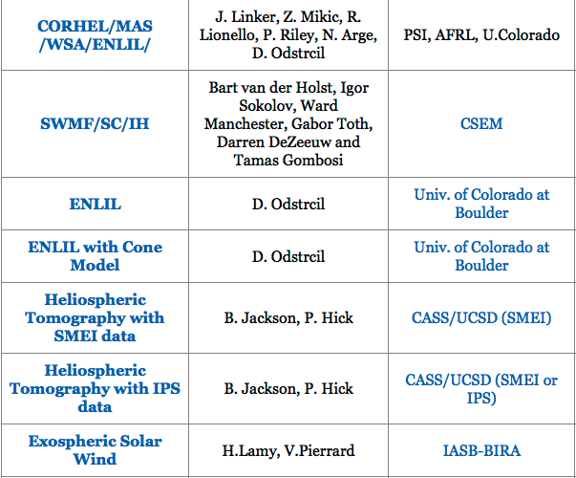
CCMC Runs on Request system
CCMC Runs on Request systems allows anyone to run space weather models hosted at the CCMC.
There are over 30 models available for Runs on Request at:
http://ccmc.gsfc.nasa.gov
MODELS at a glance
Notes:
Runs on Request is a free service open to anyone interested in running a space weather model hosted by the CCMC. There are over 30 models available for execution and analysis through this system. They cover the whole space weather domain - models describing solar corona, heliosphere, Earth’s magnetosphere and inner magnetosphere, and ionosphere.
We are interested in the ENLIL – a model of heliosphere.

Slide 4
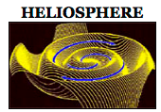
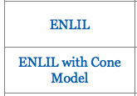
Submitting FastTrack ENLIL request
Notes:
Go to “Request A Run” tab on the CCMC website; find ENLIL with Cone Model in the Heliosphere domain and click the Request a Run button.
This will give you two options:
Regular run and
FastTrack run
FastTrack submission interface is geared for space weather forecasting, while regular run interface is a more comprehensive interface more suited for research.

Slide 5
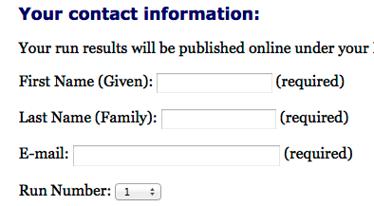
FastTrack run submission (cont.)
Provide:
your contact information,
Run Number (you can submit a limited number of runs per day and they will be distinguished by this number)
the number of CMEs in your simulation (limit 5)
Notes:
The interface asks you to provide
- your contact information,
- the Run Number (you can submit a limited number of runs per day – 10 requests maximum) and they will be distinguished by this number
- and the number of CMEs in your simulation (up to 5 in one simulation).

Slide 6
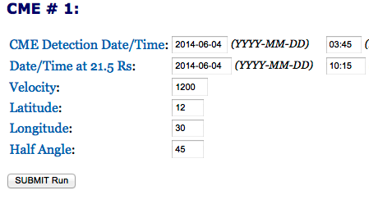
FastTrack run submission (cont.)
Enter CME parameters (e.g., parameters derived in a StereoCAT session):
Notes:
You can submit your run request online supplying input parameters.
FastTrack submission interface requests you to just the right number of input parameters

Slide 7
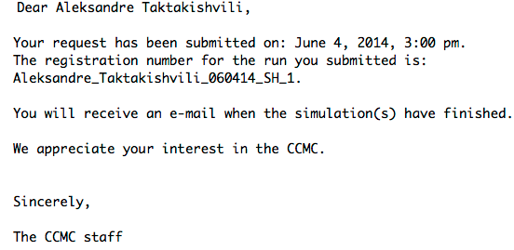
FastTrack run submission (cont.)
Enter CME parameters (e.g., parameters derived in a StereoCAT session):
Run results are usually ready in 40 mins
(for events within the last 3 months)
Notes:
Run results (for events within the last 3 months) get published on the CCMC website in less than an hour and an automated email notification is sent to you. Requests for earlier events (outside of the last 3 months) will take about one day to complete.

Slide 8
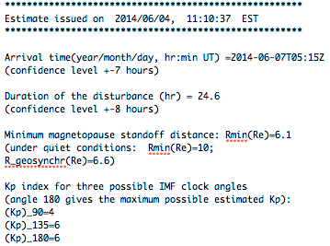
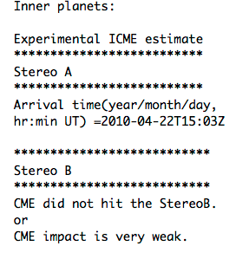
Run completion notification
Run completion notification emails contain:
Estimate of the CME arrival at Earth
Estimate of the CME arrival at planets (and satellites)
Link to the run results available on the CCMC website

Slide 9
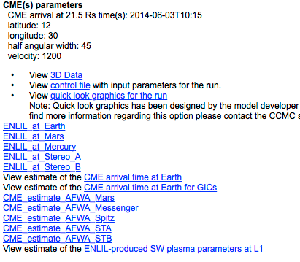
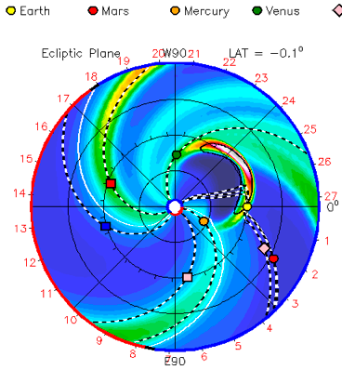
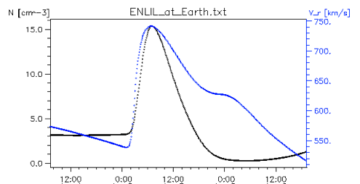
Run results on the CCMC website
The link in the run notification email will take you to your run results page on the CCMC website.
View all Heliosphere Runs
(find link to your request)
Notes:
The link in the run notification email will take you to your run results page on the CCMC website. Alternatively, you can click on the “View Results” tab in the navigation menu and follow “Heliosphere Results” link to drill down to your run name.
Quick look graphics link will show you the movies with simulation results (density, velocity, Pdyn). Note the position of the Earth, other planets and major satellites.
You can view the timeline plots at different planets – ENLIL at Earth plot shows timelines for solar wind density and velosity at Earth, showing a significant increase of both at the time of the CME arrival at Earth.

Slide 10
FastTrack DEMO and practice
DEMO
iSWA layout for FastTrack DEMO CME (2014-04-06T09:48)
http://1.usa.gov/SrNzgD
Sample saved StereoCAT session for this event:
http://1.usa.gov/1hZlHqJ
PRACTICE
iSWA layout for FastTrack practice CME (2014-05-07T16:36)
http://1.usa.gov/1mP4Idv
To submit a FastTrack run go to the CCMC website:
http://ccmc.gsfc.nasa.gov
click on Request A Run tab; find ENLIL with Cone model and click
Request A Run button; then select FastTrack submission

