Slide 1
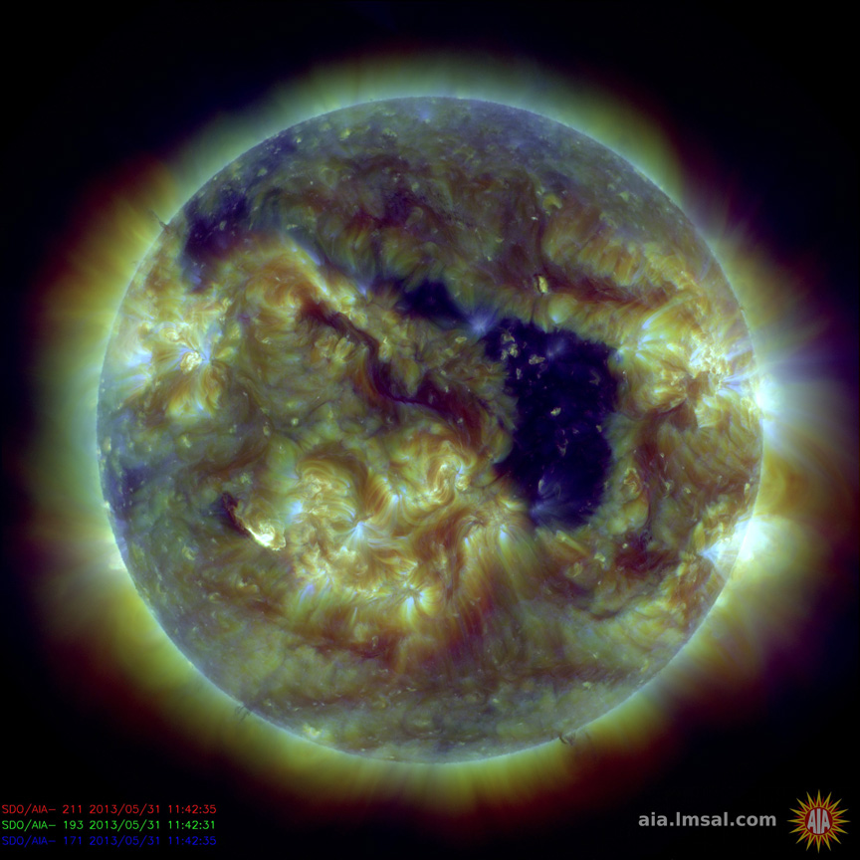
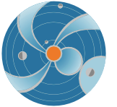
Space Weather from Coronal Holes and High Speed Streams
M. Leila Mays (NASA/GSFC and CUA)
m.leila.mays@nasa.gov
SW REDI 2014 June 2-13
Notes:
This lecture will describe features on the sun called coronal holes, and the high speed streams that result from them. The coronal hole can be seen in this SDO AIA composite image (wavelengths 211, 193, and 171 Angstroms), as the dark purple area. The bright areas are active regions.

Slide 2
The solar wind is a flow of plasma and the frozen-in solar magnetic field from the Sun. The outward flow is due to the gas pressure difference between interplanetary space and the solar corona.
Changes in the solar magnetic field (from solar activity) influence the solar wind which, in turn, influences planets, spacecraft, and other bodies inside the solar wind (the heliosphere).
near the Earth, compared to the magnetosphere, the solar wind plasma (mostly ionized Hydrogen) is hot, tenuous, and fast moving, and the weak magnetic field is nearly parallel to the ecliptic plane, but 45˚ to the Sun-Earth line
Notes:
The solar wind is a flow of plasma and the frozen-in solar magnetic field from the Sun. The outward flow is due to the gas pressure difference between interplanetary space and the solar corona.
Changes in the solar magnetic field (from solar activity) influence the solar wind which, in turn, influences planets, spacecraft, and other bodies inside the solar wind (the heliosphere).
Table 4.1 (from Kivelson and Russell, Introduction to Space Physics) shows properties of the solar wind near the Earth. Near the Earth, compared to the magnetosphere, the solar wind plasma (mostly ionized Hydrogen) is hot, tenuous, and fast moving, and the weak magnetic field is nearly parallel to the ecliptic plane, but 45˚ to the Sun-Earth line.
The graph on the right is OMNI combined solar wind data measured at L1, just ahead of Earth (1 AU), showing a typical timeseries of the solar wind average magnetic field vector (top), velocity in the x direction (Vx, GSE coordinates), proton density, and proton temperature for a period in July 2008.

Slide 3
The Parker spiral, is the spiral of Archimedes magnetic geometry of the solar wind due to solar rotation. Parcels of solar wind leaving the sun are analogous the water spirals formed from a rotating sprinkler. The angle a solar wind magnetic field line makes at 1 AU is close to 45 degrees.
Notes:
The Parker spiral, is the spiral of Archimedes magnetic geometry of the solar wind due to solar rotation. Parcels of solar wind leaving the sun are analogous the water spirals formed from a rotating sprinkler. The angle a solar wind magnetic field line makes at 1 AU is close to 45 degrees.
In Figure 4.5 (from Introduction to Space Physics) you can imagine the solar wind as parcels of plasma being released from the sun in succession (starting with parcel #1). As the sun rotates, the parcels are released from the rotated location, forming a spiral shape (parcels #1 through #8).

Slide 4
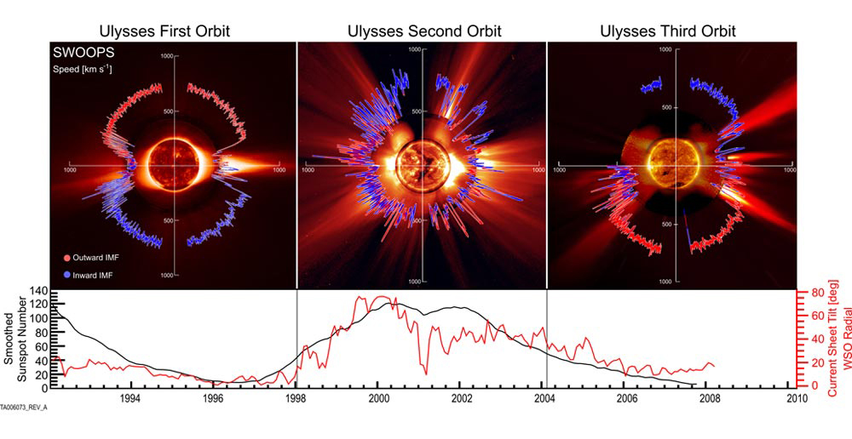
Solar wind can be divided into fast and slow wind components.
solar minimum
solar maximum
solar minimum
Notes:
Solar wind can be divided into fast and slow wind components.
In the top panel you can see Ulysses solar wind speed data plotted radially on top of a typical EUV and coronagraph image of the sun from solar minimum to maximum, then to the most recent solar minimum. In the bottom panel the sunspot number is plotted in black, which is a measure of the solar cycle, and in red the heliospheric current sheet tilt is plotted.
From this graph you can see the solar wind slow and fast components readily distinguishable during solar minimum, with faster solar wind (~700 km/s) from the poles, and slower solar wind (~400 km/s) from the equator. During solar maximum slow and fast solar wind is measured at a variety of latitudes.
Notice that in during solar minimum the current sheet is mostly equatorial but it is a highly inclined near maximum.

Slide 5
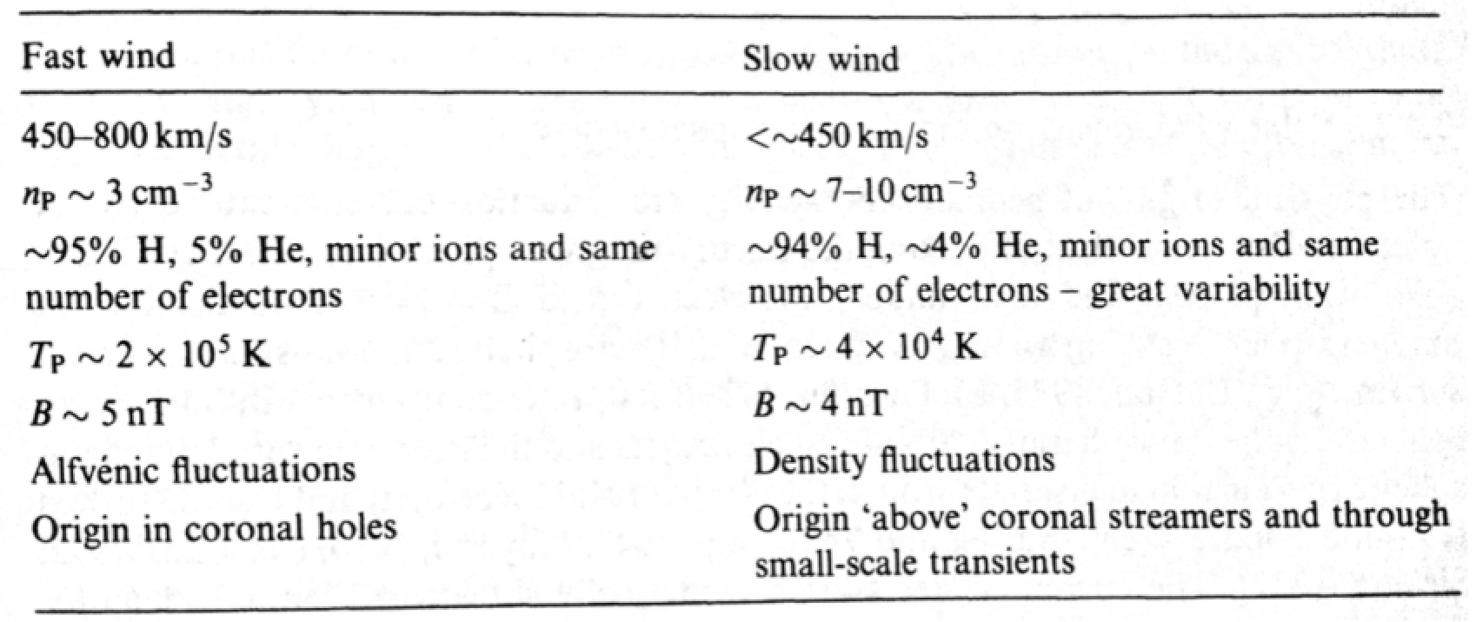
Solar wind can be divided into fast and slow wind components.
(Bothmer and Zhukov, 2007)
Notes:
This table from Bothmer and Zhukov (2007), shows typical solar wind values for the fast and slow components. The fast solar wind has a higher speed, lower density, higher temperature and originates from coronal holes. The slow solar wind has lower speeds, higher densities, lower temperatures and originates above coronal streamers or from small transients.

Slide 6
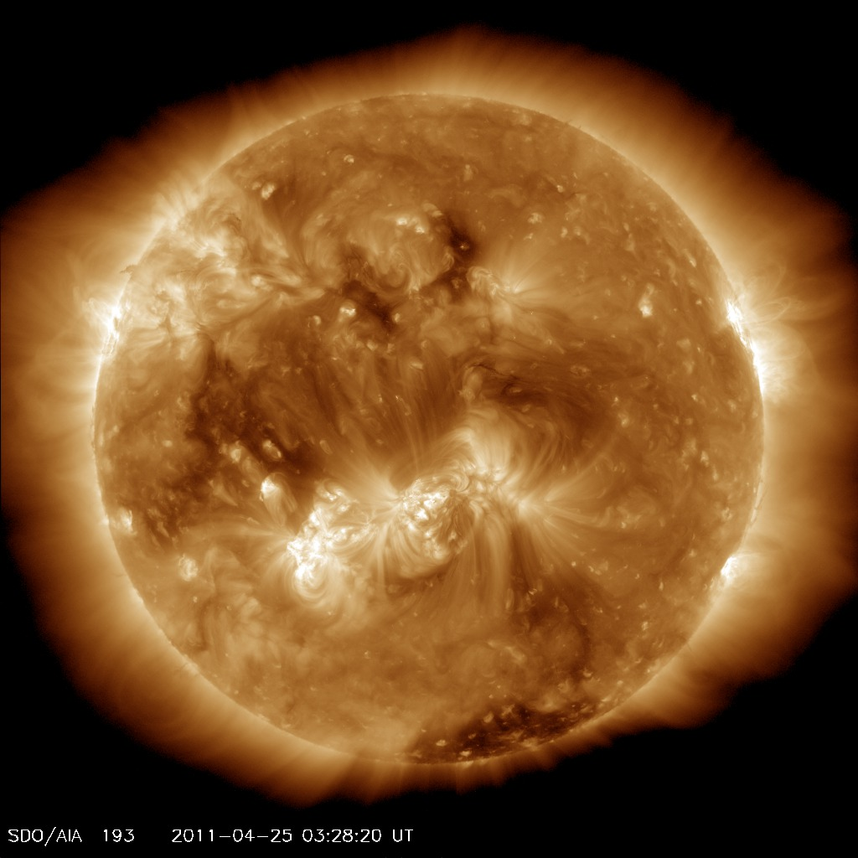
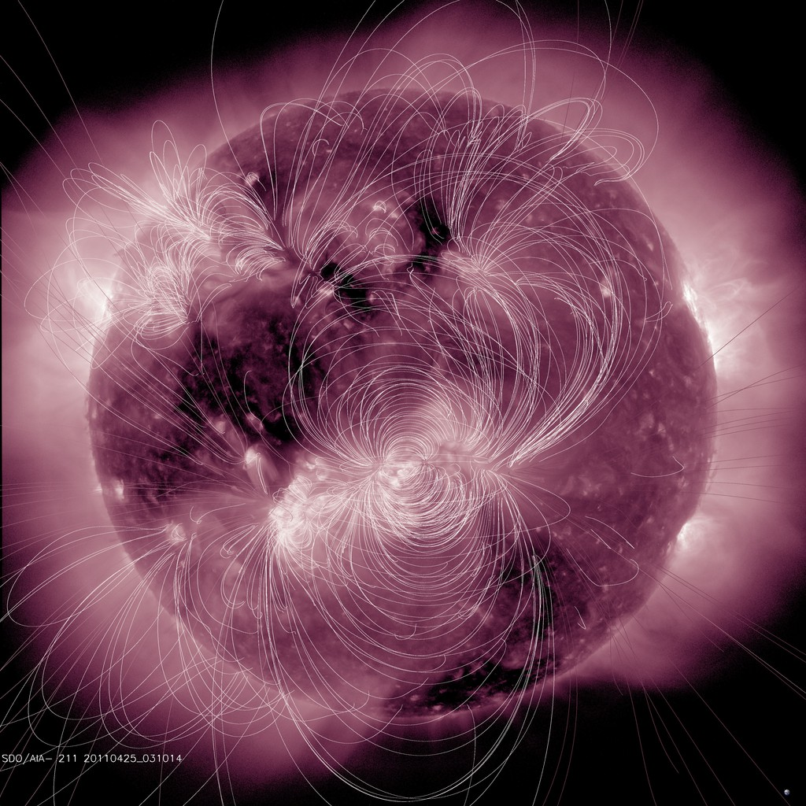
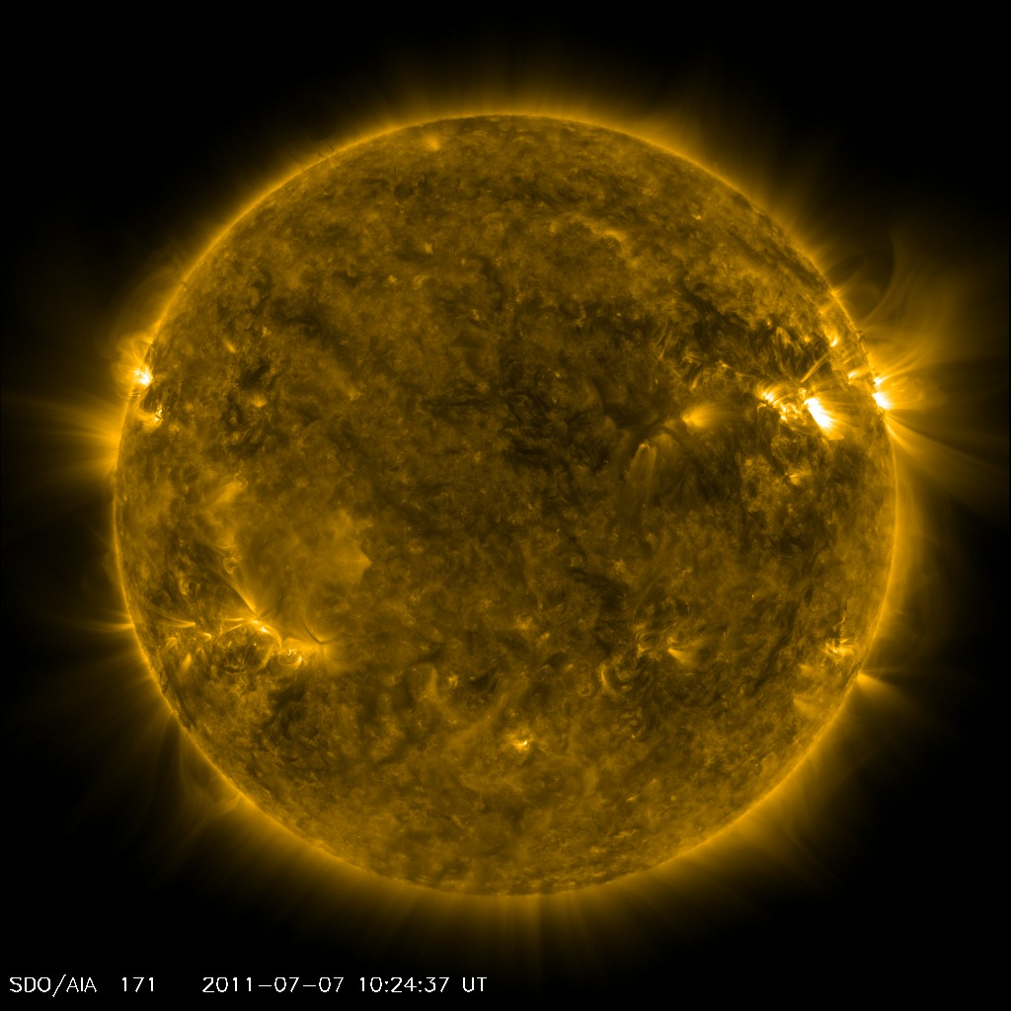
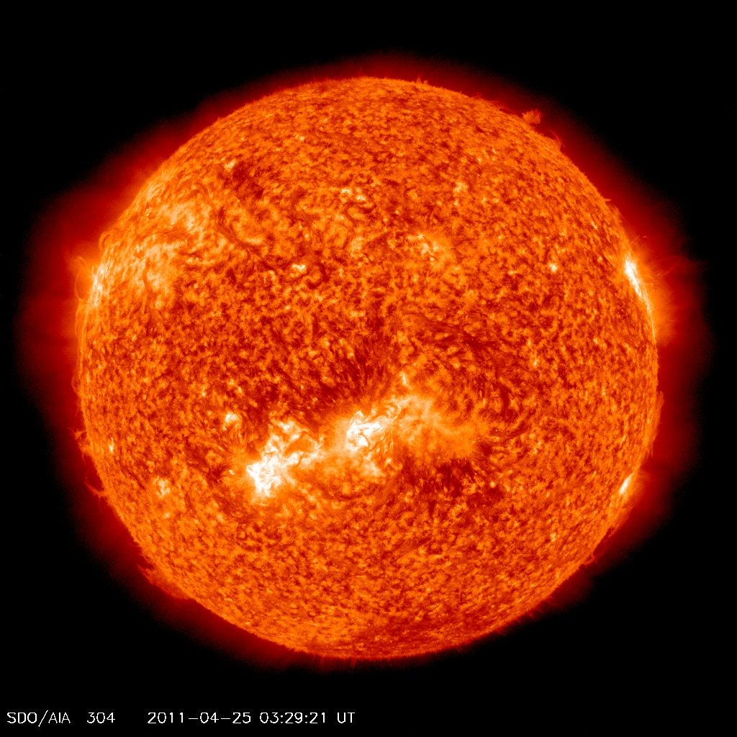
Coronal holes appear as dark areas on the solar surface in the EUV (extreme ultraviolet) and X-ray radiation. They have a lower density and temperature compared with the surrounding corona. Coronal holes correspond to regions of open magnetic fields. Visible best in lines with temperatures more than 10⁵ K.
Notes:
The faster solar wind originates from coronal holes. What are coronal holes? Coronal holes appear as dark areas on the solar surface in the EUV (extreme ultraviolet) and X-ray radiation. They have a lower density and temperature compared with the surrounding corona. Coronal holes correspond to regions of open magnetic fields. Visible best in lines with temperatures more than 10⁵ K. These images shows the Sun at various wavelengths, coronal holes appear as dark areas in the SDO AIA 211 (top left) and 193 Angstrom (top right) images, and they are less apparent in the 171 (bottom middle) and 304 Angstrom images (bottom right).
In the top left image, a PFSS model of the coronal magnetic field is overlaid on an SDO AIA 211 Angstrom image. This model illustrates the closed magnetic field line structure over active regions, and the (locally) open coronal magnetic field lines.

Slide 7
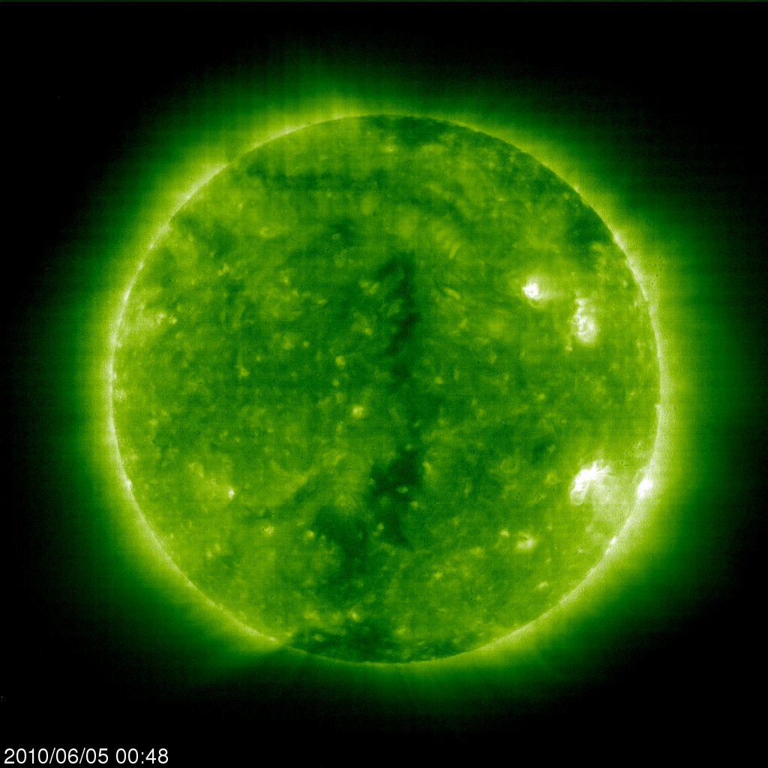
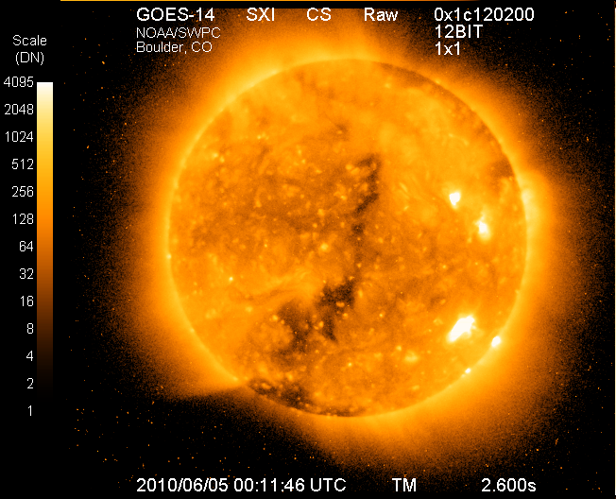
Large polar coronal holes are persistent or about 7 years around solar minimum. During solar maximum and high solar activity coronal holes exist at all latitudes, but are less persistent.
Notes:
Large polar coronal holes are persistent or about 7 years around solar minimum. During solar maximum and high solar activity they exist at all latitudes, but are less persistent.
The polar coronal holes are visible at the poles of the left image from SOHO EIT 195 Angstroms and the right GOES-14 SXI X-ray image for the same period.
Lower latitude coronal holes are also visible in the center of these images.

Slide 8
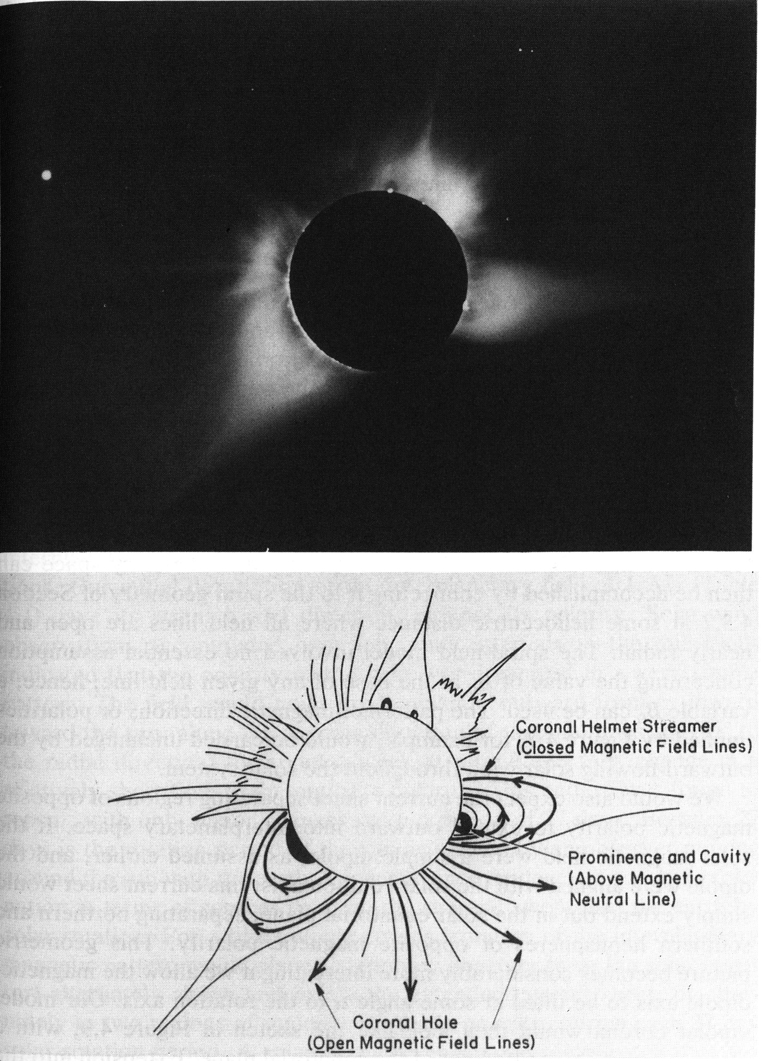
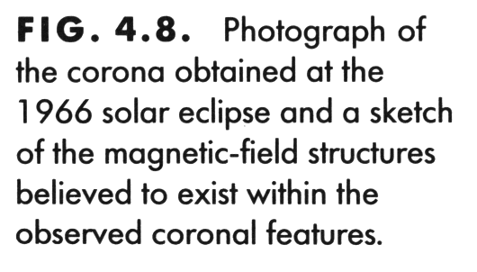
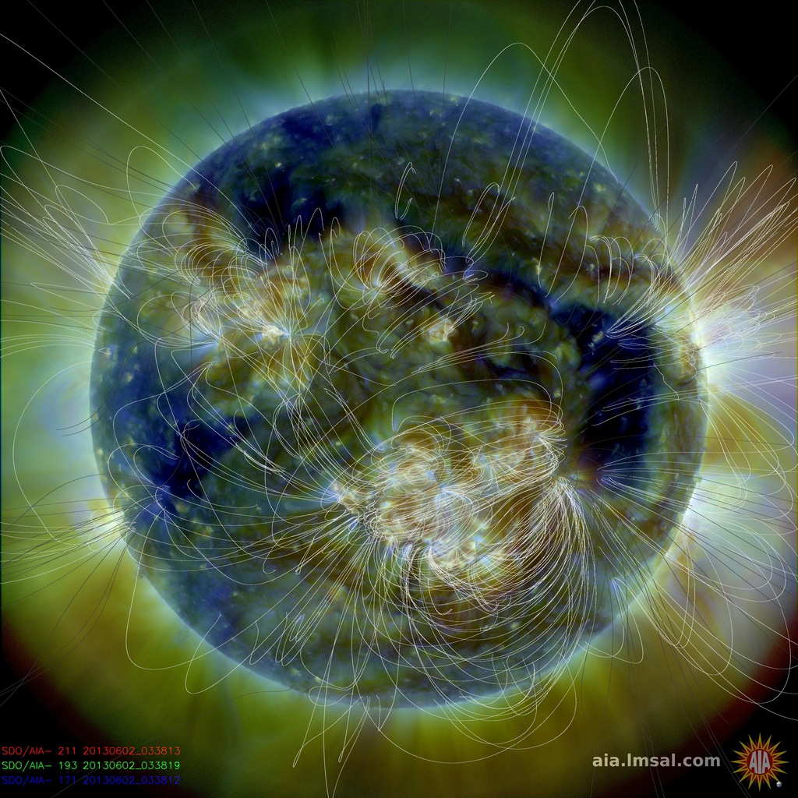
Coronal holes correspond to regions of open magnetic fields.
Notes:
Coronal holes correspond to regions of (locally) open magnetic fields.
The image on the right shows the PFSS magnetic field model overlay on the SDO AIA 211, 193, 171, composite image. Again this model illustrates the closed magnetic field line structure over active regions, and the (locally) open coronal magnetic field lines.
The top right corona photograph from an eclipse (from Introduction to Space Physics) show coronal helmet streamers as bright structures, and the dark areas correspond to coronal holes. The bottom right schematic for this photograph shows the presumed magnetic field configuration of the coronal for this photograph. Helmet streamers appear above closed magnetic field lines and prominences, and coronal holes arise from (locally) open magnetic field lines.

Slide 9
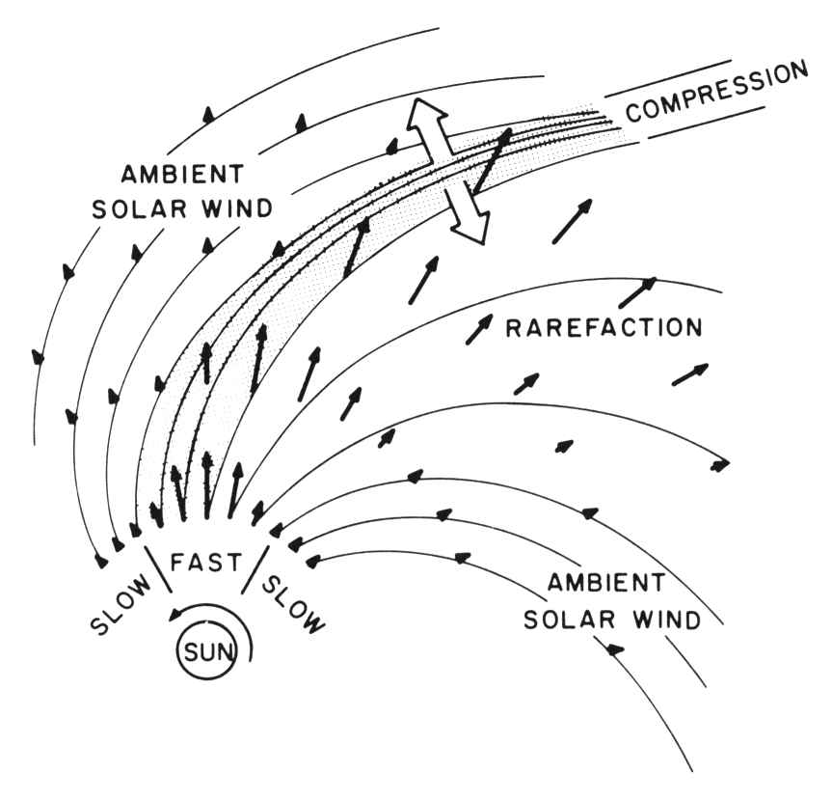
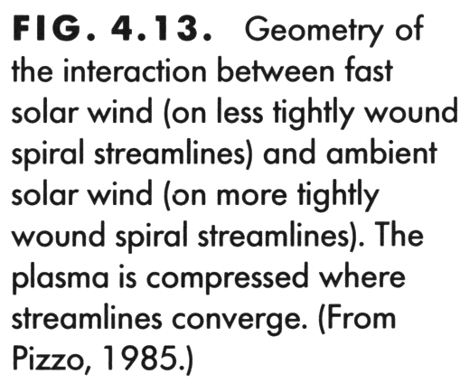
High speed solar wind streams are formed by higher speed solar wind originating from coronal holes. Higher speed streams are less tightly wound in the Parker spiral compared to slower ones, and at various distances the faster solar wind overtakes the slower wind ahead of it.
Notes:
What are high speed streams? High speed solar wind streams are formed by higher speed solar wind originating from coronal holes. Higher speed streams are less tightly wound in the Parker spiral compared to slower ones, and at various distances the faster solar wind overtakes the slower wind ahead of it.
This figure (from Introduction to space physics) shows a schematic of the interaction between parcels of fast and slow solar wind in the Parker spiral. The interaction forms compression regions where the fast solar wind catches up to the slow solar wind streams, and leaves a rarefaction region behind it.

Slide 10
A stream interaction region (SIR) forms at the compressed boundary between the fast and slow solar wind in a high speed stream. High speed streams from persistent coronal holes over multiple solar rotations are called corotating interaction regions (CIRs).

Slide 11
Example of a High speed solar wind stream observed in-situ at ACE
SYM-H geomagnetic index
bow shock nose location
iSWA layout: http://go.nasa.gov/17nkicp
Notes:
Now imagine a spacecraft sitting near the Earth in the previous diagram. What would it measure? These plots show an example of a High speed solar wind stream observed in-situ at ACE (at L1). On the left we have three magnetic field components Bx, By, Bz (in GSM coordinates), and the Sym-H geomagnetic index (measured on the ground). On the right we have the solar wind velocity, temperature, and calculatedmagnetopause bow shock nose location. On June 4th the solar wind velocity gradually rises from ~380 km/s to ~700 km/s, the temperature also increases, and the bow moves slightly towards the Earth. At the same time the solar wind magnetic field increases slightly and shows fluctuations. These observations are indicative of a high speed stream compression region passing by the spacecraft. The SymH geomangetic index indicates that the Earth’s magnetic field is slightly disturbed (decreased) due to this passage.

Slide 12
The increase in speed from a solar wind high speed stream pumps energy into the magnetosphere which can cause geomagnetic storms and energizes particles.
They can produce energetic electron flux enhancements in the radiation belt.
Geomagnetic storms are disturbances/changes in Earth's magnetic field due to changes in solar wind conditions typically lasting 3-6 days.
High speed streams can also cause geomagnetic storms, however they are longer in duration and not as strong as geomagnetic storms caused by CMEs.
(the magnetosphere lesson will go into more detail)
SYM-H geomagnetic index
Notes:
How do high speed streams effect the Earth’s magnetosphere?
The increase in speed from a solar wind high speed stream pumps energy into the magnetosphere which can cause geomagnetic storms and energizes particles.
They can produce energetic electron flux enhancements in the radiation belt.
Geomagnetic storms are disturbances/changes in Earth's magnetic field due to changes in solar wind conditions typically lasting 3-6 days.
High speed streams can also cause geomagnetic storms, however they are longer in duration and not as strong as geomagnetic storms caused by CMEs.
(the magnetosphere lesson will go into more detail)

Slide 13
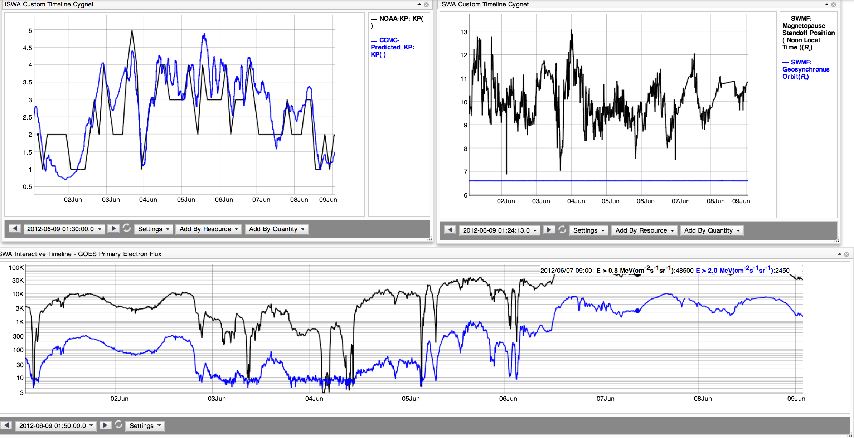
The high speed stream caused an energetic electron flux enhancement in the radiation belt.
magnetopause standoff distance
Kp geomagnetic index
GOES energetic electron flux
iSWA layout: http://go.nasa.gov/17nkicp
Notes:
These graphs show the same period in June 2012 when the high speed stream shown in the previous slides, caused an energetic electron flux enhancement in the radiation belt.

Slide 14
Coronal Holes and High Speed Streams – Assessment
Fill out the form: http://bit.ly/2014_sw2
Why is there solar wind?
Does slow solar wind generally originate from high or low latitudes on the Sun?
What is the typical speed for slow solar wind?
What is the typical density for slow solar wind?
Does fast solar wind generally originate from high or low latitudes on the Sun?
What is the typical speed for fast solar wind?
What is the typical density for fast solar wind?
What is a coronal hole? How does the plasma density of a coronal hole compare to the rest of the corona?
Where are coronal holes typically found during solar minimum, and how does that change at solar maximum?
What are some wavelengths we can view the sun
What is a high speed stream, and how is it related to a coronal hole?
What is a corotating interaction region (CIR) and stream interaction region (SIR)?
How does a high speed stream caused geomagnetic storm differ from one caused by a CME?
How are high speed streams related to energetic electron fluxes in the magnetosphere?
Update the time on various cygnets on this layout to show one high speed stream impacting Earth:
http://go.nasa.gov/15yyWcP
Did the >0.8 MeV energetic electron flux measured at GOES increase due to your chosen high speed stream? Did it go above the alert threshold value of 10^5 pfu? If so, at what time? http://go.nasa.gov/11pZxbR

Slide 15
Slide link summary
SW REDI website
http://ccmc.gsfc.nasa.gov/support/SWREDI/swredi.php
iSWA http://iswa.gsfc.nasa.gov
iSWA Cygnet Glossary http://iswa3.ccmc.gsfc.nasa.gov/wiki/index.php/Full_iSWA_Cygnet_List
iSWA Space Weather Glossary http://iswa3.ccmc.gsfc.nasa.gov/wiki/index.php/Glossary
Most figures and tables in the slides are from the “Introduction to Space Physics” textbook
http://www.cambridge.org/us/knowledge/isbn/item1145043
iSWA layout of a high speed stream observed at ACE http://go.nasa.gov/17nkicp

